Slide 1
2017 State Assessment Highlights
A-1

Slide 2
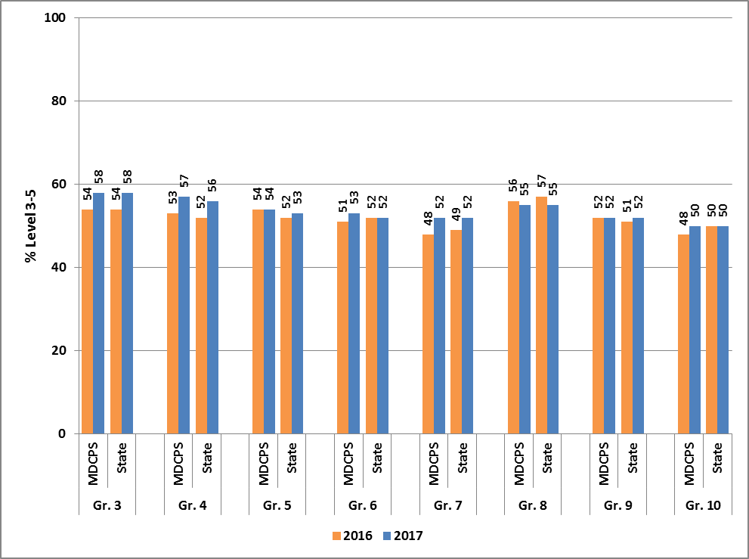
2016 and 2017 FSA English Language Arts Miami-Dade and State Percent Scoring Levels 3-5
Notes:
On June 8, the FLDOE released results from the Spring 2017 administration of the Florida Standards Assessments (FSA) in English Language Arts (ELA) and Mathematics, the Florida Comprehensive Assessment Test (FCAT) 2.0 Science, and End-of-Course (EOC) assessments.
Who tested:
209, 995 Grades 3 through 10 took FSA ELA;
145,813 Grades 3 through 8 took FSA Mathematics;
Over 25,000 students participated in each of the End-Of –Course assessment in Mathematics
Over 75,000 students in Grades 5 and 8 participate in FCAT 2.0 Science and Biology
Over 50,000 students participated in the Civics and NGSSS EOC.
Highlights:
On the FSA English Language Arts (ELA) assessment, the percentage of M-DCPS students scoring in Levels 3 or above met or exceeded the percentages of students statewide in all Grades 3 through 10.
The most growth was seen in Grades 3, 4, and 7, with a four percentage point increase on the FSA ELA assessment from 2016 to 2017.

Slide 3
Grade 3-10 FSA English Language Arts Percent Scoring Levels 3-5 M-DCPS, State, and Large Districts
 | 2016 | 2017 | Difference
DADE | 52% | 54% | +2
BROWARD | 53% | 55% | +2
DUVAL | 46% | 48% | +2
HILLSBOROUGH | 50% | 52% | +2
ORANGE | 51% | 52% | +1
PALM BEACH | 53% | 54% | +1
FLORIDA | 52% | 54% | +2
Notes:
As the chart demonstrates, the percentage of students scoring at levels 3 and above on the ELA assessment across grades 3-10 met or exceeded the state and other large district.

Slide 4
Grade 3-10 FSA English Language Arts Percent Scoring Levels 3-5 - By Subgroup
ELA | State |  |  | M-DCPS
Subgroup | 2016 | 2017 | Difference | 2016 | 2017 | Difference
Black | 34 | 36 | +2 | 34 | 37 | +3
Hispanic | 48 | 49 | +1 | 55 | 56 | +1
White | 63 | 65 | +2 | 73 | 76 | +3
English Language Learners(ELL) | 15 | 17 | +2 | 15 | 20 | +5
Students with Disabilities (SWD) | 19 | 20 | +1 | 20 | 23 | +3
Notes:
On the FSA English Language Arts (ELA) assessment, M-DCPS students outperformed the state, both in the percentage of M-DCPS students scoring in Levels 3 or above, and looking at improvement from 2016 to 2017.
Specifically, Black students improved the percent scoring levels 3 and above by 3 percentage points from 34% to 37% - surpassing the statewide rate of 36%.
ELL students improved the percent scoring levels 3 and above by 5 percentage points from 15% to 20%. – also surpassing the statewide rate of 17%.
Students with disabilities improved the percent scoring levels 3 and above by 3 percentage points from 20% to 23%. – also surpassing the statewide rate of 20%.

Slide 5
Grade 3-10 FSA English Language Arts Percent Scoring Levels 3-5 By Tiers
Subgroup | 2016 | 2017 | Difference
Tier 1 | 57 | 59 | +2
Tier 2 | 34 | 36 | +2
Tier 3 | 24 | 27 | +3
Notes:
The chart above further demonstrates that across each tier of schools, improvements occurred in grades 3-10 ELA.

Slide 6
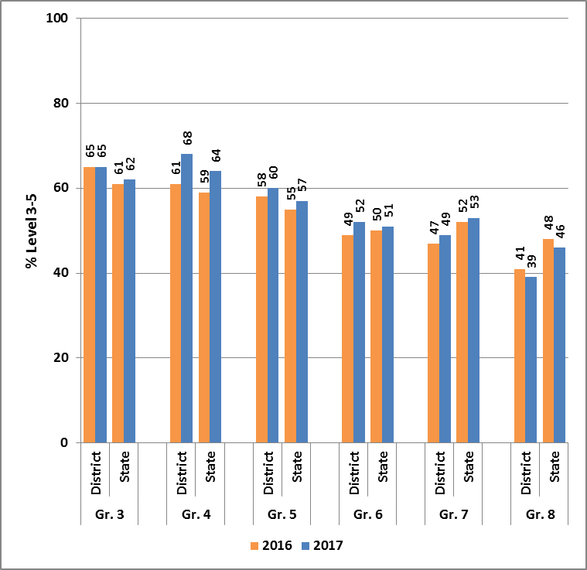
2016 and 2017 FSA Mathematics Miami-Dade and State Percent Scoring Levels 3-5
Notes:
FSA Mathematics was administered via computer in all grades 3 – 8
On the FSA Mathematics assessment, the percentage of students scoring in Levels 3 or above exceeded the state in Grades 3 through 6.
M-DCPS students’ growth in mathematics met or exceeded that of students statewide in Grades 4 through 7.
Additionally, the percentage of students scoring in Level 1 on the FSA Mathematics assessment decreased in five grade levels.

Slide 7
Grade 3-8 All Mathematics (FSA and EOCs) Percent Scoring Levels 3-5 M-DCPS, State, and Large Districts
 | 2016 | 2017 | Difference
DADE | 57% | 60% | +3
BROWARD | 58% | 60% | +2
DUVAL | 53% | 55% | +2
HILLSBOROUGH | 55% | 55% | 0
ORANGE | 54% | 57% | +3
PALM BEACH | 60% | 61% | +1
FLORIDA | 57% | 59% | +2
Notes:
As the chart demonstrates, the percentage of students scoring at levels 3 and above on the Mathematics assessment across grades 3-8 met or exceeded the state and all but one of the large districts.
Additionally, the growth in proficiency rates for Miami-Dade (3%) exceeded the statewide growth of 2%.

Slide 8
Grade 3-8 FSA Mathematics Percent Scoring Levels 3-5 - By Subgroup
MATH | State |  |  | M-DCPS
Subgroup | 2016 | 2017 | Difference | 2016 | 2017 | Difference
Black | 39 | 41 | +2 | 38 | 42 | +4
Hispanic | 54 | 55 | +1 | 57 | 59 | +2
White | 69 | 70 | +1 | 75 | 77 | +2
English Language Learners(ELL) | 29 | 34 | +5 | 32 | 38 | +6
Students with Disabilities (SWD) | 26 | 28 | +2 | 25 | 28 | +3
Notes:
On the FSA Mathematics assessment, the percentage of M-DCPS students scoring in Levels 3 and above improved across all subgroups at a higher pace than the state.
Specifically, Black students improved the percent scoring levels 3 and above by 4 percentage points from 38% to 42% - surpassing the statewide rate of 41%.
ELL students improved the percent scoring levels 3 and above by 6 percentage points from 32% to 38%. – also surpassing the statewide rate of 34%.
SWD students improved the percent scoring levels 3 and above by 3 percentage points from 25% to 28%. – meeting the statewide rate of 28%.

Slide 9
Grade 3-8 FSA Mathematics Percent Scoring Levels 3-5 By Tiers
Subgroup | 2016 | 2017 | Difference
Tier 1 | 58 | 59 | +1
Tier 2 | 37 | 40 | +3
Tier 3 | 32 | 39 | +7
Notes:
The chart above further demonstrates that across each tier of schools, improvements occurred grades 3-8 Mathematics. Specifically, a 7 percentage point increase in proficiency rates for Tier 3 schools.

Slide 10
2016 and 2017 Algebra 1 EOC Percent Scoring Levels 3-5
Algebra 1 | 2016 | 2017 | Difference
Grade 7 | 92 | 93 | +1
Grade 8 | 83 | 87 | +4
Grade 9 | 32 | 39 | +7
Grade 10 | 35 | 32 | -3
Grade 11 | 41 | 54 | +13
Grade 12 | 37 | 64 | +27
Total M-DCPS | 52 | 59 | +7
Total State | 55 | 62 | +7
Notes:
All EOCs are administered via computer (except for students who qualify for paper-based accommodations). EOC results represent all students who were enrolled in the appropriate course, and are not grade-specific.
Over 26,000 students took the Algebra 1 EOC with grade 9 having the largest group with 16,143.
On the Algebra 1 EOC, 59 percent of M-DCPS students passed the test, scoring Level 3 or above on their first attempt in 2017, up seven percentage points from 2016.

Slide 11
2016 and 2017 Algebra 2 EOC Percent Scoring Levels 3-5
Algebra 2 | 2016 | 2017 | Difference
Grade 8 | 74 | 100 | +26
Grade 9 | 67 | 79 | +12
Grade 10 | 46 | 57 | +11
Grade 11 | 18 | 27 | +9
Grade 12 | 8 | 13 | +5
Total M-DCPS | 35 | 49 | +14
Total State | 40 | 49 | +9
Notes:
14,287 students took the assessment Algebra 2 EOC assessment – a decrease from last year.
In 2017, 49 percent of M-DCPS students scored in Levels 3 or above, up 14 percentage points from 2016, and outpacing the state’s 9 point increase.

Slide 12
2016 and 2017 Geometry EOC Percent Scoring Levels 3-5
Geometry | 2016 | 2017 | Difference
District | 46 | 48 | +2
State | 51 | 54 | +3
Notes:
The majority of the students taking Geometry were in Grade 10
14,955 10th graders
6,272 9th graders
On the Geometry EOC, 48 percent of M-DCPS students scored in Levels 3 or above up 2 percentage points form the prior year.

Slide 13
2016 and 2017 FCAT 2.0 Science Grades 5 and 8 Percent Scoring Levels 3-5
Grade 5 | 2016 | 2017 | Difference
District | 50 | 51 | +1
State | 51 | 51 | 0
Grade 8 | 2016 | 2017 | Difference
District | 42 | 42 | 0
State | 48 | 48 | 0
Notes:
FCAT 2.0 Science is the one component of the program that remains a paper-based administration.
District students continued to improve on the Grade 5 Science assessment, while statewide scores remained stable.

Slide 14
2016 and 2017 Biology EOC Percent Scoring Levels 3-5
Biology | 2016 | 2017 | Difference
District | 61 | 62 | +1
State | 64 | 64 | 0
Notes:
The majority of the students taking Biology were in Grade 10
14,826 10th graders
7,215 9th graders
M-DCPS improved in the percent of students scoring at levels 3 and above in Biology from 61% to 62%. This growth continues to narrow the gap between M-DCPS and the State.

Slide 15
2016 and 2017 Civics and US History EOC Percent Scoring Levels 3-5
Civics | 2016 | 2017 | Difference
District | 64 | 69 | +5
State | 67 | 70 | +3
US History | 2016 | 2017 | Difference
District | 60 | 65 | +5
State | 66 | 67 | +1
Notes:
Civics is a middle-grades course and most students take it while in grade 7 (n=25,605)
US History is typically taken in Grade 11 and 22,932 students tested in M-DCPS.
M-DCPS students had tremendous gains in the percent of students scoring on levels 3 and above in both Civics and Us History. The 5 percentage point gain in both Civics and US History out paces the state and further reduces the gap between M-DCPS and the state.

Slide 16
Social Studies End-of-Course Assessments Percent Levels 3-5 M-DCPS, State, and Large Districts
 | Civics EOC |  |  | U.S. History EOC
 | 2016 | 2017 | Difference | 2016 | 2017 | Difference
DADE | 63% | 69% | +6 | 60% | 65% | +5
BROWARD | 68% | 70% | +2 | 63% | 65% | +2
DUVAL | 64% | 66% | +2 | 62% | 63% | +1
HILLSBOROUGH | 66% | 67% | +1 | 72% | 72% | 0
ORANGE | 66% | 67% | +1 | 64% | 63% | -1
PALM BEACH | 70% | 73% | +3 | 68% | 68% | 0
FLORIDA | 67% | 69% | +2 | 66% | 67% | +1
Notes:
As the chart demonstrates, the growth in the percentage of students scoring at levels 3 and above on Civics and US History from 2016 to 2017 exceeded the state and all of the large districts.

Slide 17
The Bottom Line
Despite the fact that Florida Standards are more rigorous and more students are being assessed on the computer, M-DCPS showed continued success in 2017 across all statewide achievement tests as compared to the state and other large districts.
Notes:
So what is the bottom line –
Despite the fact that Florida Standards are more rigorous and more students are being assessed on the computer, M-DCPS showed continued success in 2017 across all statewide achievement tests as compared to the state and other large districts.

