Slide 1
CELLA Online
CELLA Online is administered for:
Initial placement in the ESOL program for students in grades 1-12.
Extension of ESOL services - Three Years or More Anniversary in the ESOL program.
Notes:
CELLA Online is comparable to the Spring CELLA that is administered every year. CELLA online is administered for entry purposes into ESOL and for Extension of ESOL services – Three Years or More Anniversary date in ESOL.
The purpose for testing for Extension of ESOL services is to determine whether or not the student meets criteria to exit the ESOL program for FTE.

Slide 2
How to Access CELLA Online?
Go to www.awschooltest.com or
Go to the Division of Bilingual Education and World Languages website: http://bilingual.dadeschools.net/BEWL/cella.asp

Slide 3
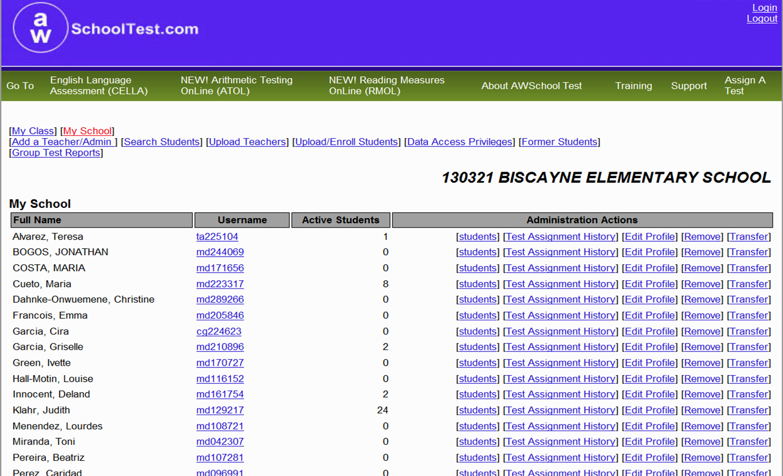
How to add a teacher?
Notes:
For the purposes of the CELLA Online system, all CELLA test administrators that you will add are considered “teachers.” Add a Teacher Form will display. Enter:
Teacher’s name
Username (md+ employee number)
Password
E-mail (M-DCPS e-mail)
M-DCPS requires:
Lowercase initials “md” followed by the teacher’s employee number (e.g., md123456).

Slide 4
My School: Add a Teacher
Enter:
Teacher’s name
Username (md+ employee number)
Password
E-mail (M-DCPS e-mail)
Required

Slide 5
Frequently Asked Questions
If you encounter any problems, please contact your assigned district supervisor.
Call 305-995-2428 for Technical Support
Notes:
Transfer of students between teachers within a school (school and district administrator)
Transfer of students between schools (district administrators)
Performance categories
Mis-scored tests

Slide 6
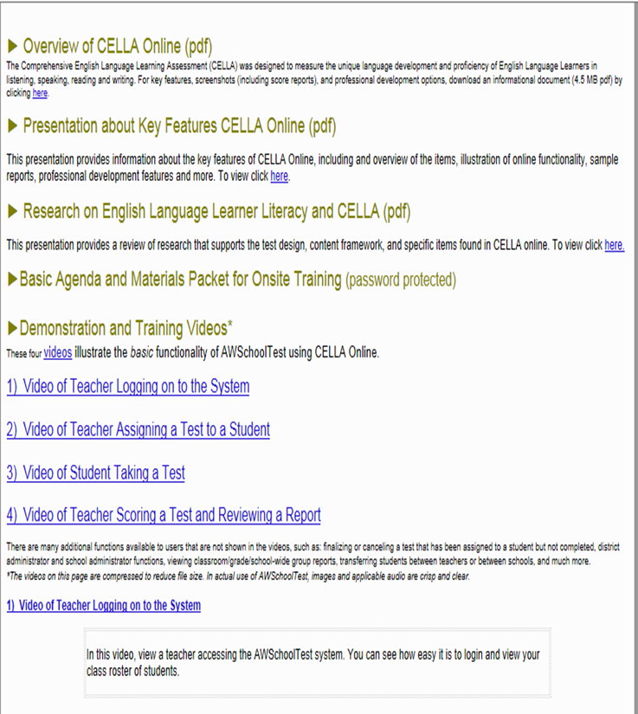
Frequently Asked Questions

