Slide 1
Test Chair 101: Guidelines and Tips for New Test Chairpersons
Wanda L. Cunningham

Slide 2
Your Role As Test Chairperson
As the school site test chairperson, you are responsible for following standards, guidelines, and procedures to ensure the accuracy and validity of all test scores, and to safeguard the security of the test content
Your responsibilities can be divided into three categories:
Planning and facilitating test preparation activities before testing
Supervising and monitoring during the test administration window
Packing and returning all materials after testing

Slide 3
Before Testing
Review the District 2014-2015 Testing Calendar
Attend district trainings for each testing program
Request the following resources from the principal:
Access to a locked storage room
Access to Online Applications
ISIS
PARIS
File Download Manager
Order Testing Supplies
# 2 pencils
Large plastic bins with lids
Copy paper in variety colors
Folders, etc.

Slide 4
Before Testing
Plan with SPED Teachers
Print testing accommodations from SPED EMS for all students who have an IEP or 504 Plan
Meet with teachers to review the allowable accommodations
Obtain an updated class list for each grade level that include primary exceptionality
Create test group rosters for individual or small group students based on their IEP or 504 Plan

Slide 5
Before Testing
Plan with ELL Teachers
Review the allowable accommodations for ELLs with teachers
Obtain an updated class list for each grade level that includes the ELL levels (1-4) and the date of entry in the program
Create ELL test group rosters for each grade level
Ensure that the school has adequate approved dictionaries

Slide 6
Before Testing
Develop test group list from PARIS or File Download Manager
Test Group List Information:
Name
Florida ID Number
Grade
Homeroom Teacher
ELL Level
Primary Exceptionality
Highlight ELL and SPED students
Create a separate test group for ELL and SPED students on each grade level
Assign an unique four-digit test group code to each testing group
Check attendance daily for students who have registered or withdrew from school
Adjust test group list accordingly

Slide 7
Test Preparation
Create a testing roster which include test administrators, proctors, test group codes and room numbers
Check all testing classrooms for working air condition, intercoms, clocks and proper lighting
Notify faculty and staff of training dates
Send parent notification letters home
Create bins and folders for test administrators
Organize bins by grade level

Slide 8
Receiving/Opening Test Materials
Document the date and time testing materials arrived
Verify the number of boxes and ensure that they all belong to your school
Locate the packing list and count the actual testing materials received without opening any shrink-wrapped test booklets
Report any discrepancies to Student Assessment and Educational Testing (SAET)
Order additional testing materials (if needed) from Testing Distribution Center (TDC)
Store all testing materials in a locked storage room

Slide 9
Preparing Test Materials
Maintain Chain of Custody form at all times
Open shrink-wrapped test booklets as outline in test chair training packet
Verify that the following five elements are correct on labels
Student name
Florida ID number
District number
School number
Grade level
Utilize test group list to count out and place labels on test booklets/answer folders
Bubble demographic information for students without a label

Slide 10
Preparing Test Materials
Place the following items in test bins:
Test Manual
Test Booklets/Answer Folders
Administration Record/Security Checklist
Security Log
Seating Chart
Electronic Devices and Testing (Do Not Disturb) Signs
Rulers/Mathematic Reference Sheets/Calculators (if applicable)
# 2 Pencils
Create sign out sheets for test administrators by grade level

Slide 11
School-Site Training
Create training packets to include:
(Testing schedule, roster list of test administrators, proctors, test groups codes, room assignments and training documents)
Schedule training one week prior to administration window
Train all test administrators and proctors (all test administrators must be certified educators)
Train additional personnel in case of absences (special area teachers, counselors, media specialists and reading/math coaches)
After Training
Ensure that all test administrators and proctors sign a Test Administration and Security Agreement form
Ensure that all test administrators sign a Test Administrator Prohibited Agreement form

Slide 12
Testing Day
Arrive to school early to prepare for distribution of testing materials
Allow test administrators to count materials and sign them out on the count form
Verify that the correct number of materials are documented on the count form
Remind clerical staff not to use PA system during testing
Monitor each testing room to ensure that test administration, test security policies and procedures are followed

Slide 13
Testing Day
As test administrators return materials
Count and verify that all test booklets/answer folders have been returned
Confirm that accommodations received have been bubbled on the test booklets/answer folders
Prepare make-up list for students who were absent
Ensure testing materials are accounted for, organized and ready for distribution the next day
Secure all testing materials in a locked storage room daily
Report any lost testing materials or security violations to Student Assessment and Educational Testing

Slide 14
After Testing
Utilize the packing list to verify that distributed secure materials have been returned
Complete Chain of Custody Form
Make copies of all required administration information seating charts, security logs, record/security checklists, chain of custody form, procedural checklist and the accounting for all form
Organize and pack testing materials as outlined in test manual
Deliver (To Be Scored) testing materials to TDC as outlined in training packet

Slide 15
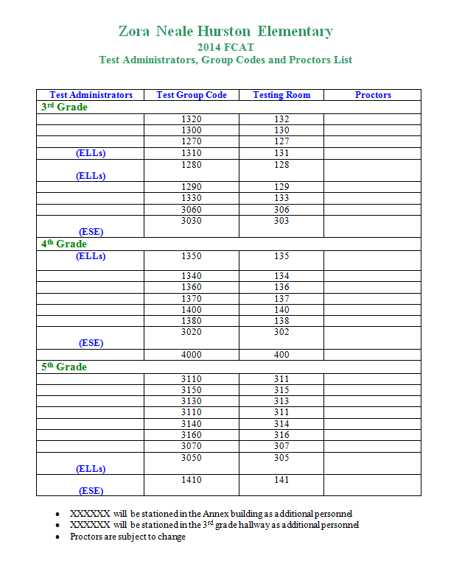
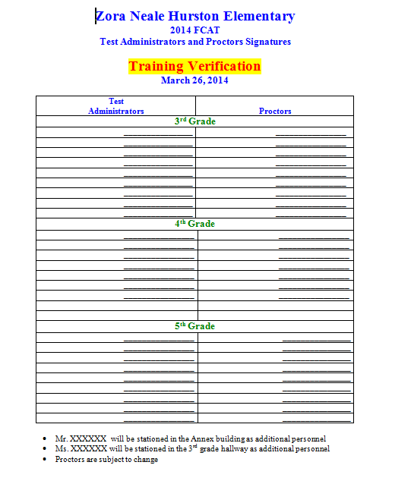
Samples

Slide 16
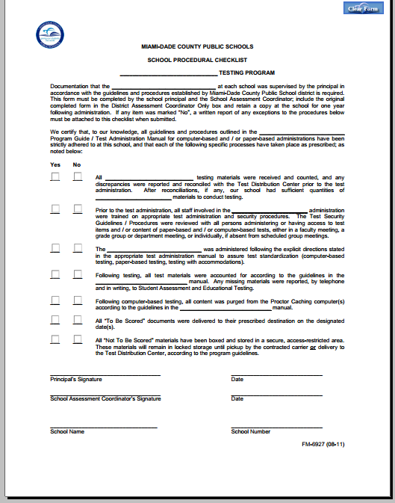
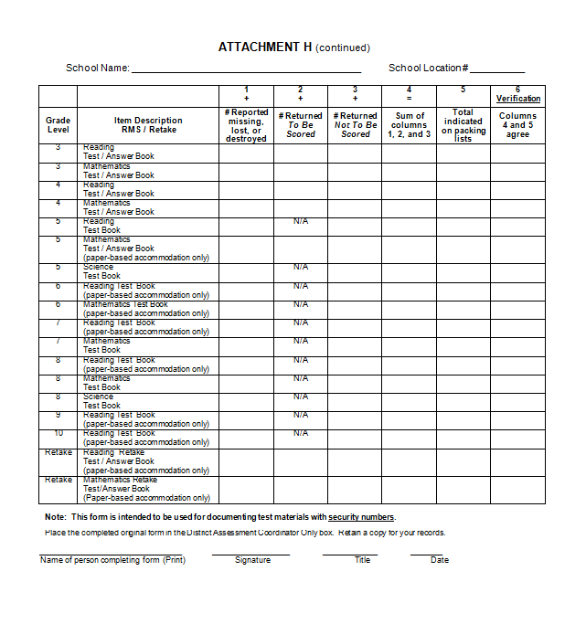
Samples

Slide 17
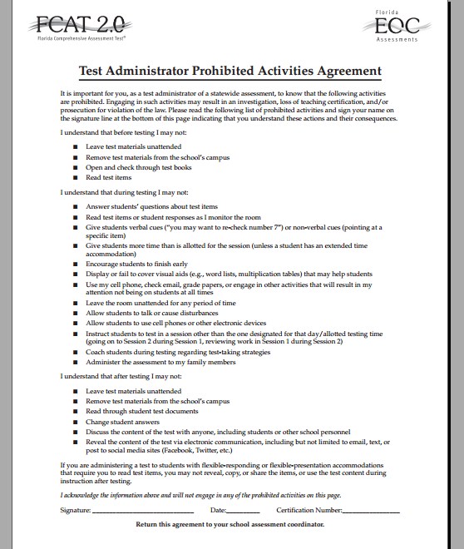
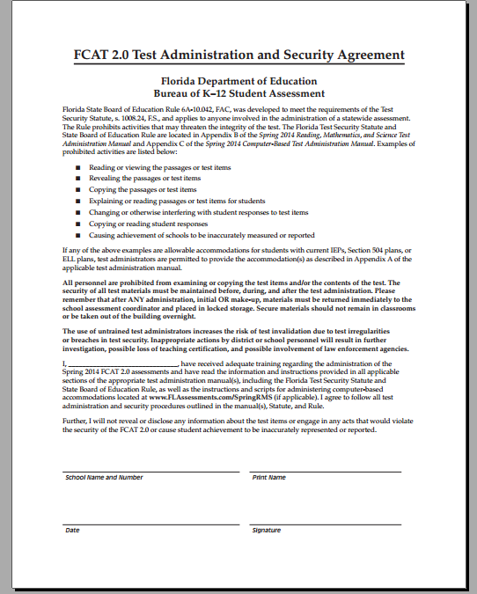
Samples

Slide 18
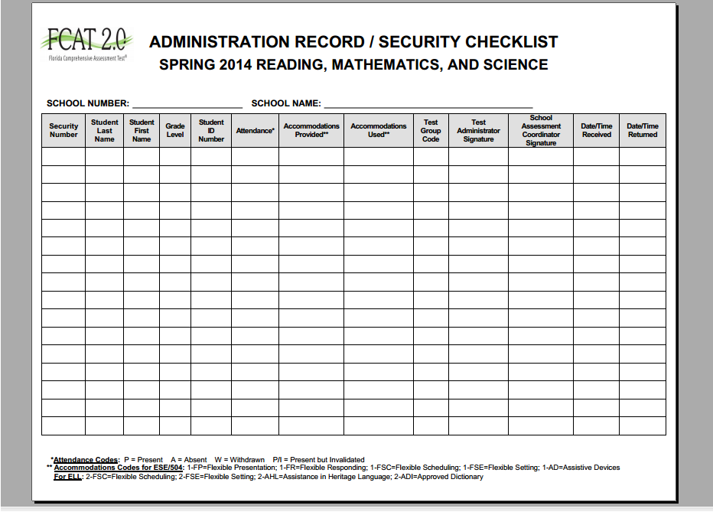
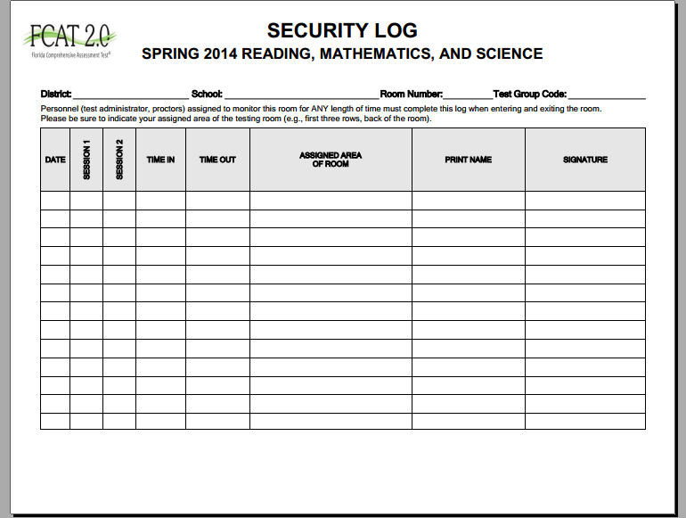
Samples

Slide 19
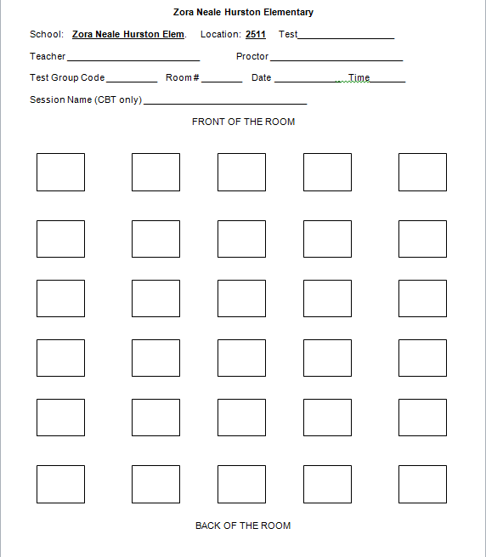
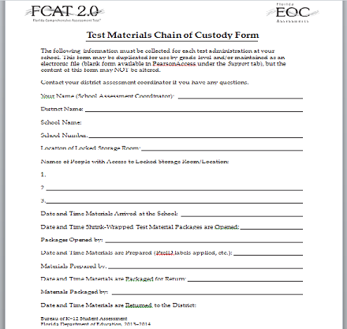
Samples

Slide 20
Keep Calm and Happy Testing
General information on testing is provided on the district’s test chairperson website
http://oada.dadeschools.net/TestChairInfo/InfoForTestChair.asp

