Slide 1



2018-2019
CBT Training Materials
FSA and NGSSS Assessments

Slide 2
2018-19 CBT Topics
FSA
NGSSS
CBT Tests to Be Administered:
  FSA ELA Writing (Gr 7-10)
  FSA ELA Reading (Gr 7-10)
  FSA ELA Retake (Writing and Reading)
  FSA Mathematics (Gr 7-8)
  FSA Algebra 1 and Geometry EOC
Testing Platforms:
  FSA Secure Browser 10.5
  TA Interface
  TIDE (fsassessments.org)
Session Management
CBT Tests to Be Administered:
  NGSSS Biology 1, Civics, and US History EOCs
Testing Platform:
  TestNav
  PearsonAccessNext.com
Session Management

Slide 3

2018-19 PBT Topics
FSA
NGSSS
PBT Tests to Be Administered:
  FSA ELA Writing (Gr 4-6)
  FSA ELA Reading (Gr 3-6)
  FSA Mathematics (Gr 3-6)
  and
  PBT Accommodations for:
    Grades 7-10 ELA Writing
    Grades 7-10 ELA Reading
    Grades 7-8 Math
    ELA Retake (Writing and Reading)
    Algebra 1 and Geometry EOC
    Testing Platform:
  TIDE (fsassessments.org)
PBT Tests to Be Administered:
  Science (Gr 5 & 8) and
  and
  PBT Accommodations for:
    Biology 1, Civics, and US History EOC
Testing Platform:
  PearsonAccessNext.com

Slide 4
FSA Program

Slide 5
FSA Terms
American Institutes for Research (AIR):
Assessment vendor for FSA assessments.
Data Recognition Corporation (DRC):
Vendor who processes the paper-based (PBT) FSA materials, including printing, shipping, receiving, and scanning.
FSA Portal:
Includes resources and information for district and school personnel.
Accessible at www.FSAssessments.org
Includes links to:
  Test Information Distribution Engine (TIDE),
  Test Administrator (TA) Training Site,
  Test Delivery System (TDS) (Secure Browser and TA Interface),
  Assessment Viewing Application (AVA), and
  FSA Reporting System.

Slide 6
FSA Terms
Test Information Distribution Engine (TIDE):
Enrollment and user management system for FSA assessments.
Used to manage student enrollment and test eligibility information by school coordinators.
All school personnel involved in the administration of FSA assessments must have TIDE user accounts.
SA (School Administrator): Principals
CBT (CBT Coordinator): School Assessment Coordinators
TA (Test Administrator): Test Administrators
AVA (AVA Test Administrator): Test Administrators administering PBT FSA ELA Reading PBT Accommodations only (for Grades 7-10 and Retake)
FSA Reporting System:
Delivers state, district, and school score results.

Slide 7
FSA Terms
Secure Browser:
Allows students to access the CBT FSA assessments.
Software must be installed on all computers or devices that will be used for student testing.
A link to download the NEW Secure Browser 10.5 is located on the FSA Portal under Technology Resources link.
Assessment Viewing Application (AVA):
System to access the listening portion (including audio passage/animation clips, Closed Captioning, or ASL videos) of the ELA Reading PBT Accommodations only (Grades 7-10 and Retake)
Test administrators log in to AVA with their unique username (email) and password.
AVA User Guide provides instructions.

Slide 8
Glossary of Terms
Student Interface (Secure Browser):
Students use the Student Interface via the secure browser to log in and take CBT FSA assessments.
Test Administrator Interface (TA Interface):
Test administrators use the TA Interface to create and monitor test sessions for all CBT FSA assessments.
Test Delivery System (TDS):
Includes the TA Interface and the Student Interface.
All CBT FSA assessments are administered via TDS.

Slide 9
Glossary of Terms
Session ID:
Unique code generated by the Test Administrator (TA) Interface.
Students use the Session ID, along with the first names and usernames to log into CBT FSA assessments.
Test administrators must record the Session ID with their required administration information.
Test Group Codes:
Unique four-digit codes used for FSA (PBT) and for NGSSS (PBT and CBT) to identify groups of students tested together.
Must be recorded on the front of the test and answer books and on the required administration information.
Generated by SAC to provide to the TA for each testing group.

Slide 10
FSA
Test Delivery System Overview
TIDE
User Management and Student Enrollment
TA Interface & Secure Browser (TDS)
Test Administration
Online (CBT) Testing
TIDE
Participation Reports
TIDE
User Management, Student Enrollment, Test Materials
Paper Testing
Test Administration
Paper Testing (PBT)

Slide 11
FSA
Common Login System
Any FSA system can be accessed from the FSA Portal at www.FSAssessments.org
The same username (email) and password can be used to log into each of the systems

Slide 12
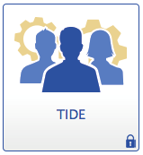
FSA
TIDE System Overview
Manage TIDE Users
View/Edit Student Information
  PreID or Add Students
  Print Student Test Tickets
  Print On-Demand PreID Labels
  Select CBT accommodated forms
  Participation/Test Completion Reports
  Manage Rosters
Invalidate Tests
Track Orders

Slide 13

FSA
Accessing TIDE
Go to the portal www.FSAssessments.org
Click the “TIDE” icon

Slide 14
FSA
Accessing TIDE (cont.)
To access TIDE, you will need:
      Username (your email address) and password
      High-speed internet connection
      Supported Internet browser
      JavaScript; and Disabled pop-up blockers
School Assessment Coordinators (SACs) are responsible for adding (and deleting) other school-level users in TIDE.
  Additional CBT Coordinator (for the SAC) account
  Test Administrator (TA)
  AVA user accounts
    Has to be added as a separate role in TIDE
Once your TIDE account is set up, your username and password will be used to access all FSA systems (TIDE, Test Administrator [TA] Interface, Assessment Viewing Application [AVA], and FSA Reporting System).

Slide 15
FSA
TIDE User Roles
TIDE is organized by user role and access to certain tasks and functions are assigned to specific roles.
A detailed list of roles and their access to tasks are available in the TIDE User Guide.
District Assessment Coordinator (DAC)
School Administrator (SA)
CBT Coordinator (CBT) for SACs
Test Administrator (TA)
AVA Test Administrator
(AVA)

Slide 16
FSA
First Time Users
Initial (CBT Coordinator) accounts for SACs will be created by Student Assessment & Educational Testing (SAET) Office.
Instructions for creating and managing user accounts are in the TIDE User Guide.
Newly added users will receive an automated email that contains the following:
      Their assigned user role(s)
      The applications to which they have access
      A secure, temporary, one-time link to activate the account
If a school user has not received the email, contact or if the link has expired, contact SAET.

Slide 17
FSA
Activating Your TIDE Account
TIDE will send you an activation email. This email contains the following information:
• A link for logging in to TIDE. This link expires 15 minutes after the email is sent.
If you do not receive an account activation email, check your spam folder. Emails are sent from Florida DoNotReply@airast.org, so you may need to add this address to your contact list.
To activate your account:
1. Click the link in the email. The “Reset Your Password” page appears.
2. In the Password and Confirm Password fields, enter a new password.
3. The password must be at least eight characters long and have three of the following: one uppercase alphabetic character, one lowercase alphabetic character, one number, and one special character %, #, or !.
4. Click Submit.
5. Your account activation is complete and you can now log in to TIDE.

Slide 18
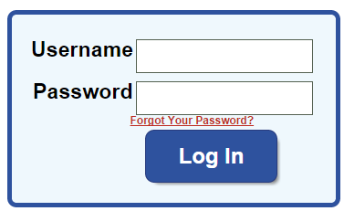
FSA
TIDE Logging In
At the FSA Portal, click on the TIDE card
Enter the username (email) and password at the login screen
Once logged in, the user may be prompted to choose an administration and a role.
If you forgot your password or need a new password, please use the Forgot Your Password? link to reset it.

Slide 19
FSA
TIDE Home Screen
Banner
Available Systems
Tasks
Banner
Tasks

Slide 20
Managing Users

Slide 21

School Tasks: Managing Users
To add an individual user, Under Preparing for Testing, Click Manage Users > Add User
Enter the email address, then click “+Add user or add roles to user with this email” link
Email will be prepopulated, enter First Name, Last Name, and Phone Number (optional). Then select the Role from the dropdown menu.
You may add multiple roles to one user and then click Save.
You may also delete roles from a user by clicking the trash can and then clicking Save.

Slide 22
School Tasks: Managing Users

Slide 23
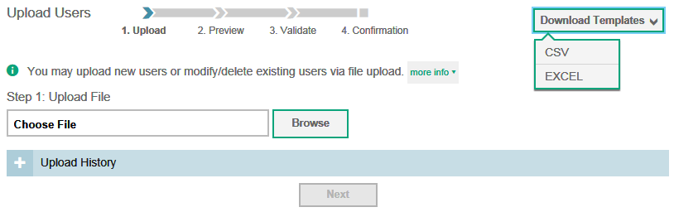
School Tasks: Uploading Users
To add multiple users, under Preparing for Testing,
Manage Users > Upload Users
Select Download Templates and
create file.

Slide 24
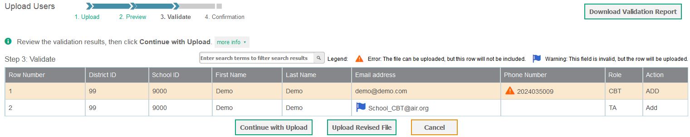
School Tasks: Uploading Users (cont.)
Upload to TIDE by Selecting Browse to select the file and Next to preview your file.
Select Next to validate the file. TIDE displays errors or warnings.
Click Continue with Upload to upload the file as is.
Or, correct the errors on the original file and Upload a Revised File.

Slide 25
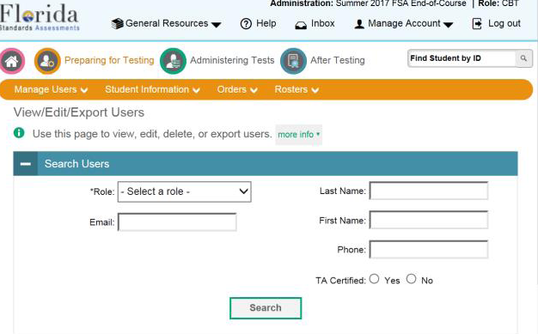
School Tasks: View/Edit Users
Under Preparing for Testing, Click Manage Users > View/Edit/Export Users, and search for the user.
Click [ ] to view or edit the user record.
Select the checkbox for a user and then the to delete users.
Select [ ] to pull an excel or csv file of all users.

Slide 26
Student Information

Slide 27
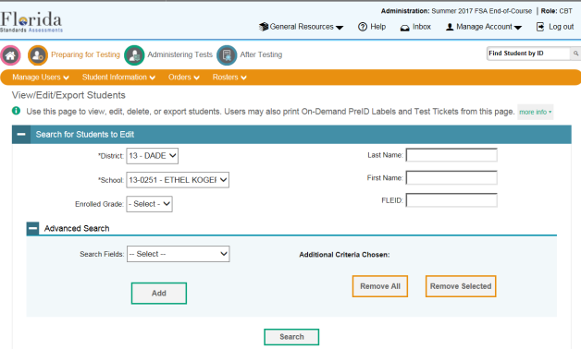
School Tasks: Confirming Student Information
Under Preparing for Testing,
Click Student Information > View/Edit/Export Students,
Enter student information and click Search to find the student record.

Slide 28
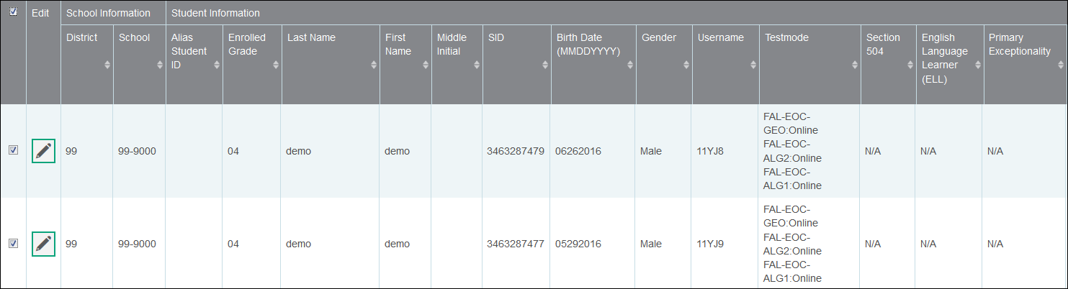
School Tasks: Confirming Student Information
A list is generated.
Click [ ] to view/edit the student record.
Click checkbox next to student name to remove a student.
  Only allowed before the testing window opens.

Slide 29
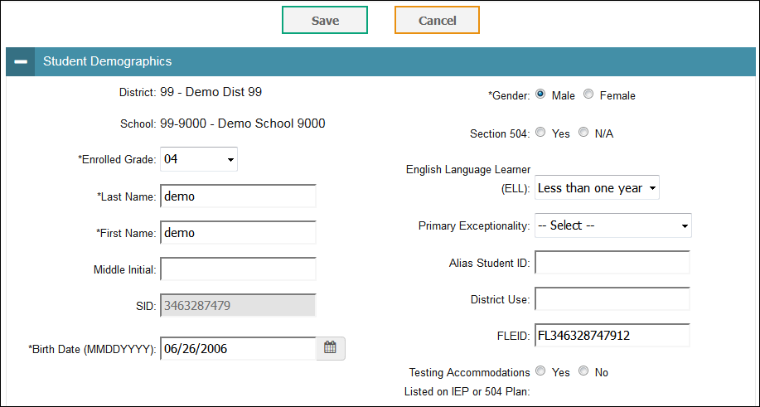
School Tasks: Confirming Student Information (cont.)
View the Student Record: Confirm/update information in the Demographics panel.

Slide 30
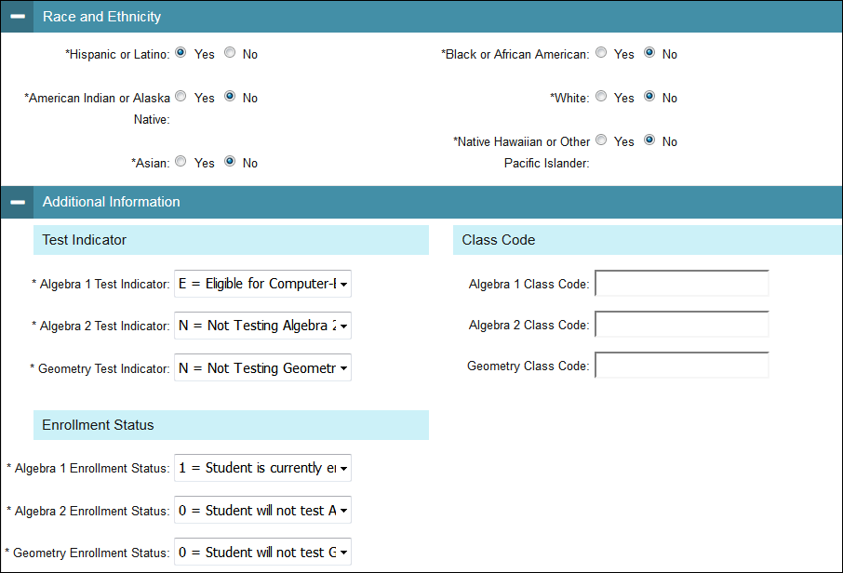
School Tasks: Confirming Student Information (cont.)
View Student Record: Confirm/update information in the Race and Ethnicity and the Additional Information panels.

Slide 31
School Tasks: Confirming Student Information (cont.)
View Student Record:
  On Accommodations panel, confirm/update information.
  Click Save when finished.

Slide 32
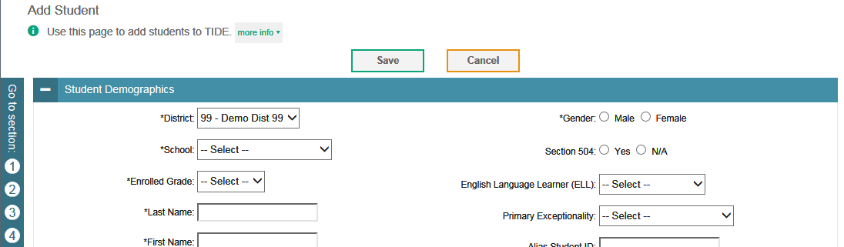
School Tasks: Adding Students
Under Preparing for Testing,
Click Student Information > Add Student
Make selections and type in entries for all required fields and click Save.

Slide 33
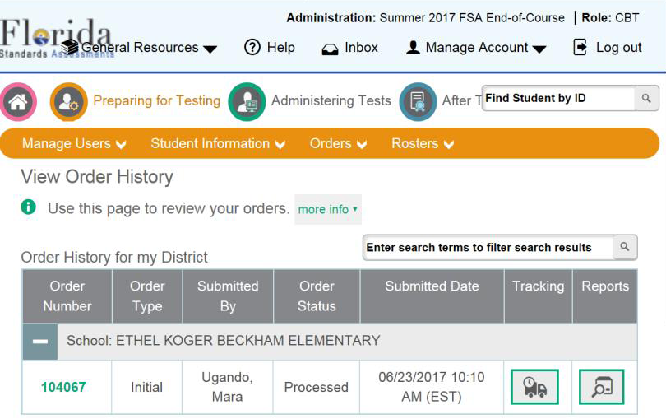
Viewing Orders
Viewing Orders and Printing Security Checklists

Slide 34

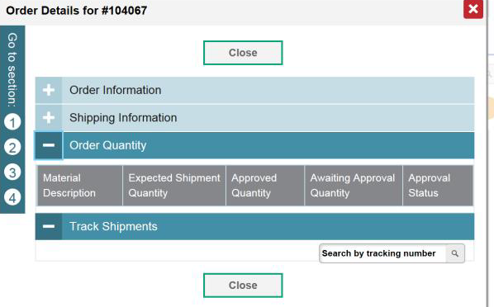
Viewing Orders
Click [ ] to view order tracking information.

Slide 35
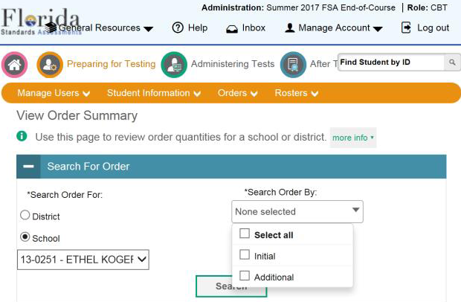
Viewing Orders
Click [ ] to view order summary information.

Slide 36

Viewing Orders
Click [ ] to view order reports.
  Packing lists
  Security checklists

Slide 37
Printing PreID Labels and Test Tickets

Slide 38
School Tasks: Printing On-Demand PreID Labels and Test Tickets
PreID labels and test tickets and Test Tickets may be printed via:
Under Preparing for Testing, Click Student Information > View/Edit/Export Students
2. Under Administering Tests, Click Print Test Tickets and PreID Labels> Print from Student List or Print from Roster List

Slide 39
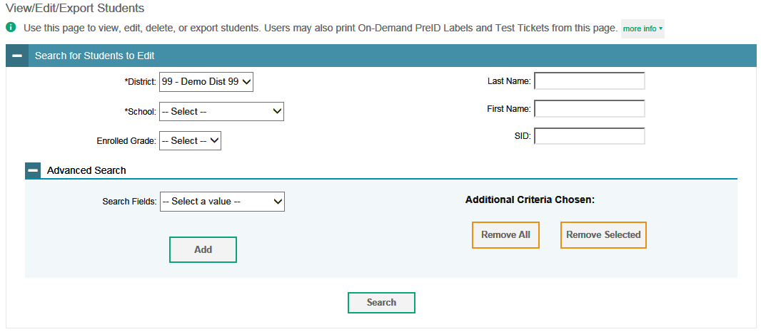
School Tasks: Printing On-Demand PreID Labels and Test Tickets
  Search for a student(s) by entering the student information and then clicking Search, or
  Generate a list of all students by clicking the Search button.

Slide 40
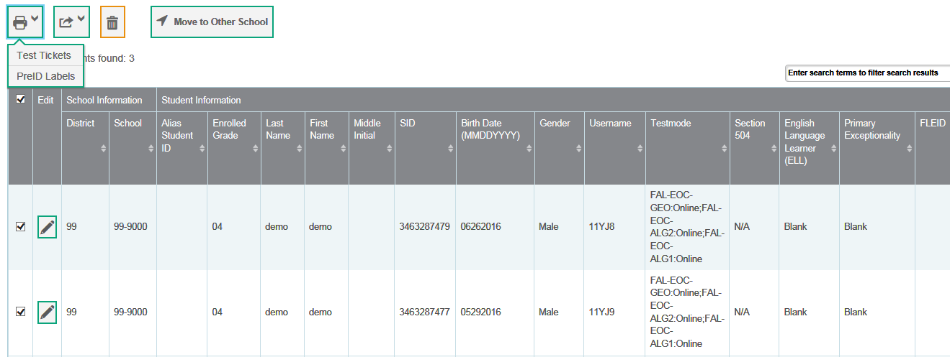

School Tasks: Printing On-Demand PreID Labels and Test Tickets
Select the record(s), click the print icon [ ] and select PreID Labels or Test Tickets. A separate window or tab will open.

Slide 41
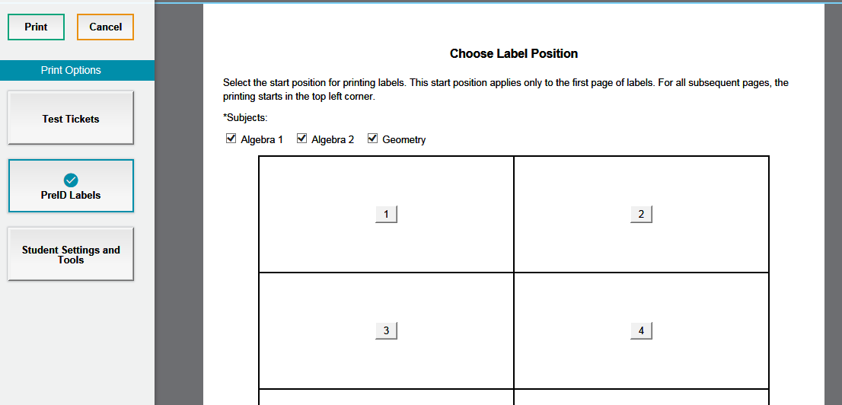
School Tasks: Printing On-Demand PreID Labels
If you select PreID Labels, Select the subject(s) you want to print a pre-ID label for, a start position and click Print.

Slide 42
School Tasks: Printing On-Demand PreID Labels
Open the generated PDF file with the selected student labels.
Print the PDF on the blank on-demand labels provided by DRC.
Sample PreID Label

Slide 43

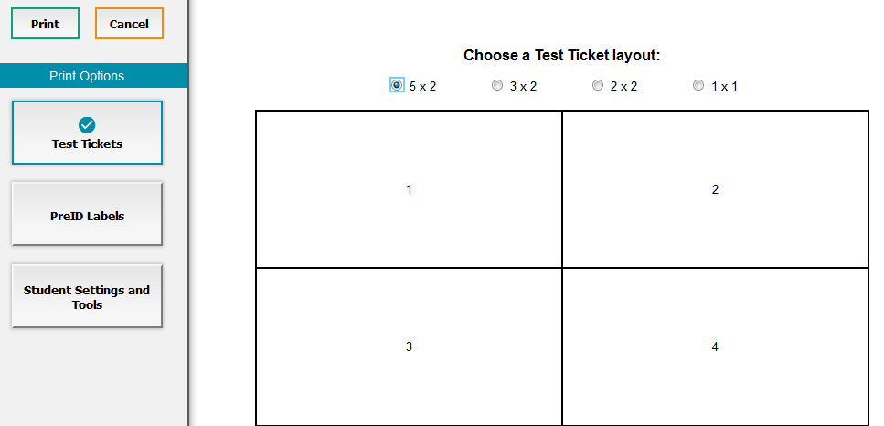
School Tasks: Printing Test Tickets
If you select Test Tickets, a separate window or tab will open.
Select a Layout and click Print.
Open the file with the selected student tickets. Print the PDF.

Slide 44
School Tasks: Printing On-Demand PreID Labels
Open the generated PDF file with the selected student test tickets.
Print the PDF on the blank paper.
Sample Test Ticket

Slide 45
Rosters

Slide 46
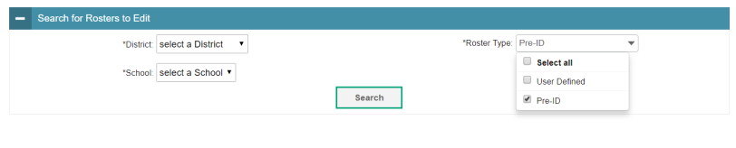
School Tasks: Rosters
To view or edit Rosters, under Preparing for Testing,
Click Rosters > View/Edit Rosters.
Select checkbox for Pre-ID or User Defined
Click Search

Slide 47
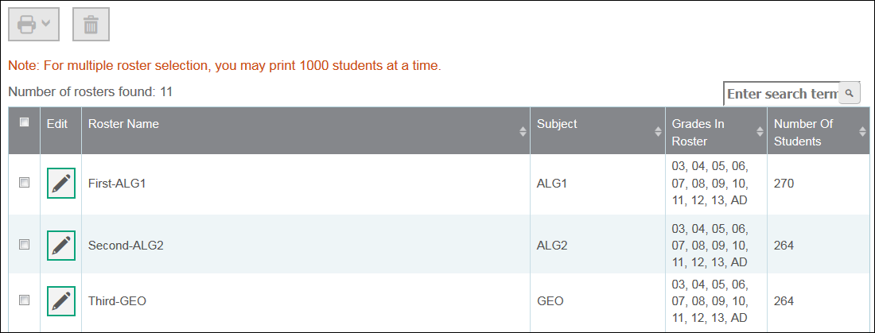
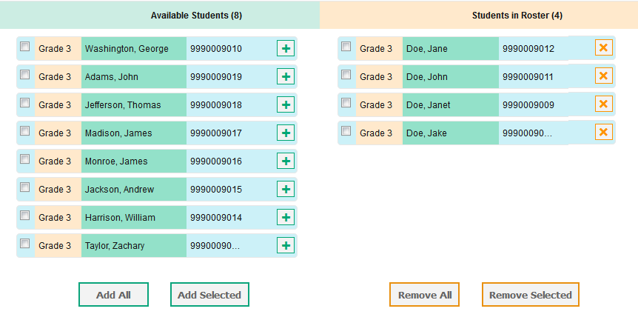
School Tasks: Rosters (cont.)
Click [ ] to view or edit a Roster.
  PreID Rosters are view only.
  User Defined Rosters created at the school can be modified.
To edit a User Defined roster
  Click [ ] to add a student, and [ ] to remove a student from a school created (User Defined) roster.

Slide 48
School Tasks: Rosters (cont.)
To Add User Defined Rosters, under Preparing for Testing,
Click Rosters > Add Roster
Select the test administration from dropdown menu
Click Search

Slide 49
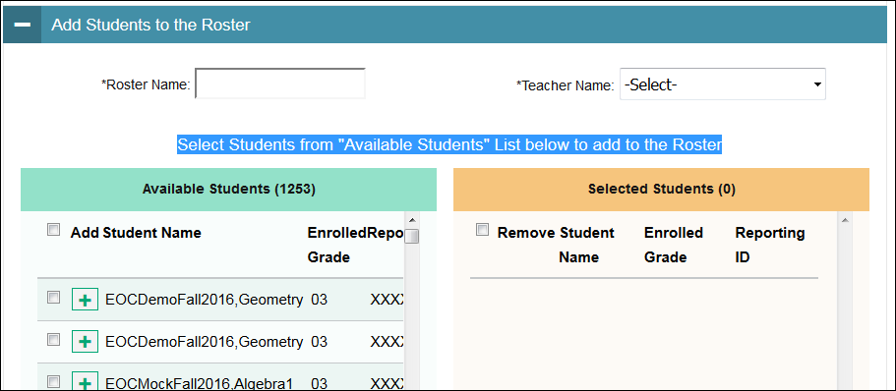
School Tasks: Adding Rosters
Select students from the “Available Students” list to add to the roster.
Type Roster Name.
Select Teacher Name.
Click Save.

Slide 50
School Tasks: Printing Rosters/Tickets
Under Preparing for Testing, select View/Edit Rosters, and click Search.
Select checkbox for roster and click [ ]
A new tab or window will open with the PDFs to print

Slide 51
Invalidations and Requests

Slide 52
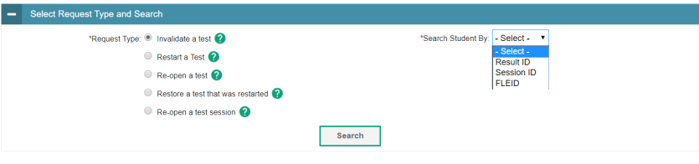
School Tasks: Create Invalidations and Requests
Under Administering Tests,
Click Invalidations and Requests > Create Requests.
Select a request type to create and enter an FLEID, Result ID, or Session ID.

Slide 53
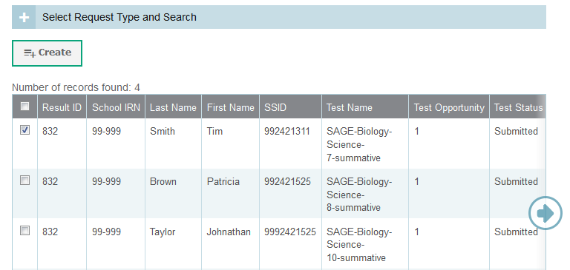
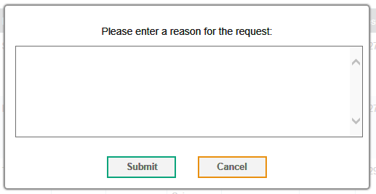
School Tasks: Create Invalidations and Requests (cont.)
Choose a record(s) and click Create.
Enter a reason and click Submit.
Requests can also be uploaded to TIDE.

Slide 54
FSA CBT Materials Needed, as applicable:

Slide 55
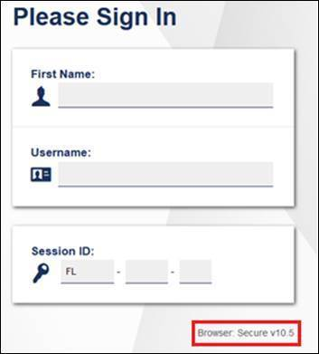
FSA
Student Test Tickets
For each test session, to log into the FSA Secure Browser, each student needs to enter their First Name and Username, which are printed on the Student Test Tickets.
Provide each student their ticket only AFTER all students have entered the testing room, as instructed in the script, and all tickets must be collected BEFORE students leave the testing room.
Student Test Tickets must be handled in a secure manner and returned to the school assessment coordinator immediately after each day of testing is completed.
Keep Student Test Tickets securely stored at all times.
FSA Student Test Ticket
FSA Secure Browser
Student Login Screen

Slide 56
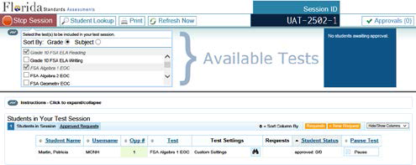
FSA
Session ID for CBT Tests
Session ID
Session IDs are unique codes generated by the Test Administrator Interface. In addition to their Username and First Name, students use the Session ID to log into computer-based FSA assessments. Test Administrators must record the Session ID as part of their required administration information.

Slide 57
FSA
CBT Work Folders
The Florida Computer-Based Testing Work Folder is a blank piece of yellow 11x17 paper folded in half with grid paper on the back page.
For the FSA Mathematics and FSA EOCs CBT test sessions, students are provided with work folders to work the problems.
Distribute work folders to students at the beginning of each test session.
Ensure that students have enough desk space to use their folders.
Once students complete the test, collect all work folders and return them to the school assessment coordinator.
Used work folders are secure materials.

Slide 58
FSA
CBT Worksheets
For the FSA ELA Reading, the CBT worksheet is provided for students to take notes.
Students must have enough desk space to use their worksheets.
Once students complete a test session, collect all worksheets and return them to the school assessment coordinator.
Used worksheets are secure materials.

Slide 59
FSA
Scientific Calculators
A scientific calculator is available in the test platform for Grades 7-8 FSA Mathematics and all FSA EOCs assessments.
Hand-held calculators may be used by students, only if all students are provided with a handheld calculator.
Handheld scientific calculators must have only allowable functionalities, as indicated in the FSA Mathematics Policies and Materials document (on the FSA portal).
Calculators can only be used in Sessions 2 and 3 of the Grades 7 and 8 Mathematics and Session 2 of the FSA EOC assessments.
If providing calculators, ensure that students are ONLY provided handheld calculators in the appropriate sessions.

Slide 60


FSA
Test Administrator (TA) Interface for CBT
Administer the FSA
TA Training Site

Slide 61
2018-19 Technical Specs -
FSA Secure Browser 10.5
AIR has released the 2018-19 technical specification updates for the upcoming school year.
    Schools should pay special attention to the operating systems and browsers that will no longer be supported.
    See Weekly Briefing #23230
On November 1, AIR released a new secure browser (version 10.5) for the 2018-19 Winter/Spring/Summer administrations.
  All desktops and laptops/tablets (Windows, Mac OS, and Linux operating systems) that will be used for testing this year must be updated with the new secure browser
  Important Note: Secondary schools must have the FSA new secure browser installed prior to the Winter 2018 FSA administrations.
  Refer to Weekly Briefings # 23912

Slide 62
FSA
Preparing/Conducting CBT Testing
    To administer either an online training test or an online operational test, you will need to:
      Ensure the technology coordinator has installed the new secure browser on student workstations or devices.
      Review that students are enrolled for the test to be administered via TIDE.
      On the day of the test, test administrators will set up a Test Session and provide the Session ID to students.
      For students to log in, test administrators will ensure students have a Test Ticket and enter their Username and First Name as they appear on the test ticket, along with the Session ID.

Slide 63


FSA
Secure Browser Student Login
After opening the FSA secure browser, students will use the information from their Test Ticket to login.
Students will be shown a screen to confirm their demographic information.
Students will be asked to select a test. The first time the student signs in, the arrow will be solid. When a student is resumed or signs in for Session 2, the arrow will be segmented.
A test confirmation page will appear, and students will then await approval from the TA to enter the test.

Slide 64

FSA
Accessing the TA Interface
The Test Administrator Interface (TA Interface) is accessed from the FSA Portal at www.FSAssessments.org/
  Select Administer the FSA (grayed out) or Test Administration Card
  Sign in using your Username (email) and Password

Slide 65
FSA
TA Interface
Select the test(s) to be administered, and click Start Session

Slide 66

FSA
Approving Students for a Test Session
Approvals button
  Located, on the right side of the top panel
  Alerts TAs that students are awaiting approval to enter a test and displays the number of pending approvals.
  Notification updates regularly
  Refresh by clicking in the upper-right corner to update manually
  Note: Students who log in to the session AFTER the test administrator has opened the Approvals and Student Test Settings screen will not automatically appear in the list.
  To update the list of students awaiting approval, click the [Refresh] button in the top row of the Approvals and Student Test Settings screen.

Slide 67
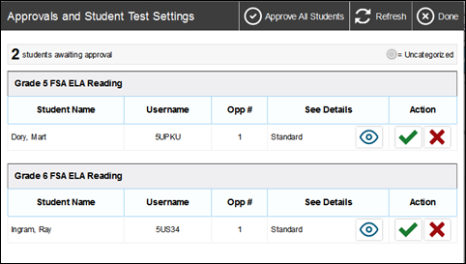
FSA
Approving Students to Test
Click Approvals.
  The Approvals and Student Test Settings screen appears, displaying a list of students grouped by test (if multiple tests were selected)
    The Approvals and Student Test Settings screen displays each student who is awaiting approval for entry into the session.
    By default, this screen shows those students who were awaiting approval when the [Approvals] button was clicked.
    Students on this screen are organized by test subject. Each row displays the student’s name, Username, opportunity number for the selected test, whether the test settings are standard or custom, and the option to approve or deny each student.
Note: To check a student’s test settings and accommodations, click for that student. A sample student information appears on the next slide.

Slide 68
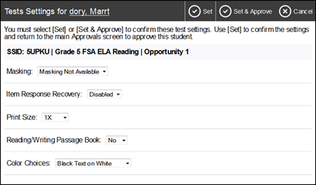
FSA
Viewing a Student’s Test Accommodations
About the Test Settings column
Students with Standard test settings have the default test settings.
Students with Custom test settings have at least one test setting that is different from the default (i.e., color contrast, enlarged print or CBT accommodations, such as text-to-speech)
Warning: Check students’ test settings and accommodations before approving students.
Students who require test settings or accommodations other than the default settings may need to have their information updated in TIDE before they can begin testing.
  TAs cannot adjust test accommodations via the TA Interface. Test accommodations must be updated in TIDE.
  If a student’s test accommodations must be updated, TAs deny the student’s test request and must contact the School Assessment Coordinator.

Slide 69

FSA
Approving Students to Test
After the TA confirmed students’ accommodations, the TA may return to the list of students awaiting approval.
  On this screen, you can approve individual students or approve all students awaiting approval at once. After the students have been approved or denied, the Approvals and Student Test Settings screen will automatically close.
To approve individual students, click the [ ] button for each student.
  The student will be approved and will also disappear from the list.
To approve all students currently displayed in the list, click the [Approve All Students] button at the top right. This will approve those students for testing.
Note: You may approve all students who appear in the list. However, students who log in to the test session after you have opened the Approvals and Student Test Settings screen will still need to be approved individually.

Slide 70
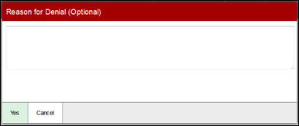
FSA
Denying Students to Test
Denying a student from entering a session has to be done individually. TAs may deny students for one of the following reasons:
  The student is not supposed to enter the session (e.g., the student does not belong to the TA or the student is not assigned to take the correct test).
  The student selected the wrong test.
  The student’s test settings or accommodations are incorrect.
  On the Approvals and Student Test Settings screen, click for the student.
  In the pop-up screen that appears, enter a brief reason for denying the student and click [Yes].
  The student will receive a message explaining the reason for the denied entry into the session. The student will then be logged out and directed to the login page.
  TA should contact the School Assessment Coordinator for instructions.

Slide 71
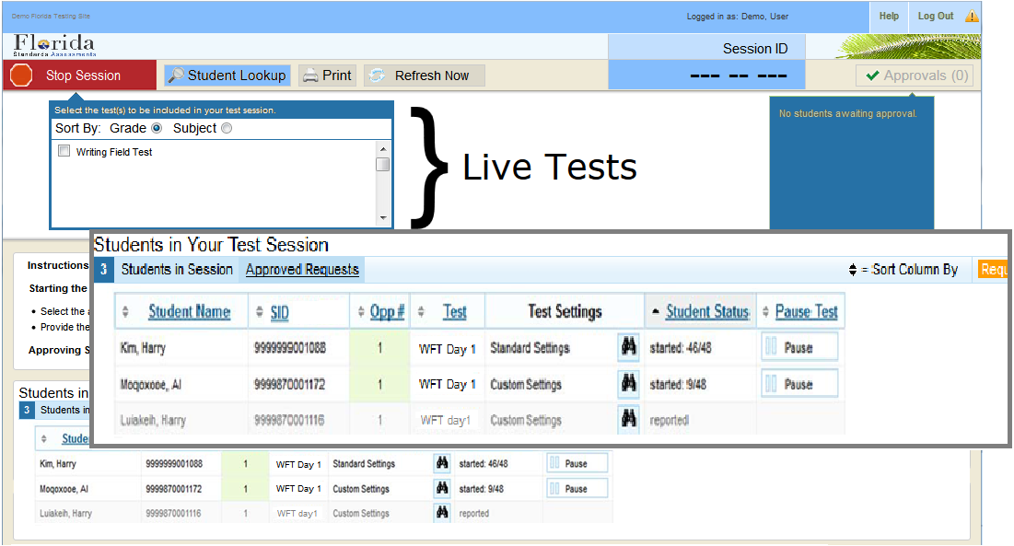
FSA
Monitoring Student Progress
After students have logged in and the Test Administrator has approved them to begin testing, the test session table at the bottom of the screen will display each student currently logged in to the session.

Slide 72
FSA
Exiting or Logging Out
In the case of an unintentional exit from the TA Site caused by a system or computer error (such as the web browser crashing or closing), a network or communication error, power loss, or other event, the 20-minute rule applies.
  If the TA does not return to the TA Site and re-enter the active session within 20 minutes, the TA will be logged out, and all students’ tests will be paused and logged out.
If TA accidentally close the browser while students are still testing, the session will remain open until it times out. TA may open the browser and navigate back to the TA Site. The TA will be prompted to enter the active Session ID.
    Warning: You must remember or write down your active Session ID. If you do not remember your Session ID, you will not be able to enter your active session, and you will need to contact the FSA Help Desk for assistance.
    If you do not return to the TA Site and reenter the active session, the 20 minute rule applies
If the TA unintentionally logs out of a TA Site while students are still testing, the session will be stopped, all in-progress tests will be paused, and the students will be logged out.
  The original session cannot resume. TA will need to log back in to the TA Interface, start a new session, and provide the new Session ID to students who need to log back in and resume testing.
  This also occurs if the TA navigates to another site from the TA Site.

Slide 73
FSA
Timing Out
As a security measure, after 90 minutes of user inactivity and student inactivity in a test session.
  Test Administrators are automatically logged out and
  The test session is automatically closed
    To enter the active session again:
      the Test Administrator has to create a new test session and provide the new Session ID to students to log back into the test.
Test Administrators should set up the session no earlier than 90 minutes before students begin to test.
Test Administrators will not be logged out as long as students are actively testing.

Slide 74

FSA
Stopping the Test Session
Test sessions cannot be resumed.
  Stopping a session will end the session and automatically pause all active students’ tests in that session.
  The students will be logged out automatically.
To stop a test session:
  Click in the upper right corner of the screen. An “Important!” box will appear, requesting verification to end the session and log students out.
  Click [OK] to continue. The test session will be closed.
Alert: Because test sessions cannot be resumed, TA MUST create a new session if a session has been stopped and there are students who need to complete their test.
When a new session is started, give the new Session ID to the students to log in and resume testing.

Slide 75
FSA
Ending a Test Session
Ending Session 1/Day 1 of Testing:
After students finish responding in Session 1 and have reviewed their answers, students will pause their test by clicking END SESSION on the Review screen and then selecting “Yes” on the pop-up message.
After all students are finished testing or after the test session is ended, Test Administrators will click the STOP button. An “Important!” box will appear, requesting verification to end the session and log students out. Click “OK” to continue. The test session will be closed.

Slide 76
FSA
Ending a Test Session (cont.)
Ending Session 2/Day 2 or Session 3/Day 2 of Testing:
Note: On Day 2, TAs will create a new test session, system will generate a new session ID, and students will log into the test. Students should select to resume the test with the segmented arrow.
For Session 2 Math (grades 7-8), the TA will need to approve the “Exit Session Approval” when students wish to move from Session 2 to Session 3.
After students finish responding to Session 2 or Session 3 (Math, grades 7-8), students will click END TEST. They will review their responses and then click Submit Test.
      After all students are finished testing or after the test session is ended, Test Administrators will click the STOP button.

Slide 77
FSA
Using Participation Report
Common examples of Participation Report cases:
Which students have not yet tested?
Which students have started but not yet completed their test?
Which students have paused tests?
Did every student in a test session (Session ID or TA Name complete their test)?
Which students have not completed?
Which student have completed?

Slide 78
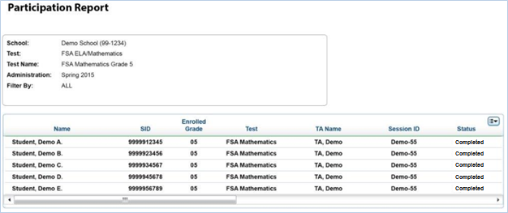
FSA
Participation Report Results
Example of a Participation Report. These reports can be used to keep track of Test Participation.

Slide 79
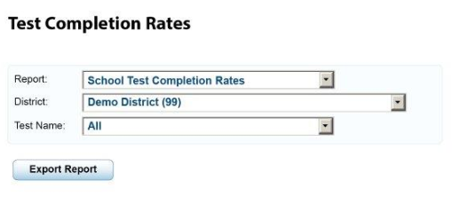
FSA
Test Completion Rates
The Test Completion Rates screen offers a high-level view of how many students have started and completed tests.

Slide 80
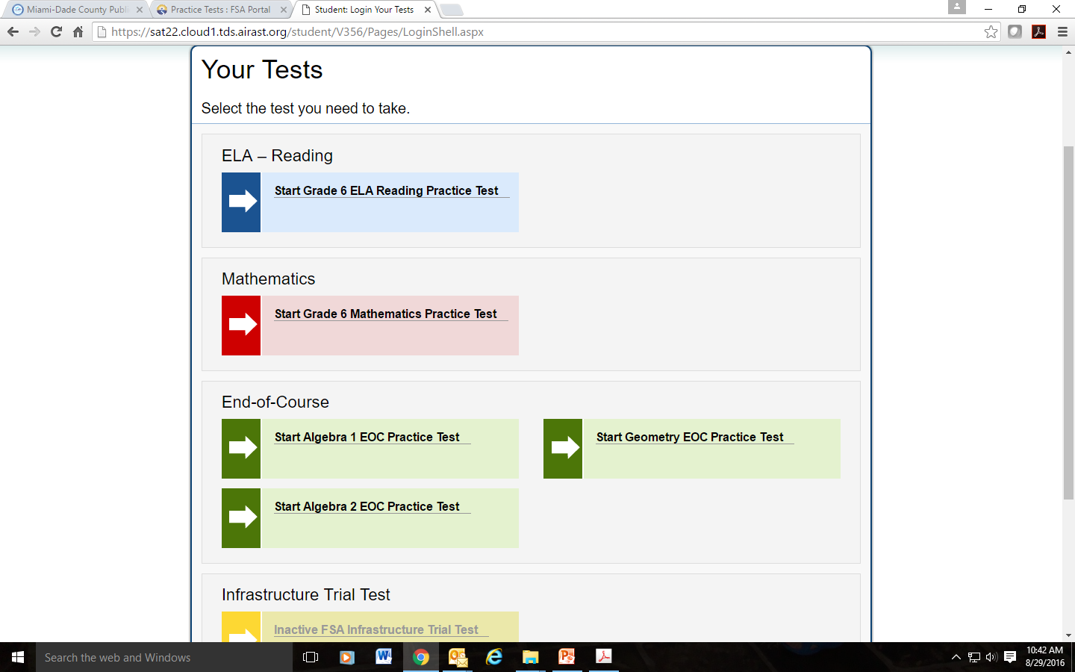
FSA
Practice Tests
  FSA Practice Tests are intended to provide students, parents, and educators with an opportunity to become familiar with the item types and functionality of the new computer-based (CBT) platform produced by AIR.
    Sample items for different grade levels and subject areas are available for the following:
      Grades 7-10 FSA ELA (Reading, Language, and Listening)
      Grades 7-10 FSA ELA Writing Component
      Grades 7-8 FSA Mathematics
      FSA EOC (Algebra 1, Geometry)
    The ratio/percentage of items of each item type in the practice tests is NOT representative of the ratio/percentage of items of each that will appear in the operational tests.

Slide 81
FSA
Other Resources
TDS Quick Guide
TIDE Quick Guide
TIDE User Guide
TIDE Online Training Module
Test Administrator User Guide
TA Certification Course
Practice Tests User Guide
AVA User Guide
FSA Reporting System User Guide
Test Administration Manuals
2018–2019 FSA Accommodations Guide
UEB Transition for Standards-Based Assessments
FSA ELA Reading Instructions for Oral Presentation Accommodations
FSA Infrastructure Trial Guide
Common Online Testing IDs and Descriptions
System Requirements for Online Testing
FSA Technical Specifications Manual
Secure Browser Installation Manual

Slide 82
FSA
Contact Information
FSA Portal: | www.FSAssessments.org
Email: | fsahelpdesk@air.org
Toll-Free Phone: | 1-866-815-7246
Hours: | 7:30 a.m.–8:00 p.m. (ET) Monday–Friday (except holidays)

Slide 83
NGSSS Program

Slide 84
2018-19 Technical Specs -
Test Nav 8 App
Pearson has released the 2018-19 technical specification updates for the upcoming school year. Refer to Weekly Briefing # 23230
    Schools should pay special attention to the operating systems and browsers that will no longer be supported.
Pearson has also released a new update for the TestNav app.
  Note: TestNav app is optional for schools to download.
    The update for the TestNav app is available at: http://download.testnav.com/.
Please note: All computers and devices running the old TestNav app must be updated prior to testing, starting with the Fall 2018 NGSSS administrations.
Pearson Portal (florida.pearsonaccessnext.com/): The portal to all Pearson services used by Florida school districts. Use this site to access test administration activities, training, and other resources.

Slide 85
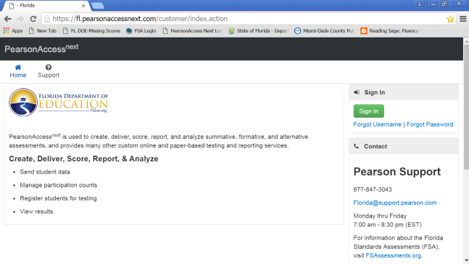
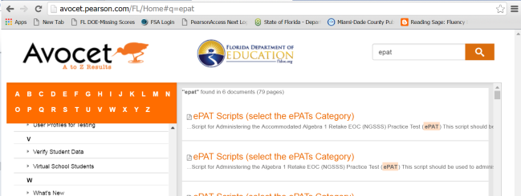
NGSSS PearsonAccess:
(Blue Site)
Website: https://fl.pearsonaccessnext.com/customer/index.action A website used for almost all test preparation (e.g., PreID), setup, administration, and reporting tasks.
  Requires a username (email) and password.
  Verify that you are working in the correct test administration each time you log in.
Link to support materials via Avocet is available at http://avocet.pearson.com/FL/Home.
  PearsonAccess will timeout after 14 minutes of inactivity.

Slide 86
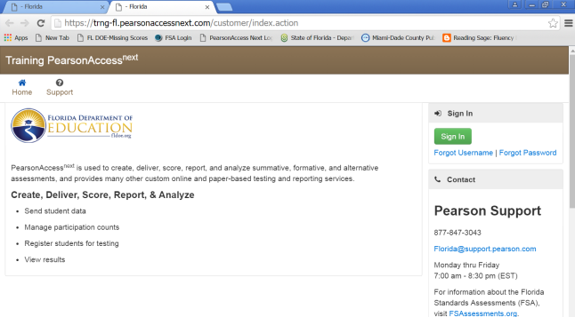
NGSSS PearsonAccess:
Training Center (Brown Site)
Website: https://trng-fl.pearsonaccessnext.com/customer/index.action
Accessed from the Training Center link on PearsonAccess Next Home page.
Provides an opportunity to
  Practice PearsonAccess tasks.
  Manage the Infrastructure Trial in preparation for testing.
Requires a username (email) and password.

Slide 87
NGSSS PearsonAccess: Create/Update School User Accounts
School user accounts are necessary to complete the CBT test activities.
DAC creates (CBT Coordinator) accounts for School Assessment Coordinators for each Pearson site (operational and training center).
Create or reset your password for each Pearson site (operational and training center).
  Test administrators may monitor and resume students with a CBT TA account.
  Optional: Create school user accounts (CBT TA accounts) for test administrators in Pearson’s operational site – if you want test administrators to resume students during CBT testing.
    Individual CBT TA accounts for each test administrator.
    Email address is the username.
    Test administrator will set up unique password.

Slide 88
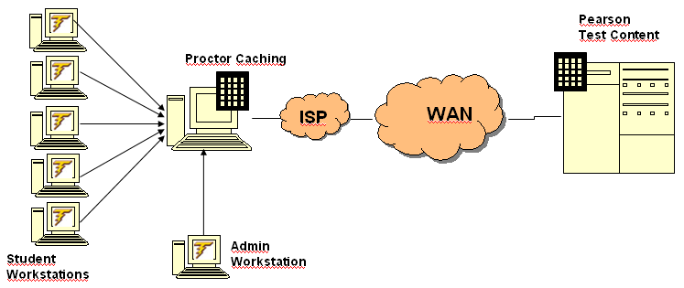
NGSSS PearsonAccess:
Proctor Caching
A process of loading or “caching” test content locally on a computer at the school level.
Does not require a separate caching server and can run on any workstation on the network that meets minimum requirements.
Proctor Caching software is provided by Pearson.
Reduces test delays due to network congestion.
Provides students with a more seamless testing experience.
Required for all NGSSS EOC computer-based testing in Florida.

Slide 89
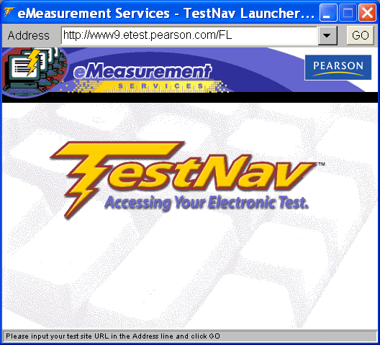
NGSSS PearsonAccess:
Testing Platform
TestNav 8
Used for CBT NGSSS Biology 1, Civics, and US History EOC.
Web-based platform - only Proctor Cache software application needs to be installed.
Integrates accommodated forms (text-to-speech and masking) for eligible students, based on an IEP or Section 504 Plan.
Optional: New TestNav app available for download – eliminates JAVA issues.
Note: This is the URL (case-sensitive) used for testing; it is different from the URL used for the Infrastructure Trial.

Slide 90
NGSSS PearsonAccess:
Florida Practice Tests
  Provides students an opportunity to practice using the computer-based platform prior to testing.
  Accommodated practice tests are also available.
  Directly available at http://florida.pearsonaccessnext.com/, select Florida Practice Tests link
  Scripts and instructions for administering practice tests are posted in Avocet available at http://avocet.pearson.com/FL/Home

Slide 91
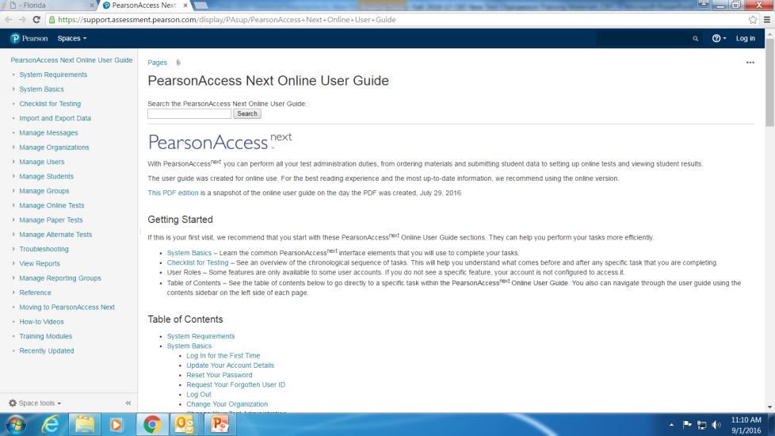
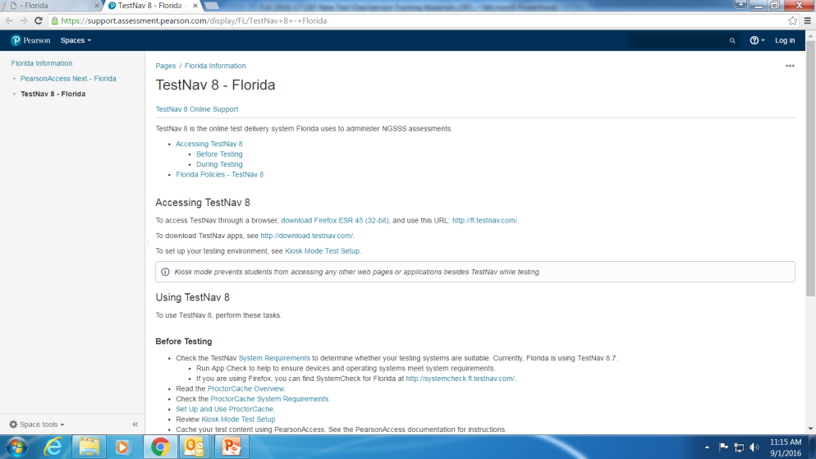
NGSSS PearsonAccess:
CBT Resources
The PearsonAccess Next Online User Guide provides guidelines to prepare before testing and to help resolve CBT issues during testing
TestNav 8 Technology Coordinator Resource Website provides resources and training materials for school technology coordinators.
Avocet (Online Reference Tool) provides links to support materials.
All resources for computer-based testing, including information about test setup, best practices, and training modules and other resources are available from http://florida.pearsonaccessnext.com/

Slide 92
NGSSS
Pearson CBT Materials
Needed, as applicable:

Slide 93
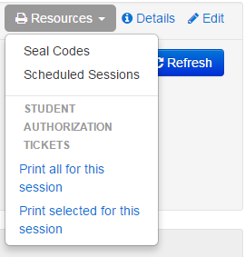
NGSSS PearsonAccess:
Student Authorization Tickets
For each test session, each student needs a Username and the First Name, printed on the Student Authorization Tickets.
Students will need a pen or pencil during testing to sign their tickets.
Provide each student their ticket only AFTER all students have entered the testing room, as instructed in the script, and all tickets must be collected BEFORE students leave the testing room.
Student Authorization Tickets must be handled in a secure manner and returned to the School Assessment Coordinator immediately after each day of testing is completed.
Keep Student Authorization Tickets securely stored at all times.

Slide 94
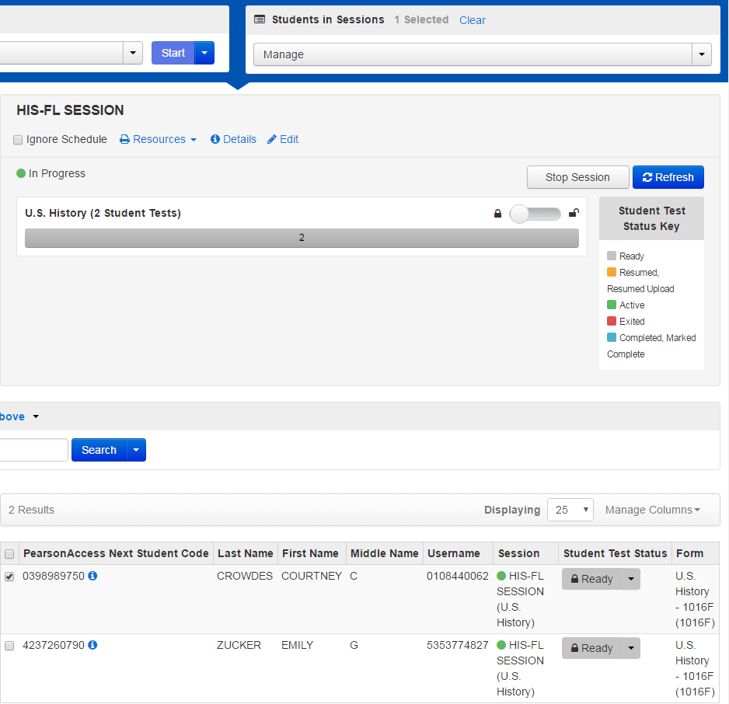
NGSSS PearsonAccess:
Student Authorization Tickets
Ability to print/reprint selected tickets within a session
Only 1 student test selected to print the authorization ticket
2 student tests in this session

Slide 95
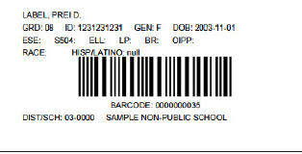
NGSSS PearsonAccess:
PreID Labels
Print PreID labels for students with PBT Accommodations

Slide 96
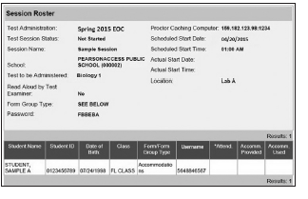
NGSSS PearsonAccess:
Advanced Session Roster
Advanced Session Roster provides a list of all students scheduled in a test session that displays important information including:
  Test Administration
  Session Name and School
  Test to be Administered
  Password
  Student Name
  FLEID#
  Student Date of Birth
  Class Information
  Test Form/Form Group Type
  Usernames
  Blank space to record attendance information and accommodations used
The Advanced Session Roster may be used to record required administration information.
Advanced Session Rosters must be handled in a secure manner and returned to the school assessment coordinator immediately after each test session is completed.

Slide 97
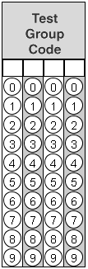
NGSSS PearsonAccess:
Test Group Code
Test Group Code
A unique four-digit number created by school assessment coordinators used to identify groups of students tested together. The test group code is entered after the Welcome screen and Testing Rules Acknowledgment and before students see the first question.

Slide 98
NGSSS PearsonAccess:
CBT Work Folders
The Florida Computer-Based Testing Work Folder is a blank piece of yellow 11x17 paper folded in half with grid paper on the back page.
For the Biology 1 CBT test sessions, students are provided with work folders to work the problems.
Distribute work folders to students at the beginning of each test session.
Ensure that students have enough desk space to use their folders.
Once students complete the test, collect all work folders and return them to the school assessment coordinator.
Used work folders are secure materials.

Slide 99
NGSSS PearsonAccess:
CBT Worksheets
Optional for the NGSSS Civics EOC and US History EOC CBT test sessions, students may be provided a worksheet to take notes.
The CBT Worksheet is an 8 1/2x11 page (located in PearsonAccess) that may be copied and distributed to students at the beginning of a test session.
If your school is providing hard copies of the CBT Worksheet, a sufficient number of copies should be available for all students taking the assessment.
Students must have enough desk space to use their worksheets.
Once students complete a test session, collect all worksheets and return them to the school assessment coordinator.
Used worksheets are secure materials.

Slide 100
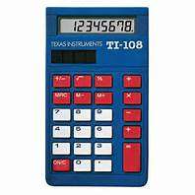
NGSSS PearsonAccess:
Four-Function Calculators
Four-Function Calculator
The computer-based NGSSS Biology 1 EOC assessment in TestNav8 has an approved built-in four-function calculator.
Students may use the approved built-in calculator, or they may use a handheld four-function calculator.

Slide 101
NGSSS
PearsonAccess
Before Testing

Slide 102
NGSSS PearsonAccess:
Organizing Test Sessions
Three ways of organizing test sessions:
  By Test Group – only includes students in a particular group (e.g., class, testing room) who will be testing together
  2. By Test Day – includes all students in a school to be tested in a subject on a particular day
  3. By Test Administration – includes all students scheduled to be tested in a subject during the entire test administration.

Slide 103
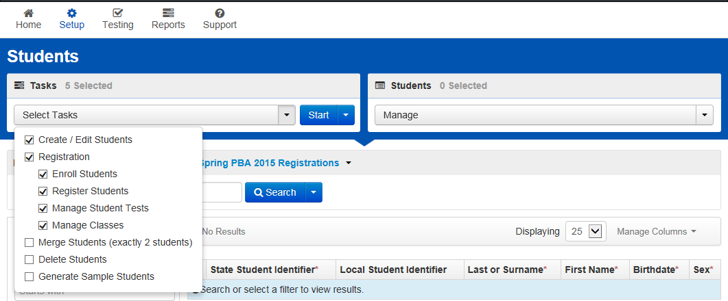
NGSSS PearsonAccess:
Create/Edit Students
Setup tasks must be completed before students can test, including enrollment, registration, test assignments and class assignments.

Slide 104
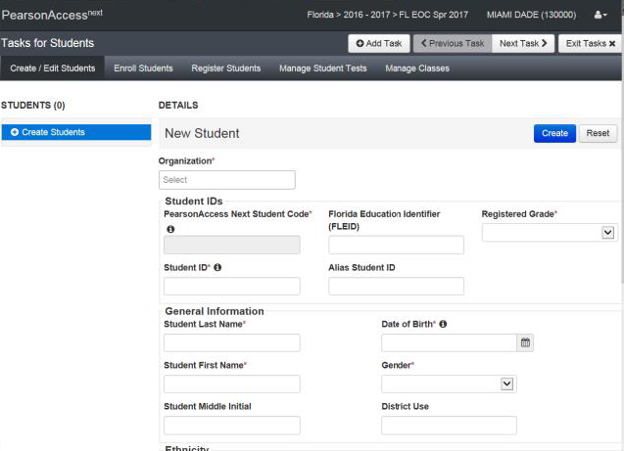
NGSSS PearsonAccess: Create/Edit Students

Slide 105
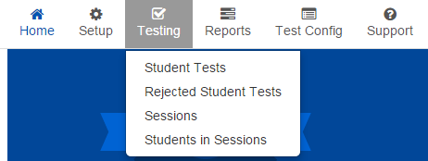
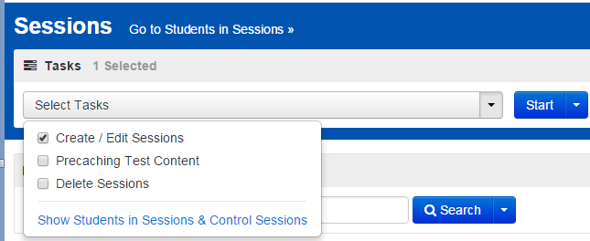
NGSSS PearsonAccess:
Creating Test Sessions

Slide 106

NGSSS PearsonAccess:
Test Session Details

Slide 107

NGSSS PearsonAccess:
Assigning Accommodated Form
Set up a separate test session for each group of students who will use accommodated forms
or
Set up in a non-accommodated session (MAIN) and individually assign each accommodated form(s) to each student
  Select the Form type from the drop-down menu

Slide 108

NGSSS PearsonAccess:
Add, Remove or Move
When test sessions are created in PearsonAccess, under the “Students in Sessions”, you can select tasks to add students to sessions, remove students from sessions and move students between sessions.
(cont.)

Slide 109

NGSSS PearsonAccess: Adding a Student to a Test Session
Select Testing, Sessions, Select “Show all Results” from the Search dropdown.
Select the checkbox of the test session you will add/delete students to or from.
Click on “Go to Students in Sessions”
Select test session from the Session List (on left side)
Then from the select task dropdown, click on “Add Students to Sessions”, then click Start.
Then find eligible students under Find Students available field by clicking on field. Note only students not already in a test session will populate the field
Select the checkbox next to student and click Add.

Slide 110

NGSSS PearsonAccess: Remove a Student from a Session
To find the test session, select Testing, Sessions, Select “Show all Results” from the Search dropdown.
Select the checkbox of the test session you will delete students from.
Click on “Go to Students in Sessions” link
Select test session from the Session List (on left side)
Select the checkbox next to the student or students to be removed.
Then from Select Task dropdown, click on “Remove Students from Sessions”, then click Start.
Select the checkbox next to the student’s name and click Remove, receive a confirmation, and then click Exit Tasks (on top right).

Slide 111

NGSSS PearsonAccess:
Prepare Sessions in Advance
Process to remove restrictions on number of students in a session.
  In the past, Pearson had recommended a session size of 200 or fewer students (had to be under 500 to start the session).
Schools can prepare sessions a week before testing.
It has also allowed the return of Start All/Stop All/Restart All Sessions Combined View capability.
A test session must be prepared before it can be started.

Slide 112

NGSSS PearsonAccess:
Prepare the Test Sessions
To prepare a test session or multiple test sessions:
From Testing>Sessions, select the session or session that will be Prepared. Click Go to Students in Sessions
Select the session in the Sessions list or select Combined View if preparing multiple sessions.
Click Prepare or Prepare All.
Provide the technology coordinator with the list of all test session created and prepared.

Slide 113


NGSSS PearsonAccess:
Lock or Unlock Test Sessions
This feature will prevent a student from being able to login to TestNav and take a test. This is the electronic equivalent to picking up all of the paper test booklets at the end of the testing period.
Default status is Unlocked.

Slide 114
NGSSS PearsonAccess:
Scenario/Action Required
Scenario | Action Required
Student Name or FLEID Number is incorrect | If the student was entered via PreID upload, then “Delete Student” and “Add a Student” (PearsonAccess Next User Guide). If the student was entered via the Create/Edit Student task, see “Manage Other Student Information” in the PearsonAccess Next User Guide.
Other student information is incorrect besides Student Name, FLEID or grade level. | See “Manage Other Student Information” in the PearsonAccess Next User Guide.
Error in Student Name after first 11 characters of the first name or after the first 12 characters of the last name. | Use the incorrect profile for testing, then update the fields after testing with the school student information database Manager.
Student not included in PreID upload, student is new to school, or student transfers from another school or district. | See “Adding a Student” in the PearsonAccess Next User Guide. (For a student transfer, do NOT attempt to change the student’s school enrollment in PearsonAccess.)
New test needs to be added or changed for an existing student, or incorrect test format is assigned (e.g., changing paper to online). | See “Manage Other Student Information” in the PearsonAccess Next User Guide. (Note: changing a test to paper in PearsonAccess will not automatically order materials or print a PreID label.)
Student not participating in the administration (e.g., withdrawn from school, absent for entire testing window) | See “Removing Students from Sessions” in the PearsonAccess Next User Guide.. No further action required.

Slide 115
NGSSS PearsonAccess:
Proctor Caching
School Technology Coordinator must configure the browser settings for caching content.
School Assessment Coordinators must cache each test session prior to the first day of testing.
  Proctor caching is available a week prior to the testing window.
  Make-up sessions must also be cached.
A test session can be cached AFTER it has been prepared.

Slide 116

NGSSS PearsonAccess:
Configure TestNav
The School Technology Coordinator will enter TestNav Configurations in PearsonAccess to manage proctor caching computer configurations and response file save locations.

Slide 117

NGSSS PearsonAccess:
Precache by Test
After configuring TestNav, creating test sessions, adding students, and preparing the test sessions, you will be able to download, or precache, the test content to the designated caching computer/server.
PearsonAccess allows you to precache content by test.
Precaching by test allows you to cache ALL forms for a specific test to specific ProctorCache machine.
29

Slide 118

NGSSS PearsonAccess:
Precaching Test Content
Find the test sessions to be cached
Select the checkbox next to the sessions to be cached
Select Precaching Test Content from the Select Tasks dropdown menu and select Start
Overview Proctor Caching Video (linked) also available in the PearsonAccess Online User Guide

Slide 119

NGSSS PearsonAccess:
Precaching Test Content (cont.)
Proctor Caching will determine which form(s) are needed for the test administration, and display the estimated size of the content, along with the estimated time to download.
Select Precache

Slide 120
NGSSS PearsonAccess:
Precaching Test Content (cont.)
A message will appear to indicate that the caching process has begun.
During testing, you can monitor Proctor Cache activity from the Tests and Clients screens.

Slide 121
NGSSS
PearsonAccess:
During Testing

Slide 122
NGSSS PearsonAccess:
Proctor Caching
Ensure Caching software is running on all Proctor Caching computers each day of testing.
  Turn on Proctor Caching software
Note: Proctor cache computer(s) cannot be used by students or test administrators during testing.
After testing, the test content has to be purged. See Purge test content via the PearsonAccess Next Online User Guide.

Slide 123

NGSSS PearsonAccess:
Test Sessions
Select Testing, Sessions.
Select Search All Results checkbox under Search
  List of all test sessions under your school will populate the screen

Slide 124

NGSSS PearsonAccess:
Students in Sessions View

Slide 125

NGSSS PearsonAccess:
Starting Test Sessions

Slide 126

NGSSS PearsonAccess:
Monitoring Test Sessions –

Slide 127

NGSSS PearsonAccess:
Resuming Student Tests

Slide 128


NGSSS PearsonAccess:
Undo Submit
SAET has the ability to undo submitted tests.
This is completed from the Students in Sessions screen.
School Assessment Coordinators must contact SAET office if they have student tests that need to be unsubmitted.

Slide 129
NGSSS
PearsonAccess:
After Testing

Slide 130
NGSSS PearsonAccess:
Test Session Management
TASK | DESCRIPTION
Mark a student’s test “complete” | Mark a student’s test complete if a student exits the test and will not resume the same test.
Stop all “Started” test sessions | A test session cannot be stopped until all students are in “Completed” or “Marked Complete” status and all “Ready” students have been removed.
Invalidate tests | Any tests that should not be scored must be invalidated.
Important Note: Manually “stop” test sessions by the end of each testing window.
Record invalidations, if applicable, by the last day of each testing window.

Slide 131
NGSSS PearsonAccess:
CBT Clean-Up Activities
Stop all started sessions.
Please remember the following:
  Absent students should be removed from the test session (not marked complete).
  If absent students have already been marked complete, nothing else needs to be done.
  Students in “Ready” status must be removed from the session before it can be stopped.
  If students are in “Active,” “Exited,” or “Resumed” status, they will need to be marked complete.
CBT clean-up activities must be completed on the last day of the testing window by 4:00 pm.
School Technology Coordinators should purge test content from the Proctor Caching Computer on the last day of the testing window.

Slide 132
NGSSS PearsonAccess:
Pearson Support
Contacting Pearson Support
  Phone Number: 1-877-847-3043 (ask for Level 2 Tech)
  E-mail: Florida@support.pearson.com
Appendix B in the Manual provides the following information:
  PearsonAccess
    User Accounts
      Instructions for setting up user accounts are posted on PearsonAccess.
    Browser requirements
    Logging in for the first time
    Resetting passwords
  Training Center
    Test Setup Exercise

Slide 133
Contact Information
Student Assessment and Educational Testing
  Maria C. Bruguera, Director
  mbruguera@dadeschools.net
  Mara Ugando, Staff Specialist
  mugando@dadeschools.net
Phone: 305-995-7520
ax: 305-995-7522
ITS - Infrastructure and System Support
Mr. Armando Machado, Director
arm@dadeschools.net
Telephone Number: 305-995-3348
ITS Technical Support Hotline
TestTechSupport@dadeschools.net
305-995-3377

Slide 134
Thank you for ensuring
secure and successful
2018-19
FSA and NGSSS administrations!
Questions?

