Slide 1

Spring 2012
Training Materials
FCAT/FCAT 2.0
Writing
Reading/Mathematics/Science
Retake

Slide 2
Overview
These training materials are based on the 2011-2012 Writing Test Administration Manual and the Spring 2012 Reading, Mathematics, and Science Test Administration Manual.
There are separate training materials and manuals for Spring 2012 Computer-Based Tests.
Training materials are available in PearsonAccess under the Support tab.

Slide 3
FCAT/FCAT 2.0
Testing Windows
TEST ADMINISTRATION | DATES
FCAT WRITING | February 28 - March 1, 2012
FCAT/FCAT 2.0 READING AND MATHEMATICS RETAKE | April 9 - 20, 2012*
FCAT 2.0 READING, MATHEMATICS, AND SCIENCE | April 16 - 27, 2012**
*FCAT Reading Retake paper-based test and paper accommodations must be administered on Days 1 - 5 of the testing window, April 9 – 13, 2012.
**All Grade 3 testing must be completed by Tuesday, April 24, 2012. All Grade 9 FCAT 2.0 Reading tests and paper-based Grade 10 FCAT 2.0 Reading tests must be completed by Friday, April 20, 2012.
Training Packet 2-4

Slide 4
Writing Daily
Administration Schedule
 | Day 1 Tuesday, February 28 | Day 2 Wednesday, February 29 | Day 3 Thursday, March 1
Grade 4 | Writing Prompt (45 Minutes) | Make-up Testing | Make-up Testing
Grade 8 | Writing Prompt (45 Minutes) | Make-up Testing | Make-up Testing
Grade 10 | Writing Prompt (45 Minutes) | Make-up Testing | Make-up Testing
*The 2012 FCAT Writing extended testing window for the Visually Impaired (VI) and Hospital/Homebound Program students is February 28 – March 6, 2012.
Training Packet 2

Slide 5
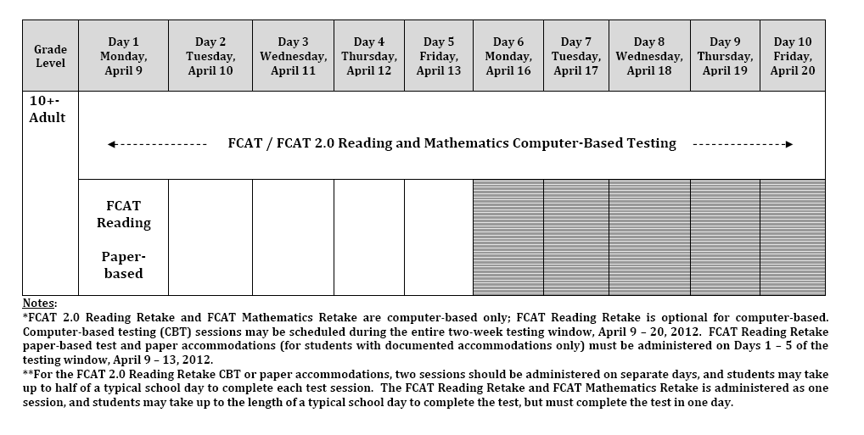
Retake Daily
Administration Schedule
Training Packet 3

Slide 6
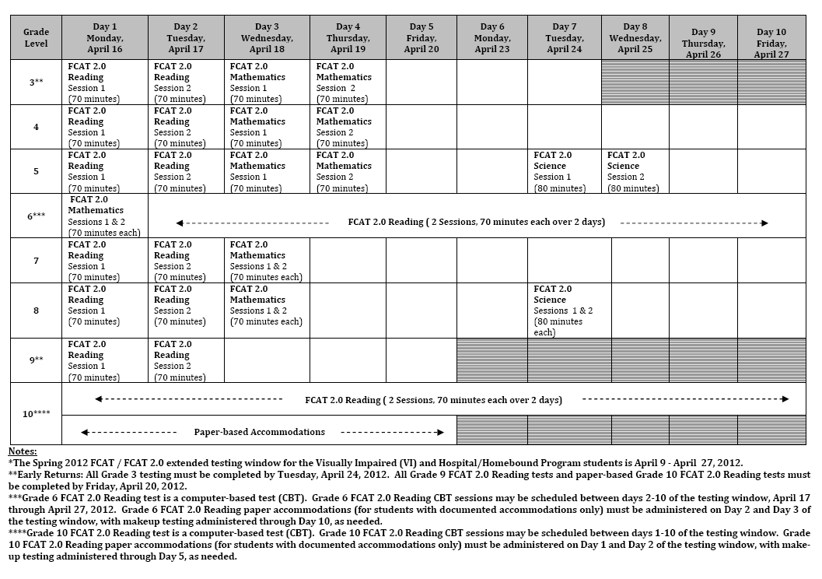
RMS Daily
Administration Schedule
Training Packet 4

Slide 7
FCAT Writing
Students to be Tested
In general, all Florida public school students enrolled in the tested grade levels (Grades 4, 8, and 10), including retained students, are required to participate in FCAT Writing, per s. 1008.22(3)(c)8, F.S. Students must take the appropriate test for the grade level in which they are enrolled.
W TAM 2

Slide 8
FCAT 2.0 R/M/S
Students to be Tested
In general, all Florida public school students enrolled in tested grade levels participate in the FCAT 2.0, per Section 1008.22(3)(c)8, Florida Statutes (F.S.). Students must take the test(s) appropriate for the grade level in which they are enrolled.
  Reading Grades 3-10
  Mathematics Grades 3-8
  Science Grades 5 and 8
RMS TAM 2-3

Slide 9
FCAT/FCAT 2.0 Retakes
Students to be Tested
Students eligible to participate in the FCAT Reading Retake and FCAT Mathematics Retake (SSS forms)
  Students who entered Grade 9 prior to Fall 2009 and are pursuing a standard Florida high school diploma
Students eligible to participate in the FCAT 2.0 Reading Retake and FCAT Mathematics Retake:
  Students who entered Grade 9 in Fall 2009 and are pursuing a standard Florida high school diploma
  Adult high school students who have not yet passed both parts of the FCAT required for graduation with a standard diploma
  Certificate of Completion students
  Students in the second and third year of the Three-Year Graduation Program
  Note: Students who entered Grade 9 in Fall 2010 and beyond do NOT take an FCAT/FCAT 2.0 Mathematics graduation test.
RMS TAM 2

Slide 10
Students to be Tested:
Special Programs
Program |  | District Number | School Number | Participation Status | Registration/ Reports
FLVS | Middle School | 71 | 0300 | MUST | Florida Virtual School Program
 | High School | 71 | 0400
 | FL Virtual Academy | 50 | 7079
Miami-Dade Online Academy |  | 13 | 7001 | MUST | Miami-Dade Online Academy
Florida Home Education |  | 13 | 9998 | MAY | Home Education Office
McKay Scholarship |  | 13 | 3518 | Private-MAY Public-MUST | ESE Office
Florida Tax Credit Scholarship |  | 97 | 9999 | MAY | Registration - Region Reports - FLDOE
Merrick Hospital/Homebound* |  | 13 | 9732 | MUST | Merrick HHIP
*District program not in the Test Administration Manuals.
W TAM 2-3; RMS TAM 3-4
Training Packet 25-37

Slide 11
Students to be Tested
English Language Learners (ELLs)
All ELL students are expected to participate in the FCAT/FCAT 2.0 Writing, Retake, and Reading, Mathematics and Science tests no matter how long these students have been receiving services.
See Appendix A of the manual for information regarding accommodations.
W TAM 3; RMS TAM 4

Slide 12
Students to be Tested
Students With Disabilities
All students with disabilities participate in the statewide assessment program by taking one of the following:
  FCAT/FCAT 2.0 without accommodations,
  FCAT/FCAT 2.0 with accommodations, or
  Florida Alternate Assessment.
All determinations regarding participation in the statewide assessment program must be documented in the student’s IEP or Section 504 plan.
See Appendix A of the manual for information regarding accommodations.
W TAM 4; RMS TAM 5

Slide 13
Administration
Accommodations
Students with Disabilities
  Accommodations stated in the student’s current IEP or 504 plan
    Presentation
    Responding
    Scheduling
    Setting
    Assistive Devices
  Emergency 504 Plan
    Contact Mary Paz, ESE at 305-995-2799
W TAM 4; RMS TAM 5;
Appendix A in manuals

Slide 14
Administration
Accommodations
English Language Learners (ELLs)
  Students who are currently receiving services in a program operated in accordance with an approved district LEP plan:
    Flexible Setting
    Flexible Scheduling
    Additional Time
    Assistance in Heritage Language
    Approved Dictionary
  ELL students in levels 1-4 only.
W TAM 4; RMS TAM 5;
Appendix A in manuals

Slide 15
Test Accommodations
Field in ISIS
Verify that all students requiring special assessment test materials have the proper test accommodation documented in ISIS
  Test Accommodations field on the Additional ESE Information screen in ISIS.
Please refer to Weekly Briefing # 10296.
Test Accommodations codes include the following:
    C - Contracted Braille
    U - Uncontracted Braille
    L - Large Print
    O - One item per page
    P - Paper format test booklet instead of CBT
    G - Large Print, Paper or CBT
    Q - Unique accommodation, other
    R – Reading Passage booklet for CBT only
    A – Accommodated CBT test form
Note: Verify receipt of Paper (CBT only), LP, Braille, and OIPP materials for all students who require them as soon as materials are delivered.
Weekly Briefing #10296

Slide 16
PreID File Submission Dates
Training Packet 44
The Writing PreID file submitted to the vendor is based on students enrolled at your school as of December 2, 2011.
Wave 1 Retake and RMS PreID file submitted to the vendor is based on students enrolled at your school as of January 6, 2012.
  Shipment of test materials will be based on Wave 1 PreID file.
  Wave 1 PreID labels will be shipped with your test materials.
Wave 2 Retake and RMS PreID file submitted to the vendor is based on students enrolled at your school as of February 24, 2012.
  Wave 2 PreID labels will be generated for new students or changes in the critical fields.
  A Control D report will be generated for Retakes to identify students with the appropriate Reading Retake test (FCAT SSS or FCAT 2.0).

Slide 17
FCAT/FCAT 2.0
W/R/M/S/Retake
Preidentified Student Labels
Verify that the student is still enrolled and will be tested.
Verify the information on the PreID Roster against the school’s student information database.
FIVE elements MUST be correct on a student PreID label for the Writing and RMS:
  Student name
  Florida ID number
  District number
  School number
  Grade level
Note: Grade level is not a critical field for Retakes.
Destroy labels in a secure manner if ANY of this information is incorrect.
If any other preidentified information (e.g., DOB) is incorrect, use the student label.
W TAM 9-10; RMS TAM 13-14

Slide 18
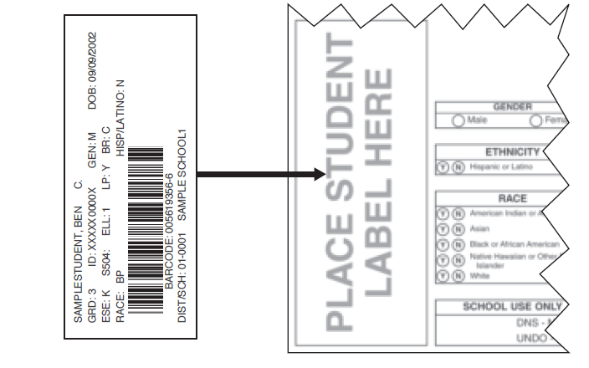
FCAT/FCAT 2.0
W/R/M/S/Retake
Preidentified Student Labels
Affix the label in the box in the lower left corner of the student grid sheet.
Do not remove labels once they have been affixed.
Do not place a label over another label.
W TAM 9; RMS TAM 13

Slide 19
FCAT/FCAT 2.0
W/R/M/S/Retake
Preidentified Student Labels
If the student name, Florida ID number, district number, school number, OR grade level (except Retake) is INCORRECT on a USED answer document, the student must, under the supervision of the test administrator, transfer his or her exact responses into a replacement answer document.
Ensure the replacement document has the same form code if the replacement is one of the following:
  Grade 3 Reading Test and Answer Book
  Grade 3 Mathematics Test and Answer Book
  Grade 4 Reading Test and Answer Book
  Grade 4 Mathematics Test and Answer Book
  Grade 5 Mathematics Test and Answer Book
RMS TAM 14

Slide 20
FCAT/FCAT 2.0
W/R/M/S/Retake
Preidentified Student Labels
The test administrator must grid ALL DNS bubbles on the answer document that contains the incorrect label and return it with all other NOT TO BE SCORED materials.
The test administrator must then grid the correct student information on the replacement document.
If any student information is missing from a student label that has been affixed to a document, add the information by gridding the appropriate bubbles on the student grid sheet. Incorrect information on a student label CANNOT be corrected in this manner.
Do not use a preidentified document for any student other than the student for whom it is preidentified.
W TAM 9-10; RMS TAM 13-14

Slide 21
FCAT Writing
Test Materials
Writing Folders
  Grade 4
  Grade 8
  Grade 10
Planning Sheets
W TAM 20-21

Slide 22
FCAT 2.0 R/M/S
Elementary School
Test Materials
GRADE | DOCUMENT TITLE | ITEM TYPE
 |  | Multiple Choice | Gridded Response
3 | Reading Test and Answer Book | 
 | Mathematics Test and Answer Book FCAT 2.0 Ruler (session 2 only) | 
4 | Reading Test and Answer Book | 
 | Mathematics Test and Answer Book FCAT 2.0 Ruler (session 2 only) |  | 
5 | Mathematics Test and Answer Book Mathematics Reference Sheet |  | 
 | Reading Test Book Reading Answer Folder | 
 | Science Test Book Science Answer Book | 
RMS TAM 26-29

Slide 23
FCAT 2.0 R/M/S
Middle School
Test Materials
GRADE | DOCUMENT TITLE | ITEM TYPE
 |  | Multiple Choice | Gridded Response
6 | Reading Test Book Reading Answer Folder (Accommodations only) | 
 | Mathematics Test Book Mathematics Answer Book Mathematics Reference Sheet |  | 
7 | Reading & Mathematics Test Book Reading & Mathematics Answer Book Mathematics Reference Sheet Calculator |  | 
8 | Reading & Mathematics Test Book Reading & Mathematics Answer Book Mathematics Reference Sheet Calculator |  | 
 | Science Test Book Science Answer Book Periodic Table Calculator | 
RMS TAM 26-29

Slide 24
FCAT/FCAT 2.0
R/M/S/Retake
High School Test Materials
GRADE | DOCUMENT TITLE | ITEM TYPE
 |  | Multiple Choice | Gridded Response
9 | Reading Test Book Reading Answer Folder | 
10 | Reading Test Book Reading Answer Folder (Accommodations only) | 
Retake | FCAT 2.0 Reading Retake Test and Answer Book (Accommodations only) | 
 | FCAT Reading Retake Test and Answer Book | 
 | FCAT Mathematics Retake Test and Answer Book (Accommodations only) Mathematics Reference Sheet Calculator |  | 
RMS TAM 26-29

Slide 25
FCAT/FCAT 2.0
W/R/M/S/Retake
Security Numbers
A security number consists of a nine-digit number followed by a check digit (located in upper right corner of secure test books or test and answer books).
Written documentation of the number ranges must be maintained at all times during distribution and return of materials.
  Pre-populated Administration Record/Security Checklists are provided with lists of security numbers for all secure documents assigned to each school
  A blank copy of the checklist is provided in Appendix C of the manuals
W TAM 11, 14-15; RMS TAM 18-19
Appendix C of manuals

Slide 26
FCAT/FCAT 2.0
W/R/M/S/Retake
Security Numbers
W TAM 14; RMS TAM 18
As directed by the school coordinator, the test administrator may use the pre-populated Administration Record/Security Checklist, a blank copy of the checklist, or may make his/her own comprehensive record of security numbers.
Security number(s) of the document(s) assigned to and returned by each student should be recorded and verified at the completion of each day of testing.
Security numbers of secure materials not already listed on the checklist (e.g., materials distributed from district overage) MUST be added to the record with the names of the students to whom the test materials are assigned.

Slide 27
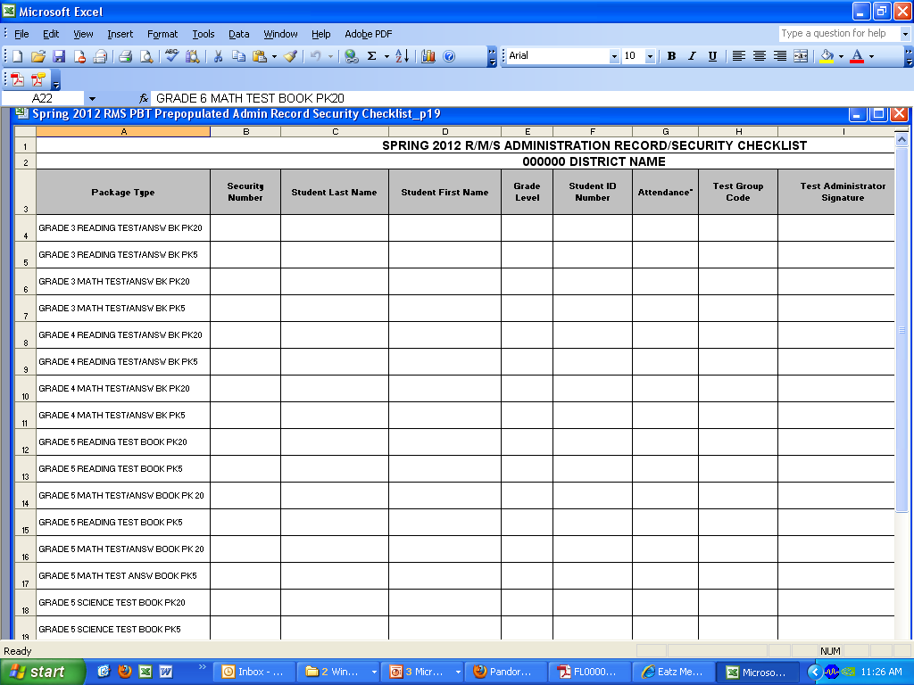
FCAT/FCAT 2.0
W/R/M/S/Retake
Pre-populated Security Checklist
In Pearson Access:
Test Setup > Order Additional Materials and Tracking > Reports
Select “Security Checklist Detail” from the drop-down list
W TAM 15; RMS TAM 19

Slide 28
FCAT/FCAT 2.0
W/R/M/S/Retake
Required Administration
Information
Test Administrators must record and maintain the following Required Administration Information:
  Students assigned to the room
  Attendance information
  Test group code
  Unique security number of secure documents assigned to each student
  Grade level
  Signatures of test administrator and school assessment coordinator
  Dates for when documents are received and returned
W TAM 18; RMS TAM 23

Slide 29
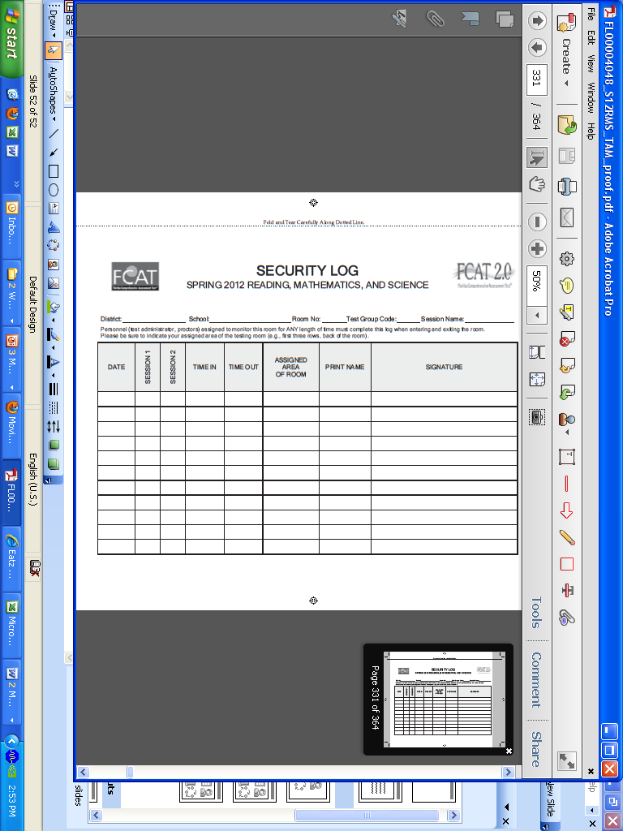
FCAT/FCAT 2.0
W/R/M/S/Retake
Security Log
A Security Log must be maintained for each testing room.
Anyone who enters a room for the purpose of monitoring a test MUST sign the log for that testing room.
W TAM 20, 105; RMS TAM 25, 319

Slide 30
FCAT/FCAT 2.0
W/R/M/S/Retake
Seating Charts
An accurate seating chart must be maintained for each testing room and for each test session. Seating charts must capture the following information:
  the room name/number
  student names and their location in the room during testing
  date
  session starting time
  test administrator name
  names of proctors (if applicable)
  test group code
All seating charts must indicate the front and back of the room, as well as the direction the students are facing.
Note: If students move around or change seating during a test session, a new seating chart must be created.
W TAM 19; RMS TAM 24
Training Packet 65

Slide 31
FCAT/FCAT 2.0 W/R/M/S/Retake
Test Group Code
A test group code is a security measure to identify groups of students tested together.
  Generate a unique four-digit numeric code to assign to each testing room.
  Record the test group code in the Administration Record/Security Checklist and seating chart.
  The scripts for administering the tests include instructions to be read to the students to grid the test group codes onto their test document (paper-based) or . enter the test group code after the “Welcome” screen (CBT).
W TAM 19; RMS TAM 24

Slide 32

Test Administration and
Security Procedures
State and District Requirements
Standards, Guidelines, and Procedures for Test Administration and Test Security available at http://oada.dadeschools.net/TestChairInfo/InfoForTestChair.asp.
  Adopted by School Board
  General Guidelines
Florida Test Security Statute and Rule
School Procedural Checklist (FM-6927)
W TAM 12; RMS TAM 16;
Appendix B in manuals;
Training Packet Attachments B & D

Slide 33
Prohibited Activities:
Florida Statute and
State Board Education Rule
  Reading the passages, test items, or performance tasks.
  Revealing the passages, test items, or performance tasks.
  Copying the passages, test items, or performance tasks.
  Explaining or reading test items or passages for students.
  Changing or otherwise interfering with student responses to test items.
  Causing achievement of schools to be inaccurately measured or reported.
  Copying or reading student responses.
W TAM 15; RMS TAM 16

Slide 34
Test Security Procedures:
Student Pledge
Prior to testing, students are required to read and sign a student pledge.
If a student refuses to sign, this must be noted in the record of required administration information, but the student should be allowed to test.
Location of student pledge:
  Back page of the student planning sheet - Writing
  Test Book/Test and Answer Book – RMS and Retake
  Page after the Welcome Screen - CBT
W TAM 22; RMS TAM 30

Slide 35
Prohibited Activities:
Electronic Devices
Possession of any electronic device that reproduces, transmits, calculates, or records IS cause for invalidation.
  “Possession” is defined as “within arm’s reach,” even if the electronic device is not visible.
  Students should not have cell phones in their pockets, clipped to their belts, at their desks, or anywhere they can be easily accessed during testing.
  Test administrators and proctors should also turn-off their electronic devices during testing.
W TAM vi, 117; RMS TAM ix, 329

Slide 36
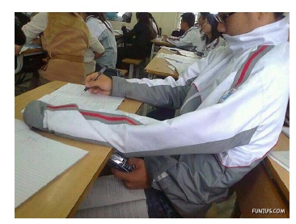
Example of
Prohibited Activity

Slide 37
Reporting Testing
Irregularities
All school staff are professionally responsible for ensuring appropriate administration procedures and reporting any irregularities.
  Specified in Standards, Guidelines, and Procedures for Test Administration and Test Security
    School Assessment Coordinator/Principal
    Student Assessment and Educational Testing
    Region Center and/or appropriate District Administrative Office
    Appropriate investigative unit, if applicable
Note: School personnel must be prepared to provide documentation and information in support of investigations of a testing irregularity.
W TAM 13-14; RMS TAM 17-18

Slide 38
Caveon Forensic Analyses
The FLDOE has contracted with Caveon Test Security to provide its Caveon Data Forensics™ for all statewide assessments.
Caveon will analyze data to identify highly unusual test results for two primary groups:
  Students with extremely similar test responses; and
  Schools with improbable levels of similarity, gains and/or erasures.
Flagging only the most extreme results

Slide 39
Test Invalidation
A test MUST be invalidated if either of the following circumstances occurs:
  A student has an electronic device during testing.
  A student is cheating during testing.
A test MAY be invalidated if one of the following circumstances occurs:
  A student becomes ill and is unable to finish.
  A student is not allowed the correct amount of time.
  A error occurs in the administration of an accommodation.
  An error occurs in test administration or procedures.
  A student is disruptive during testing.
  A student works in the wrong session.
W TAM 16-17; RMS TAM 20-21

Slide 40
Test Invalidation
W TAM 16-18; RMS TAM 20-22
The purpose of invalidation is to identify when the validity of test results has been compromised.
  School assessment coordinators must consult with school administration for the appropriate course of action if invalidation is being considered.
When a student’s test is invalidated for any reason, return the invalidated test with the DNS bubble(s) gridded with all other TO BE SCORED materials.
More information about test invalidation and instructions for defective materials may be found on pages 16-17 of the Writing manual and pages 20-22 of the RMS manual.

Slide 41
Test Administrator
Before, During, and After
Testing
W TAM 111; RMS TAM 323

Slide 42
Test Administrator before testing
Assemble Materials
  Test Administration Manual (Writing, RMS, and/or CBT)
  Test Group Codes
  Test Administrator Checklist (Appendix C of manuals)
  Signs (Appendix C of manuals)
  Security Log (Appendix C of manuals)
  Seating Chart
W TAM 19-21; RMS TAM 24-25

Slide 43
Test Administrator before testing
Assemble Materials (cont’d)
  Record of Required Administration Information
  Pencils
  Watch or Clock
  Cover sheets (Appendix C of manuals)
  Calculators
  Test Materials
W TAM 19-21; RMS TAM 24-25

Slide 44
Test Administrator before testing
Sign and return:
FCAT/FCAT 2.0 Security Agreement, which indicates that the test administrator:
  Received training
  Read the Test Security Statute and State Board Rule
  Read all applicable portions of the Test Administration Manuals
  Understands and agrees to adhere to all test security and administration policies and procedures
Test Administrator Prohibited Activities Form
  Their certification number must be recorded on this form
W TAM 18; RMS TAM 23

Slide 45
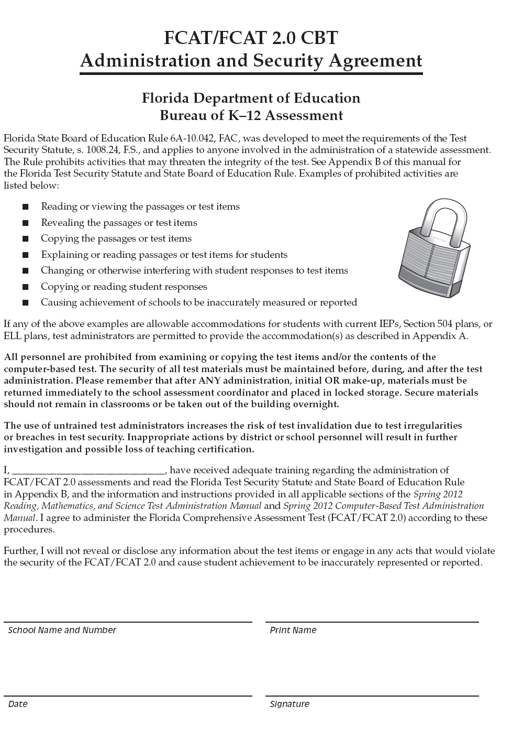
Test Administrator before testing
W TAM 99-101; RMS TAM 315-317

Slide 46
Test Administrator during testing
Maintain these documents:
  Security Log, a seating chart, and a form to collect required administration information for your room
Read the appropriate administration scripts VERBATIM to students.
  Please read the important information and adhere to the instructions between the SAY boxes.
Keep accurate time for each test session and display times for students.
W TAM 22-23; RMS TAM 30-31

Slide 47
Test Administrator during testing
Supervise test administration and ensure that students:
  Are using only No. 2 pencils
  Do not have books, notes, scratch paper, or electronic devices of any kind (except approved four-function calculators, if applicable) during testing, even if they do not use them
  Have signed the student pledge
  Do not talk or make any disturbance
  Are working independently
  Are working in the correct session and recording their answers in the appropriate area
W TAM 23; RMS TAM 31-32

Slide 48
Test Administrator during testing
It is not appropriate to use cell or classroom phones, grade papers, or work on the computer during testing.
While you may encourage students to continue working, you may not talk with them about test items or help them with their answers.
If students finish the test before the allotted time for the session has elapsed, you may encourage them to go back and check their work.
Students must be monitored during lunch break or extended breaks.
Test materials may not be returned to students once the materials have been collected.
W TAM 23; RMS TAM 31-32

Slide 49
Test Administrator after testing
Make sure that each student returns all his or her test materials, and indicate on your record of required administration information that each book is returned.
Report any missing test materials and/or test security irregularities to your school assessment coordinator immediately.
Ensure that the box in the top left corner of the student grid sheet has been completed by each student and that the gridded or preidentified information is accurate and complete.
Return all materials to your school assessment coordinator, as described on pages 41-42 of the Writing manual and on pages 236-237 of the RMS manual.
W TAM 41-42; RMS TAM 236-237

Slide 50
School Assessment Coordinator
Before, During, and After
Testing
W TAM 113; RMS TAM 325

Slide 51
School Coordinator before testing
  Keep materials secure at all times.
  No more than three individuals may have access to the locked storage area.
  Do not open shrink-wrapped materials (with security numbers) or begin preparing (applying student labels) more than 3 days prior to the Writing testing; and more than 6 days prior to the Retake and RMS testing .
  Save the original boxes for returning special document materials.
  Ensure that an adequate supply of working calculators is available prior to the beginning of test administration.
  If you need additional materials or if you have questions, contact your district assessment coordinator.
  Box contents are listed on pages 43-44 of the Writing manual and on pages 238-239 of the RMS manual.
W TAM 43-44; RMS TAM 238-239; Training Packet 47-48

Slide 52
School Coordinator before testing
Communicate Testing Policies to Parents and Students
  Electronic Devices Policy—If students are found with ANY electronic devices during testing, their tests will be invalidated. The best practice would be for students to leave devices at home or in their lockers on the day of testing.
  Leaving Campus—If students leave campus before completing the test (for lunch, an appointment, or illness, etc.), they WILL NOT be allowed to complete the test.
  Student Pledge—Students will be asked to sign a pledge prior to testing indicating that they will not give or receive unauthorized help during the test. If students are caught cheating or irregular answer patterns are detected during scoring, their tests will be invalidated.
W TAM 21; RMS TAM 29

Slide 53
School Coordinator before testing
Train Test Administrators and Proctors
  You are responsible for training all test administrators and proctors. You must train several employees to act as possible alternates.
  Test Administrators must be certified educators.
  Test administrators who will be administering the test to students using large print, Braille, and/or one-item-per-page materials must be trained in the use of those test materials.
  For students with accommodations, make sure that test administrators are aware of and have made provisions for the exact accommodations needed for individual students.
W TAM 45; RMS TAM 240

Slide 54
School Coordinator before testing
Train Test Administrators and Proctors
  Distribute Test Administration Manuals and instruct administrators to read all appropriate sections. Make sure they have manuals on each day of testing.
  Ensure all test administrators maintain the following according to the requirements in the manuals:
    Records of Required Administration Information
    Seating Charts
    Security Logs
  Review test security policy and procedures and collect the following:
    Signed Security Agreements
    Signed Test Administrator Prohibited Activities Agreement
    Note: The agreements must be kept on file at the school for one school calendar year.
W TAM 240; RMS TAM 45

Slide 55
School Coordinator before testing
Proctors Duties and Responsibilities
  Non-school Personnel may
    Assist in monitoring test administration only
    Only be used as an “extra” pair of eyes
  School Personnel may
    Prepare, distribute, and collect materials under direct supervision of the test administrator
    Complete student grid sheets
  M-DCPS students may NOT serve as proctors.
Student Ratio Paper-based Test | Student Ratio Computer-based Test | Proctors
1-30 students | 1-25 students | Test Administrator
31-60 students | 26-50 students | Test Administrator and 1 Proctor
61-90 students | 51-75 students | Test Administrator and 2 Proctors
W TAM 13; RMS TAM 17; Training Packet 42-43

Slide 56
School Coordinator before testing
Special Documents
Pages 69-84 of the Writing manual and pages 265-300 of the RMS manual contain specific information and instructions regarding Special Documents (Large Print, Braille, One-Item-Per-Page). Each document type has its own section and set of instructions for Test Administrators and School Assessment Coordinators.
Appropriate personnel must familiarize themselves with the information in this section, including:
  Test configurations and materials needed for testing
  Special Scripts/Instructions for students who test using Special Documents
  Student Responses
  Providing Accommodations
  Preparing Special Documents for return
W TAM 69-84; RMS TAM 265-300

Slide 57
School Coordinator before testing
Prepare for Testing
  Distribute Test Group Codes to Test Administrators
  Assign Proctors to test sessions
    Proctors are required for rooms where 30 or more students are tested
    It is strongly encouraged to assign proctors to rooms where fewer than 30 students are tested (paper-based) and fewer than 25 students are tested (computer-based)
  Visual barriers must be installed at every workstation
  Make arrangements to test special program students not enrolled in your school, if any
W TAM 44-46; RMS TAM 239-241

Slide 58
School Coordinator before testing
Testing Location
  The test should be administered in a room that has comfortable seating, good lighting, and sufficient workspace.
  There must be at least three feet between students.
  Make sure that students are not facing each other when seated at tables and are not in seating (stadium or staggered) that allows them to easily view other students’ answers.
  Students may not have access to any unauthorized aids.
W TAM 46; RMS TAM 241

Slide 59
School Coordinator during testing
Supervise Test Administration
  Provide test administrators with additional materials during testing, as necessary.
  Monitor each testing room to ensure that test administration and test security policies and procedures are followed.
  Be available during testing to answer questions from test administrators.
  Make sure that Security Logs, seating charts, and records of required administration information are being maintained in each testing room.
W TAM 47; RMS TAM 242

Slide 60
School Coordinator during testing
Maintain Security
  After ANY administration, initial OR make-up, materials must be returned to you immediately.
  Materials must be placed in locked storage between test sessions.
  Secure materials should never remain in classrooms or be taken from the school’s campus overnight.
  Report any testing irregularities or security breaches to your District Assessment Coordinator immediately.
W TAM 47; RMS TAM 242

Slide 61
School Coordinator after testing
W TAM 48-49; RMS TAM 243
Verify that all distributed secure materials have been returned. Notify the District Assessment Coordinator immediately if any secure materials are missing.
Check for and remove any stray reference sheets or periodic tables from the test documents (Grades 5–8 and Retake Mathematics and Grade 8 Science).
Make copies of the records of required administration information collected by test administrators and file the copies.
Make copies of all Security Logs and seating charts and file the copies.
Ensure that the DNS bubble has been gridded on invalidated tests and place the tests with TO BE SCORED materials.

Slide 62
School Coordinator after testing
Store securely any hand-held, approved four-function calculators as directed by the district assessment coordinator.
File the FCAT/FCAT 2.0 CBT Administration and Security Agreements and the Test Administrator Prohibited Activities Agreements.
Copy the seating charts, required administration information, and Security Logs, file the copies, and return the originals in the District Assessment Coordinator ONLY boxes.
Note: For CBT, Student Authorization Tickets must be kept on file for one school calendar year.
W TAM 48-49; RMS TAM 243

Slide 63
School Coordinator after testing
Clarification for Score Reporting
  Students must take both sessions (session 1 and 2) in order to receive a score.
    If a student is absent and unable to make-up one of the two sessions, then you will need to invalidate the answer document.
  Only one answer document per student for each subject-area test may be submitted for scoring.
      If a student has to make-up a session, all responses from both sessions must be in the same answer document.
      If a student is using multiple learning media (e.g., a student uses Braille materials and records his or her response in a large print document), make sure that the student’s complete response is in ONE answer document type.

Slide 64
School Coordinator after testing
Document Count Forms
  Verify that you have included all documents from make-up sessions before you complete the forms.
  Complete Document Count Forms by following the instructions on the form. There is only one version of the count form (includes special documents and Retakes).
  For Grades 3–10 TO BE SCORED materials, complete a separate Document Count Form for each grade level and document type.
  Retake TO BE SCORED materials must be sorted by document type ONLY (you may place materials for more than one grade level under one Document Count Form).
W TAM 49, 51; RMS TAM 244-245

Slide 65
School Coordinator after testing
Document Count Forms
  Do not copy blank count forms; however, once the count forms are completed, you may copy them for your records. If you need additional count forms, contact your district assessment coordinator.
  Place each completed form on top of the first stack of corresponding TO BE SCORED answer documents.
  Separate Document Count Forms must be completed for any special program student documents (Home Ed, Virtual School, etc.).
W TAM 49, 51-55; RMS TAM 244-249

Slide 66
School Coordinator after testing
Document Count Forms
  The information on the Document Count Form will be used for scoring purposes. If information (e.g., school number) on the Document Count Form conflicts with information on a PreID label or a student grid sheet, the information on the Document Count Form will be used. Therefore, it is vital that all information on this form be accurate.
  See pages 48-57 of the Writing manual and pages 244-249 of the RMS manual for more detailed instructions.
W TAM 48-57; RMS TAM 244-249

Slide 67
Ensure that the correct district and school numbers are gridded
Grid the correct document type,
number of documents under the
form, and special document
type, if applicable
W TAM 51; RMS TAM 245

Slide 68
School Coordinator after testing
Paper Bands
Documents for each grade level and document type must be banded separately. You may use more than one paper band per grade level and document type, if necessary.
Follow these steps for each paper band you use:
  In the space labeled District/School Number, write your district number and your school number OR the special program district/school number, as applicable.
  Count the number of TO BE SCORED answer documents that will be banded in each paper band. Write that number under Number of TO BE SCORED Documents Contained in This Paper Band, include DNS documents in count.
W TAM 52; RMS TAM 246

Slide 69
School Coordinator after testing
Paper Bands
Under Number of Banded Stacks per Document Count Form, number the paper bands 1 of n, 2 of n, etc., where n is the total number of banded stacks per Document Count Form.
Place a paper band around each stack of TO BE SCORED answer documents. The Document Count Form must be under the paper band on top of the stack labeled 1 of n.
Seal the paper band and be sure that it securely holds the documents. Do not use staples, paper clips, or tape.
W TAM 52; RMS TAM 246

Slide 70
School Coordinator after testing
WRITING: Prepare the following types of boxes for return:
  All TO BE SCORED Writing folders—Red-labeled boxes
  All NOT TO BE SCORED materials—Yellow-labeled boxes
  All Special Documents, if applicable—White-labeled boxes (To Be Scored and Not To Be Scored)
  District Assessment Coordinator ONLY box
See pages 83–84 of the Writing manual for instructions on the packaging and return of Special Documents.
Please refer to the Friendly Reminder in your training packet, page 69 (Attachment H).
W TAM 56-57

Slide 71
School Coordinator after testing
RETAKE AND RMS Return Labels
  See pages 299-300 of the RMS manual for instructions on the packaging and return of Special Documents.
  Please refer to the Friendly Reminder in your training packet, page 69 (Attachment H).
PEACH LABELS
Grades 9-10 & Retake TO BE SCORED
BLUE LABELS
Grade 3 TO BE SCORED
RMS TAM 250-253

Slide 72
School Coordinator after testing
RETAKE AND RMS Return Labels
  See pages 299-300 of the RMS manual for instructions on the packaging and return of Special Documents.
  Please refer to the Friendly Reminder in your training packet, page 69 (Attachment H).
RED LABELS
Grades 4-8 TO BE SCORED
WHITE LABELS
Special Document
TO BE SCORED Only
RMS TAM 250-251

Slide 73
School Coordinator after testing
RETAKE AND RMS Return Labels
  See pages 299-300 of the RMS manual for instructions on the packaging and return of Special Documents.
  Please refer to the Friendly Reminder in your training packet, page 69 (Attachment H).
YELLOW LABELS
All NOT TO BE SCORED (including special documents)
RMS TAM 253

Slide 74
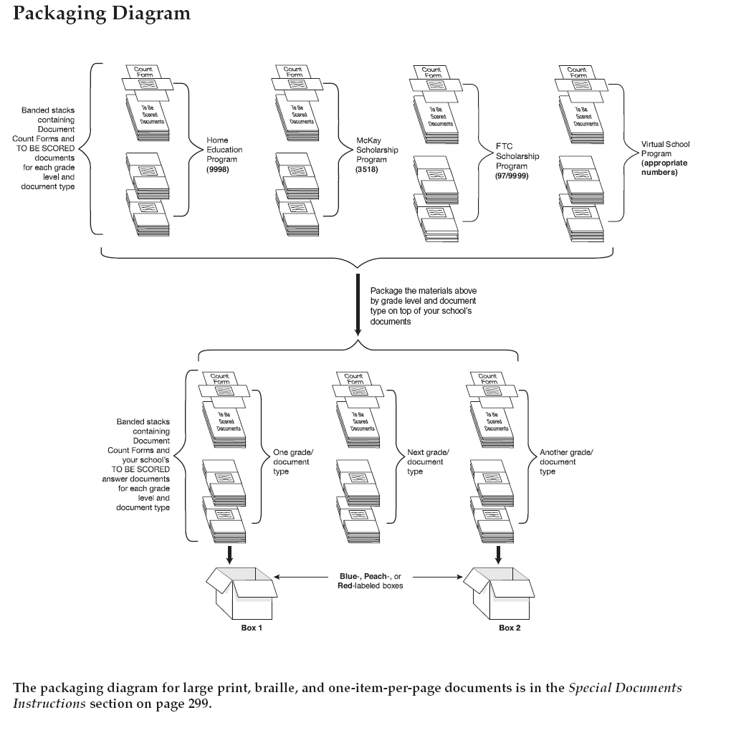

School Coordinator after testing
Retake and RMS
Miami Dade Online Academy
(13/7001)
Merrick
Hospital/Homebound
(13/9732)
Note:
Place invalidated documents marked DNS below the Document Count Form and include in count.
W TAM 57; RMS TAM 252

Slide 75
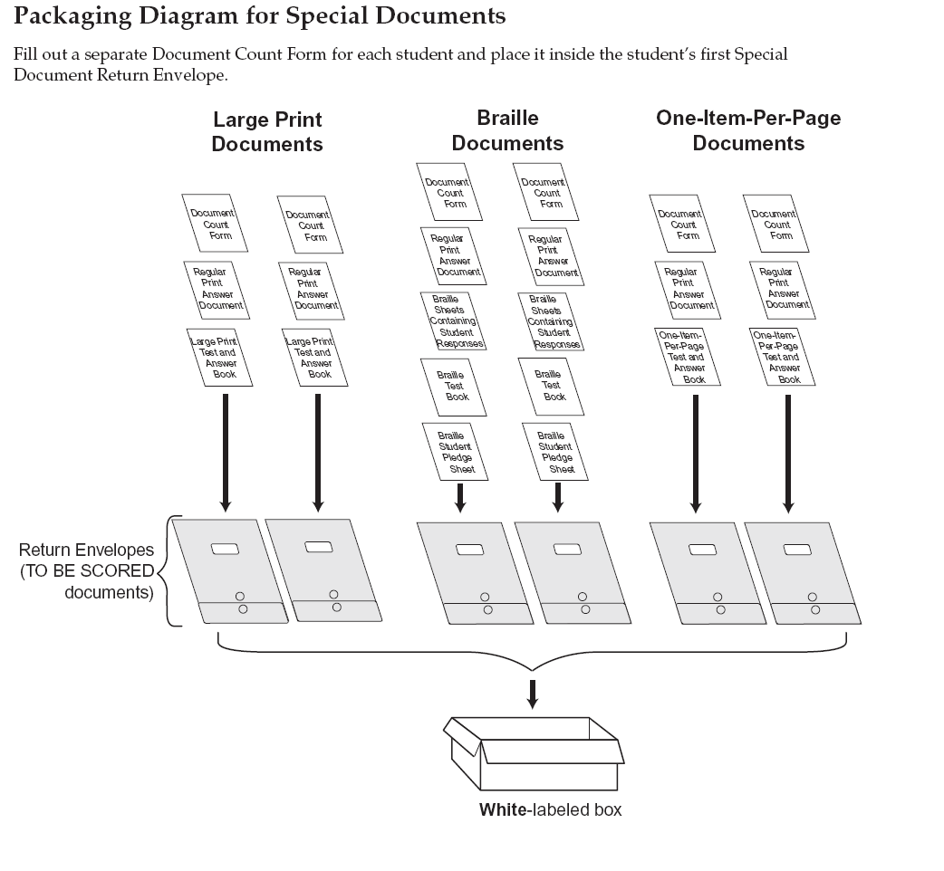
School Coordinator after testing
Retake and RMS
W TAM 83; RMS TAM 265-300

Slide 76
School Coordinator after testing
District Assessment Coordinator ONLY Boxes
Test | MATERIALS INCLUDED | LABEL COLOR | MANUAL REFERENCE
Writing | All Planning Sheets (used with signed student pledge, and unused). Original Administration Record/Security Checklist Original Security Logs Original Seating Charts Original Accounting for All Secure Documents Original School Procedural Checklist (FM-6927) | No Return Label – Mark Boxes District Coordinator ONLY | Page 58 Steps 1-4
Retake, and Reading, Mathematics, and Science (including CBT) | Original Administration Record/Security Checklists Session Rosters (CBT only) Florida Computer Based Testing Work Folders (used and unused) (CBT only) Reference sheets and Periodic Table of the Elements (used and unused) Original Security Logs Original Seating Charts Original Accounting for All Secure Documents Original School Procedural Checklist (FM-6927) | No Return Label – Mark Boxes District Coordinator ONLY | Page 253 Steps 1-4

Slide 77
Return Schedule:
FCAT Writing
Training Packet 5, 69
ALL WRITING MATERIALS | HAND-DELIVER ALL MATERIALS TO TDC RETURN DATES
RED - “TO BE SCORED” GRADES 4, 8, AND 10 WHITE - ALL SPECIAL DOCUMENTS (LARGE PRINT, BRAILLE, AND ONE-ITEM-PER-PAGE) (used and unused) YELLOW – “NOT TO BE SCORED” DISTRICT ASSESSMENT COORDINATOR ONLY BOX | Middle, Senior High, and Alternative Centers: March 2 or 5, 2012*
 | Elementary and K-8 Centers: March 6 or 7, 2012*
*Schools must hand-deliver all FCAT Writing materials to TDC by 3:30 p.m.

Slide 78
Return Schedule:
Retake and RMS
COLOR LABEL BOXES | SCHOOL RETURN DATES (No exceptions)
PEACH – Grades 9 – 10 and Retakes (paper-based tests) | Senior High Schools: Monday - Wednesday, April 23 - 25, 2012*
BLUE – Grade 3 ONLY | Elementary Schools and K – 8 Centers: Monday - Wednesday, April 23 - 25, 2012*
RED – Grades 4 – 8 | Elementary Schools, K – 8 Centers and Middle Schools (Grades 4 – 8): Monday - Wednesday, April 30 - May 2, 2012*
WHITE –“TO BE SCORED ONLY”* Special Documents (Large Print, Braille, and One-Item-Per-Page) | For the return of Special Documents, please follow the aforementioned school return dates.
*Schools must hand-deliver all “To Be Scored” materials to TDC by 3:30 p.m.
*Adult Centers must return ALL test materials to TDC by 3:30 p.m. on April 23 – 25.
Training Packet 6, 70-72

Slide 79
Pick-up Schedule:
Retake and RMS
Falcon Shipping Inc. will pick-up “NOT TO BE SCORED” materials and “District Assessment Coordinator Only Box” from schools, as follows:
Yellow Labeled Boxes (Include within this total the number of “NOT TO BE SCORED” Special Document yellow boxes) District Assessment Coordinator Only Box | May 7 - 15, 2012
Please note that approved four-function calculators remain at the school site, except for talking calculators.
Training Packet 6, 72

Slide 80
PearsonAccess
Resources
The following materials may be found on the PearsonAccess website (www.PearsonAccess.com/fl) under the Support tab:
  Test administration manuals
  Forms to report missing materials and test irregularities/security breaches
  Training materials
  Comment forms
  Blank Administration Record/Security Checklist
  Security Log
  Materials Return Lists
  Braille Scripts

Slide 81
Comment Forms
After testing, test administrators and school coordinators are encouraged to complete a Writing, Retake, and RMS comment form located at www.PearsonAccess.com/fl under the Support tab.
Thank you for your valuable feedback!

Slide 82
Reminders
Inappropriate actions by school or district personnel before, during, or after test administration may result in consequences such as test invalidations and/or loss of teaching certification.
All personnel involved in test administration must read and sign an FCAT/FCAT 2.0 Administration and Security Agreement (corrected version provided online and in manual shipments).
Test administrators must sign a Test Administrator Prohibited Activities Agreement, provided in Appendix C in manuals.
Test administrators must NOT administer the FCAT to their family members. Students related to their assigned test administrator should be reassigned to an alternate test administrator.
Students may not have any electronic or recording devices at their desks, in their pockets, or anywhere they can reach them during testing, even if the devices are turned off or the students do not use them.

Slide 83
Reminders
If a student begins a session and leaves campus without finishing (due to an appointment, illness, etc.), he or she will NOT be allowed to complete that session.
A student with the accommodation of extra time must complete one session before continuing to the next session.
Test administrators are required to use ALL of the allotted time in each session and should not end a session early.
FCAT 2.0 Rulers for Session 2 only of Grades 3 and 4 Mathematics will be provided on perforated sheets with other test materials. Rulers must not be distributed for Session 1.

Slide 84
Contact Information
Student Assessment and Educational Testing
  Maria C. Bruguera, Director
  Email: mbruguera@dadeschools.net or
  Mara Ugando, Staff Specialist
  Email: mugando@dadeschools.net
Phone: 305-995-7520
Fax: 305-995-7522

Slide 85
Training Materials
The state’s training materials are available at :
www.PearsonAccess.com/fl
click on Support tab
Training materials from today’s training are available at:
http://oada.dadeschools.net/TestChairInfo/InfoForTestChair.asp

