Slide 1
Access for ELLs 2.0
Department of Bilingual Education and World Languages & Bilingual ESOL/ESE Program
Test Chairpersons Trainings
December 2016

Slide 2
Training Objectives
Describe specific procedures for test administration for grades K through12 .
Understand the organization, layout, and scripting of the tests.
Learn the procedures for administering and reliably scoring the tests.
Discuss the Dos and Don’ts for Grades K-12.
Notes:
Kindergarten Assessment training video available to view on the training course as well.
WIDA includes extra practice items for Test Administrators to practice to feel comfortable with the administration of the test.
2

Slide 3
Purpose of the
ACCESS for ELLs 2.0 Tests
Assesses students’ academic English language proficiency.
  Academic language is the vocabulary, grammatical structures and discourse required in learning the academic content of school subjects; aspects of language strongly associated with literacy development and achievement.
Notes:
3

Slide 4

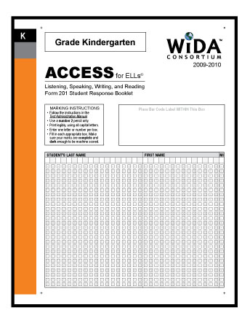
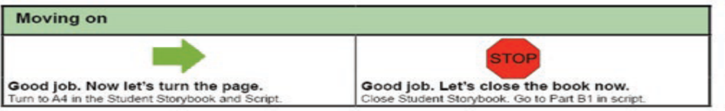
Test Materials (1 of 2)
The Kindergarten Student Story Booklet contains:
  Pictures and story for the Narrative section of the test (resembling authentic children’s literature)
  Graphic organizers related to designated sections of the test
Kindergarten Student Response Booklet contains:
  Answer key for Listening & Reading items
  Space to record and tally student responses
  Criteria for moving on/winding down
  Student writing and teacher transcription of student writing
Student Story Booklet
Student Response Booklet
Notes:
4
4
The Student Story Booklet is reusable and can be used with multiple students (students do not write in it). However, it must be returned along with the Student Response Booklets.
Graphics show sample materials because actual testing materials are secure.

Slide 5
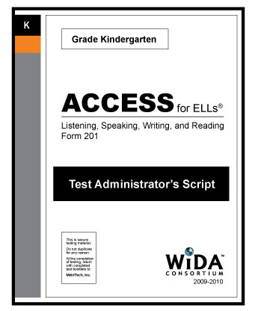
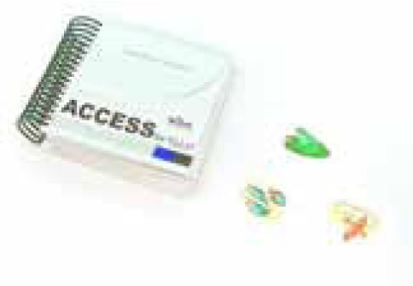

Test Materials (2 of 2)
Kindergarten Test Administrator Script contains:
  Moving on/winding down script
  Expect boxes to assist with scoring students’ speaking responses
Kindergarten Student Activity Board
Kindergarten Cards & Card Pouch Booklet
Test Administrator Script
Cards and Card Pouch Booklet
Student Activity Board
Notes:
The Test Administrator should always use the Test Administrator’s Script. It contains everything the Test Administrator says and must followed exactly. The story book is used by the student. It includes the narrative story and pictures, background graphics, and a graphic organizer for reading items.
The Student Response Booklet is primarily used by the Test Administrator to record the student’s answers. For Writing (Parts B and E), the booklet is placed in front of the students for them to write their responses.
Please not that when the students finish the Writing Experience (Part B), The T.A. transcribes what students say they wrote.
The Activity Board must be placed in front of the students during the expository sections of the test (Parts D-F). One panel is opened at a time, to reveal graphics related to the expository story.
The Cards and Card Pouch is held in a card pouch by the T.A., but placed in front of students as directed in the script. Students may be asked to point to the correct card, find the cards that go together, or move the cards to the appropriate place.

Slide 6
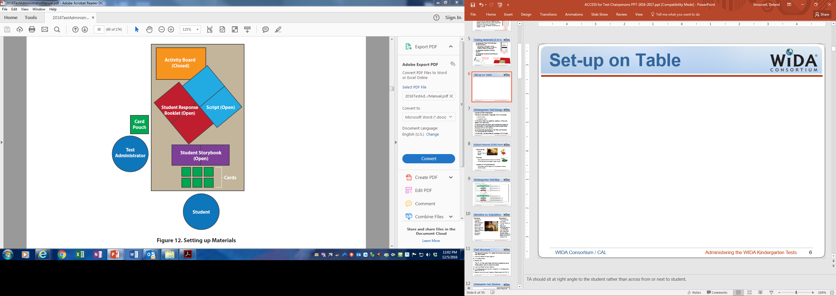
Set-up on Table
The “Do Not Disturb” Testing sign must be placed outside the testing room
It is highly recommended to sit at a right angle to the student rather than across or next to the student
Notes:
Test Administrator should sit at right angle to the student rather than across from or next to student.

Slide 7
Kindergarten Test Design
Aligned to PreK-K Standards
The test is thematically integrated within two stories:
  A narrative story
  An expository story
All domains (listening, speaking, reading, writing) are tested within each story.
All domains are individually administered and adaptive so the student will start sections at appropriate levels and stop at his or her “ceiling.”
All components are scored by the Test Administrator (TA) during test administration.
In its entirety, the test takes an average of 45 minutes.
Notes:
The Kindergarten assessment takes an average of 45 minutes per student. However, due to the adaptive nature of the assessments, high proficiency students will likely take longer than 45 minutes, while low proficiency students may take less than 45 minutes. Please be advised that the 45 minutes does not include test preparation time and breaks, which may be appropriate for Kindergarten students. See the subsection on breaks within this section for more information on breaks during the test.
The Kindergarten tests are individually-administered, adaptive assessments. An adaptive test avoids the need to ask questions of a student that are almost certainly beyond his or her abilities.
“Ceiling” is defined as no longer meeting the expectations as defined in the rubric for the task level.
Each student is tested in all sections (Listening, Speaking, Reading, Writing), although you may not administer all questions in any given Part.

Slide 8



Unique Features of the Tests
Manipulatives
  Cards
  Student Activity
  Board
Thematic
  Test questions center around two themes.
  All four domains are tested in each theme.
Interactive Writing Experience
  The student has an opportunity to produce whatever he/she is able.
Notes:
MANIPULATIVES
Much of kindergarten learning is hands-on. The tests incorporate picture cards and an activity board with various matching, identifying, and describing activities. Additionally, the tests are more interactive and task-based with a variety of activities for the student to demonstrate his/her language proficiency. In this way, the test is similar to a kindergartener’s classroom experience.
THEMATIC
Students in Pre-K/Kindergarten (and higher grade levels) do not respond well to cognitive leaps and disconnect between questions. It was suggested that the entire test be centered around one or two central themes. To organize this format logically, it was decided that each test form should also allow students to experience both a narrative text and an informational/expository test.
WRITING
A “Writing Experience,” associated with the narrative story, allows whatever the students are able to produce in writing to be scored with a rubric as a level 0–6 depending on the performance of the students. In the second folder, students will begin the writing tasks based on their previous performance.
During this task, the TA will also ask the student, “Tell me what you wrote,” and will record this within the sample to provide extra guidance/evidence of what the student is able to do.
8

Slide 9
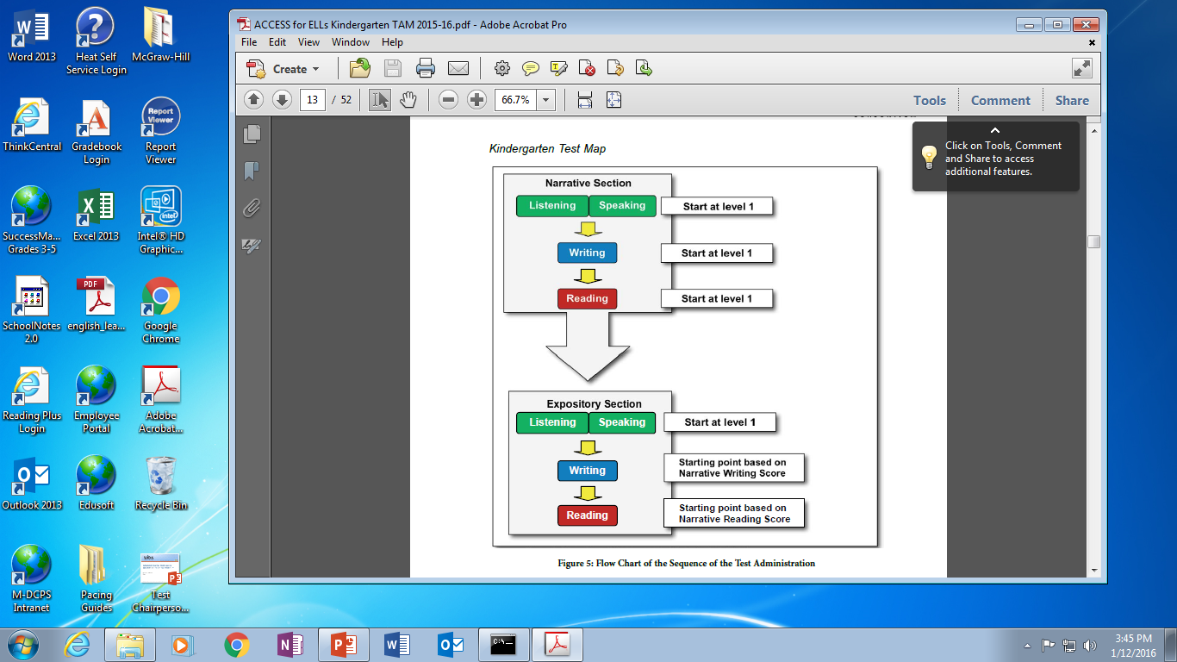
Kindergarten Test Map
Notes:
This graph illustrates test progression and starting point for the expository section of the test.

Slide 10
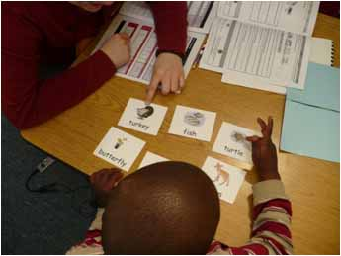
Narrative vs. Expository
Narrative:
Appropriate graphics
Main characters are animals
Description
Rhyme, Rhythm
Reminiscent of quality children’s literature
3rd person
Fictional
Expository:
Time sequence
Non-fiction
Involves "doing“ or “how to”
Realistic or
believable actions with people as main characters
Story sequence between steps, logical organization
Relate to events in student’s life
Notes:
Members of our expert panel were strong proponents of the need to expose children to both narrative and expository texts.
This distinction may have (positive) wash-back effects for classroom teachers to do the same in their classroom instruction and assessment.
10

Slide 11
Test Design
The test administrator (TA) reads the Narrative storybook, then administers:
Listening & Speaking Tests (together)
Writing Experience
Reading Test
The TA will then administer the following sections using the Expository activity board and cards:
Listening & Speaking Tests (together)
Writing Experience (starting point is based on Writing Experience score from Part B)
Reading Test (starting point based on Reading score from Part C)

Slide 12
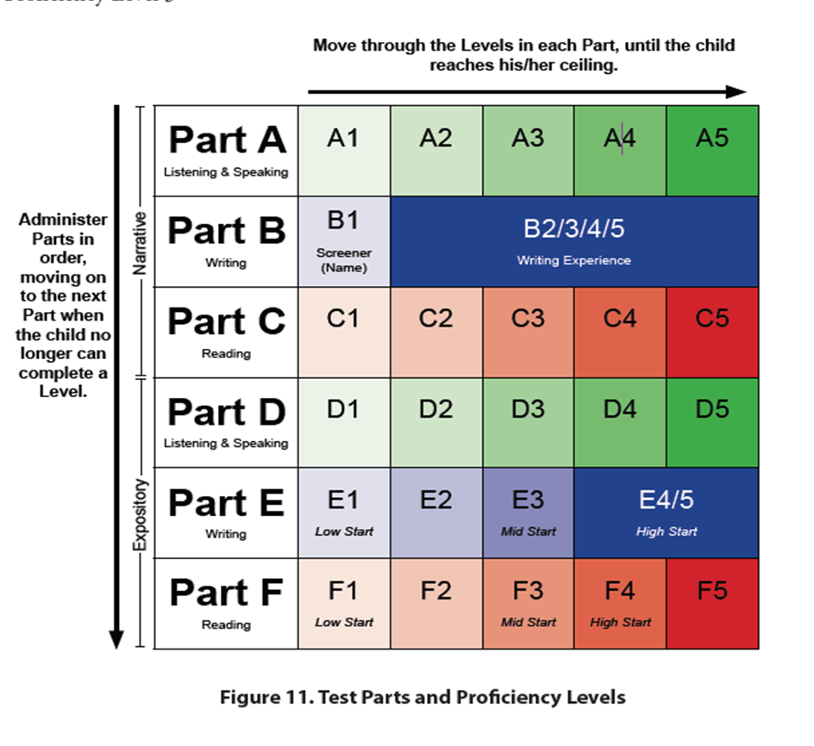
Kindergarten Test Design
Move through the Levels of each part until student reaches his/her ceiling
Part E (Writing) and Part F (Reading) Starting points are determined by performance on prior Writing and Reading tasks.
Notes:
12
12
At a minimum 6 tasks must be administered to each student (the first level 1 items in each of Parts A-F). At a maximum, all 20 tasks would be administered. The time needed for an individual test will vary with the number of tasks administered. On average, the test will take about 45 minutes.

Slide 13
General Test
Administration Procedures
Follow the script EXACTLY. Read aloud everything in black bold and blue bold print.
Student responses must be recorded and scored IMMEDIATELY after each level is complete (e.g. after A3).
You must administer and score all items in any one level of a Part before making a determination about whether to continue to the next level or to stop that Part.
Kindergarteners may need breaks during the test administration.
  Stretch breaks may be taken between each section of the test (e.g. after Listening/Speaking, before Writing)
  The test may be administered in two sessions with a break of no more than 2 school days between Parts C (Narrative) & D (Expository)
Notes:
13
13
As soon as the student does not meet the criteria for advancement listed in the student response booklet, check the “stopped here” box next to the level administered and leave all boxes in higher levels blank.
Stretch breaks may be taken between components of the test (for example, between the Listening/Speaking and the Writing sections). There are notes in the Test Administrator Script indicating when you may want to take a stretch break with the student. Note that the break time is not included in the total testing time.
If a longer break is needed (e.g., for lunch or to break the test into two separate sessions), it must take place between Parts C & D (between the Narrative & Expository stories). The second part of the test must be completed after a break of no more than 2 school days (e.g., if Parts A-C are given on Monday, Parts D-F must be administered no later than Thursday of the same week).

Slide 14
Preparing for Test Administration
Familiarize yourself with the Test Administrator Script for each portion of the Kindergarten Test prior to administering the test. It is recommended to practice with a colleague before you administer to a student.
You will need 2 sharpened pencils: one for you and one for the student.
Testing should occur in a quiet room.
Administer the test to the student using rectangular (preferable) or circular table.
Place yourself at a right angle to the student, rather than across from or next to the student.
Notes:
14
Make sure the student’s chair is high enough for him/her to see the pictures in the Picture Cue Booklet when it lies flat on the table.

Slide 15
Parts A ― C:
Narrative Administration Information
Notes:
Parts A, B, and C of the Kindergarten Test are based on a Narrative storyline. They contain tests in each domain – Listening & Speaking (A), Writing (B), and Reading (C).
15

Slide 16
Part A: Listening & Speaking
Format: Both domains are administered together by level. The Listening items for one level are administered, then the Speaking items for that same level are administered.
Directions: Read the entire narrative story first, then go to the beginning of Part A (level A1) to administer Listening and Speaking. Move through the levels, A1 to A5, based on student’s responses.
Guidelines: Follow the Test Administration Script exactly, including pauses. Keep the test going at a steady pace.
Scoring: After the student answers all items in a level, complete the score sheet in the Student Response Booklet.
Notes:
16

Slide 17
Listening Items
Listening items prompt the student to point to something in a picture, or point to and/or move a card.
Do NOT read a Listening item more than one time.*
Scoring: Listening items are marked correct or incorrect.
Notes:
*Only if there is a significant interruption while you are reading a Listening Test item—such as an announcement over the loudspeaker, a fire drill, or a loud noise outside—may you repeat the item one time, for a total of two complete readings of the item

Slide 18
Speaking Items
Speaking items prompt the student to talk about the pictures and the story.
Scoring: There is guidance as to what to look for in a student response, found in the “Expect” box. Follow these guidelines to determine if the student meets or does not meet the task-level expectations.
NOTE: These are based on the WIDA Speaking Rubric; Refer to the rubric if you have questions.
Notes:
For a more comprehensive explanation of the Kindergarten Speaking Test and scoring guidance and practice, refer to the separate presentation entitled Scoring the ACCESS for ELLs Kindergarten Speaking Test.

Slide 19
Scoring Rules
The TA must score the item immediately after the student responds to the last question in a task.
  If unsure whether to score a response Meets or Approaches, the “?” (question mark) box can be marked.
  Then administer the next task.
  If the response to the next task scores Meets, go back and rate the previous task (the one with ? marked) Meets.
  If the response to that next task scores Approaches, go back and rate the previous task Approaches.
  Note: The last task on a Part may not be scored with a “?”.
The rating represents the student’s performance on the complete task, not on individual questions within the task.
Notes:
19
19
If in doubt between a score of Meets or Approaches, you can mark in the center column below the question mark (?) on the score sheet and administer the next task.
If the student gives a performance that meets the task level expectations on the next task, assign that task a score of Meets, and go back and assign the task, previously scored a question mark, a score of Meets. If the student gives a performance that very clearly fails to meet the task level expectations on the next task, it is most likely that the performance was also deficient on the previous task. Assign the current task a score of Approaches and go back and assign the task in question a score of Approaches.

Slide 20
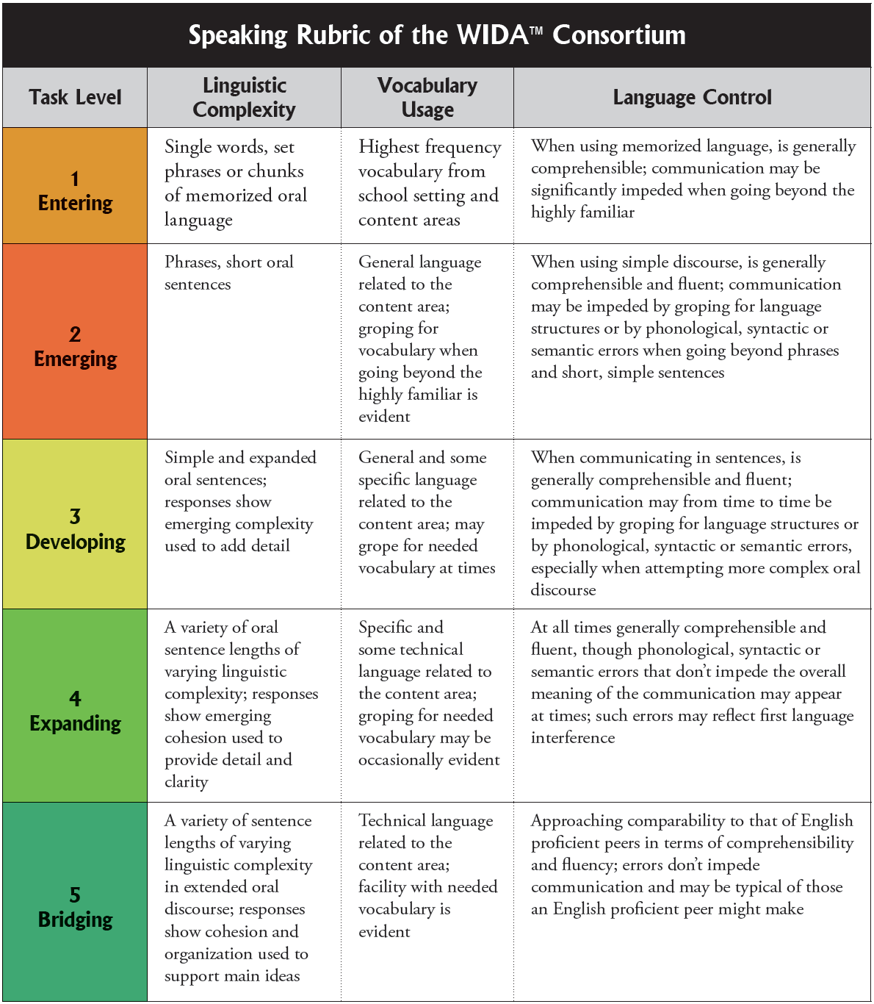
Speaking Rubric
Speaking Rubric
TAM
figure 18, pg. 45
Notes:
Note that while the full task level expectations are contained in this rubric, a summary of each level is contained in the “Expect” box at the end of each Speaking task in the Test Administrator Script. This is to guide the TA in what to listen for in a student’s response and to facilitate “on-the-spot” scoring.
For practice scoring items on the Speaking Test, please refer to the Scoring the ACCESS for ELLs Kindergarten Speaking Test PowerPoint.
20

Slide 21
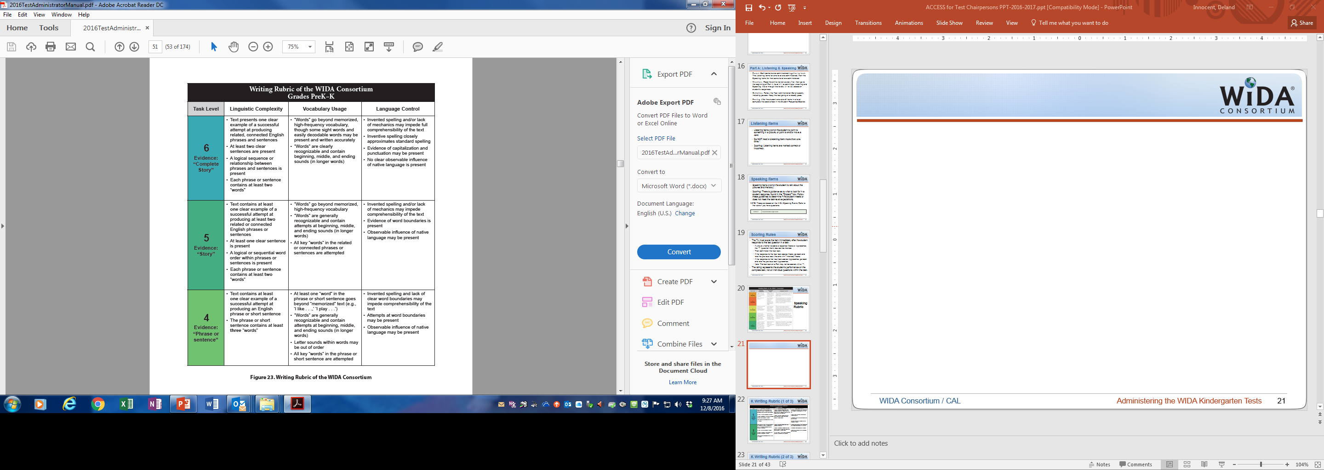
Writing Rubric
TAM figure 23, pg. 51

Slide 22
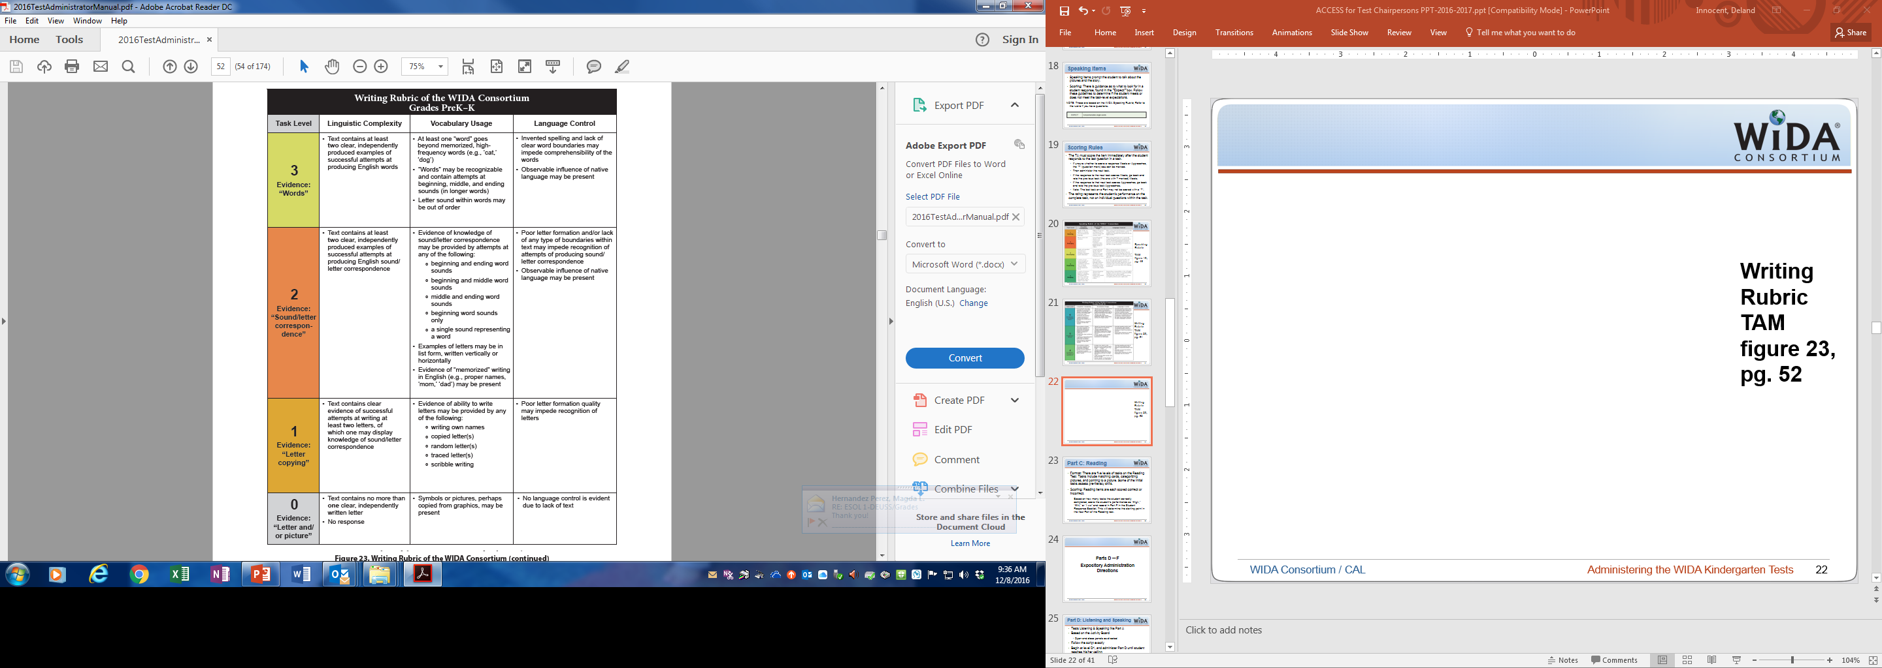
Writing Rubric
TAM figure 23, pg. 52

Slide 23
Part C: Reading
Format: There are five levels of tasks on the Reading Test. Tasks include matching cards, categorizing pictures, and pointing to a picture. Some of the initial tasks assess pre-literacy skills.
Scoring: Reading items are each scored correct or incorrect.
  Based on how many tasks the student correctly completed, score the student’s performance as “High,” “Mid,” or “Low” and record in Part F in the Student Response Booklet. This will determine the starting point in the next Part of the Reading test.

Slide 24
Parts D — F
Expository Administration Directions
Notes:
24

Slide 25
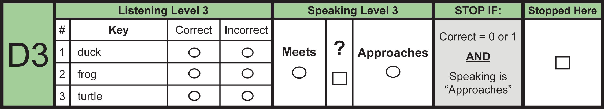
Part D: Listening and Speaking
Tests Listening & Speaking like Part A
Based on the Activity Board
  Open and close panels as directed
Follow the script exactly
Begin at level D1, and administer Part D until student reaches his/her ceiling
Scoring rules for Part D are the same as for Part A

Slide 26
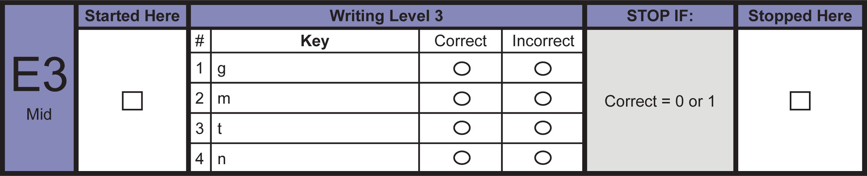
Part E: Writing
Leveled writing tasks
Entrance point based on student’s performance on Part B.
  Mark the student’s starting point in Part E under the Started Here column
  If “High” start with E4/5 (Writing Experience)
  If “Mid” start with E3 (Leveled Tasks – Beginning & Ending Sounds)
  If “Low” start with E1 (Leveled Tasks – Tracing & Copying)
Notes:
E4/5 is the Writing Experience for the Expository section. If the child easily completed the first one, he/she should be able to do this as well.
E3 is writing beginning and end sounds. If the child was struggling a little with Part B, but still recognizing beginning or ending sounds, here that child has the opportunity to do a more focused sound-letter recognition task.
E1 is a tracing task for children whose English writing skills are in the early stages.
Note: Do not go back to a previous level in Part E, if the child cannot successfully complete the Level on which you have started him/her.

Slide 27
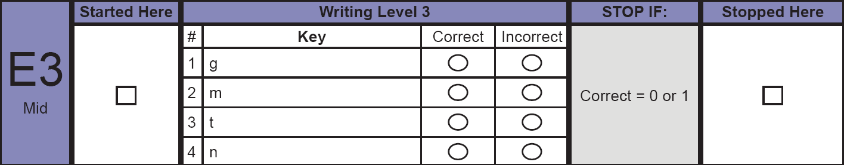
Part E: Writing
If a student is unable to complete the task or scores only one item correctly, the test administrator will mark Stopped Here, indicating that the student is done with this Writing section.

Slide 28
Part E: Scoring Guidance
E1 – E3 Leveled Tasks : Scored as Correct or Incorrect.
  If the student completes a level successfully (following the Stop If criteria), move on to the next level.
E4/5 Writing Experience Task: Rated using the PreK-K Writing Rubric.
  The test administrator assigns the writing a score of 0-6 using the Writing Rubric after the student completes the entire test.

Slide 29
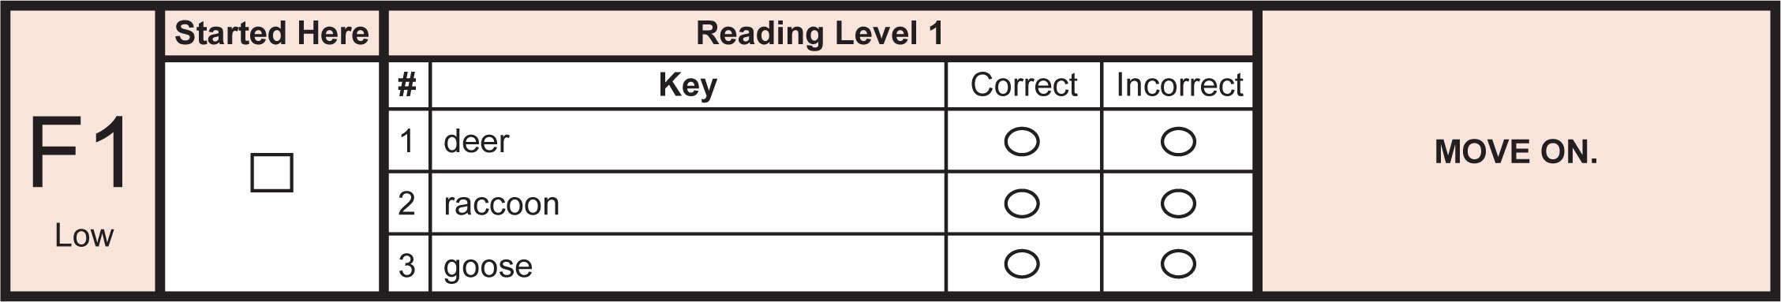
Part F: Reading
There are 5 levels of Reading tasks in Part F.
Entrance point based on student’s performance on Part C.
  Mark the student’s starting point in Part F under the Started Here column
  If “High” start with F4 (reading short phrases)
  If “Mid” start with F3 (reading words)
  If “Low” start with F1 (pre-literacy task)
Scoring Part F is the same as scoring Part C.
Both F1 and C1 require you to MOVE ON, regardless of the number of correct answers.

Slide 30
Positive Reinforcement
Be sure you end the test with something the student can do so that students leave with a positive feeling about the experience.
In Listening Parts: If the student clearly does not understand the listening task, you may repeat the model. If the student still doesn’t understand, continue modeling with the other items, but score them as incorrect.
In Speaking Parts: If the student says “I don’t know” you may assist him/her, but mark the answer “Approaches.”
In Writing Parts: If the student cannot write sentences, prompt him/her to write single words or letters.
In Reading Parts: If the student can’t read words or sentences encourage him/her to identify a sound or a picture he/she recognizes.

Slide 31
Remember…
Kindergarteners are easily distracted.
Make sure testing area is quiet and away from student traffic.
Although TAs should be ready to redirect students to the task, the scripts will include advice for extra prompting.
Kindergarteners need more stretch breaks.
Take time before test administration to establish rapport with the student.
Experience with young students is recommended for TAs for the Kindergarten test.
Notes:
Consider carefully the Test Administrator for Kindergarten. It is highly recommended to have staff with experience with kindergarteners.

Slide 32
Test Administration Procedures
(Grades 1-12)

Slide 33
Grade 1-12 Test Materials
Image | Title | Content and Use
 | Test Administrator’s Script | Always in use by Test Administrator Contains everything the TA says for all four domains Must be followed exactly
 | Listening and Speaking CDs | To be used in a CD player or computer fro Listening and Speaking administration.

Slide 34
Grade 1-12 Test Materials
Image | Title | Content and Use
 | Speaking Test Booklets | Used by the student during the Speaking administration to see the pictures and prompts. This is a reusable test materials; students should not write in this booklet
 | Form 401 Test Booklet | Used by the student to record their responses during the Listening, Reading, and Writing test. The TA also records the rating for the Speaking test in this booklet as well.

Slide 35
Administering the Speaking Test
Prepare the Speaking Test CD to begin at the appropriate track number (Recording Track List in T.A. Script booklet)
Read the T.A. script aloud to student
Play the CD track when indicated in the script
Follow along with the student
Evaluate and score student responses immediately after the student gives a response.

Slide 36
Test Environment/Setting
One-to-One Speaking by school personnel/paraprofessional, familiar to student (trained and certified to administer ACCESS for ELLs 2.0)
Group administration (listening, reading, writing) by student’s teacher or other teacher (trained and certified to administer ACCESS for ELLs 2.0)
Small group (not more than 22 students in a single group-testing session)
In a separate room

Slide 37
Test Environment/Setting
Tier A | Newcomers, and All Level 1s (regardless of years)
Tier B | All level 2s
Tier C | All level 3/4s
Note: Schedule only one Tier/Grade Level in a single test session.

Slide 38
Test Administration Times
Test | Scorer | Administration
Speaking Test | Scored by the Test Administrator | Individually Administered
Session 3 Speaking Administration (Individually Administered)
Grade-level-cluster | Tier | Domain | Time to administer
ALL | ALL | Speaking | 15 – 35 minutes per student
Note: Listening/Speaking requires CD Player for CD provided with test kit.
Notes:
CD player needed for CD that comes with kit

Slide 39

Test Items Dos (1 of 2)
Answer student procedural questions.
Answer content questions during practice items.
Monitor student progress to promote on-task
behavior.
Rephrase, explain in English, or, if specifically requested, translate the test directions and practice into the student’s native language.
Notes:
The list below of Dos applies while students are completing the test items.

Slide 40

Test Items Dos (2 of 2)
Adjust the volume for student(s) if the audio is not loud enough.
Assist students with turning the page (during the Speaking test, especially at the younger grades).
Notes:
The list below of Dos applies while students are completing the test items.

Slide 41

Test Items Don’ts (1 of 2)
Select or change an answer for the student.
Tell student what he/she should or should not bubble in (Receptive domain).
Tell student that he/she provided a correct/incorrect response.
Provide a response for the student
(Writing/Speaking domains).

Slide 42

Test Items Don’ts (2 of 2)
Answer questions about content, vocabulary or grammar (instead remind students to try their best).
Interrupt students who are working independently.
Translate test item prompts into student’s native
language.
Rephrase, explain, or read aloud test item prompts.
Bilingual word-to-word dictionary

Slide 43

Notes:
43

Slide 44
Questions or Comments?
  District Contact:
  Assessment Department
  Ms. Felicia Mallory
  Ms. Denetria Collins
  (305) 995-7520
  Deland Innocent North Region 305-995-2977
Alina Plasencia Central Region 305-995-2433
Mercy Abadie-Lux South Region 305-995-2098
Reagan Chalmers ESE/ESOL 305-274-8889
Dahlia M. Gonzalez Charter Schools 305-995-1901
Notes:
Please contact the Assessment, Research and Data department regarding ALL questions that pertains test materials. Our department will only answer questions about the Kindergarten test administration and the One-on-One Speaking section of the test.

Slide 45
ACCESS for ELLs 2.0
ACCOMMODATIONS

Slide 46
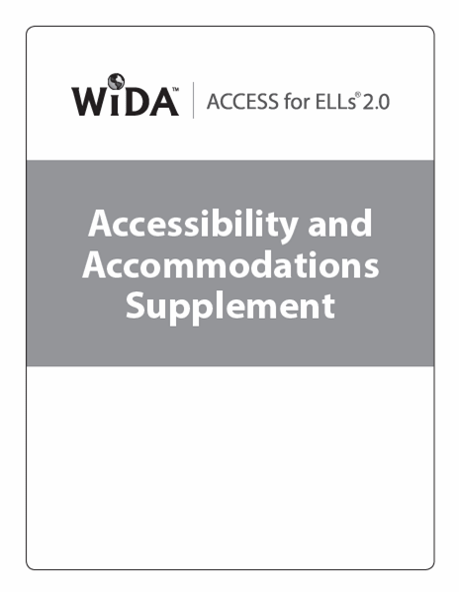
Accessibility and Accommodations Supplement
Participation Guidance
Framework
Types of Supports
Alternate ACCESS for ELLs criteria
Keyboard Shortcuts
Transcription Guidance
Scribe Guidance
Accommodations Checklists
Notes:
The resource you will use to learn about available accessibility supports is the ACCESS for ELLs 2.0 Accessibility and Accommodations Supplement. This document supplements the ACCESS for ELLs 2.0 Test Administrator Guide, and replaces the previous WIDA accessibility and accommodation documents.
This document includes:
ACCESS for ELLs participation guidance
More detail regarding the WIDA Accessibility and Accommodations Framework.
And specifics on the different types of supports available.
At the end of this document you’ll find supplemental guidelines on Alternate ACCESS for ELLs participation criteria, keyboard shortcuts, transcription guidance, scribe guidance and accommodation checklists for IEP and 504 teams.

Slide 47







Accessibility
Accessibility supports all students
Notes:
WIDA’s approach to accessibility is rooted in the understanding that ELLs are diverse; all ELLs are capable of making progress toward English language proficiency; and ELLs must acquire discipline-specific language practices that enable them to produce, interpret, and effectively collaborate on content-related grade-appropriate tasks.
In the past assessment supports most for students were added on as an extension of the test’s standard format. In 2015 WIDA transitioned an approach to accessibility that provides a wider range of supports within the test.
Development of accessible assessments make sure students are able to show what they know without changing what is being measured.
NOTE: This slide is animated and timed, it will go through the pictures automatically

Slide 48
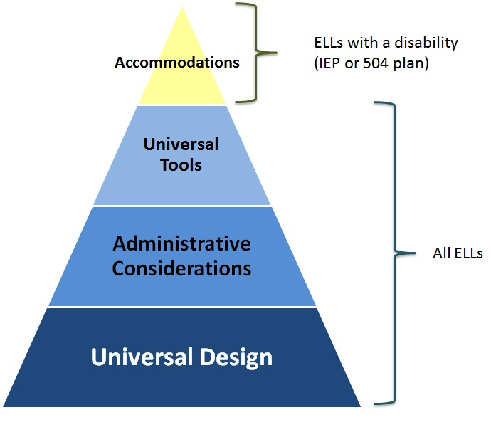
The WIDA Accessibility and Accommodations Framework
Notes:
All assessments in the ACCESS for ELLs 2.0 suite of assessments use the WIDA Accessibility and Accommodations Framework.
As you can see from the graphic, the Framework provides support for all ELLs, as well as more targeted accommodations for students with IEPs or 504 plans. These supports will help all ELLs -- with and without an IEP -- to better access the test.
Now let’s go the key elements of the supports shown in the Accessibility and Accommodations Framework triangle: Universal Design, administrative considerations, universal tools, and accommodations.

Slide 49

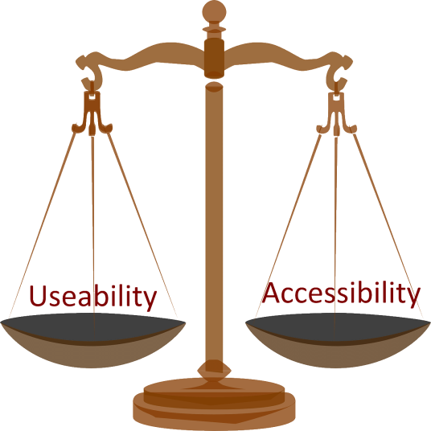

Universal Design
Notes:
The base of the Accessibility and Accommodations Framework is Universal Design.
Planning for accessibility starts early in the development process. The principals of Universal Design were used while developing tasks as well as the online testing platform, and paper-based test booklets. Test delivery options were developed to ensure a balance between the accessibility and usability. Item layouts are designed to be user-friendly. For example, all the information students need to answer a question is included on the computer screen, or on the same page of the test booklet. Students do not need to switch between screens or pages as they work through an item. Additionally, navigation components will always appear in the same place. Stimulus pictures and text, item stems, and response options appear in predictable locations.
The test items are presented using multiple modalities, including supporting prompts with graphics, embedded scaffolding, tasks broken into chunks, and modeling using task prototypes and guides.
NOTE: This slide is animated, the scale will appear

Slide 50
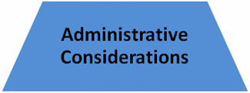
Administrative Considerations
Notes:
The next section of the Accessibility and Accommodations Framework is Administrative Considerations.
Individualized administration procedures provide flexibility to district or school in determining the conditions under which ACCESS for ELLs 2.0 can be administered most effectively. Test security may not be compromised and testing environment requirements must be met. Administrative considerations may not change what the test items are designed to measure or the way test scores are interpreted.
NOTE: This slide is animated

Slide 51

Administrative Considerations
Adaptive and Specialized Equipment or Furniture
Alternative Microphone
Familiar Test Administrator
Frequent or Additional Supervised Breaks
Individual or Small Group Setting
Monitor placement of responses in the test booklet or onscreen
Participate in different testing format
Read Aloud to Self
Specific Seating
Short Segments
Verbal praise or tangible reinforcement for on task or appropriate behavior
Verbally redirect student’s attention to the test
Notes:
The Accessibility and Accommodations Supplement also contain information to support school Multidisciplinary teams when assigning accommodations. Page 14 in the supplement has a guide for them to follow if they have questions.
Districts and schools have the authority to make administrative determinations for any ELL student as long as test security is not compromised and the requirements are met regarding testing conditions and environment. These individualized administration procedures provide flexibility to schools and districts in determining the conditions under which ACCESS for ELLs 2.0, Kindergarten ACCESS for ELLs and Alternate ACCESS for ELLs can be administered most effectively.
In addition to administration procedures already listed in the Test Administrator Manual, consider the following administrative procedures that may be customized to meet the needs of students.

Slide 52

Universal Tools
Notes:
Now lets take a few minutes to look at the Universal tools available to all ELLs.
Universal tools are available to address individual student accessibility needs. These may be embedded in the online test platform or provided by Test Administrators during testing.
Provided that students have become familiar with the appropriate use and availability of universal tools, these should reinforce students’ abilities to demonstrate their knowledge and skills.
Best practice includes educators ensuring that students have opportunities to practice using the tools, and helping students determine when a tool may be appropriate and useful. Making connections between learning strategies used during instruction and similar universal tools available on the assessment, also may help students decide which tools are appropriate and when to use them. Remember, sample items are available for students to practice using the Universal tools.
NOTE: This slide is animated

Slide 53
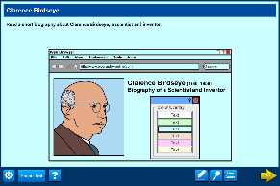
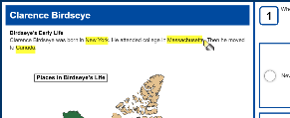
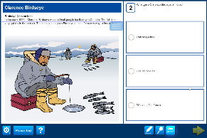
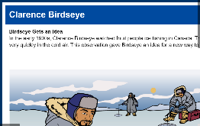
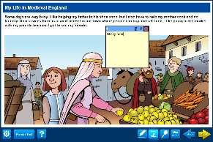
Universal Tools
Audio Aid
Color Overlay
Highlighter
Line Guide
Magnification
Sticky Notes
Scratch paper
Color Contrast
online only
Notes:
Universal Tools are available to all students taking the computer-based or paper-based assessments.
Universal tools should be familiar to students from their use during instruction.
While available in both online and paper-based testing formats, universal tools may look different. Most universal tools are embedded in the computer-based test platform; however for paper-based testing universal tools are provided by the test administrator.
Universal tools do not need to be indicated in WIDA AMS.
Scratch paper is not embedded in the test platform, and should be available to students upon request. Used scratch paper is considered secure test material. Test administrators must collect used scratch paper at the end of each test domain to maintain test security. Scratch paper must be returned with test materials or disposed of according to state policy.
Descriptions of Universal Tools are available in the Accessibility and Accommodations Supplement.

Slide 54
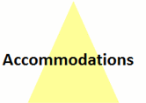
Accommodations
Notes:
Accommodations are at the top of the triangle, and are available only to students with a documented disability.
Accommodations are allowable changes to the way the test is presented, the way a student responds to test items, the timing of the test, or the testing environment.
Providing appropriate accommodations, that do not change what is being measured by the test, is required by both state and federal law.
Testing accommodations must be listed in a student’s active IEP or 504 plan.
NOTE: This slide is animated

Slide 55
ELL SWD Accommodations
Accommodations are intended:
To provide testing conditions that do not result in changes to what the test measures
To provide comparable test results to those students who do not receive accommodations
Sources: ACCESS for ELLs 2.0 Paper Test Administrator Training
ACCESS for ELLs 2.0 Accessibility and Accommodations Guidelines
Notes:
IDEA requires that states provide appropriate accommodations where needed in accordance with student’s IEP or 504 Plan.

Slide 56

Selecting Accommodations
Make a team decision
Using guiding decision-making questions
Be careful not to confuse content area testing with ELP testing
Base accommodation decisions on individual student needs
Notes:
The Accessibility and Accommodations Supplement also contain information to support school Multidisciplinary teams when assigning accommodations.
It is important that IEP and 504 teams for ELLs with disabilities are multidisciplinary and collaborative in nature. It is recommended the team includes people with expertise in second language acquisition and other professionals, such as speech-language pathologists, who understand how to differentiate between limited English proficiency and a disability.
WIDA recommends that the team:
1. Make a team decision and use the guiding decision-making questions found in the supplement.
2. Teams should be careful not to confuse content area testing with English language proficiency testing, and understand the difference in what is being tested as well as available accommodations.
3. Be sure to base accommodation decisions on individual student needs. Blanket or formulaic decisions should not be applied.

Slide 57
Kindergarten ACCESS for ELLs Accommodations
Accommodations:
Extended testing of a test domain multiple days (EM) *must provide written request and evidence supporting the need due to a student’s illness, disability, or extended interruption in testing, to the state assessment official | Extended Speaking test response time (ES)
Extended testing time within the school day (ET) | Interpreter signs test directions in ASL (SD) *directions refer to administration logistics, test directions and practice items provided prior to first test item
Large Print (LP) | Scribed response (SR) *for students who are unable to write due to a disability. TA writes student responses as the student dictates responses directly into the test book during testing
Test may be administered by school personnel in non-school setting (NS)- *hospital/homebound | Word processor or similar keyboarding device to respond to test items (WD)
Notes:
The accommodations utilized by the student must be bubbled by the test administrator on the student’s test booklet.

Slide 58
ACCESS for ELLs 2.0 Accommodations Selections- Paper
Accommodations:
Braille with Tactile Graphics (Braille Writer/Braille Note-taker) *Tier B, must be ordered in either uncontracted or contracted UEB | Extended testing of a test domain multiple days (EM) *must provide written request and evidence supporting the need due to a student’s illness, disability, or extended interruption in testing
Extended Speaking test response time (ES) | Extended testing time within the school day (ET)
Human reader for items (HI) *reader must read item text exactly as it appears in test book | Human reader for response items (HR) *reader must read answer choice exactly as it appears in test booklet
Human reader for repeat of test items (RI) *listening items may only be repeated once | Human reader for repeat of response options one time (RR) *option to repeat one time only
Interpreter signs test directions in ASL (SD) | Large Print (LP) *18 point font, responses must be transcribed
Manual control of item audio (MC) | Repeat item audio (RA) *listening items may only be repeated once
Scribed response (SR) | Student responds using a recording device, which is played back and transcribed by the student (RD)
Word processor or similar keyboarding device to respond to test items (WD) | Test may be administered by school personnel in non-school setting (NS) *hospital/homebound
Notes:
The accommodations utilized by the student must be bubbled by the test administrator on the student’s test booklet.

Slide 59
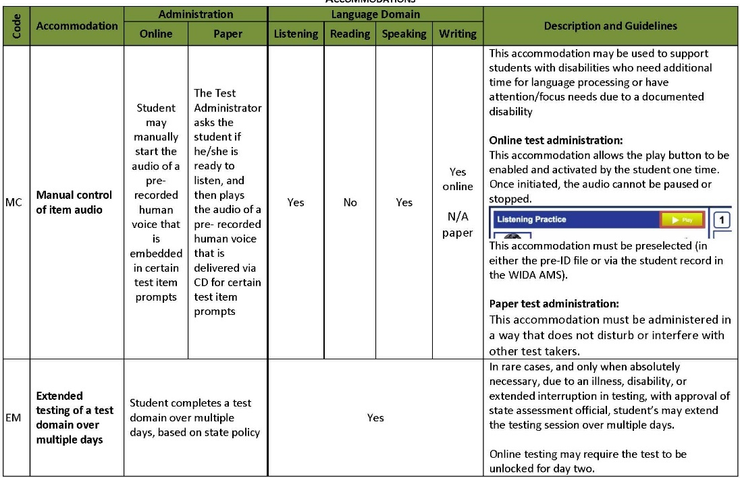
Accommodations Tables
Test domains in which it may be allowed
Two-letter
data code
Accommodation is different for
online and paper administrations
Administration guidelines
Accommodation is the same for both online and paper administrations
Name
Notes:
Found on pages 16-24 in the Accessibility and Accommodations Supplement. Advise them to review this.
As a reminder accommodations are only available to students with disabilities. Available accommodations are found in the Accessibility and Accommodations Supplement.
Two factors are crucial in assigning an accommodation First, the accommodation must be carefully selected and appropriate to the student’s need. Second, the student must be familiar with how to use the accommodation.
Provided a familiar, appropriate accommodation, ELLs with disabilities will have the opportunity to demonstrate their English language skills.
The accommodations tables contain guidance to match specific students’ needs and to ensure the accommodations selected do not alter the what the test is measuring.
Let's take a quick tour of the Accommodations Table layout:
CLICK 1
The first column shows the two-letter data code assigned to each accommodation. This code will be used in data files.
CLICK 2
The accommodations tables are alphabetized by accommodation name.
CLICK 3
The next two columns show how the accommodation will be administered during online and paper administrations. If the accommodation is the same for both assessment formats, the columns are merged.
CLICK 4
These four columns indicate the test domains for which the accommodation may be available. Your state accommodation policy may vary. Language domains are listed in alphabetical order: Listening, Reading, Speaking and Writing. If the accommodation is available in all domains the cells are merged.
CLICK 5
The final column includes a brief description of the accommodation and administration guidelines.
NOTE: This slide is animated and advances on mouse click.

Slide 60
Comparison of WIDA to FSA Accommodations
WIDA Accommodation | FSA Accommodation
Extended testing time within a school day | Flexible Scheduling- Allow extended time >50% not to exceed the end of the school day for a test session (more than 50% as compared to peers)
Human Reader for Test Items (HI) Human Reader for response options (HR) | Flexible Presentation- Oral presentation of test directions, questions, and answer choices in --- (ELA Writing; Math; Science). On ACCESS for ELLs 2.0, students CANNOT have any portion of the Reading Section read to them.
Scribed Response (SR) | Flexible Responding- Dictation of responses to a test administrator/proctor; Flexible Responding- Oral rather than written response
Administrative Consideration- Small group testing | Flexible Setting- Small group testing
Administrative Consideration- Breaks | Flexible Setting- Allow movement as needed Flexible Scheduling/Timing- Testing time separated into short periods for single sessions over multiple days for Paper Based Test
Notes:
Participants need to know that if a student does NOT have WIDA accommodations this does not mean that they will not have accommodations provided to them. They must refer to the student’s IEP and cross reference what their FSA Accommodation is to the WIDA accommodations.

Slide 61
Deaf or Hard of Hearing ELLs
Students who are deaf and are unable to produce spoken language and receive language input only through signing should be exempt from the Listening and Speaking sections.
The teacher (e.g., ESOL teacher) of each deaf or hard of hearing student should make a determination regarding whether the student is able to participate in the Listening and Speaking sections.
Once a determination is made by the teacher it should be reflected in the student’s response booklet.

Slide 62
Deaf or Hard of Hearing ELLs
LISTENING SECTION
Students who are deaf and receive language input only through signing should be exempt from the Listening section
For students who have some hearing ability, Test Administrators may use signing to clarify the directions to the Listening section, but they may not use signing to explain the content of the Listening section questions.
An administrator may read the Listening script aloud (rather than playing the CD) for reinforcement for a hard-of-hearing student who is a proficient speech (lip) reader

Slide 63
Deaf or Hard of Hearing ELLs
SPEAKING SECTION
Students who are not able to produce spoken language should be exempt from the Speaking section.
Test administrator may use signing to clarify the directions to the Speaking sections, but they may not use signing to explain the content of the Speaking section questions
READING and WRITING SECTION
Test administrators may sign the directions and may use signing to answer any questions the students have about the directions. However, administrators may not use signing to explain the content of the Reading or Writing section questions

Slide 64
ELLs with Visual Impairments
ACCESS for ELLs 2.0 is available either in contracted or uncontracted Braille in the domains of reading and writing
WIDA will provide “hard copy” tactile Braille assessments for ACCESS for ELLs 2.0
Accommodations also include the use of Braille writers, notetakers as response accommodations for the reading and writing domains
(source: ACCESS for ELLs 2.0 Accessibility and Accommodations Guidelines)
Notes:
Braille versions for ACCESS for ELLs 2.0 permit ELLs with Vision Impairment the opportunity to demonstrate their reading and writing of Braille English. For the 2016 ACCESS for ELLs 2.0 only the Tier B version is available. Next year WIDA should provide Tiers B and C in Braille
Test chairperson is responsible for making request for these materials and making sure they are available for the student.

Slide 65
Prohibited Accommodations
The following accommodations are NOT ALLOWED for use on ACCESS for ELLs 2.0, Kindergarten ACCESS for ELLs, or Alternate ACCESS for ELLs:
  Reading aloud test items or passages on the Reading test
  Translating test items into a language other than English
  Reading test items in a language other then English
  Using a bilingual word-to-word dictionary
  Responding to test questions in a language other than English
Notes:
These accommodations aren’t allowed as they would alter the results obtained on the test.

Slide 66
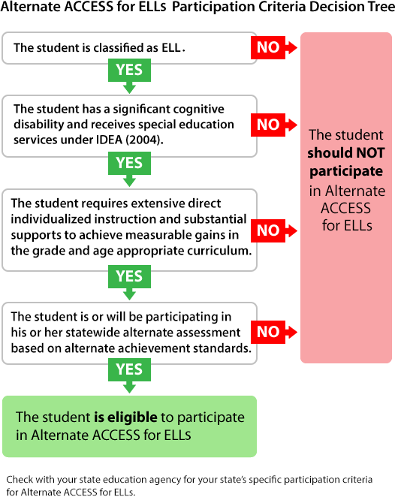
Alternate ACCESS for ELLs
Alternate Access for ELLs is NOT available for Kindergarten students with disabilities. They must take the KG ACCESS for ELLs 2.0
Notes:
Some ELLs with significant cognitive disabilities will be unable to take ACCESS for ELLs, even with supports and accommodations. These students may be eligible to take the Alternate ACCESS for ELLs. This assessment is only for students who meet specific participation criteria. WIDAs guidance for participation on the Alternate ACCESS for ELLs is found in Appendix A of the WIDA Accessibility and Accommodations Supplement.
Check with your state education agency for your state’s specific participation criteria for alternate assessment participation.

Slide 67
Overview of Alternate ACCESS for ELLs
Paper and pencil assessment
All components of the tests are individually administered
Semi-Adaptive
Test administrator will be scoring the assessment
Materials Needed:
Test Administrator Manual
Test Administrator Script
Test booklet (legal size paper)
Student Response booklet

Slide 68
Features of the Test
Scripted cues and repetition
Modeled tasks in the writing section
Repetition and multiple opportunities for students to demonstrate their proficiency
Produce the most valid results of students’ abilities as possible
Notes:
3 cues in the listening and reading
3 opportunities for students to respond in the speaking section
Modeled tasks in the writing section

Slide 69
Who Should Administer the Alternate ACCESS for ELLs?
ESE Teacher or licensed staff (WIDA online certification)
Staff member familiar with student’s dedicated communication system and response modes
Practice ahead of time is important due to logistics of managing:
  Student Response Booklet
  Test Administrator’s Script
  Test Booklet
  Test Administrator Manual
  Individual Student Supports

Slide 70
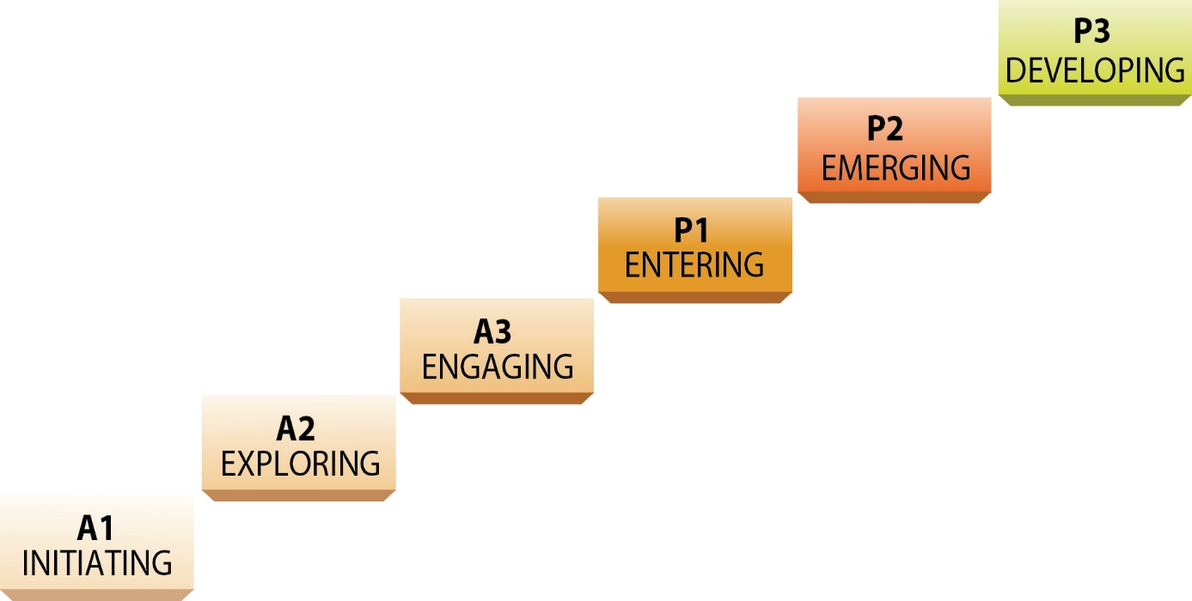
Alternate ACCESS Proficiency Levels

Slide 71
Administration Overview
Test Section |  | Number of Tasks | Range of Levels
Listening |  | 9 | A1-A3; P1- P2
Reading |  | 9 | A1-A3; P1- P2
Speaking | Part A | 8 | A1-A3; P1- P2
 | Part B
Writing | Part A | 10 | A1-A3; P1- P3
 | Part B
 | Part C
Notes:
Made up of four sections assessing four language domains. All sections are semi-adaptive
The Speaking Section is divided into two parts Part A and Part B. The Writing Section is divided into three parts: A, B and C.
3 cues in the listening and reading
3 opportunities for students to respond in the speaking section
Modeled tasks in the writing section

Slide 72
General Test Administration Procedures
Prior to administering test fill out Additional Student Information data form located in Student Response Booklet
Administer each section separately and in one session
All sections are semi-adaptive and must be administered unless indicated on the IEP
Semi-adaptive means that the administration of a test section is ended if the student scores No Response, Incorrect, or Approaches on 3 consecutive tasks
The administration of one domain section should not begin before finishing the administration of the previous section (one section at a time).
Notes:
Use professional judgment to determine if student is ready to take test. If the student is having a bad day please do not test the student. Please read page 64 and follow administration procedures.
Semi-adaptive means that the administration of a test session should be ended if the student scores No Response, Incorrect, or Approaches on three consecutive tasks.

Slide 73
Test Administration Overview
Listening
Reading
Speaking
Writing

Slide 74
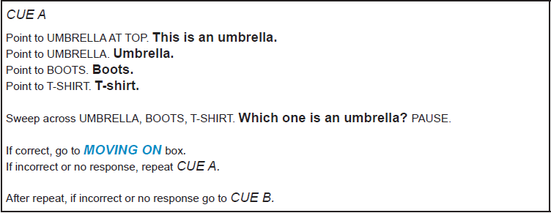
Sample Script
Read bold text aloud

Slide 75
Listening Test Overview
Format: 9 tasks that correspond to the AMPI levels A1-A3 and MPI levels 1 and 2
Every task contains 3 cues: CUE A, CUE B, and CUE C
Time: 20 minutes*
Scoring: Correct or Incorrect
Notes:
AMPI- Alternate Model Performance Indicator
MPI- Model Performance Indicator

Slide 76
Administration of Listening Tasks
Task
Cue A
Cue B
Cue C
Next Task
Next Task
Next Task
Notes:
Facilitation Note: Instruct participants to take out sample items or view from the Downloads and Products at https://www.wida.us/assessment/alternateaccess.aspx
Practice the script ahead of time. Repeat tasks as indicated in the TAM in order to facilitate student’s understanding
Find Cue A in the Listening Sample.
There are a total of nine tasks in the Listening Section.
This slide represents the step by step process you will take to administer a task.
You will always start by administering Cue A in the task.
From there, depending on the student’s response, it will determine what you do next.
If the answer is correct, move on to the next task.
If the answer is incorrect/no response, repeat Cue A one more time.
If after the repeat, the answer is correct, move on to the next task.
If after the repeat, the answer is incorrect/no response, go to Cue B.
In Cue B, if the answer is correct, move on to the next task.
If the answer is incorrect/no response, go to Cue C.
In Cue C, regardless of the answer (correct, incorrect, or no response) move on to the next task.
When marking the score sheet, whenever the student is correct (regardless of what cue you are on), you will immediately mark “correct” into the Student Score Sheet. Do not mark in incorrect/no response bubbles until the whole task has been given (after administering all three cues).
If after three consecutive incorrect/no response scores for three tasks, discontinue the Listening Test.

Slide 77
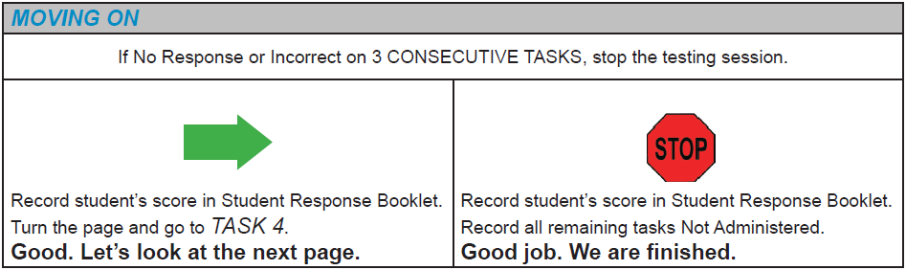
Administration
Follow Moving On box a

Slide 78

Ending the Listening Section
After administering test task 9
OR
The student responded incorrectly or did not provide a response for 3 consecutive tasks

Slide 79
Scoring
Test administrator scores each task after the completion of the entire task
Follow the scoring key in the Student Response Booklet
The Test Administration Manual gives specific guidelines for scoring the listening section

Slide 80
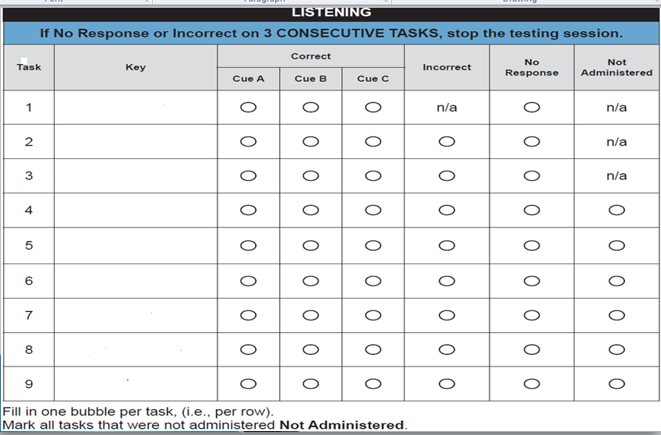
Listening Scoring Sheet

Slide 81
Test Administration Overview
Listening
Reading
Speaking
Writing

Slide 82
Reading Test Overview
Format: 9 tasks that correspond to the AMPI levels A1-A3 and MPI levels 1-2
Every task contains 3 cues- CUE A, CUE B, and CUE C
Time: 20 minutes*
Scoring: Correct or Incorrect
Notes:
Please refer to pages 72-76 in the TAM.
The ELL SWD needs to Demonstrate their reading comprehension in English
*Does not include distributing and collecting materials. Additional time may be given
Correct –
Incorrect – student has heard CUES A-B- and C read aloud and repeated and the student provides an answer that does not match the expectation
No response – No evidence of engagement (not pointing, not looking) or response is not in English even after student has heard CUES A-B- and C
Read aloud
Not administered – task was not administered for whatever reason

Slide 83
Administration of Reading Tasks
Task
Cue A
Cue B
Cue C
Next Task
Next Task
Next Task
Notes:
Follow the script and only read aloud the text that appears in bold in the script
Find Cue A in the Reading Sample.
There are a total of nine tasks in the Reading Section.
This slide represents the step by step process you will take to administer a task.
You will always start by administering Cue A in the task.
From there, depending on the student’s response, it will determine what you do next.
If the answer is correct, move on to the next task.
If the answer is incorrect/no response, repeat Cue A one more time.
If after the repeat, the answer is correct, move on to the next task.
If after the repeat, the answer is incorrect/no response, go to Cue B.
In Cue B, if the answer is correct, move on to the next task.
If the answer is incorrect/no response, go to Cue C.
In Cue C, regardless of the answer (correct, incorrect, or no response) move on to the next task.
When marking the score sheet, whenever the student is correct (regardless of what cue you are on), you will immediately mark “correct” into the Student Score Sheet. Do not mark in incorrect/no response bubbles until the whole task has been given (after administering all three cues).
If after three consecutive incorrect/no response scores for three tasks, discontinue the Reading Test.

Slide 84
Administration
Follow Moving On box a

Slide 85
Ending the Reading Section
After administering test task 9
OR
The student responded incorrectly or did not provide a response for 3 consecutive tasks

Slide 86
Scoring
Test administrator scores each task after the completion of the entire task
Follow the scoring key in the Student Response Booklet
The Test Administration Manual gives specific guidelines for scoring the reading section

Slide 87
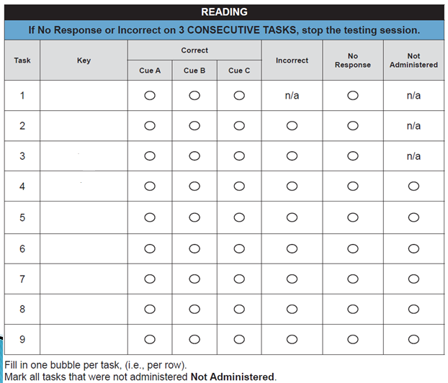
Reading Scoring Sheet
Notes:
Please note that for TASK 1: the student is required to “attend” or “acknowledge”. The TA should rate the student’s response as correct if there is evidence that the student is engaged in the task by paying attention. N/A means not ADMINISTERED
When marking the score sheet, whenever the student is correct (regardless of what cue you are on), you will immediately mark “correct” into the Student Score Sheet. Do not mark in incorrect/no response bubbles until the whole task has been given (after administering all three cues).

Slide 88
Test Administration Overview
Listening
Reading
Speaking
Writing

Slide 89
Speaking Test Overview
Format: Contains 2 Parts: Part A and Part B that correspond to the AMPI levels A1-A3 and MPI levels 1 and 2
  Within each Part there are a set of tasks
  Each task contains 3 questions: Question 1, Question 2, and Question 3
Time: 20 minutes*
Scoring: Meets or Approaches
Notes:
Please refer to pages 77-87
Read aloud any text that appears in bold type
Tasks begin with relatively easy tasks and progresses to more linguistically demanding tasks.
Additional time can be given as needed

Slide 90
Administration of Speaking Tasks
Task
Cue A
Cue B
Cue C
Next Task
Next Task
Next Task
Notes:
Facilitation Note: Instruct participants to take out sample items or view from the Downloads and Products at https://www.wida.us/assessment/alternateaccess.aspx
Find Question 1 in the Speaking Sample.
There are a total of eight tasks in the Speaking Section (split between Part A and Part B).
This slide represents the step by step process you will take to administer a task.
You will always start by administering Question 1 in the task.
From there, depending on the student’s response, it will determine what you do next.
If the answer is meets, move on to the next task.
If the answer is approaches/no response, repeat Question 1 one more time.
If after the repeat, the answer is meets, move on to the next task.
If after the repeat, the answer is approaches/no response, go to Question 2.
In Question 2, if the answer is meets, move on to the next task.
If the answer is approaches/no response, repeat Question 2 one more time.
If after the repeat, the answer is meets, move on to the next task.
If after the repeat, the answer is approaches/no response, go to Question 3.
In Question 3, if the answer is meets, move on to the next task.
If the answer is approaches/no response, repeat Question 3 one more time.
If after the repeat, regardless of the answer (meets, approaches, or no response) move on to the next task.
When marking the score sheet, whenever the student is meets (regardless of what question you are on), you will immediately mark ‘meets’ into the Student Score Sheet. Do not mark in approaches/no response bubbles until the whole task has been given (after administering all three questions).
If after three consecutive approaches/no response scores for three tasks, discontinue the Speaking Test.

Slide 91
Administration
Follow Moving On box a

Slide 92
Ending the Speaking Section
After administering test task 8
OR
The student received a score of Approaches or No Response in 3 consecutive tasks

Slide 93
Scoring
Test administrator scores each response and records the score in the SRB
The Test Administration Manual gives specific guidelines for scoring the speaking section
Use the Alternate ACCESS for ELLs Speaking Rubric and expect boxes to score student responses

Slide 94
Scoring of Speaking Section
Meets
Satisfies the requirements of the level in quantity and quality
Approaches
Clear evidence that the requirements of the task were not met
No Response
There was no response to the task
Not Administered
Task was not administered to the student
Student’s response needs to be related to the task
The performance was not ratable

Slide 95
Speaking Rubric
Notes:
In order to administer and score the SPEAKING section it is important to gain a thorough understanding of the Performance Definitions for each of the proficiency levels. Each task targets one specific level. Test administrator should internalize these task level expectations in order to score the Speaking section

Slide 96
Test Administration Overview
Listening
Reading
Speaking
Writing

Slide 97
Writing Test Overview
Format: Contains 3 Parts: Part A, Part B, and Part C that correspond to the AMPI levels A1-A3 and MPI levels 1, 2, and 3
  Within each part there are a set of tasks
  Tasks are modeled for students
Time: 20 minutes*
Scoring: Meets or Approaches

Slide 98
Writing Test Guidelines
Put the SRB in front of the student
Have pre-sharpened pencils
Assistive devices need to be available and ready to use if necessary

Slide 99
Administration of the Writing
Tasks: Parts A and B
Task 1
Task 2
Task 3
Task 4
Part A
Task 1
Task 2
Task 3
Task 4
Part B
Part C
The student must score “Meets” on at least seven out of eight tasks in Parts A and B to move on to Part C

Slide 100
Administration
Follow Moving On box a

Slide 101
Scoring
Test administrator scores each response and records the score in the SRB
The Test Administration Manual gives specific guidelines for scoring the reading section
No partial credit can be given on any writing tasks

Slide 102
Scoring of Writing Section
Meets
Student provides an answer that meets the expectations of the task provided in the Expect box
Approaches
Response does not meet the expectations of the task provided in the Expect box
No Response
Student does not produce any intentional marks (i.e. circle, trace, copy, etc.)
Not Administered
Task was not administered to the student

Slide 103
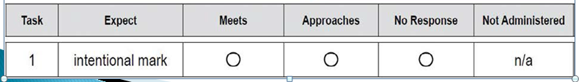
Scoring Sheet for Parts A and B
Scoring boxes are placed at the bottom left side of the Student Response booklet for each the corresponding Writing Task.
Notes:
When marking the score box, whenever the student is meets (regardless of what question you are on), you will immediately mark ‘meets’ into the score into the Scoring box. Do not mark in approaches/no response bubbles until the whole task has been given (after administering all three questions).

Slide 104
Administration of Writing Tasks for Part C
Part C
Task 9
Task 10
The student must score “Meets” on at least seven out of eight tasks in Parts A and B to move on to Part C.

Slide 105
Writing Rubric for Part C
Notes:
The tasks in Part C are aimed to elicit original or adapted text from the student. Task 9 asks the student to produce a word and Task 10 asks the student to write a sentence. As such, the tasks will be scored using the Alternate ACCESS for ELLs Writing Rubric.
If the response meets expectations at levels P1, P2, or P3, as described in the rubric, record the corresponding rating of 1, 2, or 3 under the “Meets” heading in the Student Response Booklet. For
example, if a student writes or produces an original or adapted phrase related to the task for Task 10, mark a rating of 2 under the “Meets” heading. For responses that are copied or not related to the task, assign a score of Approaches.

Slide 106
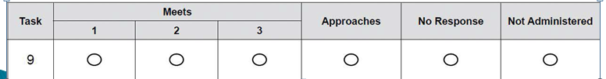
Scoring Sheet Part C
Scoring boxes are placed at the bottom left side of the Student Response booklet for each the corresponding Writing Task.

Slide 107
Ending the Writing Section
End the Writing test after administering the last task in Part C
OR
If student received a score of Approaches or No Response on 3 consecutive tasks
OR
After Part B if the student scored less than seven out of eight tasks with Meets

Slide 108
Questions
For further information, please contact:
Bilingual/ESOL ESE Program
(305)274-8889
Reagan Chalmers, Instructional Supervisor, reaganlyn@dadeschools.net
Sylvia Crespo, Bilingual Assessor, srcrespo@dadeschools.net
Malena Escobar-Matamoros, Bilingual Assessor, maescobar@dadeschools.net
Isabel Lopez-Trudelle, Bilingual Assessor, isabellopez@dadeschools.net
Debbie Sosa, Bilingual Assessor, debbiesosa@dadeschools.net
Raquel Fernandez, Bilingual Assessor, RFernandez3@dadeschools.net
Rosa Duarte, Bilingual Assessor, rduarte@dadeschools.net
WEB SITE: Division of Special Education; click on Programs; click on Bilingual
http://ese.dadeschools.net/ESOL_ESE/

