Slide 1
Spring 2015 Test Chairperson Training
Florida Standards Assessments (FSA)
English Language Arts (ELA) including Writing
Mathematics
End-of-Course (EOC)
Florida Comprehensive Test (FCAT 2.0)
Science

Slide 2
Overview
These training materials are based on the following Spring 2015 test administration manuals:
FSA English Language Arts (ELA) Writing Component
FSA Computer-Based (CBT) ELA Reading, Mathematics, and EOC Assessments
FCAT 2.0 Grades 5 & 8 Science
These training materials are designed to highlight important information regarding test administration policies and procedures.
All FSA support materials can be found at:
www.FSAssessments.org

Slide 3
FSA Guides
District and school personnel should read and have access to the following materials, which are available on the FSA Portal:
  The 2014–2015 FSA Paper-Based Materials Return Instructions, which provides guidance regarding the packaging and return of paper-based materials after testing.
  TIDE User Guide (for District and School Assessment Coordinators)
  Test Administrator User Guide (for School Assessment Coordinators, Test Administrators, and Technology Coordinators)
  ORS User Guide (District and School Assessment Coordinators) (coming soon)
  TIDE Online Training Module

Slide 4
FSA Training Modules
Test Administrator Certification Course Now Available
An online training course and additional information document are now available for test administrators who will be administering the Florida Standards Assessments. The course and the document are available on the TA Certification Course page in the FSA portal (http://www.fsassessments.org/ta-certification-course).
TIDE Online Training Module
Training Module for school and district assessment coordinator tasks completed in the Test Information Distribution Engine (TIDE).

Slide 5


Test Administration Manuals

Slide 6
Test Administration Manual—
Grades 3 & 4 PBT(Online Only)
  For the Spring 2015 administration of Grades 3 & 4 FSA ELA Reading and Mathematics, there is not a separate hardcopy test administration manual.
  Instead, test administrators must refer to the Grades 3 & 4 FSA TA Manual, which is available ONLY in the portal, for scripts for administering the paper-based Grades 3 & 4 FSA ELA Reading and Mathematics, as well as test administrator responsibilities before, during, and after testing. Test administrators must familiarize themselves with these instructions prior to testing.
  For test administration and security policies and procedures, test administrators should read the appropriate sections of the Spring 2015 FSA CBT Manual, including the General Information sections and the Test Security Statute and Rule in Appendix B.
Important

Slide 7
FSA Paper-Based
Materials Return Instructions
District and school personnel should refer to the 2014–2015 FSA Paper-Based Materials Return Instructions, available in the FSA Portal, for guidance regarding the packaging and return of FSA paper-based materials after testing. This information is not provided in the test administration manuals for the FSA assessments.
Important

Slide 8
Sample Test Materials/
Training Tests
Materials are developed by FDOE to assist teachers in preparing students for the statewide assessment programs.
Schools are encouraged to use sample test materials and training tests to familiarize students with the test format. Sample test materials can be accessed online at the FSA portal at http://www.fsassessments.org for FSA tests and at http://fcat.fldoe.org/fcat2/fcatitem.asp for the FCAT 2.0 tests.
Braille, Large Print, and One-Item-Per-Page sample materials/training tests will be provided for eligible students.
Teachers should instruct students that they can access the materials themselves at any time as they prepare for testing.

Slide 9
FSA Terms
American Institutes for Research (AIR): AIR is the assessment vendor for FSA assessments.
Data Recognition Corporation (DRC): DRC is the vendor responsible for processes associated with paper-based FSA materials, including printing, shipping, receiving, and scanning.
FSA Portal: Resources and information for district and school personnel are located in the FSA Portal, which is accessed at www.FSAssessments.org.
  The portal is organized by user roles and also includes links to the Test Delivery System (TDS), Test Information Distribution Engine (TIDE), and Online Reporting System (ORS).
Test Information Distribution Engine (TIDE): TIDE is the enrollment and user management system for the FSA assessments. Student enrollment and test eligibility information is managed via TIDE. All school personnel who will administer FSA assessments must have user accounts in TIDE.
Test Delivery System (TDS): All computer-based FSA assessments are administered via TDS, which includes the Test Administrator Interface as well as the Student Interface.

Slide 10
FSA Terms (cont.)
Secure Browser: The secure browser allows students to access the computer-based FSA assessments. This software must be installed on all computers or devices that will be used for student testing. A link to download the secure browser is located in the FSA Portal.
Online Reporting System (ORS): ORS allows school personnel to track the progress of student computer-based testing and access student results. ORS is accessed via the FSA Portal using the same username and password used to access other AIR systems.
Student Interface: Students use the Student Interface to log into and take computer-based FSA tests.
Test Administrator Interface: Test administrators use the Test Administrator Interface to create and monitor test sessions for all computer-based FSA assessments.
Session ID: Session IDs are unique codes generated by the Test Administrator Interface. In addition to their Username and First Name, students use the Session ID to log into computer-based FSA assessments. Test Administrators must record the Session ID as part of their required administration information.

Slide 11
FSA Terms (cont.)
Test Tickets: Test Tickets contain login information for students. Each student must have a test ticket to log into computer-based FSA assessments. Test tickets are generated in TIDE and contain the following fields: Username, Last Name, First Name (password), Grade, Date of Birth, Student ID Number, District and School.
District/School Labels: Schools will receive District/School Labels, which must be applied to hand-gridded test and answer books. If a document is hand-gridded and an On- Demand PreID Label cannot be printed, then a District/School Label must be applied to ensure the student’s results are reported to the correct district and school.
DO NOT PROCESS Labels: Schools will receive DO NOT PROCESS Labels, which must be applied to any USED NOT TO BE SCORED test and answer books that should NOT be scanned or counted for participation. The DO NOT PROCESS Label should be applied in the same location as the PreID or District/School Label and should cover the label currently on the test and answer book.
On-Demand PreID Labels: On-Demand PreID Labels may be printed locally for any students who were not included in the original PreID upload for this administration or for students who transferred to a school after the PreID upload.
School Box Range Sheet: This sheet identifies the total number of boxes shipped to the school.
New

Slide 12
Summary of Testing Schedule
Daily Schedule | March 2015 |  |  |  |  |  |  |  |  |  |  |  |  |  |  |  |  |  | April 2015 |  |  |  |  |  |  |  |  |  |  |  |  |  |  |  |  |  |  |  |  |  | May 2015
Grades | Monday, March 02, 2015 | Tuesday, March 03, 2015 | Wednesday, March 04, 2015 | Thursday, March 05, 2015 | Friday, March 06, 2015 | Monday, March 09, 2015 | Tuesday, March 10, 2015 | Wednesday, March 11, 2015 | Thursday, March 12, 2015 | Friday, March 13, 2015 | Monday, March 16, 2015 | Tuesday, March 17, 2015 | Wednesday, March 18, 2015 | Thursday, March 19, 2015 | Friday, March 20, 2015 | Spring Break March 23 - 27, 2015 | Monday, March 30, 2015 | Tuesday, March 31, 2015 | Wednesday, April 01, 2015 | Thursday, April 02, 2015 | Friday, April 03, 2015 | Monday, April 06, 2015 | Tuesday, April 07, 2015 | Wednesday, April 08, 2015 | Thursday, April 09, 2015 | Friday, April 10, 2015 | Monday, April 13, 2015 | Tuesday, April 14, 2015 | Wednesday, April 15, 2015 | Thursday, April 16, 2015 | Friday, April 17, 2015 | Monday, April 20, 2015 | Tuesday, April 21, 2015 | Wednesday, April 22, 2015 | Thursday, April 23, 2015 | Friday, April 24, 2015 | Monday, April 27, 2015 | Tuesday, April 28, 2015 | Wednesday, April 29, 2015 | Thursday, April 30, 2015 | Friday, May 01, 2015 | Monday, May 04, 2015 | Tuesday, May 05, 2015 | Wednesday, May 06, 2015 | Thursday, May 07, 2015 | Friday, May 08, 2015 | Monday, May 11, 2015 | Tuesday, May 12, 2015 | Wednesday, May 13, 2015 | Thursday, May 14, 2015 | Friday, May 15, 2015 | Monday, May 18, 2015 | Tuesday, May 19, 2015 | Wednesday, May 20, 2015 | Thursday, May 21, 2015 | Friday, May 22, 2015
K SAT-10 |  |  |  |  |  |  |  |  |  |  |  |  |  |  | Teacher Planning Day | Spring Break |  |  |  |  | Teacher Planning Day |  |  |  |  |  | SAT-10 Reading 1 Session Approx. 30 minutes | SAT--10 Mathematics 1 Session Approx. 30 minutes | Make up | Make up | Make up
1-2 SAT-10 |  |  |  |  |  |  |  |  |  |  |  |  |  |  | Teacher Planning Day | Spring Break |  |  |  |  | Teacher Planning Day |  |  |  |  |  | SAT-10 Reading 1 Session Approx. 40 minutes | SAT--10 Mathematics 1 Session Approx. 40 minutes | Make up | Make up | Make up
4-7 FSA ELA Writing | FSA ELA/Writing PBT 90 minutes (+30 if needed) | Make up | Make up | Make up | Make up | Make up (FSA ELA/ Writing) | Make up | Make up | Make up | Make up |  |  |  |  | Teacher Planning Day | Spring Break |  |  |  |  | Teacher Planning Day | FSA ELA/Writing Make up | Make up | Make up | Make up |  |  |  |  |  |  |  |  |  |  |  |  |  |  |  |  | FSA ELA/Writing Make up | Make up | Make up | Make up | Make up
8-11 FSA ELA Writing | FSA ELA/Writing CBT 90 minutes (+30 if needed) | =====> | =====> | =====> | =====> | ELA/Writing CBT==> | =====> | =====> | =====> | =====> |  |  |  |  | Teacher Planning Day | Spring Break |  |  |  |  | Teacher Planning Day | FSA ELA/Writing Make up | Make up | Make up | Make up |  |  |  |  |  |  |  |  |  |  |  |  |  |  |  |  | FSA ELA/Writing Make up | Make up | Make up | Make up | Make up
3-4 FSA ELA and Math |  |  |  |  |  |  |  |  |  |  | FSA ELA PBT Session 1 80 minutes | FSA ELA PBT Session 2 80 minutes | Make-up | Make-up | Teacher Planning Day | Spring Break | Make-up (FSA ELA) | Make-up (FSA ELA) | FSA Mathematics PBT Session 1 80 minutes | FSA Mathematics PBT Session 1 80 minutes | Teacher Planning Day | FSA ELA and Math Make-up | Make up | Make up | Make up | Make up
5 FCAT 2.0 Science |  |  |  |  |  |  |  |  |  |  |  |  |  |  | Teacher Planning Day | Spring Break |  |  |  |  | Teacher Planning Day |  |  |  |  |  | FCAT 2.0 Science PBT Session 1 80 minutes | FCAT 2.0 Science PBT Session 2 80 min | Make up | Make up | Make up | Make up (FCAT 2.0 Science) | Make up | Make up | Make up | Make up
8 FCAT 2.0 Science |  |  |  |  |  |  |  |  |  |  |  |  |  |  | Teacher Planning Day | Spring Break |  |  |  |  | Teacher Planning Day |  |  |  |  |  | FCAT 2.0 Science PBT Sessions 1 and 2 80 minutes each | Make up | Make up | Make up | Make up | Make up (FCAT 2.0 Science) | Make up | Make up | Make up | Make up
5 FSA ELA |  |  |  |  |  |  |  |  |  |  |  |  |  |  | Teacher Planning Day | Spring Break |  |  |  |  | Teacher Planning Day |  |  |  |  |  | FSA ELA CBT 2 Sessions over 2 days 80 minutes each | =======> | =======> | =======> | =======> | FSA ELA CBT ====> | =======> | =======> | =======> | =======> | FSA ELA CBT ====> | =======> | =======> | =======> | =======> | FSA ELA CBT ====> | =======> | =======> | =======> | =======>
6-8 FSA ELA |  |  |  |  |  |  |  |  |  |  |  |  |  |  | Teacher Planning Day | Spring Break |  |  |  |  | Teacher Planning Day |  |  |  |  |  | FSA ELA CBT 2 Sessions over 2 days 85 minutes each | =======> | =======> | =======> | =======> | FSA ELA CBT ====> | =======> | =======> | =======> | =======> | FSA ELA CBT ====> | =======> | =======> | =======> | =======> | FSA ELA CBT ====> | =======> | =======> | =======> | =======>
9-11 FSA ELA |  |  |  |  |  |  |  |  |  |  |  |  |  |  | Teacher Planning Day | Spring Break |  |  |  |  | Teacher Planning Day |  |  |  |  |  | FSA ELA CBT 2 Sessions over 2 days 90 minutes each | =======> | =======> | =======> | =======> | FSA ELA CBT ====> | =======> | =======> | =======> | =======> | FSA ELA CBT ====> | =======> | =======> | =======> | =======> | FSA ELA CBT ====> | =======> | =======> | =======> | =======>
5 FSA Math |  |  |  |  |  |  |  |  |  |  |  |  |  |  | Teacher Planning Day | Spring Break |  |  |  |  | Teacher Planning Day |  |  |  |  |  | FSA Mathematics CBT 2 Sessions over 2 days 80 minutes each | =======> | =======> | =======> | =======> | FSA Math CBT ====> | =======> | =======> | =======> | =======> | FSA Math CBT ====> | =======> | =======> | =======> | =======> | FSA Math CBT ====> | =======> | =======> | =======> | =======>
6-8 FSA Math |  |  |  |  |  |  |  |  |  |  |  |  |  |  | Teacher Planning Day | Spring Break |  |  |  |  | Teacher Planning Day |  |  |  |  |  | FSA Mathematics CBT 3 Sessions over 2 days 60 minutes each | =======> | =======> | =======> | =======> | FSA Math CBT ====> | =======> | =======> | =======> | =======> | FSA Math CBT ====> | =======> | =======> | =======> | =======> | FSA Math CBT ====> | =======> | =======> | =======> | =======>
6-12, Enrolled Students FSA EOCs |  |  |  |  |  |  |  |  |  |  |  |  |  |  | Teacher Planning Day | Spring Break |  |  |  |  | Teacher Planning Day |  |  |  |  |  |  |  |  |  |  | FSA EOCs Algebra 1, Geometry, and Algebra 2 2 Sessions over 2 days 90 minutes each | =======> | =======> | =======> | =======> | FSA EOCs =======> | =======> | =======> | =======> | =======> | FSA EOCs =======> | =======> | =======> | =======> | =======> | FSA EOCs =======> | =======> | =======> | =======> | =======>
6-12, Enrolled Students NGSSS EOCs |  |  |  |  |  |  |  |  |  |  |  |  |  |  | Teacher Planning Day | Spring Break |  |  |  |  | Teacher Planning Day |  |  |  |  |  |  |  |  |  |  | NGSSS EOCs Biology1, Civics, US History 1 Session 160 minutes | =======> | =======> | =======> | =======> | NGSSS EOCs =======> | =======> | =======> | =======> | =======> | NGSSS EOCs =======> | =======> | =======> | =======> | =======> | NGSSS EOCs =======> | =======> | =======> | =======> | =======> | NGSSS EOCs =======> | =======> | =======> | =======> | =======>
FCAT2.0 Reading Retake |  |  |  |  |  |  |  |  |  |  | FCAT 2.0 Reading Retake 2 Sessions 1/2 school day each | =====> | =====> | =====> | Teacher Planning Day | Spring Break | FCAT 2.0 Reading Retake | =====> | =====> | =====> | Teacher Planning Day
FCAT/FCAT2.0 Retake |  |  |  |  |  |  |  |  |  |  | FCAT Mathematics Retake 1 Session 1 school day | =====> | =====> | =====> | Teacher Planning Day | Spring Break | FCAT Math Retake | =====> | =====> | =====> | Teacher Planning Day
NGSSS Algebra 1 Retake |  |  |  |  |  |  |  |  |  |  | NGSSS Algebra 1 Retake 1 Session 160 minutes | =====> | =====> | =====> | Teacher Planning Day | Spring Break | NGSSS Algebra 1 Retake | =====> | =====> | =====> | Teacher Planning Day
Provided in Weekly Briefing 17018
Includes testing windows, number of sessions, and time limits.

Slide 13
FSA ELA Writing: Test Administration Schedule
Dates | Florida Standards Assessment | Grade Level | Mode | Session Length
March 2, 2015 | FSA ELA Writing Component | 4-7* | Paper | 90 minutes + 30 minutes
March 2–13, 2015 |  | 8-10 11? | Computer | 90 minutes + 30 minutes
For FSA ELA Writing Grades 4-7 paper-based assessments , all schools in the district must administer the test on March 2nd, as scheduled; with later makeup sessions as needed.
Make-up testing can be scheduled through March 13, 2015.
The FSA ELA Writing Component Test is administered in one 90-minute test session; however, any students who have not completed testing at the end of 90 minutes may have an additional 30 minutes to complete the test session.
Any deviation from this schedule requires written approval from FDOE.

Slide 14
FSA ELA Writing: Test (Make-up) Administration Schedule
“Make-up” Testing Window
Dates | Florida Standards Assessment | Grade Level | Mode | Session Length
April 6 – 9, 2015* | FSA ELA Writing Component | 4-7* | Paper | 90 minutes + 30 minutes
May 4 – 8, 2015** |  | 8-10 11? | Computer | 90 minutes + 30 minutes
*Students who complete the Writing Component during this make-up window will be included in regular reporting. **Students who complete the Writing Component during this make-up window will be included in late reporting.
The FSA ELA Writing Component Test is administered in one 90-minute test session; however, any students who have not completed testing at the end of 90 minutes may have an additional 30 minutes to complete the test session.
Any deviation from this schedule requires written approval from FDOE.

Slide 15
FSA Grades 3 & 4
Test Administration Schedule
FSA Grades 3 & 4 Dates | Subject | Session Length
March 16 and 17, 2015 | ELA | 80 min. per session; One session, per day
April 1 and 2, 2015 | Mathematics | 80 min. per session; One session, per day
Make-up testing may be scheduled until April 10, 2015.
All FSA Grades 3 and 4 assessments are paper-based , all schools in the district must adhere to the same daily test administration schedule.
Note: Any deviation from the approved schedule requires written approval from FDOE.

Slide 16
FSA Grades 5 – 10 & 11 ? and EOCs Test Administration Schedule
Dates | Florida Standards Assessments (FSA) | Grade Level
April 13 – May 8, 2015 | FSA ELA Reading CBT | 5-10 11?
April 13 – May 8, 2015 | FSA Mathematics CBT | 5-8
April 20 – May 15, 2015 | FSA Algebra 1, Geometry, & Algebra 2 EOC Assessments | Enrolled students
These are all computer-based assessments. Note: PBT accommodations must be completed within the first two weeks of each CBT window. Any deviation from the approved schedule requires written approval from FDOE.

Slide 17
FCAT 2.0 Science
Test Administration Schedule
FCAT 2.0 Science Dates | Grade Level | Sessions Length
April 13 and 14, 2015 | 5 | 80 min. per session; One session, per day
April 13, 2015 | 8 | 80 min. per session; Two sessions in one day
Make-up testing may be scheduled until April 24, 2015.
Grade 5 and 8 FCAT 2.0 Science assessments are paper-based, all schools in the district should adhere to the same daily test administration schedule.
Note: Any deviation from the approved schedule requires written approval from FDOE.

Slide 18
Mode for Testing
Grade Level | FSA ELA/Writing | FSA ELA | FSA Mathematics | FCAT 2.0 Science
3 | --- | Paper | Paper | ---
4 | Paper | Paper | Paper | ---
5 | Paper | Computer | Computer | Paper
6 | Paper | Computer | Computer | ---
7 | Paper | Computer | Computer | ---
8 | Computer | Computer | Computer | Paper
9 | Computer | Computer | All EOCs Computer
10 | Computer | Computer
11 ? | Computer | Computer

Slide 19
FSA Session Lengths
Session Lengths by Grade Level and Subject
FSA ELA Reading Component
All FSA ELA Reading Component assessments are administered in two sessions over two days.
Grade | Session Length | Number of Sessions
3 | 80 minutes | 2
4 | 80 minutes | 2
5 | 80 minutes | 2
6 | 85 minutes | 2
7 | 85 minutes | 2
8 | 85 minutes | 2
9 | 90 minutes | 2
10 | 90 minutes | 2
11 ? | 90 minutes | 2

Slide 20
FSA Session Lengths (cont.)
Session Lengths by Grade Level and Subject
FSA Mathematics
All FSA Mathematics assessments are administered over two days.
For Grades 6–8, the three sessions may be administered as determined school by school: Sessions 1 and 2 on Day 1 and Session 3 on Day 2, OR Session 1 on Day 1 and Sessions 2 and 3 on Day 2.
Please note that Grades 7 and 8 students can only access a scientific calculator during Sessions 2 and 3 of the Math test.
Grade | Session Length | Number of Sessions
3 | 80 minutes | 2
4 | 80 minutes | 2
5 | 80 minutes | 2
6 | 60 minutes | 3
7 | 60 minutes | 3
8 | 60 minutes | 3

Slide 21
FSA Session Lengths (cont.)
Session Lengths by Grade Level and Subject
FSA EOC Assessments
All FSA EOC assessments are administered in two sessions over two days. Any student who has not completed the session by the end of the allotted time may continue working; however, each session may last no longer than half the length of a typical school day.
Please note that students can only access a scientific calculator during Session 2 of the EOC test.
Subject | Session Length | Number of Sessions
Algebra 1 | 90 minutes | 2
Geometry | 90 minutes | 2
Algebra 2 | 90 minutes | 2

Slide 22



Throughout this presentation, you will notice a small box in the upper right corner of the header that looks like one of the following:
These boxes indicate whether the information on that slide pertains to paper-based tests (PBT), computer-based tests (CBT), or both (CBT PBT).

Slide 23
Students to Be Tested:
FSA and FCAT 2.0
CBT
PBT
All students enrolled in tested grade levels/subject participate in the Spring 2015 FSA and FCAT 2.0 administrations with or without accommodations, per Section 1008.22(3)(a), Florida Statutes.
English Language Learners (ELLs)
All ELLs are expected to participate in statewide assessments.
Students With Disabilities
Students with disabilities who participate in the standardized testing program with or without accommodations are expected to participate

Slide 24
Students to Be Tested:
Special Programs
CBT
PBT
Make arrangements to test special program students.
Special Programs |  | District Number | School Number
FLVS | Full-Time K-8 | 71 | 0300
 | Full-Time 9-12 | 71 | 0400
 | FL Virtual Academy | 50 | 7079
Miami-Dade Online Academy |  | 13 | 7001
Florida Home Education |  | 13 | 9998
McKay Scholarship |  | 13 | 3518
Florida Tax Credit Scholarship |  | 97 | 9999
Hospital/Homebound* (Brucie Ball Educational Center) |  | 13 | 9732
*District program not in the Test Administration Manual.

Slide 25
What To Do –
Temporary Section 504
CBT
PBT
When a student sustains an impairment / injury during a statewide test window, they may be eligible for Section 504
  You may consider scheduling the test on an available make-up day, if possible, to provide more time to collect written medical documentation from the parent and schedule a 504 Eligibility Meeting
Contact the Regional Special Education Staffing Specialist for assistance and directions on proceeding with a Section 504 Eligibility Meeting / Plan
Send / provide a Notification of Meeting to the parent
Only a designated LEA may facilitate a Section 504 Meeting

Slide 26
SPED Office Contacts
CBT
PBT
  NORTH
  North Central (786) 413-3001
  Alfreida Robinson
    Instructional Supervisor
  Elena Hernandez
    Lead Staffing Specialist
  North (305) 827-3025
  Kate Cadieux
    Instructional Supervisor
  Cindy O’Donnell
    Lead Staffing Specialist
  SOUTH
  South Central (786) 268-4757
  Kathy Maguire
    Instructional Supervisor
  Lourdes Alonso
    Lead Staffing Specialist
South (305) 242-8432
  Helene Chait
    Instructional Supervisor
  Maria McMann Sifre
    Lead Staffing Specialist

Slide 27
Appendix A:
Accommodations
CBT
PBT
Appendix A provides specific information and instructions regarding the following:
Accommodations for Students with Disabilities
Unique Accommodations
Accommodations for ELLs
Large Print Test Administrator Instructions
Braille Test Administrator Instructions
One-Item-Per-Page Test Administrator Instructions
School personnel responsible for administering tests to students with accommodations must familiarize themselves with all relevant information in Appendix A before testing.

Slide 28
Accommodations
CBT
PBT
General Information about Accommodations
For eligible students participating in the computer-based statewide assessment programs, the following accommodations are available:
Accommodated Computer-Based Forms
Masking ▪ Masking + Text-to-speech
Text-to-speech
Reading Passage Booklets
Regular print reading passage booklets
Large print reading passage booklets
Writing Passage Booklets
Regular print Writing Passage Booklets
Large print Writing Passage Booklets
Paper-Based Test Materials
Regular print ▪ Uncontracted braille
Large print ▪ One-item-per-page
Contracted braille

Slide 29
Accommodations (cont.)
CBT
PBT
English Language Learners (ELLs)
ESOL Levels 1- 4 Only
  Students who are currently receiving services in a program operated in accordance with an approved district LEP plan:
        Flexible Setting
        Flexible Scheduling
        Assistance in Heritage Language
        Approved Dictionary

Slide 30
Test Materials: FSA ELA Writing
CBT
PBT
Test and Answer Books
Grades 4–7 students and Grades 8–10 & 11 ? students with regular print paper-based accommodations receive FSA ELA Writing Component Test and Answer Books.
Writing Planning Sheets
ALL Grades 4–10 & 11 ? students receive Writing Planning Sheets that they may use to take notes and plan their responses. The planning sheet is a one-page, letter-sized sheet. The front of the sheet is lined. The Testing Rules Acknowledgment is printed on the back of the sheet.

Slide 31
Test Materials: FSA ELA
Writing (cont.)
CBT
Writing Passage Booklets
Regular print and large print Writing Passage Booklets are provided for eligible students taking the computer-based FSA ELA Writing Component Test who have accommodations requiring their use as indicated in their IEPs or Section 504 plans. The booklets contain passages but do not contain the writing prompt. Students may write in the booklets but will respond to the writing prompt on the computer or device they are using to take the assessment.
Writing Passage Booklets are secure materials and must be stored in a secure location before and after testing.

Slide 32
Test Materials: Grades 3 & 4
FSA ELA and Math
PBT
Grades 3 and 4 students participating in the Spring 2015 FSA ELA Reading and Mathematics administrations will receive the following test materials:
Grade 3 ELA Reading Test and Answer Book
Grade 3 Mathematics Test and Answer Book
Grade 4 ELA Reading Test and Answer Book
Grade 4 Mathematics Test and Answer Book
Directions for Completing the Grades 3 & 4 FSA ELA Reading Items
Directions for Completing the Grades 3 & 4 FSA Mathematics Items
Students taking Grades 3 and 4 Mathematics are NOT provided with standalone references sheets, calculators, or rulers for this test administration.
Students taking paper-based tests are not provided with CBT Worksheets, Work Folders, or scratch paper of any kind.

Slide 33
Test Materials:
FCAT 2.0 Science
PBT
Grades 5 and 8 students participating in the Spring 2015 FCAT 2.0 Science administrations will receive the following test materials:
Grade 5 FCAT 2.0 Science NGSSS Test Books
Grade 5 FCAT 2.0 Science NGSSS Answer Books
Grade 8 FCAT 2.0 Science NGSSS Test Books
Grade 8 FCAT 2.0 Science NGSSS Answer Books
Periodic Tables of the Elements (Grade 8 Only)
Calculators (Four-Function) (Grade 8 only)

Slide 34
Test Materials: FSA CBT
(ELA, Mathematics, and EOC)
CBT
Students participating in the computer-based Grades 5–10 & 11? FSA ELA Reading Component, Grades 5–8 FSA Mathematics, and FSA EOC assessments will receive the following materials as applicable:
CBT Worksheets (ELA Reading Component only)
Florida Computer-Based Testing Work Folders (Mathematics and EOCs only)
Reading Passage Booklets Regular Print and Large Print (ELA Reading Component with eligible accommodation only)
Reading Passage Booklets are secure materials and must be stored in a secure location before and after testing.
Paper-based accommodated test materials will be provided for students who require them.

Slide 35
Test Materials: FSA Math and FSA EOCs
CBT
Scientific Calculators
Grades 7 and 8 FSA Mathematics, and Algebra 1, Geometry, and Algebra 2 EOC assessments include a scientific calculator in the test delivery system. The scientific calculator is available for:
  Session 2 and 3 of the Grades 7 and 8 Mathematics
  Session 2 of the Algebra 1, Geometry, and Algebra 2 EOCs.
Handheld scientific calculators MAY be provided to ALL students during the appropriate test sessions. FDOE is not providing a list of approved handheld calculators; instead, a list of required and prohibited functionalities is available in the FSA Portal.
Providing a calculator in the incorrect test session or with prohibited functionalities is cause for test invalidation.

Slide 36
Test Materials: FSA ELA
CBT
Headphones/Earbuds
Grades 5–10 & 11? MUST have headphones or earbuds for the CBT ELA Reading Component assessment.
FDOE does not provide headphones or earbuds. Students may use their own. These should be checked to ensure they work with the computer or device the students will use for the assessment prior to the first day of testing.
A sound check is built in to the assessment, and students are asked to verify that headphones and earbuds are working prior to entering the test.

Slide 37
Test Materials: FCAT 2.0 Science
PBT
Four-function Calculators
Each district should have an adequate supply of four-function calculators provided by FDOE.
  Calculators must be provided for the Grade 8 Science test.
  Calculators may not be used by students on the Grade 5 Science test.
Districts are responsible for establishing policies for the storage, use, and retention of calculators.
Students with visual impairments may use the approved large key/large display calculators or approved talking calculators supplied by FDOE.
No other calculators may be used.

Slide 38
Test Materials: FCAT 2.0 Science
PBT
Periodic Tables of the Elements
Periodic Tables of the Elements are provided to students for Grade 8 Science.
Periodic tables are stand-alone pages and are shipped with test materials.
Test administrators will distribute periodic tables on the day of the test, according to the directions in the scripts. Students may refer to them at any time during both sessions of the test.
After students complete the test, the test administrator should collect all periodic tables.
Used periodic tables are secure materials and must not be reused.

Slide 39
PreID Files for FSA
CBT
PBT
Wave 1 PreID file is based on student information on December 12 for FSA W/R/M , and on January 16 for FSA EOC.
  PreID label and initial test material shipment will generated based on Wave 1 only.
Wave 2 PreID file is based on student information on February 6 for FSA W/R/M, and on February 27 for FSA EOC .
  Print On-Demand PreID labels for students captured in Wave 2 if taking paper-based test.
  New students after Wave 2 must be entered manually into TIDE to participate in both CBT and PBT administrations.
  District orders will be placed for schools that have eligible students with PBT accommodations added to their IEP or Section 504 plan between December 12 and February 6.
    TDC staff will try to include these materials with the initial shipment delivery.
  Important Note: Eligible students that have PBT accommodations added to their IEP or Section 504 plan after Wave 2 will NOT have these materials ordered.
    Please contact Mara Ugando via email at mugando@dadeschools.net to order these additional materials.

Slide 40
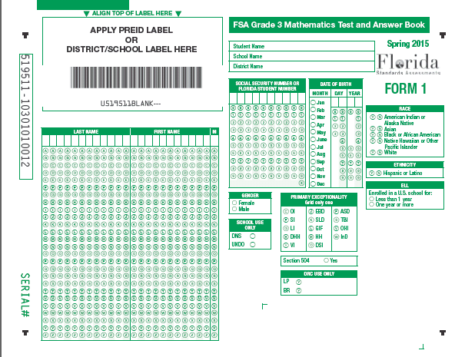
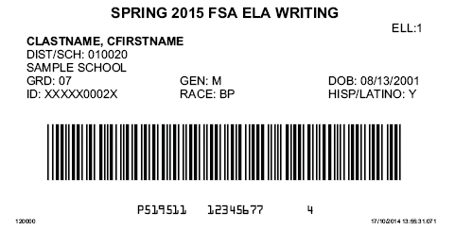
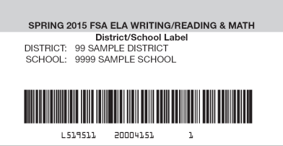

FSA: Labels
PBT
Labels must be applied to all USED test and answer books
  PreID Label
  District/School Label
  Do Not Process Label

Slide 41
FSA: Preidentified Student Labels
PBT
The preidentification information provided by districts is used to print PreID Labels and rosters. If the district supplied class code information, the labels are sorted by class code; otherwise, they are sorted alphabetically by grade level. School staff may verify and apply labels and/or complete grid sheets no sooner than five (5) days prior to testing.
On-Demand PreID Labels
Schools will receive blank labels to create On-Demand PreID Labels in TIDE for students who need them. Additional blank labels may be ordered from TDC, if needed.

Slide 42
FSA: Preidentified Student Labels (cont.)
PBT
Affix PreID Labels
Please adhere to the following policies when preparing student materials:
Affix labels in the box on the student grid sheet that appears below the statement, “ALIGN TOP OF LABEL HERE.” Please note that this box contains a barcode used for scanning unused documents, which will be covered by the PreID Label on TO BE SCORED documents.
Only the school assessment coordinator and other certified school personnel may open the shrink-wrapped packages and affix labels. Sealed test and answer books must not be opened. Do not use student labels from previous administrations.
Students and non-certified school personnel are not permitted to assist in preparing secure materials before testing or in organizing and returning materials after testing.
The Test Materials Chain of Custody Form must be maintained at all times.
All secure materials must be returned to locked storage and remain there until testing.

Slide 43
FSA: Preidentified Student Labels (cont.)
PBT
District/School Labels
Student grid sheets do not include fields for entering district and school numbers. If a document is hand-gridded and an On-Demand PreID Label cannot be printed, then a District/School Label must be applied to ensure the student’s results are reported to the correct district and school. However, PreID Labels or On-Demand PreID Labels should be used whenever possible.
Schools will receive District/School Labels with their test materials. Each District/School Label includes a barcode identifying the district, school, and administration.
The District/School Label should be applied to hand-gridded student grid sheets in the box directly below the test “APPLY PREID LABEL OR DISTRICT/SCHOOL LABEL HERE.”
District/School Labels for the Spring 2015 FSA ELA Reading, Mathematics, and EOC test administrations may not be used for other FSA test administrations.

Slide 44
FSA: Preidentified Student Labels (cont.)
PBT
DO NOT PROCESS Labels
Schools will receive DO NOT PROCESS Labels.
Only apply to any USED NOT TO BE SCORED test and answer book that should NOT be scanned or counted for participation (i.e., responses were transcribed into another test and answer book).
Apply in the same location as the PreID or District/School Label and should cover the label currently on the test and answer book.
Test and answer books with DO NOT PROCESS Labels should be returned with other NOT TO BE SCORED materials.
Do not apply to unused or blank NOT TO BE SCORED materials.

Slide 45
FSA: Preidentified Student Labels
PBT Test Materials
PBT
PBT administrations and PBT accommodations
Wave 1 PreID file is based on student information for FSA W/R/M as of December 12 and for FSA EOC as of January 16.
Note: PreID student labels and roster will be based on Wave 1.
The PreID roster should be verified against the school’s student information database.
  Verify that students with PreID labels are still enrolled and will be tested.
ONE element MUST be correct on a student PreID label:
  Student Florida ID number
Destroy labels in a secure manner if the FL ID # is incorrect. Create a new record in TIDE for the student and print an On-Demand PreID label.
If any other preidentified information (e.g., date of birth) is incorrect, use the label and update the student record in TIDE.

Slide 46
FCAT 2.0 Science: Preidentified Student Labels
PBT
FCAT 2.0 Science Wave 2 PreID file is based on student information as of February 27.
Note: PreID student labels and roster will be based on Wave 2.
Before applying PreID labels to student answer documents:
Verify that the student is still enrolled and will be tested.
Verify the information on the PreID roster against the school’s student information database.
FIVE elements MUST be correct on a student PreID label:
Student name
Student ID number
District number
School number
Grade level
Destroy labels in a secure manner if ANY of this information is incorrect.
If any other preidentified information (e.g., date of birth) is incorrect, use the PreID student label.

Slide 47
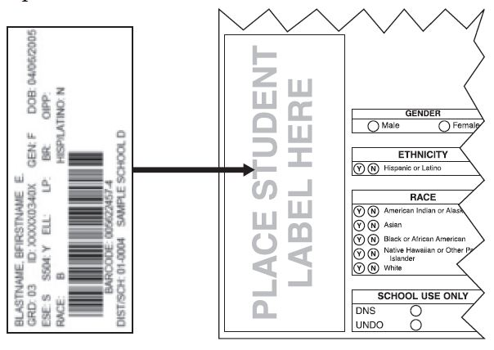
FCAT 2.0 Science: Preidentified Student Labels (cont.)
PBT
Affix the label in the box in the lower left corner of the student grid sheet.
Do not remove labels once they have been affixed.
Do not place a label over another label.

Slide 48
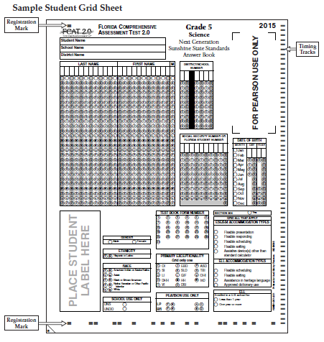
Student Demographic Information
PBT
FCAT 2.0 Science
The student grid sheet captures student demographic information.
A document is preidentified if it has a student label affixed.
Blank student grid sheets (non-preidentified) must be gridded using a No. 2 pencil.
For more information about specific demographic fields, see pages 4-8 of the Spring 2015 FCAT 2.0 Science Manual.

Slide 49

State and District
Requirements
CBT
PBT
Standards, Guidelines, and Procedures for Test Administration and Test Security available at http://oada.dadeschools.net/TestChairInfo/InfoForTestChair.asp
  Adopted by School Board
  General Guidelines
Florida Test Security Statute and Rule
School Procedural Checklist (FM-6927)
A screencast training on Test Security to use during your school-level training session may be accessed at http://oada.dadeschools.net/Screencasts/TestSecurity/TestSecurity.html

Slide 50
Test Security
Policies and Procedures
CBT
PBT
Per Test Security Statute, s. 1008.24, F.S., and Florida State Board Rule, 6A-10.042, Florida Administrative Code (FAC), inappropriate actions by school or district personnel can result in student or classroom invalidations, loss of teaching certification, and/or involvement of law enforcement.
Examples of prohibited activities include the following:
Reading or viewing the passages or test items before, during, or after testing
Revealing the passages or test items
Copying the passages or test items
Explaining the passages or test items for students
Changing or otherwise interfering with student responses to test items
Copying or reading student responses
Causing achievement of schools to be inaccurately measured or reported

Slide 51
Test Security
Policies and Procedures (cont.)
CBT
PBT
Only the school assessment coordinator and other certified school personnel designated by the site/building administrator may open the shrink-wrapped packages and affix labels. Secure books must not be opened.
Under no circumstances are students permitted to assist in preparing secure materials before testing or in organizing and returning materials after testing.
After ANY administration, initial or make-up, secure materials (e.g., passage booklets, test tickets, used worksheets, used work folders) must be returned immediately to the school assessment coordinator and placed in locked storage. The Test Materials Chain of Custody Form must be maintained at all times.
No more than three people should have access to the locked storage room. Test and answer books, test tickets, passage booklets, and used planning sheets must never be left unsecured and must not remain in classrooms or be taken off the school’s campus overnight. Secure materials should never be destroyed (e.g., shredded, thrown in the trash), except for soiled documents, as described in the “Hazardous Materials” section of the manual.
Any monitoring software that would allow test content on student workstations to be viewed or recorded on another computer during testing must be turned off.

Slide 52
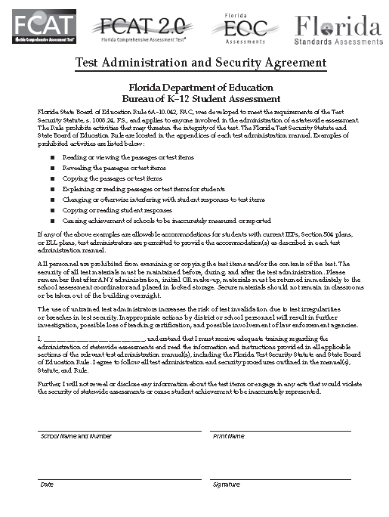
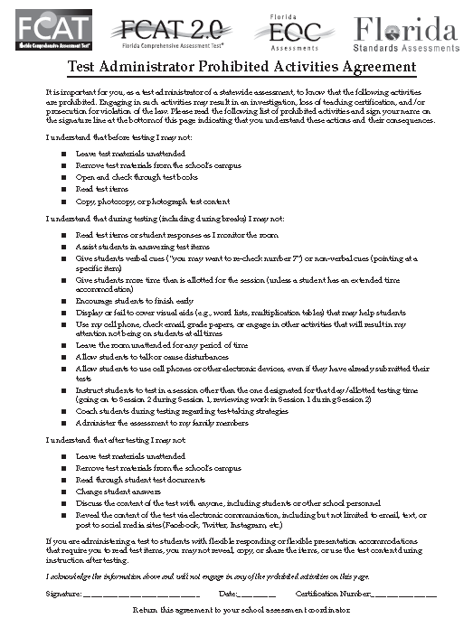
Test Security
Policies and Procedures (cont.)
CBT
PBT
School administrators, school assessment coordinators, technology coordinators, test administrators, and proctors must receive adequate training prior to test administration and all personnel must sign and return a Test Administration and Security Agreement stating that they have read and agree to abide by all test administration and test security policies and procedures
Test administrators must sign a Test Administrator Prohibited Activities Agreement, located in Appendix D of the manual. Remember that ALL test administrators must be certified educators.
Test administrators must NOT administer tests to their family members. Students related to their assigned test administrator should be reassigned to an alternate test administrator. In addition, under NO circumstances may a student’s parent/guardian be present in that student’s testing room.

Slide 53
Test Security
Policies and Procedures (cont.)
PBT
Student Test Tickets for CBT administrations.
FSA Security Numbers
The following SECURE materials will have a security #:
All regular print test and answer books
Writing and Reading Passage Booklets (CBT accommodation)
Special document (large print, braille, and one-item-per-page)
A unique identification number and barcode is printed on the front cover of all secure documents.
The security number consists of the last eight digits of the identification number. These eight digits are located under the barcode on the right.

Slide 54

Test Security
Policies and Procedures (cont.)
PBT
FSA Security Numbers
In the sample barcode below, the security number is 00000001.
A range sheet on top of each pack of test and answer books identifies the range of security numbers in the pack. Schools are expected to maintain test security by using the security numbers to account for all secure test materials before, during, and after test administration until the time they are returned to the contractor.

Slide 55
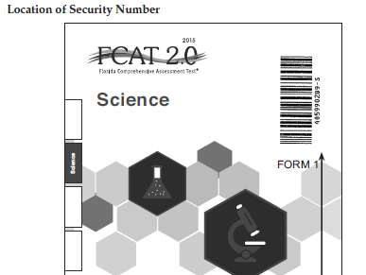
Test Security
Policies and Procedures (cont.)
FCAT 2.0 Science Security Numbers
Security numbers on test and answer books:
  Are used to account for each test and answer book.
  Consist of a nine-digit number followed by a check digit located in the upper right corner of test and answer books.
The packing list shows the number ranges assigned to each school, and written documentation of the number ranges must be maintained at all times during distribution and return of books.
A blank Administration Record/Security Checklist is provided in PearsonAccess and in Appendix D of the manual.
Each test administrator should maintain a list of all secure materials assigned to him or her, including any additional materials assigned throughout the administration.

Slide 56
Test Security
Policies and Procedures (cont.)
PBT
Hazardous Materials
If a used test and answer book is soiled (e.g., with blood or vomit), notify Student Assessment Office immediately via email at mugando@dadeschools.net. Please include a description of the incident with the student’s name; and also specify the grade level/subject test and security number.
At the school’s discretion, school personnel may transcribe the response into a replacement test and answer book.
The damaged test and answer book should then be destroyed or disposed of in a secure manner (e.g., shredding, burning). Soiled test and answer books should not be returned to DRC.

Slide 57
Test Security
Policies and Procedures (cont.)
CBT
PBT
Missing Materials/Testing Irregularity/Security Breach
Schools must investigate ANY report of missing materials (e.g., test and answer books, Writing Passage Booklets, used planning sheets) and any testing irregularity that may compromise the security of the test administration and report it to Student Assessment Office at 305-995-7520 immediately.
For test irregularities/security breaches needing further investigation, within 7 calendar days of the incident, a written report must be submitted to Student Assessment Office.
Note: Secure student information (e.g., SSN) must never be communicated via email.

Slide 58
Test Invalidation/Defective Materials Policies and Procedures
CBT
PBT
Test Invalidation
Remember that the main purpose of invalidation is to identify when the validity of test results has been compromised.
A test administrator should discuss any situation involving possible invalidation with the school assessment coordinator, and the situation should be investigated immediately.
If a situation described in the Test Invalidation/Defective Materials Policies and Procedures section of the manual occurs, test administrators should discuss the situation with the school assessment coordinator, and the situation should be investigated immediately.

Slide 59
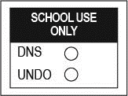
Test Invalidation/Defective Materials
Policies and Procedures (cont.)
CBT
PBT
FSA Test Invalidation
Grid the DNS bubble on paper-based tests that are invalidated. If a DNS bubble is gridded by mistake, erase it completely and grid the UNDO bubble. Remember that invalidated paper-based tests should be returned with TO BE SCORED test and answer books in order to be counted for participation purposes.
Test invalidations for CBT assessments are handled in TIDE. Invalidating a test will require the student’s ID number and the reason for invalidation. Complete instructions on invalidating tests via TIDE are available in the TIDE User Guide.

Slide 60
Test Invalidation/Defective Materials
Policies and Procedures (cont.)
PBT
FSA DNS Guidelines for Defective Materials
If a defective test and answer book is identified before testing begins, give the student a replacement book. Return the defective test and answer book with all other NOT TO BE SCORED materials. It is NOT necessary to grid the DNS bubble if the test and answer book is defective and UNUSED and has been packaged properly for return with all other NOT TO BE SCORED materials.
If the test and answer book is defective and USED, a DO NOT PROCESS Label MUST be applied. Remember that the DO NOT PROCESS Label should be applied to any USED NOT TO BE SCORED test and answer books that should NOT be scanned or counted for participation (i.e., responses were transcribed into another test and answer book or documents with a PreID label applied). The DO NOT PROCESS Label should be applied in the same location as the PreID or District/School Label and should cover the label currently on the test and answer book.

Slide 61
Test Invalidation/Defective Materials
Policies and Procedures (cont.)
PBT
FSA DNS Guidelines for Defective Materials
If a student discovers that the test and answer book is defective during testing, instruct the student to continue writing his or her response in the test and answer book. After the test session has ended, the student must, under the supervision of the test administrator, transfer the exact response from the test and answer book to a replacement test and answer book.
If the defective test and answer book has a student label applied, do not remove the label. You may either print a new On-Demand PreID Label via TIDE or grid all information on the student grid sheet and affix a District/School Label to the replacement test and answer book. (See the Script for Gridding a Non-Preidentified Student Grid Sheet in the manual.) Instructions for printing On-Demand PreID Labels are available in the TIDE User Guide. Place a DO NOT PROCESS Label on the defective USED test and answer book and return it with all other NOT TO BE SCORED materials.

Slide 62
Science DNS Guidelines for Defective Materials
FCAT 2.0 Science DNS Guidelines for Defective Materials
Under the following circumstances, it is NOT necessary to grid the DNS bubble if the document has been properly packaged for return with all other NOT TO BE SCORED materials:
  The preidentified answer book belongs to a student who has withdrawn before testing begins.
  The preidentified answer book belongs to a student who was absent during the entire testing window.
  The answer document is defective and unused.
  The preidentified information is incorrect and the answer document is unused.
  If a test document is soiled, see the “Security Numbers” section on page 14 of the Spring 2015 Science Manual.
  For more information on defective materials, see pages 19–20 of the Spring 2015 Science Manual.

Slide 63
School Assessment Coordinator
Before Testing
CBT
PBT
FSA Receive Materials
School Box contents (as applicable):
School Assessment Coordinator Box (White)
School Cover Memo ▪ School Packing List
School Box Range Sheet ▪ School Security Checklist
PreID Rosters ▪ PreID Labels
Blank PreID Labels ▪ District/School Labels
DO NOT PROCESS Labels ▪ Roll of Plastic Return Bags
Green, Blue, Orange, or Purple Labels (TO BE SCORED Materials)
White Labels (TO BE SCORED Large Print/One-Item-Per-Page Materials)
Pink Labels (TO BE SCORED Braille Materials)
Yellow Labels (NOT TO BE SCORED Materials)
Test and Answer Books
Writing Passage Booklets (CBT Accommodation)
Reading Passage Booklets (CBT Accommodation)
Directions for Completing the Grades 3 & 4 FSA ELA Reading Items
Directions for Completing the Grades 3 & 4 FSA Mathematics Items

Slide 64
School Assessment Coordinator
Before Testing
CBT
PBT
FSA Receive Materials (cont.)
Special Document Boxes:
Large Print Kits
Special Document Cover Memo
Special Document Return Envelope
Regular Print Test and Answer Book
Large Print Test and Answer Book
Large Print Planning Sheet (writing)
One-Item-Per-Page Kits
Special Document Cover Memo
Special Document Return Envelope
Regular Print Test and Answer Book
One-Item-Per-Page Test and Answer Book
Braille Kits
Special Document Cover Memo
Special Document Return Envelope
Regular Print Test and Answer Book
Braille Script
Braille Notes
Braille Test Book

Slide 65
School Assessment Coordinator
Before Testing
CBT
PBT
FCAT 2.0 Science Receive Materials (cont.)
School Box contents
School Cover Memo
Packing List
School Assessment Coordinator Kit—clear plastic bag
Document Count Forms
Paper Bands
Red Labels (Grades 5 and 8 Science TO BE SCORED materials)
Yellow Labels (NOT TO BE SCORED materials)
PreID Rosters
PreID Labels
Periodic Tables (Grade 8 Science)
Science Test Books and Answer Books

Slide 66
School Assessment Coordinator
Before Testing
CBT
PBT
FCAT 2.0 Science Receive Materials (cont.)
Special Document Boxes if applicable:
White Labels (TO BE SCORED Large Print/One-Item-Per-Page Materials) or Pink Labels (TO BE SCORED Braille Materials)
Yellow Labels (NOT TO BE SCORED Materials)
Document Count Forms
Special Document Return Envelopes
Special Document Test Materials

Slide 67
School Assessment Coordinator
Before Testing
Communicate Testing Policies to Students and Parents/Guardians
Electronic Devices Policy—If students are found with ANY electronic devices, including, but not limited to, cell phones and smartphones, during testing OR during breaks, their tests will be invalidated.
Leaving Campus—If students leave campus before completing a session (for lunch, an appointment, illness, etc.), they WILL NOT be allowed to complete that session. If a student does not feel well on the day of testing, it may be best for the student to wait and be tested on a make-up day.
Testing Rules Acknowledgment—Prior to testing, students will be asked to sign below a Testing Rules Acknowledgment that reads: “I understand the testing rules that were just read to me. If I do not follow these rules, my test score may be invalidated.”
Discussing Test Content after Testing—The last portion of the testing rules read to students before they sign below the acknowledgment reads, “After the test, you may not reveal details about the test items to anyone. This includes any type of electronic communication, such as texting, emailing, or posting online, for example, on websites like Facebook, Twitter, or Instagram.

Slide 68
School Assessment Coordinator
Before Testing
FSA PBT and FCAT 2.0 Science
Test group codes are a security measure to identify groups of students tested together.
For a PBT administration, school assessment coordinators must provide each test administrator a unique four-digit numeric code in his or her testing room for both test sessions. Each testing room must use a different test group code.
Schools must ensure that students grid the test group code on the back of their answer documents at the beginning of each test session, and test administrators record the code with their required administration information and on seating charts.
FSA CBT
Session ID numbers will replace test group codes for FSA CBT administrations.
  Session ID numbers are generated by the test delivery system when the TA creates the test session.

Slide 69
School Assessment Coordinator
Before Testing
CBT
PBT
Preparation and Training
You are responsible for training all test administrators and proctors, including non-school-based instructors (e.g., itinerant teachers). You must train several employees to act as possible alternates. In the absence of sufficiently trained administrators, postpone testing until trained personnel are available.
Test administrators must be certified educators.
Test administrators must have a computer or mobile device during testing.
Test Administrator (TA) Accounts
TA accounts must be created in TIDE to allow TA to administer the FSA tests.
Assign Proctors
Assign proctors to testing rooms according to the guidelines for proctors, make sure that they understand their responsibilities, and explain the Security Log to them.
FDOE strongly encourages use of proctors in ALL testing rooms.

Slide 70
School Assessment Coordinator
Before Testing
Provide instructions for the following:
School’s policy for electronic devices, breaks, and extended time accommodations.
Option (A, B, or C) to use when reading the test script and accessing the Student Comment Forms.
A student has not participated in a training test session.
A student has trouble logging in the first time or gets kicked out of his or her test more than once.
A student refuses to acknowledge the testing rules.
A student moves to the next session and gets approved by TA inadvertently.
A test administrator is concerned that a student is unable (e.g., too ill) to finish the test.
A disruption occurs (e.g., a technical disruption, power outage, disruptive behavior).

Slide 71
School Assessment Coordinator
Before Testing
TA must have accounts created In TIDE by School Assessment Coordinators (SAC):
SAC will need to log into TIDE and go to the Manage User tab.
  This tab may be used to search for existing user records, export a list of user records, view and/or edit user records, delete user records, and add or upload users
Click on Add User or Upload Users tab depending on your preference
Required fields to add a user are:
  Role, Email Address (username), First and Last Name, and Phone (optional).
Once an account is created in TIDE, TA will receive an email from Florida DoNotReply@airast.org with the following:
  A link to log into TIDE (expires in 30 days)
  A temporary password.
TA must contact FSA Help Desk at 1-866-815-7246 if the email is not received.

Slide 72
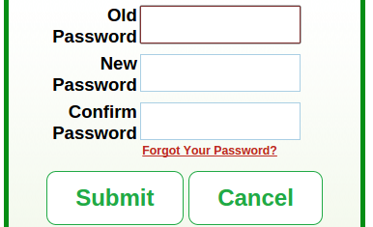
School Assessment Coordinator
Before Testing
TA must have accounts created In TIDE by School Assessment Coordinators (SAC) (cont.):
To activate the TIDE account:
  Click link on email
  In the Old Password field, enter the password sent in email
  In the other password field, enter new password (follow criteria required)
Click Submit
Next select Security Question and provide answers
Finally SAVE.
You will then be taken back to FSA Portal.

Slide 73
School Assessment Coordinator
Before Testing
CBT
PBT
Test Administrators Procedures for Testing
To create the test session, complete the following steps:
Go to the FSA Portal, click the “Test Administrator” icon, and then click the “Test Administration” icon.
Log in to the Test Administrator Interface with your username and password.
Select the test you will be administering (e.g., Grade 9 FSA ELA Reading), and then click “Start Session.”
Record the Session ID, which students will need in order to log in to the test.
To log in to the test, students will enter their First Names, their Usernames, and the Session ID.
After students begin logging in and requesting approval, the Approvals button will become clickable on the TA interface.
Test Administrators must Approve students before they can begin testing.
  This process includes viewing each student’s test settings and verifying that they are correct.
After all students have finished testing or the test session has ended, Test Administrators will click the Stop Session button.

Slide 74
School Assessment Coordinator
Before Testing
CBT
PBT
Required Administration Information
Communicate to test administrators the process for collecting the required administration information.
For paper-based testing, maintain a record of the security numbers of the test and answer books and Writing/Reading Passage Booklets.
Seating Charts
Test administrators are required to maintain an accurate seating chart for each group of students in their rooms during testing. Ensure that test administrators record all required information and that they create a new seating chart if the seating configuration changes during a test session.
  If laptops or other mobile devices are used, identify and record the device on which each student is testing.
Security Logs
Anyone who enters a room for the purpose of monitoring a test MUST sign the log for that testing room.

Slide 75
School Assessment Coordinator
Before Testing
CBT
PBT
Manage Student Information in TIDE for FSA
Please refer to the TIDE User Guide for information on managing student information in TIDE.
Prior to testing, ensure that all student information listed in TIDE is correct, including any accommodations students will be using to test.
Students to be tested who were not included in your district’s PreID upload will need to have their information added in TIDE, and On-Demand PreID Labels should be printed for these students.
For paper-based tests, if documents are hand-gridded for these students and District/School Labels are applied instead, student information must still be added to TIDE to ensure timely reporting of results for these students. See the TIDE User Guide for information on adding student information to TIDE and printing On-Demand PreID Labels.

Slide 76
School Assessment Coordinator
Before Testing
CBT
Meet with Technology Coordinator
For CBT administrations, it is important that technology coordinators understand their responsibilities before, during, and after a computer-based test administration. Review the instructions and information for technology coordinators (located in the portal), as well as all test administration and security policies and procedures included in the test administration manuals, with your technology coordinator and create a plan for handling issues during testing.
Ensure that the technology coordinator has verified that all computers and devices meet the requirements needed to administer the computer-based tests, as indicated in the System Requirements for Online Testing document available in the portal, and have installed the correct secure browser.
Technology coordinators are required to sign the Test Administration and Security Agreement.
The technology coordinator should also be involved in all planning meetings to provide input on logistics and resolve any network issues.

Slide 77
School Assessment Coordinator
Before Testing
CBT
Arrange CBT Training Test Sessions
For computer-based administrations, schedule and arrange for students to take the training tests as described in the manuals.
Before a student can participate in a computer-based administration, the student must complete the appropriate training test to learn how to use the computer-based system.
  The appropriate test script should be used when administering the training test session.
Instruct school personnel to make students aware that they can access training tests on their own any time prior to testing.
The training tests and scripts for administering the training tests are available in the portal.

Slide 78
School Assessment Coordinator
During Testing
CBT
PBT
Supervise Test Administration and Maintain Test Security
Provide test administrators with paper-based test materials (test and answer books, Writing/Reading Passage Booklets, special document test materials, as applicable), and with planning sheets, worksheets, work folders, and test tickets for students prior to testing.
Monitor each testing room to ensure that test administration and test security policies and procedures are followed.
  Make sure that visual barriers are installed on every computer.
  Make sure that Security Logs and seating charts are being completed properly and that all required administration information is being maintained in each testing room.
The test administrator should contact you or the technology coordinator if an error message appears on a student’s computer or device during testing.

Slide 79
School Assessment Coordinator
During Testing
CBT
PBT
Supervise Test Administration and Maintain Test Security (cont.)
If the Internet connection is interrupted during testing, students will not be able to continue testing. If the Internet connection is not restored in time for students to complete the test, the test administrator should contact you or the technology coordinator for assistance.
If a technical issue interrupts testing and is not able to be resolved quickly, you should contact the FSA Help Desk at 866-815-7246 and notify the Student Assessment Office immediately at 305-995-7520.
Test administrators are instructed to contact you if a student does not sign below the Testing Rules Acknowledgment. Any student who refuses to affirm the Testing Rules Acknowledgment should still be tested, but a record of the student’s refusal should be retained at the school.

Slide 80
School Assessment Coordinator
During Testing
CBT
PBT
Monitor Student Progress
Student progress and test completion rates can be monitored via ORS. School assessment coordinators should use the Participation Reports feature of ORS to track completion rates and determine which students still need to be tested. Further information on Participation Reports can be found in the Online Reporting System User Guide.
Supervise Make-Up Administrations
Ensure all test security and test administration policies and procedures are followed while conducting make-up tests. Be available to assist test administrators as needed during make-up administrations.

Slide 81
School Assessment Coordinator
After Testing
CBT
PBT
Update Student Information
If student information is discovered to be incorrect during FSA testing, update the corrected information in TIDE immediately following test administration. Instructions on updating student information are available in the TIDE User Guide.
Record Accommodations
Ensure all accommodations provided to and used by students are recorded on each record of required administration information, as applicable. This documentation may be necessary in the case of investigations regarding possible test irregularities.

Slide 82
School Assessment Coordinator
After Testing
PBT
Overview of Materials Return Process for FSA
The descriptions and steps below and on the following slides provide a general overview of the materials return process. Detailed instructions are included in the 2014–2015 FSA Paper-Based Materials Return Instructions.
School assessment coordinators will complete the following steps before returning materials to district assessment coordinators:
Receive all secure materials from test administrators.
Ensure all test and answer books have the appropriate labels applied:
PreID Labels should be used on TO BE SCORED test materials whenever possible. On-Demand PreID Labels may be printed for any students for whom PreID Labels were not included in the shipment of test materials (e.g., students who enrolled after the PreID upload.)

Slide 83
School Assessment Coordinator
After Testing
PBT
Overview of Materials Return Process for FSA (cont.)
District/School Labels should be used on TO BE SCORED test materials if PreID Labels are not available and cannot be printed. Student demographic information must also be gridded on documents with District/School Labels applied, and student information must be entered in TIDE.
DO NOT PROCESS Labels should be applied to all used NOT TO BE SCORED materials, including used defective documents and documents from which student responses have been transcribed into another test and answer book.
Separate TO BE SCORED and NOT TO BE SCORED materials.

Slide 84
School Assessment Coordinator
After Testing
PBT
Overview of Materials Return Process for FSA (cont.)
Place all TO BE SCORED materials in the plastic return bags included in your test materials.
Separate TO BE SCORED regular print materials from TO BE SCORED special documents (large print, braille, one-item-per-page).
Important Note: Although the vendor does not require materials to be banded by grade level or subject, you will be held accountable for verifying that all materials have been returned.
  Group all TO BE SCORED regular print documents by grade level and subject.
  Record the number TO BE SCORED and NOT TO BE SCORED on the district’s “Accounting for All” form
  Special Program Students’ “TO BE SCORED” regular print documents should be placed on top of your school’s documents

Slide 85
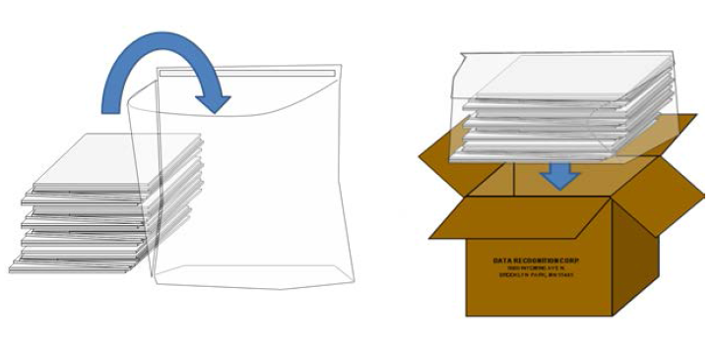
School Assessment Coordinator
After Testing
PBT
Overview of Materials Return Process for FSA (cont.)
Place filled return bags in boxes, and apply the appropriate TO BE SCORED return labels to the boxes.
Note: You will receive zip ties with your shipment of test materials. Use the zip ties to close the return bags prior to placing them in boxes.

Slide 86
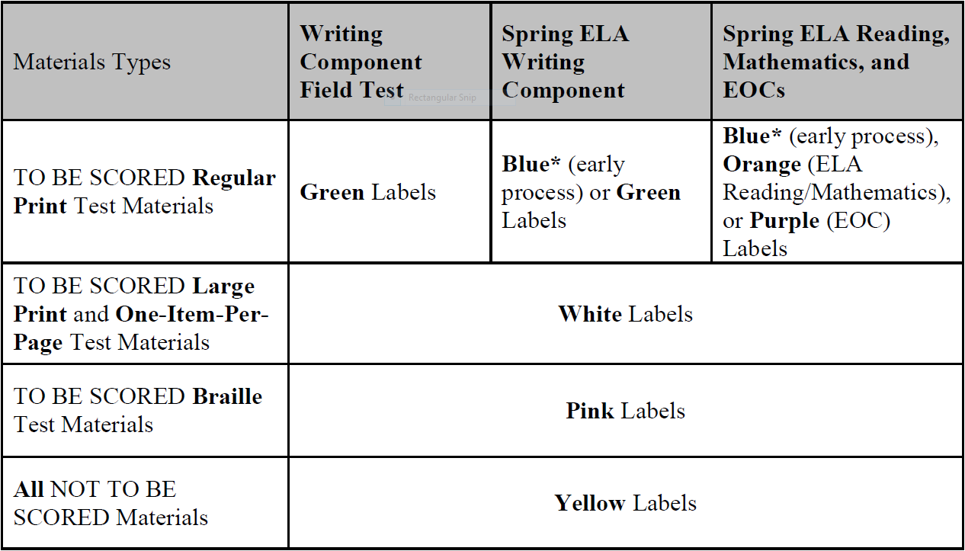
School Assessment Coordinator
After Testing
PBT
Overview of Materials Return Process for FSA (cont.)
Use the following chart, found on page 7 of the Materials Return Instructions to ensure you apply the appropriate color label to each box:
*Schools that receive blue labels will not receive green (ELA Writing) or orange (ELA Reading and Mathematics) return labels. Blue return labels should be applied TO BE SCORED materials, and materials should be returned as instructed in the 2014–2015 FSA Paper-Based Materials Return Instructions.

Slide 87
School Assessment Coordinator
After Testing
PBT
Overview of Materials Return Process for FSA (cont.)
Package all NOT TO BE SCORED materials, including NOT TO BE SCORED special documents, passage booklets, and used defective documents with the DO NOT PROCESS Label applied, in boxes. Apply yellow NOT TO BE SCORED return labels.
Complete your Test Materials Chain of Custody Form. Report missing materials to Student Assessment Office immediately and conduct the necessary investigation.
Make copies of all collected required administration information, seating charts, and Security Logs, and file the copies.
Review the Friendly Reminders for specific instructions on packing and returning materials.
Return all boxes to TDC by the established deadlines.

Slide 88
School Assessment
Coordinator After Testing
Complete Document Count Forms for FCAT 2.0 Science
  Verify that you have included all documents from make-up sessions before you complete the forms.
  Complete Document Count Forms by following the instructions on the form.
  Complete a separate Document Count Form for each grade level.
  Separate Document Count Forms must be completed for any special program student documents (Home Education, Virtual School, etc.).
  Place each completed form on top of the first stack of corresponding TO BE SCORED answer documents.

Slide 89
School Assessment
Coordinator After Testing
Complete and Apply Paper Bands for FCAT 2.0 Science
Documents for each grade level and special program must be banded separately. You may use more than one paper band per grade level and document type, if necessary.
Follow these steps for each paper band you use:
  Write your district number and your school number.
  Count the number of TO BE SCORED answer documents that will be banded in each paper band. Write that number under Number of TO BE SCORED Documents Contained in This Paper Band.
  Under Number of Banded Stacks per Document Count Form, number the paper bands 1 of n, 2 of n, etc., where n is the total number of banded stacks per Document Count Form.
  Place a paper band around each stack of TO BE SCORED answer documents. The Document Count Form must be under the paper band on top of the stack labeled 1 of n.
  Seal the paper band and be sure that it securely holds the documents. Do not use staples, paper clips, or tape.

Slide 90
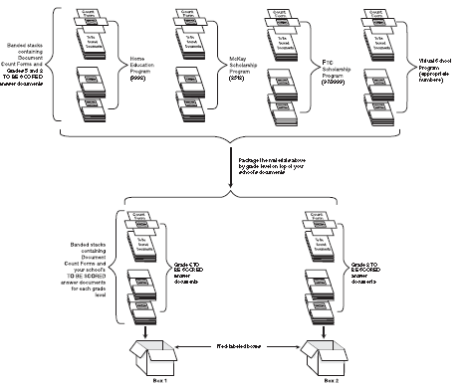
School Assessment Coordinator
After Testing
PBT
Pearson Packaging TO BE SCORED Science Grades 5 and 8 Materials for Return

Slide 91
School Assessment Coordinator
After Testing
PBT
Pearson Packaging TO BE SCORED Science Special Documents for Return

Slide 92
FSA ELA Writing:
Return Schedule
CBT
PBT
ALL FSA ELA WRITING (4-10 & 11 ?) PAPER TEST MATERIALS | RETURN DATES
BLUE (Early Processing) OR GREEN - “TO BE SCORED” WHITE – “TO BE SCORED” Large Print and One-Item-Per-Page materials, if applicable PINK - “TO BE SCORED” Braille materials, if applicable | Elementary, K-8 Centers, Middle Schools, Senior High Schools and Alternative Centers hand-deliver: March 12, 13, OR 16
YELLOW – All “NOT TO BE SCORED” materials (including NOT TO BE SCORED special documents) | Comet Courier will pick up at schools FSA and FCAT 2.0: May 12-21
DISTRICT ASSESSMENT COORDINATOR ONLY BOXES (DAC) Box 1: FSA ELA Writing, ELA, Mathematics, and FCAT 2.0 Science; FCAT/FCAT 2.0 Retake and NGSSS EOC Algebra 1 Retake Box 2: FSA and NGSSS EOC Assessments | Comet Courier will pick up at schools Spring 2015 DAC Boxes Only as applicable: May 28-June 3
Note: Schools must hand-deliver TO BE SCORED FSA ELA Writing materials to TDC by 3:30 p.m. at 13135 S.W. 26 Street, Miami, FL 33175.
Friendly Reminders

Slide 93
FSA ELA Writing:
Make-up Return Schedule
CBT
PBT
ALL FSA ELA WRITING (4-10 & 11 ?) PAPER TEST MATERIALS | RETURN DATES
BLUE (Early Processing) OR GREEN - “TO BE SCORED” WHITE – “TO BE SCORED” Large Print and One-Item-Per-Page materials, if applicable PINK - “TO BE SCORED” Braille materials, if applicable | Elementary, K-8 Centers, Middle Schools, Senior High Schools and Alternative Centers hand-deliver: April 10 (Make-up Window #1) May 11 (Make-up Window #2)
YELLOW – All “NOT TO BE SCORED” materials (including NOT TO BE SCORED special documents) | Comet Courier will pick up at schools FSA and FCAT 2.0: May 12-21
DISTRICT ASSESSMENT COORDINATOR ONLY BOXES (DAC) Box 1: FSA ELA Writing, ELA, Mathematics, and FCAT 2.0 Science; FCAT/FCAT 2.0 Retake and NGSSS EOC Algebra 1 Retake Box 2: FSA and NGSSS EOC Assessments | Comet Courier will pick up at schools Spring 2015 DAC Boxes Only as applicable: May 28-June 3
Note: Schools must hand-deliver TO BE SCORED FSA ELA Writing materials to TDC by 3:30 p.m. at 13135 S.W. 26 Street, Miami, FL 33175.
Friendly Reminders

Slide 94
FSA and FCAT 2.0: Return Schedule
CBT
PBT
ALL FSA ELA (3-10 & 11 ?), MATHEMATICS (3-8), AND FCAT 2.0 SCIENCE (Grades 5 and 8) PAPER TEST MATERIALS | RETURN DATES
FSA ELA and Mathematics: BLUE (Early Process) or GREEN – “TO BE SCORED” WHITE – “TO BE SCORED” large print materials, if applicable PINK - “TO BE SCORED” Braille materials, if applicable | Elementary and K-8 Centers (Grades 3 and 4) hand-deliver: Friday or Monday, April 10 or 13 Elementary, K-8 Centers, Middle Schools, Senior High Schools and Alternative Centers (Grades 5-10 & 11 ?) hand-deliver: Thursday – Monday, April 23-27
FCAT 2.0 Science (Pearson): RED – “TO BE SCORED” Science Grades 5 and 8 WHITE – “TO BE SCORED” large print materials, if applicable PINK - “TO BE SCORED” Braille materials, if applicable
YELLOW – All “NOT TO BE SCORED” materials (including NOT TO BE SCORED special documents) | Comet Courier will pick up at schools FSA and FCAT 2.0: May 12-21
DISTRICT ASSESSMENT COORDINATOR ONLY BOXES (DAC) Box 1: FSA ELA Writing, ELA, Mathematics, and FCAT 2.0 Science; FCAT/FCAT 2.0 Retake and NGSSS Algebra 1 EOC Retake Box 2: FSA and NGSSS EOC Assessments | Comet Courier will pick up at schools Spring 2015 DAC Boxes Only, as applicable: May 28-June 3
Friendly Reminders

Slide 95
FSA EOC: Return Schedule
CBT
PBT
ALL FSA AND NGSSS EOC ASSESSMENTS PAPER TEST MATERIALS | RETURN DATES
FSA EOC ALGEBRA 1, GEOMETRY, ALGEBRA 2: GREEN - “TO BE SCORED” FSA EOC WHITE – “TO BE SCORED” large print materials, if applicable PINK - “TO BE SCORED” Braille materials, if applicable YELLOW – All “NOT TO BE SCORED” materials (including NOT TO BE SCORED special documents) | K-8 Centers, Middle Schools, Senior High Schools and Alternative Centers hand-deliver TO BE SCORED AND NOT TO BE SCORED: FSA EOC Assessments: April 30-May 4
DISTRICT ASSESSMENT COORDINATOR ONLY BOX(ES) (DAC) Box 1: FSA ELA Writing, ELA, Mathematics and FCAT 2.0 Science; FCAT/FCAT 2.0 Retake and NGSSS Algebra 1 EOC Retake Box 2: FSA and NGSSS EOC Assessments | Comet Courier will pick up at schools Spring 2015 DAC Boxes Only on: May 28-June 3 ADULT CENTERS: Hand-deliver the District Coordinator Only Box: May 20-21
Note: Schools must hand-deliver all FSA EOC materials to TDC by 3:30 p.m. at 13135 S.W. 26 Street, Miami, FL 33175.
Friendly Reminders

Slide 96
District Assessment Coordinator
ONLY Box 1 (Writing/ELA/Math/Science/Retake)
CBT
PBT
Place the following materials in the District Assessment Coordinator Only Box:
  All used and unused planning sheets, worksheets, work folders, reference sheets, and Periodic Tables of the Elements
  Original records of required administration information, such as Administration Record/Security Checklist
  Original Security Logs
  Original Seating Charts
  Original Test Materials Chain of Custody Form (for PBT administrations)
  Original School Procedural Checklist (FM-6927)
  Original Accounting for All Form
Seal the box.
Write District Assessment Coordinator ONLY on the side of the box, the school location # and school name.
Friendly Reminders

Slide 97
District Assessment Coordinator
ONLY Box 2 (FSA EOCs)
CBT
PBT
Place the following materials in the District Assessment Coordinator Only Box:
  All used and unused work folders and reference sheets
  Original records of required administration information, such as Administration Record/Security Checklist
  Original Security Logs
  Original Seating Charts
  Original Test Materials Chain of Custody Form (for PBT accommodations)
  Original School Procedural Checklist (FM-6927)
Seal the box.
Write District Assessment Coordinator ONLY on the side of the box, the school location # and school name.
Friendly Reminders

Slide 98
Comment Form
CBT
PBT
After testing, go to the FSA Portal at www.fsassessments.org for FSA and go to Pearson site at www.FLAssessments.com/Spring2015 for FCAT 2.0 to complete the appropriate comment forms.

Slide 99
Appendices
CBT
PBT
Appendices in the Spring 2015 FSA CBT Manual includes:
Appendix A—Accommodations
Appendix B—FSA Help Desk/Customer Support
Appendix C—Florida Test Security Statute and Rule
Appendix D—Perforated Forms and Signs
School personnel administering both computer-based and paper-based FSA assessments should familiarize themselves with the information in the appendices of the appropriate manuals prior to testing.

Slide 100
FSA Help Desk
CBT
PBT
Contact the FSA Help Desk at:
1-866-815-7246
(Monday–Friday, 7:00am–8:30 pm ET)
fsahelpdesk@air.org

Slide 101
Contact Information
Student Assessment and Educational Testing
  Maria C. Bruguera, Director
  Email: mbruguera@dadeschools.net or
  Mara Ugando, Staff Specialist
  Email: mugando@dadeschools.net
Phone: 305-995-7520
Fax: 305-995-7522

Slide 102
Thank you for ensuring a secure
and successful Spring 2015
test administrations.

