Slide 1

Florida
K-Readiness
Screencast Training 2018-2019

Slide 2

Agenda
The FLKRS Assessment: Star Early Literacy
  What is Star Early Literacy
Getting Ready to Administer the Assessment
Assessing Students
Overview of K-Readiness Reports
  Student, Class and School
Support and Resources

Slide 3

The new FLKRS assessment

Slide 4
Star Early Literacy is the new Florida Kindergarten Readiness Screener (FLKRS)
Section 1002.69, Florida Statutes, requires FDOE to adopt a statewide kindergarten screening instrument that assesses the readiness of each enrolled kindergarten student.
All public school kindergarten students must participate
Private school kindergarten students may participate.
The screener shall be
  administered within the first 30 school days of the school year
    August 20 – October 3, 2018
  based on performance standards adopted by FDOE for Voluntary Prekindergarten (VPK) Education Programs
  used in calculating the kindergarten readiness rate for students who were enrolled in VPK.
Students scores serve as the accountability measure of the VPK program the students attended.
MM/DD/YY
PREPARED BY:
Insert Your Name
Insert Your Name
Insert Your Name

Slide 5
Providers on Probation (POP)
Kindergarten Readiness Rate for VPK
Star Early Literacy determines your schools’ VPK Program’s Readiness Rate for 2018 – 2019.
VPK Programs that do not meet the state’s calculated readiness rate will become Providers on Probation (POP)
POP Implications
VPK Programs that become POP will be required to submit and implement an improvement plan throughout the year.
Schools that remain POP for 3 years must apply and be granted a good cause exemption or be removed from the VPK program for 5 years.

Slide 6

What is Star Early Literacy?
Computer-adaptive assessment
27 items assessing early literacy and numeracy skills
Takes approximately 15-20 minutes to complete
Designed for students who do not yet read independently
Appropriate for students ages 3 to 9
Administered to all Florida Kindergarten students

Slide 7
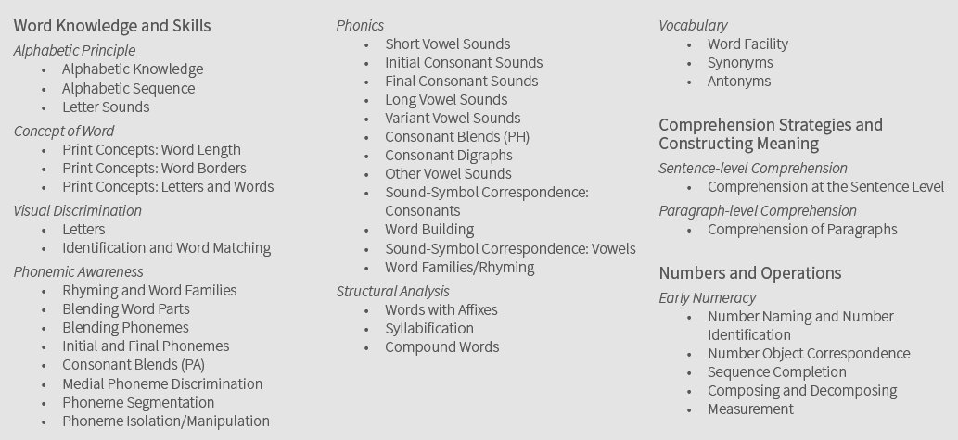
Three key domains
Notes:
Star Early Literacy covers three domains, 10 sub domains and 41 skill areas.

Slide 8
How computer-adaptive testing works
More
Difficult
Easier
Items answered by a student
Correct Response
Incorrect Response
Standard Error of Measurement

Slide 9
State Board Rule Development
Florida Kindergarten Readiness Rate Calculation
For More on the rule
Administrative Rule 6M-8.601
  Readiness rate calculation for use in evaluating VPK providers, accountability
  Benchmark SEL score at 500 in proposed rule language
For more on the rule – see the Florida Administrative Code and Register website at https://www.flrules.org/ (type in “6M-8.601” in search field)

Slide 10

Star Early Literacy Scaled Score (SS)
Scale Score 500 or higher for “readiness”
Scaled Score Range
300 – 900

Slide 11
Preparing for the assessment

Slide 12

Who will test?
Incoming Kindergarten Students
  All public students must test
  Private school students may test
    At their school site
    VPK students may request to test in public school.

Slide 13
Planning for assessment
Download the Star Early Literacy Test Administration Manual
  http://www.fldoe.org/core/fileparse.php/18494/urlt/StarEarlyLiteracy-TAM.pdf
Train kindergarten teachers prior to the administration of STAR
Parent letters
Testing window (August 20 – October 3)
Testing schedule (computer labs)
Prepare technology
  desktops, tablets
  keyboards/mouse/touchscreen
  headphones
Provide student username/passwords

Slide 14
Preparing for assessment
View video with students
  http://www.renlearn.com/lp/Florida%20K-Readiness%20Practice/
Explain the reasons for testing
Explain that they will be using headphones
Give the students the opportunity to try a practice test
Practice test instructions
  http://www.fldoe.org/core/fileparse.php/18494/urlt/SELPI.pdf

Slide 15
Motivate students
Share reasons for testing
Positive motivation
Avoid putting undo stress on students – Not a pass or fail test
Avoid offering an activity to students as they finish, as that will encourage others to finish early
Teacher attitude = student attitude

Slide 16
Monitoring students
Proctors must actively monitor students
Have multiple proctors if possible
Monitors should be aware of best practices

Slide 17
Let’s practice!

Slide 18
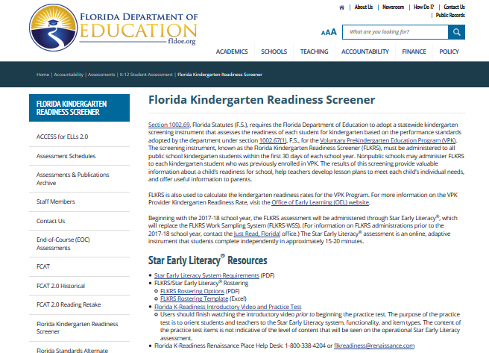
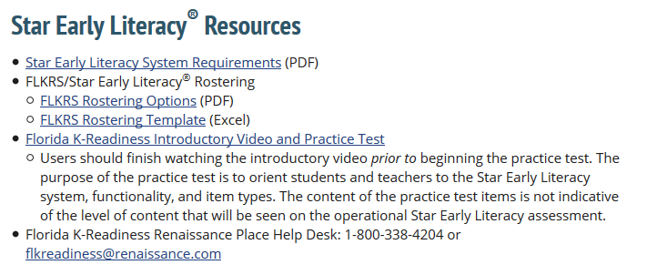
State Department resource site
http://www.fldoe.org/accountability/assessments/k-12-student-assessment/flkrs

Slide 19
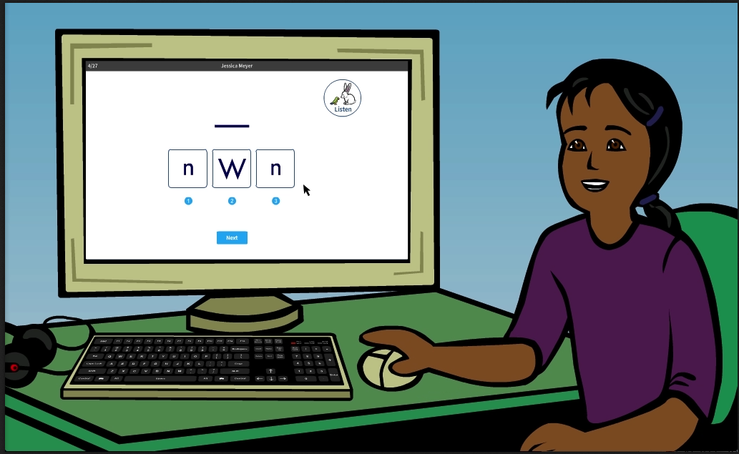
Introductory video

Slide 20
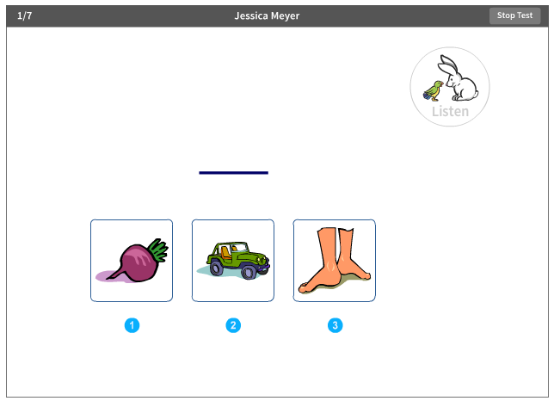
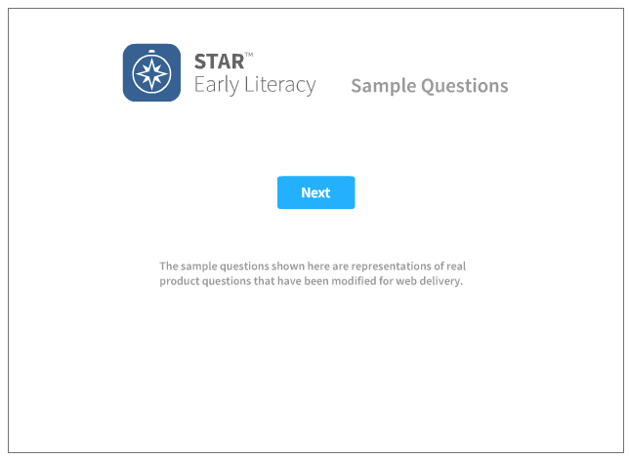
Practice sample questions

Slide 21
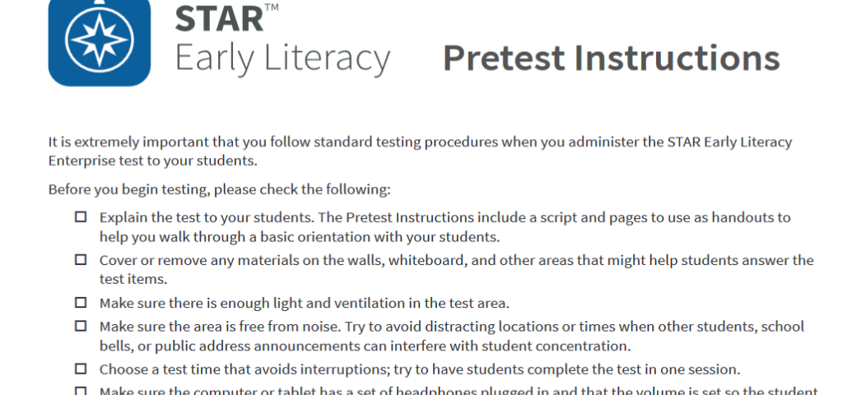

Slide 22
Printing the student roster
Notes:
.

Slide 23
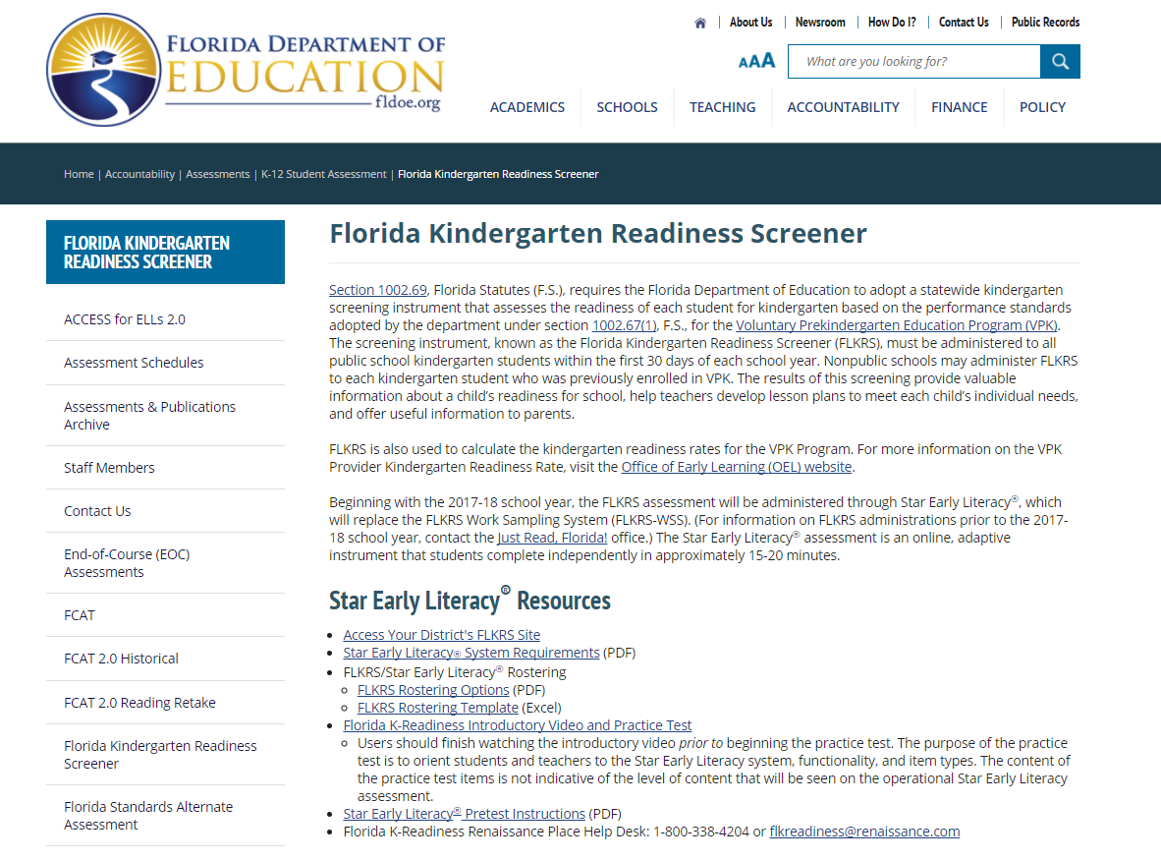
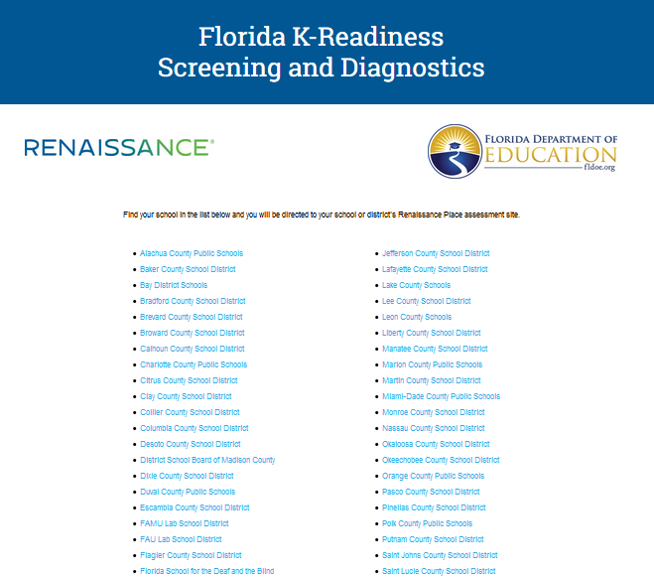
Access your district FLKRS site
http://www.fldoe.org/accountability/assessments/k-12-student-assessment/flkrs
Select your district from the list
Access District FLKRS Site

Slide 24

Teacher Logins
Kindergarten teachers’ names will be populated in the Renaissance Place platform for the 2018-19 school year.
Teachers will NOT be able to use their login information from last year.
NEW procedures for teacher logins:
  Username: Employee number (i.e. 123456)
  Password: full first name . full last name (i.e. Mayda.Cabeza)

Slide 25
Administrator Logins
Principals will be emailed an Administrator (Admin) Login during the school the week of August 13, 2018.
Function of Admin Login
  Add new teacher if needed
  Pull overall school level FLKRS data
Please note new students are added to the platform within 48 hours of registration
  After 48 hours, new students may be added via the Admin login if they don’t appear.

Slide 26
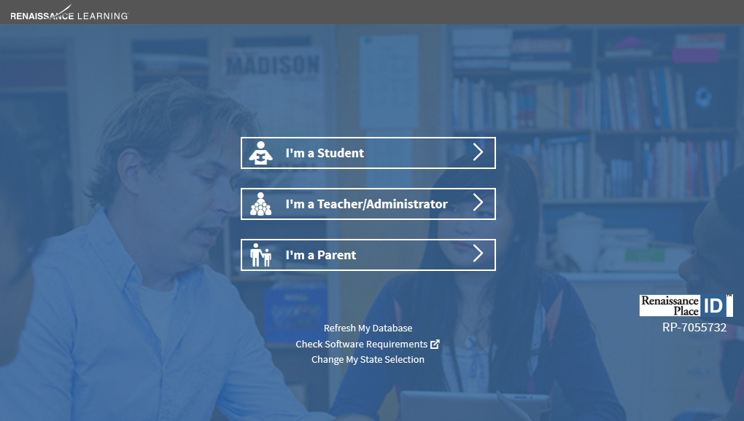
Teacher/Administer login

Slide 27
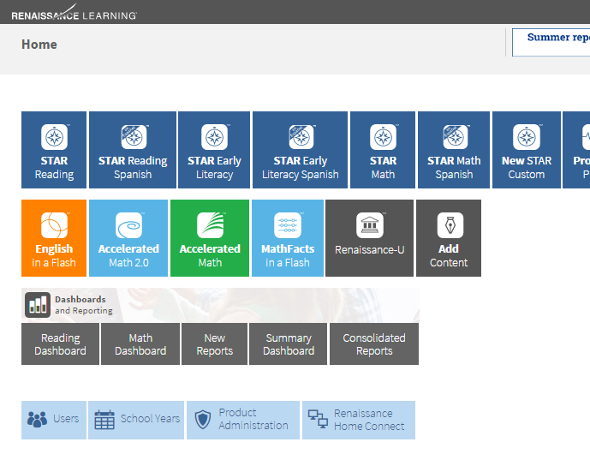

Print student roster

Slide 28
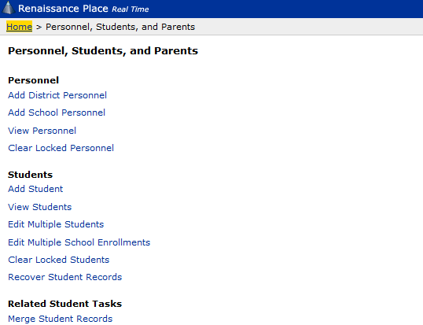
Print student roster

Slide 29
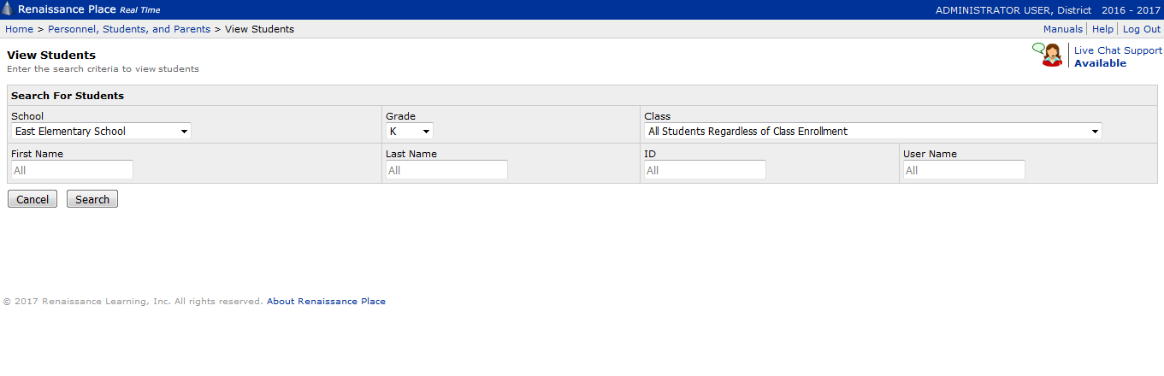
Print student roster

Slide 30
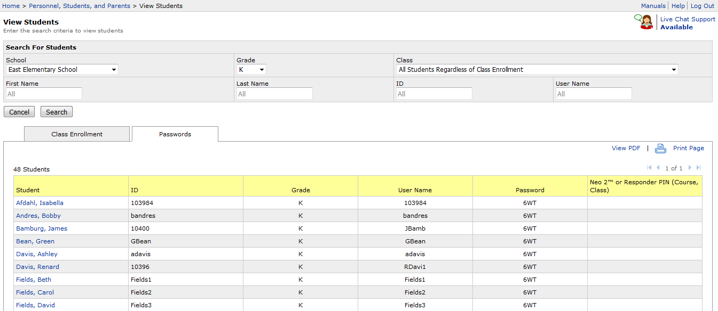
Print student roster

Slide 31
Accommodations
The Star Early Literacy is not appropriate for students who are deaf or blind.
Teachers should evaluate the platform to see if it is appropriate based on the students’ specific disabilities.
Visually impaired students may use a screen magnifier

Slide 32
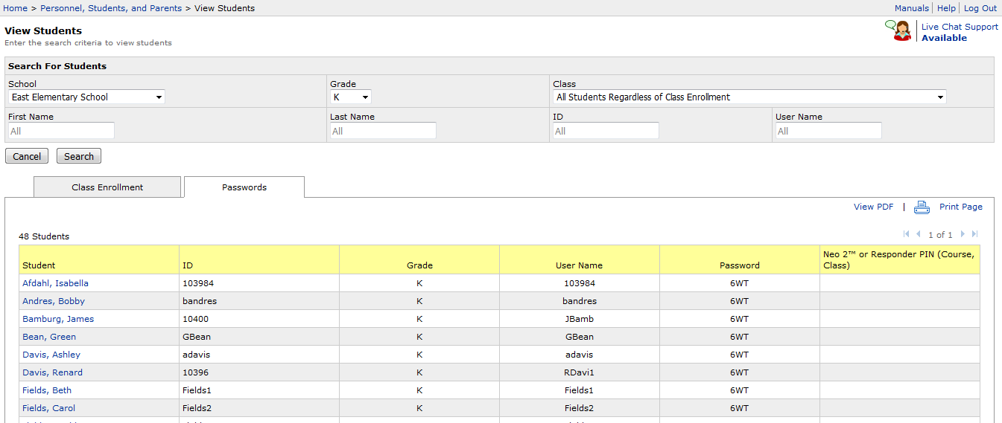
Non-participation characteristic

Slide 33
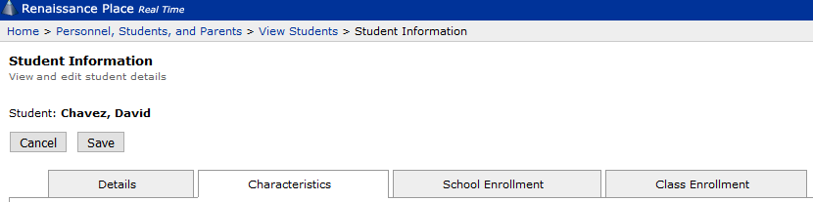

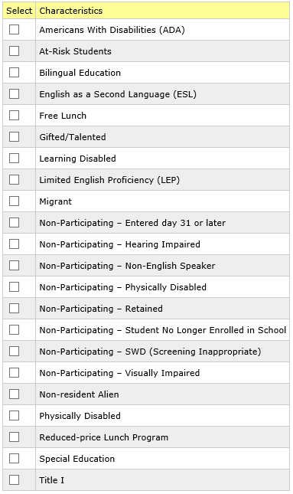
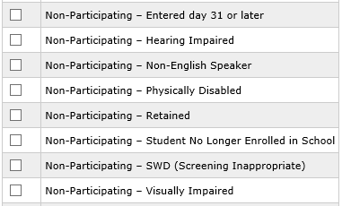
Non-participation characteristic

Slide 34
Assessing students

Slide 35
Student login
Notes:
Make sure to return to the FLKRS Miami Dade County Public Schools site on the FLDOE website. Select I’m a Student and enter the username and password.
Students will likely need assistance with this task.
Teachers may sign students in- but do not do so until the student is sitting at the work station to ensure that a student does not take someone else's’ test.

Slide 36

Launch Star Early Literacy
John Tyler

Slide 37

Begin practice

Slide 38
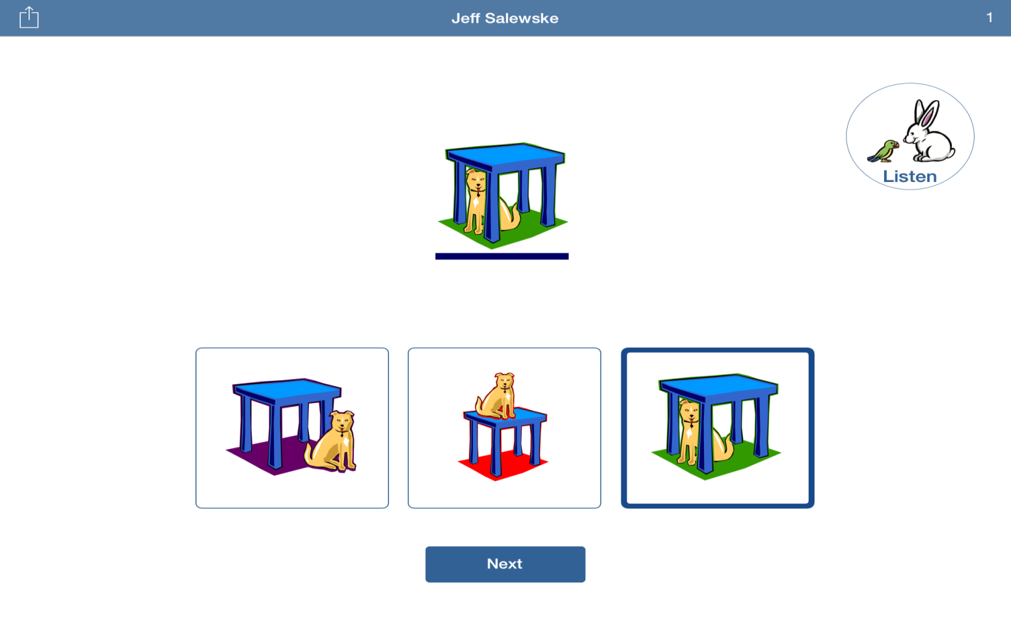
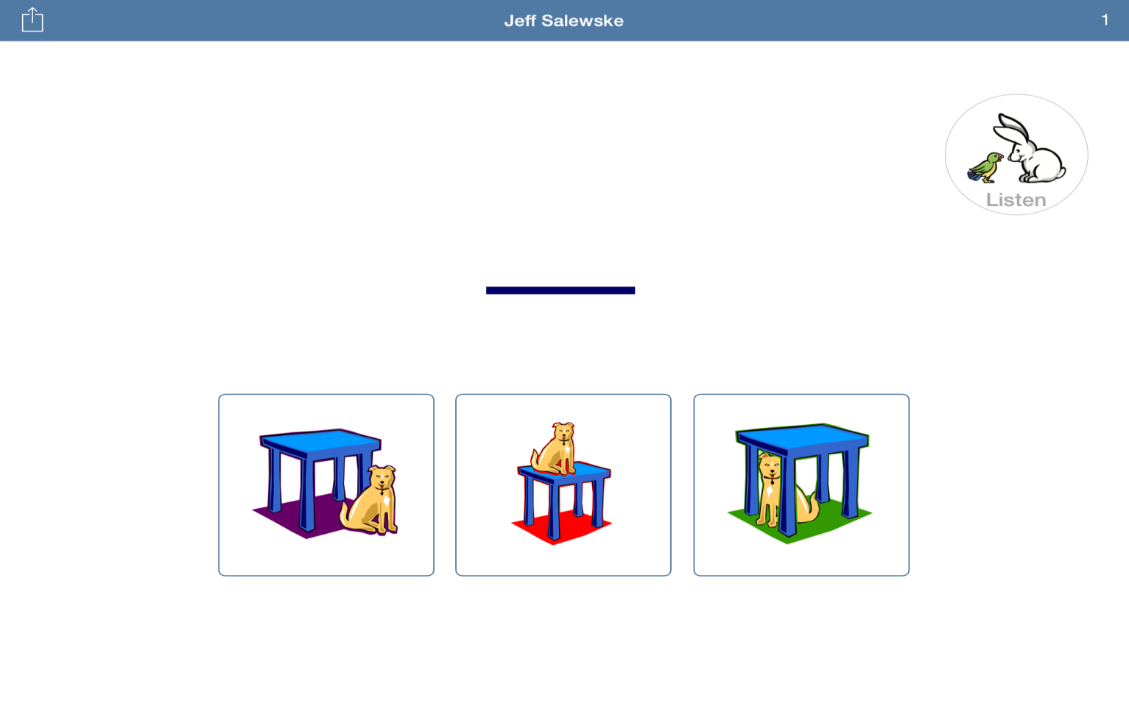
Sample item

Slide 39
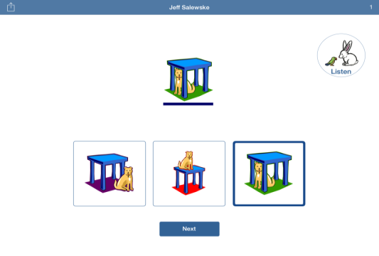
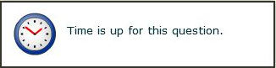
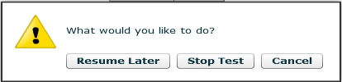
Practice Items
Item Time Limits
1
2
pausing
Pause or Stop a Test
(Ctrl + A)

Slide 40
Accessing reports

Slide 41

Reports
Student
Class
School

Slide 42
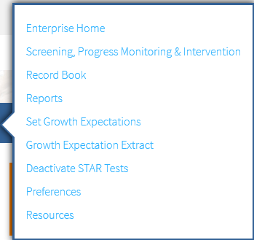
Accessing reports

Slide 43
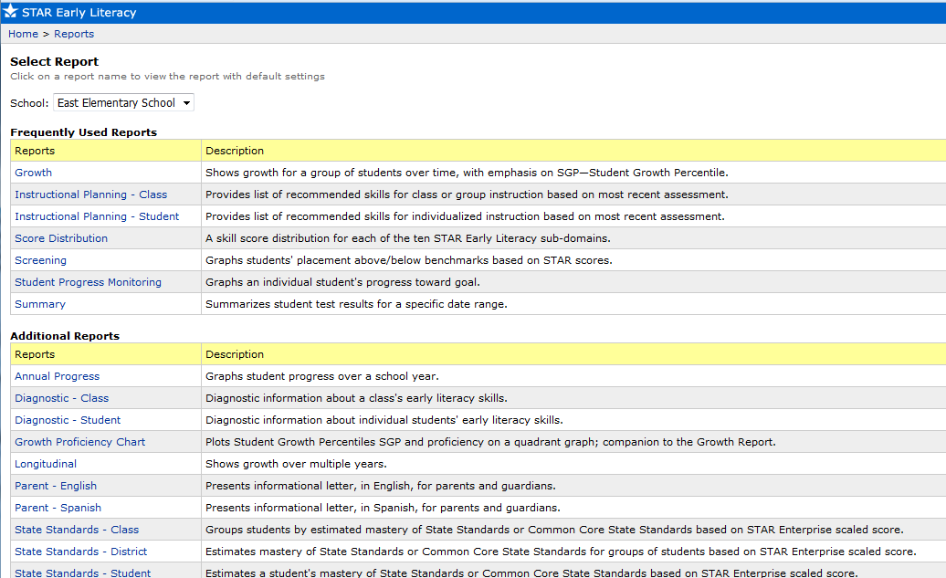
Star Early Literacy reports

Slide 44
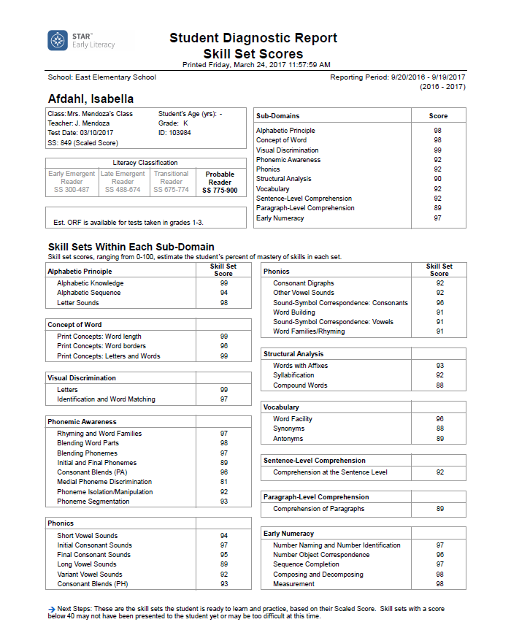
Student Diagnostic Report

Slide 45
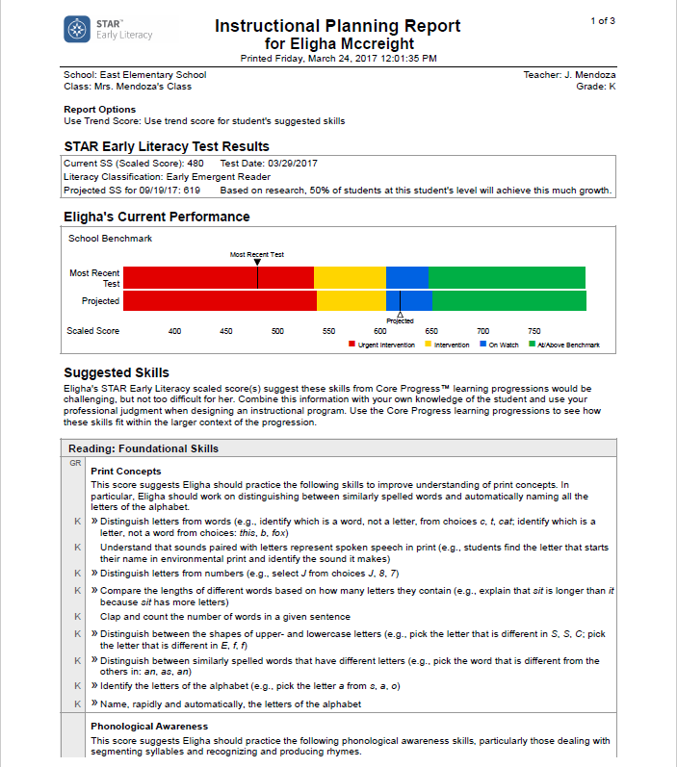
Instructional Planning Report

Slide 46
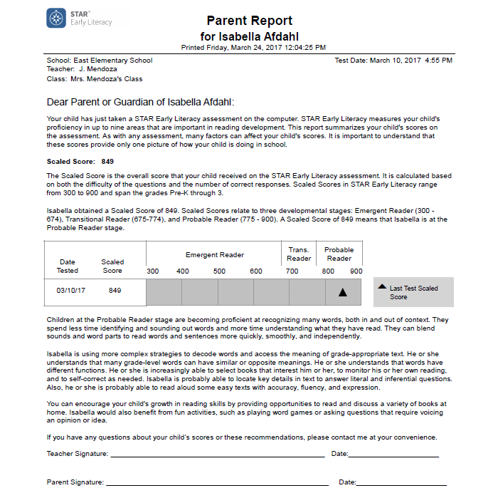
Parent Report

Slide 47
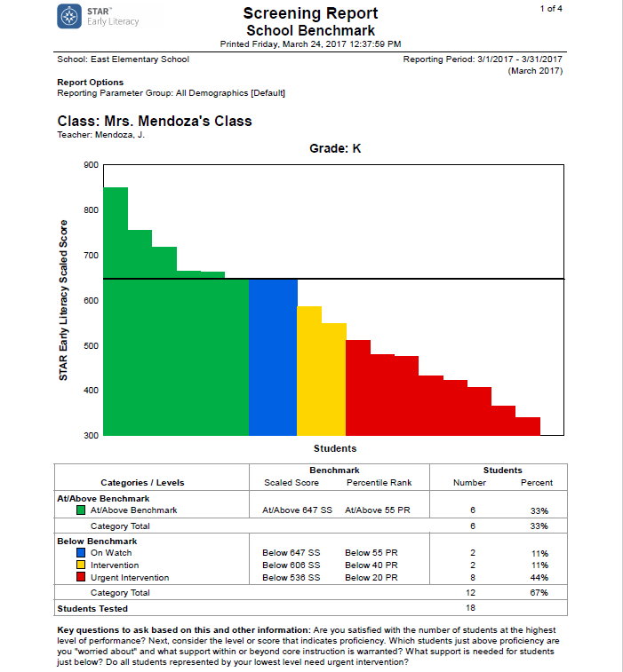
Class Screening Report

Slide 48
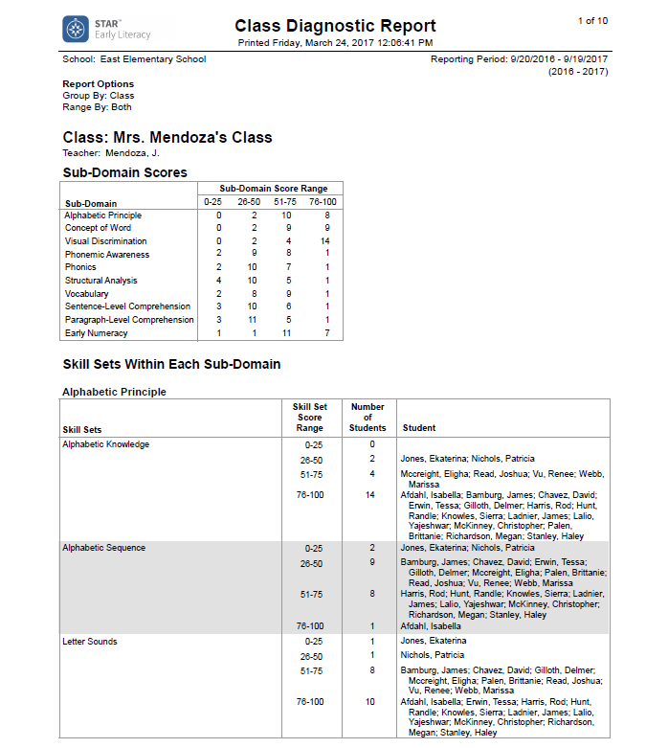
Class Diagnostic Report

Slide 49
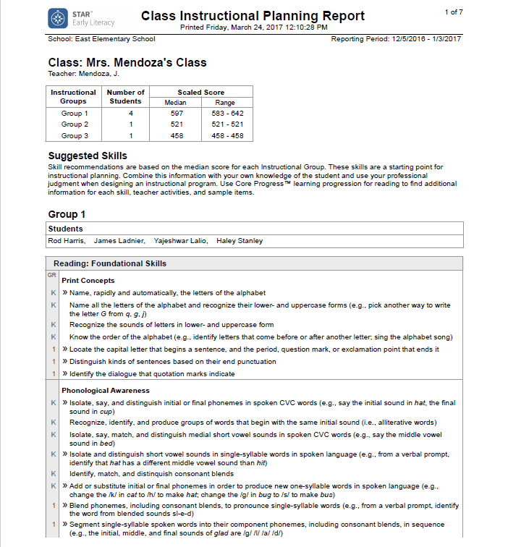
Class Instructional Planning Report

Slide 50
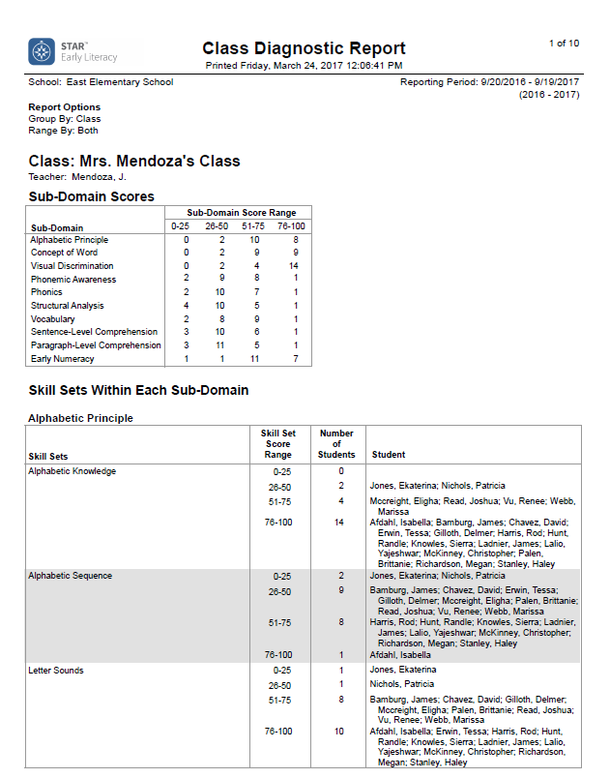
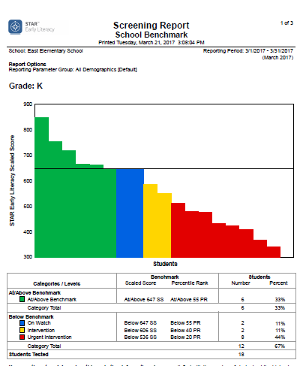
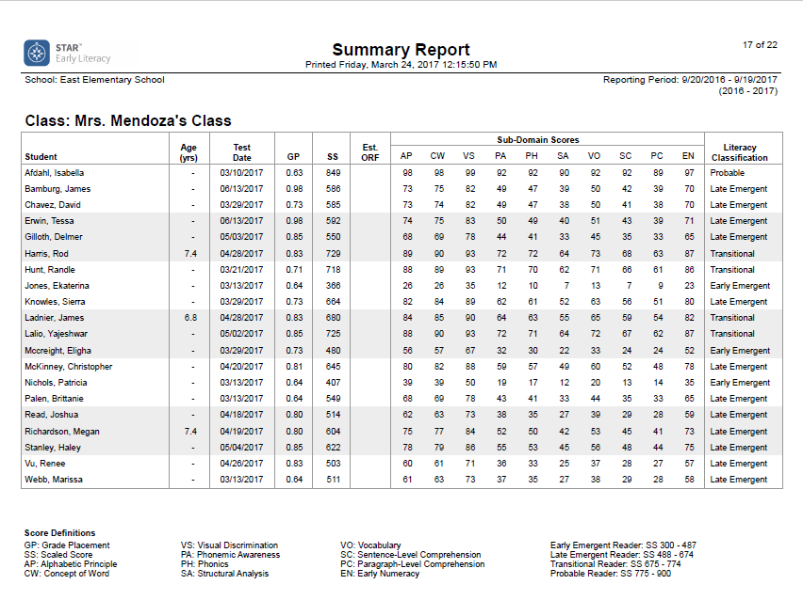
School-level reports
School Summary
School Diagnostic
Screening Report

Slide 51
Support and resources

Slide 52
Renaissance resources

Slide 53


Renaissance Place Help
Help at your fingertips
Help
  Searchable
  Specific to the page you’re on
Live Chat support
  Always live
  Always ready
Email help
  answers@renaissance.com
Give us a call
  1-800-338-4204

Slide 54
District Contacts for Star Early Literacy Implementation
For questions related to the implementation of the Star Early Literacy:
  Assessment, Research and Data Analysis
  305-995-7520
  Mayda Cabeza, Director I, or mcabeza@dadeschools.net
For questions related to the implications of the kindergarten readiness rates for the VPK program:
Office of Early Childhood Programs
305-995-7632
Dina Westberg, District Supervisor, or dina@dadeschools.net
Judy Palenzuela, District Coordinator, or jpalenzuela@dadeschools.net

Slide 55
Thank you! https://www.surveymonkey.com/r/HSLKX6B
Notes:
Thank you for viewing this screencast training. This screencast will remain active for you to use as you train your teachers for the administration of this assessment. At this time, please click on the screencast verification link to validate your training.

