Slide 1
Spring 2017
Florida Standards Assessments (FSA) and Florida Comprehensive Assessment Test (FCAT 2.0)
Training Materials for Paper-Based Administrations
Grades 4–7 FSA ELA Writing; Grade 3 FSA ELA Reading; and Grades 5 & 8 FCAT 2.0 Science

Slide 2
Agenda
Overview
Test Administration Schedules and Session Lengths
What’s New
Test Administration Policies and Procedures
  Accommodations
  Practice Tests
  Test Materials
  PreID labels and Rosters
Test Security Policies and Procedures
Test Invalidations/Defective Materials Policies and Procedures
School Assessment Coordinator Before, During, and After Testing
Return Schedules

Slide 3
Overview
These training materials are based on the Spring 2017 FSA Paper-Based Test Administration Manual available at www.FSAssessments.org and Spring 2017 Grades 5 & 8 Statewide Science Assessment Test Administration Manual, which is available at www.avocet.pearson.com/FL/Home.
There are separate training materials for the Spring 2017 FSA and NGSSS CBT administrations available on the FSA Portal and PearsonAccess Next, via Avocet.
These training materials are designed to highlight important information regarding test administration policies and procedures.

Slide 4

Test Administration Manual
Spring 2017 FSA PBT Manual
Includes scripts and instructions for administering the PBT:
  Grades 4–7 FSA ELA Writing and
  Grade 3 FSA ELA Reading
Appendix A includes script modifications and instructions for large print and one-item-per-page accommodations.
Scripts for Large Print and OIPP Accommodations are found in the FSA Accommodations Manual on the portal.

Slide 5

Test Administration Manual
Spring 2017 Grades 5 & 8 Statewide Science Assessment Manual
Includes scripts and instructions for administering the Statewide Science Assessment
Please note the following correction to the manual:
On page 66, the first bullet indicates that the test administrator should contact you “if a student has not participated in a test item practice session.”
  An item practice session is NOT required for the Science test. Please cross out the first bullet.
This correction has been made to the online version of the manual that is posted to Avocet.

Slide 6
Test Administration Schedule
Weekly Briefing ID #: 20444
PBT Test | Grades | Testing Day* | Make-up Testing
FSA ELA Writing | 4-7 | February 28 | March 1-3
FSA ELA Reading | 3 | March 28-29 | March 30-April 6
FCAT 2.0 Science | 5 | May 2-3 | May 4-5
 | 8 | May 2 | May 3-5
*Schools must adhere to the district-designated test administration day(s).
Any deviation from this schedule requires written approval from the Florida Department of Education (FLDOE).
FSA PBT TAM cover page 2; SCIENCE TAM cover page 2

Slide 7
Test Administration Schedule
Session Lengths
FSA ELA Writing Grades 4–7
  One 120-minute session.
FSA ELA Reading Grade 3
  Two 80-minute sessions over two days.
FCAT 2.0 Science Grades 5 and 8
  Grade 5 Science is administered in two 80-minute test sessions over two days.
  Grade 8 Science is administered in two 80-minute test sessions in one day.
FSA PBT TAM cover page 2; SCIENCE TAM cover page 2

Slide 8
What’s New
FSA ELA Writing Scripts
  Contain a scheduled stretch break at 60 minutes.
  Ensure that all school assessment coordinators train test administrators on how much time is allowed for the stretch break.
Test and Answer Books
  No longer contain a field to collect Student Identification Numbers.
  Students are asked to write in “Today’s Date” when completing other information (name, date of birth, etc.) when the script is read
NOT TO BE SCORED Return Labels
  For paper-based FSA and FCAT 2.0 assessments are now white (previously yellow).
FSA PBT TAM v; SCIENCE TAM iv

Slide 9
What’s New
Avocet
  Is an online resource guide, has been updated for Spring 2017 and is available for locating information on topics related to the Statewide Science Assessment, as well as FCAT 2.0 and NGSSS EOC assessments. Go to http://avocet.pearson.com/FL/Home to access the Avocet guide.
PreID labels can now be printed locally for NGSSS assessments. For information on printing PreID labels, see the Florida PearsonAccess Next User Guide.
SCIENCE TAM iv, v, 8

Slide 10

Test Administration Policies and Procedures
General Information about Accommodations
Spring/Summer 2017 FSA Accommodations TAM for information on accommodated PBT, including scripts. Available on the FSA Portal (Early February)
Appendix A of the PBT Manuals provide information concerning allowable accommodations for students with disabilities and for ELLs. The test administrator and the school assessment coordinator are responsible for ensuring that arrangements for accommodations have been made prior to the test administration dates.
For eligible students participating in the paper-based Grades 4–7 FSA ELA Writing, Grade 3 FSA ELA Reading, and Grades 5 and 8 FCAT 2.0 Science the following PBT accommodations are available:
  Large print – Contracted braille (EBAE and UEB)
  One-item-per-page – Uncontracted braille (EBAE and UEB)
FSA PBT TAM v, 4; SCIENCE TAM 3; Appendix A

Slide 11
Test Administration Policies and Procedures
FSA Test Item Practice
Students participating in a Grade 3 FSA ELA Reading assessment MUST participate in a test item practice session. During these practice sessions, test administrators will use a script to walk students through the Directions for Completing Grade 3 FSA ELA Reading Paper-Based Test Item Practice handout that will familiarize them and their students with the test format and item types.
Students participating in the Grades 4–7 FSA ELA Writing assessment are NOT required to participate in a practice test.
Students with a braille or large print accommodation are required to participate in a paper-based practice test using the appropriate practice materials.
  Braille and LP practice materials will be delivered to schools by February 3rd.
  Students should be encouraged to access the Directions handouts, as well as the full-length paper-based practice tests and answer keys, on the FSA portal to practice on their own.
FSA PBT TAM 4

Slide 12
Test Administration Policies and Procedures
FCAT 2.0 Science Sample Test Materials
Sample materials are developed by FDOE to assist teachers in preparing students for the Statewide Science Assessment. Schools are encouraged to use sample test materials to familiarize students with the test format.
Sample test materials can be accessed online at www.fldoe.org/accountability/assessments/k-12-student-assessment/science.stml.
Teachers should instruct students that they can access the materials themselves at any time as they prepare for testing.
SCIENCE TAM 4

Slide 13
Test Administration Policies and Procedures
FSA PBT Test Materials
The following test materials will be provided for students participating in the Spring 2017 FSA Grade 3 ELA Reading and Grades 4–7 ELA Writing PBT administrations:
  Grade 3 ELA Reading Test and Answer Books
  Grade 4 ELA Writing Test and Answer Books
  Grade 5 ELA Writing Test and Answer Books
  Grade 6 ELA Writing Test and Answer Books
  Grade 7 ELA Writing Test and Answer Books
  Planning Sheets for FSA ELA Writing
FSA PBT TAM 5

Slide 14
Test Administration Policies and Procedures
FSA PBT Test Materials (cont.)
FSA Writing Planning Sheets
  All students taking FSA ELA Writing will receive Writing Planning Sheets that they may use to take notes and plan their responses.
  The planning sheet is a one-page, letter-sized sheet. The front of the sheet is lined. The Testing Rules Acknowledgment is printed on the back of the sheet; students taking PBT Writing will disregard the acknowledgment on the planning sheet and sign next to the acknowledgment in their test and answer books.
  Planning sheets are distributed to students at the beginning of the ELA Writing test session. School assessment coordinators and test administrators must ensure that students have enough desk space to use their planning sheets.
  Used planning sheets are considered secure materials and must be kept in locked storage and returned in the District Assessment Coordinator ONLY box.
FSA PBT TAM 5

Slide 15
Test Administration Policies and Procedures
FCAT 2.0 PBT Test Materials
The following test materials will be provided for students participating in the FCAT 2.0 Science, as applicable:
  Grade 5 Statewide Science Assessment NGSSS Test Books
  Grade 5 Statewide Science Assessment NGSSS Answer Books
  Grade 8 Statewide Science Assessment NGSSS Test Books
  Grade 8 Statewide Science Assessment NGSSS Answer Books
  Periodic Tables of the Elements
Test materials for students who require large print, braille, or one-item-per-page accommodations are described in Appendix A of the manual.
SCIENCE TAM 4

Slide 16
Test Administration Policies and Procedures
Calculators for FCAT 2.0 Science
Four-function calculators must be provided to students for Grade 8 Science.
The school assessment coordinator and test administrators must ensure that one working calculator is available for each student in Grade 8 for use on the Science test.
Calculators may not be used by students on the Grade 5 Science test.
Contact the Test Distribution Center at 305-995-3743 to order additional four-function calculators.
SCIENCE TAM 4, 24

Slide 17
Test Administration Policies and Procedures
Calculators for FCAT 2.0 Science (cont.)
Students with visual impairments may use the approved large key/large display four-function calculators or approved talking four-function calculators supplied by FDOE.
Schools that have not yet accumulated an adequate supply of approved large key/large display or talking four-function calculators to accommodate all students with visual impairments may use comparable calculators that are regularly used in their classrooms.
  Such calculators must be basic, four-function models and must not have functions that are unavailable on approved calculators.
  No other calculators may be used.
SCIENCE TAM 4, 24

Slide 18
Test Administration Policies and Procedures
Periodic Tables for FCAT 2.0 Science
Periodic Table of the Elements are provided to students for Grade 8 Science.
Periodic tables are stand-alone pages and are shipped with test materials.
Test administrators will distribute periodic tables on the day of the test, according to the directions in the scripts.
Students may refer to them at any time during both sessions of the test.
After students complete the test, the test administrator should collect all periodic tables.
The school assessment coordinator should package the used periodic tables in the District Assessment Coordinator ONLY box.
Used periodic tables are secure materials and must not be reused.
SCIENCE TAM 4

Slide 19
Test Administration Policies and Procedures
Pencils
Ensure that students use No. 2 pencils to complete information on the student grid sheets, sign below the Testing Rules Acknowledgment, and record their responses.
Mechanical pencils must not be used.
Students should bring No. 2 pencils on the day of the test, but a supply of sharpened No. 2 pencils should also be available.
FSA PBT TAM 20; SCIENCE TAM 22

Slide 20
Test Administration Policies and Procedures
Watch or Clock
Starting and stopping times should be displayed for students according to the instructions in the test administration script.
If a disruption occurs during testing, note the time of the disruption in order to provide students the appropriate amount of remaining time once testing resumes.
Remember that failure to provide the correct amount of time will likely result in test invalidation.
FSA PBT TAM 20; SCIENCE TAM 22

Slide 21
Test Administration Policies and Procedures
Student Demographic Information
Basic student information is captured on the front cover of the test and answer book.
The preidentification (PreID) information provided by MDCPS is used to create student PreID labels, which are shipped with test materials or printed locally at the schools via TIDE or PearsonAccess Next.
The demographic information described on the following slides must be verified on PreID labels or rosters BEFORE they are applied to documents and verified in TIDE and PearsonAccess Next before printing PreID Labels.
Note: A PreID label must be applied to all used test and answer FSA books. Results for TO BE SCORED test and answer books returned without labels will be included in late reporting if FDOE can determine to whom the materials belong.
FSA PBT TAM 6-9; SCIENCE TAM 8

Slide 22
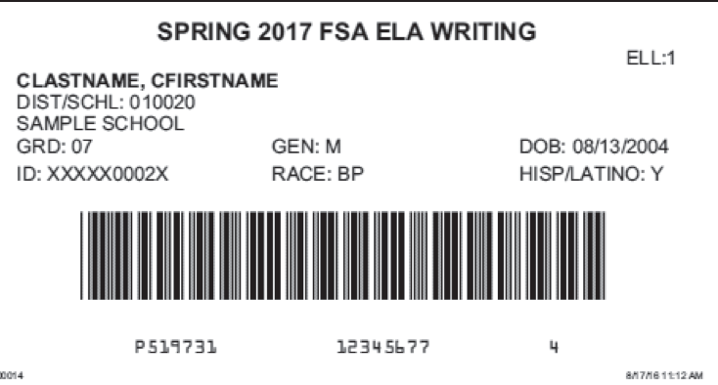
Test Administration Policies and Procedures
Student Demographic Information (cont.)
In TIDE, verify this information before FSA PBT testing :
  Student name
  District/school number
  Florida Student ID Number
  Grade level
  Date of birth
  Gender
  Ethnicity
  Race
FSA PBT TAM 6-9

Slide 23
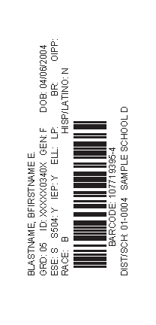
Test Administration Policies and Procedures
Student Demographic Information (cont.)
For FCAT 2.0 Science destroy labels in a secure manner if any of the following information is incorrect:
  Student Name
  Student ID Name (Social Security Number or Florida Student Number)
  District Number
  School Number
  Grade Level
If any other preidentified information (e.g., gender, date of birth) is incorrect, report the incorrect information to the school student information database manager after testing has been completed.
SCIENCE TAM 5-10

Slide 24

Test Administration Policies and Procedures
Student Demographic Information (cont.)
  In addition, verify the following categories, if applicable.
Primary Exceptionality
Section 504
Testing Accommodations Listed on IEP or 504 Plan
ESE/504 and ELL Accommodation Types
ELL (length of time)
  If demographic information needs to be updated in TIDE, follow the instructions in the TIDE User Guide.
FSA PBT TAM 6-9; SCIENCE TAM 5-10

Slide 25
Test Administration Policies and Procedures
Preidentified (PreID) Student Labels
The preidentification information provided by MDCPS is based on student enrollment as of the following dates for each PBT test:
For FSA and FCAT 2.0, the PreID files as used to populate TIDE and PearsonAccess Next and print PreID labels and rosters.
M-DCPS supplied class code and homeroom information for Elementary, K-8, and Middle schools, therefore the labels and PreID information in TIDE and PearsonAccess Next are sorted by homeroom.
School staff may verify and apply labels no sooner 5 working days prior to testing.
PreID Labels—Schools will receive blank labels to create On-Demand PreID Labels in TIDE and print PreID labels in PearsonAccess Next for students who need them. Additional blank labels may be ordered from TDC at 305-995-3743, if needed.
Test | Wave 1 Date | Wave 2 Date
FSA ELA Writing, Reading, and Math | December 2* | January 20
FCAT 2.0 Science | March 10
*PreID labels and rosters will be printed from Wave 1.
FSA PBT TAM 6-9; SCIENCE TAM 8-10

Slide 26
Test Administration Policies and Procedures
Preidentified (PreID) Student Labels (cont.)
Please adhere to the following policies when preparing student materials:
  Affix labels in the box on the student demographic page that states “APPLY PREID LABEL HERE.”
  Please note that this box on FSA documents contains a barcode used for scanning unused documents that will be covered by the label on TO BE SCORED FSA documents.
  For FSA tests, the PreID label number below the barcode must be readable. Be sure that the barcodes are not faded or torn.
FSA PBT TAM 6-9; SCIENCE TAM 8-10

Slide 27
Test Administration Policies and Procedures
Preidentified (PreID) Student Labels (cont.)
Please adhere to the following policies when preparing student materials:
  Only the school assessment coordinator and other authorized school personnel may open the shrink-wrapped packages and affix labels. Sealed test and answer books must not be opened.
  Ensure that the administration (e.g., Spring 2017 FSA ELA Writing) is correctly indicated on the label.
  Students and unauthorized school personnel are not permitted to assist in preparing secure materials before testing or in organizing and returning materials after testing.
  The Test Materials Chain of Custody Form must be maintained at all times.
  All secure materials must be returned to locked storage and remain there until testing.
FSA PBT TAM 6-9; SCIENCE TAM 8-10

Slide 28
Test Security Policies and Procedures
Security Numbers
All regular print test and answer books and special document test materials (large print, braille, and one-item-per-page) are secure documents and must be protected from loss, theft, and reproduction in any medium.
A unique identification number and barcode are printed on the front cover of all secure test and answer books.
  For FSA test books: The security number consists of the last eight digits of the identification number. These eight digits are located next to the barcode.
  For FCAT 2.0 books: The security number consists of a nine-digit number followed by a check digit.
Schools must maintain test security by using the security numbers to account for all secure test materials before, during, and after test administration until the time they are returned to the contractor.
The test administrator should also maintain a record of the security numbers for all test and answer books assigned to him or her. The security number(s) of the document(s) assigned to and returned by each student should be recorded and verified at the completion of each day of testing.
FSA PBT TAM 11-13; SCIENCE TAM 13-14

Slide 29
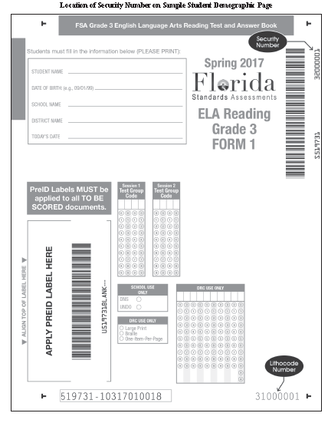


Test Security Policies and Procedures
Location of Security #s
FSA PBT TAM 11-13; SCIENCE TAM 13-14

Slide 30
Test Security Policies and Procedures
Hazardous Materials
If a used test and answer book is soiled (e.g., with blood or vomit), the school assessment coordinator should email the security number to Mara at mugando@dadeschools.net. School personnel may transcribe responses into a replacement test and answer book.
The damaged test and answer book should then be destroyed or disposed of in a secure manner (e.g., shredding, burning). Soiled test and answer books should not be returned with test materials.
Missing Materials
School assessment coordinators must verify that all secure materials are received and should report any mispackaged or missing materials to SAET immediately at 305-995-7520.
Individuals responsible for handling secure materials are accountable for the materials assigned to them. Test administrators should report any missing materials to the school assessment coordinator immediately.
Schools must investigate any report of missing materials. If, after a thorough investigation, a secure document is not found, the school assessment coordinator must contact SAET at 305-995-7520.
FSA PBT TAM 13; SCIENCE TAM 13-15

Slide 31
Test Security Policies and Procedures
Missing Materials and Security Breach
A written report must be submitted to the Office of SAET within 7 calendar days after secure materials have been identified as missing or a security breach has been reported. The report must include the following, as applicable:
  The nature of the situation
  The time and place of the occurrence
  The names of the people involved
  Copies of completed forms (Test Administration and Security Agreements, Test Administrator Prohibited Activities Agreements, Test Materials Chain of Custody Form, etc.)
  A description of the communication between the district assessment coordinator’s office and school personnel
  How the incident was resolved
  What steps are being implemented to avoid future losses
FSA PBT TAM 13-14; SCIENCE TAM 15-16

Slide 32

Test Invalidation/Defective Materials Policies and Procedures
Do Not Score (DNS) and UNDO Bubbles
DNS and UNDO bubbles are located in the SCHOOL USE ONLY box on the student demographic page.
The DNS bubble must be gridded when a test and answer book is invalidated.
If a DNS bubble has been gridded by mistake, erase the DNS bubble and grid the UNDO bubble. Then package the test and answer book with all other TO BE SCORED materials.
FSA PBT TAM 15-17; SCIENCE TAM 17-19

Slide 33
Test Invalidation/
Defective Materials
DNS Guidelines for Defective Materials
Identified BEFORE testing:
Provide a replacement document
  If original is USED, mark the DNS bubble and return with NOT TO BE SCORED (NTBS)
  If original is UNUSED, do not mark DNS and return with NOT TO BE SCORED (NTBS)
Identified DURING testing:
Give student replacement with the same form number, if available, if not give any form
After testing, under the supervision of the test administrator, the student must transfer the exact responses to the replacement
If test items differ, student should leave them blank in replacement
Return defective in NTBS box with the DNS marked
Return replacement in TO BE SCORED box
Print an ON-DEMAND PreID label for FSA
Print a PreID label or hand-grid demographic information for FCAT 2.0
FSA PBT TAM 15-17; SCIENCE TAM 17-19

Slide 34
Calibration Schools
FSA ELA Calibration Schools
Schools designated as ELA calibration schools will receive striped return labels that will be used to return TO BE SCORED materials for paper-based calibration materials (Grades 4, 5, 6, or 7 ELA Writing and Grade 3 ELA Reading).
Calibration labels will be the same color as the applicable administration (e.g., gray for Grade 3 ELA Reading) but will include a stripe across the middle of the label.
SAET has provided a list of calibration schools to each school via Weekly Briefing # 20184.
FSA PBT TAM v

Slide 35
School Assessment Coordinator
Before Testing
Receive FSA Materials
You will receive the following materials for the FSA (CBT and PBT) administrations, as applicable:
FSA School Boxes
  School Assessment Coordinator Box (White) will include:
    School Cover Memo
    School Box Range Sheet
    School Security Checklist
    PreID Labels
    PreID Rosters
    On-Demand PreID Labels
    School Packing List
    School Order Summary
    Roll of Plastic Return Bags
FSA PBT TAM 46-47

Slide 36
School Assessment Coordinator
Before Testing
Receive FSA Materials (cont.)
FSA School Boxes
  School Assessment Coordinator Box (White) (cont.)
  Return labels:
    Green Labels (TO BE SCORED ELA Writing)
    Green-Striped Labels (Calibration TO BE SCORED ELA Writing—selected grade)
    Gray Labels (TO BE SCORED Grade 3 ELA Reading)
    Gray-Striped Labels (Calibration TO BE SCORED Grade 3 ELA Reading)
    Blue Labels (TO BE SCORED large print/one-item-per-page)
    Pink Labels (TO BE SCORED braille)
    White Labels (NOT TO BE SCORED)
  Test administration manuals
  Planning sheets
  FSA Test and Answer Books
FSA PBT TAM 46-47

Slide 37
School Assessment Coordinator
Before Testing
Receive FSA Materials (cont.)
FSA Special Document Boxes
  Large Print Kits
    Special Document Return Envelope
    Regular Print Test and Answer Book
    Large Print Planning Sheet (if applicable)
    Large Print Test and Answer Book
  Braille Kits
    Special Document Return Envelope
    Regular Print Test and Answer Book
    Braille Scripts
    Braille Notes
    Braille Test Book
  One-Item-Per-Page Kits
    Special Document Return Envelope
    Regular Print Test and Answer Book
    One-Item-Per-Page Test and Answer Book
FSA PBT TAM 46-47

Slide 38
School Assessment Coordinator Before Testing
Receive FCAT 2.0 Science Test Materials
The first school box is a white box with a red stripe.
FCAT 2.0 Science School Boxes
    School Cover Memo
    Packing List
    School Assessment Coordinator Kit—clear plastic bag
      Document Count Forms
      Paper Bands
      Red Labels (TO BE SCORED Grades 5 and 8 Science)
      White Labels (NOT TO BE SCORED materials)
    PreID Rosters
    PreID Labels
    Periodic Tables (Grade 8 Science)
    Science Test Books and Answer Books
SCIENCE TAM 63-64

Slide 39
School Assessment Coordinator Before Testing
Receive FCAT 2.0 Science (cont.)
  Special Document Kits will include the following:
    Blue Labels (TO BE SCORED large print/one-item-per-page) or Pink Labels (TO BE SCORED braille)
    White Labels (NOT TO BE SCORED)
    Document Count Forms
    Special Document Return Envelopes
    Special Document Test Materials
    Inventory the contents of boxes within 24 hours of receipt, and maintain an accurate Test Materials Chain of Custody Form at all times. Contact SAET immediately at 305-995-7520 to report missing materials. To request additional materials call TDC at 305-995-3743.
    Remember to save the original boxes for returning TO BE SCORED special document materials.
SCIENCE TAM 63-64

Slide 40
School Assessment Coordinator Before Testing
Test Materials Chain of Custody Form
    You are required to maintain a Test Materials Chain of Custody Form, located in the manuals and online at Avocet and the FSA Portal.
    The purpose of this form is to track test materials (secure test and answer books) at all times, including their location, the dates and times they are handled, and the names of the people performing various activities involving the materials.
    Schools must retain electronic or hard copies of completed forms for their files after materials are packaged for pickup and return the originals in the District Assessment Coordinator ONLY box.
FSA PBT TAM 48, Appendix E and SCIENCE TAM 65, Appendix C

Slide 41
School Assessment Coordinator
Before Testing
Assign Test Group Codes
Test group codes are used as a security measure to identify groups of students tested together.
School assessment coordinator will create a unique four-digit test group code to provide to each test administrator.
Each test administrator must be given one four-digit test group code to use in his or her testing room. Each testing room must use a different test group code.
If any students are missing during an assessment, a different and unique test group code must be provided for each make-up session.
FSA PBT TAM 56; SCIENCE TAM 64

Slide 42
School Assessment Coordinator
Before Testing
Print PreID Labels
If necessary, print PreID Labels for students who were not included in the original PreID upload for this administration, who transferred to your school after the PreID upload, or whose PreID label contains incorrect information or has been damaged.
Blank labels for printing On-Demand PreID Labels in TIDE and PreID labels in PearsonAccess Next will be included with your initial shipment of test materials. Contact TDC at 305-995-3743 to order additional blank labels if needed.
See the TIDE User Guide and Florida PearsonAccess Next User Guide for instructions on how to print PreID Labels.
FSA PBT TAM 47, TIDE User Guide and SCIENCE TAM 8, PearsonAccess Next User Guide

Slide 43
School Assessment Coordinator
Before Testing
Required Administration Information
  Students assigned to each testing room—provide Student Names and Student ID Numbers
  Attendance information—P=Present, A=Absent, W=Withdrawn, and P/I=Present but Invalidated
  Grade level
  Test group code
  Accommodations provided to students
  Accommodations used by students
  Signatures of test administrator and school assessment coordinator
  Unique security numbers of secure documents assigned to each student
  Dates and times when secure materials (e.g., test and answer books) are received and returned
  Copy and file all required administration information for future reference.
FSA PBT TAM 47; SCIENCE TAM 20

Slide 44
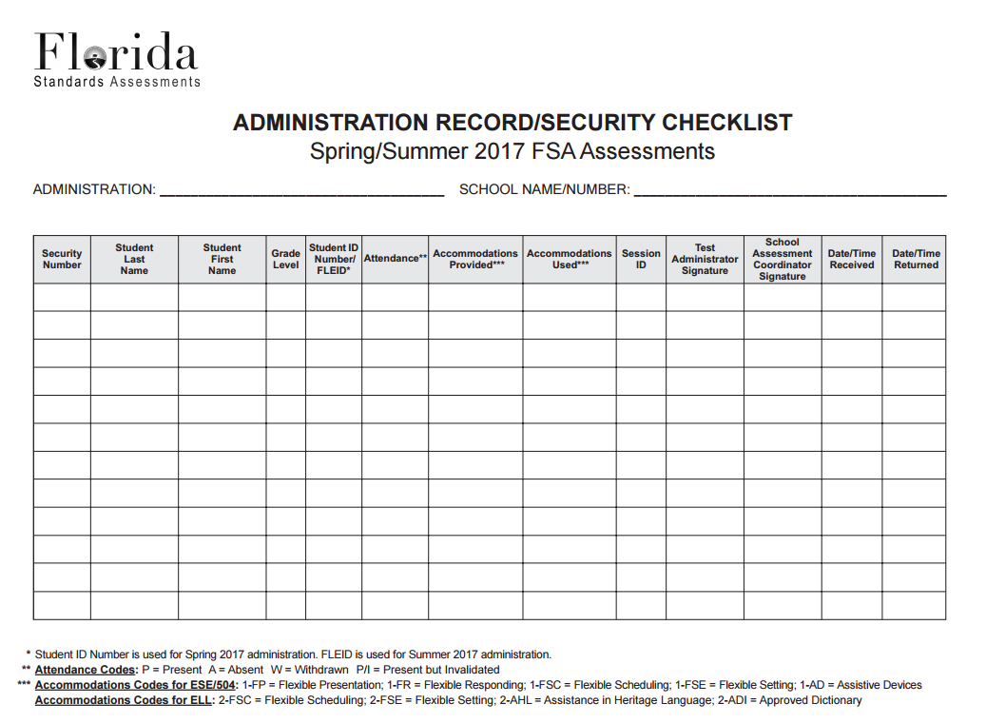
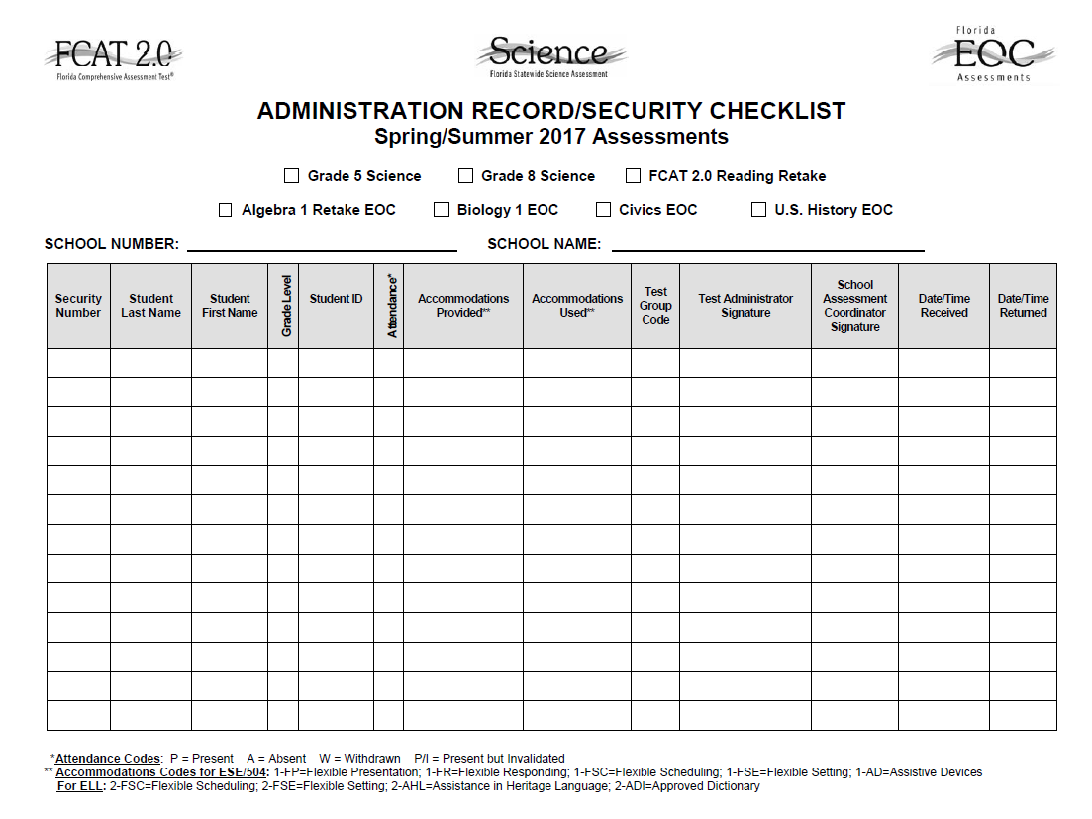
School Assessment Coordinator
Before Testing
FSA PBT TAM Appendix E; SCIENCE TAM Appendix C
Pre-populated Security Checklists: will be provided
  FSA: Access the checklists in TIDE
  FCAT 2.0: Access the checklists in PearsonAccess Next
Blank security checklists are available in the manuals and online.
School assessment coordinators can create their own checklists.

Slide 45
School Assessment Coordinator
Before Testing
Ensure Implementation of Accommodations
Schools will use the new Spring/Summer 2017 FSA Accommodations Test Administration Manual for information about accommodated paper-based assessments, including scripts. This manual is located on the FSA Portal only.
Appendix A of the Spring 2017 FSA PBT Manual and the FCAT 2.0 Science Manual provides information concerning allowable accommodations for students with disabilities and for ELLs.
When testing students with accommodations, prior planning is necessary to ensure that accommodations indicated on student IEPs, Section 504 plans, or ELL plans are implemented.
Arrangements for implementing accommodations must be made prior to the administration dates. Make sure that test administrators have been properly trained and have made provisions for the exact accommodations needed for individual students to avoid test invalidations.
FSA PBT TAM 48; SCIENCE TAM 66; Appendix A

Slide 46
School Assessment Coordinator
Before Testing
Preparation and Training
Be aware of the following policies, procedures, and instructions, and emphasize this information during training at your school:
  Test administrators must read and be familiar with all appropriate sections of the manuals.
  Test administrators who will be administering a test to students using large print, braille, or one-item-per-page accommodations must be trained in the use of those test materials, including requirements for administering test item practice tests and paper-based practice tests.
FSA PBT TAM 48-50; SCIENCE TAM 47-67

Slide 47
School Assessment Coordinator
Before Testing
Preparation and Training (cont.)
  Train test administrators on how to administer practice tests at your school. Test administrators should access the practice test to become familiar with item types and format of the test prior to administering a practice test and prior to a test administration.
  Writing Responses : For Writing PBT assessments, students must use the three lined pages in their test and answer books to provide their responses. No extra paper may be provided. Planning sheets will not be scored.
FSA PBT TAM vi, 48-50; SCIENCE TAM 4

Slide 48
School Assessment Coordinator Before Testing
Preparation and Training (cont.)
    In the test administration scripts, test administrators are instructed to contact you in the circumstances listed below. Provide instructions for how to handle these circumstances:
      A defective test book or answer book is found.
      A PreID label contains incorrect information.
      A student has not participated in a test item practice session.
      Option A, B, or C to read to students at the end of the script.
      A student refuses to acknowledge the Testing Rules Acknowledgement.
FSA PBT TAM 48-50; SCIENCE TAM 65-66

Slide 49
School Assessment Coordinator
Before Testing
Manage Student Information in TIDE
See the TIDE User Guide, available on the FSA Portal, for instructions on managing student information in TIDE and how to perform the following tasks prior to testing:
  Adding Students
  Editing Student Demographic Information
  Printing On-Demand PreID Labels
Arrange Practice Sessions
Schedule and arrange test item practice sessions as described in the Spring 2017 FSA PBT Manual. Students participating in a Grade 3 FSA ELA Reading assessment are required to participate in a test item practice session.
Students with braille or large print PBT accommodation are required to participate in a paper-based practice test using the appropriate practice materials.
FSA PBT TAM 50; SCIENCE TAM 90

Slide 50
School Assessment Coordinator
During Testing
Distribute Test Materials
On each day of testing, you are responsible for providing each test administrator the test materials before testing begins, as applicable:
  Test and answer books
  Planning sheets (FSA Writing)
  Test group code
  Periodic Tables (Grade 8 Science)
  Approved Four-Function Calculators (Grade 8 Science)
  Other materials, including a supply of No. 2 pencils, a Security Log, and a form to collect required administration information.
FSA PBT TAM 51; SCIENCE TAM 68

Slide 51
School Assessment Coordinator
During Testing
Supervise Test Administrations
Ensure all test security and test administration policies and procedures are followed while conducting make-up tests. Be available to assist test administrators as needed during make-up administrations.
For Grade 3 ELA Reading and Grades 5 and 8 FCAT 2.0 Science Session 1 must be administered before Session 2.
For Grade 3 ELA Reading and FCAT 2.0 Science Grade 5, the two sessions must be administered over two days.
For Grade 8 Science, Sessions 1 and 2 are administered in one day.
  However, students with disabilities and ELL students with extended time accommodation may complete a session per day.
FSA PBT TAM 51; SCIENCE TAM 68

Slide 52
School Assessment Coordinator
After Testing
Receive Materials from Test Administrators
Follow these steps as you receive materials from test administrators:
Verify that all secure materials have been returned. Notify SAET at 305-995-7520 immediately if any secure materials are missing and complete the necessary investigation.
Make copies of the following completed documents and file the copies:
Seating charts
Records of required
administration information
Return the originals in your District Assessment Coordinator ONLY box.
Security Logs
Chain of Custody forms
FSA PBT TAM 52-53; SCIENCE TAM 69-72

Slide 53
School Assessment Coordinator
After Testing
Receive Materials from Test Administrators (cont.)
Ensure each test and answer book has a PreID label. To print PreID Labels, follow the instructions in the TIDE User Guide or in the Florida PearsonAccess Next User Guide.
Verify DNS bubbles.
  If a test has been invalidated, verify that the DNS bubble has been gridded and that the document is placed with TO BE SCORED materials.
  Verify that no DNS bubbles have been gridded by mistake.
  Verify that the DNS bubble has been gridded on any defective documents and place the documents with NOT TO BE SCORED materials.
Ensure that the PreID labels applied to special program students’ test and answer books indicate the correct district/school numbers.
Prepare materials for return using the FSA Paper-Based Materials Return Instructions in Appendix C of the Spring 2017 PBT FSA Manual and the Spring 2017 Grades 5 and 8 Statewide Science Assessment TAM page 69; and the Friendly Reminders from TDC.
FSA PBT TAM 52-53; SCIENCE TAM 69-72

Slide 54
School Assessment Coordinator
After Testing
Update Student Information
If student information is discovered to be incorrect during testing, update the corrected information in TIDE or PearsonAccess Next immediately following test administration. Instructions for updating student information can be found in the TIDE User Guide and in the Florida PearsonAccess Next User Guide.
Record Accommodations
Ensure all accommodations provided to and used by students are recorded on each record of required administration information, as applicable. This documentation may be necessary in the case of investigations regarding possible test irregularities.
FSA PBT TAM 53; SCIENCE TAM 9, 21

Slide 55
TDC Important Announcements Regarding Material Returns
The following exams are ALL due back to the vendors prior to Spring Break and must ship no later than April 7th:
  FCAT Reading Retakes & NGSSS Algebra 1 Retakes
  FSA ELA Retakes and FSA Algebra 1 Retakes
  Grade 3 FSA ELA Reading (Calibration & Non-Calibration)
  SAT-10 and FSA ELA Writing Window 1 Make ups
It is imperative that materials be delivered as early as possible, by April 5th, to allow the staff at TDC time to prepare return shipments. PLEASE DO NOT WAIT UNTIL APRIL 6TH TO RETURN MATERIALS.
Delivery schedule at TDC has been modified as follows:
  Monday, Tuesday, Thursday and Friday – deliveries will be accepted from 8:00 am to 2:00 pm
  Wednesday – deliveries will be accepted from 8:00 am to 1:00 pm

Slide 56
Return Dates of TBS
See Friendly Reminders
Test | Grade | Label | “TO BE SCORED” Return
FSA ELA Writing | 4-7 | STRIPED GREEN | Calibration and Non-Calibration: March 2-6
 |  | GREEN
 |  | GREEN | Make-up 1: April 5-6
 |  |  | Make-up 2*: May 11-12
FSA ELA Reading | 3 | STRIPED GRAY | Calibration : March 30-31
 |  | GRAY | Non-Calibration: April 3-5
FCAT 2.0 Science | 5 and 8 | RED | May 4-5
Also return any Large Print (Blue Label), Braille (Pink Label), and OIPP (Blue Label) To Be Scored Boxes.
*FSA ELA scores will be reported late.
Note: Schools must hand-deliver TO BE SCORED materials to TDC by 2 p.m. daily, EXCEPTION is on Wednesdays, return by 1 PM. TDC is at 13135 S.W. 26 Street, Miami, FL 33175.
Friendly Reminders from TDC

Slide 57
District Assessment Coordinator Only Box
TESTS | MATERIALS TO BE INCLUDED | LABEL
FSA ELA Writing Grades 4-7 FSA ELA Reading Grade 3 FCAT 2.0 Science Grades 5 and 8 | Original Test Materials Chain of Custody Form (PBT only) Original Security Agreements and Test Administrator Prohibited Activities Agreements Original Administration Record / Security Checklist or school’s developed form with all required administration information Original Security Logs Original Seating Charts Planning Sheets (used and unused) Periodic Table of Elements (used and unused) Original School Procedural Checklist (FM-6927) | A fillable PDF “RETURN LABEL” – Enter requested information, Print, and Tape to the side of the box
NEW
Note: Test Administration and Security Agreement forms, and Test Administrator Prohibited Activities Agreement forms will remain at the school for one calendar school year.
Please retain copies of all of the above documents for your records for one year. Do not copy planning sheets. Do Not Pack Paper-based test materials in these boxes
Friendly Reminders from TDC

Slide 58
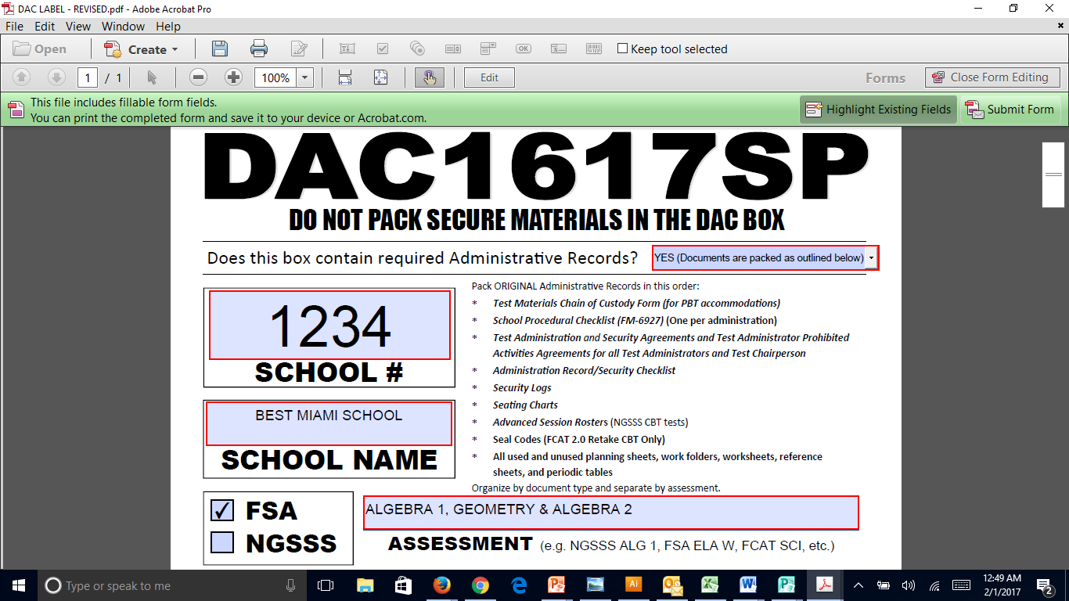
District Assessment Coordinator Only Box LABEL

Slide 59
Pick-Up Dates of NTBS and DAC Only Box
Comet Delivery Services will pick- up FSA and FCAT 2.0 “NTBS” and DAC Boxes:
Materials | Materials | Date*
All “NOT TO BE SCORED” materials (including NOT TO BE SCORED special documents) | WHITE Labeled Boxes | May 19-26
DISTRICT ASSESSMENT COORDINATOR ONLY BOXES (DAC) (No DRC/PEARSON Color Return Label) Include all documentation for: FSA ELA Writing (Grades 4-10 and Retakes); FSA ELA Reading (Grades 3-10 and Retakes); FSA Mathematics (Grades 3-8); FCAT 2.0 Science (Grades 5 and 8); FCAT 2.0 Reading Retake; NGSSS Algebra 1 Retake EOC; FSA Algebra 1 Retake EOC; and FSA and NGSSS EOC Assessments |  | May 30-June 5
*Please note that if materials are not ready for pick-up, you must hand-deliver them to TDC no later than June 5th, by 2 p.m. daily (EXCEPTION, on Wednesday return by 1 pm).
Friendly Reminders from TDC

Slide 60
NEW at TDC
Ordering Additional Materials (New this Year!)
TDC Documents webpage (link located above the “Test Chairperson Info” link)
Orders submitted before 3:00 pm will be available for pick up in 24 hours; order placed after 3:00 pm will require 48 hours processing
Email will only be sent by TDC when materials are on backorder

Slide 61
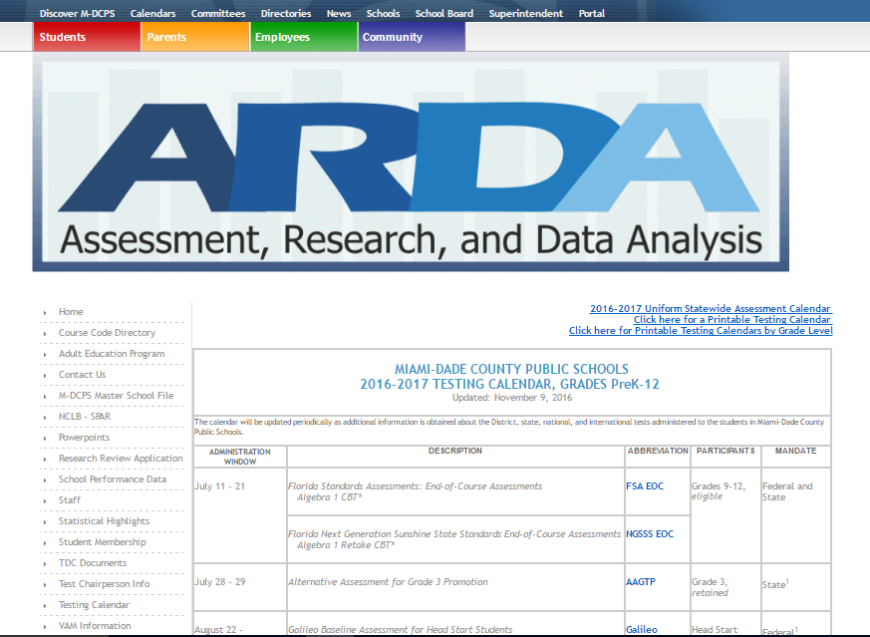

Slide 62
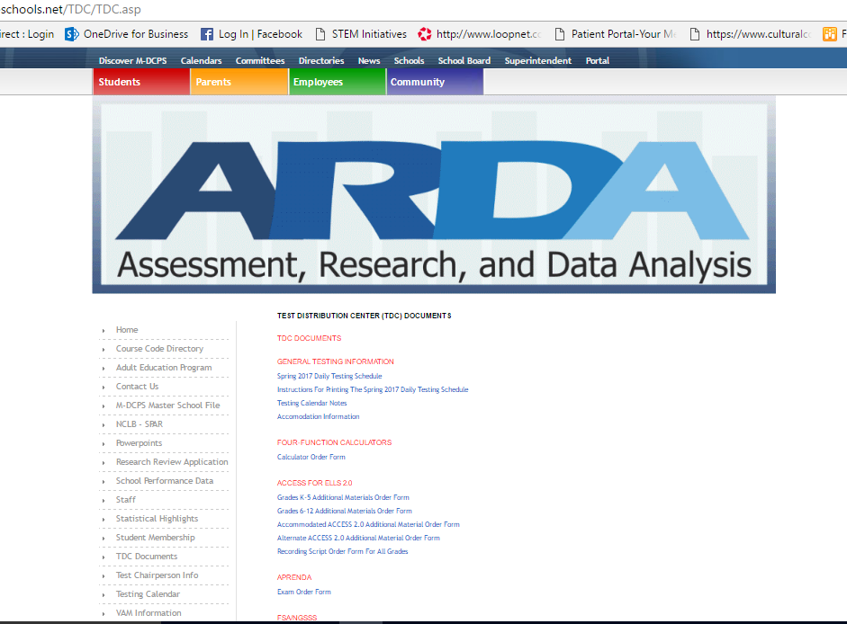
Exam Titles
Available Forms

Slide 63
Appendices
Appendices in the Spring 2017 FSA PBT Manual include:
Appendix A: Accommodations
Appendix B: FSA Help Desk
Appendix C: FSA Paper-Based Materials Return Instructions
Appendix D: Florida Test Security Statute and Rule
Appendix E: Perforated Forms and Signs
Appendices in the Spring 2017 Statewide Science Manual include:
Appendix A: Accommodations
Appendix B: Florida Test Security Statute and Rule
Appendix C: Perforated Forms and Signs

Slide 64
Contact Information
Student Assessment and Educational Testing
  Maria C. Bruguera, Director
  Email: mbruguera@dadeschools.net or
  Mara Ugando, Staff Specialist
  Email: mugando@dadeschools.net
Phone: 305-995-7520
Fax: 305-995-7522

Slide 65
Thank you for ensuring a secure
and successful
test administration!

