Slide 1


Fall/Winter 2019
Next Generation Sunshine State Standards
End-of-Course Assessments
Training Materials
Biology 1, Civics, & U.S. History EOC
Notes:
The following presentation will review the guidelines for administering the NGSSS Biology 1, Civics, and US History EOC assessments during the fall and winter administrations.
There is a Training Packet posted to the Test Chairperson website that we urge you to review and print out for more information.

Slide 2

Test Administration Manual
Scripts and instructions for administering the Biology 1, Civics, and U.S. History End-of-Course (EOC) assessments are included in the manual available on the Florida Resource Center at florida.pearsonaccessnext.com/resources-training.
If you are administering a paper-based test or an accommodated computer-based test (CBT) form, refer to the appropriate script available at. http://avocet.pearson.com/FL/Home
Notes:
These training materials are based on the Fall/Winter 2019 NGSSS End-of-Course Test Administration Manual, which is available on the Florida Resource Center noted on this slide.
These training materials are designed to highlight important information regarding test administration policies and procedures.
Not all information from the test administration manual is included in this presentation, so it is imperative that school staff read and familiarize themselves with all information in the manual in addition to using these training materials.

Slide 3

Resources
CBT
PBT
Additional resources for the NGSSS assessments are available at Florida Resource Center at http://florida.pearsonaccessnext.com/resources-training, including:
  2019–2020 Florida PearsonAccess Next User Guide
    Florida-specific resource for the most common tasks in PearsonAccess Next
  PBT Accommodated Scripts
  CBT Accommodated Scripts
  Other administration materials
Information and instructions for technology coordinators to follow before, during, and after testing are provided at http://florida.pearsonaccessnext.com/technology-resources.
  Technology coordinators must familiarize themselves with all information at this site prior to the beginning of test administration.
Notes:
Additional resources for the NGSSS EOC assessments are available at Florida Resource Center at http://florida.pearsonaccessnext.com/resources-training, including:
2019–2020 Florida PearsonAccess Next User Guide
PBT Accommodated Scripts
CBT Accommodated Scripts
Other administration materials
Information and instructions for technology coordinators to follow before, during, and after testing are provided at in the web link on this slide.
Technology coordinators must familiarize themselves with all information at this site prior to the beginning of test administration.

Slide 4

Fall 2019:
Test Administration Schedule
PBT
CBT
Date* | Assessment | Duration**
PBT: September 9-20 | Biology 1, Civics, and US History EOCs | 160 minutes
CBT: September 9-27
*Paper-based test accommodations must be completed within the first 2 weeks of the window to meet the return deadline and ensure timely reporting of test results.
**Each NGSSS EOC assessment will be administered in one 160-minute session with a scheduled stretch break after 80 minutes. Any student who has not completed the test by the end of the allotted time may continue working; however, testing must be completed within one school day. After the first 80 minutes, students may be dismissed from the testing room as they complete testing.
Any deviation from this schedule requires written approval from FDOE prior to implementation.
Notes:
The fall administration window for the computer-based Biology 1, Civics, and U.S. History NGSSS EOC assessments is September 9-27. However, Paper-based test accommodations for all subject areas (NGSSS Biology 1, Civics, and US History) must be completed during the first 10 days of the testing window (September 9-20) to meet the return deadline and ensure timely reporting of test results.
The EOC computer-based tests may be administered in any order, by school, based on needs of students within a school. One subject does not need to be completed before another begins, and subject tests may be administered concurrently. Additionally, testing should be completed within the least number of days possible but must be completed by the last day of the testing window.
Each NGSSS EOC assessment will be administered in one 160-minute session with a scheduled stretch break after 80 minutes. Any student who has not completed the test by the end of the allotted time may continue working; however, testing must be completed within one school day. (Note: A student is not required to have extended time accommodation documented on an IEP or Section 504 Plan in order to receive extended time up to one school day on an NGSSS EOC assessment.) After the first 80 minutes, students may be dismissed from the testing room as they complete testing. Any deviation from this schedule requires written approval from FDOE prior to implementation.

Slide 5
Winter 2019:
Test Administration Schedule
PBT
CBT
Date* | Assessment | Duration**
PBT: December 2-13 | Biology 1, Civics, and US History EOCs | 160 minutes
CBT: December 2-20
*Paper-based test accommodations must be completed within the first 2 weeks of the window to meet the return deadline and ensure timely reporting of test results.
**Each NGSSS EOC assessment will be administered in one 160-minute session with a scheduled stretch break after 80 minutes. Any student who has not completed the test by the end of the allotted time may continue working; however, testing must be completed within one school day. After the first 80 minutes, students may be dismissed from the testing room as they complete testing.
Any deviation from this schedule requires written approval from FDOE prior to implementation.
Notes:
The winter administration window for the computer-based Biology 1, Civics, and U.S. History NGSSS EOC assessments is December 2-20. However, Paper-based test accommodations for all subject areas (NGSSS Biology 1, Civics, and US History) must be completed during the first 10 days of the testing window (December 2-13) to meet the return deadline and ensure timely reporting of test results.
Any deviation from this schedule requires written approval from FDOE prior to implementation.

Slide 6
Presentation Features
In the slides that follow, the right portion of the header will indicate when slides are relevant to computer-based testing (CBT), paper-based testing (PBT), or both:
PBT
CBT
CBT
PBT
Notes:
In the slides that follow, the right portion of the header will indicate when slides are related to computer-based testing (CBT), paper-based testing (PBT), or both.

Slide 7

What’s New
CBT
PBT
Pearson has released the new TestNav App for the 2019–2020 school year. All schools administering NGSSS tests must download and install this new app.
The previous version of the app (version 8.12.x) has been blocked; please ensure to update your computers and devices prior to administering Fall 2019 NGSSS EOC tests.
  Instructions and download links for the new app are available at: http://download.testnav.com/.
The 2019-2020 supported operating system changes from Pearson has been provided in Weekly Briefing #26033.
Notes:
Pearson has released the new TestNav App for the 2019–2020 school year. All schools administering NGSSS tests must download and install this new app.
The previous version of the app (version 8.12.x) has been blocked; please ensure to update your computers and devices prior to administering Fall 2019 NGSSS EOC tests.
Instructions and download links for the new app are available at: http://download.testnav.com/.
The 2019-2020 supported operating system changes from Pearson has been provided in Weekly Briefing #26033.

Slide 8
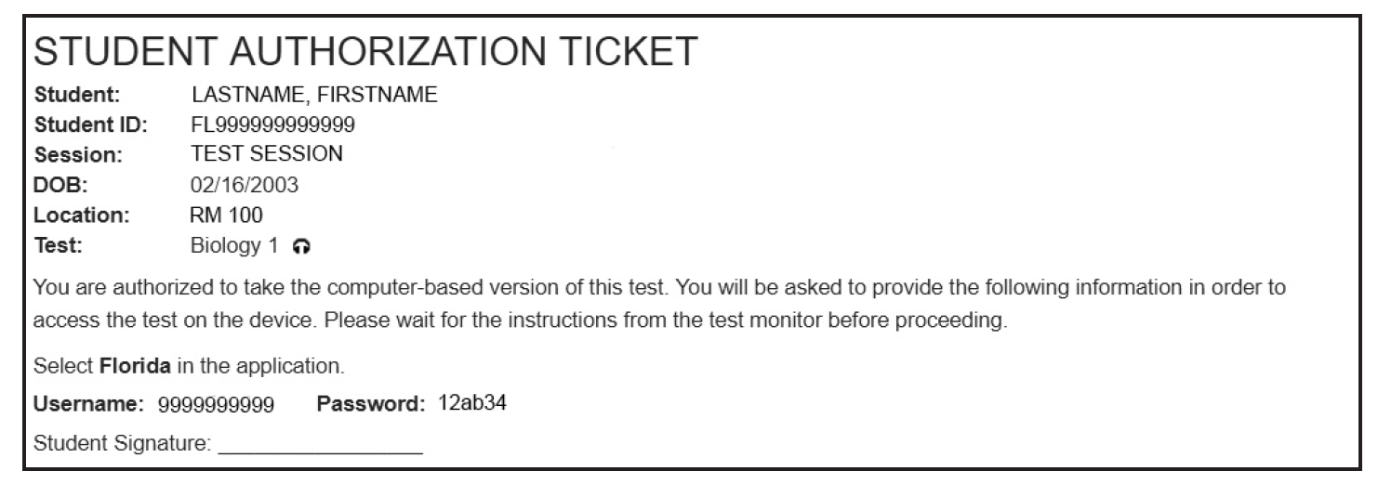
What’s New
CBT
PBT
An audio icon will now appear on Student Authorization Tickets for students who have a text-to-speech accommodation.
The zoom tool for computer-based assessments is now available in the user drop-down menu within TestNav.
Notes:
An audio icon will now appear on Student Authorization Tickets for students who have a text-to-speech accommodation. Text to speech is the read aloud accommodation.
The zoom tool for computer-based assessments is now available in the user drop-down menu within TestNav.

Slide 9

Assessment Services Application
PBT
CBT
The “Assessment Services” application is found on the Apps/Services/Sites tab of the M-DCPS employee portal.
Used by principals to designate the school assessment coordinator, and other roles at the school (School Assessment Team link).
Used by school assessment coordinators to securely place additional paper-based accommodations orders for eligible students based on IEP or 504 Plan (PBT Accommodations link).
The application provides a cumulative listing of all additional PBT accommodations orders placed, for each administration.
Principals assign access to this application (WPBS-PBA SCHOOLS) to the designated school assessment coordinator via QUAD-A.
Refer to Weekly Briefing #26037
Notes:
The Assessment Services app allows principals to designate the school assessment coordinator and it is also used by the school assessment coordinator to securely order paper-based accommodations under “PBT Accommodations” link for eligible students who have an IEP or 504 plan. The link to the “Assessment Services” application is found on the Apps/Services/Sites tab of the employee portal.
Access to the app should be assigned to the designated School Assessment Coordinator via QUAD-A.
Note: School Assessment Coordinators will be notified via email during each testing window of eligible students with PBT accommodations who were identified via the PreID file for verification purposes and School Assessment Coordinators will have to order the PBT accommodations for any eligible student who will test in the fall and/or winter.
Additionally, supplemental orders for accommodated forms must be ordered for newly enrolled students or when an IEP/504 plan gets updated by using the new Assessment Services app on the employee portal.

Slide 10
Students to be Tested: NGSSS EOC
PBT
CBT
Students enrolled in and completing one of the courses aligned to the Next Generation Sunshine State Standards participate in the appropriate EOC assessment as indicated in the manual
Students who must earn a passing score on an assessment for a standard diploma with a scholar designation (Biology and US History)
Students who have not yet taken an assessment to be averaged as 30% of their course grades (see next slide)
Students who are in grade forgiveness programs and wish to retake an assessment to improve their course grades
Students in a credit acceleration program (CAP) who wish to take an assessment to earn course credit
Notes:
Students enrolled in and completing one of the courses aligned to the Next Generation Sunshine State Standards participate in the appropriate assessment as indicated in the manual.
Eligible students also include:
Students who must earn a passing score on an assessment for a standard diploma with a scholar designation
Students who have not yet taken an assessment to be averaged as 30% of their course grades (they have an NG or no grade for the course)
Students who are in grade forgiveness programs and wish to retake an assessment to improve their course grades
Students in a credit acceleration program (CAP) who wish to take an assessment to earn course credit

Slide 11
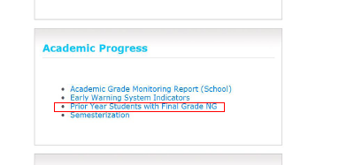
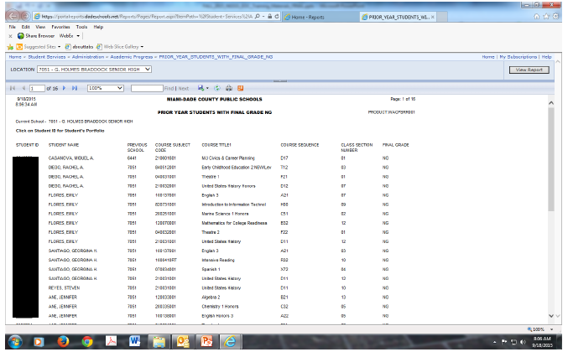
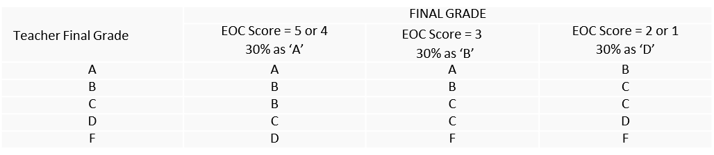
Students to be Tested: NGSSS EOC
PBT
CBT
Prior Year Students with Final Grade NG
(no grade)
Prior Year Students with Final Grade NG Report is available on the employee portal (click on “Reports” tab then search for “Academic Progress” title) to identify students
  These students must participate in the Fall EOC administration to earn an EOC score so that the 30% can be applied to the final course grade.
What will your final grade be for the NGSSS or FSA EOCs?
Notes:
Because the EOC test scores must be calculated as 30% of the final course grade, students that did not take the test or had their score invalidated will not have received a final grade last school year. Therefore, these students must be tested so that the 30% calculation can be applied and a final grade issued and credit applied.
Schools have access to a report called “Prior Year Students with Final Grade NG” to identify students that did not receive a final grade. Please use this report to identify eligible students to be tested. The report is under the “Academic Progress” title under the reports in the portal.
School staff must apply the 30% calculation to the final course grade that was initially held once the student receives the Fall 2019 EOC score and update the student’s final course grade in DSIS.
Also, students who tested but had test results reported late after the initial release will NOT have a final grade. These
Schools must follow the EOC methodology listed below on this slide to apply the 30 % to the final grade.

Slide 12
Students to be Tested: NGSSS EOC
PBT
CBT
Special Programs |  | District Number | School Number
Home Education Program |  | 13 | 9998
FLVS | Full-Time 6-8 | 71 | 0801
 | Full-Time 9-12 | 71 | 0400
Miami-Dade Online Academy |  | 13 | 7001
Important Note: Please do not add any special program students in TIDE or Pearson under your school for testing. District staff will email the test tickets to the SAC at the student’s assigned school.
.
Notes:
Special Program students will be tested during this administration including (FL Virtual School Full Time, Miami Dade Online, and Home Education).
If any of these special program students are assigned to your school for testing, notifications will be sent via email to the principal and test chairperson. Student demographic information and test tickets will be attached to the email. Please do not enter the special program students in PearsonAccess Next under your school.
Note, the parent or guardian of students in these programs is responsible for contacting the district to register their student and for transporting the student to and from the district-assigned testing location.
The parent/guardian is also responsible for providing the following to the testing location on or before the day of the test: 1) All student demographic information 2)Photo identification (if the student is unknown to the test administrator or other school staff) 3)Emergency contact information
Please make arrangements to test these special program students and use the appropriate test tickets.
Specific testing procedures for special program students are found in the training packet.

Slide 13
Students to be Tested: NGSSS EOC
PBT
CBT
English Language Learners (ELLs)
All ELLs participate in statewide assessments.
All ELLs who complete the applicable courses are expected to participate in the statewide assessment programs no matter how long these students have been enrolled in a U.S. school.
Students with Disabilities
Students with disabilities participate in the statewide assessment program by taking one of the following:
NGSSS without accommodations
NGSSS with accommodations
Florida Standards Alternate Assessment (FSAA)
All determinations regarding participation in the statewide assessment program must be documented in the student’s IEP or Section 504 Plan.
Notes:
All English Language Learners who complete the applicable courses are expected to participate in the EOC assessments no matter how long these students have been enrolled in a U.S. school.
Students who are identified as ELLs must be provided with the allowable accommodations listed in Appendix A.
Students with disabilities participate in the statewide assessment programs by taking one of the following:
NGSSS without accommodations,
NGSSS with accommodations, or
Florida Standards Alternate Assessment (FSAA)
All determinations regarding participation in the statewide assessment program must be documented in the student’s IEP or Section 504 plan.

Slide 14

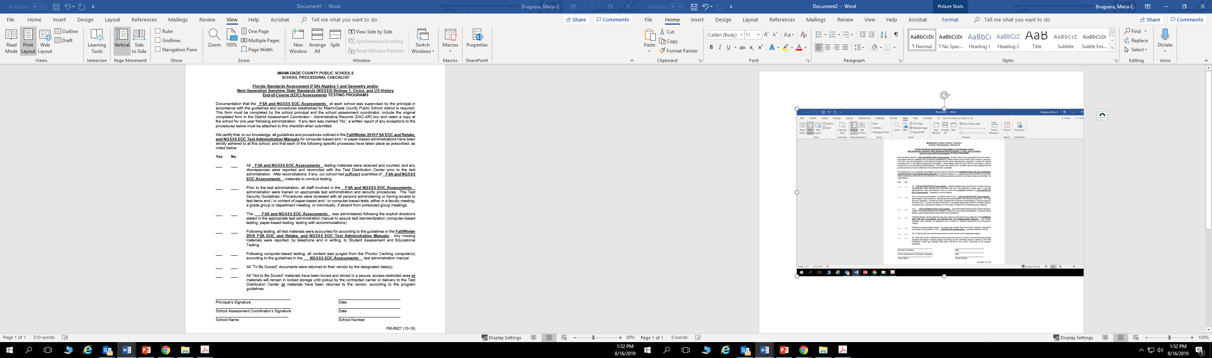
Test Security
Policies and Procedures
Florida State Board of Education Rule 6A-10.042, FAC, was developed to meet the requirements of the Test Security Statute, s. 1008.24, F.S., and applies to anyone involved in the administration of a statewide assessment.
Appendix D of the manual provides the full text of the Florida Test Security Statute and State Board of Education Rule.
Standards, Guidelines, and Procedures for Test Administration and Test Security and Test Security Screencast for Test Administrators and Proctors are available at the Test Chairperson Info website at http://oada.dadeschools.net/TestChairInfo/InfoForTestChair.asp
  Adopted by School Board
School Procedural Checklist (FM-6927) must be completed and signed by the principal and SAC at the conclusion of testing.
Notes:
Now we will review test security policies and procedures…
School personnel and proctors must read and familiarize themselves with the Florida statute and rule in the manuals. The rule prohibits activities that may threaten the integrity of the test.
The district’s Standards, Guidelines, and Procedures for Test Administration and Test Security handbook provides detailed guidelines for a secure test administration that apply to all personnel involved with any aspect of testing, and are in effect for district, state, and national assessment programs. This handbook was recently updated and is available on the test chairperson website.
The School Procedural Checklist form 6927 is a district form ( a copy is found in your training packet). This form must be completed and signed by the school principal AND the school assessment coordinator at the conclusion of testing to certify that all test administration and security procedures were followed.
Other security forms are the Test Administration and Security Agreement, Test Administrator Prohibited Activities Agreement, and Test Materials Chain of Custody Form.
As part of the Assessment Team at your school, you are required to view a test security training video titled: Test Security for test administrators and proctors. An email was sent to you to view the video. Please follow the link in the email to access the video. You must use your employee portal credentials to view the video to receive credit for meeting this requirement. This video can also be accessed on the test chairperson website under Miscellaneous. You are encouraged to use this short video to train test administrators and proctors at your school.
Please remember that inappropriate actions by school or district personnel can result in student or classroom invalidations, loss of teaching certification, and/or involvement of law enforcement.

Slide 15
Test Security
Policies and Procedures
CBT
PBT
Caveon Data Forensics
The FDOE uses Caveon Test Security to provide its Caveon Data Forensics™ for all statewide assessments.
Caveon analyzes data to identify highly unusual test results for two primary groups:
  Students with extremely similar test responses
  Schools with improbable levels of similarity, gains and/or erasures
Flagging only the most extreme results.
Notes:
The Florida Department of Education contracts with Caveon Test Security to provide its Caveon Data Forensics™ for all statewide assessments.
Caveon Data Forensics conducts analyses on all statewide assessments.
Two groups are targeted – individual student results for similarity (matched answer patterns) and school level results based on improbable levels of similarity, gains, and/or erasures.
If a student’s test is flagged, the state will automatically invalidate the test score. When test results are released, there will be an NR8 next to the student’s name in the Report of Student Results. In addition, an email will be sent to your principal notifying him/her which student’s scores were invalidated with a spreadsheet that provides detailed information regarding the matched answer pattern.
The school or parent can request an appeal on behalf of the student to have the test score restored and reported. There must be compelling evidence to submit the appeal. An appeals packet must be submitted to Student Assessment by the deadline to have it reviewed and approved by Dr. Sally Shay. The packet is then forwarded to the FDOE to review and make a final decision. Please note that if there is no compelling evidence to support the appeal, the state will not release the test score.

Slide 16
School Assessment Coordinator Before Testing
PBT
CBT
The School Assessment Coordinator Checklist in Appendix E of the manual lists SAC activities before, during, and after testing.
Available at http://florida.pearsonaccessnext.com/resources-training.
Receive Test Materials
Work folders arrived with your test administration manuals in the fall.
Order additional ancillary materials via the TDC Documents website.
If you receive paper-based test materials (regular print, large print, braille, one-item-per-page) for eligible students at your school, verify that you have all necessary materials, and report any missing materials to SAET immediately at 305-995-7520
To order additional PBT Accommodations not received, place an order in the Assessment Services App, via the PBT Accommodations link.
Notes:
Please use the School Assessment Coordinator Checklist in Appendix E of the manual before, during, and after testing.
Work folders arrived with your test administration manuals delivered mid August.
If you receive paper-based test materials (regular print, large print, braille, one-item-per-page) for eligible students at your school, verify that you have all necessary materials, and report any missing materials to Student Assessment at 305-995-7520.
Remember to maintain your Test Materials Chain of Custody Form at all times when handling secure test materials with security numbers such as regular print test books.
Remember to save the original boxes that were received with your test materials for returning TO BE SCORED and Not To Be Scored materials.

Slide 17
School Assessment Coordinator Before Testing
PBT
Maintain the Test Materials Chain of Custody Form (PBT Accommodations)
Required form
Retain electronic or hard copies of completed forms for one calendar school year
Blank form located in Avocet and in Appendix E of the manual.
Return the originals in the DAC-AR Box.
Notes:
You are required to maintain a Test Materials Chain of Custody Form, located on Avocet and in Appendix E. The purpose of this form is to track test materials at all times, including their location, the dates and times they are handled, and the names of the people performing various activities involving the materials. Schools must retain electronic or hard copies of completed forms for their files after materials are packaged for pickup and return the originals in the District Assessment Coordinator-Administrative Records box.

Slide 18
School Assessment Coordinator Before Testing
PBT
PBT Accommodations
Place additional orders for PBT accommodations for eligible students with an IEP or Section 504 Plan via the PBT Accommodations App:
  Log into your M-DCPS employee portal.
  Select the Apps|Services|Sites tab, then select the Assessment Services Application
  Select the PBT Accommodations link and complete the Request form for each student, as eligible
Principals can provide access via QUAD A, select WPBS-PBA Schools. Refer to QUAD A User Guide found in Weekly Briefing # 22049.
Note: Contact Mara Ugando if access to the app is not available.
Orders placed by the deadline will be delivered to schools via Comet Delivery Service on August 29-Septermber 3, 2019. Orders placed after the deadline will need to be picked up at the Test Distribution Center (TDC).
  Always call TDC at 305-995-3743 to ensure materials are ready.
Notes:
SAC must order PBT Accommodations via the Assessment Services app by completing the PBT Accommodations form
for eligible students who have it documented in their IEP or Section 504 Plan.
The PBT Accommodations form can be accessed from your employee portal. The request form should be completed for any student who needs PBT Accommodations and will test in the Fall or Winter with Large Print, Regular Print, Braille, and OIPP accommodations.
Note, a list of preidentified students with PBT accommodations for the Fall and Winter EOCs will be sent to the school assessment coordinators. Review the list and place an order in the Assessment Services App (complete the PBT Accommodations Form) by the set deadline if materials are needed, also place additional orders in the PBT Accommodations App for students who need PBT not listed in the PreID list. PBT accommodation orders processed by the deadline will be delivered to schools by Comet Delivery Service on August 29-September 3. If orders are placed after the deadline, you will need to pick them up the Test Distribution Center (TDC). Allow 24 to 48 hours to receive the materials at TDC. Always call TDC at 305-995-3743 to ensure materials are ready before you drive to TDC.

Slide 19
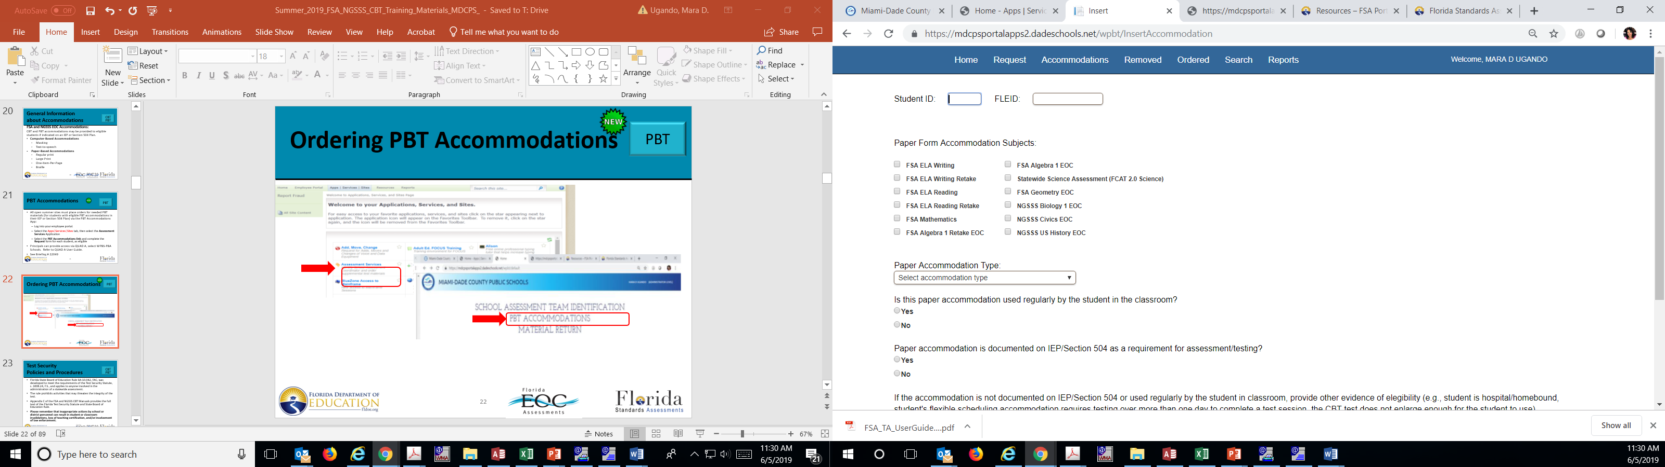

School Assessment Coordinator Before Testing
PBT
Ordering PBT Accommodations
1
2
3
Notes:
Listed on this slide are the steps to access the PBT accommodations form on the employee portal to place an order.

Slide 20
School Assessment Coordinator Before Testing
CBT
CBT Work Folders (Biology 1 EOC)
A piece of yellow 11” x 17” paper folded in half. The last page (back cover) of the folder is printed with graph paper.
One work folder should be sufficient for each student; however, students may request additional folders.
Collect all work folders when students finish testing.
Used work folders are secure materials.
Return in the DAC-SWR box
CBT Worksheets (Optional for Civics and US History EOC)
A 8½” x 11” page (located in Avocet) may be copied and distributed to students at the beginning of each test.
Collect all worksheets when students finish testing.
Used worksheets are secure materials.
Return in DAC-SWR box
Notes:
You will receive work folders for all students participating in CBT administrations of NGSSS Biology 1 EOC to work the problems during each test session. You should have extra work folders on hand in case students need additional space to work the problems. The Testing Rules Acknowledgment is printed on page 2 of the work folder. Distribute the work folders before testing as instructed in the administration scripts, and collect work folders after each test session. Used work folders are considered secure materials.
CBT Worksheets are optional for US History and Civics EOCs. You will need to print the worksheets if you will provide students with worksheets.
The Testing Rules Acknowledgment is printed on the back of the worksheet. Distribute worksheets as instructed in the administration scripts, and collect worksheets after each test session. Used worksheets are considered secure materials.

Slide 21
School Assessment Coordinator Before Testing
PBT
CBT
Four-Function Calculators (Biology 1 EOC)
Students may use the built-in calculator in TestNav, a handheld calculator, or both.
You should have enough handheld four-function calculators to provide one to every student.
No other calculators may be used.
Periodic Table (Biology 1 EOC)
Available in TestNav for the Biology 1 CBT.
Optional to print paper copies of the periodic table for all students taking the CBT Biology 1 EOC.
Paper copies of the Periodic Table are provided for students testing with PBT accommodations.
Collect all periodic tables when students finish testing.
Used periodic tables are secure materials
Return in the DAC-SWR box
Notes:
TestNav has a built-in four-function calculator for the Biology 1 CBT test. Students may use the built-in or the handheld four-function calculators.
Students with visual impairments may use the approved large key/large display four-function calculators or approved talking four-function calculators.
Students who will test using paper-based accommodations must be provided handheld four-function calculators. No other calculators may be used.
The Periodic Table of Elements for the Biology 1 EOC Assessment is provided only in an online format for computer-based testing (students with paper-based accommodations are provided a paper copy). The periodic table is displayed in pop-up window in TestNav 8.
Schools may provide hardcopy periodic tables to students taking the computer-based assessments. Any hardcopy periodic tables must be photocopies found in Appendix E of your manual. Schools that provide hardcopy periodic tables must ensure copies are available for all students taking the test. After testing, the test administrator should collect all periodic tables. Used periodic tables are secure materials and must not be reused.

Slide 22
School Assessment Coordinator Before Testing
CBT
Student Authorization Tickets (CBT)
Student needs the username and password, printed on the Student Authorization Tickets to log into TestNav.
Retain test tickets at the school for one calendar school year.
If a student has been assigned the text-to-speech accommodation, an audio icon will be displayed next to the test name on the Student Authorization Ticket.
Notes:
After you schedule students into a PearsonAccess test sessions you can print the Student Authorization Tickets. Student Authorization Tickets must be handled in a secure manner and returned to the school assessment coordinator immediately after each day of testing is completed.
The test administrator will give each student a ticket only after all students have entered the testing room, as instructed in the script, and all tickets must be collected before students leave the testing room. Student authorization tickets are secure.
SEE a sample of a student authorization ticket ON THE SLIDE. Each student needs the Username and Password printed on his or her Student Authorization Ticket to sign in to the test. Students will need a pen or pencil during testing to sign their tickets. Refer to the Pearsonaccessnext user guide for instructions to print tickets. Ensure these files are deleted from your computer after you have printed them. Retain test tickets at school for 1 calendar school year after testing.

Slide 23
School Assessment Coordinator Before Testing
PBT
CBT
Assign Test Group Codes (CBT and PBT)
Test group codes are used as a security measure to identify groups of students tested together.
It may be needed during investigations after testing to verify whether students were tested in the same room.
Each test administrator must be given one unique four-digit test group code to use in his or her testing room for each test administered.
Each testing room must use a different test group code.
A different unique test group code must be provided for each make-up session.
Notes:
Test group codes are used to identify groups of students tested together and may be needed during investigations after testing to verify whether students were tested in the same room.
The test group code can be the room number followed by a zero. For example, if the room number is 124, then the test group code can be 1240. School assessment coordinators must assign a unique four-digit test group code for every testing room, including make-up sessions.
Students will enter the test group code before beginning the test, as indicated in the scripts, and test administrators will record the code with their required administration information and on seating charts.
Record the test group code in the record of required administration information/or advanced session roster and on the seating chart.

Slide 24
School Assessment Coordinator Before Testing
CBT
Advanced Session Roster (CBT)
Is a list of all students scheduled in a test session in PearsonAccess Next
Use to confirm students were assigned the correct CBT accommodations
May be used to record required administration information
  Includes blank fields for recording accommodations and attendance information
  Other required information (e.g., test group code) may be recorded anywhere on the roster
Log into PearsonAccess Next at http://fl.pearsonaccessnext.com,
  Click Reports, Operational Reports, select Online Testing from the Report Categories and click Advanced Session Roster link
Copy and file all records of required administration information
Return the originals in the DAC-AR box
Notes:
A Session Roster is a list of all students scheduled in a PearsonAccess Next test session.
The Session Roster may be used to record required administration information and should be used to confirm students have been assigned the correct form (TestNav—Main or TestNav—specific accommodated form—text to speech or masking).
Advanced Session Rosters must be handled in a secure manner and returned to the school assessment coordinator immediately after each test session is completed.
To view the Advanced Session Roster, log in to PearsonAccess, go to Reports and select Operational Reports, then select Online Testing from the Report Categories and click on Advanced Session Roster.
Return the Advanced Session Rosters or school generated rosters in the District Assessment Coordinator - Administrative Records box.

Slide 25
School Assessment Coordinator Before Testing
PBT
PreID Labels (PBT)
For students taking paper-based tests, PreID labels are not provided for Fall/Winter 2019 administrations.
You may print PreID labels for students who will test using paper-based accommodations or you may hand-grid student demographic information.
You may order blank labels, via the TDC Documents website at http://oada.dadeschools.net/TDC/TDC.asp.
Refer to the 2019–2020 PearsonAccess Next User Guide for instructions on how to print PreID labels.
  PreID labels must be printed using the highest quality printer settings available to ensure readability for scanning purposes.
Notes:
For students taking paper-based tests, PreID labels are not provided for Fall/Winter 2019 administrations. If students will test on paper, PreID labels may be printed and applied to the test and answer books, or student information may be gridded on the demographic pages.
Follow the instructions in the Pearsonaccess Next User Guide. Contact PearsonAccess Support at 877-847-3043 if you need assistance.
You may order additional blank labels from TDC Documents webpage.

Slide 26
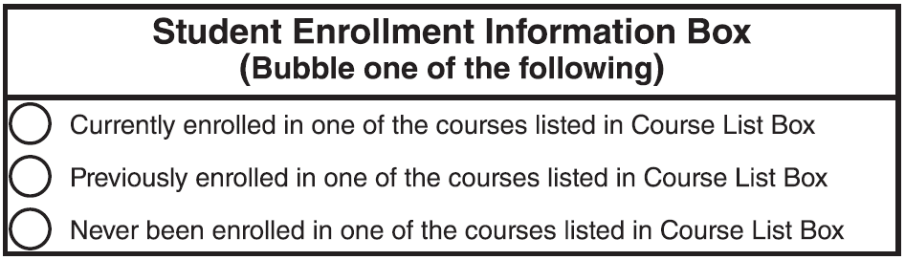
School Assessment Coordinator Before Testing
PBT
Student Demographic Information
Only school personnel may hand-grid the following on test and answer books:
  Primary Exceptionality, Section 504, Testing Accommodations listed on IEP or 504 Plan, ELL
School personnel or students may hand-grid the following:
  Student Name, District/School Number, FLEID, Date of birth, Grade level, Gender, Ethnicity, Race, Student Enrollment Information box.
  For non-preidentified test and answer books, complete the Student Enrollment Information Box on the back of the book.
Notes:
Only school personnel may hand-grid the following on test and answer books if no PreID label is used:
Primary Exceptionality, Section 504, Testing Accommodations listed on IEP or 504 Plan, ELL
School personnel or students may hand-grid the following:
Student Name, District/School Number, FLEID, Date of birth, Grade level, Gender, Ethnicity, Race, Student Enrollment Information box.
If a PreID label is not used on the test and answer books, complete the Student Enrollment Information Box on the back of the book.

Slide 27
School Assessment Coordinator Before Testing
PBT
CBT
Manage Student Information
Pre-ID File Upload
 | Test | Cut-off Date | Test Management
FALL | Biology 1, Civics, US History EOC | August 16 | August 26
WINTER | Biology 1, Civics, US History EOC | November 1 | November 12
  Important Note: SAC will order PBT accommodations for eligible students who have an IEP or Section 504 plan.
  Go to the “Assessment Services Application” in the Employee Portal to order additional PBT accommodations.
Notes:
The FALL 2019 PREID Cut date for NGSSS EOCs (Biology, Civics, and US History) is August 16.
The Winter 2019 PREID Cut Date for NGSSS EOCS is November 1.
New students or changes to student demographic information after the cutoff dates must be manually entered into PearsonAccess. If you will print PreID labels for students with paper-based accommodations, then you will need to ADD the student record in PearsonAccess if not already in Pearson to be able print the student label.
Important Note: SAC will order PBT accommodations for eligible students who have an IEP or Section 504 plan.
Go to the “Assessment Services Application” in the Employee Portal, select the PBT Accommodations link and complete the Request form.
Also important to mention, do not work in PearsonAccess (updating student information or adding new students) until August 26 for the FALL and November 12 for the Winter. If you begin working in PearsonAccess before the test management dates, the information may be erased/wiped out if we do a district upload.

Slide 28
School Assessment Coordinator Before Testing
CBT
Manage Student Information
PreID Upload and Test Sessions
Students have been placed into a session in PearsonAccess Next based on the PREID file:
  Biology 1— BIO-NGBIOLOGY1
  Civics—CIV-NGCIVICS
  U.S. History—HIS-USHISTORY
  Use these created sessions or divide students into smaller sessions to verify student information, or to use for testing.
  Please note students with PBT accommodations will not be placed in the test sessions.
Notes:
Test sessions were automatically created via PreID upload, you will see these sessions when you log in to PA Next in bold on the slide:
BIO-NGBIOLOGY1, CIV-NGCIVICS, and HIST-NGUSHISTORY
The district-created test sessions can be temporary sessions for the purpose of verifying student information, or they can be the test sessions you plan to use for testing.
Descriptions providing guidelines for setting up test sessions, with advantages and disadvantages of each method, are available in the manual.
Schools may choose to set up test sessions in the way that best suits their needs. Do not print the student authorization tickets until the test sessions have been finalized. Please note that if a student is later moved to another test session, a new student authorization ticket must be printed, and the old ticket securely destroyed.
Please note students with PBT accommodations will not be placed in the test sessions.

Slide 29
School Assessment Coordinator Before Testing
CBT
PBT
Manage Student Information
School users may add students individually using the Create/Edit Students task in PearsonAccess Next.
Pearson Access Next will require users who try to add students that already exist in the system to first complete the step of Manage Enrollment before they can complete the full registration process.
Test sessions must be created in PearsonAccess Next and students must be assigned to the test sessions before you can access the Advanced Session Roster for each session.
Verify the accuracy of Student Names and FLEIDs prior to testing.
  Student information can be viewed and verified using an Advanced Session Roster.
Test sessions can be modified at any time prior to testing.
Notes:
School users may add students individually using the Create/Edit Students task in PearsonAccess Next.
Pearson Access Next will require users who try to add students that already exist in the system to first complete the step of Manage Enrollment before they can complete the full registration process.
Test sessions must be created in PearsonAccess Next and students must be assigned to the test sessions before you can access the Advanced Session Roster for each session.
Verify the accuracy of Student Names and FLEIDs prior to testing.
Student information can be viewed and verified using an Advanced Session Roster.
Test sessions can be modified at any time prior to testing.

Slide 30
School Assessment Coordinator Before Testing
CBT
PBT
Ensure Implementation of Accommodations
The following categories of accommodations may be provided to eligible students with disabilities:
  Administration Accommodations (e.g., flexible presentation, flexible responding, flexible scheduling, flexible setting)
  Computer-Based Accommodations (text-to-speech, masking)
  Paper-Based Accommodations (regular print, large print, braille, one-item-per-page)
Scripts and instructions for administering CBT and PBT accommodations is available at http://avocet.pearson.com/FL/Home
See Appendix A of the manual for information about administration accommodations.
Notes:
Appendix A of the manual provides information concerning allowable accommodations for students with disabilities (SWD) and for English Language Learners (ELLs).
The test administrator and the school assessment coordinator are responsible for ensuring that arrangements for accommodations have been made prior to the administration dates.
Train test administrators regarding accommodations.
CBT or PBT accommodations may be provided to eligible students if indicated as an accommodation on an IEP or Section 504 plan.
The following CBT accommodations are available for students who have these accommodations specified on their IEPs or Section 504 Plans:
Text-to-speech
Masking
If students will use any of the CBT accommodations, school assessment coordinators must ensure that students have been assigned the appropriate accommodation(s) in PearsonAccess Next prior to testing to ensure that they are assigned the correct CBT functionality or form.
Paper-based accommodations include regular print, large print, braille, one-item-per-page. Scripts and instructions for administering paper-based tests are available at Avocet.
Note: Schools are required to report whether students have testing accommodations listed on their Individual Education Plans (IEPs) or Section 504 plans. This information will be captured on the PreID file, when adding a new student in PearsonAccess, and when gridding student demographic information on test and answer books.

Slide 31
School Assessment Coordinator Before Testing
CBT
Manage Test Sessions
The main test session management tasks that must be completed prior to the first day of testing:
View or Edit an Online Test Session
Add Students to Test Sessions
Manage Class Information –FLCLASS
Assigning Accommodated Forms
  To individual students
  To a test session
*Refer to the PearsonAccess Next User Guide for details on how to complete these tasks and manage sessions in PearsonAccess.
Notes:
Since test sessions are automatically created for students via the PreID upload and by school assessment coordinator before the first day of testing (unlike FSA), you will need to manage these test sessions.
View or Edit an Online Test Session— to Check the session details and verify that all students are assigned to the correct session.
If you have new students that you added to PearsonAccess, then be sure to add them to the correct test session based on the subject test they are eligible to take
Class is a required field in PearsonAccess that students are assigned when added through PreID upload or added manually in Pearson Access. FLCLASS was the default class name used for the PREID file. We recommend you use the FLCLASS as the class name for students added using the Create/Edit Students task.
Ensure students who require an accommodated CBT form (masking or text to speech) have been assigned the correct form in PearsonAccess Next before they test. There are two ways to assign accommodated forms:
By test session : Create a separate test session for each group of students to be tested together and ensure the correct Form Group Type is assigned for the session. If you have a large group of students using “Text-to-Speech” for the Biology 1 EOC, for example, then you can place these students under a test session together and be sure to select Text-to-Speech form when you create the test session.
OR By Individual Student: You can have a test session with the “Main” form selected, then you can go into each student’s profile and Override and assign a new form like Text-to-Speech through the Students in Sessions area in PearsonAccess Next.
If students are moved to a different session in Pearson, their form assignments change. Check the form assignment very carefully prior to testing. Also, reprint the student authorization ticket for any student who has been moved to a new test session like a make-up session. The old ticket will not work.

Slide 32
School Assessment Coordinator Before Testing
PBT/CBT
Manage Test Sessions
Additional required test session management tasks:
Prepare Test Sessions
Proctor Cache Test Items (Technology Coordinator) (available one week prior to testing window)
Start the Test Sessions
Unlock/Lock a Test Session
Print Student Authorization Tickets, PreID labels, and Advanced Session Rosters
Schedule/create a new session for make-ups
*Refer to the PearsonAccess Next User Guide for details on how to complete these tasks and manage sessions in PearsonAccess.
Notes:
Sessions must be marked Prepared before a school may proctor cache or start a session. Refer to the 2019–2020 PearsonAccess Next User Guide for instructions on how to prepare sessions. This step allows student tests to be staged and ready when the session is started.
Proctor Caching is required for efficient test delivery of the NGSSS tests. Provide Technology coordinators with a list of all test sessions for the school. Confirm that test content has been cached for all scheduled test sessions. Test content is available one week prior to the test administration window.
Sessions must be started and unlocked before students can begin logging into the test.
Before testing, make sure to Print Student Authorization Tickets, PreID labels, and Advanced Session Rosters.
Schedule a New Session for Make-Ups. Refer to the PA Next User Guide for instructions on how to schedule a new session for make-ups.
Note: Since multiple test sessions may be scheduled throughout the testing window, it is also possible to reassign absent students to existing sessions scheduled later in the window rather than creating make‑up sessions. You may also keep just one giant test session open with all students during the entire testing window rather than creating multiple sessions and moving students from one session to another.

Slide 33
School Assessment Coordinator Before Testing
PBT
CBT
Collect Required Administration Information
  Students assigned to the room—provide student names and FLEIDs
  Attendance information
  Accommodations provided to students
  Accommodations used by students
  Test group code
  Grade level
  Unique security numbers of secure documents assigned to each student (for PBT accommodations)
  Signatures of test administrator and school assessment coordinator
  Dates and times for when secure materials are received and returned
Notes:
Communicate to test administrators the process for collecting the required administration information (as listed in the manual).
A blank Administration Record/Security Checklist can be used to capture all required administration information for each testing room. This form is available online and in the manual.
For the NGSSS computer based tests, the Advanced Session Roster can be used to record or verify required administration information.
Keep a separate, complete record of required administration information (including security numbers) for paper-based tests administered.
Copy and File all required administration information for future reference.
Return the Originals in the District Assessment Coordinator Administrative records box.

Slide 34
School Assessment Coordinator Before Testing
PBT
CBT
Seating Chart (Required for each testing room)
  Date
  Test Administrator name
  Room name/number
  Subject
  Student names and their locations in the room during testing
  Direction students are facing
  Starting and stopping times
  Names of proctors
  Test group code
  Session name in PearsonAccess (CBT)
  Laptops/mobile device assignments (if applicable
Return the originals in the DAC-AR box.
Training Packet
Notes:
Test administrators are required to maintain an accurate seating chart for each group of students in their rooms during testing, as described on page 27 of the manual.
Ensure that test administrators record all information indicated in the manual and listed on the slide
After testing, you must make copies of all seating charts, file the copies, and return the original charts in the District Assessment Coordinator –AR box.
All seating charts must indicate the front and back of the room.
FOR CBT, also record which devices students are testing on so that student responses can be recovered, if necessary.
If students using extra time are moved to a new location or the seating configuration changes during testing, a new seating chart must be created.
Collect, make copies, and return the original in the District Assessment Coordinator – Administrative Records Box.
A sample is provided in the training packet, posted on the Test Chairperson website.

Slide 35
School Assessment Coordinator Before Testing
CBT
Meet with Technology Coordinator
Technology coordinators should understand their responsibilities before, during, and after each computer-based test administration:
Review the instructions and information including:
  Technology requirements online at PearsonAccess Next http://florida.pearsonaccessnext.com/technology-resources
  Security policies and procedures in the test administration manual
  Must read and sign the Test Administration and Security Agreement
Involve in all planning meetings to provide input on logistics and resolve any network issues.
Create a plan for handling issues during testing.
Notes:
It is important that technology coordinators understand their responsibilities before, during, and after each computer-based test administration.
Review the instructions and information available online at pearsonaccess next.com, as well as all test administration and security policies and procedures included in the manual, with your technology coordinator
The technology coordinator should be involved in all planning meetings to provide input on logistics and resolve any network issues. Create a plan for handling issues during testing.
Technology coordinators are required to sign the 2019–20 Test Administration and Security Agreement.

Slide 36
School Assessment Coordinator Before Testing
PBT
CBT
Prepare Test Settings, Computers, and Devices
Testing rooms must have comfortable seating, good lighting, an appropriate temperature and must be properly ventilated and free of distractions.
Students must have sufficient workspace provided to use CBT work folders, CBT worksheets, calculators, or periodic tables.
Students must not be able to easily view other students’ computer screens, devices, or test materials.
Check the configuration of the testing rooms to make sure you will be able to provide a secure environment during testing.
  If necessary, use visual blocks (e.g., file folders taped to the sides of computer screens).
Also, check for and remove all unauthorized visual aids posted in classrooms or affixed to student desks.
Before each test session, the test administrator should open each computer or device to the Sign In screen.
Notes:
Before testing begins do a walk through of the testing rooms.
Tests should be administered in rooms with comfortable seating, good lighting, and an appropriate temperature. Make sure that testing rooms are properly ventilated and free of distractions.
Check for and remove all unauthorized visual aids posted in classrooms or affixed to student desks.
Sufficient workspace should be provided for students to use assigned test materials.
Check the configuration of the testing rooms to make sure you will be able to provide a secure environment during testing. students must not be able to easily view other students’ computer screens, devices, or test materials. If necessary, use visual blocks (e.g., file folders taped to the sides of computer screens).
On day of testing, open each student computer/device in the testing room to the login screen, but do not log in for students

Slide 37
School Assessment Coordinator Before Testing
CBT
PBT
Preparation and Training of Test Administrators
Test administrators should refer to the Test Administrator Checklist, provided in Appendix E of the manual and at http://florida.pearsonaccessnext.com/resources-training before, during, and after testing.
Test administrators must be familiar with all appropriate sections of the manual, including scripts, as well as accommodated scripts and instructions located at http://florida.pearsonaccessnext.com/resources-training, if applicable.
Test administrators who will administer a test to students using large print, braille, or one-item-per-page accommodations must be trained in the use of those test materials.
Notes:
Be aware of the following policies, procedures, and instructions, and emphasize this information during training at your school:
You are responsible for training all test administrators and proctors, including non-school-based instructors (e.g., itinerant teachers). Always train several employees to act as possible alternates.
In the absence of trained administrators, you may have to postpone testing until trained personnel are available.
Test administrators should reference the Test Administrator Checklist, provided in Appendix E and online at PearsonAccess Next before, during, and after testing.
Test administrators must be familiar with all appropriate sections of this manual; the separate, printed test administration scripts; and accommodated scripts and instructions located in Avocet, as applicable.
Test administrators who will administer a test to students using large print, braille, or one-item-per page accommodations must be trained in the use of those test materials.

Slide 38
School Assessment Coordinator Before Testing
CBT
PBT
Preparation and Training
Electronic Devices and Breaks
Determine your school’s policy for the storage of electronic devices during testing.
  Direct test administrators on what to do if students have electronic devices in their possession before testing begins.
  Highlight the policy that students are not allowed to access electronic devices at any time during a test session, including breaks. If a student accesses his or her electronic device(s) during a break, his or her test must be invalidated.
  If a student is found with an electronic device and test content has been photographed or shared via text, email or social media, contact SAET immediately at 305-995-7520.
How to secure a student’s computer or device during a break?
  Short breaks: Use a visual block
  Long breaks: Student can exit test
Notes:
Determine your school’s policy for the storage of electronic devices during testing.
According to the administration script, before testing begins, test administrators ask students to raise their hands if they have any electronic devices with them. Direct test administrators on what to do if students have electronic devices in their possession before testing begins.
Students may place devices in the student’s backpacks and the backpacks placed in the front of the class.
Ensure that test administrators are aware of the policy that students are not allowed to access electronic devices at any time during a test session, including breaks. If a student accesses his or her electronic device(s) during a break, his or her test must be invalidated.
If a student is found with an electronic device and test content has been photographed or shared via text, email or social media, contact the office of student assessment immediately
Train test administrators on how to secure a student’s computer or device during a break. If a student leaves the room and will resume testing, the student must either exit the test by signing out of testnav or some type of visual block (e.g., a file folder) must be applied to obscure the computer screen or device.
For short breaks (e.g., restroom), it is recommended that a visual block be applied to the student’s computer screen or device. For longer breaks, it is recommended that the student exit the test. If students exit the test, they will not be able to continue testing until they are resumed in PearsonAccess Next. See the script for detailed instructions on how a student signs out of testnav.

Slide 39
School Assessment Coordinator Before Testing
CBT
Preparation and Training (cont.)
Policies and Procedures
  If SAC creates Test Administrator accounts in PearsonAccess Next, train test administrators on how to monitor sessions and resume students in PearsonAccess Next.
  If the SAC will be responsible for resuming students, instruct test administrators on how to contact you during testing to request that students be resumed.
  Test administrators may be able to assist students with errors when logging in but should not try to resolve issues during testing. Determine and communicate how test administrators can request assistance during testing, if necessary.
  Train test administrators on how to administer practice tests at your school.
Notes:
Test administrators may be able to assist students with errors when logging in but should not try to resolve issues during testing. Determine and communicate how test administrators can request assistance during testing, if necessary.
If you create Test Administrator accounts in PearsonAccess Next, train test administrators on how to monitor sessions and resume students in PearsonAccess Next. If you will be responsible for resuming students, instruct test administrators on how to contact you during testing to request that students be resumed.
Train test administrators on how to administer practice tests at your school. Test administrators should use the practice test to become familiar with the available tools prior to administering a practice test and prior to the operational test.
Always take attendance during the administration of the practice tests.

Slide 40
School Assessment Coordinator Before Testing
CBT
Preparation and Training (cont.)
Policies and Procedures
Provide instructions for how to handle these circumstances:
  A student has not participated in a practice test session.
  A student has trouble logging in the first time or is logged out of his or her test more than once.
  A test administrator does not have a Student Authorization Ticket for a student.
  A First Name, Last Name, or FLEID is not correct on the Student Authorization Ticket.
  A student is in the wrong test or wrong form.
Notes:
Provide your test administrators instructions for how to handle these circumstances:
If student has not participated in a practice test session for the subject test, the student cannot test. Reschedule the student for a makeup session.
--If a student has trouble logging in the first time or gets logged out of his or her test more than once, have the student log into another computer that has been set up for testing. If the issue continues, do not have the student continue to log in. Have the TA contact you or the technology coordinator. The student may log in again when the technical issue is resolved. Report any technical issues not resolved in a timely manner to the office of student assessment.
If the test administrator does not have a Student Authorization Ticket for a student, the student won’t be able to log into the CBT test. Print and provide the test ticket or reschedule the student for a makeup session.
If a Student Name or FLEID is not correct on the Student Authorization Ticket. Do not test student and schedule the student for a makeup session.
If the student name or FLEID is wrong on the ticket, do not test the student. Update the name or FLEID in Pearson and then print a new test ticket.
--If a student is in the wrong form (e.g., text-to-speech accommodations not assigned) or wrong test. Have the student exit the test right away and contact our office for guidance. Please check the form assignment very carefully prior to testing students.

Slide 41
School Assessment Coordinator Before Testing
CBT
Preparation and Training (cont.)
Policies and Procedures
Provide instructions for how to handle these circumstances:
  Which option (A, B or C) test administrators read to students at the end of the script.
  A student refuses to acknowledge the testing rules.
  A test administrator is concerned that a student is unable (e.g., too ill) to finish the test.
  A student exits the test to finish later and must be resumed.
  A disruption occurs (e.g., a technical disruption, power outage, disruptive behavior).
  A student has not completed the test at the end of the allotted time and will need additional time to continue working.
Notes:
-- Decide which Options a, b, or c test administrators will read to students After Testing Is Complete and provide the information to your test administrators.
Students may read after they have finished the test AND their test materials have been collected. But, students are not permitted to write or to use computers or devices after they have finished the test, even after their test materials have been collected. Test materials may not be returned to students once the materials have been collected.
--Any student who refuses to affirm the Testing Rules Acknowledgment should still be tested, but a record of the student’s refusal should be retained at the school.
A test administrator is concerned that a student is unable (e.g., too ill) to finish the test then do not test the student and schedule for a makeup day.
If the student exits the system, to finish later, the student must be resumed in PearsonAccess before signing back in. If the Test Administrator has a Test Administrator account in Pearson and is trained on how to resume a student, the test administrator will be able to resume testing for the students. Otherwise, the school assessment coordinator must resume the student’s test in PearsonAccess.
If A disruption occurs (e.g., a technical disruption, power outage, disruptive behavior). –Maintain security of all materials. The TA should notify the SAC immediately. The SAC should notify SAET immediately.
For all NGSSS EOC assessments, all students may be provided additional time to complete the test, but test sessions must be completed within one school day. If students using extra time are moved to a new location to complete the test, a new seating chart must be created for this location.

Slide 42
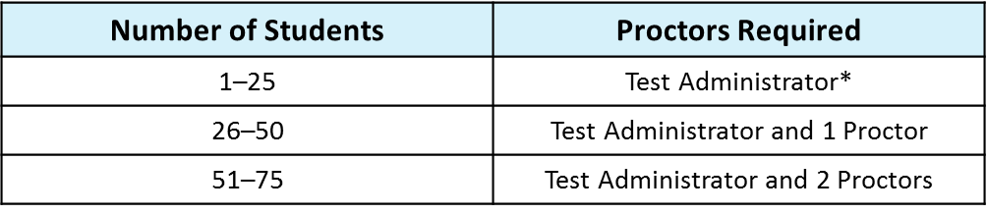
School Assessment Coordinator Responsibilities Before Testing
CBT
PBT
Preparation and Training (cont.)
Proctors
Each proctor who monitors a testing room for any length of time must sign a 2019-2020 Test Administration and Security Agreement and the Security Log for that room. These forms are located in the manual.
Refer to the table below for the required number of proctors.
* FDOE strongly recommends that a proctor be assigned to rooms with 25 or fewer students whenever possible.
Notes:
You are responsible for training test administrators and proctors.
School personnel and non-school personnel may be trained as proctors. Prior to testing, proctors must be informed of their duties and of the appropriate test security policies and procedures.
School personnel proctor duties may include preparing and distributing secure materials (such as test tickets) under the supervision of the test administrator who is certified.
Non-school personnel may assist test administrators during test administration; however, they may not participate in any of the test administration procedures (such as distributing and collecting secure materials, providing accommodations).
Volunteers (e.g., parents, retired teachers) may be trained as proctors and may perform non-school personnel duties. Volunteers can only be used as an extra pair of eyes. They must sign the volunteer's security form found in the training packet posted on the test chairperson website and the security agreement form found in the manual.
ALSO, please be reminded that proctors may not assist in rooms where their family members are testing.
Assign proctors to testing rooms according to the guidelines for proctors on page 17 of the manual. Ensure proctors understand their responsibilities, and explain the Security Log to them.

Slide 43
School Assessment Coordinator Before Testing
CBT
Arrange Practice Test Sessions
Train TA on how to administer practice tests at your school.
Schedule and arrange practice tests as described in the manual.
Before CBT administration, the student must complete the appropriate practice test(s) to learn how to use the computer-based system.
  Exception: Students who previously participated in a TestNav 8 practice test for the subject test they are scheduled to take
Students who require CBT accommodations (e.g., text-to-speech, masking) must also complete the appropriate accommodated practice test(s).
Practice tests (both accommodated and non-accommodated) are also available on the TestNav desktop app.
  Launch the app and then select Practice Tests in the bottom right.
Notes:
All students who will participate in this administration for the first time must participate in a practice test conducted at their school to become familiar with TestNav interface and functionality updates.
Access to practice tests and appropriate practice test script are located in PearsonAccess Next.
Students who will test using accommodated computer-based forms (text-to-speech, masking) must practice using the accommodated practice test.
Note, Students who previously participated in a TestNav 8 practice test for the subject test they are scheduled to take are not required to participate in a practice test session for this administration,
Always take attendance of your practice test sessions.

Slide 44
School Assessment Coordinator During Testing
PBT
CBT
Distribute Test Materials
On each day of testing, provide each test administrator the following test materials before testing begins, as applicable:
Paper-based Tests (accommodations)
Student Authorization Tickets for CBT
Advanced Session Roster for CBT or Security Checklist/Administration Record for PBT
Test group code (CBT and PBT)
CBT Work folders
CBT Worksheets (optional for Civics and US History)
Periodic Tables
Four-Function Calculators
Notes:
On each day of testing, the SAC is responsible for providing each test administrator with the test materials before testing begins, as applicable:

Slide 45
School Assessment Coordinator During Testing
PBT
CBT
Supervise Test Administration and Maintain Test Security
Provide test administrators with additional materials as needed.
Monitor each testing room to ensure that test administration and test security policies and procedures are followed and security logs, seating charts are being maintained.
SAC and the technology coordinator must be available during testing to answer questions from test administrators and to assist with technical problems.
If a technical issue interrupts testing and cannot be resolved quickly, contact Pearson Customer Support at
877-847-3043 and notify SAET immediately at 305-995-7520.
Notes:
During testing supervise test administration
TAs must Read the appropriate script verbatim to students an ADHERE TO the important information and instructions between the SAY boxes.
Any desktop-viewing programs or similar software that would enable to view test items and student responses must be turned off during testing.
If students finish the test before the allotted time has elapsed, TA may encourage them to go back and check their work.
SAC and the technology coordinator must be available during testing to answer questions from test administrators and to assist with technical problems.
If a technical issue interrupts testing and cannot be resolved quickly, schools should contact Pearson Customer Support at 877-847-3043 and notify the office of student assessment immediately.
During testing, a test administrator should not attempt to resolve technology issues if it is disruptive to students. The test administrator must have a way to contact the school assessment coordinator or technology coordinator without leaving the room unattended.
If the Internet connection is interrupted during testing, the student should still be able to complete the test. The student responses are automatically saved and, once the Internet connection has been restored, will be sent to Pearson.
If the Internet connection is not restored by the time the student has finished the test, the test administrator should contact the SAC or the technology coordinator for assistance.
If login problems persist on a computer or device and another computer or device has been set up for testing, shut down the first computer or device and move the student to resume testing.
The student should be able to resume testing where he or she left off if the responses are saved to the network. If a technical issue interrupts testing and is not able to be resolved quickly, you should contact Pearson Customer Support and notify the office of assessment immediately.
The test administrator should contact you or the technology coordinator if an error message appears on a student’s computer screen or device during testing and he or she cannot resolve the issue.
Note, a TestNav8 common error codes resource is accessible via pearsonaccessnext, technology resources link
For additional information about support for computer-based testing, see “Contacting Pearson Customer Support” in Appendix B of the manual

Slide 46
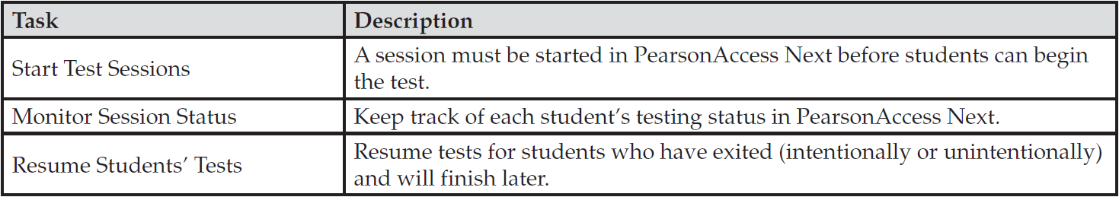
School Assessment Coordinator During Testing
CBT
Session Management Tasks During Testing
Never submit a student’s answers or mark a student’s test complete because of a technical issue without first receiving directions from FDOE or Pearson.
Mark a student’s test complete only if the test has been completed and should be submitted for scoring or the student has exited the test and will not complete the test.
Contact SAET to reopen a test that has been submitted in error, on same day only.
Notes:
SAC must first, START A SESSION in PearsonAccess BEFORE STUDENTS CAN LOG IN. Pearson recommends to start the session the day before it is scheduled to begin. The session must also be marked prepared in Pearson before it can be started.
DURING TESTING MONITOR REAL TIME Status of student tests AND RESUME STUDENTS TO TEST, as needed. Student statuses are listed in the manual on page 72.
If a student exits TestNav (either intentionally or unintentionally) before completing a test and the student should be able to continue testing, then the student’s test must be resumed in PearsonAccess before he/she can continue.
If needed, contact the office of assessment at 305-995-7520 to reopen a test that has been submitted in error, on same day only.

Slide 47
School Assessment Coordinator After Testing
PBT
CBT
Receive Materials from Test Administrators
Verify all secure materials have been returned and notify SAET immediately if any secure materials are missing.
Make copies of completed administration records and file the copies.
Ensure that used test and answer books have a PreID label affixed OR a completed student grid sheet.
Verify that the DNS bubble has not been gridded incorrectly.
Placed used documents marked DNS in the TO BE SCORED box.
Verify the correct PreID labels are applied to special program students’ test and answer books (if applicable).
Retain and securely store 4-function calculators.
Retain Student Authorization Tickets for one calendar school year.
Notes:
1. After testing, Verify all secure materials have been returned. Notify the office of student assessment immediately if any secure materials are missing and complete the necessary investigation.
2. Make copies of the Records of required administration information; Security Logs; Seating Charts; and Chain of Custody completed forms and file the copies for one calendar school year. Also copy the signed agreements. Retain the copies for one calendar school year.
3. Ensure that test and answer books have a completed student grid sheet or a PreID label affixed.
Verify the DNS bubble has not been marked by mistake on documents. -----------
If the DNS bubble was marked by mistake, erase the DNS bubble and grid the UNDO bubble and return the book in the TO BE SCORED box.
Note, do not grid the DNS bubble on defective and unused books, simply return with all other NOT TO BE SCORED materials.
5. Prepare materials for return as described in the manual and in the Comprehensive Assessment Chart posted on the TDC documents site ..

Slide 48

School Assessment Coordinator After Testing
PBT
CBT
Test Invalidation
The main purpose of invalidation is to identify when the validity of test results has been compromised.
  Review policies regarding test invalidation and a list of situations where invalidation may be considered on pages 23-24 in the manual.
  Test administrators should discuss the situation with the school assessment coordinator, and the situation should be investigated immediately. SAET can advise schools of the appropriate course of action if invalidation is being considered.
  On paper based tests, the DNS and UNDO bubbles are located in the SCHOOL USE ONLY box near the bottom of the student grid sheet.
Notes:
The office of student assessment can advise schools of the appropriate course of action if invalidation is being considered. Remember that the main purpose of invalidation is to identify when the validity of test results has been compromised.
If a situation described in the manual occurs, test administrators should discuss the situation with the school assessment coordinator, and the situation should be investigated immediately.
Remember that invalidations must be recorded in PearsonAccess by 4:00 p.m. on the final day of testing for each administration.
Step-by-step instructions for invalidating tests in PearsonAccess can be found in the PearsonAccess Next User Guide.
For PBT, The Do Not Score (DNS) and UNDO bubbles are located in the SCHOOL USE ONLY box near the bottom of the student grid sheet.
The DNS bubble must be gridded when a test is invalidated or when a document is defective and used.

Slide 49
School Assessment Coordinator After Testing
CBT
  Conduct these activities in PearsonAccess Next by 4:00 p.m. on the last day of the testing window:
  Mark Test Complete
    If a student exits and will not resume testing or if a student accidentally exited a test instead of submitting, you must manually mark that student’s test complete.
  Update Student Information
    You are allowed to edit demographic fields once a student is in Completed or Marked Complete status.
Stop Test Sessions
    All students must be in Completed or Marked Complete status and any Ready students must be removed to MANUALLY STOP a test session.
  Invalidate Student Tests
    Students must be in completed or marked complete status to invalidate a test.
Notes:
These activities must be completed in PearsonAccess by 4:00 PM the last day of the testing window for each administration:
1-A computer-based test should only be Marked Complete in PearsonAccess if a:
A student had to exit the test (e.g., due to illness) and will not finish the test. (After the test is marked complete, school personnel must invalidate the test.)
A student finished the test but exited instead of submitting the test and the test should be scored.
As otherwise directed by FDOE or Pearson after a technical difficulty or other extenuating circumstance.
You will need to enter the reason when marking a test complete. See step-by-step instructions for marking tests complete in the PearsonAccess Next User Guide.
2-Once a student completes a test and the student’s test status in PearsonAccess displays as Completed or Marked Complete, the SAC may edit certain demographic fields, as needed.
3- After all students have completed the test and submitted their responses, manually stop the test session in PearsonAccess.
To STOP a session in Pearson, all students in the session MUST BE in Completed or Marked Complete status.
To STOP a session in Pearson, students in Ready status have to be removed.
Test sessions may remain in started status for more than one day but should be stopped after all students have completed testing or the administration window is closing.
4- To invalidate a test in Pearson the first ensure the test is in COMPLETED or Marked Completed status. See the PearsonAccess User Guide to invalidate a test.

Slide 50
School Assessment Coordinator After Testing
PBT
CBT
Prepare Materials for Return
Prepare To Be Scored and Not To Be Scored boxes.
Prepare the District Assessment Coordinator Boxes Administrative Records (AR) and Student Work Records Boxes (SWR).
PBT Accommodations Only: Complete the Fall Materials Return Verification Form accessible at the TDC Documents website 24 hours before scheduling UPS pickup at your school.
PBT Accommodations Only: Schedule UPS pickup at your school only for the TO BE SCORED and NOT TO BE SCORED boxes, 24-48 hours before the return dates.
The DAC-AR and DAC-SWR boxes must be returned to TDC.
Notes:
Prepare To Be Scored and Not To Be Scored boxes with PBT accommodation for return to the vendor. Place the correct UPS and Pearson color return labels on the boxes
Prepare the District Assessment Coordinator Boxes Administrative Records (AR) and Student Work Records Boxes (SWR) boxes.
Complete the Fall Materials Return Verification Form accessible at the TDC Documents website before scheduling UPS pickup at your school.
Schedule UPS pickup at your school only for the TO BE SCORED and NOT TO BE SCORED boxes.
The DAC-AR and DAC-SWR boxes must be returned to TDC.

Slide 51

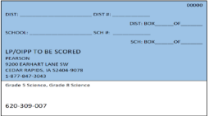
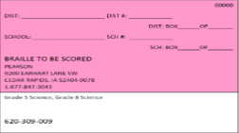
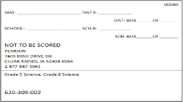
Return Schedule
Biology, Civics, and US History EOC PBT Accommodations
PBT
K-8 Centers, Middle Schools, Senior HS and Alternative Centers:
Biology 1, Civics, and US History PBT Accommodations | Pearson Color Return Labels | Deadline to schedule school pickup with UPS:
Regular Print | BROWN “TO BE SCORED” | Fall: September 24 Winter: December 17
Large print, One-item-per-page | BLUE – “TO BE SCORED”
Braille materials | PINK – “TO BE SCORED”
Damaged books marked DNS, unused test and answer books (including NOT TO BE SCORED special documents) | WHITE “NOT TO BE SCORED”
Notes:
The Chart provides the Return Schedule for NGSSS EOC PBT Accommodation materials.
The Fall return date is September 24: all K-8 Centers, Middle, Senior High Schools, and Alternative Centers with TO BE SCORED and NOT TO BE SCORED Biology 1, Civics, and US History EOC PBT accommodations, must schedule pick up of those materials with UPS by September 24
The Winter return date is December 17: all K-8 Centers, Middle, Senior High Schools, and Alternative Centers with TO BE SCORED and NOT TO BE SCORED Biology 1, Civics, and US History EOC PBT accommodations, must schedule pick up of those materials with UPS by December 17
Prepare the following types of boxes for return (as applicable):
Brown-labeled boxes—TO BE SCORED regular print EOC (Biology 1, Civics, U.S. History) test and answer books
White-labeled boxes—NOT TO BE SCORED materials and NOT TO BE SCORED special document materials The Not TO BE SCORED boxes should include document marked DNS, unused paper tests, and special documents.
Blue-labeled boxes—TO BE SCORED large print and one-item-per-page materials
Pink-labeled boxes—TO BE SCORED braille materials
It is your responsibility to package all materials correctly. Mispackaged materials or materials not returned on your scheduled pickup date will delay reporting of student results.

Slide 52
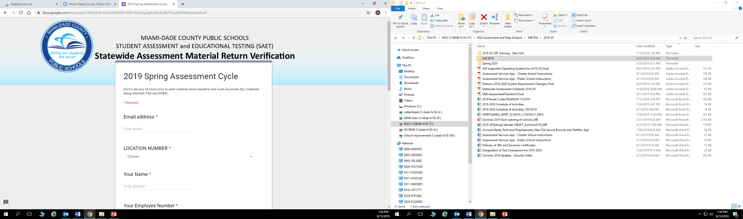
Return Schedule
PBT Accommodations
PBT
The Statewide Assessment Material Return Verification Form is due 24 hours prior to each material return deadline and must document all materials being returned (TBS and NTBS).
Example: The return window for the Fall NGSSS TBS material is September 24th. Therefore, the form must be completed and submitted by September 23rd.
Schools with multiple locations must complete separate forms for each location.
Notes:
The Statewide Assessment Material Return Verification Form is due 24 hours prior to each material return deadline and must document all materials being returned (TBS and NTBS).
Complete the form by September 23rd for the Fall and by December 16th for the Winter.
The form is accessible via the TDC Documents website.

Slide 53


Return Schedule
PBT Accommodations
PBT
Contact UPS, 24-48 hours, in advance of return deadlines
Scheduling a UPS Pickup of NGSSS EOC Materials to PEARSON:
Call UPS at 800.823.7459 to schedule all UPS pickups (Ground or Next Day Air).
Inform UPS customer representative that you are calling to schedule a PEARSON pickup.
Provide the following information:
    Tracking number located at bottom of label.
    The physical location where packages are to be picked up from.
    Estimated number of packages that will be available for pick up.
Record the pickup confirmation number that will be provided to you by the UPS customer representative.
Notes:
Scheduling a UPS Pickup of NGSSS EOC Materials to PEARSON:
Call UPS at 800.823.7459 to schedule all UPS pickups (Ground or Next Day Air).
Inform UPS customer representative that you are calling to schedule a PEARSON pickup.
Provide the following information:
Tracking number located at bottom of label.
The physical location where packages are to be picked up from.
Estimated number of packages that will be available for pick up.
Record the pickup confirmation number that will be provided to you by the UPS customer representative.

Slide 54
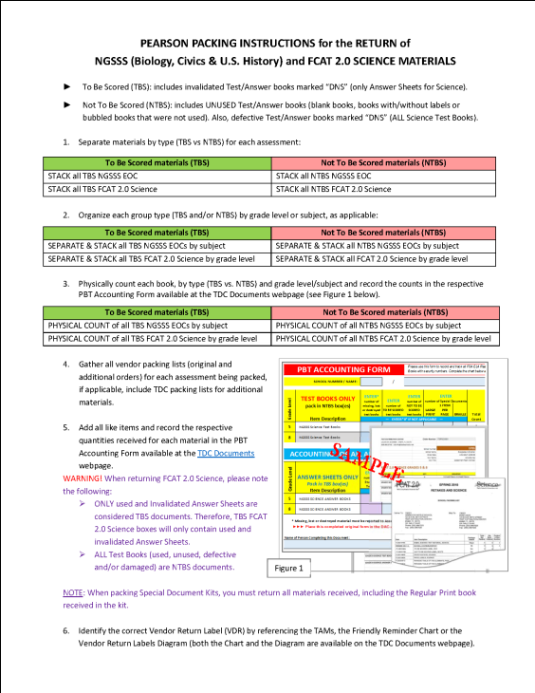
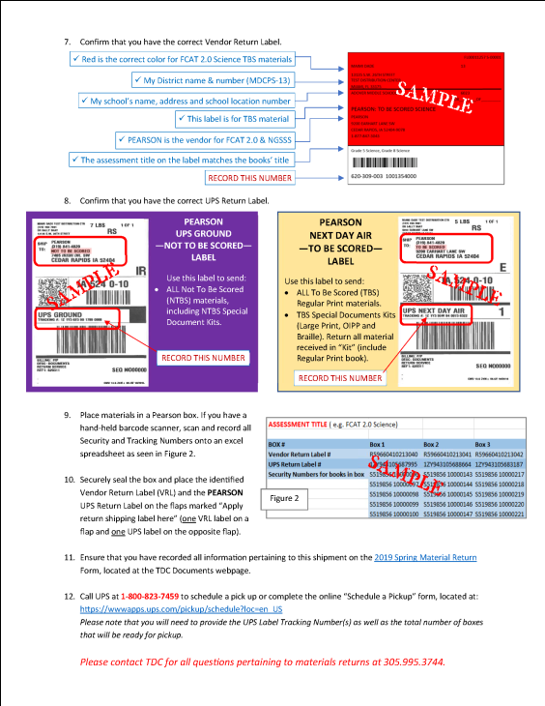
NGSSS (Pearson) Additional Resources
PBT
PEARSON PACKING INSTRUCTIONS
— NGSSS
Notes:
Generic packing instructions for the NGSSS Pearson Civics, Biology and US History PBT accommodations are available at the TDC Documents site.

Slide 55
DAC- Administrative Records (AR) Box
PBT
CBT
Prepare DAC-AR Box(es)
Place the following materials in the Administrative Records Box(es):
  Original Test Materials Chain of Custody Form (for PBT accommodations)
  Original School Procedural Checklist (FM-6927) (One per administration)
  Original Test Administration and Security Agreements and Test Administrator Prohibited Activities Agreements
  Original records of required administration information, such as Administration Record/Security Checklist
  Original Advanced Session Rosters (NGSSS CBT ONLY)
  Original Security Logs
  Original Seating Charts
  Group documentation by type and include an Administrative Records Cover Sheet (found on the TDC Documents website)
Seal the box and complete, print and tape a DAC-AR box label to the side of the box available on the TDC Documents web page.
Notes:
Schools will prepare a DAC – AR, District Assessment Coordinator-Administrative Records Box to include all FSA and NGSSS EOC administration documentation for both Fall and Winter 2019 (as applicable).
A Comprehensive Assessment Chart is provided by TDC and posted to the TDC Documents page.
Prepare your documentation according to the Comprehensive Assessment Chart. When packing your required administrative records, group like documents together and neatly place them in the DAC-AR box in the order that they are listed. Maintain the DAC-AR box in locked storage until you return it to TDC.
Include in your school’s AR box the materials listed on the slide as applicable. Include (read list from slide):
Original Test Materials Chain of Custody Form (for PBT accommodations, if applicable)
Original School Procedural Checklist (FM-6927) (Pre-populated forms are posted in the Training Packet on the test chairperson site)
Original Test Administration and Security Agreements and Test Administrator Prohibited Activities Agreements
Original records of required administration information, such as Administration Record/Security Checklist
Original Advanced Session Rosters (NGSSS CBT tests)
Original Security Logs
Original Seating Charts
Do not place any of the colored labels provided by DRC or PEARSON on the AR box or pack any SECURE test materials.
A PDF fillable “Return Label” form is posted on the TDC Document webpage. The label will have a space provided for your School Name, Number, and assessment details. Complete the form, print the label on white paper and tape it to the side of your DAC AR box.

Slide 56
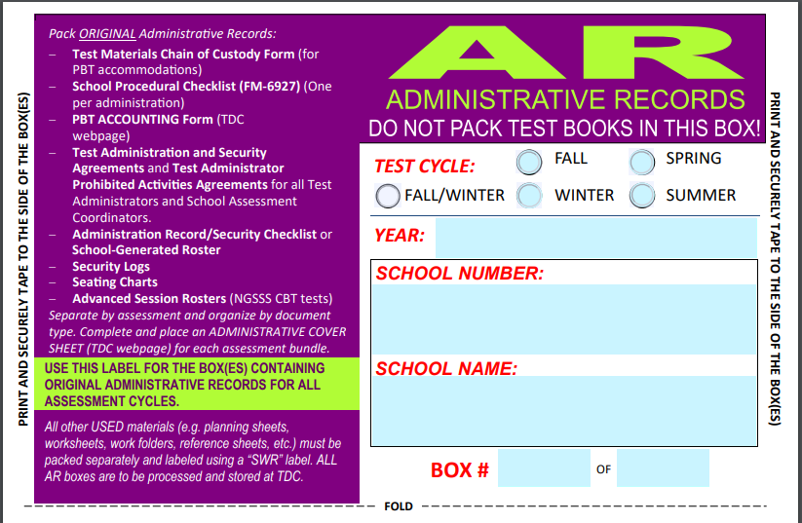
Complete, Print, and Attach AR Return Label
DAC-AR Return Label
PBT
CBT
Notes:
Do not place any of the colored labels provided by DRC or PEARSON on the DAC AR box or pack any SECURE test materials.
A PDF fillable “Return Label” form is posted on the TDC Document webpage. The label will have a space provided for your School Name, Number, and assessment details. Complete the form, print the label on white paper and tape it to the side of your box.
This is the PDF fillable DAC-AR label that will be used to identify your school’s Administrative Records box.. Print and place the label on the side of the box . It is accessible in the TDC Documents page.

Slide 57
DAC–Student Work Records (SWR) Box
PBT
CBT
Prepare the DAC–SWR Box(es)
Place the following materials in the District Assessment Coordinator (DAC) – Student Work Records (SWR) Box(es):
  All used work folders
  All used worksheets (optional for Civics and US History EOC)
  All used periodic tables
Seal the box
Complete, print and tape a DAC–SWR box label to the side of the box available on the TDC Documents website.
Comprehensive Assessment Charts
Notes:
Schools will prepare “one” DAC-SWR (original Student Work Records) Box that will include all used Fall and Winter 2019 documents listed on the slide for the FSA AND NGSSS EOC (as applicable).
For the NGSSS tests, Include in your school’s DAC-SWR Box:
All used work folders
All used worksheets (optional for Civics and US History EOC)
All used periodic tables
Do not place any of the colored return labels provided by DRC or PEARSON on the DAC –SWR boxes or pack any SECURE test materials in the box. This box remains at TDC.
A PDF fillable “DAC-SWR Return Label” form is posted on the TDC Document webpage. The label will have a space provided for your School Name, Number, and assessment details. You will complete the form, print the label on white paper and tape it to the side of your DAC-SWR box.
Note: As a reminder, the four-function calculators remain at the school and should be stored securely. CBT Test Tickets and copies of all required administrative records, Test Administrator training documents, relevant notes and applicable materials will remain at the school for one calendar school year.

Slide 58
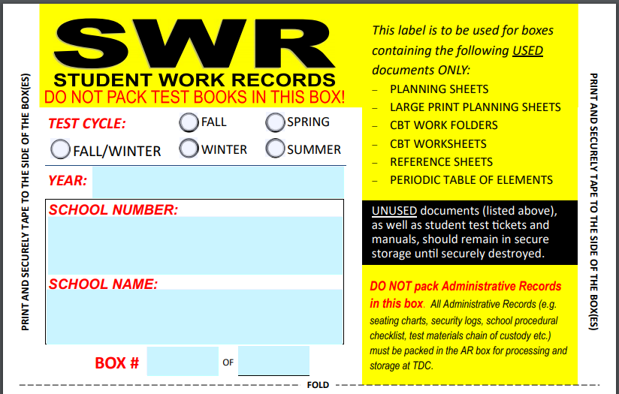
Complete, Print, and Attach SWR Return Label
DAC-SWR Return Label
PBT
CBT
  DAC-SWR
Notes:
Do not place any of the colored return labels provided by DRC or PEARSON on the DAC –SWR boxes or pack any SECURE test materials in the box. This box remains at TDC.
A PDF fillable “DAC-SWR Return Label” form is posted on the TDC Document webpage. The label will have a space provided for your School Name, Number, and assessment details. You will complete the form, print the label on white paper and tape it to the side of your DAC-SWR box.
This is the PDF fillable DAC-SWR label that will be used to identify your school’s Student Work Records box. Print and place the label on the side of the box . It is accessible in the TDC Documents page.

Slide 59
Return Schedule
DAC-AR and DAC-SWR Box(es)
PBT
CBT
K-8 Centers, Middle Schools, Senior HS and Alternative Centers Return to TDC:
District Assessment Coordinator (DAC) Boxes | BOX RETURN LABEL | RETURN DATE
DAC-Administrative Records (DAC-AR) and DAC –Student Work Records (DAC-SWR) | (No Color Return Label) Print DAC-AR & DAC-SWR Labels from TDC Documents website | December 16-20
Include original documentation for: NGSSS Biology 1, Civics, US History EOCs; FSA ELA Writing (Retake); FSA ELA Reading (Retake); and FSA Algebra 1 and Geometry EOCs
Note: Fall 2019 materials to be returned with the Winter materials by the return date.
Comprehensive Assessment Chart
Notes:
It is your responsibility to package all materials correctly.
Mispackaged materials or materials not returned on your scheduled pickup date will delay reporting of student results.
District Assessment Coordinator ONLY boxes containing documentation for the listed exams for the Fall and Winter administrations must be returned to TDC by December 16-20
Include ALL documentation as applicable to your school for:
NGSSS Biology 1, Civics, US History EOC
FSA ELA Writing (Retake)
FSA ELA Reading (Retake)
FSA Algebra 1 and Geometry EOC Assessments

Slide 60
Fall/Winter 2019 NGSSS EOC
Results Access
Fall/Winter 2019 NGSSS EOC test results are expected 4-6 week after the testing window ends.
Principals will access test results for NGSSS via:
  PearsonAccess Next, log in, under Published Reports
  Must use login credentials:
    Username: prXXXX@dadeschools.net
    Password: created by principal
    Email: use the prXXXX@dadeschools.net generic email address
    Passwords may be reset as needed by clicking on Forgot Password link
SAC must ensure that all results were released for students tested.
Submit missing score/desk audit requests to the SAET by the set deadline.
Notes:
Principals will access to NGSSS test results at:
PearsonAccess Next under Published Reports
Only school principals and school assessment coordinators who have been provided with access by the principal can download test results. If your principal wants to you give you access, principal will need to send request to Maria Bruguera. Access can be provided immediately.
Once results are released, it’s important that you verify that you have received test results for all students tested.
Submit any missing score/desk audit requests to the SAET by the set deadline.

Slide 61
Appendices
CBT
PBT
Appendices in the manual include:
  Appendix A: Accommodations
  Appendix B: Pearson Custom Support
  Appendix C: Paper-Based Materials Return Instructions
  Appendix D: Florida Test Security Statute and Rule
  Appendix E: Perforated Forms and Signs
Notes:
School personnel administering NGSSS assessments should familiarize themselves with the information in the appendices of the NGSSS Manual prior to testing.

Slide 62
Technical Support
District MSTs will be available to help schools with any hardware/internet issues.
District technical support is available at:
Email: TestTechSupport@dadeschools.net
Contact Pearson Customer Support at:
  1-877-847-3043 (Monday–Friday, 7:00 a.m.–8:30 p.m. ET)
  Webform: http://download.pearsonaccessnext.com/ref/w.html?p=FLORIDA
Notes:
District technical support for traditional schools is available at:
Email: TestTechSupport@dadeschools.net
Charter schools must have technical support readily available to answer calls and help troubleshoot.
Always, call the office of Student Assessment to keep us informed.
For NGSSS assistance, call Pearson Customer Support for immediate assistance OR you can email them if you don’t need an response right away.

Slide 63
Test Distribution Center (TDC)
Location & Hours of Operation
TDC POLICIES:
All testing materials must be securely stored at the school site. Please refrain from picking up materials on your way home.
When requesting orders through TDC Documents’ “Order Forms,” please be advised that orders placed before 3:00 pm will be available for pick up within 24 hours. Otherwise, allow 48 hours for processing. Notification emails will be sent only if materials are on backorder.
All testing materials must be inventoried, and discrepancies reported to TDC within 24 hours of material delivery.
ONLY TDC ID card holders are authorized to receive or return materials. Staff must be assigned by the school principal through the Assessment Services’ “School Assessment Team Identification and Contact Information” screen.
ADDRESS
13135 SW 26 Street, Miami, FL 33175
OFFICE HOURS
Monday through Friday
7:30 a.m. – 4:00 p.m.
MATERIAL PICK-UP & RETURN HOURS
Monday through Friday
7:30 a.m. to 2:00 p.m.
Wednesdays
7:30 a.m. to 1:00 p.m.
Notes:
This slide provides TDC policies for return and pickup of materials at the Test Distribution Center.

Slide 64
Contact Information
PBT
CBT
Student Assessment and Educational Testing
Phone: 305-995-7520
Fax: 305-995-7522
  Maria C. Bruguera, Director mbruguera@dadeschools.net
  Mara Ugando, Staff Specialist mugando@dadeschools.net
  Kathleen Sierra, Supervisor ksierra@dadeschools.net
Notes:
This slide lists our contact number.
You may contact Maria, Kathy or myself, Mara for assistance with any questions or concerns.

Slide 65
Thank you for ensuring a secure and successful NGSSS EOC administration!
Notes:
Thank you for ensuring secure and successful Fall and Winter 2019 NGSSS EOC test administrations!

