Slide 1
Resources for Test Chairs
by Kathleen Sierra
Darma Rodriguez

Slide 2


Slide 3
District Staff
Dr. Sally Shay, District Director
Administrator | Email
Maria Bruguera Mara Ugando | mbruguera@dadeschools.net mugando@dadeschools.net
Felicia Mallory Denetra Collins | fmallory@dadeschools.net collinsd@dadeschools.net
Mayda Cabeza | MCabeza@dadeschools.net
Kathleen Sierra | ksierra@dadeschools.net
Office Phone # (305)995-7520

Slide 4
Testing Distribution Center (TDC)
Personnel:
    Magaly Hernandez
    Darma Rodriguez
  Maria Vargas
Address: 13135 SW 26 St
Phone: (305)995-3743

Slide 5

Important Websites
ARDA website
http://oada.dadeschools.net/
Testing Calendar
http://oada.dadeschools.net/TestingCalendar/TestingCalendar.asp
Test Chair Page
http://oada.dadeschools.net/TestChairInfo/InfoForTestChair.asp

Slide 6
Communication from District
Review Testing Calendar
District Briefings
      Alerts about upcoming assessments
      Notifications of training
        District Test Meetings (face-to-face)
        Screencasts (only for selected programs)
Emails from Student Assessment
      Dr. Sally Shay
      Barbara Betancourt

Slide 7
Review Program Guides
Each testing program has a Program Guide or Test Administration Manual
Testing window
Who is tested
How it is delivered (paper or computer)
Procedures and guidelines
Accommodations for SPED and ELL
http://oada.dadeschools.net/TestChairInfo/InfoForTestChair.asp

Slide 8
Test Platforms & Websites
Gateway 2 Data (G2D)
  https://tg.dadeschools.net/FLMiamiDade/tglogin.aspx
  Testing platform for Baseline and Mid Year Assessments (contact: Denetra Collins & Felicia Mallory)
PearsonAccessNext
  https://fl.pearsonaccessnext.com/customer/index.action
  Testing Platform for EOCs and FCAT Retakes (contact: Maria Bruguera & Mara Ugando)
ORS and TIDE
  https://fl.sso.airast.org/auth/UI/Login
  Testing Platform for FSA, FSA EOCs and FSA Retakes (contact: Maria Bruguera & Mara Ugando)

Slide 9
Test Platform & Websites (continued)
Cambridge
  http://www.cie.org.uk/
    Site used to order AICE Materials (contact: Renee Ilhardt, Advanced Academics)
Collegeboard
  https://www.collegeboard.org/
  Site used to order AP and PSAT Materials (contact: Montserrat "Montse" Parradelo, Advanced Academics)
College Measured Success
    https://college/measuredsuccess.com
  Testing Platform for PERT (contact: Mayda Cabeza)

Slide 10
District Applications
File Download Manager (FDM)
  Identify students to be tested and to create your testing roster
Accelify ESE- EMS System
  Identify Students' specific testing accommodations
Student Performance Indicators (SPI)
  Look up all student scores
DSIS (formerly ISIS)
  Look up student information
Make sure you request access to these from your principal

Slide 11
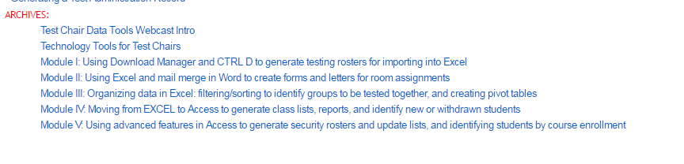
Software and Resources
Microsoft Office:
  MS Word
  MS Excel
  MS Access
  MS Outlook (installed version)
Technology Tools for Test Chairs:
  http://oada.dadeschools.net/TestChairInfo/TechnologyToolsforTestChairs2.pdf
  Training Modules (Under “Archives”
  on Test Chair Information Page)
  Basic MS Excel functions
  How to use Mail Merge
  How to use MS Access

Slide 12
Support Modules
Support modules for test chairs to help save time organizing test administrations
Go to:
http://oada.dadeschools.net/SupportModules/SupportModules.asp
Topics include demonstrations in:
  District Applications (FDM, ISIS, SPED EMS, SPI)
  Excel (pivot tables, subtotal function, macros, Vlookup)
  Word (mail merge for letters, CBT tickets, email)
  Google Forms

Slide 13
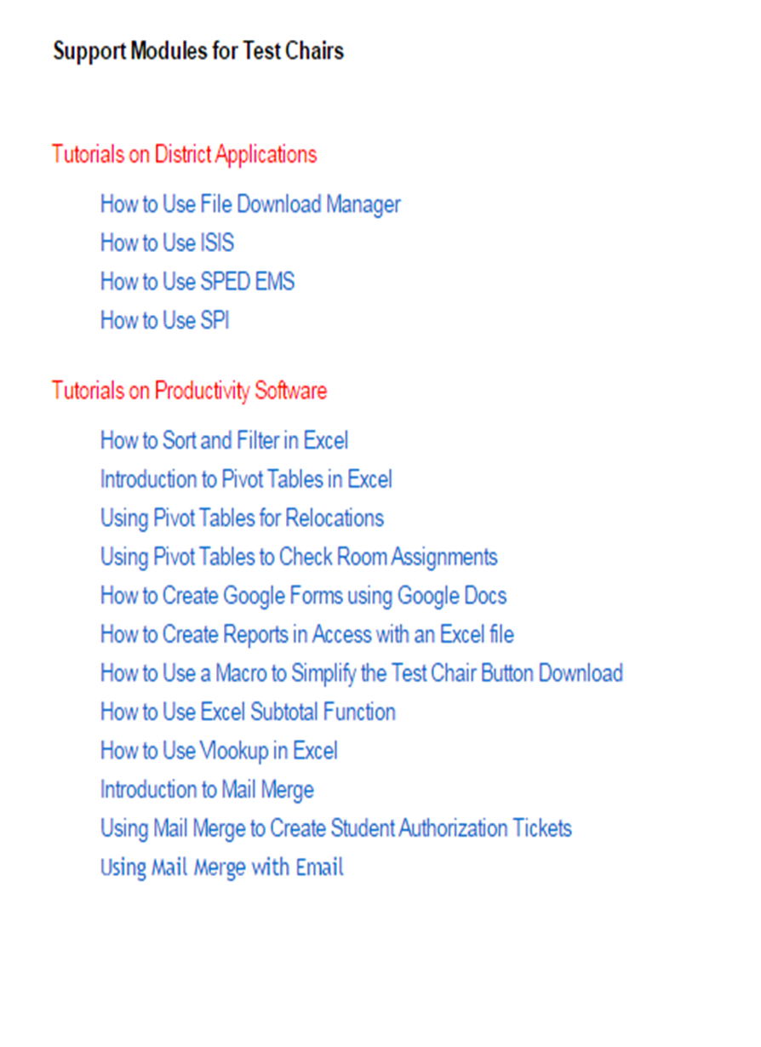

Slide 14

Where do I begin?

Slide 15

3 Initial Steps
… that will get you on your way!
What test is being administered and who needs to test?
    Identify, organize and schedule the students
How many rooms and days will be needed?
    This will be based on your school’s capacity and/or computer availability, as well as HOW you choose to organize your sessions.
        By Curriculum Groups
        By Class vs. Alpha
        PBT, ESE and ELL have been isolated
        Consolidation rooms have been designated
        Sessions are “stacked” (AM/PM Session) as a way to shorten the number of days that will be required to test all students
TRY MIXING & MATCHING!
For example, test ELA Grade 9 by class, but extract SPED students to test on a designated day and organize alphabetically.

Slide 16
3 Initial Steps (continued)
Who will proctor?
    Consider teachers from the content areas that are being tested, co-teachers, teachers from departments that can offer department coverage such as TMH or P.E. and teachers with smaller classes that will require fewer students be displaced.
    Don’t forget Para-professionals can be assigned as the second proctor in a large room.
    Consider “quilting” the proctoring assignments by period (ex. On Monday, November 14, in room 2101 Ms. Jackson will be the proctor during 1st period, Mr. Watson during 2nd period, and Mrs. Fernandez during 3rd period). This will require that security be notified so that rooms can be monitored between transition.

Slide 17

Communication in KEY!
Notify students and teachers of testing dates and locations
    Create testing assignment notices
    for students and teachers by using
    MS Word Mail Merge and/or Excel
    Send e-mail notifications
    Posts lists on your website
    Post lists on wall
    Generate Connect Ed calls
NEVER include the FL Student ID, the D.O.B., ESE Exceptionalities or ESOL Levels on posted lists
When posting lists on walls, bulletin boards or websites, ONLY include the following information:
Student ID
Grade
Test Date
Room Number
Remember to sort the list by Student ID for quick reference.

Slide 18
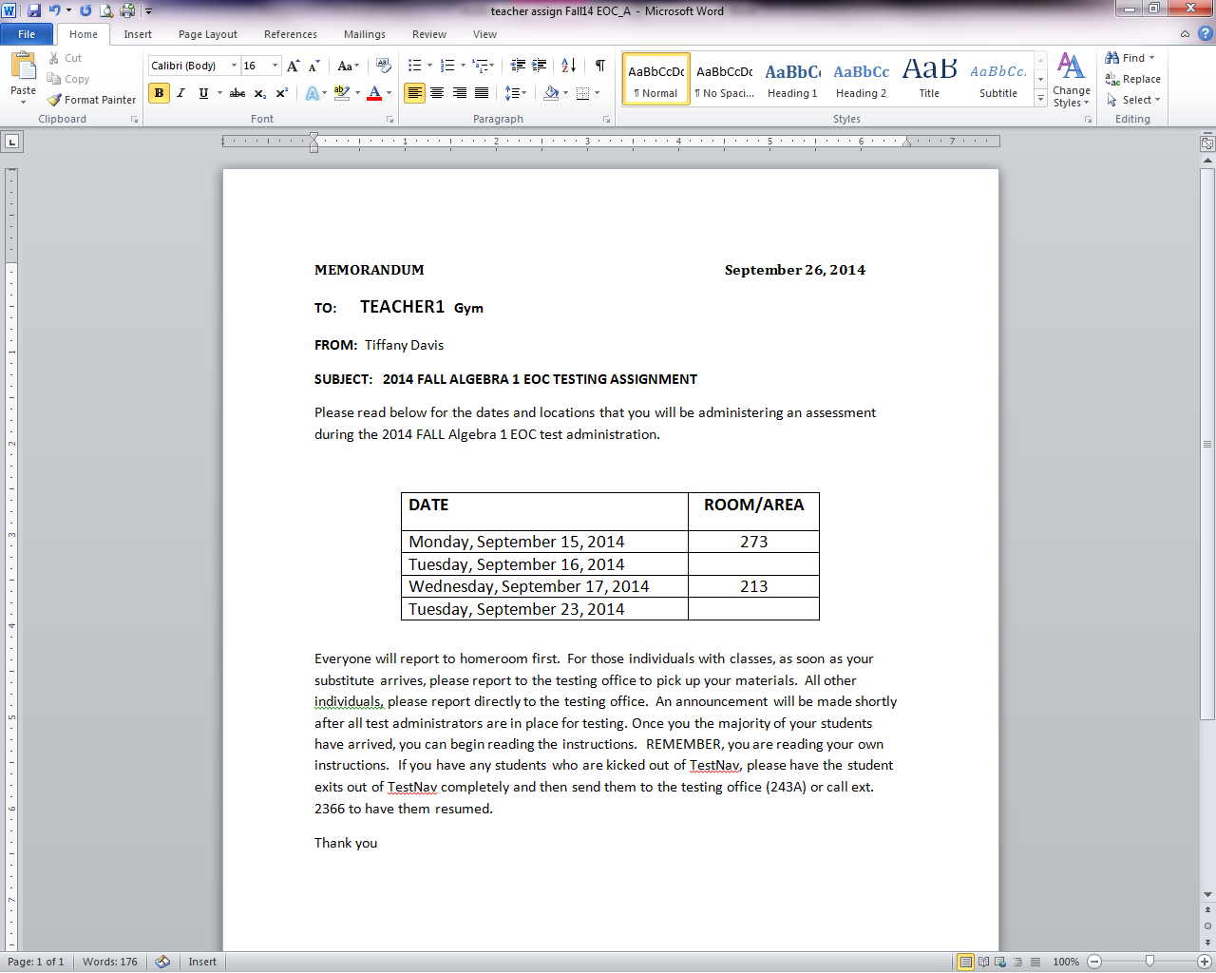
Communication (continued)
Notify Teachers and staff of the Test Administrator/Proctor assignments and training date and location.
This Test Administrator Notice was generated using MS Mail Merge and can provide as much information as you deem necessary. For instance, it could detail the proctoring assignment, instructions for student displacement or class coverage, what the procedures will be to collect/return materials, when to report to the testing room, what to do in the event of error codes, etc.

Slide 19
Communication (continued)
Prepare your coverage plan and notify all staff (security, teachers, sub locator, administrative team, etc.)
    Secure substitute teachers, if necessary
    Notify teachers who will be covering classes of period/location assignment
    Inform the cafeteria manager is there will be changes in lunch schedules or if you will need to provide lunch to students who complete exams late.

Slide 20
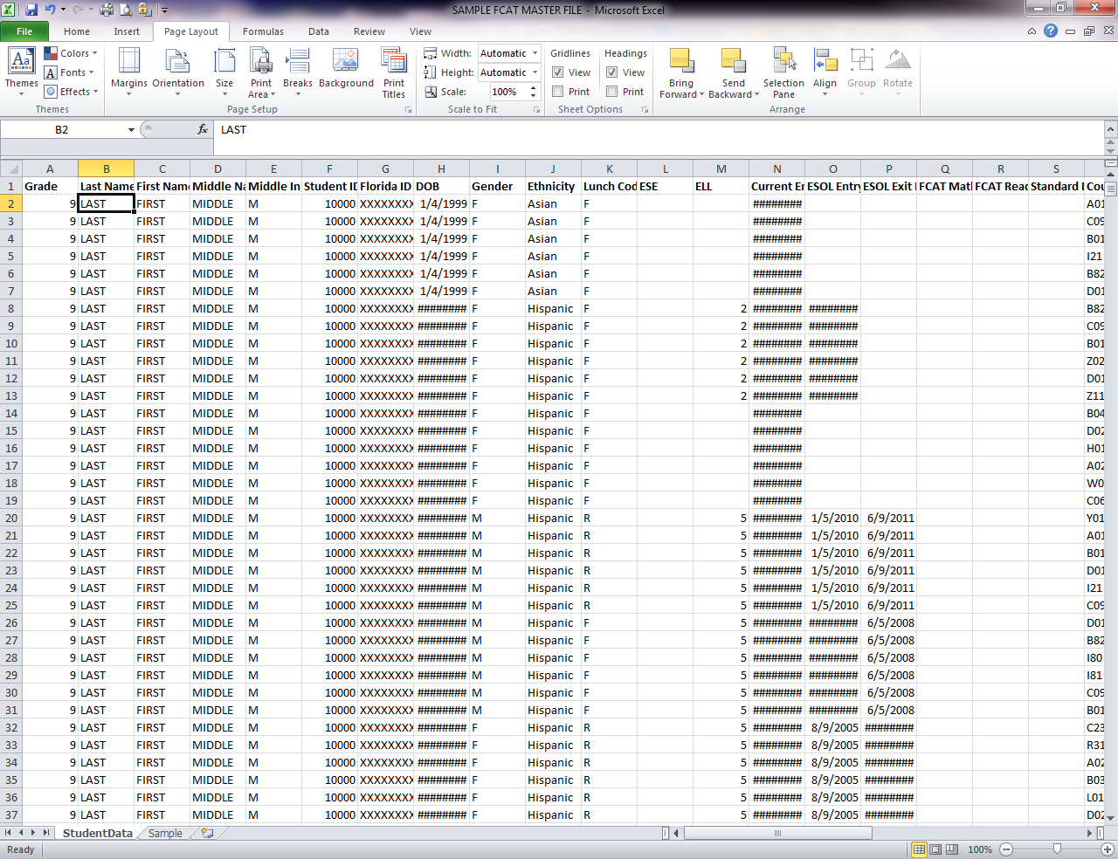
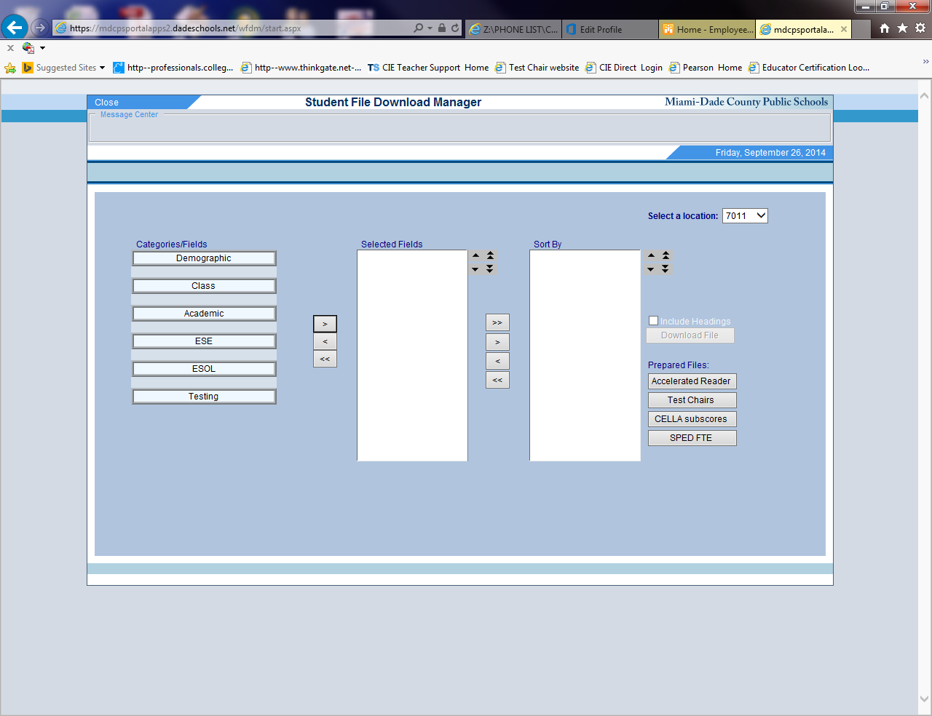
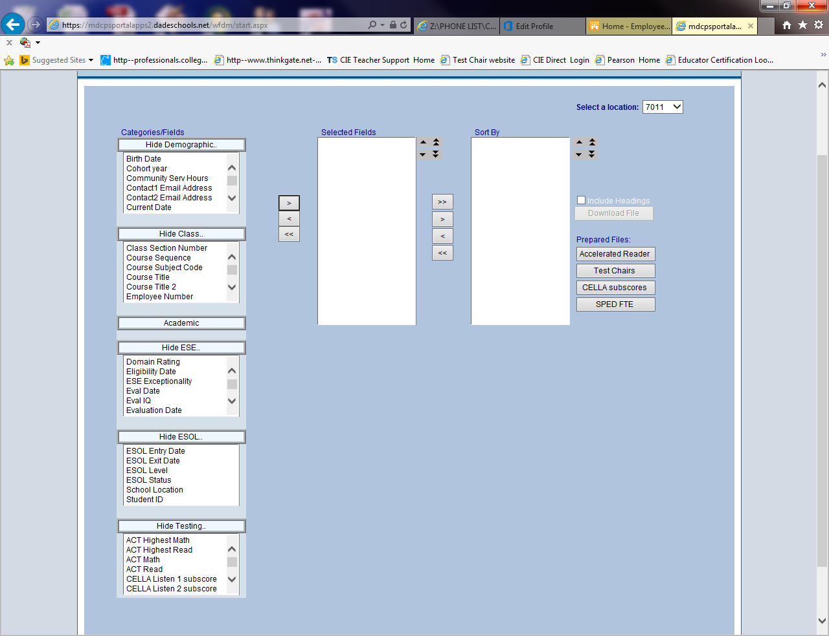
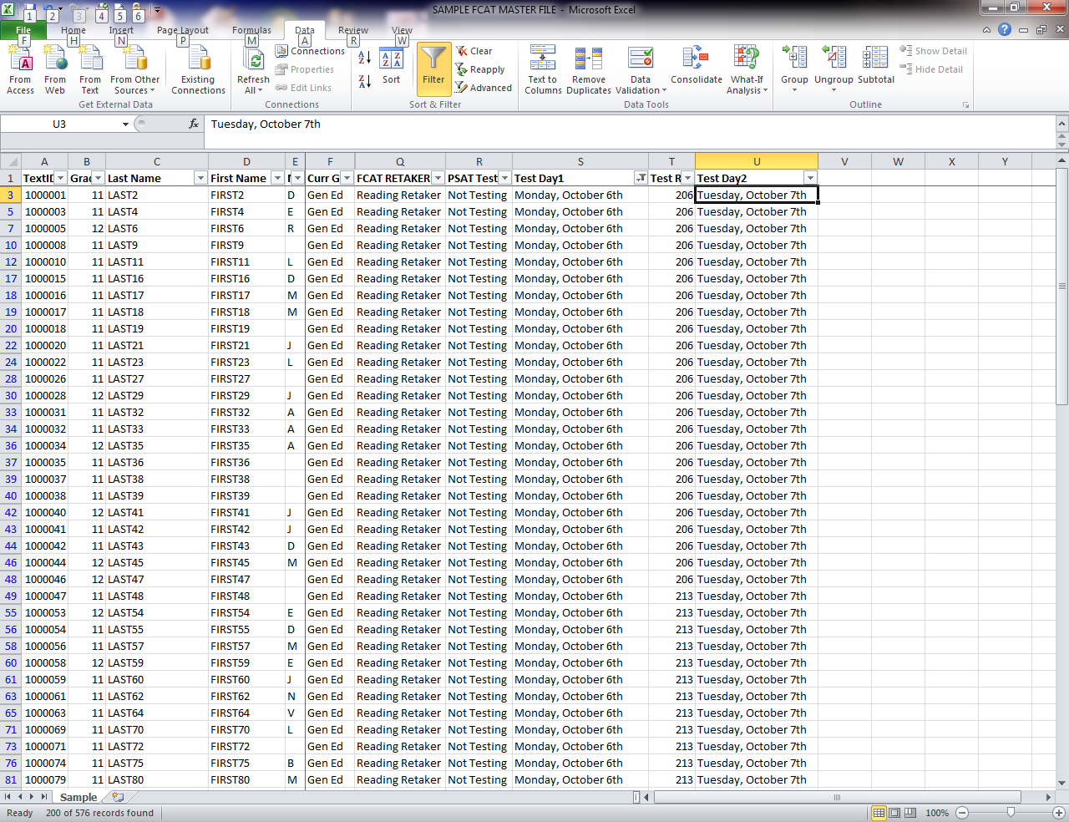
Generate Required Documents
Download FDM file into MS Excel
    Select criteria by using the “Test Chairs” button or use the menu on the left to custom select criteria and open file in Excel
    Sort and Filter
Most common criteria to consider when sorting and filtering:
    Test being administered
    Course/Course Code
    Grade Level/Cohort Year
    ESOL/SPED/STND Students
    Previous test results

Slide 21
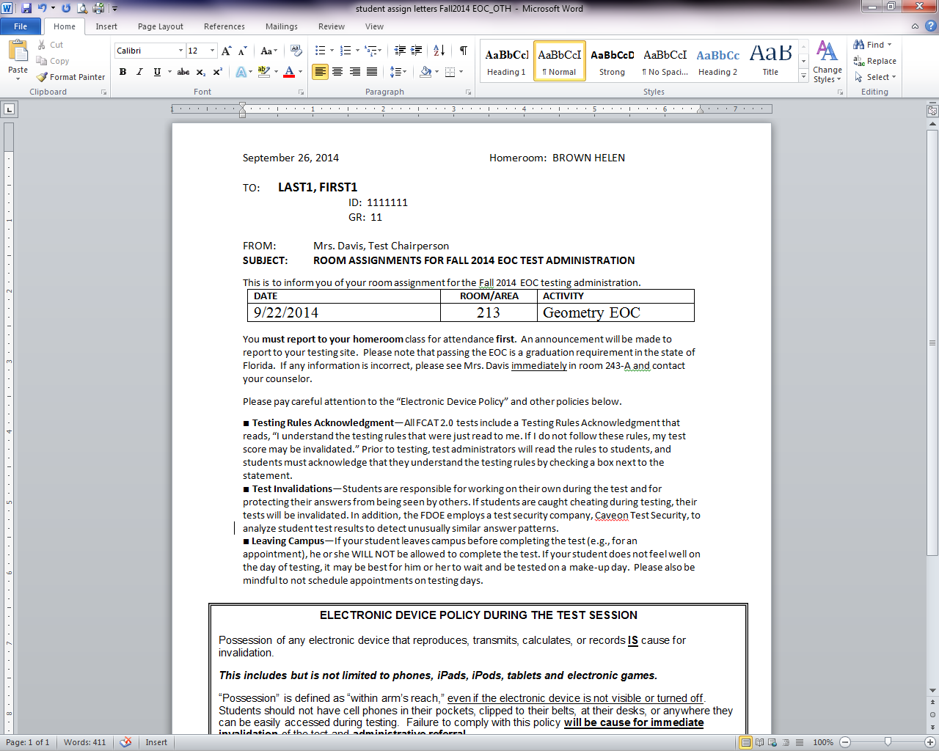
Sample Testing Notices (generated with MS Mail Merge)
A comprehensive student pass that informs the students of their assigned test date, location and testing policies minimizes scheduling confusion and student infractions.

Slide 22
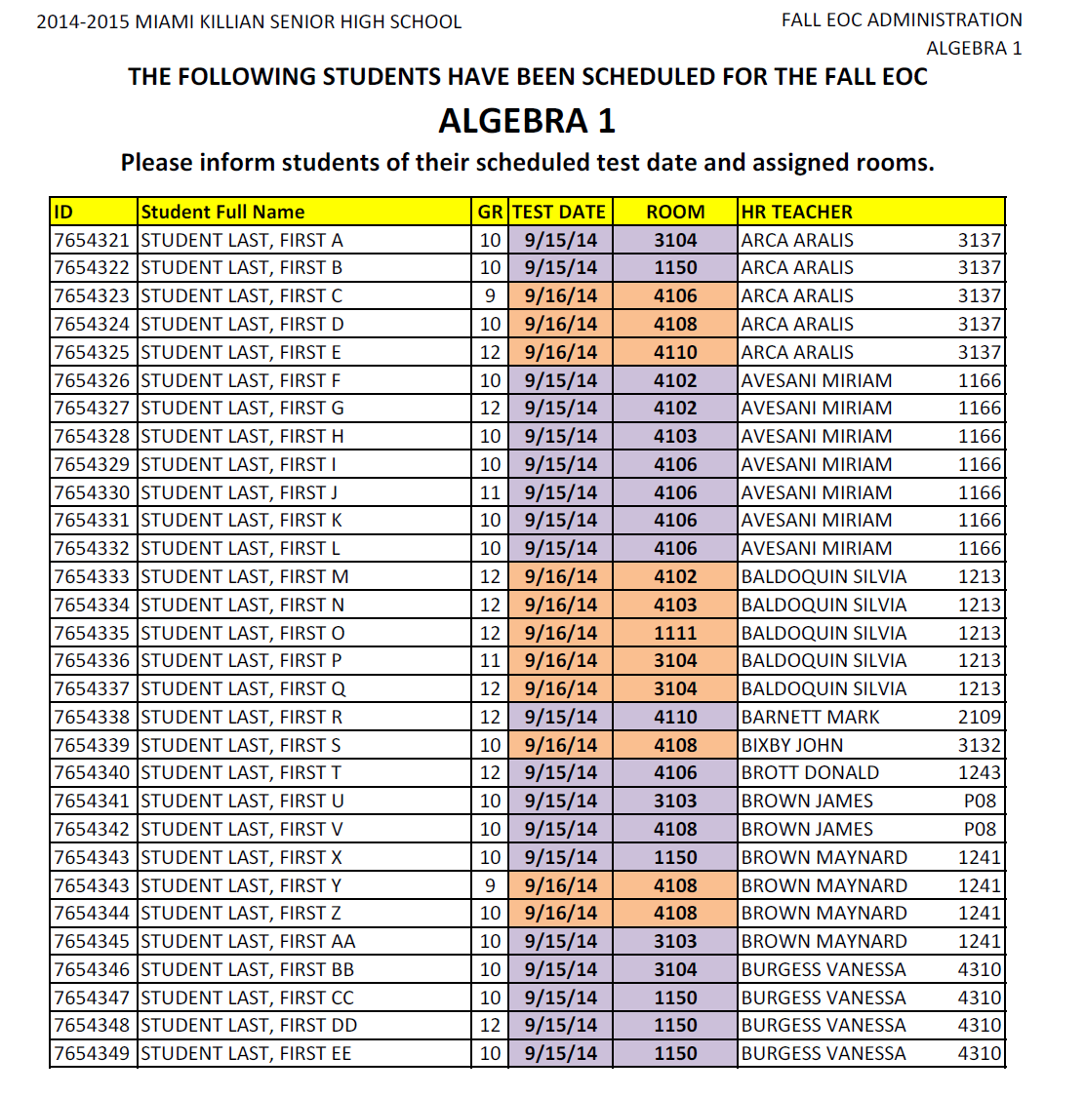
Sample EMAIL List of Testing Assignments (generated with Excel)
This emailed list enables all teachers to assist with notifying students of their testing dates and locations.
By including homeroom numbers on your list, Student Aides can quickly help locate students the morning of testing!
If your testing roster includes multiple test dates, remember to include the date on your email list to avoid confusion. You may also want to color code the fonts or the cells to highlight the different dates.

Slide 23
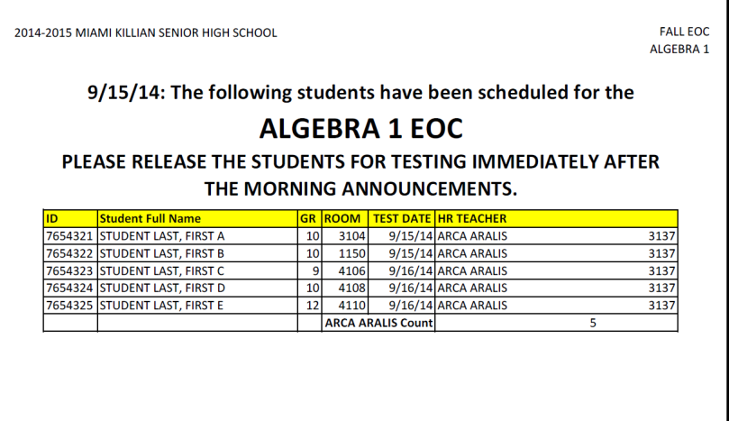
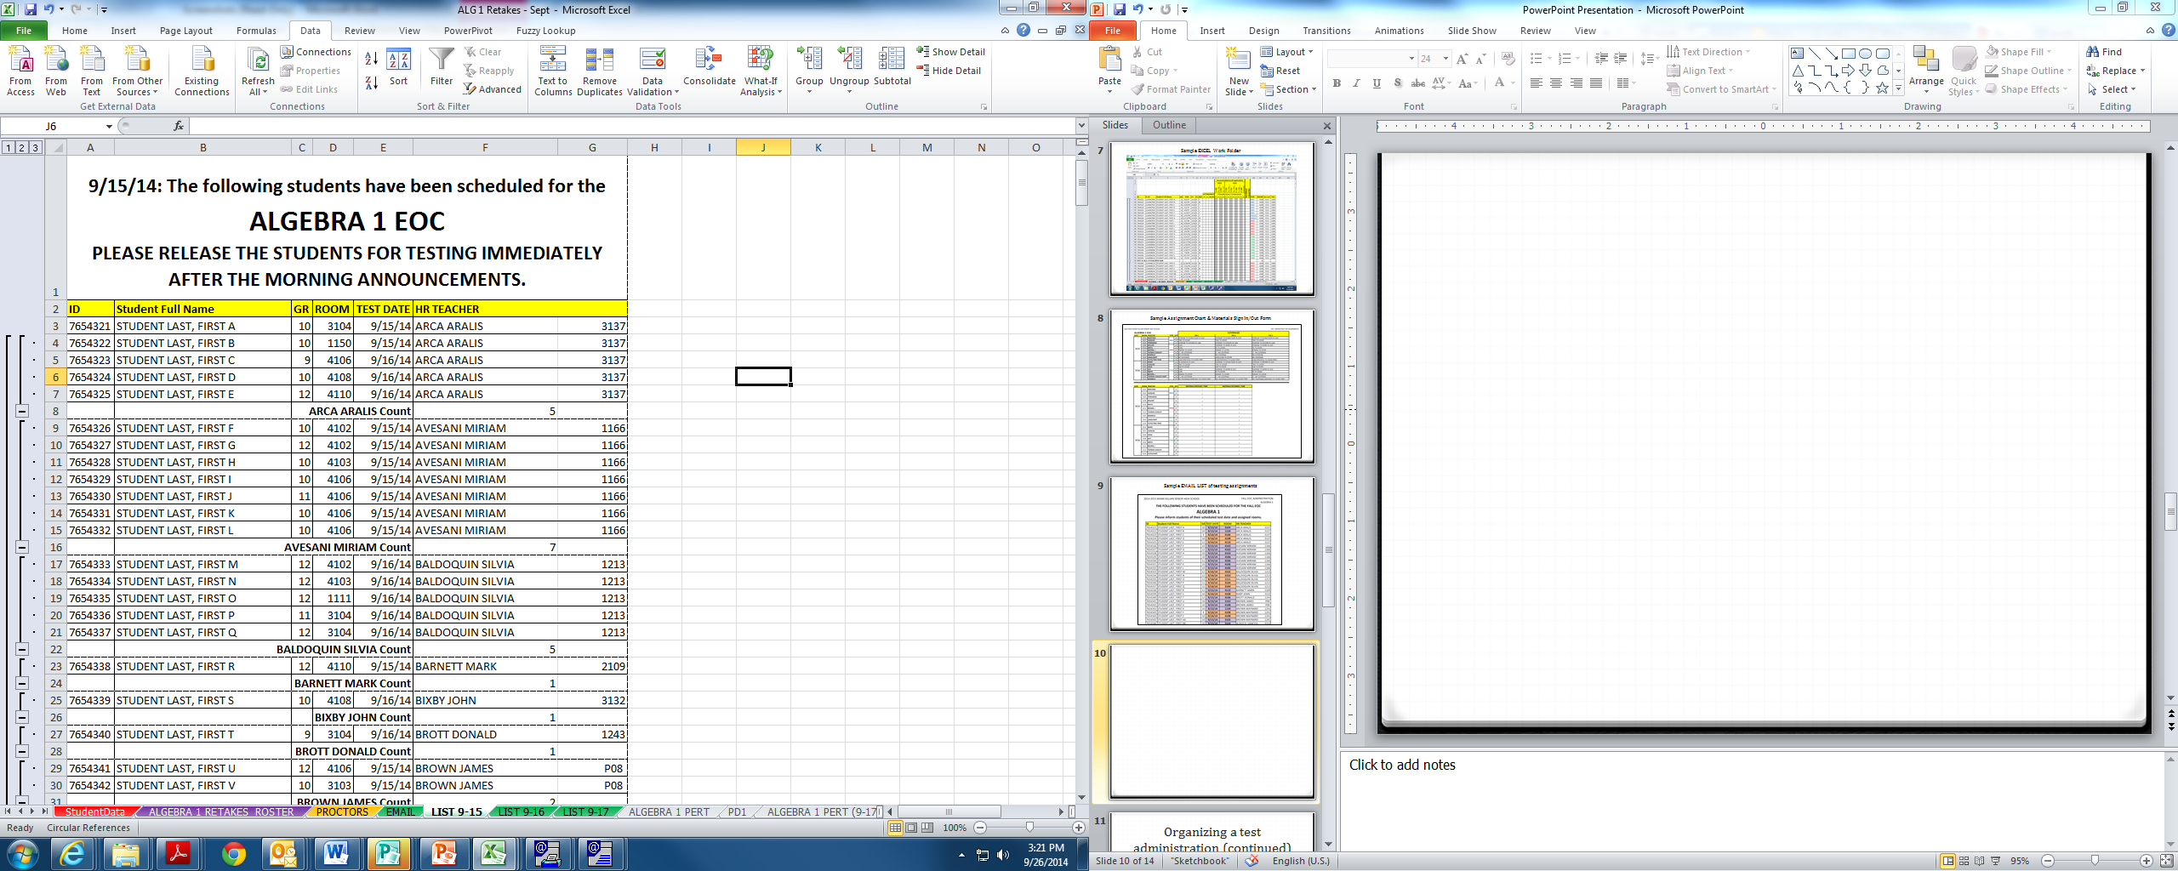
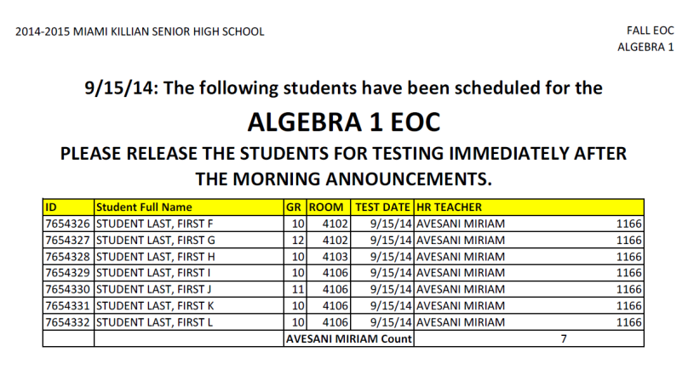
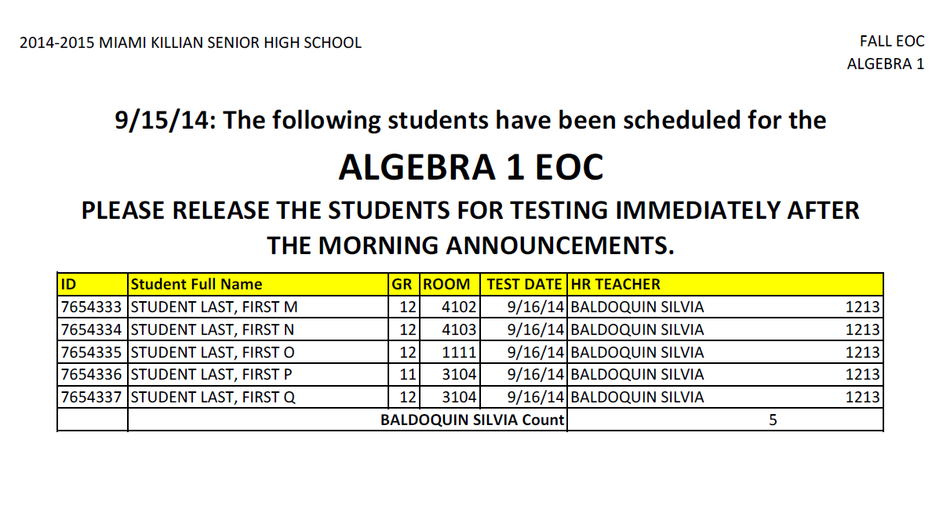
Sample Teacher Lists for
Testing Assignments (generated with Excel)
This Excel sheet was used to create teacher-specific lists that are placed in mailboxes the afternoon prior to the test day.

Slide 24
Set up Procedures… for EVERYTHING!
Determine how testing materials will be distributed and collected.
Have the Test Administrators pick up materials before schools starts or before the scheduled test administration (to be determined by the testing time allowed and/or how you choose to schedule the sessions).
Have the materials returned to you IMMEDIATELY following a test administration
  For instance, for the Algebra I EOC, students have “one school day to test,” therefore, testing will start immediately after morning announcements. However, the ELAs have specific time constraints, so each lab can be scheduled for two sessions per day. As such, Test Administrators scheduled for the later session, would pick up materials minutes before the second administration is scheduled to commence.
If testing in another building or under tight time constraints, designate an empty room, or a hallway immediately outside the testing rooms, to collect materials. Remember to bring carts, bins and staff (authorized to handle the testing material) to assist in transporting the materials back to the office (this is a helpful strategy for paper-based exams such as the PSAT). If in the hallway, secure materials before releasing students.

Slide 25
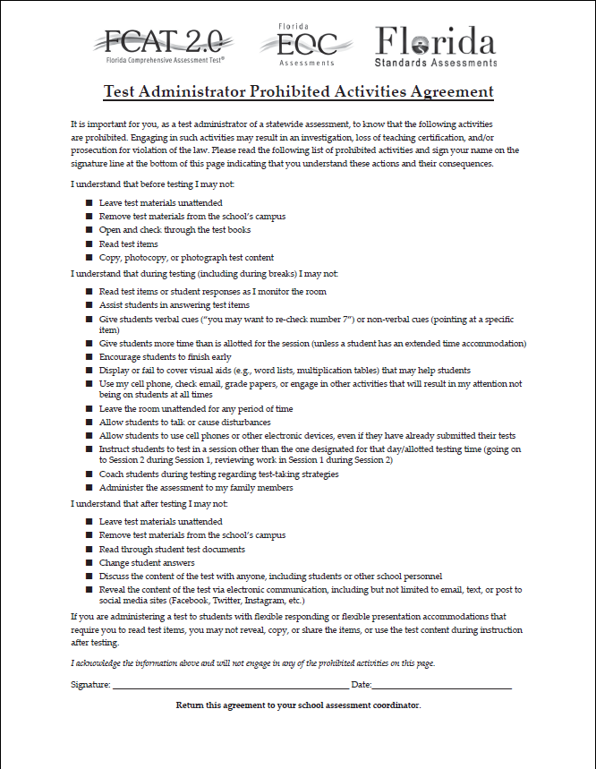
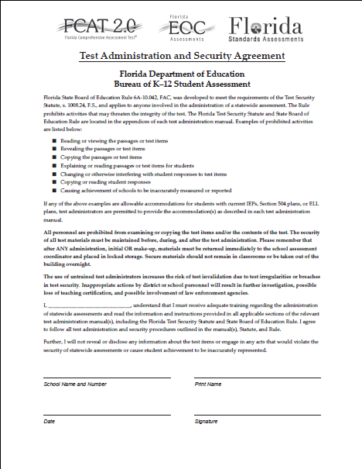
PRINT, SIGN, DATE & RETURN

Slide 26
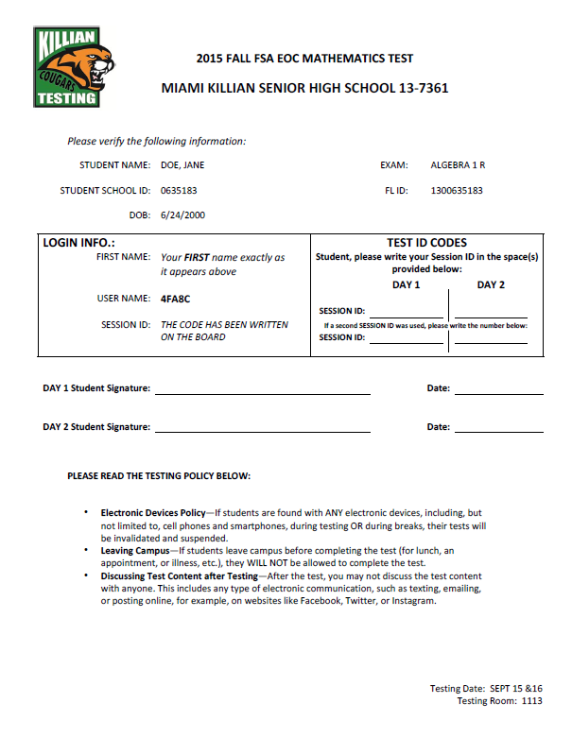
FSA Ticket
Login Information:
First Name
Username
  This information will also appear on your roster for easy reference.
Session ID
  You will generate by logging into www.fsassessments.org and starting a new session.

Slide 27
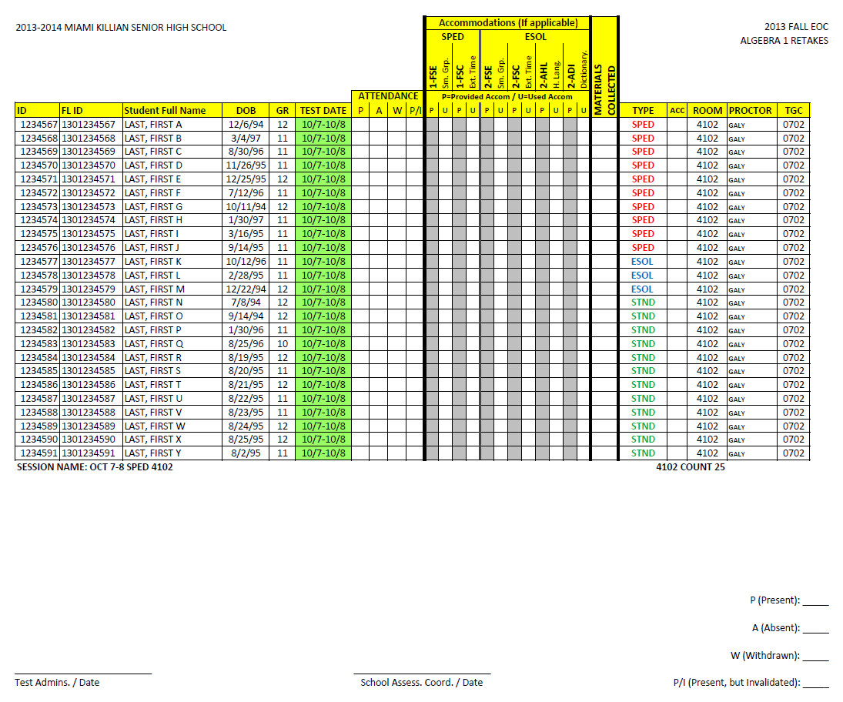
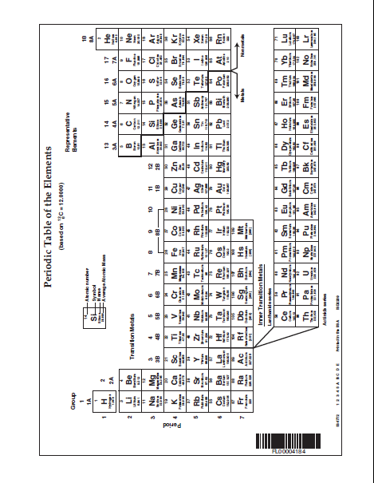
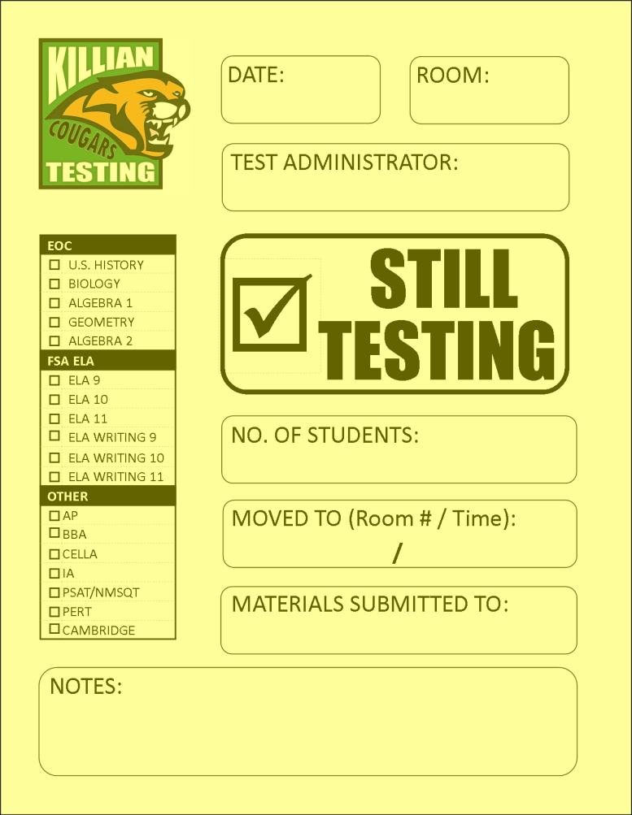
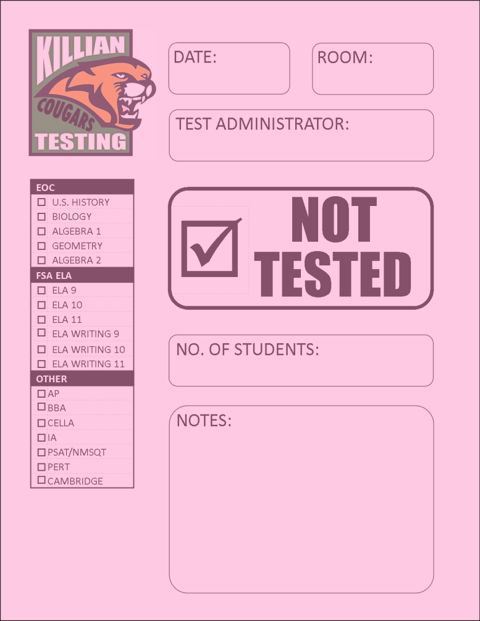
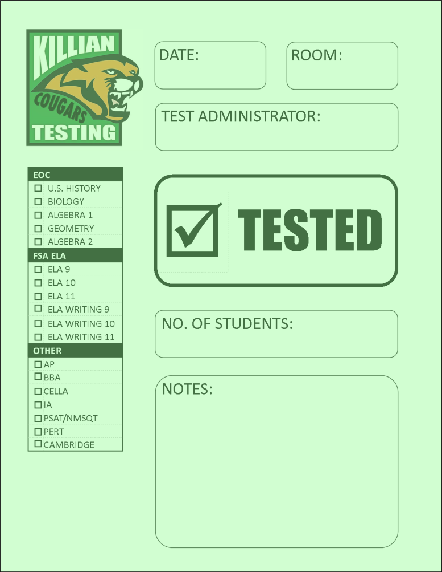

Test Administrator’s folder – LEFT POCKET

Slide 28
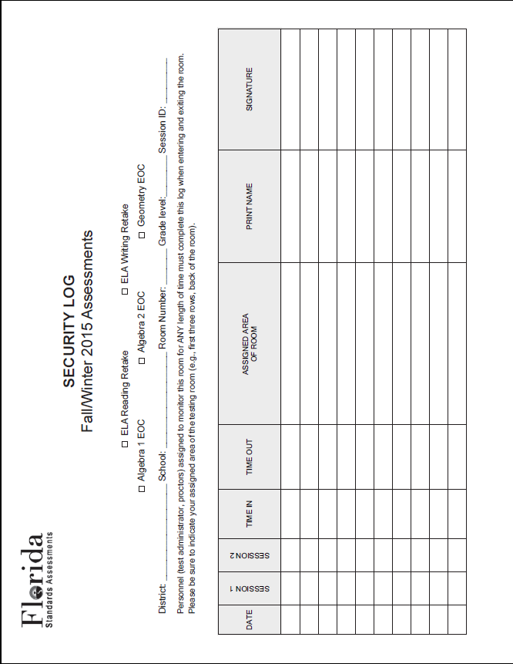
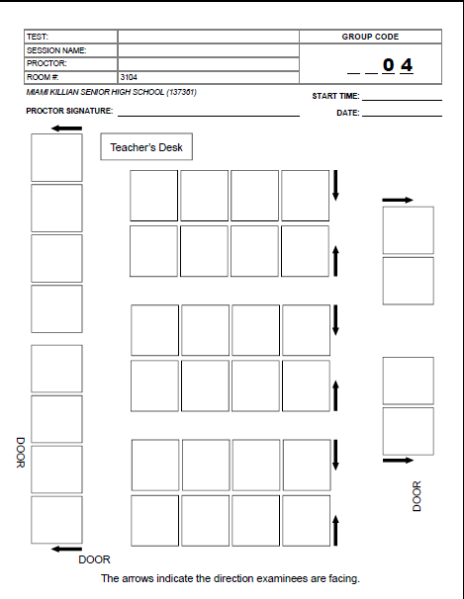
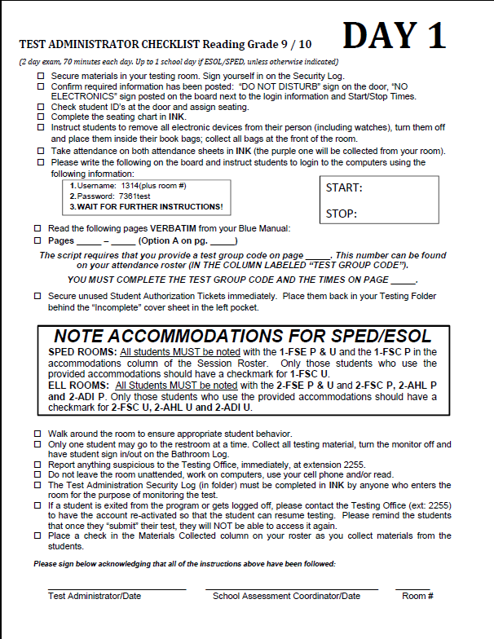
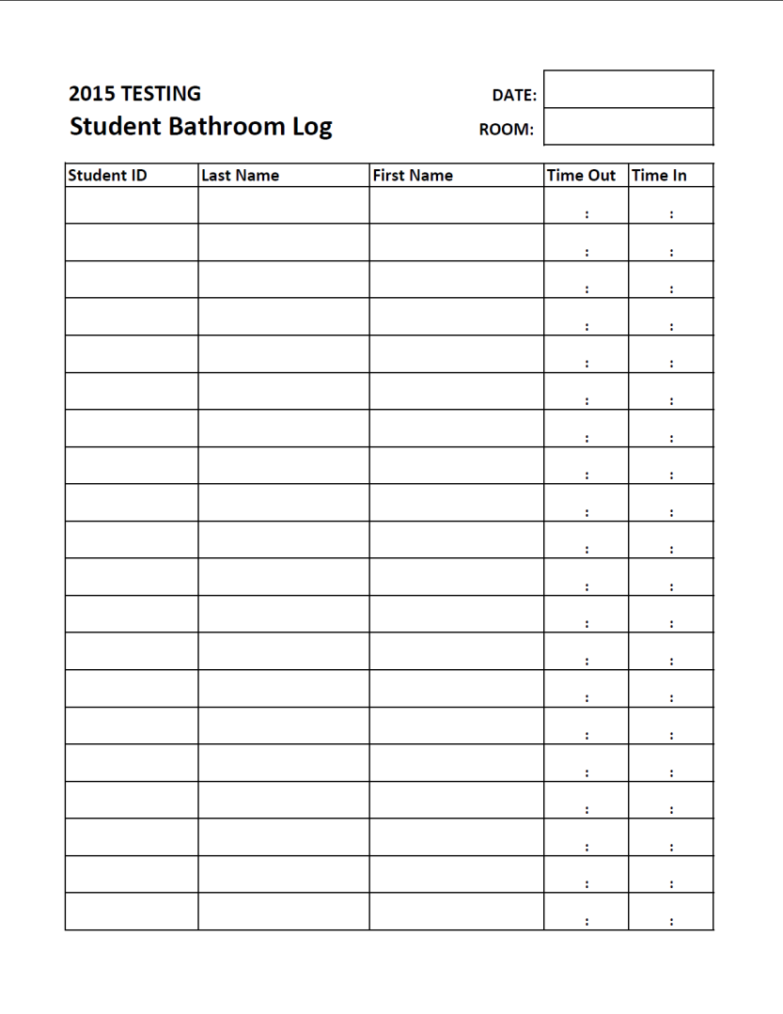
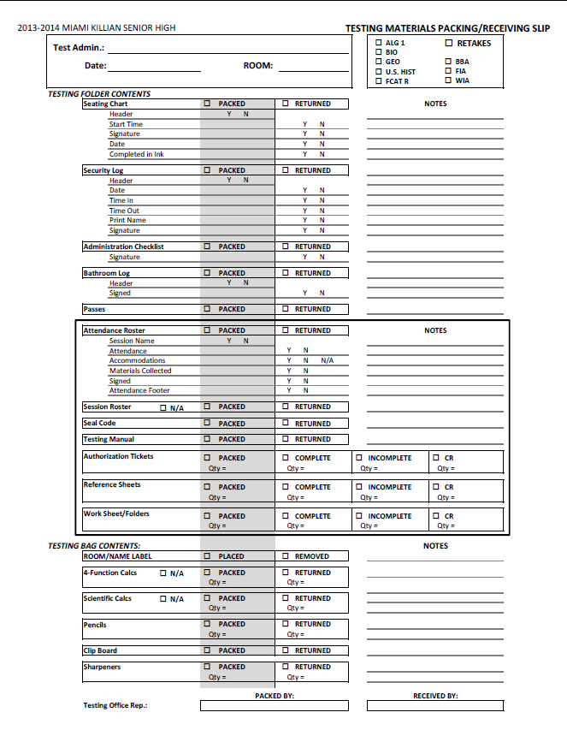

Test Administrator’s Folders – Right Pocket
BATHROOM PASS
STUDENT IS TESTING
If the student is seen using an electronic device, immediately contact the Test Administrator in 3103

Slide 29
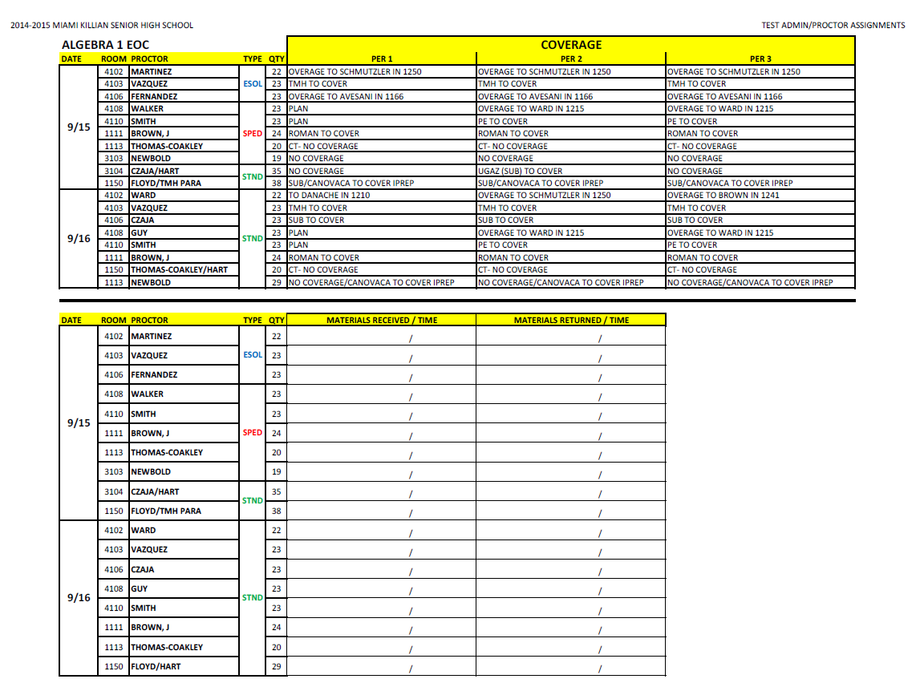
Sample Assignment Chart & Materials Sign In/Out Form
This is an example of another Test Administrator notice that details proctoring assignments, the population being tested, the number of students assigned, as well as the coverage/displacement assignments. In addition, part of the same chart is used to generate the Materials Received/Returned sign in sheet.

Slide 30
Final Steps before Testing
Train Test Administrators/Proctors and collect signed Security Agreement forms
    Create a PowerPoint presentation or customize the presentations posted on the Test Chairpersons Information Page to train your Test Administrators
Prepare materials and rooms for testing
    Install the computer dividers
    Ensure required signs are posted (No Electronic Devices, Do not disturb and Session 1 or 2 – when applicable)
    Check all computers for functionality, keyboard damage, required icons
    Label the Proctor Cache computers

Slide 31
After the Test . . . Regroup!
Replenish supplies
    Request feedback from the Test Administrators, proctors, and staff. Assess the administration and implement necessary changes for the next exam.
    Copy forms (seating charts, signs, passes, etc.)
    Sharpen and re-bundle pencils
    Inventory and re-bundle calculators
    Collect and clean up the computer dividers
    Inventory your labs/rooms and check computers for functionality, keyboards and necessary program icons. Report any repairs to your IP contact immediately.
Student Aides, clubs, students in CSI or TMH can help!

Slide 32
TEST CYCLE PREPARATION TIMELINE
From the student list, identify the curriculum groups that the students belong to.
Download a list of students via File Download Manager and save it as an Excel Workbook.
Calculate the number of rooms needed for each group of testers (by grade level and curriculum group).
Identify the testing area, the room numbers and teacher that will serve as test administrators. Also, designate an area for non-testers.
Identify the Students who will be testing and those who will not.
Assign students to rooms according to their testing/non-testing designations.
Check for updates or changes in enrollment.
Prepare materials and rooms for the testing administration.
Notify students of their testing time, date and locations.
Notify faculty of their testing duties, room/area assignments, time, date, and location of training and test dates.
Assign students to rooms according to their testing/non-testing designations.
Make sure all documents are correct and in place.
TEST DAY

Slide 33
Material Collection
STAY ORGANIZED!
Consider using an inventory list to track all outgoing/incoming materials
Consider packing material in a “School Assessment Coordinators” box – much like the mandatory “District Assessment Coordinator” boxes.

Slide 34
Helpful Tips
Always plan ahead
    Avoid oversights, mistakes and chaos by identifying your examinees and determining dates and proctors early.
Utilize your resources
    Student Aides, CSI, TMH and/or Clubs are
    great sources of manpower for sharpening
    pencils, organizing NON-SECURE testing
    materials, running passes on testing mornings,
    setting up/removing computer dividers as well
    as a myriad of other time-consuming tasks that
    you will not have time for.
Communication is vital
    A well informed school community will be better prepared to manage the chaos that test administrations can cause.
Be consistent and organized
    Test Administrators and students will perform better when they are familiar with formats, materials and procedures.
NEVER allow students to handle secure testing materials or be in the same area as the secure materials.

Slide 35
Helpful Tips (continued)
Learning Excel will be crucial to your success. This is a powerful tool with the potential to drastically increase your productivity and accuracy while greatly reducing your stress level.
Explore incorporating other programs such as Microsoft Access to help manage and format your data.
Earn MASTER PLAN POINTS while learning Excel, MS Word or MS Access by visiting http://tlc.dadeschools.net/skillsoft/
In addition, links have been provided on the Test Chair Information page for instructions and training videos directly relating to test administration preparation.
Find a process that works for you!
Not sure how to perform a task on Excel? simply “Google” it!
Filter on Excel
Sort on Excel
Count data on excel
Create a page break on excel
Adding formulas on Excel

Slide 36
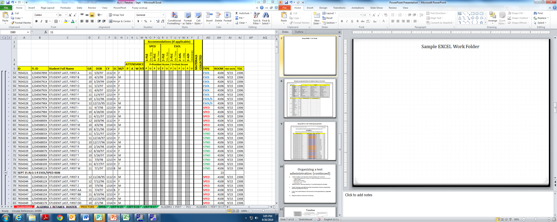
Sample EXCEL Work Folder
Excel allows you to use the same data to create multiple documents that will serve various needs. This work folder demonstrates how the original FDM student data download was used to create the testing roster; the Test Administrator Assignment, Coverage plan, and Materials Received/Returned sign in sheet; the Testing List distributed via email detailing students’ testing assignments and the daily individual Homeroom Teacher List placed in mailboxes the night before the test.
Original FDM student data download
Filtered, Sorted and formatted Student Testing Roster
Email Testing List and daily Homeroom Teacher Lists
Proctoring Assignments, Coverage plan and Materials sign in sheet

Slide 37
Resources and Help
Test chair information page
  http://oada.dadeschools.net/TestChairInfo/InfoForTestChair.asp
Technology Tools for Test Chairs:
  http://oada.dadeschools.net/TestChairInfo/TechnologyToolsforTestChairs2.pdf
TDC Documents Web page
  http://oada.dadeschools.net/TDC/TDC.asp
Training Modules
  Under “Archives” on Test Chair Information Page

Slide 38
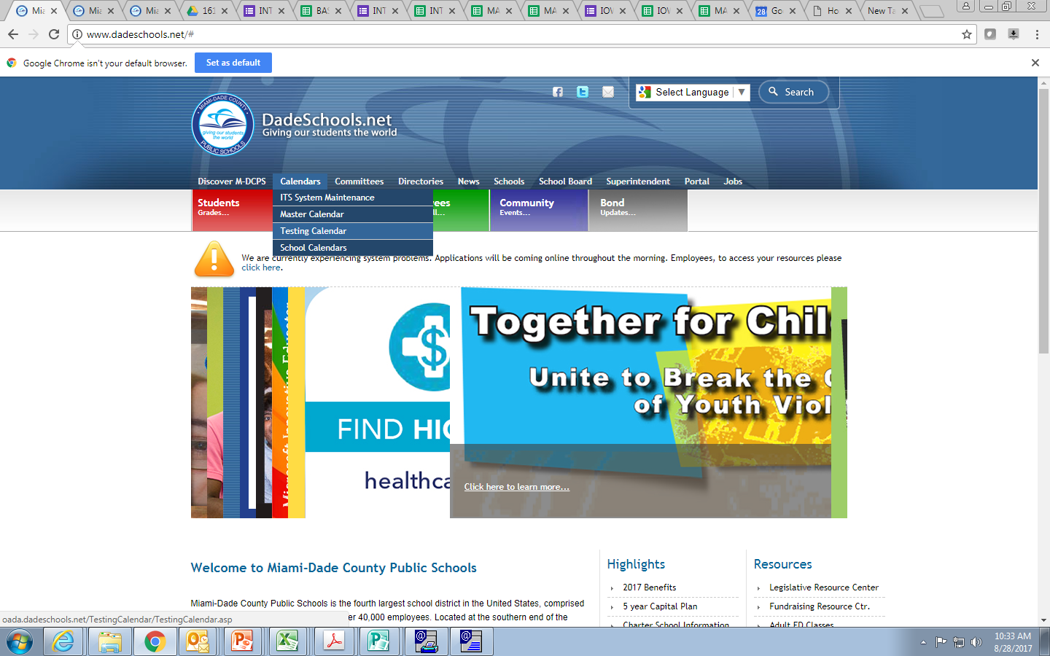
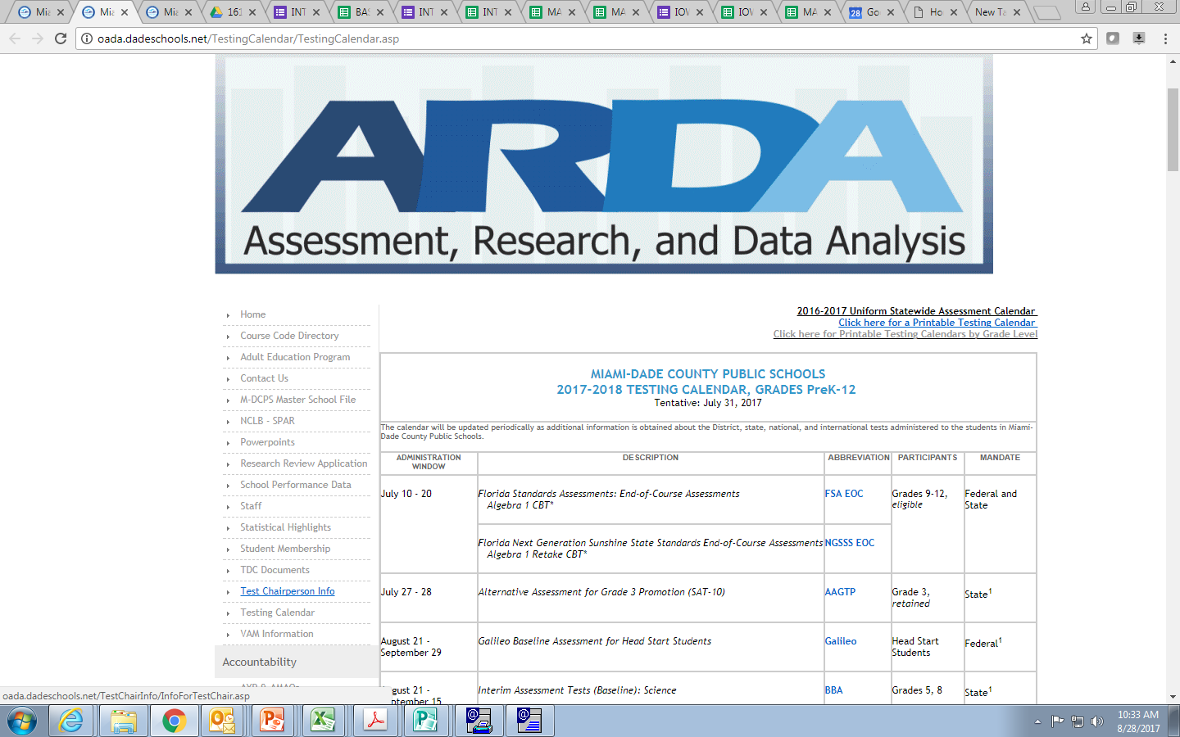
Access TDC Web page www.dadeschools.net
Click on “Calendars,”
then “Testing Calendar.”
Click on
“TDC Documents”

Slide 39
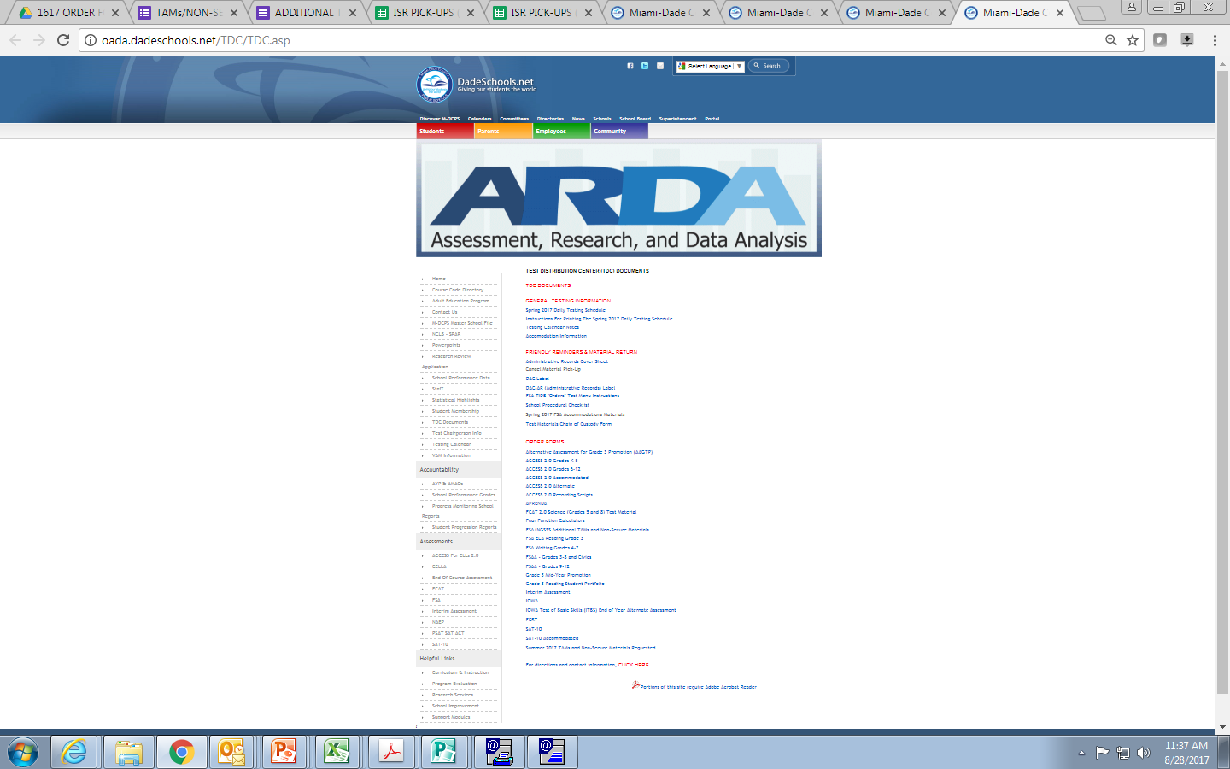
TDC Documents Web Page
General Testing Information
Friendly Reminders, Administrative Forms, DAC & DAC-AR Labels and Packing Instructions
Order forms for additional materials
TDC Directions & Contact Information

