Slide 1
Test Security for Test Administrators
Dr. Sally A. Shay, District Director
Assessment, Research and Data Analysis
Miami-Dade County Public Schools

Slide 2
Purpose of Test Security
Standardized administration of tests ensures that all students have an equal opportunity to “show what they know,” resulting in valid results.
We aim for optimal student performance, not providing an advantage to some students that others do not have.

Slide 3
Basis for Implementing Test Security
Florida Test Security Statute and Rule
Florida Statute 1008.24 – criminal misdemeanor
Florida State Board Rule 6A-10.042
Standards, Guidelines, and Procedures for Test Administration and Test Security
Adopted by School Board: SB Policys 2605, 2623
Individual testing programs Test Administration Manuals and Program Guides

Slide 4
General Roles and Responsibilities
Principal
Ensure all tests are administered in accordance with established professional standards.
Test Chairperson (certification required)
Organize and monitor testing programs; train test administrators and proctors.
Test Administrators (certification required)
Conduct testing sessions in accordance with training and established professional standards.
Proctors
Assist test administrator and actively monitor test sessions.
All school staff are responsible for reporting any observed violations of test administration and/or security procedures.
SGP, pages 3 - 4

Slide 5
Security of Test Content
Materials must be stored in a locked location with strictly limited access.
Under no circumstances shall secure test materials be intentionally examined or reviewed (before, during, or after the testing session).
Parents, volunteers, or other community members shall not have access to secure test materials at any time.
Test documents and/or answer sheets may not be copied, photographed, or reproduced in any way.
Students may only have access to their test materials during the actual testing session.
SGP, page 5

Slide 6
Preparing Students for Testing
Appropriate
Inappropriate
Prepare students for the test experience using appropriate materials.
Test-taking strategies
Formats
Procedures
Include ELL and ESE students in test preparation.
Provide appropriate accommodations in instruction and testing.
Provide practice tests for computer-based testing.
Tests/items are copyrighted materials and may not be duplicated.
Actual test items, paraphrased, or modified items based on actual items may never be provided to students.
Never provide correct responses/ answers .
Never divulge test content to your students, children, friends/family.
SGP, page 7

Slide 7
Handling and Management of Test Materials
Verify counts of materials when you accept them and return them.
A “chain of custody” record must be maintained for FCAT 2.0 and EOCs.
Test materials may not be left unattended.
Test materials must be handed to and collected from students individually.
Maintain required information: security number for assigned materials, absent/present for testing session.
Ensure correct book (security number) is provided to each student.
Test materials must be collected if a break occurs in the testing session.
SGP, pages 8 - 9

Slide 8
Security Before the Test Session
All classroom materials that may provide clues must be removed or covered.
Seating must be arranged to discourage cheating.
Seating charts must be maintained.
Visual barriers for computer-based testing must be set up.
Students’ identification must be verified if they are not known to you.
Electronic devices are prohibited.
Student to adult ratio must be followed.
SGP, pages 12-14

Slide 9
Security During the Test Session
Scripts and directions must be read verbatim.
Time limits must be strictly followed.
Students may not be assisted or coached in any way by any person.
Items may not be read, re-read, or translated for a student (unless specified in the directions or as approved, documented accommodations).
If breaks are given, steps must be taken to ensure test content is not discussed, and outside information is not accessed.
SGP, pages 12-14

Slide 10
Supervision and Monitoring
Students must be closely supervised at all times
Test administrators/proctors must be actively engaged in monitoring the session.
Attention must be focused on the students.
No computer use, reading, grading papers, etc.
The principal and school administrators monitor test sessions to ensure that proper testing conditions are maintained.
District administrators visit randomly selected schools and classrooms to monitor standardized test administration and adherence to procedures.
SGP, page 15

Slide 11
Security After the Test Session
Students’ answers may not be reviewed.
Students may never be prompted to review a specific test item or change a specific answer.
Test/answer documents may not be changed in any way.
Test/answer documents may not be copied, photographed, or captured via electronic communication.
Test content may not be discussed with anyone, including students or other school personnel.

Slide 12
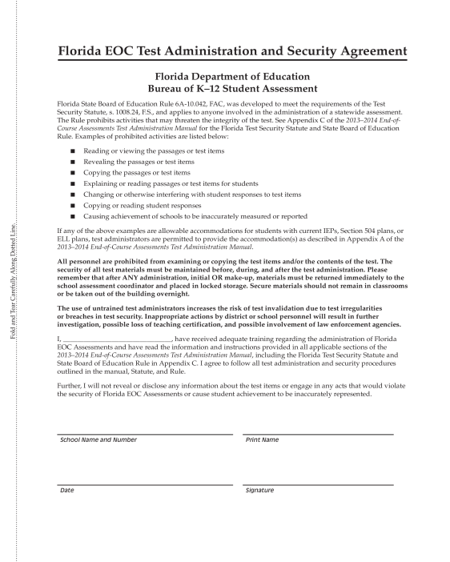
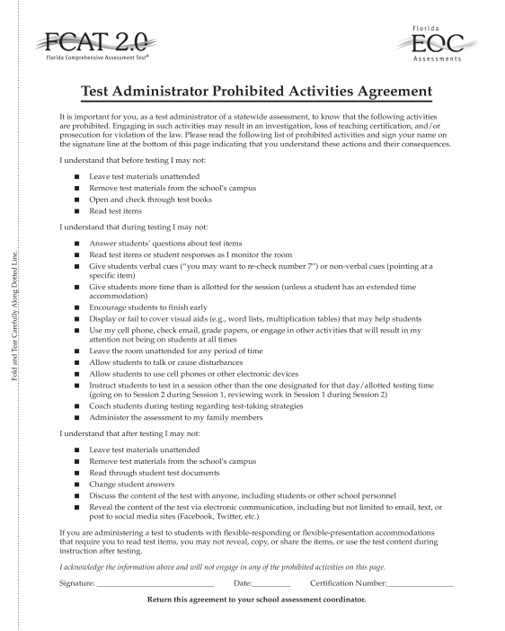
Security Agreements
Security agreements are included in the Test Administration Manual for state testing programs, and in Program Guides for district testing programs.
These must be signed and maintained at the school site for one year.

Slide 13
What is a Testing Irregularity
Any event or circumstance occurring before, during, or after the actual testing session that could impact the security of the test content or validity of student results.
Damaged materials
Improper handling of secure materials
Timing error
Missing test booklet
Possession of cell phone during testing
Students talking during administration
Unauthorized access to test content
Improper administration procedures
Coaching of students
Student “cheat sheets”

Slide 14
Reporting Testing Irregularities
It is the professional responsibility of all school staff to report testing irregularities that could expose test content or invalidate student results.
All irregularities must be reported by the school to Assessment, Research and Data Analysis (ARDA: 305-995-7520).
Minor administration irregularities may be addressed quickly and students’ scores salvaged if reported immediately.
ARDA may need to confer with the state in the resolution.
Any criminal and all serious non-criminal incidents must be reported directly to the Miami-Dade School Police, as per the district’s PIM (Personnel Investigative Model).
SGP, page 17-18

Slide 15
Test Auditing Procedures
An auditing system is in place for state and district assessment programs to improve the validity of the testing process and of the resulting test scores.
Accuracy of scoring
Excessive omits, blanks, and other irregular patterns on the actual answer documents
Review of irregular or invalidated tests or test scores
Use of special test codes and appropriate determination of exemptions.
Participation rates
Longitudinal patterns of test performance for possible aberrations (i.e., unusual gains or losses)
SGP, page 20

Slide 16
Caveon Data Forensics
The FLDOE has contracted with Caveon Test Security to provide its Caveon Data Forensics™ for all statewide assessments.
Caveon analyzes data to identify highly unusual test results for two primary groups:
Students with extremely similar test responses; and
Schools with improbable levels of similarity, gains and/or erasures.
Flagging only the most extreme results.

Slide 17
Similarity
Most Powerful & “Credible” Statistic
Measures degree of similarity between two or more test instances.
Analyzes each test instance against all other test instances in the school.
Possible causes of extremely high similarity:
Answer Copying
Test Coaching
Proxy Test Taking
Collusion
Notes:
17

Slide 18
Erasures
Based on estimated answer changing rates
Possible causes of high erasure rates:
Inappropriate test-taking strategy – “cross out” implausible item options near the “bubble”, then erase the markings
Tampering
“Panic” cheating
Important! No student–level score invalidations are based on erasure analysis; erasure analysis limited to school-level flagging for additional review.
Notes:
18

Slide 19
Implications of Caveon Analyses
Student invalidations
Schoolwide investigations
Personnel actions

Slide 20
Resources
Test Chairperson’s Web Page accessible at http://oada.dadeschools.net/
State Test Administration Manuals (FCAT 2.0, EOC, CELLA)
Standards, Guidelines, and Procedures (SGP) for Test Administration and Test Security available at http://oada.dadeschools.net/TestChairInfo/StandardsGuidelinesandProceduresMay2013.pdf http://oada.dadeschools.net/
Contact Assessment, Research, and Data Analysis at 305-995-7520

