Slide 1
Computer-Based Testing (CBT) Certification Tool (FSA, FCAT/FCAT 2.0, and EOC)
Maria C. Bruguera, Director 1
Mara C. Ugando, Staff Specialist Assessment, Research, and Data Analysis

Slide 2
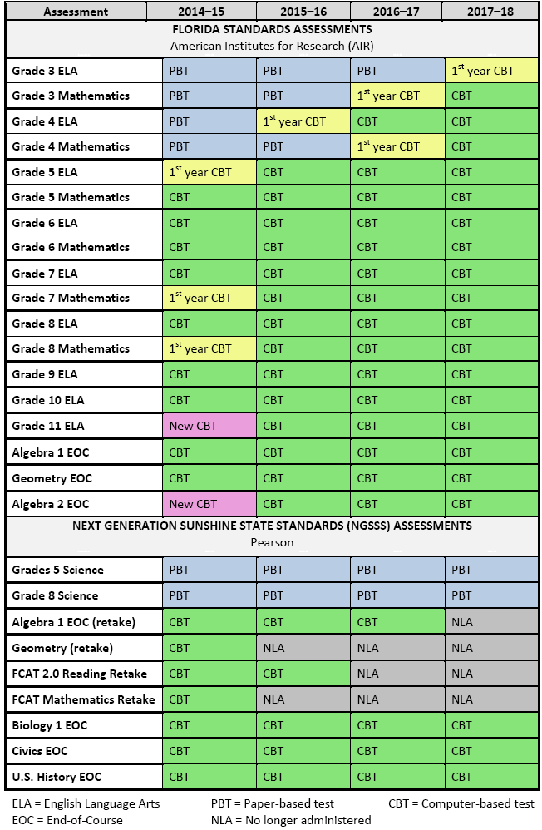
Florida’s Transition to CBT

Slide 3
CBT Assessments in 2014-15
Florida Standards Assessments (FSA)
Grades 5 -11 ELA
Grades 5-8 Mathematics
Algebra 1 EOC
Geometry EOC
Algebra 2 EOC

Slide 4
CBT Assessments in 2014-15
NGSSS FCAT/FCAT 2.0 and EOC
FCAT 2.0 Reading Retake
FCAT SSS Mathematics Retake
Algebra 1
Biology 1
Civics
Geometry
US History

Slide 5
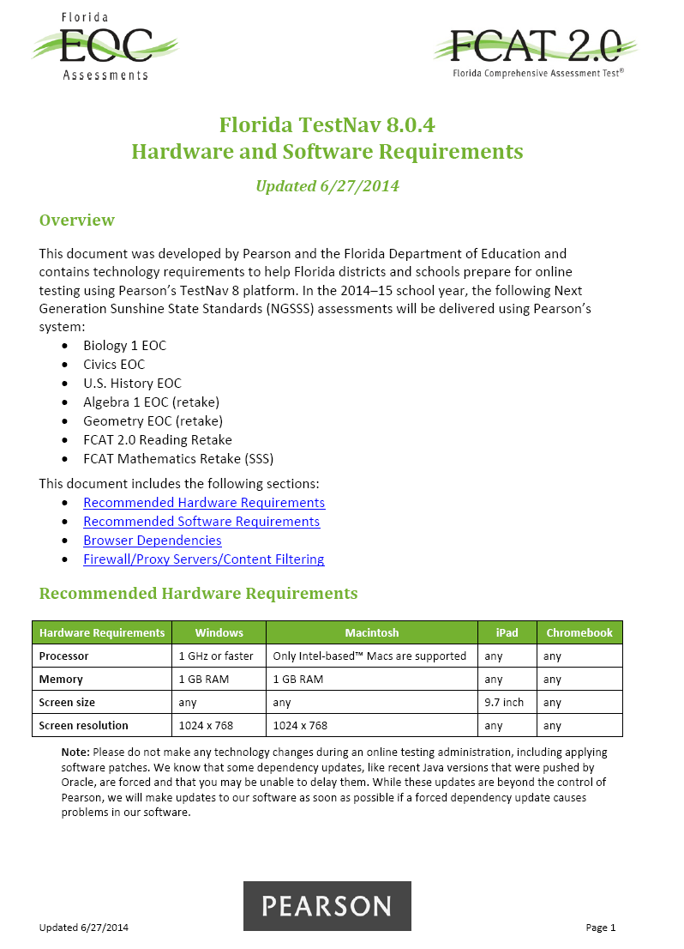
2014-15 Pearson’s TestNav 8
Minimum Specifications

Slide 6
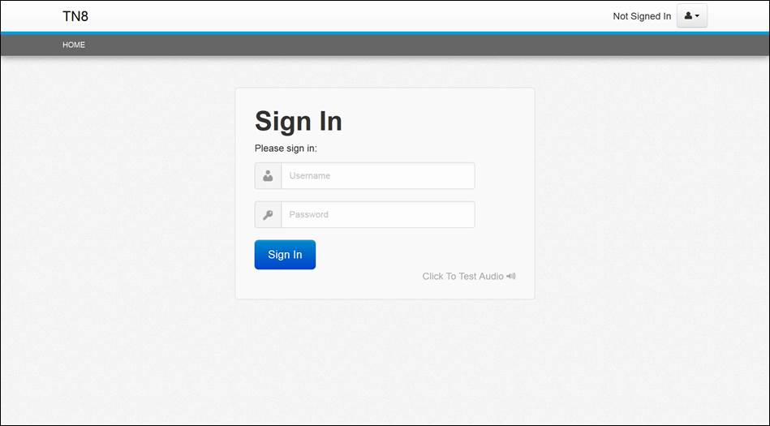
TestNav 8
Pearson’s CBT platform for Florida’s high-stakes computer-based statewide assessments
Browser-based platform with integrated test accommodations (only the URL is needed)
Updated Proctor Caching interface will require installation

Slide 7
Winter 2014 Certification Process
Tool opens for Winter certification
October 21, 2014
Tool closes for Winter certification
November 4, 2014
Note: This survey must be completed by ALL schools and centers administering the Winter 2014 NGSSS EOC Computer-based Assessments.

Slide 8
Winter 2014 Certification Process
M-DCPS’ CBT Test Administration Schedules
Date | Assessment
December 1-19 | Winter 2014 NGSSS EOC Algebra 1 Biology 1 Civics Geometry US History Note: The tests may be administered in any order, by school. One subject test does not need to be completed before another begins, and subject tests may be administered concurrently.

Slide 9
Certification Tool
Access the tool at https://app1.fldoe.org/CBT/CertificationTool.
Step 1: Log in and Create Your Password
Step 2: Enter Contact Information
Step 3: Complete the Survey
I. Computer Specifications
II. Student Scheduling Plan
III. Annual/Long-Term Checklist
IV. Administration-Specific Checklist
Note: Once you have entered all of the data, click “Save” and select the link to continue the survey at the top of the screen.
Step 4: Review the Data with School Staff
Step 5: Confirm School Computer-Based Assessment Certification Team
Step 6: Submit to District Office

Slide 10
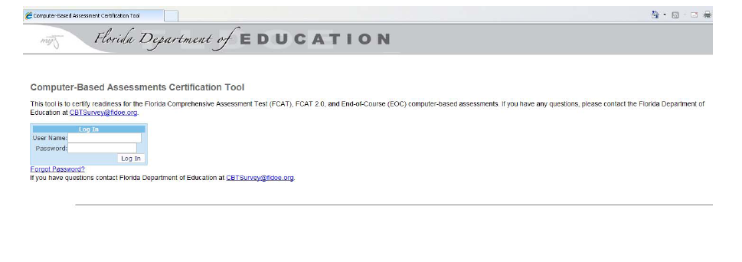
Step 1: Log in and Create Your Password
Your username and password will be your two-digit district number (13) and your four-digit school number (XXXX) with no spaces (e.g., 139732).

Slide 11
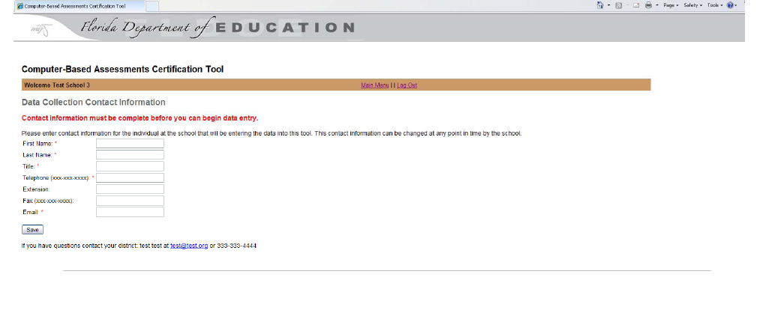
Step 2: Enter Contact Information
The first time you log in, you will be required to give contact information for the individual at your school who will be responsible for reviewing and approving school data in the tool.
Note: Once you have entered and saved the contact information, click on the Main Menu to proceed.

Slide 12
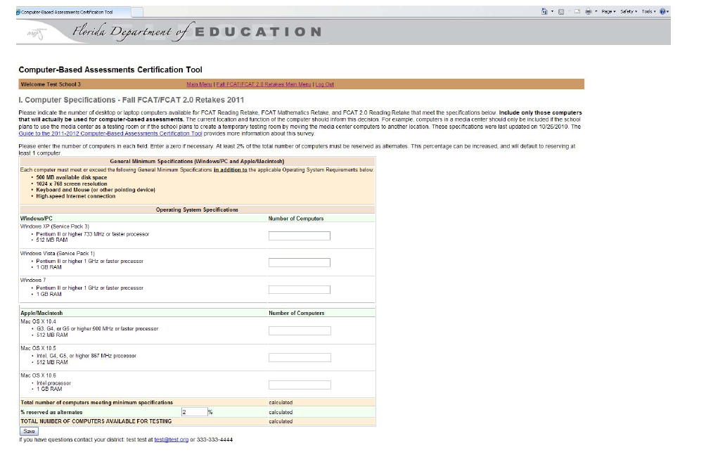
Step 3: Complete the Survey I. Computer Specifications
Enter the number of computers that are available for high-stakes computer-based assessments, and meet minimum stated specifications.
Note: This section must be completed first because the data you enter will be used to populate fields in the next section.

Slide 13
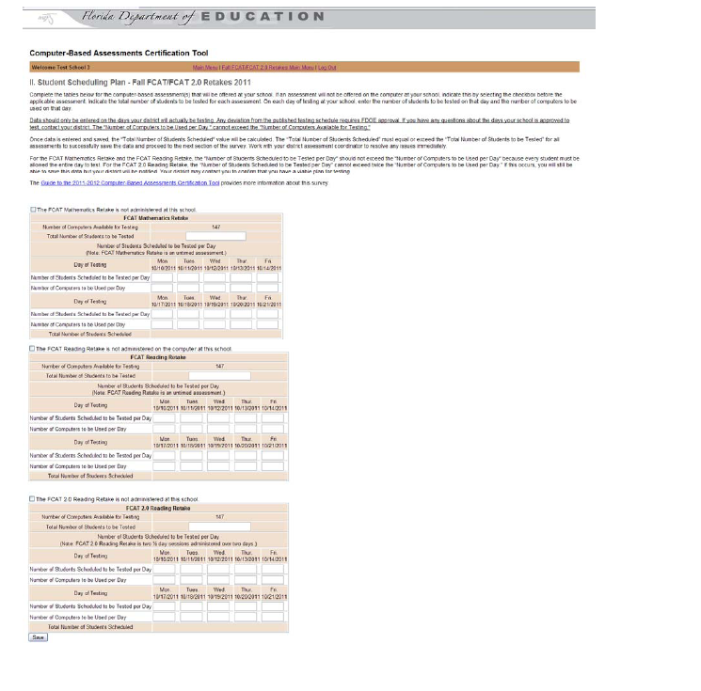
Step 3: Complete the Survey II. Student Scheduling Plan
Enter the number of students to be tested and the number of sessions the school plans to conduct each day of the assessment window.
Note: Only enter data for the dates your school has been approved to test.

Slide 14
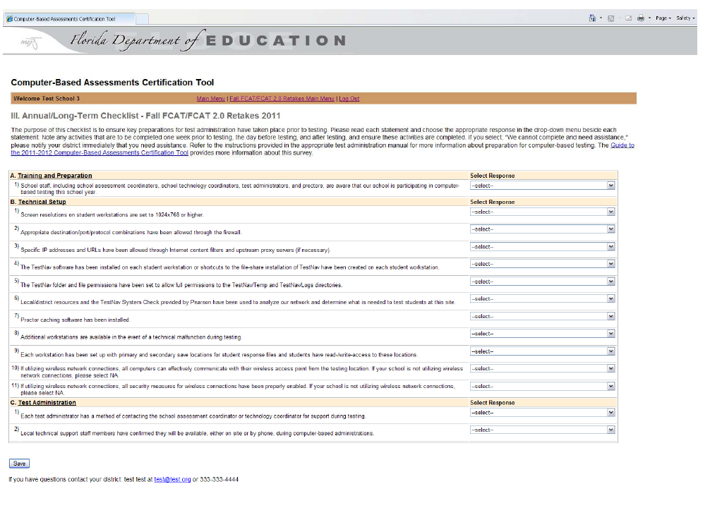
Step 3: Complete the Survey III. Annual/Long-Term Checklist

Slide 15
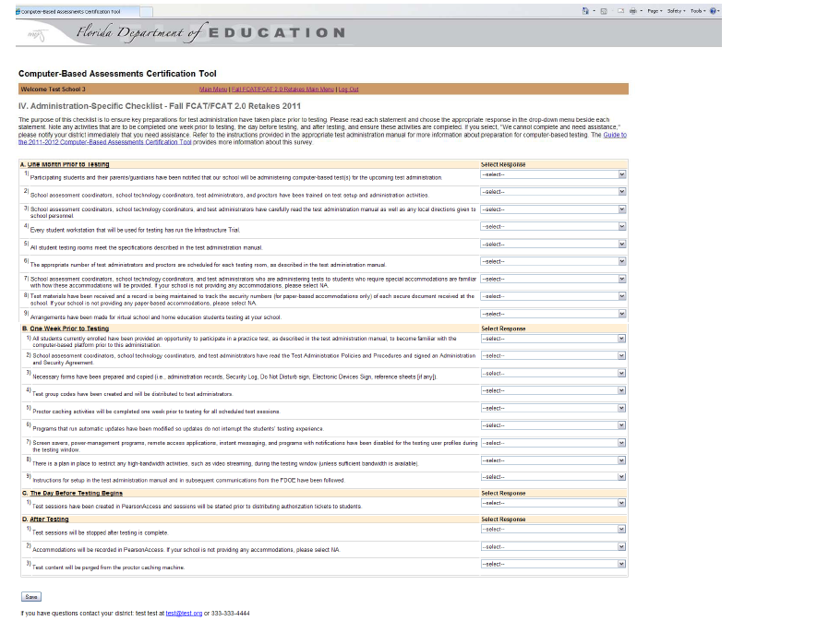
Step 3: Complete the Survey IV. Administration-Specific Checklist

Slide 16
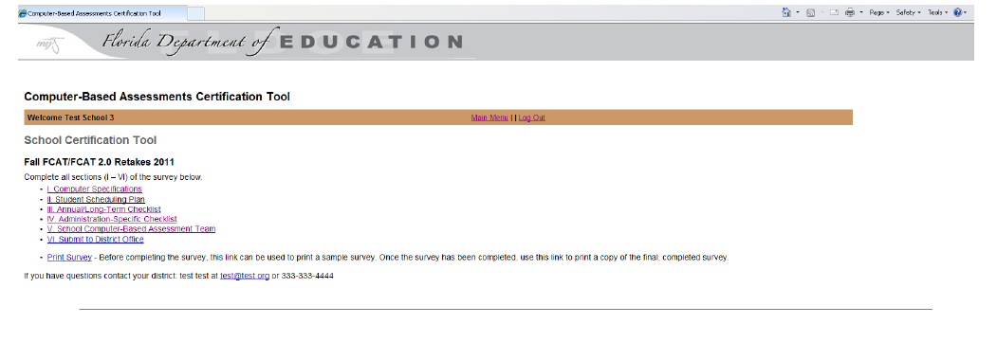
Step 4: Review the Data with Your Principal
Use the “Print Survey” function from the Main Menu to print all data that has been entered in the tool for your school to review with school staff.

Slide 17
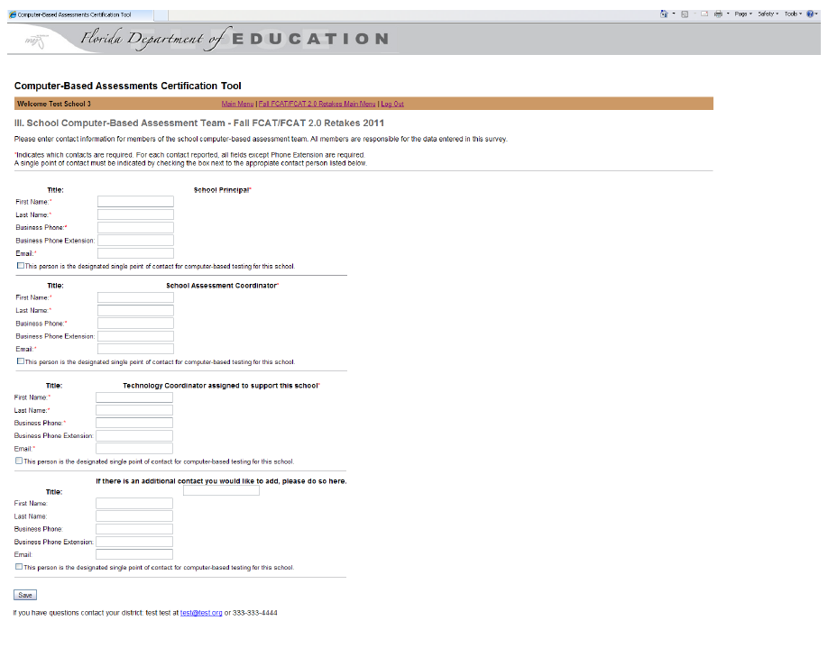
Step 5: School Computer-Based Assessment Certification Team
Identify the principal and a school-level team of contacts for computer-based testing.
Note: One person is also to be identified as the primary point of contact for the school.

Slide 18
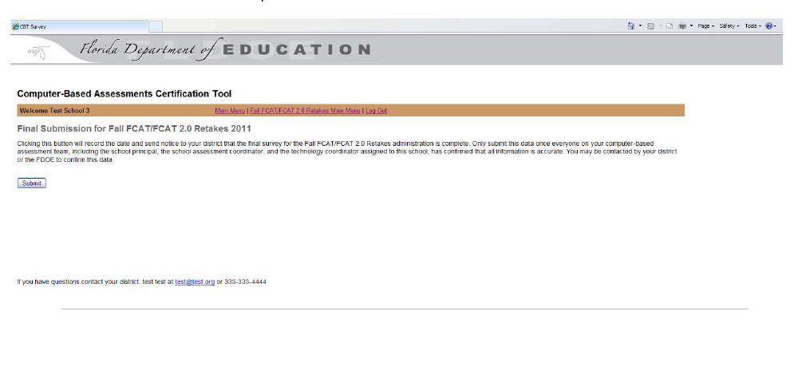
Step 6: Submit to District Office
Go to the Survey section and select “VI. Submit to District Office.”
Note: Clicking the Submit button on this page will record the date and notify your district that the survey is complete.

Slide 19
Contact Information:
Student Assessment and Educational Testing
305-995-7520

