Slide 1
Winter 2016 Next Generation Sunshine State Standards End-of-Course Assessments Training Materials
Algebra 1 EOC Retake
Biology 1, Civics, & U.S. History EOC

Slide 2
Test Administration Manual
Instructions for administering the NGSSS Algebra 1 Retake, Biology 1, Civics, and U.S. History End-of-Course (EOC) Assessments are included in the Fall/Winter 2016 NGSSS EOC & Retakes Manual.
Test Scripts

Slide 3
Appendices
Appendices in the Fall/Winter 2016 NGSSS EOC & Retakes Manual include:
Appendix A: Accommodations
Appendix B: Pearson Customer Support and PearsonAccess
Appendix C: Florida Test Security Statute and Rule
Appendix D: Perforated Forms and Signs

Slide 4
Avocet
Avocet, an online resource guide, is available for locating information on topics related to the FCAT 2.0 and NGSSS EOC assessments.
Beginning with the 2016–17 school year, resources for these assessments will be found on the Avocet site ONLY, and will no longer be posted to PearsonAccess (PA) Next.
Go to http://avocet.pearson.com/FL/Home to access the Avocet guide.

Slide 5
Technology Coordinator Resources
Review the before, during, and after testing checklists in the Fall/Winter 2016 NGSSS EOC & Retakes Manual.
Read the documentation available at www.FLAssessments.com/TestNav8, as well as the relevant portions of this test administration manual and any local directions that have been given. Resolve any questions with your supervisor or contact Student Assessment and Educational Testing (SAET) at 305-995-7520.
Read the Test Administration Policies and Procedures and Appendix C, then sign the Test Administration and Security Agreement (located in Appendix D of the manual).

Slide 6
Presentation Features
Throughout this presentation, you will notice one of the following small boxes in the lower right corner of the header:
These boxes indicate whether the information on that slide pertains to paper-based tests (PBT), computer-based tests (CBT), or both (CBT PBT).

Slide 7
Test Administration Schedule
CBT
PBT
Winter 2016 NGSSS EOC Scheduling
Dates | Mode | EOC Subjects | Duration*
November 28 – December 9 | Paper-based Accommodations | Algebra 1 Retake, Biology 1, Civics, and US History EOC | 1 session, 160 minutes
November 28 – December 16 | Computer-based
*Any student not finished by the end of the 160-minute test session may continue working; however, testing must be completed within the same school day.
Any deviation from these scheduling rules requires written approval from FDOE prior to implementation.

Slide 8
Students to be Tested
CBT
PBT
Students that failed the NGSSS Algebra 1 EOC test and do NOT have a comparative PERT mathematics score.
Students who took the Algebra 1 course prior to Fall 2014.
Students whose NGSSS Algebra 1 Retake test was invalidated and don’t have a valid score.
Students who have an NG reported for an EOC course because they did not take the EOC test to be calculated as 30% of the final course grade.
Students that have completed an eligible EOC course via the part-time Florida Virtual Program and are at 80% or more complete or recent completers.
Students who must earn a passing score in Biology 1 and/or US History for a standard diploma with a scholar designation.
Students in a credit acceleration program (CAP) who wish to take the assessment to earn course credit.

Slide 9
Students to be Tested
CBT
PBT
Special Program Students
Special Programs |  | District Number | School Number
FLVS | Full-Time K-8 | 71 | 0300
 | Full-Time 9-12 | 71 | 0400
Miami-Dade Online Academy |  | 13 | 7001
Florida Home Education |  | 13 | 9998
FLVS Full Time Students
Per Section 1002.45(6)b, Florida Statutes (F.S.), districts must make arrangements to test Florida Virtual School (FLVS) Full Time public school students, as well as other virtual program students.

Slide 10
Students to be Tested
CBT
PBT
English Language Learners (ELLs)
All ELLs participate in statewide assessments.
All ELLs who complete the applicable courses are expected to participate in the EOC assessments no matter how long these students have been enrolled in a U.S. school.
Students with Disabilities
Students with disabilities participate in the statewide assessment program by taking one of the following:
NGSSS without accommodations,
NGSSS with accommodations, or
Florida Standards Alternate Assessment (FSAA).
All determinations regarding participation in the statewide assessment program must be documented in the student’s IEP or Section 504 plan.
See Appendix A of the Fall/Winter 2016 NGSSS Manual for information regarding allowable accommodations for students with disabilities.

Slide 11
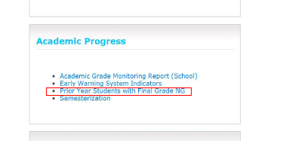
Final Grade NG Report
CBT
PBT
What will your final grade be without performing the computation for the NGSSS or FSA EOCs?
Teacher Final Grade | FINAL GRADE
 | EOC Score = 5 or 4 30% as ‘A’ | EOC Score = 3 30% as ‘B’ | EOC Score = 2 or 1 30% as ‘D’
A | A | A | B
B | B | B | C
C | B | C | C
D | C | C | D
F | D | F | F

Slide 12
State and District Requirements
CBT
PBT
Standards, Guidelines, and Procedures for Test Administration and Test Security available at http://oada.dadeschools.net/TestChairInfo/InfoForTestChair.asp
Adopted by School Board
General Guidelines
Florida Test Security Statute and Rule
School Procedural Checklist (FM-6927)
A screencast training on Test Security to use during your school-level training session may be accessed at http://oada.dadeschools.net/Screencasts/TestSecurity/TestSecurity.html

Slide 13
Test Security
CBT
PBT
Per the Test Security Statute, s. 1008.24, F.S., and Florida State Board Rule 6A-10.042, FAC, inappropriate actions by school or district personnel can result in student or classroom invalidations, loss of teaching certification, and/or involvement of law enforcement.
Examples of prohibited activities include the following:
Reading or viewing the passages or test items before, during, or after testing
Revealing the passages or test items
Copying the passages or test items
Explaining or reading passages or test items for students
Changing or otherwise interfering with student responses to test items
Copying or reading student responses
Causing achievement of schools to be inaccurately measured or reported

Slide 14
Test Irregularities/Security Breaches
CBT
PBT
Test administrators should report any test irregularities (e.g., disruptive students, loss of Internet connectivity) and possible breaches of test security to the school assessment coordinator immediately.
If a test irregularity or security breach is identified, the school assessment coordinator MUST contact Student Assessment and Educational Testing (SAET) at 305-995-7520 to discuss possible test invalidations.
For test irregularities requiring further investigation by the district and for security breaches, a written report must be submitted within 7 calendar days after the irregularity or security breach was identified.
Remember that secure student information (e.g., SSN) must not be communicated via email.

Slide 15
Missing Materials
CBT
PBT
Schools must investigate ANY report of missing materials and report missing secure materials (e.g., Student Authorization Ticket, used work folder, Session Roster) to SAET at 305-995-7520 immediately.
Within 7 calendar days of the incident, a written report must be submitted to FDOE. The report must include the following, as applicable:
The nature of the situation
The time and place of the occurrence
The names of the people involved
Copies of completed forms (Test Administration and Security Agreements, Test Administrator Prohibited Activities Agreements, Test Materials Chain of Custody Forms, etc.)
A description of the communication between Office of SAET and school personnel
How the incident was resolved
What steps are being implemented to avoid future missing materials

Slide 16
School Assessment Coordinator Before Testing
CBT
PBT
Receive Test Materials
CBT Work Folders
CBT Scripts
Test Administration Manuals
Paper-based test materials including Reference Sheets/Periodic Tables (regular print, large print, braille, one-item-per-page) for eligible students
Return Labels
Document Count Forms
Paper Bands
Verify that you have all necessary materials, and report any missing materials to SAET at 305-995-7520 immediately.
Remember to save the original boxes for returning TO BE SCORED materials.

Slide 17
School Assessment Coordinator Before Testing
CBT
PBT
Test Materials Chain of Custody Form
You are required to maintain a Test Materials Chain of Custody Form, located in Avocet and Appendix D of the manual.
The purpose of this form is to track secure test and answer books at all times.
Record accurate information on the form including their location, the dates and times they are handled, the names of the people performing various activities involving the materials, and information about the locked storage room.
Schools must retain electronic or hard copies of completed forms for their files after materials are packaged for return. Include the originals in the District Assessment Coordinator (DAC) ONLY box.

Slide 18
School Assessment Coordinator Before Testing
CBT
PBT
Assign Test Group Codes
Test group codes are used as a security measure to identify groups of students tested together.
Create and distribute the four-digit test group codes to test administrators.
Each test administrator must be given one unique four-digit test group code to use in his or her testing room for each test administered. Each testing room must use a different test group code.
If any students are absent during an assessment, a different unique test group code must be provided for each make-up session.

Slide 19
School Assessment Coordinator Before Testing
CBT
PBT
Required Administration Information
Communicate to test administrators the process for collecting the required administration information (as described on
page 38 of the manual).
Provide Session Rosters, Student Authorization Tickets, and test group codes.
Maintain records of accommodations provided and accommodations used by eligible students.
Keep a separate, complete records of required administration information (including security numbers) for paper-based tests administered, if applicable.
Copy and file all required administration information for future reference.

Slide 20
School Assessment Coordinator Before Testing
CBT
PBT
Seating Charts
Test administrators are required to maintain an accurate seating chart for each group of students in their rooms during testing.
Ensure that test administrators record all information indicated on page 27 of the manual and that they create a new seating chart if the seating configuration changes during testing.
After testing, you make copies of all seating charts, file the copies, and return the original charts in the DAC ONLY box.
A sample seating chart is provided in the Training Packet available on the Test Chairperson Info site http://oada.dadeschools.net/TestChairInfo/InfoForTestChair.asp

Slide 21
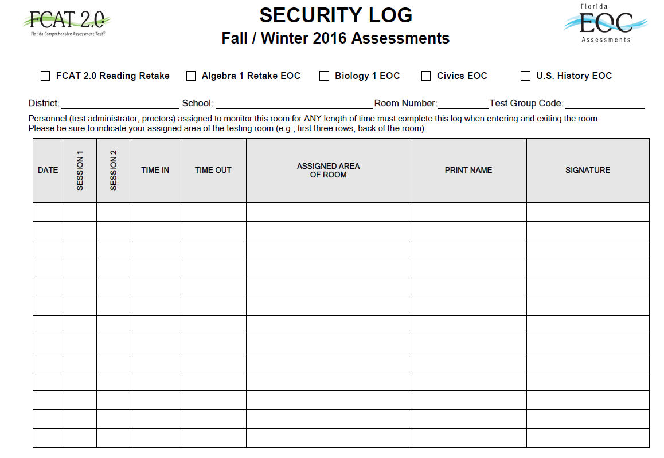
School Assessment Coordinator Before Testing
CBT
PBT
Security Log
A Security Log must be maintained for each testing room.
Anyone who enters a room for the purpose of monitoring a test MUST sign the log for that testing room.
Copy and return the originals in the DAC ONLY box.

Slide 22
School Assessment Coordinator Before Testing
CBT
Session Roster
Provide test administrators a Session Roster, which can be used to record or verify most of the required administration information.
The roster will include blank fields for recording accommodations and attendance information.
Other required information (e.g., test group code) may be recorded anywhere on the roster.
Copy and file all required administration information for future reference.
Return the originals in the DAC ONLY box.

Slide 23
School Assessment Coordinator Before Testing
CBT
Student Authorization Tickets
For each computer-based test, each student needs a username and password, which are printed on the Student Authorization Tickets.
Test administrator will provide each student a ticket only AFTER all students have entered the testing room, as instructed in the script, and all tickets must be collected BEFORE students leave the testing room.
Student Authorization Tickets must be handled in a secure manner and returned to the school assessment coordinator immediately after each day of testing is completed.
Retain and securely store the Student Authorization Tickets for one calendar school year.

Slide 24
School Assessment Coordinator Before Testing
PBT
Paper-Based Test Materials
If you will administer test(s) to students using regular print paper-based accommodations, you will receive the following materials, as applicable:
Test and Answer Books
Algebra 1 Retake, Biology 1, Civics, and US History EOC
Algebra 1 Retake End-of-Course Assessment NGSSS Reference Sheets
Periodic Table of the Elements (Biology 1)
Four-Function Calculators (Algebra 1 Retake and Biology 1)

Slide 25
School Assessment Coordinator Before Testing
CBT
CBT Work Folders
Provided for students to work the problems for Algebra 1 Retake and Biology 1 EOC assessments
A piece of yellow 11” x 17” paper folded in half with graph paper printed on the back cover
One work folder should be sufficient for each student; however, students may request additional folders
Must be distributed to students at the beginning of each test
Ensure that students have enough desk space to use their folders
Collect all work folders when students finish testing
Used work folders are secure materials.

Slide 26
School Assessment Coordinator Before Testing
CBT
CBT Worksheets (Optional)
For the computer-based Civics and U.S. History EOC assessments, CBT Worksheets may be provided for students to take notes.
It is an 8½” x 11” page (located in Appendix D and Avocet) that may be copied and distributed to students at the beginning of each test.
If your school is providing copies of the CBT Worksheet, a sufficient number of copies should be available for all students taking the assessment.
Students must have enough desk space to use their worksheets.
Collect all worksheets when students finish testing.
Used worksheets are secure materials.

Slide 27
School Assessment Coordinator Before Testing
CBT
PBT
Four-Function Calculators
For the computer-based Algebra 1 Retake EOC and Biology 1 EOC assessments, students may use the built-in calculator in TestNav, a handheld calculator, or both.
You should have enough handheld four-function calculators to provide one to every student taking an Algebra 1 Retake EOC and Biology 1 EOC assessment.
Test administrators should provide handheld calculators at the beginning of a test session to all students who request one, as indicated in the test administration script.
Only use the supply of approved four-function calculators provided by the FLDOE. No other calculators may be used.

Slide 28
School Assessment Coordinator Before Testing
CBT
PBT
Reference Sheet and Periodic Table
Reference sheets and periodic tables are provided in an online format only for CBT testers; however, schools may provide hardcopy reference sheets or periodic tables to students.
Any hardcopy reference sheets or periodic tables must be photocopies of the reference sheet and periodic table in Appendix D of the manual (also available at http://avocet.pearson.com/FL/Home).
If your school will provide hardcopy reference sheets or periodic tables to students, check each copy before distributing to students and follow the instructions in the administration scripts.
Reference sheets and periodic tables for students with paper-based accommodations are packaged with test materials and should be distributed to students as indicated in the administration scripts.
Once students complete the test session, the test administrator should collect all reference sheets and periodic tables.
Used reference sheets and periodic tables are secure materials.

Slide 29
School Assessment Coordinator Before Testing
CBT
PBT
Additional Items
Pens and/or pencils
Ensure each student has a pen or pencil to sign his or her authorization ticket and take notes or work the problems during testing
Students taking paper-based tests must use No. 2 pencils
Clock or watch
Signs (Appendix D)
Do Not Disturb Sign—display on all entrances
Electronic Devices Sign—display where it will be visible to all students in the testing room
Session Signs—display where it will be visible to all students
Cover Sheets (Appendix D)
Use cover sheets to separate TO BE SCORED and NOT TO BE SCORED paper-based materials

Slide 30
School Assessment Coordinator Before Testing
CBT
PBT
Communicate Testing Policies to Parents/Guardians and Students
Electronic Devices Policy
Leaving Campus
Testing Rules Acknowledgment
Discussing Test Content after Testing
While students may not share information about secure test content after testing, this policy is not intended to prevent students from discussing their testing experiences with their parents/families.

Slide 31
School Assessment Coordinator Before Testing
CBT
Meet with Technology Coordinator
Review the instructions and information available at www.FLAssessments.com/TestNav8, and all test administration and security policies and procedures included in the manual.
Create a plan for handling issues during testing.
Technology coordinators are required to sign the Test Administration and Security Agreement.
The technology coordinator should also be involved in all planning meetings to provide input on logistics and resolve any network issues.
Updated TestNav App and ProctorCache Software
If your school is using the TestNav desktop or mobile app, an updated TestNav app is required for the 2016–17 school year.
The ProctorCache software has also been updated.
Please refer to Weekly Briefing #19797
The app and software are available at http://download.testnav.com.

Slide 32
School Assessment Coordinator Before Testing
CBT
PBT
Preparation and Training
You are responsible for training all test administrators and proctors, including non-school-based instructors (e.g., itinerant teachers). You must train several employees to act as possible alternates.
In the absence of sufficiently trained administrators, postpone testing until trained personnel are available.
Test administrators who will administer the test to students using large print, braille, and one-item-per-page materials must be trained in the use of those test materials.
For students with accommodations, make sure that test administrators are aware of and have made provisions for the exact accommodations needed for individual students.
Test administrators must be familiar with all appropriate sections of the manual, as well as the test administration scripts and instructions located at http://avocet.pearson.com/FL/Home.
Test administrators should refer to the Test Administrator Checklist, provided in Appendix D of the manual.

Slide 33
School Assessment Coordinator Before Testing
CBT
PBT
Preparation and Training (cont.)
Proctors
When testing a large group of students, proctors must be assigned to the room. Refer to the table below for the required number of proctors.
*FLDOE strongly recommends that proctors be assigned to rooms with 25 or fewer students whenever possible.
1–25 students | Test Administrator*
26–50 students | Test Administrator and 1 Proctor
51–75 students | Test Administrator and 2 Proctors

Slide 34
School Assessment Coordinator Before Testing
CBT
PBT
Preparation and Training (cont.)
Electronic Devices and Breaks
Determine your school’s policy for the storage of electronic devices during testing. Direct test administrators on what to do if students have electronic devices in their possession before testing begins.
Ensure that test administrators are aware of the policy that students are not allowed to access electronic devices at any time during a test session, including breaks.
Ensure test administrators are aware of how to secure a student’s computer or device during a break.

Slide 35
School Assessment Coordinator Before Testing
CBT
Preparation and Training (cont.)
CBT Policies and Procedures
If you will be responsible for resuming students, instruct test administrators on how to contact you during testing to request that students be resumed.
If you create Test Administrator accounts in PA Next, train test administrators on how to monitor sessions and resume students in PA Next.
Test administrators may be able to assist students with errors when logging in but should not try to resolve issues during testing. Determine how test administrators can request assistance during testing, if necessary.
Train test administrators on how to administer practice tests at your school.

Slide 36
School Assessment Coordinator Before Testing
CBT
Preparation and Training (cont.)
CBT Policies and Procedures (cont.)
In the test administration scripts, test administrators are instructed to contact you in the circumstances listed below. Provide instructions for how to handle these circumstances:
A student has not participated in a practice test session.
A student has trouble logging in the first time or gets logged out of his or her test more than once.
A test administrator does not have a Student Authorization Ticket for a student.
A Student Name or Student ID is not correct (e.g., misspelled) on the Student Authorization Ticket.

Slide 37
School Assessment Coordinator Before Testing
CBT
Preparation and Training (cont.)
CBT Policies and Procedures (cont.)
Provide instructions for how to handle these circumstances (cont.):
A student is in the wrong test or the wrong accommodated form.
A student refuses to acknowledge the testing rules.
A test administrator is concerned that a student is unable (e.g., too ill) to finish the test.
A student exits the test to finish later and needs to be resumed.
A student has not completed the test at the end of the allotted time and will need additional time to continue working.

Slide 38
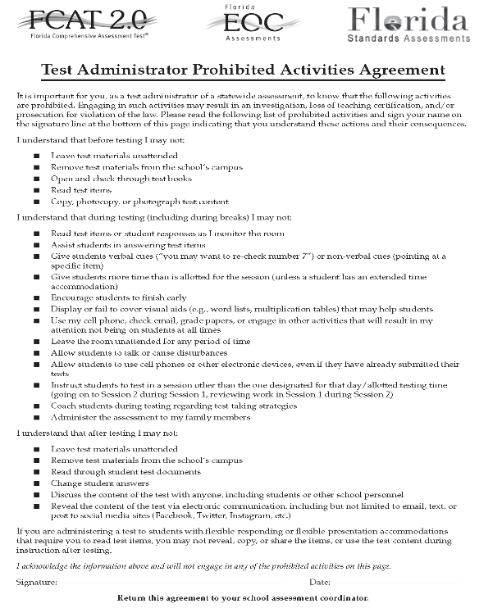
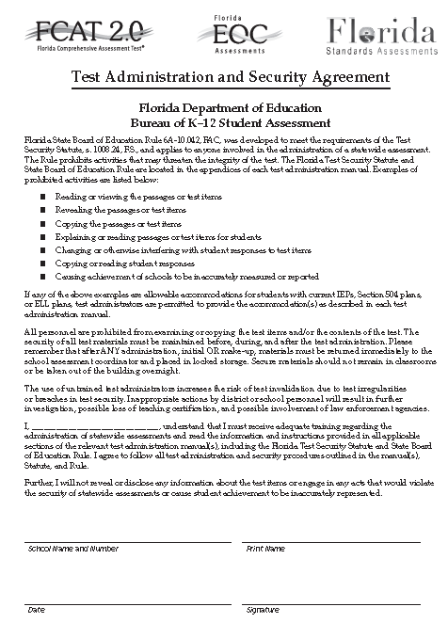
School Assessment Coordinator Before Testing
CBT
PBT
Preparation and Training (cont.)
Test Security
Ensure that test administrators, proctors, technology coordinators and any other personnel involved in test administration sign a Test Administration and Security Agreement after training is complete.
Also ensure that test administrators read and sign a Test Administrator Prohibited Activities Agreement.
Collect and file the signed agreements.

Slide 39
School Assessment Coordinator Before Testing
CBT
Arrange Practice Test (ePAT) Sessions
Schedule and arrange practice tests (ePATs) as described in the Fall/Winter 2016 NGSSS EOC & Retakes Manual.
Before a student can participate in a computer-based administration, the student must complete the appropriate ePAT(s) to learn how to use the computer-based system.
Exception: Students who previously participated in a TestNav 8 ePAT for the subject test they are scheduled to take but should be encouraged to interact with the ePAT to familiarize themselves with any interface or functionality updates that may occur between administrations.

Slide 40
School Assessment Coordinator Before Testing
CBT
Arrange Practice Test (ePAT) Sessions (cont.)
Students who require accommodated CBT forms (e.g., text-to-speech, masking) must also complete the appropriate accommodated practice tests(s).
Practice test scripts are available at http://avocet.pearson.com/FL/Home.
The practice tests are available at https://fl.pearsonaccessnext.com and on the TestNav desktop app.
40

Slide 41
School Assessment Coordinator Before Testing
CBT
Manage Student Information in PA Next
Ensure all students participating in this administration have been added to PA Next, via the PreID upload
The PREID upload is based on student enrollment as of October 28th.
Verify the accuracy of Student Names and Student IDs prior to testing.
Add new students individually using the Create/Edit Students task under Setup > Students, if needed
View and verify student information using an Advanced Session Roster from the test sessions created

Slide 42
School Assessment Coordinator Before Testing
CBT
Create Test Sessions
Test sessions were automatically created via PreID upload, you will see these sessions when you log in to PA Next as follows:
ART-NGALGEBRA1, BIO-NGBIOLOGY1, CIV-NGCIVICS, HIST-NGUSHISTORY
The district-created test sessions can be temporary sessions for the purpose of verifying student information, or they can be the test sessions you plan to use for testing.
Detailed instructions on how to create test sessions and verify student information are on pages 43–45 of the Fall/Winter 2016 NGSSS EOC and Retakes Manual.

Slide 43
School Assessment Coordinator Before Testing
CBT
Assigning Accommodated Forms
Ensure students who require an accommodated CBT form have been assigned the correct form in PA Next.
There are two ways to assign accommodated forms:
By Test Session: Create a separate test session for each group of students to be tested together and ensure the correct Form Group Type is assigned for the session.
By Individual Student: Override and assign an individual student the required form through the Students in Sessions area in PA Next.
If students are moved to a different session, their form assignments may change. Check the form assignment very carefully prior to testing.
If a student was assigned the wrong form, it is very difficult to reassign the form once the student has logged into the test.

Slide 44
School Assessment Coordinator Before Testing
CBT
Preparing Sessions
A session must now be marked as “prepared” before a school may proctor cache or start a session.
This step allows student tests to be staged and ready when the session is started.
Work with your technology coordinator to ensure sessions have been proctor cached prior to testing.
Instructions to prepare sessions are located on page 53 of the manual and at http://avocet.pearson.com/FL/Home.

Slide 45
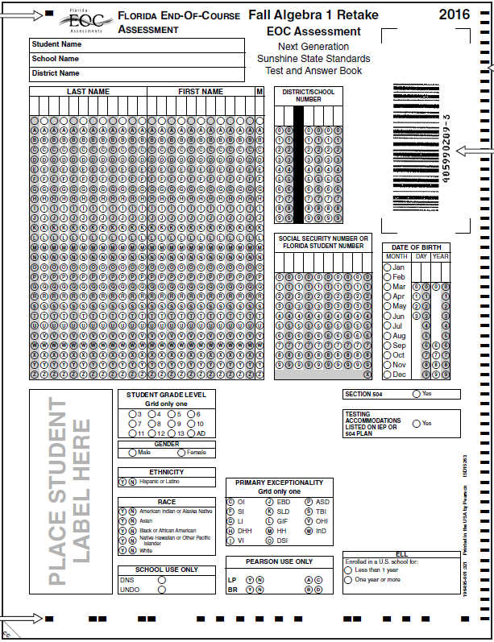
School Assessment Coordinator Before Testing
PBT
Student Demographic Information
The student grid sheet captures student demographic information.
Blank student grid sheets (non-preidentified) must be gridded using a No. 2 pencil.
For more information about specific demographic fields, see pages 11–15 of the Fall/Winter 2016 NGSSS EOC & Retakes Manual.

Slide 46
School Assessment Coordinator Before Testing
CBT
PBT
Student Enrollment Information/Course List Boxes
Complete the Student Enrollment Information Box on the back of the book to indicate whether the student is currently enrolled in, was previously enrolled in, or has never been enrolled in one of the courses in the Course List Box.
There are fields in PA Next to enter this information when adding a student for CBT testing.
See page 14 of the Fall/Winter 2016 NGSSS EOC & Retakes Manual for samples of the boxes for the different subjects.

Slide 47
School Assessment Coordinator Before Testing
CBT
PBT
Testing Accommodations
Beginning in Fall 2016, the district and schools will be required to report whether students have testing accommodations listed on their Individual Education Plans (IEPs) or Section 504 plans.
The district will capture this information in the PREID file.
This information will be required when school assessment coordinators add a new student in PA Next, and when gridding student demographic information on test and answer books.
Schools should also maintain records of accommodations provided and accommodations used with their required administration information.

Slide 48
School Assessment Coordinator During Testing
CBT
Distribute Test Materials
On each day of testing, you are responsible for providing each test administrator the following test materials before testing begins, as applicable:
Student Authorization Tickets
Session Roster
Test group code
CBT Work Folders
CBT Worksheets
Reference Sheets
Periodic Tables
Four-Function Calculators

Slide 49
School Assessment Coordinator During Testing
CBT
PBT
Supervise Test Administration
Ensure the test sessions have been started in PA Next.
Provide test administrators with additional materials, as necessary.
Monitor each testing room to ensure that test administration and test security policies and procedures are followed, seating charts and Security Logs are properly completed, and required administration information is collected.
Be available during testing to answer questions from test administrators.
In PA Next, monitor session status and resume student tests, if necessary.
If a technical issue interrupts testing and cannot be resolved quickly, schools should contact Pearson Customer Support at 877-847-3043 and notify SAET at 305-995-7520 immediately.
Arrange for and supervise make-up administrations.

Slide 50
School Assessment Coordinator After Testing
CBT
PBT
Prepare Materials for Return
Securely store any handheld four-function calculators.
Store Student Authorization Tickets for one calendar school year, and then destroy them securely.
USED and UNUSED CBT worksheets, CBT work folders, reference sheets, and periodic tables are secure materials and must be returned in the DAC ONLY Box.
Ensure that the materials listed on the Friendly Reminder are packaged in your DAC ONLY box.
File the signed Test Administration and Security Agreements and the Test Administrator Prohibited Activities Agreements.

Slide 51
School Assessment Coordinator After Testing
CBT
DO Mark Complete a CBT test if:
A student had to exit the test (e.g., due to illness) and will not finish the test.
After the test is marked complete, school personnel must invalidate the test.
A student finished the test but exited instead of submitting the test and the test should be scored.
As otherwise directed by FLDOE or Pearson after a technical difficulty or other extenuating circumstance.
DON’T Mark Complete a CBT Test if:
The student was absent and is still in Ready status.
Absent students should be removed from the session or moved to a make-up session.

Slide 52
School Assessment Coordinator After Testing
CBT
Stop Test Sessions
After all students have completed the test and submitted their responses, manually stop the test session in PA Next.
Any students who were absent and who may test at a later date may remain in Ready status and should be removed from this session (and/or moved to a make-up session).
Test sessions may remain in started status for more than one day but should be stopped after all students have completed testing or the administration window is closing. All sessions must be stopped in PA Next by 4:00 p.m. on December 16, 2016.

Slide 53
School Assessment Coordinator After Testing
CBT
Invalidate Tests
Review policies regarding test invalidation in the manual. Remember that invalidations must be recorded in PA Next by 4:00 p.m. on the final day of testing for each administration, December 16.
Step-by-step instructions for invalidating tests in PA Next can be found on pages 63–64 of the Fall/Winter 2016 NGSSS EOC and Retakes Manual.

Slide 54
School Assessment Coordinator After Testing
CBT
Correcting Student Profiles
Incorrect student profiles in PA Next that were created via the New Student wizard may be updated before or after testing.
Contact SAET at 305-995-7520, to submit a request by 10 am on Friday, December 16th.
SAET will submit the request to Pearson Customer Support.

Slide 55
School Assessment Coordinator After Testing
PBT
Do Not Score (DNS) and UNDO Bubbles
The DNS and UNDO bubbles are located in the SCHOOL USE ONLY box near the bottom of the student grid sheet.
The DNS bubble must be gridded when a test is invalidated or when a document is defective and USED.
If a DNS bubble has been gridded by mistake, erase the DNS bubble and grid the UNDO bubble. Then package the document with all other TO BE SCORED materials.
The DNS bubble MUST be gridded if the test and answer book is defective and USED.
Do not DNS documents for students who were withdrawn or absent during the testing window.

Slide 56
School Assessment Coordinator After Testing
PBT
Document Count Forms
Complete the Document Count Form by following the instructions on the form.
Include all documents from make-up sessions
Complete a separate Document Count Form for:
Document type (Algebra 1 Retake, Biology 1, Civics, US History),
Each Special Program and
For TO BE SCORED special document (large print, braille, one-item-per-page) materials.
Do not copy blank count forms
Contact TDC at 305-995-3743, to order additional document count forms.
Place each completed form on top of the first stack of corresponding TO BE SCORED test and answer books.
IMPORTANT: Verify the accuracy of the NUMBER OF TO BE SCORED DOCUMENTS (Box 5) on your Document Count Form.

Slide 57
School Assessment Coordinator After Testing
PBT
Paper Bands
Documents for each special program must be banded separately. You may use more than one paper band per document type, if necessary.
Follow these steps for each paper band you use:
Write the district/school number and school name on the paper band.
Count and record the number of TO BE SCORED documents that will be banded in each paper band.
Number the paper bands 1 of n, 2 of n, etc., where n is the school’s total number of banded stacks per Document Count Form.
Place a paper band around each stack of TO BE SCORED test and answer books include the Document Count Form under the paper band.
Seal the paper band and be sure that it securely holds the documents. Do not use staples, paper clips, or tape.

Slide 58
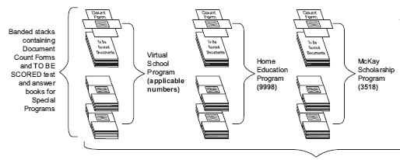
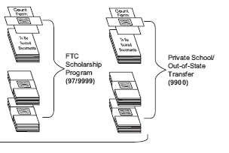
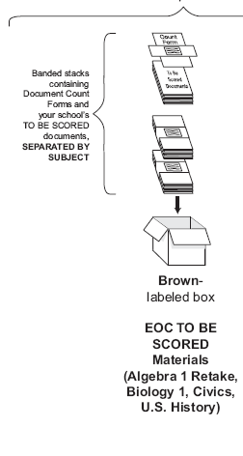
School Assessment Coordinator After Testing
PBT
Packaging Diagram for TO BE SCORED Regular Print PBT
Refer to the packaging diagrams on pages 73–74 of the Fall/Winter 2016 NGSSS EOC & Retakes Manual for guidance.

Slide 59
School Assessment Coordinator After Testing
(see Friendly Reminder)
CBT
PBT
District Assessment Coordinator Box
NGSSS EOC TEST | MATERIALS TO BE INCLUDED | LABEL COLOR
Algebra 1 Retake Biology 1 Civics US History | Original Administration Record / Security Checklist or school’s developed form Session Rosters (CBT) Original Security Logs Original Seating Charts Original Test Materials Chain of Custody Form (PBT only) CBT Work Folders (used and unused) CBT Worksheets (used and unused) Algebra 1 Retake EOC Reference Sheets (used and unused) Periodic Tables (used and unused) Original School Procedural Checklist (FM-6927) | No Return Label – Mark Box “District Coordinator ONLY”
Keep copies of documentation for your records. However, do not copy used work folders or worksheets. Note that the Student Authorization Tickets must be kept at the school for one calendar school year.

Slide 60
School Assessment Coordinator After Testing
Training Packet (see Friendly Reminder)
CBT
PBT
Winter 2016 NGSSS EOC Return Schedule
Return Label |  | Return Date
BROWN -- ”To Be Scored” (Regular Print) Algebra 1 Retake, Biology 1, Civics, and US History |  | Hand-deliver EOC PBT “To Be Scored” and “Not To Be Scored” to the TDC by 3:30 p.m. on: December 8 or 9, 2016
WHITE -- ”To Be Scored” (Large Print and OIPP) | PINK --”To Be Scored” (Braille)
YELLOW* -- “Not To Be Scored”
Note: DAC ONLY Box/Envelope is due to TDC by December 19, 2016
*Include unused Special Documents (Large Print, Braille, and OIPP) and any Special Documents with the DNS bubble marked.

Slide 61
Comment Forms
CBT
PBT
After testing, test administrators, school coordinators, technology coordinators, and district coordinators are encouraged to complete the appropriate comment form located at http://avocet.pearson.com/FL/Home.
FLDOE and Pearson appreciate feedback from district and school personnel.

Slide 62
Pearson Customer Support
CBT
PBT
Contact Pearson Customer Support at:
1-877-847-3043
(Monday–Friday, 7:00 am–8:30 pm ET)
Florida@support.pearson.com

Slide 63
Contact Information
Student Assessment & Educational Testing (SAET)
Maria C. Bruguera, Director
Email: mbruguera@dadeschools.net or
Mara Ugando, Staff Specialist
Email: mugando@dadeschools.net
Phone: 305-995-7520
Fax: 305-995-7522
District MSTs will be available to help schools with any hardware/internet issues. Contact SAET at 305-995-7520 for technical issues not resolved.

Slide 64
Thank you for ensuring a secure and successful administration!

