Slide 1
Florida’s Value Added Model
Overview of
the Model to Measure Student Learning Growth on FCAT
January 2012

Slide 2
New Standard for Teacher Evaluations
As set forth in the Student Success Act and Race to the Top, teacher evaluations are:
Designed to support effective instruction and student learning growth
Used when developing district and school level improvement plans
Used to identify professional development and other human capital decisions for instructional personnel and school administrators

Slide 3
New Standard for Teacher Evaluations
To support those objectives, the law sets forth that teacher evaluations are to be based on sound educational principles and contemporary research in effective practices:
The performance of students – IPEGS Standard 1
Instructional practice and job responsibilities – IPEGS Standards 2-8 or 2-7

Slide 4
New Standard for Teacher Evaluations
Performance of Students. At least 50% of a performance evaluation must be based upon data and indicators of student learning growth assessed annually and measured by statewide assessments or, for subjects and grade levels not measured by statewide assessments, by district assessments as provided in s. 1008.22(8), F.S.
-Section 1012.34(3)(a)1., Florida Statutes

Slide 5
Florida’s Value-Added Model Developed by Florida Educators
The Department convened a committee of stakeholders (Student Growth Implementation Committee –or SGIC) to identify the type of model and the factors that should be accounted for in Florida’s value-added models
To provide technical expertise, the Department contracted with the American Institutes for Research (AIR) to help the SGIC develop the recommended model that was adopted.
The SGIC’s recommended model was fully adopted by the Commissioner with no additions, deletions, or changes

Slide 6
Florida’s Value-Added Model Developed by Florida Educators
The Student Growth Implementation Committee (SGIC) is composed of 27 members from across the state. The group includes:
Teachers (across various subjects and grade levels, including exceptional student education)
School administrators
District-level administrators (Assessment and HR)
Postsecondary teacher educators
Representatives from the business community
Parents
The SGIC met from March through June 2011
2 two-day in-person meetings
4 conference call meetings

Slide 7
Florida’s Value-Added Model Developed by Florida Educators
After exploring eight different types of value-added models, the SGIC recommended a model from the class of covariate adjustment models
This model begins by establishing expected growth for each student:
Based on historical data each year
Represents the typical growth seen among students who have earned similar test scores the past two years, and share the other characteristics identified by the committee

Slide 8
The NEW Measure: Value-Added Analysis
A value-added model attempts to measure the impact of a teacher on student learning, by accounting for other factors that may impact the learning process.
These models DO NOT:
Evaluate teachers based on a single year of student performance or proficiency (status model) or
Evaluate teachers based on simple comparison of growth from one year to the next (simple growth)

Slide 9
Advantages of Value-Added Models
Teachers teach classes of students who enter with different levels of proficiency and possibly different student characteristics
Value-added models ATTEMPT to “level the playing field” by accounting for differences in the proficiency and characteristics of students assigned to teachers
Value-added models are designed to MITIGATE the influence of differences among the entering classes so that schools and teachers do not have advantages or disadvantages simply as a result of the students who attend a school or are assigned to a class
Value-Added models are not perfect. Model will be continually reviewed by the FLDOE in case adjustments are necessary

Slide 10
Value-Added Example
The difference between the predicted performance and the actual performance represents the value-added by the teacher’s instruction.
The predicted performance represents the level of performance the student is expected to demonstrate after statistically accounting for factors through a value-added model.

Slide 11
What are the scores?
What is the Predicted Student Score?
It is the score you would EXPECT a student to achieve based on the student’s performance on prior tests and other information available on the student.
A predicted score for a student is generated based on what would normally happen in an average class with a typical teacher.
What is the Student Learning Growth Score?
The difference between Current test score and Predicted test score.

Slide 12
Factors used to adjust predicted score
Student Characteristics:
Up to two prior years of achievement scores (the strongest predictor of student growth)
The number of subject-relevant courses in which the student is enrolled
Students with Disabilities (SWD) status
English Language Learner (ELL) status
Gifted status
Attendance
Mobility (number of transitions)
Difference from modal age in grade (as an indicator of retention)
Classroom characteristics:
Class size
Homogeneity of students’ entering test scores in the class

Slide 13
Factors NOT used to adjust predicted score
Student Characteristics NOT directly accounted for:
Gender
Race
Ethnicity
Socio-Economic Status
These factors are not directly included in a teacher’s VAM score.
However, since these factors already influence a student’s performance and prior performance is the predictor with the strongest weight, they are indirectly accounted for

Slide 14
How do the factors affect the predicted scores – an example
In a classroom of 25 students, every student may have a different predicted(expected) score because of the student’s individual prior performance and student characteristic variables
For example 2 students in the same class with the same teacher:
Student A has
Prior Year FCAT Reading Score of 1700
Attendance = 10 days absent
Student is English Language Learner
Student B has
Prior Year FCAT Reading Score of 1700
Attendance = no days absent
Student is NOT English Language Learner
What is the expected score for each of these students ?
Student A has an expected score of 1750 and
Student B has expected score of 1790

Slide 15
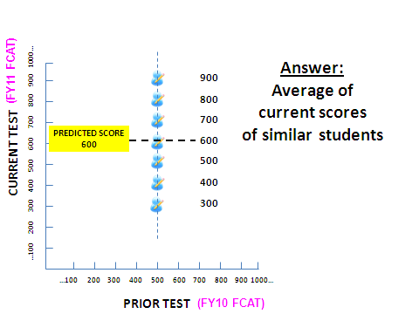
What is the predicted score?

Slide 16
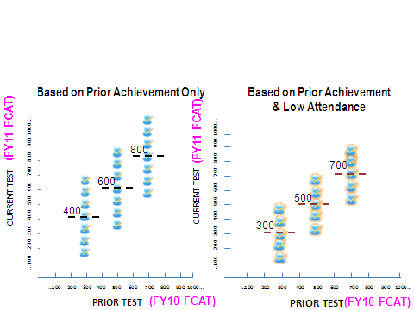
what does the predicted score look like after adjusting for attendance?

Slide 17
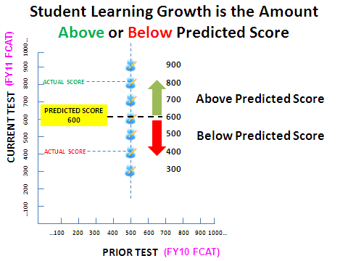
How is student learning growth measured?

Slide 18
How precise is this VAM score?
Precision in a VAM score is used to measure the consistency of the individual teacher VAM estimates.
It is measuring how much individual teacher VAMS would change if they were computed over and over again.
Example: Weighing yourself on a scale

Slide 19
What is standard error in a VAM score?
The standard error gives the uncertainty (error band) surrounding a teacher’s VAM score
It can be used to prevent classifying teachers when that categorization would be uncertain
Standard errors will be used when classifying teachers in the lowest tier to ensure that there is a high degree confidence on this categorization

Slide 20
Components of the overall teacher vam estimates
The model recognizes that there is an independent factor related to the school that impacts student learning –a school component
Calculated based on the predicted and observed scores of students in the school for each grade and subject while controlling for the students’ and classrooms’ factors mentioned previously
May represent the impact of the school’s leadership, the culture of the school, or the environment of the school on student learning

Slide 21
Components of the overall teacher vam estimates
SGIC decisions on the use of the school component
The SGIC decided to include 50% of the school component in the measurement of the teacher’s effectiveness
By attributing a portion of the school component to the teacher in the measurement of his/her effectiveness, one recognizes that the teacher contributes somewhat to the overall school component, but there are factors imbedded in that component that are beyond his/her direct control and that he/she should not directly be held accountable for

Slide 22
Fldoe’s conceptual calculation for a Teacher Value-added score
Teacher Value-Added Score is :
Teacher Growth Score
+
50 percent of the School Growth Score

Slide 23
What does a VAM score look like?
A VAM score represents the amount of a year’s growth above or below expectation for a particular grade level and subject area.

Slide 24
Why normalizing Teacher VAM scores is important?
Teachers may be teaching multiple grade levels and subject areas
VAM scores are made comparable by standardizing within grade level and subject area
Aggregated standardized VAM scores are converted to percentile ranks within M-DCPS to ensure comparability across grades and subject areas
Percentile ranks are used for classification purposes

Slide 25
Why Standardize the scores? Distribution of 6th and 7th Grade Reading VAM Estimates
The graphs demonstrate that the center and spread of the VAM scores differ across grades
Therefore, standardizing will ensure comparability across grade levels

Slide 26
Steps towards converting the vam to percentile standings
To create standardized score:
Subtract the mean of the distribution from the observed VAM score
Grade 6 10 – 6.7 = 3.3
Grade 7 10 – 9.2 = 0.8
Divide the result by the standard deviation
Grade 6 3.3 / 19.5 = 0.17
Grade 7 0.8 / 17 = 0.05
Refer the standardized score to the normal distribution to obtain the percentile standing
Grade 6 Standard score of 0.17 = 57th percentile
Grade 7 Standard score of 0.05 = 52nd percentile
 | VAM | Mean | Stand. Dev. | Standard Score | Percentile
Grade 6 | 10 | 6.7 | 19.5 | 0.17 | 57%
Grade 7 | 10 | 9.2 | 17 | 0.05 | 52%

Slide 27
Teacher FINAL EVALUATION
Teacher’s Unified Summative Rating includes two components:
Professional Practices - measured by IPEGS Standards 2-8 or 2-7
Quantifiable Student Data – IPEGS Standard 1
Measured using a VAM score that has been converted to a percentile rank which is currently the most accurate and objective measure available that can be used to measure student growth
The VAM measure takes into account multiple indicators and prior student performance to predict a teacher’s value–added contribution to a student’s academic growth

Slide 28
Florida’s Value Added Model
Questions

