Slide 1
2016-17 New Test Chairperson Computer-Based Testing (CBT) Training Materials
FSA and NGSSS Assessments
Notes:
This presentation will cover computer-based testing as it relates to the FSA, FCAT 2.0, and EOC assessments.

Slide 2
2016-17 CBT Topics
FSA
NGSSS
Tests to Be Administered:
FSA ELA Writing
FSA ELA Reading
FSA ELA Retake (Writing and Reading)
FSA Mathematics
FSA EOC (Algebra 1, Algebra 2, and Geometry)
FSA EOC Algebra 1 Retake (only Spring 2017)
Testing Platform:
FSA Secure Browser (student)
TA Interface (teacher)
Session Manage
TIDE (www.fsassessments.org)
Tests to Be Administered:
FCAT 2.0 Reading Retake
NGSSS Algebra 1 Retake, Biology 1, Civics, and US History EOCs
Testing Platform:
TestNav 8 (student)
Session Management
Blue Site (www.fl.PearsonAccessNext.com)
Notes:
These are topics we will cover today. We will cover the FSA tests first, then the Pearson tests.

Slide 3
FSA Terms
American Institutes for Research (AIR): AIR is the assessment vendor for FSA assessments.
Assessment Viewing Application (AVA): The system used by test administrators administering paper-based ELA Reading Retake tests to play audio passage clips or American Sign Language (ASL) videos for students.
Data Recognition Corporation (DRC): DRC is the vendor responsible for processes associated with paper-based FSA materials, including printing, shipping, receiving, and scanning.
FSA Portal: Resources and information for district and school personnel are located on the FSA Portal, which is accessed at www.FSAssessments.org. The portal includes links to TDS, TIDE, and the FSA Reporting System.
FSA Reporting System: The FSA Reporting System will deliver state, district, and school score results.
On-Demand PreID Labels: PreID Labels will not be provided for the Fall and Winter assessments. On-Demand PreID Labels must be printed locally.
Secure Browser: The secure browser allows students to access the computer-based FSA assessments. This software must be installed on all computers or devices that will be used for student testing. A link to download the secure browser is located on the FSA Portal.
Notes:
American Institutes for Research (AIR): AIR is the assessment vendor for FSA assessments.
Data Recognition Corporation (DRC): DRC is the vendor responsible for processes associated with paper-based FSA materials, including printing, shipping, receiving, and scanning.
FSA Portal: Resources and information for district and school personnel are located in the FSA Portal, which is accessed at www.FSAssessments.org.
The portal is organized by user roles and also includes links to the Test Delivery System (TDS), Test Information Distribution Engine (TIDE), and Online Reporting System (ORS).
Test Information Distribution Engine (TIDE): TIDE is the enrollment and user management system for the FSA assessments. Student enrollment and test eligibility information is managed via TIDE. All school personnel who will administer FSA assessments must have user accounts in TIDE.

Slide 4
FSA Terms (cont.)
Session ID: Session IDs are unique codes generated by the Test Administrator (TA) Interface. In addition to their first names and usernames, students use the Session ID to log in to computer-based FSA assessments. Test administrators must record the Session ID with their required administration information.
Student Interface: Students use the Student Interface via the secure browser to log in to and take computer-based FSA assessments.
Test Administrator Interface: Test administrators use the Test Administrator (TA) Interface to create and monitor test sessions for all computer-based FSA assessments.
Test Delivery System (TDS): All computer-based FSA assessments are administered via TDS, which includes the Test Administrator (TA) Interface and the Student Interface.
Test Group Codes: Test group codes are four-digit codes used during paper-based administrations to identify groups of students tested together and are recorded on the front of the test and answer books and in the test administrator’s required administration information.
Test Information Distribution Engine (TIDE): TIDE is the enrollment and user management system for FSA assessments. Student enrollment and test eligibility information is managed in TIDE. All school and district personnel involved in the administration of FSA assessments must have TIDE user accounts.
Test Tickets: Student test tickets contain login information for students. Each student must have a test ticket to log in to computer-based FSA assessments. Test tickets are generated in TIDE and contain the following fields: username, last name, first name, grade, date of birth, student ID number, district, and school.
Notes:
Test Delivery System (TDS): All computer-based FSA assessments are administered via TDS, which includes the Test Administrator Interface as well as the Student Interface. TDS is the background platform. You won’t see it.
Secure Browser: The secure browser allows students to access the computer-based FSA assessments. This software must be installed on all computers or devices that will be used for student testing. A link to download the secure browser is located in the FSA Portal. The FSA secure browser is what the student will double click to access the test.
Online Reporting System (ORS): ORS allows school personnel to track the progress of student computer-based testing and access student results. ORS is accessed via the FSA Portal using the same username and password used to access other AIR systems.
Student Interface: Students use the Student Interface (via the FSA Secure Browser) to log into and take computer-based FSA tests.

Slide 5
FSA Test Delivery System Overview
TIDE
User Management and Student Enrollment
TA Interface/ Secure Browser
Test Administration
Online (CBT) Testing
TIDE
Participation Reports
TIDE
User Management, Student Enrollment, Test Materials
Paper Testing
Test Administration
Paper Testing (PBT)
Notes:
For online testing, the FSA Test Delivery System is made of several systems that are integrated in the assessment process, TIDE, TA Interface, and ORS.
For paper-based testing, users will need to understand the tasks that need to be completed in TIDE in order to administer tests.

Slide 6
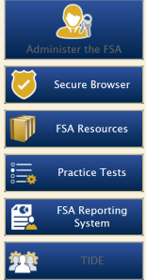
FSA Common Login System
Any FSA system can be accessed from the FSA Portal at www.FSAssessments.org
The same username and password can be used for each of the systems
Notes:
All FSA systems are accessed using a Common Login System. Once you have logged in to one system, you can navigate to other systems without having to log back in. The same username and password are used to log in to each system. Your email address will serve as your username.

Slide 7
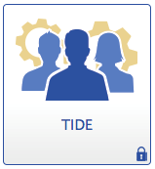
FSA TIDE System Overview
Manage Users
View/Edit Student Information
PreID or Add Students
Print Student Test Tickets
Print On-Demand PreID Labels
Participation/Test Completion Reports
Invalidate Tests
Notes:
We will begin with an overview of the TIDE system. TIDE is used to complete a variety of tasks (or functions) to prepare for testing: Managing Users, Viewing and editing student information, Adding Students, Printing Test Tickets, Printing On-Demand PreID Labels for paper-based testing, and creating test invalidations. While basic access to TIDE is available year round, some functions are time sensitive and restricted to specific administrative windows.

Slide 8
FSA Accessing TIDE
Go to the portal www.FSAssessments.org
Click the “TIDE” icon
Notes:
To access TIDE, go to the FSA Portal. Select the appropriate role which will take you to a user page, and click the TIDE icon.

Slide 9
FSA Accessing TIDE (cont.)
To access TIDE, you will need:
Username (email address) and password
High-speed internet connection
Supported Internet browser
JavaScript; and Disabled pop-up blockers
School Assessment Coordinators (SACs) are responsible for entering other school-level users into TIDE:
School Assessment Coordinator (SAC) and/or
Test Administrator (TA) accounts.
Once the account is set up, the username and password will be used to access all FSA systems (TIDE, Test Administrator [TA] Interface, Assessment Viewing Application, FSA Reporting System).
Notes:
To access and use TIDE, users will need:
a username and password (your username will be your email address);
a computer with a high-speed Internet connection (DSL, cable, or LAN) (direct dial-up connections are not recommended);
a supported Internet browser;
JavaScript; and disabled pop-up blockers.
The School Assessment Coordinator is responsible for entering school-level users into TIDE. School Assessment Coordinators will be able to add other School Assessment Coordinators as well as Test Administrator accounts. Once your account is set up, your username and password is sent to you and will be used to access all FSA systems (TIDE, Test Administrator Interface [TA Interface], Online Reporting System [ORS]).

Slide 10
FSA TIDE User Roles
TIDE is organized by user role and access to certain tasks and functions are assigned to specific roles.
A detailed list of roles and their access to tasks are available in the TIDE User Guide.
District Assessment Coordinator (DAC)
School Administrator
School Assessment Coordinator (SAC)
Test Administrator (TA)
Notes:
TIDE is organized by user role and access to certain tasks and functions are assigned to specific roles. A detailed list of roles and task permissions are available in the TIDE User Guide.
For example School Assessment Coordinators cannot access test results in ORS.

Slide 11
FSA First Time Users
Initial SAC accounts will be created by Student Assessment & Educational Testing (SAET) Office.
Instructions for creating and managing user accounts are in the TIDE User Guide.
Newly added users will receive an automated email that contains the following:
Their assigned user role(s)
The applications to which they have access
A secure, temporary, one-time link to activate the account
If a school user has not received this email, or if the link has expired, contact SAET.
Notes:
Initial accounts for School Assessment Coordinators are established in TIDE by Student Assessment & Educational Testing Office. After a NEW TIDE account is established an automated email will be sent and will include the following information:
User role
Applications to which access is provided (TIDE, TDS, ORS)
A secure, temporary, one-time link to activate the account. Note that this link expires in 30 days.
School Assessment Coordinators who do not receive an automated email should contact FSA Help Desk.

Slide 12
FSA Activating Your TIDE Account
TIDE will send you an introductory email. This email contains the following information:
• A link for logging in to TIDE. This link expires 30 days after the email was sent.
• Your temporary password.
If you do not receive an account activation email, check your spam folder. Emails are sent from Florida DoNotReply@airast.org, so you may need to add this address to your contact list.
To activate your account:
1. Click the link in the introductory email. The “Please Log In” page appears.
2. In the Old Password field, enter the password provided in the activation email.
3. In the other password fields, enter a new password. The password must be at least eight characters long and have three of the following: one lowercase alphabetic character, one uppercase alphabetic character, one number, and one special character %, #, or !.
4. Click Submit. The Select a Security Question page appears.
5. Mark the checkbox next to a question, and enter an answer.
6. Click Save. The FSA portal page appears.
Notes:
When your account is created, you will receive an email from Florida DoNotReply@airast.org. Click on the link to the introductory email and enter a new password. Please note that the password must be at least eight characters long and have three of the following: one lowercase alphabetic character, one uppercase alphabetic character, one number, and one special character %, #, or !. Click submit and then select the security question and mark the checkbox next to the question and enter an answer then save.

Slide 13
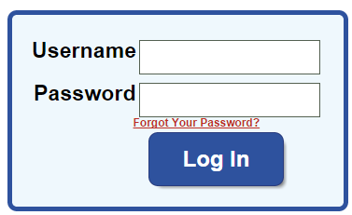
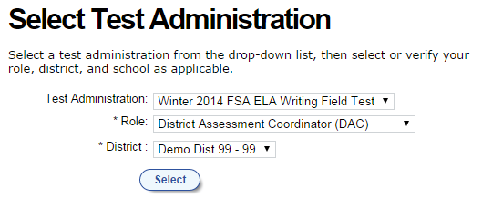
FSA TIDE Logging In
When prompted, the user should enter his or her username (email) and password.
After a user has logged in, he or she may be prompted to choose an administration, depending on role.
If you forgot your password or need a new password, please use the Forgot Your Password? link to reset it.
Notes:
A user should log in on the TIDE login screen using his or her username and password. If the user has access to multiple schools, he or she will be asked to choose the school to complete the login process. After logging in, a user may be prompted to choose an administration (the Winter 2016 FSA EOC), depending on their role.
If you have a previous TIDE account, you will not receive a new email to create a new password. If you forgot your password, you may reset your password by clicking FORGOT YOUR PASSWORD link from the TIDE login screen.

Slide 14
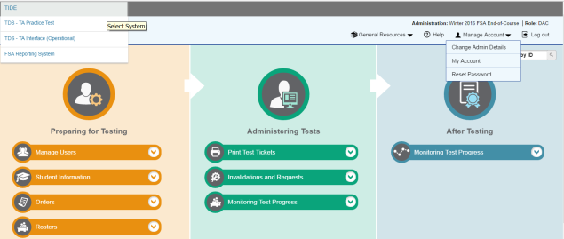
FSA TIDE Home Screen
Available Systems
Banner
Tasks
Notes:
A TIDE training module is available on the FSA Portal demonstrating school and district assessment coordinator tasks completed in the Test Information Distribution Engine (TIDE).
This is an example of the FSA TIDE Home screen. From here, users can access every aspect of the TIDE system that they have permission to view. The tabs toward the top of the screen, which are also represented by icons in the center of the page, direct users through the tasks that are available to their administration level.
The banner at the top of the TIDE homepage will indicate your role and the administration you are logged in to. It contains the System Navigation menu, a General Resources drop-down, a Help button, a Manage Account drop-down, a Log Out button, and a Find Student by ID search field.
TIDE Tasks are now organized in columns based on tasks typically completed before, during, or after testing:
The first section, Preparing for Testing, includes tasks associated with Users, Students, Orders, and Rosters
The second section, Administering Tests, includes access to Printing Test Tickets, tasks associated with Invalidations and Requests, and Monitoring Test Progress, where you will access participation reports.
The third section, After Testing, will include Test Completion Rates.

Slide 15
FSA Managing Users
Notes:
We will start with Managing Users. While the tasks are similar as outlined for District Assessment Coordinators, the ability to perform some of the tasks is limited for school level users.

Slide 16
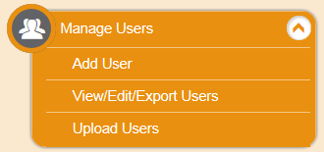
FSA School Tasks: Managing Users
To add an individual user, under Preparing for Testing,
Click Manage Users > Add User
Select the role and enter in user’s Email Address, Last Name, First Name, and Phone Number (optional) and then click Save.
Notes:
CBT Coordinators are the only school level role that can Add Users.
To add a user, expand Manage Users and click Add User.
Select the role and enter in the user’s Email Address, Last Name, and First Name. Phone Number is optional and then click Save.

Slide 17
FSA School Tasks: Uploading Users
To add multiple users, under Preparing for Testing,
Click Manage Users > Upload Users
Select Download Templates and create file.
Select Browse to select the file and Next to preview your file.
Notes:
To add multiple users, click Upload Users.
Select Download Templates, choose either a CSV or Excel file format, and create a file.
Select Browse to select the file and Next to preview your file.

Slide 18
FSA School Tasks: Uploading Users (cont.)
Select Next to validate the file. TIDE displays errors or warnings.
Click Continue with Upload to upload the file as is.
Or, correct the errors on the original file and Upload a Revised File.
Notes:
After verifying you uploaded the correct file, Select Next to validate the file. TIDE will display errors or warnings. For User uploads, TIDE will display errors if the field contains invalid characters or values.
A warning will display if the user is already in TIDE. Records with warnings will still upload.
You can click the error icon to view a message that provides more information on how to correct the error.
You can choose to Continue with the Upload, however, TIDE does not upload records that have errors, or Upload a Revised File by correcting errors in the original file and starting the upload process again.

Slide 19
FSA School Tasks: View/Edit Users
Under Preparing for Testing,
Click Manage Users > View/Edit/Export Users, and search for the user.
Click [ ] to view or edit the record.
Notes:
To search for users to view or edit information, expand Manage Users and click View/Edit/Export Users. You can search by role, email address, name or phone number. Click the edit icon to view or edit the record.
Remember that Email Addresses are not modifiable.

Slide 20
FSA Student Information
Notes:
Tasks associated with Student Information varies by role at the school level. All school users can view and export students within their school. CBT Coordinators also have the ability to add and edit students.

Slide 21
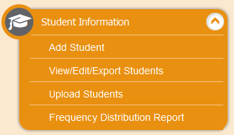
FSA School Tasks: Confirming Student Information
Under Preparing for Testing,
Click Student Information > View/Edit/Export Students, and search for the student.
Click [ ] to view the record.
Notes:
To view/edit students, expand Student Information and click View/Edit/Export Students.
Search for all students within the school or add additional criteria to narrow your search.
Click the edit icon to view a student record.

Slide 22
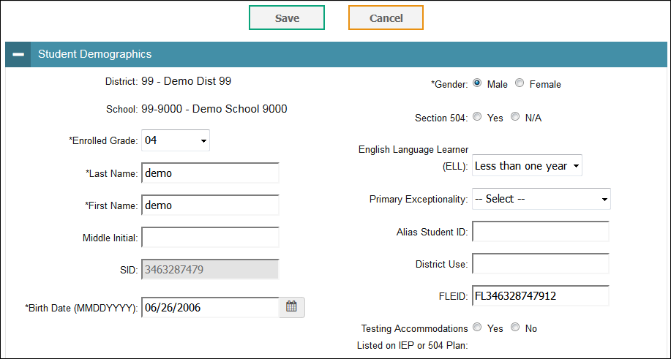
FSA School Tasks: Confirming Student Information (cont.)
Confirm/update information in the Demographics panel of the record.
Notes:
Student information is displayed in 4 panels on the page. The first panel is Student Demographics. The SID field is not modifiable but all other fields in this section can be edited.

Slide 23
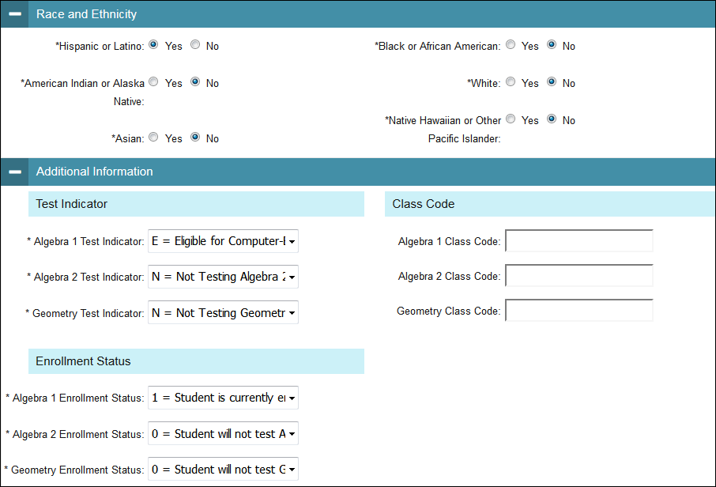
FSA School Tasks: Confirming Student Information (cont.)
Confirm/update information in the Race and Ethnicity and the Additional Information panels of the record.
Notes:
The second panel is Race and Ethnicity. The third panel is Additional Information, which contains Test Indicator, Enrollment Status for EOC tests, and Class Code.
Selecting class code allows you to include the student in the original roster.

Slide 24
FSA School Tasks: Confirming Student Information (cont.)
On Accommodations panel, confirm/update information.
Click Save when finished.
Notes:
The fourth panel is Accommodations. You can update accommodations by toggling the on/off button. If student information was modified in any of the 4 panels, Click Save when finished to update student information.

Slide 25
FSA School Tasks: Adding Students
Under Preparing for Testing,
Click Student Information > Add Student
Make selections and type in entries for all required fields and click Save.
Notes:
To add a new student, expand Student Information and click Add Student.
Make selections and type entries for all required fields in the four panels and click Save. If a field contains invalid characters/values or a required field is left blank, an error message will be displayed. You will need to correct the error before you can add the student.
You will receive a confirmation message after the student has been successfully added to TIDE.

Slide 26
FSA Printing PreID Labels and Test Tickets
Notes:
The next few slides will provide information on printing PreID Labels and Test Tickets.

Slide 27
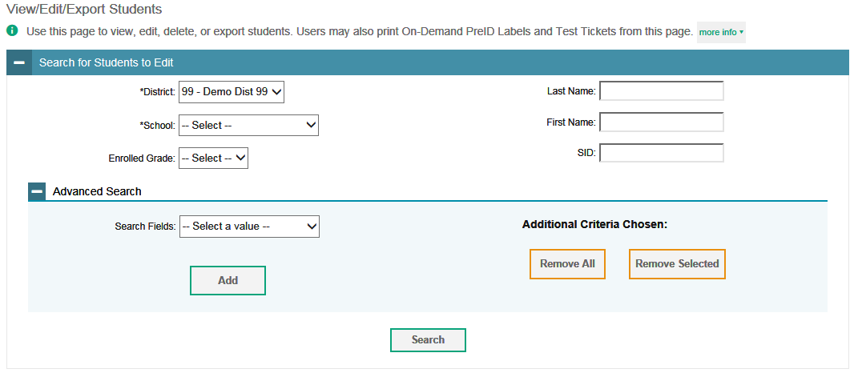
FSA School Tasks: Printing On-Demand PreID Labels
Under Preparing for Testing,
Click Student Information > View/Edit/Export Students.
Search for students.
Notes:
To print On-Demand PreID Labels, Expand Student Information and click View/Edit/Export Students. Search for the student(s) you need to print PreID labels for.

Slide 28
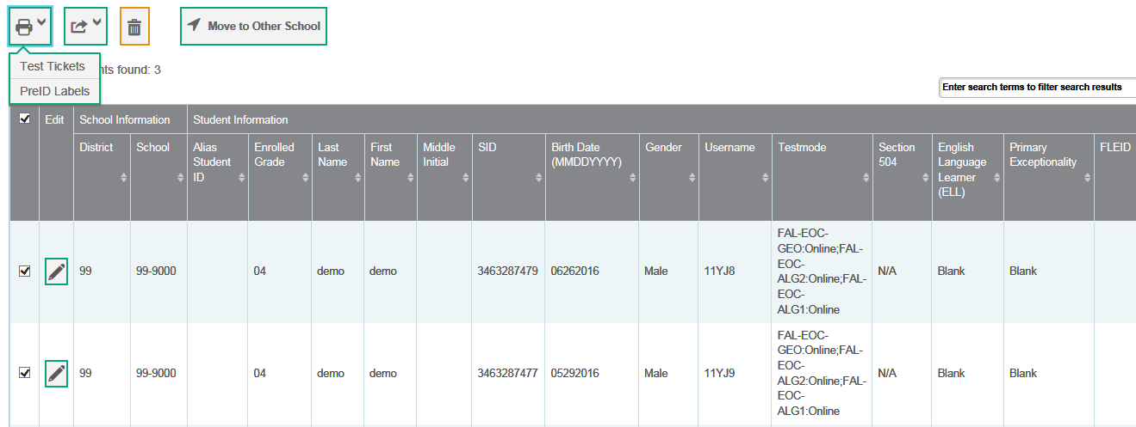
FSA School Tasks: Printing On-Demand PreID Labels (cont.)
Select records, click the print icon [ ] and select PreID Labels. A separate window or tab will open.
Notes:
You will then select the records, click the print icon and then select PreID Labels.
A separate window or tab will open.

Slide 29
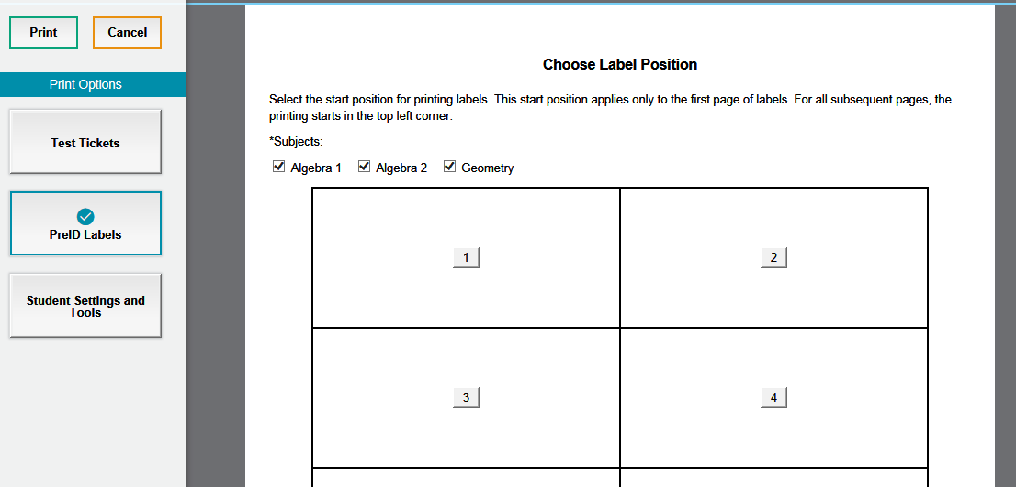
FSA School Tasks: Printing On-Demand PreID Labels (cont.)
Select the subject(s) you want to print a label for, a start position and click Print.
Notes:
Next, select the subject(s) you want to print a label for, select a start position, and then click Print.

Slide 30
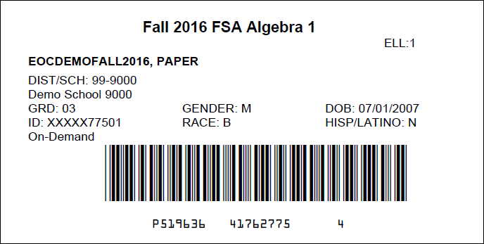
FSA School Tasks: Printing On-Demand PreID Labels (cont.)
Open the file with the selected student labels. Print the PDF on the blank labels provided by DRC.
Notes:
Open the file with the selected student labels and Print the PDF on the labels provided by DRC.

Slide 31
FSA School Tasks: Printing Test Tickets
Under Administering Tests,
Click Print Test Tickets > Print from Student List.
Search for students.
Notes:
To print Test Tickets, expand the Print Test Tickets menu under Administering Tests and click Print from Student List. Search for students and select the records that need test tickets.

Slide 32
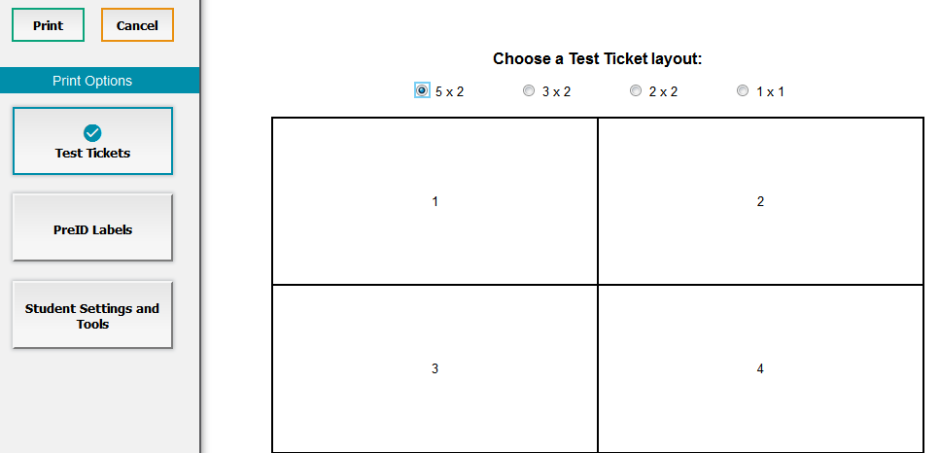
FSA School Tasks: Printing Test Tickets (cont.)
Select the records you wish to print and click [ ] and select Test Tickets. A separate window or tab will open.
Select a Layout and click Print.
Open the file with the selected student tickets. Print the PDF.
Notes:
Click the print button and select Test Tickets. A separate window or tab will open. Select a layout and click print. Open the file with the selected students’ test tickets and print the PDF.
Test Tickets can also be printed from the View/Edit/Export Students task. Follow the same steps for PreID Labels, except choose Test Tickets.

Slide 33
FSA Rosters
Notes:
Tasks associated with Rosters will be discussed next.

Slide 34
FSA School Tasks: Rosters
To view or edit Rosters, under Preparing for Testing,
Click Rosters > View/Edit Rosters.
Search for a Roster.
Notes:
To view or edit Rosters, expand Rosters and click View/Edit Rosters.
Then search for a Roster.

Slide 35
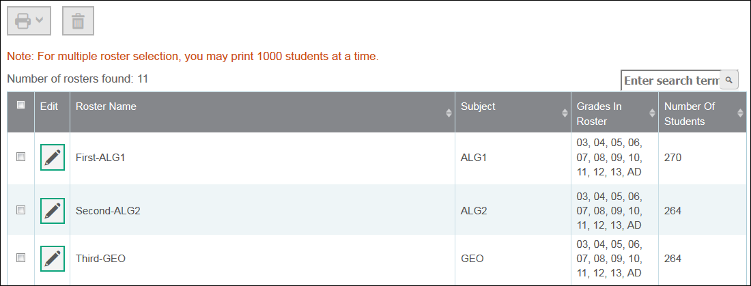
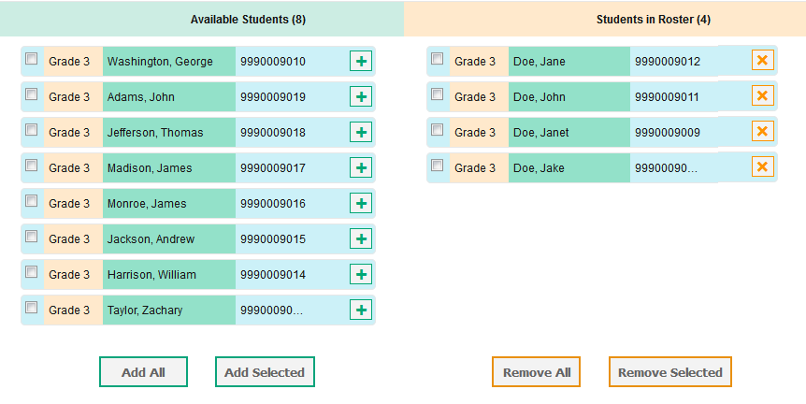
FSA School Tasks: Rosters (cont.)
Click [ ] to view or edit a Roster.
PreID Rosters are view only.
User Defined Rosters can be modified.
Click [ ] to add a student, and [ ] to remove a student.
Notes:
Click the edit icon to view or edit a roster. PreID Rosters are view only. User Defined Rosters can be modified.
On the View/Edit Rosters page, you can search for students to add to a Roster.
Click the plus icon to add a student and click the x icon to remove a student.

Slide 36
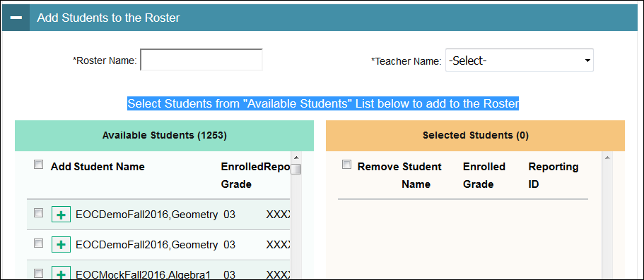
FSA School Tasks: Adding Rosters
To Add Rosters, under Preparing for Testing,
Click Rosters > Add Roster.
Search for students.
Select students from the “Available Students” list to add to the roster.
Type Roster Name.
Select Teacher Name.
Click Save.
Notes:
To add a new roster, expand Rosters then click Add Roster.
Search for students and then select students to add to the roster.
Type in a Roster Name, Select a Teacher from the drop-down and then Click Save.

Slide 37
FSA School Tasks: Printing Rosters/Tickets
Click [ ] and select Roster or Test Tickets.
A new tab or window will open.
Notes:
You can print a roster list or test tickets from a roster. After searching for rosters, select the roster, click the print icon and select Roster or Test Tickets. You will follow the same process as described before for printing PreID Labels and Test Tickets.

Slide 38
FSA Invalidations and Requests
Notes:
CBT Coordinators have the ability to create the following invalidations and request types: “Invalidate a test”, “Re-open and test”, and “Re-open a test session”. Let’s review how these requests are created in TIDE.

Slide 39
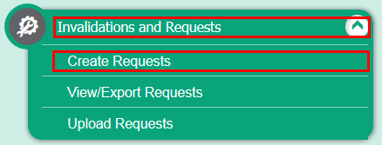
FSA School Tasks: Create Invalidations and Requests
Under Administering Tests,
Click Invalidations and Requests > Create Requests.
Select a request type to create and enter an SID, Result ID, or Session ID.
Notes:
To create an invalidation or other request, expand invalidations and requests and click create requests.
Select a request type, enter an SID, Result ID or Session ID and click Search.

Slide 40
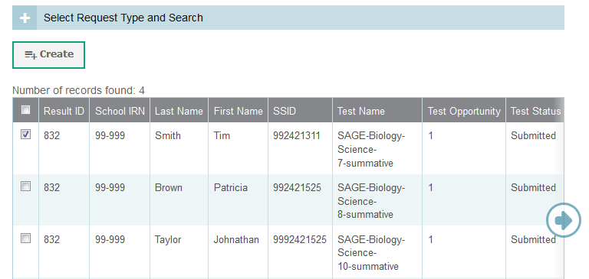
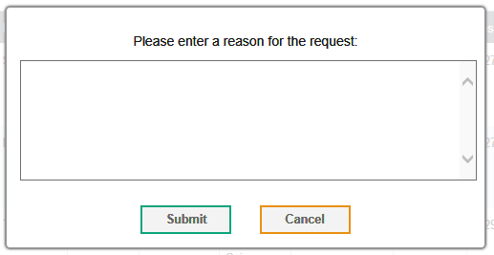
FSA School Tasks: Create Invalidations and Requests (cont.)
Choose a record(s) and click Create.
Enter a reason and click Submit.
Notes:
Select a record(s) and click Create. Enter a reason and click Submit.
You can view submitted requests, by selecting “View/Export Requests”.
CBT Coordinators also have the ability to upload Invalidations and Requests.

Slide 41
FSA
CBT Materials Needed, as applicable:
Notes:
The next few slides will cover FSA materials needed:

Slide 42
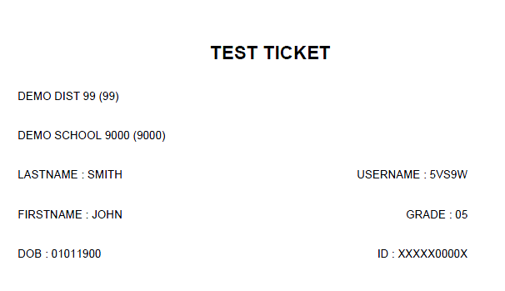
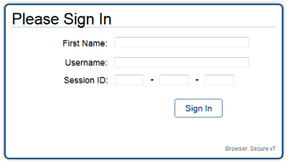
FSA Student Test Tickets
For each test session, to log into the FSA Secure Browser, each student needs a Username and a password, which are printed on the Student Test Tickets.
Provide each student their ticket only AFTER all students have entered the testing room, as instructed in the script, and all tickets must be collected BEFORE students leave the testing room.
Student Test Tickets must be handled in a secure manner and returned to the school assessment coordinator immediately after each day of testing is completed.
Keep Student Test Tickets securely stored at all times.
FSA Student Test Ticket
FSA Secure Browser Student Login Screen
Notes:
The FSA student test ticket is generated in TIDE for every student testing (think of it as a PreID label). It can only be used by the student listed on the ticket. Test tickets are secure documents and must be kept in locked storage until the first day of testing.
Test Tickets contain login information for students. Each student must have a test ticket to log into computer-based FSA assessments. Test tickets contain the following fields: Username, Last Name, First Name (password), Grade, Date of Birth, Student ID Number, District and School. The test administrator will give each student a ticket only AFTER all students have entered the testing room, and all tickets must be collected BEFORE students leave the testing room.
Test Tickets must be handled in a secure manner and returned to the school assessment coordinator immediately after each test session is completed.
Report any missing tickets to Student Assessment immediately.

Slide 43
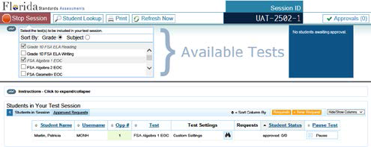
FSA Session ID
Session ID
Session IDs are unique codes generated by the Test Administrator Interface. In addition to their Username and First Name, students use the Session ID to log into computer-based FSA assessments. Test Administrators must record the Session ID as part of their required administration information.
Notes:
Session IDs are unique codes generated by the Test Administrator Interface, when the test administrator creates a test session.
The session ID should be displayed where it is visible to all students. In addition to their Username and First Name, students use the Session ID to log into computer-based FSA assessments. Test Administrators must record the Session ID as part of their required administration information and on the seating chart.

Slide 44
FSA CBT Work Folders
The Florida Computer-Based Testing Work Folder is a blank piece of yellow 11x17 paper folded in half with grid paper on the back page.
For the FSA Mathematics and EOCs CBT test sessions, students are provided with work folders to work the problems.
Distribute work folders to students at the beginning of each test session.
Ensure that students have enough desk space to use their folders.
Once students complete the test, collect all work folders and return them to the school assessment coordinator.
Used work folders are secure materials.
Notes:
The Florida Computer-Based Testing Work Folder is a blank piece of yellow 11x17 paper folded in half with grid paper on the back page. You will receive a Work Folder for each student taking a FSA Mathematics (grades 5-8) and FSA EOC (Algebra 1, Algebra 2, and Geometry) computer-based assessment.
One work folder per student should be sufficient per session; however, students may request additional folders. Distribute these folders as indicated in the script. School assessment coordinators and test administrators must ensure that students have enough desk space to use their folders.
Work Folders are not provided for practice tests so students should bring their own scratch paper.
Once students complete the test, the test administrator must collect all Work Folders. Used folders are secure materials. The school assessment coordinator should return the used and unused Work Folders in the District Assessment Coordinator Box.

Slide 45
FSA CBT Worksheets
For the FSA ELA Reading, the CBT worksheet is provided for students to take notes.
Students must have enough desk space to use their worksheets.
Once students complete a test session, collect all worksheets and return them to the school assessment coordinator.
Used worksheets are secure materials.
Notes:
The CBT Worksheet is an 8 1/2x11 page that will be provided to students at the beginning of each CBT test session for the FSA ELA Reading (Grades 4-10). You will receive hard copies like the CBT Work Folders.
School assessment coordinators and test administrators must ensure that students have enough desk space to use their worksheets.
Worksheets are not provided for practice tests.
Once students complete the test each day, the test administrator must collect all Worksheets. Used worksheets are secure materials. The school assessment coordinator should return the used and unused worksheets in the District Assessment Coordinator Box.

Slide 46
FSA Scientific Calculators
A scientific calculator is available in the test platform for Grades 7-8 FSA Mathematics and all FSA EOCs assessments.
Hand-held calculators may be used by students, only if all students are provided with a handheld calculator.
Handheld scientific calculators must have only allowable functionalities, as indicated in the FSA Mathematics Policies and Materials document (on the FSA portal).
Calculators can only be used in Sessions 2 and 3 of the Grades 7 and 8 Mathematics and Session 2 of the FSA EOC assessments.
If providing calculators, ensure that students are ONLY provided handheld calculators in the appropriate sessions.
Notes:
A scientific calculator is available in the test platform for Grades 7-8 FSA Mathematics and all FSA EOCs assessments
Hand-held calculators may be used by students, only if all students are provided with a handheld calculator.
Handheld scientific calculators must have only allowable functionalities, as indicated in the FSA Mathematics Policies and Materials document posted on the FSA portal.
Calculators can only be used in Sessions 2 and 3 of the Grades 7 and 8 FSA Mathematics and Session 2 of the FSA EOC assessments.
If providing calculators, ensure that students are ONLY provided handheld calculators in the appropriate sessions.

Slide 47
FSA Test Administrator (TA) Interface for CBT
Administer the FSA
TA Training Site
Notes:
This next section covers the Test Administrator Interface (TA Interface) that will be used to administer the Online FSA EOC. The Test Administrator Training site, a sister site to the TA Interface, is used to practice administering online tests.

Slide 48
FSA Preparing/Conducting CBT Testing
To administer either an online training test or an online operational test, you will need to:
Ensure the technology coordinator has installed the secure browser on student workstations or devices.
Review that students are enrolled for the test to be administered via TIDE.
On the day of the test, test administrators will set up a Test Session and provide the Session ID to students.
When students log in, test administrators will ensure students have a Test Ticket and enter their Username and first name as they appear on the test ticket, along with the Session ID.
Notes:
Before Test Administrators can administer online FSA Tests, they must ensure that the appropriate technology preparations for online testing have been made.
The secure browser is available for download from the FSA portal and instructions are available for both manual and network installation for Macs, Windows, Linux, and mobile devices.
SACs must review student demographic information and enrollment in the TIDE system prior to the testing date. SACs will print out tickets to give to TAs on the day of testing.
On the test day, Test Administrators will need to set up a test session and provide students with the Session ID number. Also, each student will need to have a test ticket in order to take an online test. Be sure they enter their Username and first name as they appear on the test ticket.

Slide 49
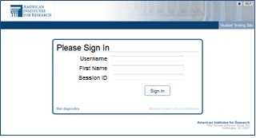
FSA Secure Browser Student Login
After opening the FSA secure browser, students will use the information from their Test Ticket to login.
Students will be shown a screen to confirm their demographic information.
Students will be asked to select a test. The first time the student signs in, the arrow will be solid. When a student is resumed or signs in for Session 2, the arrow will be segmented.
A test confirmation page will appear, and students will then await approval from the TA to enter the test.
Notes:
The secure browser should be opened on each student’s computer before testing begins. Students will use the information from their Test Ticket to log in to the test. Students will be asked to confirm demographic information about themselves, and then will select a test. On day one of any FSA test, the arrow in front of the test name will be solid. On day two of any FSA Test, the arrow will be segmented and Resume will appear before the test name. A test confirmation page will appear, and students will then await approval from the TA to enter the test.
10, 6, or 4 tickets can be printed per page – you will need to cut out tickets.

Slide 50
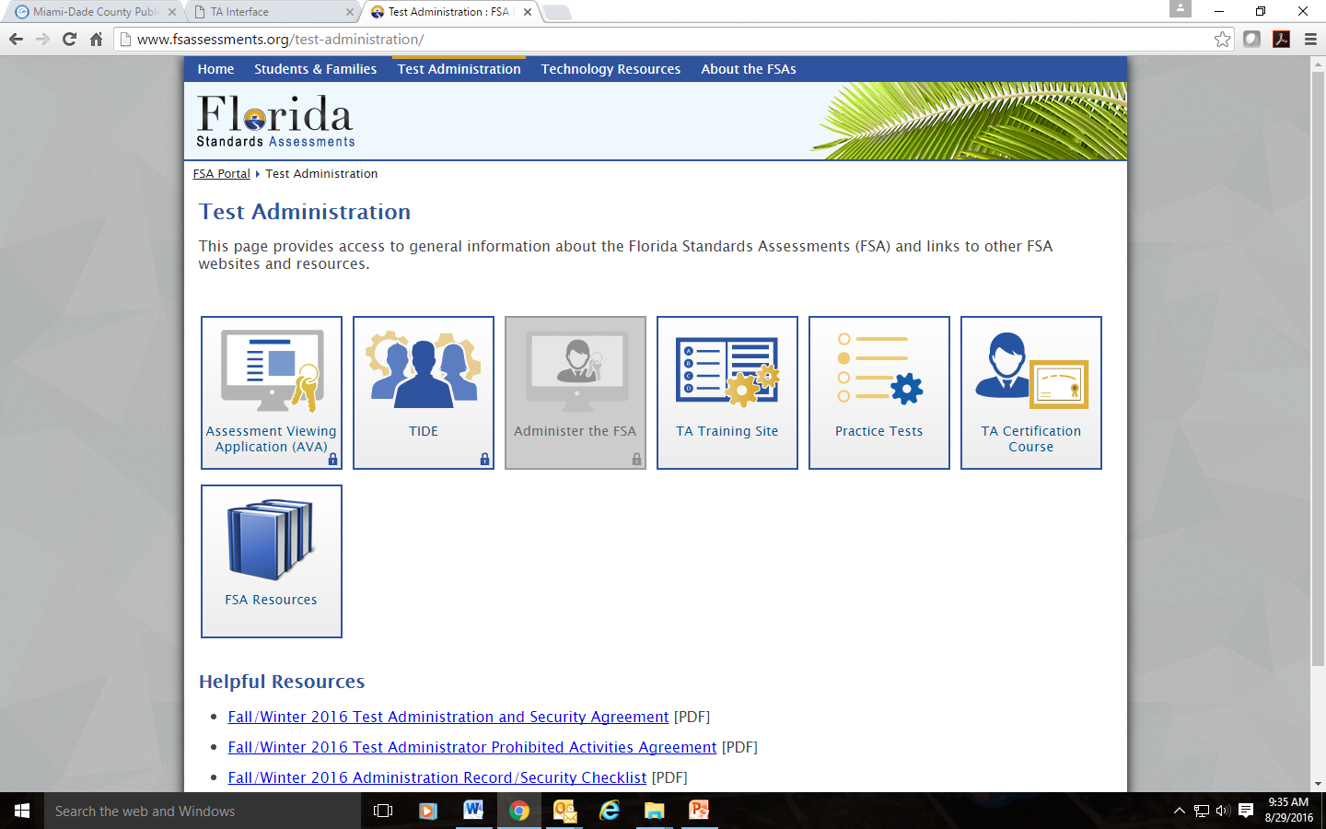
FSA Accessing the Test Administrator Interface
The Test Administrator Interface (TA Interface) is accessed from the FSA Portal:
Go to the portal at www.FSAssessments.org/
Select Administer the FSA or Test Administration Card
Sign in using your Username and Password
Notes:
TA will use your FSA common login to access the Test Administrator Interface (TA Interface) or Training Site.
To access the TA Interface, go to the FSA portal and select the appropriate user card. On that page you will find access to two Test Administrator systems: the Training Tests and the Operational TA Interface (Test Administration Card).
The training site offers users the ability to practice administering a test in a non-operational environment. The TA Interface (Test Administration Card).
gives you access to live testing.

Slide 51
FSA Test Administrator Interface

Slide 52
FSA Approving Students for a Test Session
The right side of the top panel contains the [Approvals] button, which alerts TAs that students are awaiting approval to enter a test and displays the number of pending approvals.
The Approvals notification updates regularly, but you can also click in the upper-right corner to update it manually.
Note: Students who log in to your session AFTER you have already opened the Approvals and Student Test Settings screen will not automatically appear in this list. To update the list of students awaiting approval, click the [Refresh] button in the top row of the Approvals and Student Test Settings screen.
Notes:
The right side of the top panel contains the [Approvals] button, which alerts TAs that students are awaiting approval to enter a test and displays the number of pending approvals.
The Approvals notification updates regularly, but you can also click refresh in the upper-right corner to update it manually.
Note: Students who log in to your session after you have already opened the Approvals and Student Test Settings screen will not automatically appear in this list. To update the list of students awaiting approval, click the [Refresh] button in the top row of the Approvals and Student Test Settings screen.

Slide 53
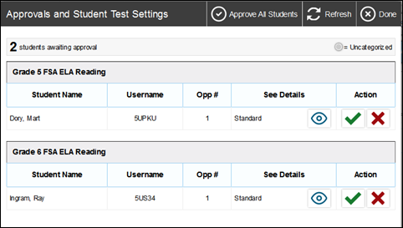
FSA Approving Students to Test
Click Approvals. The Approvals and Student Test Settings screen appears, displaying a list of students grouped by test.
The Approvals and Student Test Settings screen displays each student who is awaiting approval for entry into your session. By default, this screen shows those students who were awaiting approval when you clicked the [Approvals] button.
Students on this screen are organized by test subject. Each row displays the student’s name, Username, opportunity number for the selected test, whether the test settings are standard or custom, and the option to approve or deny each student.
Note: To check a student’s test settings and accommodations, click for that student. A sample student information appears on the next slide.
Notes:
When you click Approvals, the Approvals and Student Test Settings screen opens and displays each student who is awaiting approval for entry into your session. You will see each student’s name, ID number, whether the test settings are standard or custom, and the option to approve or deny each student.
Click Approvals. The Approvals and Student Test Settings screen appears, displaying a list of students grouped by test.
Students with standard test settings are students whose test settings are set to default. Students with custom test settings are those who have at least one test setting that is not the default (e.g., background color or print size).
If a student’s demographic information is incorrect, then that student should not test and TA should contact you.
Students on this screen are organized by test subject. Each row displays the student’s name, Username, opportunity number for the selected test, whether the test settings are standard or custom, and the option to approve or deny each student.
Note: To check a student’s test settings and accommodations, click on the eye for that student. A sample student information appears on the next slide.

Slide 54
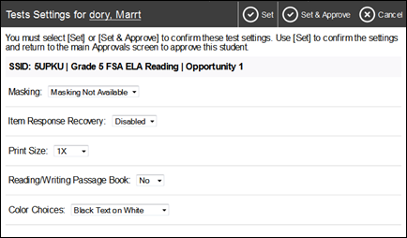
FSA Viewing a Student’s Test Accommodations
About the Test Settings column
Students with Standard test settings have the default test settings.
Students with Custom test settings have at least one test setting that is different from the default.
Warning: Check students’ test settings and accommodations before approving them.
Students who require test settings or accommodations other than the default settings may need to have their information updated in TIDE before they can begin testing.
TAs cannot adjust test accommodations via the TA Interface. Test accommodations must be updated in TIDE.
If a student’s test accommodations must be updated, deny the student’s test request and contact your School Assessment Coordinator.
Notes:
Warning: Check students’ test settings and accommodations before approving them.
Students who require test settings or accommodations other than the default settings may need to have their information updated in TIDE before they can begin testing. If a student’s settings are incorrect, please contact your School Assessment Coordinator before allowing the student to test.
TAs cannot adjust test accommodations via the TA Interface. Test accommodations must be updated in TIDE. If a student’s test accommodations must be updated, deny the student’s test request and contact your School Assessment Coordinator.
Appendix B. Student Test Settings and Accommodations provides an overview of the test settings and accommodations that appear in the TA Interface.

Slide 55
FSA Approving Students to Test
After you have confirmed students’ accommodations, you may return to the list of students awaiting approval. On this screen, you can approve individual students or approve all students awaiting approval at once. After the students have been approved or denied, the Approvals and Student Test Settings screen will automatically close.
To approve individual students, click the [ ] button for each student. The student will be approved and will also disappear from the list.
To approve all students currently displayed in the list, click the [Approve All Students] button at the top right. This will approve those students for testing.
Note: You may approve all students who appear in the list. However, students who log in to the test session after you have opened the Approvals and Student Test Settings screen will still need to be approved individually.
Notes:
After you have confirmed students’ accommodations, you may return to the list of students awaiting approval. On this screen, you can approve individual students or approve all students awaiting approval at once. After the students have been approved or denied, the Approvals and Student Test Settings screen will automatically close.
Note: You may approve all students who appear in the list. However, students who log in to the test session after you have opened the Approvals and Student Test Settings screen will still need to be approved individually.
After students have logged in and you have approved them to begin testing, the Students in Your Test Session table will display each student logged in to your session and their testing progress.

Slide 56
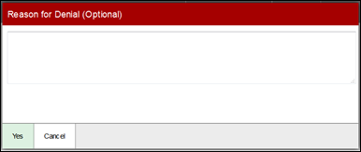
FSA Denying Students to Test
Although TAs can approve all students at the same time, if a student needs to be denied from entering a test session, this must be done individually. TAs may deny students for one of the following reasons:
The student is not supposed to enter the session (e.g., the student does not belong to the TA or the student is not assigned to take the correct test).
The student selected the wrong test.
The student’s test settings or accommodations are incorrect.
On the Approvals and Student Test Settings screen, click for that student.
In the pop-up screen that appears, enter a brief reason for denying the student and click [Yes].
The student will receive a message explaining the reason he or she was denied entry into the session. The student will then be logged out and directed to the login page. Contact your school assessment coordinator for instructions.
Notes:
Although TAs can approve all students at the same time, if a student needs to be denied from entering a test session, this must be done individually. TAs may deny students for one of the following reasons:
The student is not supposed to enter the session (e.g., the student does not belong to the TA or the student is not assigned to take the correct test).
The student selected the wrong test.
The student’s test settings or accommodations are incorrect.

Slide 57
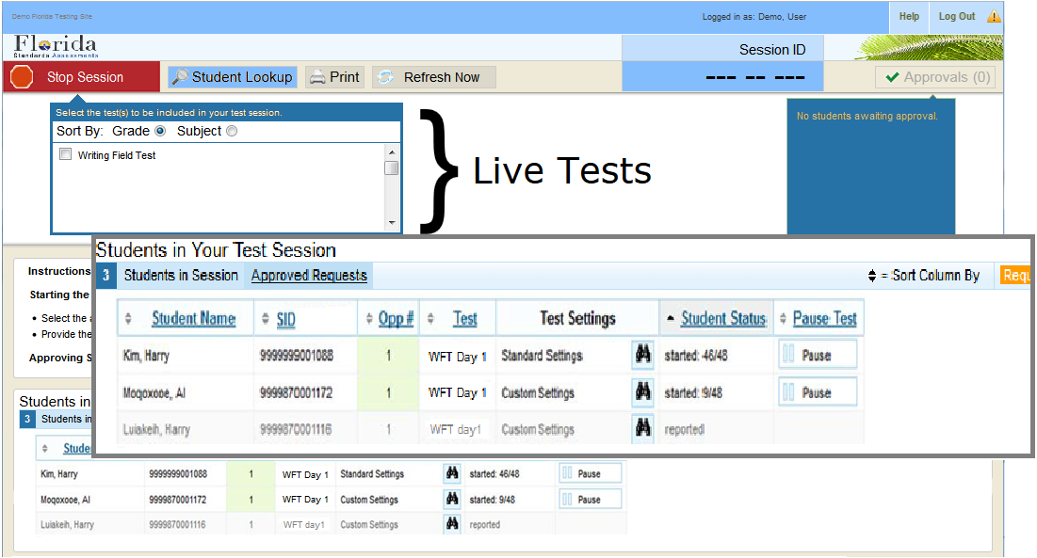
FSA Monitoring Student Progress
After students have logged in and the Test Administrator has approved them to begin testing, the test session table at the bottom of the screen will display each student currently logged in to the session.
Notes:
After students have logged in and the Test Administrator has approved them to begin testing, the Students in Your Test Session table will display each student currently logged in to the session.
For each student you will see, their name, SID, the name of the test they are taking (for example FSA Algebra 1 EOC), and if they have standard or custom test settings. The binoculars icon displayed in this column is clickable. Click the icon for a student to view his or her test settings.
Also included in the TA interface table is a column that lists each Students Status in the test session. Statuses can range from Approved (student was approved but has not started) to Submitted (test was submitted for quality assurance) other statuses include: Started (#/# Items answered/total number of items), Review (student answered all items and is currently in review screen), Segment Entry (student is requesting entry into the next session), Completed (Student submitted the test) and are used by the TA to help keep track of student testing; Denied Paused, Pending Suspended are other statuses. In the last column you will find the Pause Test button which will stop a student’s test and log him or her out.
Please note that if a student’s row is grayed out, this indicates that the student is not actively testing. This occurs when the student’s test is paused or the student has completed the test.
For more detailed information about the columns in the table or statuses, please see the Test Administrator User Guide.

Slide 58
FSA Exiting or Logging Out
In the case of an unintentional exit from the TA Site caused by a system or computer error (such as the web browser crashing or closing), a network or communication error, power loss, or other event, the 90-minute rule applies.
If you accidentally close the browser while students are still testing, your session will remain open until it times out. You can open the browser and navigate back to the TA Site. You will be prompted to enter your active Session ID.
Warning: You must remember or write down your active Session ID. If you do not remember your Session ID, you will not be able to enter your active session, and you will need to contact the Help Desk for assistance.
If you unintentionally log out of a TA Site while students are still testing, your session will be stopped, all in-progress tests will be paused, and the students will be logged out. You cannot resume the original session. You will need to log back in, start a new session, and provide the new Session ID to students who need to log back in and resume testing.
Notes:
In the case of an unintentional exit from the TA Site caused by a system or computer error (such as the web browser crashing or closing), a network or communication error, power loss, or other event, the 90-minute rule applies.
If you accidentally close the browser while students are still testing, your session will remain open until it times out. You can open the browser and navigate back to the TA Site. You will be prompted to enter your active Session ID.
You must remember or write down your active Session ID. If you do not remember your Session ID, you will not be able to enter your active session, and you will need to contact the Help Desk for assistance.
If you unintentionally log out of a TA Site while students are still testing, your session will be stopped, all in-progress tests will be paused, and the students will be logged out. You cannot resume the original session. You will need to log back in, start a new session, and provide the new Session ID to students who need to log back in and resume testing.

Slide 59
FSA Timing Out
As a security measure, Test Administrators are automatically logged out after 90 minutes of user inactivity and student inactivity in a test session. This will result in closure of the test session. Note:
If a Test Administrator is logged out due to inactivity, the Test Administrator has to create a NEW test session and provide another Session ID to allow students to log back into the test.
The Test Administrator should set up the session no earlier than 90 minutes before students begin to test.
Test Administrators will not be logged out as long as students are actively testing.
Notes:
As a security measure, Test Administrators are automatically logged out after 90 minutes of user inactivity and student inactivity in the session. Therefore Test Administrators should set up the session no sooner than 90 minutes before students begin to test. Test Administrators will not be logged out as long as students are actively testing; TAs are free to monitor the room without being logged out as long as students are still taking the test.

Slide 60
FSA Stopping the Test Session
Although students’ tests can be resumed, test sessions cannot be resumed. Stopping a session will end the session and automatically pause all active students’ tests in that session. The students will be logged out automatically.
To stop the test session:
Click in the upper right corner of the screen. An “Important!” box will appear, requesting verification to end the session and log students out.
Click [OK] to continue. The test session will be closed.
Alert: Because test sessions cannot be resumed, you will need to create a new session if your session has been stopped and there are students who need to complete their test. When you start a new session, give the new Session ID to your students so that they can log in and resume testing.
Notes:
Although students’ tests can be resumed, test sessions cannot be resumed. Stopping a session will end the session and automatically pause all active students’ tests in that session. The students will be logged out automatically.
To stop the test session:
Click in the upper right corner of the screen. An “Important!” box will appear, requesting verification to end the session and log students out.
Click [OK] to continue. The test session will be closed.
Alert: Because test sessions cannot be resumed, you will need to create a new session if your session has been stopped and there are students who need to complete their test. When you start a new session, give the new Session ID to your students so that they can log in and resume testing.
Detailed steps of ending each session can be found in the TIDE User Guide or the TIDE Quick Guide.

Slide 61
FSA Ending a Test Session
Ending Session 1/Day 1 of Testing:
After students finish responding in Session 1 and have reviewed their answers, students will click END SESSION on the Review screen and then selecting “Yes” on the pop-up message.
After all students are finished testing or after the test session is ended, Test Administrators will click the STOP button. An “Important!” box will appear, requesting verification to end the session and log students out. Click “OK” to continue. The test session will be closed.
Ending Session 2/Day 2 of Testing:
*Note on Session 2/Day 2 TAs will create a new test session, system will generate a new session ID, and students will log into the test. Students should select to resume the test with the segmented arrow.
After students finish responding to Session 2, students will click END TEST. They will review their responses and then click Submit Test.
After all students are finished testing or after the test session is ended, Test Administrators will click the STOP button.
Notes:
For two session tests administered over days, students should not be allowed to move to the second session on day 1.
After students have finished responding to session 1 on day 1, they will review their response and click PAUSE. After all students are finished testing or the test session has ended, Test Administrators will click the Stop Session button.
On day two, TAs will create a new test session and a new session ID number will be generated. TAs will NOT need to approve students to test for session 2. When students have finished responding to session 2, students will click End Test. They will then review their response and click Submit Test. After all students have finished testing or the test session has ended, Test Administrators will click the Stop Session button.
Detailed steps of ending each session can be found in the TIDE User Guide or the TIDE Quick Guide.

Slide 62
FSA Using Participation Report
Common examples of Participation Report cases:
Which students have not yet tested?
Which students have started but not yet completed their test?
Which students have paused tests?
Did every student in a test session (Session ID or TA Name complete their test)?
Which students have not completed?
Which student have completed?
Notes:
Here are examples of queries you can use to search for students.
Which students have not yet tested?
Which students have started but not yet completed their test?
Which students have paused tests? Means exit.
Did every student in a test session (Session ID or TA Name complete their test?
Which students have not completed?
Which student have completed?
You can export the reports.

Slide 63
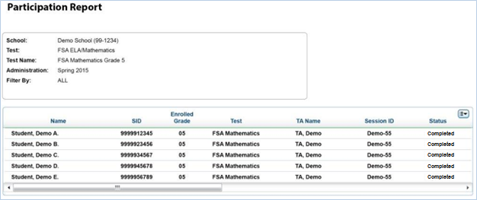
FSA Participation Report Results
Example of a Participation Report. These reports can be used to keep track of Test Participation.
Notes:
Once the user has made the appropriate selections and clicked the Generate Report button, the output table will display results. This Participation Report output example shows the list of students who have completed grade 5 math.
With these results, school personnel can track participation in their school.
Note that participation reports automatically take student test enrollment into account. The reports will only return results for students who were enrolled for the selected test.
Also note the unique Results ID for students is accessible from the ORS Participation Reports only.

Slide 64
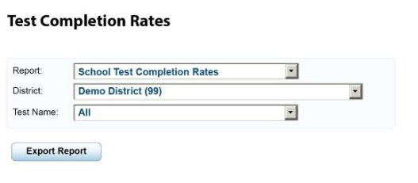
FSA Test Completion Rates
The Test Completion Rates screen offers a high-level view of how many students have started and completed tests.
Notes:
Test Completion Rates provide a high-level view of how many students have started and completed all possible tests by school. Choose information from the drop-down menus and click Export Report.
To see which individual students have or have not completed a given test in a school, the user can view the reports in Participation Report.

Slide 65
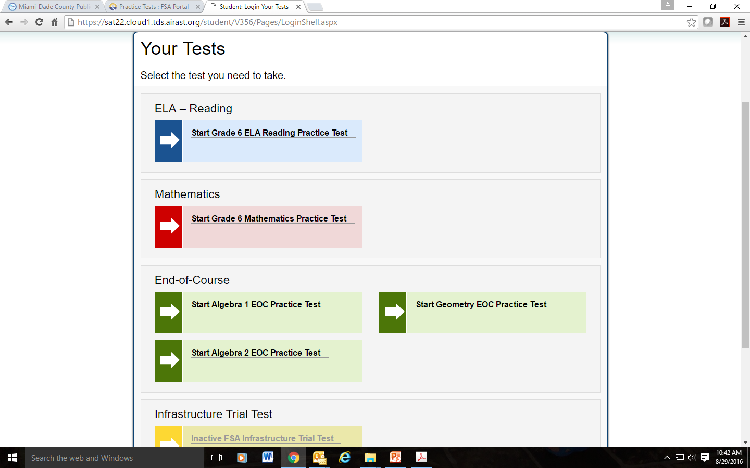
FSA Training Tests
FSA Practice Tests (CBT) are intended to provide students, parents, and educators with an opportunity to become familiar with the item types and functionality of the new computer-based (CBT) platform produced by AIR.
Sample items for different grade levels and subject areas are available for the following:
Grades 3-10 FSA ELA (Reading, Language, and Listening)
Grades 8-10 FSA ELA Writing Component (CBT)
Grades 3-8 FSA Mathematics
FSA EOC (Algebra 1, Geometry, Algebra 2)
The ratio/percentage of items of each item type in the practice tests is NOT representative of the ratio/percentage of items of each that will appear in the operational tests.
See the Practice Tests Quick Guide and Answer Keys posted on the FSA Portal.
Notes:
There are practice tests called FSA Training Tests that are available for all (students, parents, educators, and the general public) to access. No download is required. No username or password is required. These tests are accessed from the online FSA portal at www.fsassessments.org.
The Training Tests are intended to provide opportunities to become familiar with the item types and functionality of the CBT platform.
Sample items for each EOC assessment is available. In addition, sample items for the ELA, Writing, and Math are currently available for grade bands and by subject areas. However, in late fall, the FLDOE will rollout the training tests by each specific grade level and subject area. There will also be a new look applied to the training tests. For example, the background color will be changed.
Please note the following :
The platform allows users to select features such as color contrast/print size, zoom, and audio that were previously only available as an accommodation for students with disabilities. This will allow the students to play with the different types of features and determine before the first day of testing, if they want to use a different color contrast or print size.
Assessments for students in Grade 3 ELA and Grades 3 and 4 Math will be paper-based in 2015-16, however sample tests are provided for these grades as well which illustrate the types of items that will be available once each assessment moves to online.
The ratio/percentage of items of each item type in the training tests is NOT representative of the ratio/percentage of items of each that will appear in the operational tests.

Slide 66
Other Resources for FSA Test Administrations
TDS Quick Guide
TIDE Quick Guide
TIDE User Guide
TIDE Online Training Module
Test Administrator Interface & Student Interface Presentation
Test Administrator User Guide
TA Certification Course
Practice Tests User Guide
Practice Tests Quick Guide
AVA User Guide
FSA Reporting System User Guide
Test Administration Manuals
FSA Infrastructure Trial Guide
Common Online Testing IDs and Descriptions
System Requirements for Online Testing
Accessing Listening Items on FSA ELA Reading Paper-Based Practice Tests
Assessment Accommodations FAQ (Updated Spring 2016)
FSA ELA Reading Instructions for Oral Presentation Accommodations
Notes:
Other resources to help with the administrations of the FSA Tests are posted on the FSA Portal. Please check the FSA portal frequently for up-to-date information. To receive updates on newly posted resources to the portal, please register for email alerts.
The following resources are now available:
TIDE User Guide
Tide Online Training Module
Training Module for school and district assessment coordinator tasks completed in the Test Information Distribution Engine (TIDE).
Common Online Testing IDs and Descriptions
ORS Participation Reports Quick Guide
FSA Infrastructure Trial Guide
Test Administration Manuals
System Requirements for Online Testing
2015-2016 FSA Paper-Based Materials Return Instructions
Secure Browser and TA Interface Demonstration Webinar
Test Administrator User Guide
TA Certification Course and TA Certification Course Additional Information
This course will demonstrate the process of logging in to the Test Administrator Interface and administering an online assessment. The course also demonstrates the Student Log In process on one of AIR’s Universal Testing Systems. Prior to taking the TA Certification course, please read the TA Certification Course Additional Information document by clicking on the icon above. This document covers policy, procedures, and functionality specific to the Florida Standards Assessments.

Slide 67
FSA Contact Information
FSA Portal: | www.FSAssessments.org
Email: | fsahelpdesk@air.org
Toll-Free Phone: | 1-866-815-7246
Hours: | 7:30 a.m.–8:00 p.m. (ET) Monday–Friday (except holidays)
Notes:
More detailed information on TIDE and the Test Delivery System can be found in the User and Quick Guides posted to the FSA portal. If you need additional assistance, please contact the AIR Help Desk.
Hours: 7:30 a.m.–8:00 p.m. (ET) Monday–Friday (except holidays)

Slide 68
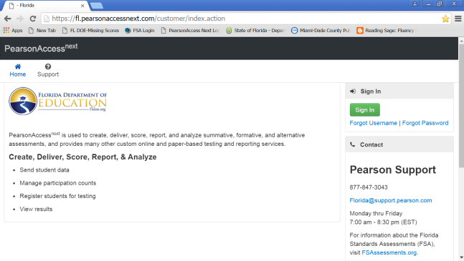
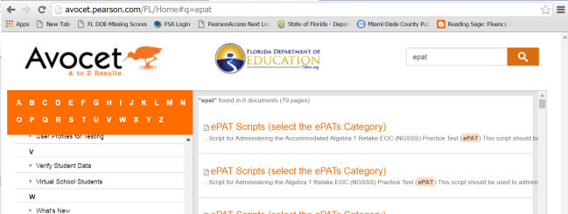
NGSSS PearsonAccess: Blue Site
Website: www.fl.pearsonaccessnext.com/fl
A website used for almost all test preparation (e.g., PreID), setup, administration, and reporting tasks.
Requires a username and password.
Verify that you are working in the correct test administration each time you log in.
Link to support materials via Avocet is available at http://avocet.pearson.com/FL/Home.
PearsonAccess will timeout after 14 minutes of inactivity.
Notes:
This is the vendor’s website for NGSSS EOC and FCAT 2.0 assessments. School assessment coordinators will need an account in Pearson to complete all test preparation activities, including managing student information, adding new students, creating new test sessions for testing, and placing students into test sessions. This is also the website where you get your Security Checklists for paper tests, and where test results are posted. You have to ensure that you click on the correct administration when logging into the site.
Principals have an account with PearsonAccess but only to view and download test results.

Slide 69
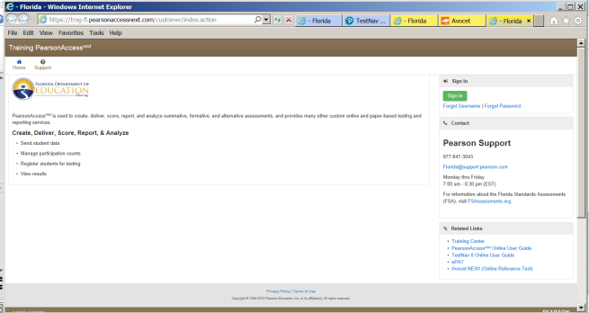
NGSSS PearsonAccess: Training Center: Brown Site
Website:
Accessed from the Training Center link on PearsonAccess Next Home page.
Provides an opportunity to
Practice PearsonAccess tasks.
Manage the Infrastructure Trial in preparation for testing.
Requires a username and password.
Notes:
The training center is found in PearsonAccess under the Training Center tab. You also need an account to have access to this site. This is the site where you manage the Infrastructure Trial and practice PearsonAccess tasks. It provides an opportunity to practice PearsonAccess tasks without jeopardizing student data or test administration. The username will have a –TC at the end to identify the login to this site.

Slide 70
NGSSS PearsonAccess: Create/Update School User Accounts
School user accounts are necessary to complete the CBT test activities.
DAC creates accounts for School Assessment Coordinators (CBT Coordinator) for each Pearson site (operational and training center).
Create or reset your password for each Pearson site (operational and training center).
Test administrators may monitor and resume students with a (TA) school user account.
(OPTIONAL) SAC creates school user (TA) accounts for test administrators in Pearson’s operational site
Individual accounts for each test administrator.
Test administrator will set up unique password.
Notes:
School user accounts are necessary to complete computer-based test activities in PearsonAccess. There are three types of school user accounts
--First, the School Administrator account provides access to FCAT and EOC test results but does not allow access to complete any CBT test activities. Principals have this type of account and sometimes the test chairperson has it, if the principal gives permission for RESULTS access.
--Second, is the CBT Coordinator account which is assigned to test chairpersons; it provides access to all the CBT test administration activities but does not have access to test results.
--The third type of account is the Test Administrator account, this type of account is used by the Test Administrator to monitor student statuses and to RESUME students in PearsonAccess during the test administration. FOR EXAMPLE, if a student is kicked out of the test or exits the test for lunch, the student must be resumed in PearsonAccess before the student can log back in. See the back of the training packet for a description of each school user account role.
Keep in mind that you are not required to set up test administrator accounts – if you don’t set up TA accounts, then you will be the ONLY person with access to resume students OR you may just create one TA account for one helper that can sit by the computer to monitor or resume students. – if you decide to set up Test Administrator accounts, instructions are provided in the back of the training packet to set up accounts individually or upload a group of accounts. If you decide to create accounts for TA, then there must be a proctor in the room during testing so that while the TA is monitoring students or resuming students on the computer, the 2nd person can be walking around the room and keeping their eyes on students.

Slide 71
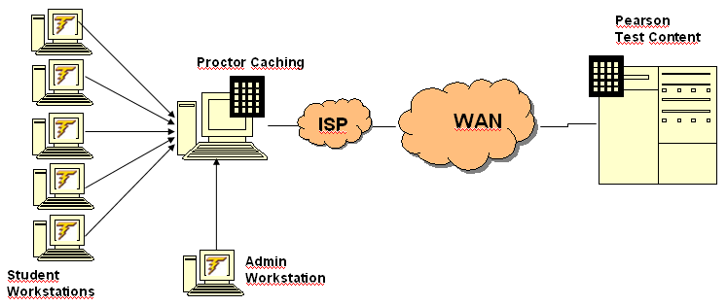
NGSSS PearsonAccess: Proctor Caching
Proctor Caching is a process of loading or “caching” test content locally on a computer at the school level.
Does not require a separate caching server and can run on any workstation on the network that meets minimum requirements.
Proctor Caching software is provided by Pearson.
New software update highly recommended to download for faster caching (see weekly briefing #19797).
Reduces test delays due to network congestion.
Provides students with a more seamless testing experience.
Required for all NGSSS (FCAT 2.0 and EOC) computer-based testing in Florida.
Notes:
Proctor caching is very important and mandatory for CBT testing via Pearson. Proctor Caching is a process of loading or “caching” test content locally on a computer at the school level; therefore, it reduces test delays due to network congestion. As you can see in this diagram, the workstations must be pointing to the proctor cache computer to get test content and then the proctor cache computer communicates with Pearson. If there is an interruption in internet service, students can continue testing as long as there are two save locations where the student’s responses can be saved. When the internet is restored, student responses are uploaded and sent to the Pearson server.
It is recommended that there be a proctor cache computer for every lab. This computer must be on and running during testing. In addition, the proctor cache computer cannot be used by students or test administrators during testing.

Slide 72
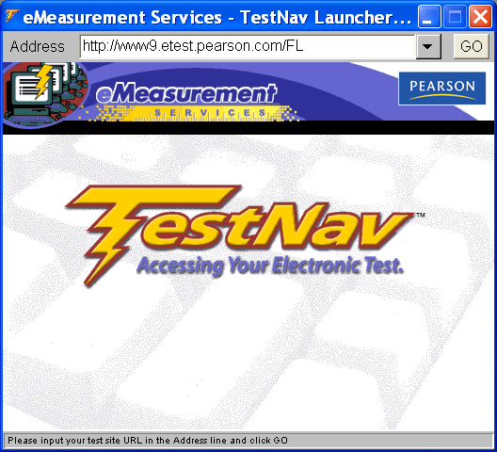
NGSSS PearsonAccess: Testing Platform
TestNav 8
Is used for CBT NGSSS assessments, including FCAT 2.0 Reading Retake, and Algebra 1 Retake, Biology 1, Civics, and US History EOC administrations only.
Web-based platform - only Proctor Cache software application needs to be installed.
Optional TestNav app available for download – eliminates JAVA issues.
-- The updated TestNav app is available at: http://download.testnav.com/.
-- See Briefing# 19797
Integrates accommodated forms (text-to-speech and masking) for eligible students, based on an IEP or Section 504 Plan.
Note: This is the URL (case-sensitive) used for testing this Fall; it is different from the URL used for the Infrastructure Trial.
Notes:
Beginning in the Winter 2014 EOC administration and beyond, FLDOE upgraded the computer-based testing for the NGSSS assessments to TestNav 8 platform. This is a browser based platform that has integrated test accommodations and runs on tablets as well as desktops/laptops. Only proctor cache software will need to be installed – may be installed on a file server on the computer or computers used as the proctor cache machine. Practice tests are be provided for students and teachers as soon as they are available.

Slide 73
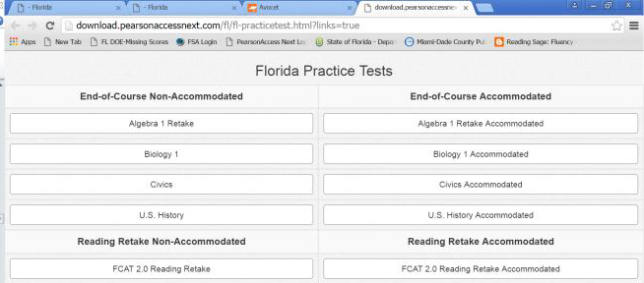
NGSSS PearsonAccess: ePAT
Electronic Practice Assessment Tool (ePAT)
Provides students an opportunity to practice using the computer-based platform prior to testing.
ePATs are available from the www.fl.pearsonaccessnext.com home page
Accommodated ePATs are also available.
Scripts and instructions for administering the ePATs are posted in Avocet, accessible from the home page.
Notes:
The ePAT practice test is intended to familiarize students with the platform and item types, but the sample items are not intended to indicate the rigor or complexity of the actual test items.
Students can access the ePATs directly from www.FLAssessments.com/ePATs link. No installation is required.
Students also should be provided with the ePAT link so that they may practice at home. Note that students practicing at home does not replace the school mandated practice. Students must participate in a practice session at the school and the test script found in PearsonAccess must be read by the teacher.
ePAT accommodated forms are also available. Note that ESE students testing using the accommodated forms must use the ePAT accommodated form to practice.
It is recommended that test administrators ALSO use the ePAT to become familiar with the available tools prior to administering a practice test and prior to the operational test.

Slide 74
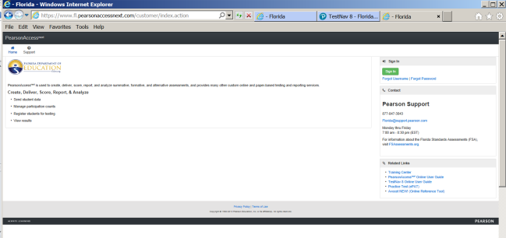
NGSSS PearsonAccess: CBT Resources
The TestNav 8 Online User Guide, provides guidelines to prepare before testing and to help resolve CBT issues during testing, available from the Pearson home page, select the TestNav 8 Online User Guide link.
TestNav 8 Technology Coordinator Resource Website (www.FLAssessments.com/TestNav8) provides resources and training materials for school technology coordinators.
Avocet NEW! (Online Reference Tool) provides links to support materials.
Resources for CBT, including information about test setup, best practices, and training modules and other resources are available from the home page at www.fl.PearsonAccessnext.com, select PearsonAccessNext Online User Guide link or
Notes:
PearsonAccess CBT training materials and resources are available at the website listed on this slide.

Slide 75
NGSSS
(FCAT 2.0 & EOCs)
Pearson CBT Materials
Needed, as applicable:
Notes:
The next few slides will cover materials needed for FCAT 2.0 and NGSSS:

Slide 76
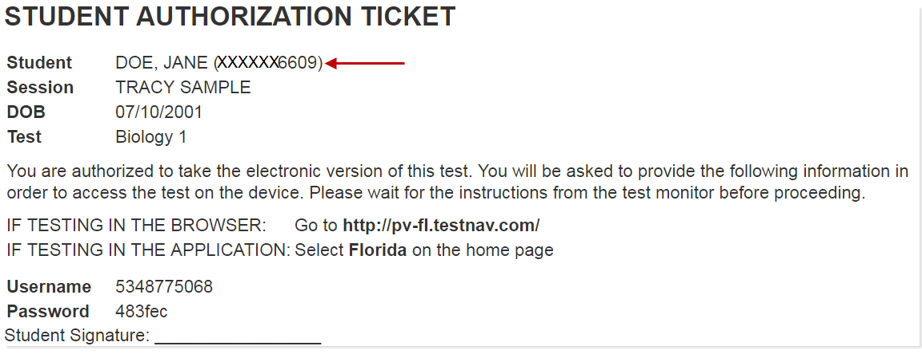
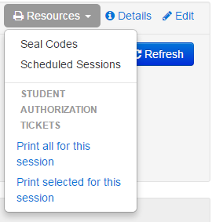
NGSSS PearsonAccess: Student Authorization Tickets
For each test session, each student needs a Username and a password, which are printed on the Student Authorization Tickets.
Students will need a pen or pencil during testing to sign their tickets.
Provide each student their ticket only AFTER all students have entered the testing room, as instructed in the script, and all tickets must be collected BEFORE students leave the testing room.
Student Authorization Tickets must be handled in a secure manner and returned to the school assessment coordinator immediately after each day of testing is completed.
Keep Student Authorization Tickets securely stored at all times.
Notes:
The student authorization ticket is generated by PearsonAccess for every student placed in a test session (think of it as a PreID label). It can only be used by the student listed on the ticket. This is a secure document and must be kept in locked storage until the first day of testing.
Each student is assigned a Username and a password for each test session. Username and passwords are printed on the Student Authorization Tickets. The tickets will include the student’s name, FL ID #, and DOB for verification purposes. The tickets also include a URL for access to the test. (students must enter the URL exactly as noted on the ticket to prevent getting an error message) or students can launch the TestNav8 icon to access the test.
Students will need a pen or pencil during testing to sign their tickets.
The test administrator will give each student a ticket only AFTER all students have entered the testing room, and all tickets must be collected BEFORE students leave the testing room.
Student Authorization Tickets must be handled in a secure manner and returned to the school assessment coordinator immediately after each test session is completed.
Report any missing tickets to Student Assessment immediately.
The authorization tickets can be downloaded and printed in 4 different formats: Detail Views , List View and Grid View.
a. Detail View only shows one authorization ticket per page and Detail View 4 per page (2-row/two column) layout.
b. List View displays tickets separated horizontally.
c. Grid View shows eight authorization tickets per page in a four row/two column
layout.
It is strongly recommended that you select one format and use it consistently at your schools so that students and test administrators are familiar with the ticket. Note that if you choose to print list view or grid view, you will have to cut out the tickets and ensure that you don’t cut off any important information like the Test Code on the bottom.

Slide 77
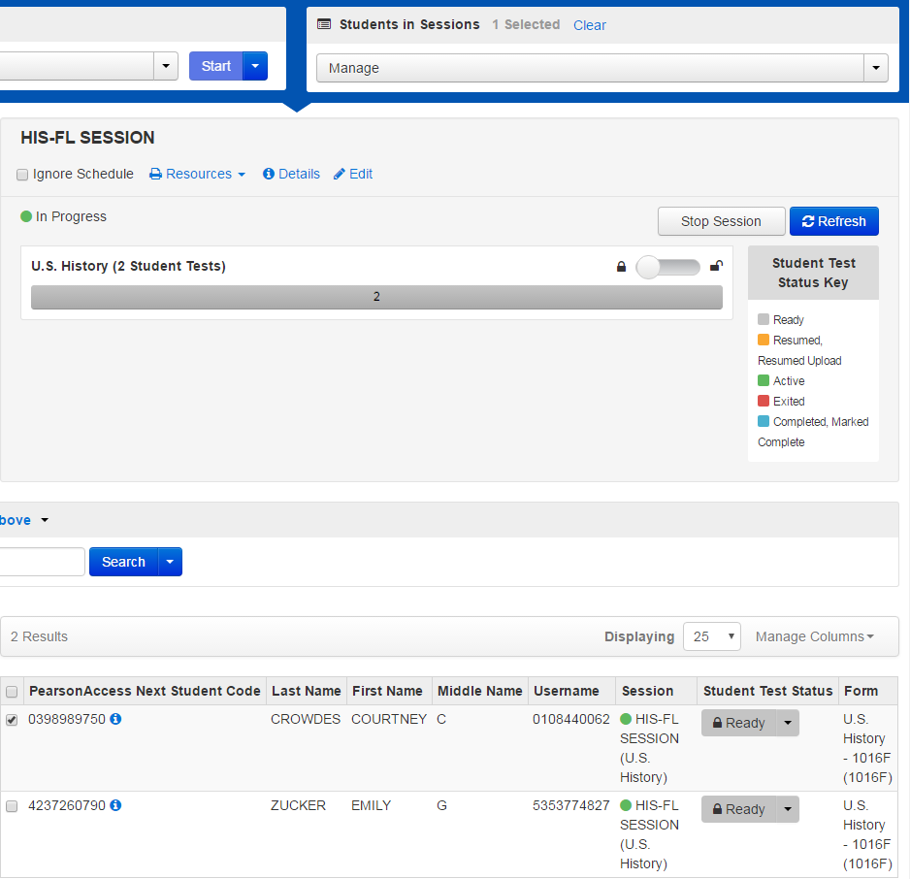
NGSSS PearsonAccess: Student Authorization Tickets
Added the ability to print/reprint selected tickets within a session
Only 1 student test selected to print the authorization ticket
2 student tests in this session
Notes:
Pearson is continuing to work on developing an easier process for identifying and printing authorization tickets.

Slide 78
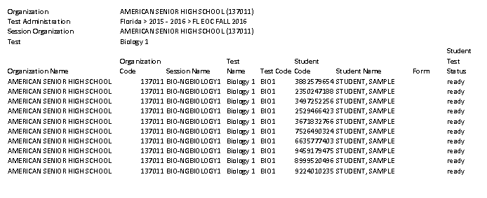
NGSSS PearsonAccess: Session Roster
A Session Roster is a list of all students scheduled in a test session that displays important information including:
Test Administration
Session Name and School
Test to be Administered
Password
Student Name
Florida Student ID #
Student Date of Birth
Class Information
Test Form/Form Group Type
Usernames
Blank space to record attendance information and accommodations used
The Session Roster may be used to record required administration information.
Session Rosters must be handled in a secure manner and returned to the school assessment coordinator immediately after each test session is completed.
Notes:
A Session Roster is generated by PearsonAccess when a test session is created. It will need to be printed out after each test session created. This is a secure document and must be kept in locked storage until the first day of testing. It provides a list of the students to test in the same session. This roster may be used to collect the required administration information.
The top portion includes the test administration, session name, school name, the test scheduled to be administered to a group of students, and the password which is the same for every student in the room. Student names, Student ID#, DOB, Class information, Test form/Form Group type, and usernames.
The scheduled date and time as well as the location is found on the top right. Column for attendance and accommodations provided and accommodations used are also provided . Note: Test administrators should write the test group code assigned by you anywhere on this roster.
ALL Session Rosters are secure and MUST BE RETURNED AT THE CONCLUSION OF TESTING.

Slide 79
NGSSS PearsonAccess: Test Group Code
Test Group Code
A unique four-digit number created by school assessment coordinators used to identify groups of students tested together. The test group code is entered after the Welcome screen and Testing Rules Acknowledgment and before students see the first question.
Notes:
Test Group Code-A unique four-digit number used to identify groups of students tested together in the same testing room.
It is created by school assessment coordinators.
The test group code is used for (CBT and PBT) NGSSS tests and for the FSA PBTs.
For PBT, students grid the test group code in the back of the test/answer book. For CBT, the test group code is entered before beginning the test, as told to do so on the script.

Slide 80
NGSSS PearsonAccess: CBT Work Folders
The Florida Computer-Based Testing Work Folder is a blank piece of yellow 11x17 paper folded in half with grid paper on the back page.
For the NGSSS Algebra 1 Retake and Biology 1 CBT test sessions, students are provided with work folders to work the problems.
Distribute work folders to students at the beginning of each test session.
Ensure that students have enough desk space to use their folders.
Once students complete the test, collect all work folders and return them to the school assessment coordinator.
Used work folders are secure materials.
Notes:
The Florida Computer-Based Testing Work Folder is a blank piece of yellow 11x17 paper folded in half with grid paper on the back page. You will receive a Work Folder for each student taking a computer-based assessment NGSSS Algebra 1 Retake and Biology 1 EOC assessments.) Sample is also posted on PearsonAccess.
One work folder per person should be sufficient for each student per session; however, students may request additional folders. Distribute these folders as indicated in the script. School assessment coordinators and test administrators must ensure that students have enough desk space to use their folders.
Work Folders are not provided for practice tests so students should bring their own scratch paper.
Once students complete the test, the test administrator must collect all Work Folders. Used folders are secure materials. The school assessment coordinator should return the used and unused Work Folders in the District Assessment Coordinator Box.

Slide 81
NGSSS PearsonAccess: CBT Worksheets
The CBT Worksheet is an 8 1/2x11 page (located in PearsonAccess) that may be copied and distributed to students at the beginning of a test session.
(Optional) For the NGSSS FCAT 2.0 Reading Retake, Civics, and US History EOC CBT test sessions, students may be provided with worksheets to take notes.
If your school is providing hard copies of the CBT Worksheet, a sufficient number of copies should be available for all students taking the assessment.
Students must have enough desk space to use their worksheets.
Once students complete a test session, collect all worksheets and return them to the school assessment coordinator.
Used worksheets are secure materials.
Notes:
The CBT Worksheet is an 8 1/2x11 page (located in the manuals and in PearsonAccess) that may be copied and distributed to students at the beginning of each test session. This may be provided for the NGSSS FCAT 2.0 Reading Retake, and Civics and US History EOC CBT sessions. You will not receive hard copies like the CBT Work Folders. It’s optional for schools to make copies; however, if you make copies you must provide it to all students in your school.
School assessment coordinators and test administrators must ensure that students have enough desk space to use their worksheets.
Worksheets are not provided for practice tests.
Once students complete the test each day, the test administrator must collect all Worksheets. Used worksheets are secure materials. The school assessment coordinator should return the used and unused worksheets in the District Assessment Coordinator Box.

Slide 82
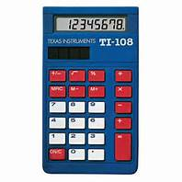
NGSSS PearsonAccess: Approved Four-Function Calculators
Four-Function Calculator
The computer-based TestNav8 NGSSS Algebra 1 and Biology 1 EOC assessments have a built-in four-function calculator.
Students may use the built-in calculator, or they may use a handheld four-function calculator.
Notes:
The computer-based NGSSS Algebra 1, and Biology 1 has a built-in, four-function calculator.
Supplied by FLDOE

Slide 83
NGSSS PearsonAccess: Seal Code
Unique four-digit number
Used on Day 2,
to access Session 2 of the FCAT 2.0 Reading Retake
Print from PearsonAccess Next
Seal codes are secure
Notes:
A seal code is a unique four-digit number used to allow students to access Session 2 of the FCAT 2.0 Reading
Retake after they have completed Session 1. Seal codes will be provided in PearsonAccess, and all students in a test session will use the same seal code. Students should NOT be given seal codes until Session 2/Day 2, when
indicated in the Session 2 administration script. Seal codes must be handled securely and must NOT be used as test group codes.

Slide 84
NGSSS
(FCAT 2.0 & EOCs)
PearsonAccess
Before Testing

Slide 85
NGSSS PearsonAccess: Organizing Test Sessions
Three ways of organizing test sessions
By Test Group – only includes students in a particular group (e.g., class, testing room) who will be testing together
2. By Test Day – includes all students in a school to be tested in a subject on a particular day
3. By Test Administration – includes all students scheduled to be tested in a subject during the entire test administration.
Notes:
Test sessions are created to schedule students to test on the computer. The district created test sessions via the PreID file for all schools. However, you can move the students out of these test sessions based on your preference for organizing the test sessions. The following are three ways to organize test sessions.
By Test Group – (this is the recommended method) - Sessions can be set up to only include students in a particular group (e.g., Mr. Smith class or by homeroom) who will be testing together. It can also be used to distinguish between students taking the regular CBT test and ESE students taking the accommodated forms. Therefore, if you have 4 labs that will be used on Monday – you would have 4 test sessions created for Monday’s testing then on Tuesday, if you are using 3 labs, you will create 3 test sessions for Tuesday’s testing, and so forth.
Advantage: PearsonAccess can be used to manage the testing groups and session rosters will include only one group of students testing together- this method increases security because the test session is opened each morning and closed at the end of the day.
Disadvantage: will require setup and management of more sessions.
By Test Day – Sessions can be set up to include all students in a school to be tested in a subject on a particular day – like all students taking the Algebra test on Monday. If you have 3 labs used for testing on Monday, you would only have one test session for Monday with students from all three labs.
Advantage: Only one session has to be started and stopped each day.
Disadvantage: it requires coordination of testing groups at the school – outside of PearsonAccess - session roster would print with all three groups of students and you would need to separate lists by group.
By Test Administration –Sessions can be set up to include all students scheduled to be tested in a subject during the entire test administration – that would mean that for the Algebra 1 EOC test, you would have only one test session for the entire testing window –you would START the test sessions on day 1 and it would remain open during the entire testing window and be STOPPED at the end of the testing window.
Advantage: limits setup and management to one session and additional make-up sessions do not need to be created
Disadvantage: test sessions are open and active during the entire testing window, which may present a security concern; greater coordination of testing groups at schools; and may be cumbersome to locate and manage specific students
This type of test session is not recommended. If a student authorization ticket gets lost, you have a great security issue at hand. Anyone that finds the ticket can log into the test.

Slide 86
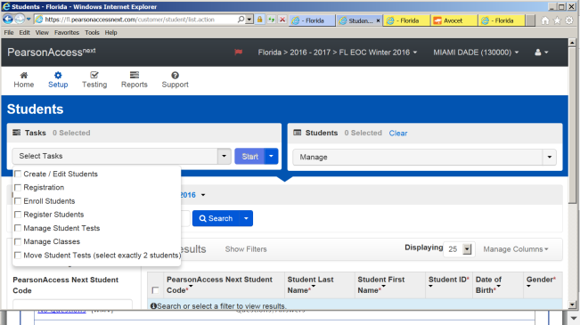
NGSSS PearsonAccess: Create/Edit Students
Setup tasks must be completed before students can test, including enrollment, registration, test assignments and class assignments.
Notes:
If you need to Add a Student because the student enrolled at your school after the PreID file–or if you had to delete a student because the student name or student FL ID was incorrect and now you need to enter the correct student profile – then you would need to complete the 5 part process to be able to create the new student –.
Note that if all five parts are not completed, the student record will not be created.
The Create / Edit Students functionality will walk you through the steps of creating, registering, assigning tests, adding classes and moving the student into a session.
Registering students through PearsonAccess^{next} requires you to complete the following steps:
Create a Student
Confirm Enrollment
Register a Student
Manage Student Tests
Manage Classes (if using classes to organize students)

Slide 87
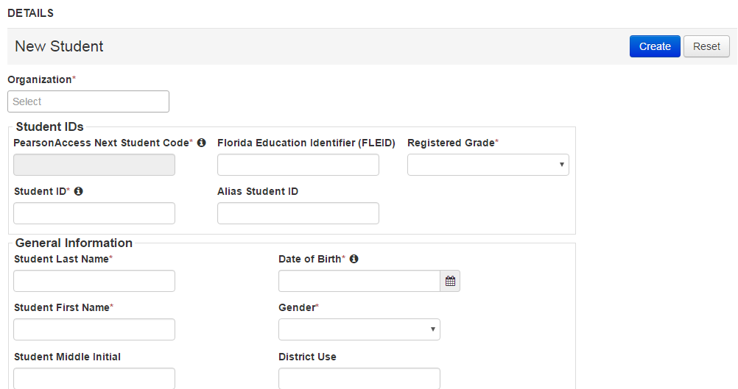
NGSSS PearsonAccess: Create/Edit Students
Notes:
There may be times when you will need to add one student without importing an entire Student Registration File. For example, if a student transfers after the PreID file has been imported. This can be accomplished through PearsonAccess^{next} . You can add students at any time, however, if test sessions have already been created be sure they get added to the appropriate session.
Access the “i” button for additional information.
FLEID field is optional for Fall. Pearson is working with development to remove or hide the Enroll Students and Register Students tabs.

Slide 88
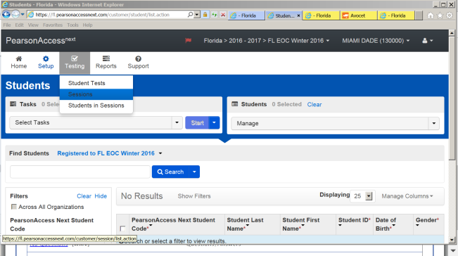
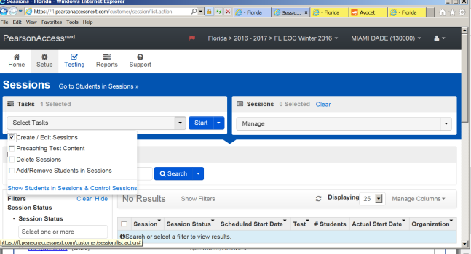
NGSSS PearsonAccess: Creating Test Sessions
Notes:
To create test sessions, go to the Testing tab and click Sessions.
From the Select Tasks pull-down menu select Create/Edit Sessions and click Start.
Sessions are automatically created during the PreID upload.

Slide 89
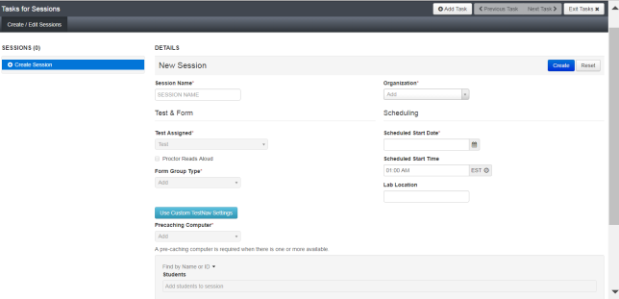
NGSSS PearsonAccess: Test Session Details
Notes:
Here is where you will enter session details such as session name and start times, and assign form group type. You will also add a precaching computer (drop down will list one or more options based on TestNav configurations). Next find and add individual students or groups of students to the test session. Click create. You can go back and edit details as needed.

Slide 90
NGSSS PearsonAccess: Assigning Accommodated Form
Set up a separate test session for each group of students who will use accommodated forms or
Set up in a non-accommodated session (MAIN) and individually assign each accommodated form(s) to each student
Select the Form type from the drop-down menu
Notes:
If you have students that are eligible to be tested with an accommodated form, then you will need assign the form type to each student. There are two ways of assigning the form type. If you have a specific form that will be used by the majority of students, you can set up the test session with that particular form like “text-to-speech”, then every student that you place in this test session will automatically have text to speech as their form type.
The second method is to set up the students in a non-accommodated test session (MAIN form type), and then individually select the accommodated form type for each student. This is recommended if you have to assign various form types or if you only have a small group of students needing an accommodated form.

Slide 91
NGSSS PearsonAccess: Add, Remove or Move
When test sessions are created in PearsonAccess^{next}, you can select tasks to add students to sessions, remove students from sessions and move students between sessions.
(cont.)
Notes:
If you have students that are eligible to be tested with an accommodated form, then you will need assign the form type to each student. There are two ways of assigning the form type. If you have a specific form that will be used by the majority of students, you can set up the test session with that particular form like “text-to-speech”, then every student that you place in this test session will automatically have text to speech as their form type.
The second method is to set up the students in a non-accommodated test session (MAIN form type), and then individually select the accommodated form type for each student. This is recommended if you have to assign various form types or if you only have a small group of students needing an accommodated form.

Slide 92
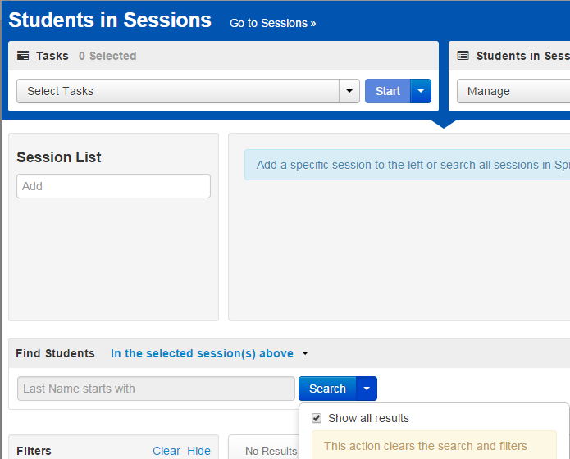
NGSSS PearsonAccess: Adding a Student to a Test Session
Notes:
From Testing > Students in Sessions, search to find the student(s) you want to add or click the down arrow next to the Search button to reveal and select the option to show all results. Select the student(s) you want to add. IF a student is not listed, then the student has already been assigned to a test session or the student has to be added in PearsonAccess Next.

Slide 93
NGSSS PearsonAccess: Adding a Student to a Session (cont.)
Notes:
Open the task list and select Add Students to Sessions and click Start
Select the session from the Session menu. You cannot add students to a Stopped session

Slide 94
NGSSS PearsonAccess: Adding a Student to a Session (cont.)
Notes:
Under Find available students (not assigned to a test session), search to find specific student(s) or click the down arrow next to the Search button to reveal and select the option to show all results. Select students to add by marking the box next to each name. Click Add. Note if the student has been assigned to a test session, the student will not show.

Slide 95
NGSSS PearsonAccess:
Prepare the Test Sessions
To prepare a test session or multiple test sessions:
From Testing>Sessions, select the session or session that will be Prepared. Click Go to Students in Sessions
Select the session in the Sessions list or select Combined View if preparing multiple sessions.
Click Prepare or Prepare All.
Provide the technology coordinator with information about this
Notes:
This new process has allowed the removal of restrictions on number of students in a session. In past Pearson had recommended a session size of 200 or fewer students (had to be under 500 to start the session).
The prepare step should be completed prior to the day of testing, when possible. This is more important for larger sessions. For smaller sessions the prepare step should complete very quickly and could be done the day of testing without experiencing any delays.
The prepare step can be completed by users that are assigned the District Coordinator role or the CBT Coordinator role.

Slide 96
NGSSS PearsonAccess: Prepare Sessions in Advance
This new process has allowed the removal of restrictions on number of students in a session. In past Pearson had recommended a session size of 200 or fewer students (had to be under 500 to start the session).
Schools can prepare sessions a week before testing.
It has also allowed the return of Start All/Stop All/Restart All Sessions capability.
Notes:
The prepare step should be completed prior to the day of testing, when possible. This is more important for larger sessions. For smaller sessions the prepare step should complete very quickly and could be done the day of testing without experiencing any delays.
The prepare step can be completed by users that are assigned the District Coordinator role or the CBT Coordinator role.

Slide 97
NGSSS PearsonAccess: Lock or Unlock Test Sessions
This feature will prevent a student from being able to login to TestNav and take a test. This is the electronic equivalent to picking up all of the paper test booklets at the end of the testing period.
Notes:
Once a session has been prepared and started, the session will still need to be unlocked, you can unlock the session as soon as a session has been started. The unlock and lock functionality is an added security measure. When session are started, any test in ready or resumed status could be accessed using the student authorization ticket. This new functionality allows you to lock (and unlock) student tests. This could be utilized for students that are absent on the day of testing and need to make up the test at a later date.

Slide 98
NGSSS PearsonAccess: Scenario/Action Required
Scenario | Action Required
Student Name or Florida ID Number is incorrect | If the student was entered via PreID upload, then “Delete Student” and “Add a Student” (EOC Manual). If the student was entered via the New Student wizard, see “Manage Other Student Information” in EOC Manual.
Other student information is incorrect besides Student Name or Florida ID | See “Manage Other Student Information” and “Update Student Information” in EOC Manual.
Error in Student Name after first 11 characters of the first name or after the first 12 characters of the last name. | Use the incorrect profile for testing, then update the fields after testing with the school student information database Manager.
Student not included in PreID upload, student is new to school, or student transfers from another school or district. | See “Add a Student” in EOC Manual. (For a student transfer, do NOT attempt to change the student’s school enrollment in PearsonAccess.)
New test needs to be added or changed for an existing student, or incorrect test format is assigned (e.g., changing paper to online). | See to “Change the tests assigned to a student “ in EOC Manual. (Note: changing a test to paper in PearsonAccess will not automatically order materials or print a PreID label.)
Student not participating in the administration (e.g., withdrawn from school, absent for entire testing window) | Remove from test session. No further action required.
Notes:
This chart provides procedures to follow to resolve certain scenarios. For example: If Student Name or Student FL ID Number is incorrect for a student who was PREIDENTIFIED IN PEARSON by preid file upload…You will need to Delete the student from PearsonAccess, and then add a new student record with correct information.
Note: Deleting a Student means: you must remove the test assignment, when you want to delete the student although technically you won’t completely delete the record-removing the test will prevent the student from being assigned to a test session.
You will only need to add students to PearsonAccess if they are not included in your PreID file. If a student transfers from another school to your school, you cannot change their enrollment. You must add the student from scratch as a new student to your school. Note that when adding students: the student name must be entered in all caps 17 character limit for last name and 12 character limit for the first name. Also keep in mind that when you enter the class name – it has to be in all caps and it has 12 character limit- you may use the default class name FL CLASS or create a new class. Student Name or Student FL ID # entered manually incorrectly, can be corrected by Pearson. You will need to call in the correction to SAET and we will contact Pearson. The correction will be made before the student tests or After he/she tests.
Students that are absent may be moved to a make-up session. You must reprint the Student Authorization Ticket if a student is moved. A student that withdraws from your school, you simply remove the student from the test session, no further action is required.

Slide 99
NGSSS PearsonAccess: Proctor Caching
School Technology Coordinator must configure the browser settings for caching content.
School Assessment Coordinators must cache each test session prior to the first day of testing.
Proctor caching is available a week prior to the testing window.
Make-up sessions must also be cached.
Notes:
The proctor caching software has to be installed on the proctor cache computer. This task will be completed by district ITS staff; as well as configure the browser settings for caching content.
School assessment coordinators will need to click on “Proctor Caching button” found in each test session to cache the test session. Test content can be cached a week prior to the testing window. If you create make-up sessions during the testing window, those sessions must also be cached.

Slide 100
NGSSS PearsonAccess: Technology Coordinator Configure TestNav
Enter TestNav Configurations in PearsonAccess^{next} to manage proctor caching computer configurations and response file save locations. This is the same process districts have used in PearsonAccess.
Notes:
Enter TestNav Configurations in PearsonAccess^{next} to manage proctor caching computer configurations and response file save locations.
This is an important step! Configuration needs to take place in order to cache test content. Proctor Cache does not automatically do it. Save response files (SRFs) are back-up locations in case Pearson needs to locate log files to recover student responses if an issue occurred.
Enter details including: configuration name, your organization(s), computer name, the Proctor Caching machine IP address, enter port 4480 to configure Proctor Caching.
For SRFs as a default, TestNav creates a Pearson directory in the home directory of the testing computer. It is recommended to create a secondary location. If you are using Android, Chromebooks or iPad devices there is only one save file location and is not customizable.

Slide 101
NGSSS PearsonAccess: Precache by Test
After configuring TestNav, creating test sessions and adding students to test sessions, you will be able to download, or precache, the test content to the designated caching computer/server.
PearsonAccess^{next} allows you to precache content by test.
Precaching by test allows you to cache ALL forms for a specific test to specific ProctorCache machine.
29
Notes:
There is a new version of Proctor Cache software. The update is optional.

Slide 102
NGSSS PearsonAccess: Precaching Test Content
How to video available within PearsonAccess^{next} Online User Guide

Slide 103
NGSSS PearsonAccess: Precaching Details
Proctor Caching will determine which form(s) are needed for the test administration, and display the estimated size of the content, along with the estimated time to download.
Select Precache

Slide 104
NGSSS PearsonAccess: Precaching
A message will appear to indicate that the caching process has begun.
From the Pearson Proctor Cache Java Applet, select Run (the Chrome browser can not be used to precache tests since it no longer supports Java).

Slide 105
NGSSS
(FCAT 2.0 and EOC)
PearsonAccess:
During Testing

Slide 106
NGSSS PearsonAccess: Proctor Caching
Ensure Proctor Caching software is running on all Proctor Caching computers each day of testing.
Turn on Proctor Caching software
Windows: go to Start>All Programs>Proctor Caching>Proctor_Caching
Mac: once Proctor Caching is initiated it will not have to be restarted unless it has been manually stopped.
Note: Proctor cache computer(s) cannot be used by students or test administrators during testing.
Notes:
Each morning before testing begins, please ensure that the proctor cache machine is turned on and running during the entire test session. The proctor cache computer may not be used by any one during testing.

Slide 107
NGSSS PearsonAccess: Starting Test Sessions
Notes:
This slide demonstrates the combined session view where you can start multiple sessions at once.
Once a session is started this button will change to a red Stop button. DO not stop a session until all students have completed their tests!

Slide 108
NGSSS PearsonAccess: Monitor Students in Sessions
Select Testing>Sessions
Notes:
To monitor students currently testing in sessions, you will have to choose which sessions to monitor first Select Testing>Sessions.
Click the down arrow next to the Search button to reveal and select the option to show all results. Select the sessions you want to monitor by checking the checkbox next to them.
Then select Go to Students in Session, to see students in selected sessions.

Slide 109
NGSSS PearsonAccess: Monitor Students in Sessions
Notes:
(Animations) Click once:
In the Students in Sessions screen you can click on the ADD Session on field to add more sessions to the Session List. This will allow you to manage multiple sessions and switch between them easily. You can also select “Go to Sessions” to view and select one or more sessions you would like to view and add to the session list.
Click twice: When multiple sessions are added to the Session List, you can click Combined View to display all session details on one page. This allows you to easily monitor students and to start and stop all sessions at once.
Click once:
You can also search for Students using the Search function. Note the filter for Find Students is set to search for students in the selected sessions. You can switch this filter to search for other students.

Slide 110
NGSSS PearsonAccess: Monitoring Test Sessions –
Notes:
When students begin testing you can monitor how they are progressing by using the status information. Test sessions can be monitored by single session or combined view of multiple test sessions

Slide 111
NGSSS PearsonAccess: Resuming Student Tests
Notes:
(Animations) Click Once:
If a student is exited from the test and needs to resume, the Test Administrator can use the Resume Students Tests task to resume the student’s test. Be sure to first select the students name then select resume students tests.
Once resumed a student can login with their ticket to complete the test. The student’s status will update in the Students in Sessions screen to an orange indicator they have been “resumed”.

Slide 112
NGSSS PearsonAccess: Undo Submit
Users with the DAC user role now have the ability to undo submitted tests.
This is completed from the Students in Sessions screen.
Schools must contact SAET office if they have student tests that need to be unsubmitted.
Notes:
Districts no longer need to contact FDOE or Pearson to unsubmit tests. Districts should keep a local record of the tests that have been unsubmitted for reference.

Slide 113
NGSSS
(FCAT 2.0 and EOC)
PearsonAccess:
After Testing
Notes:
After testing…

Slide 114
NGSSS PearsonAccess: Test Session Management
TASK | DESCRIPTION
Mark a student’s test “complete” | Mark a student’s test complete if a student exits the test and will not resume the same test.
Stop test sessions | A test session cannot be stopped until all students are in “Completed” or “Marked Complete” status and all “Ready” students have been removed.
Invalidate tests | Any tests that should not be scored must be invalidated.
Important Note: Manually “stop” test sessions by the end of each testing window.
Record invalidations, if applicable, by the last day of each testing window.
Notes:
These are activities to conduct after testing is complete.
At the end of each session, all students should be in “Completed” status.
It is critical that you STOP the test session after testing when students are in “Completed” status.
Before you can stop the test session, you must ensure that students’ tests are in “Completed” or “Mark Complete” status . FOR STUDENTS THAT FORGOT TO SUBMIT THE TEST BUT YOU KNOW HAVE FINISHED, YOU MAY MARK COMPLETE their test. When you mark a test complete, you will need to provide a reason for marking the test complete. When you mark tests complete, you can select multiple students and select the same reason for all.
NEVER SUBMIT A STUDENT’S ANSWERS OR MARK A STUDENT’S TEST COMPLETE BECAUSE OF A TECHNICAL ISSUE WITHOUT FIRST RECEIVING instructions FROM THE FLDOE OR PEARSON.
Do not mark complete the test for ABSENT students. You can move absent students to a make-up test session or an existing test session. If the student was absent during the entire testing window or the student withdrew, simply remove the (READY) student from the test session and no further action is required.
If a student’s test needs to be invalidated, the test must be in completed or mark complete status (if not, you will not be able to invalidate), then you can invalidate the test by clicking on Yes invalidate test and select the appropriate reason from the list of reasons.
AGAIN, IT IS VERY IMPORTANT THAT YOU STOP ALL TEST SESSIONS WHEN TESTING IS OVER FOR THAT PARTICULAR GROUP OF STUDENTS. Please try to Stop test sessions at the end of each day so that you don’t forget to do this last task. In order for Pearson to download the test data, the session MUST be STOPPED.

Slide 115
NGSSS PearsonAccess: CBT Clean-Up Activities
Stop all started sessions.
Please remember the following:
Absent students should be removed from the test session (not marked complete).
If absent students have already been marked complete, nothing else needs to be done.
Students in “Ready” status must be removed from the session before it can be stopped.
If students are in “Active,” “Exited,” or “Resumed” status, they will need to be marked complete.
CBT clean-up activities must be completed on the last day of the testing window by 4:00 pm.
School technology coordinators should purge test content from the Proctor Caching Computer on the last day of the testing window.
Notes:
The following activities must be completed by 4:00 pm (EDT) in PEarsonAccess Next, BY the last day of the testing window.
Stop All Started Sessions: Please ensure that all sessions that were in Started status in your schools are in “Stopped” status.
After testing, also, all test content must be purged from the proctor cache computers. School technology coordinators should purge test content from the Proctor Caching Computer by the deadline established for each testing window.

Slide 116
NGSSS PearsonAccess: Pearson Support
Contacting Pearson Support
Phone Number: 1-877-847-3043 (ask for Level 2 Tech)
E-mail: Florida@support.pearson.com
Appendix B in the Manual provides the following information:
PearsonAccess
User Accounts
Instructions for setting up user accounts are posted on PearsonAccess.
Browser requirements
Logging in for the first time
Resetting passwords
Training Center
Test Setup Exercise
Notes:
This is the contact information for Pearson. If you have a technical problem, please be sure to ask for a Level 2 tech and provide specific details to the technical issue so that you can receive immediate assistance.

Slide 117
Contact Information
Student Assessment and Educational Testing
Maria C. Bruguera, Director
mbruguera@dadeschools.net
Mara Ugando, Staff Specialist
mugando@dadeschools.net
Kathleen Sierra, Supervisor
ksierra@dadeschools.net
Phone: 305-995-7520
Fax: 305-995-7522
ITS - Infrastructure and System Support
Mr. Javier Perez, Executive Director
JPerez@dadeschools.net
Telephone Number: 305-995-3331
Mr. Roly Avila, Supervisor
RAvila@dadeschools.net
Telephone Number: 305-995-3334
Notes:
This is our contact information, as well as the ITS staff that works with us and supervises the school technology coordinators.

Slide 118
Thank you for ensuring
secure and successful
2016-2017
FSA, FCAT 2.0, and EOC administrations.
Questions?
Notes:
Questions???

