Slide 1
Spring 2017
Florida Standards Assessments (FSA) and Next Generation Sunshine State Standards (NGSSS)
Training Materials for Computer-Based Assessments
FSA: Grades 8–10 ELA Writing and ELA Writing Retake; ELA Reading Retake and Algebra 1 Retake EOC; Grades 4–10 ELA Reading and Grades 3–8 Mathematics; and Algebra 1, Geometry, and Algebra 2 End-of-Course (EOC)s
NGSSS: FCAT 2.0 Reading Retake and Algebra 1 Retake; Biology 1, Civics, and US History EOCs

Slide 2
Agenda
Overview
Test Administration Schedules and Session Lengths
FSA/Pearson Terms
Students to Be Tested
Accommodations
Test Materials and Computer Preparations
Test Security Policies and Procedures
Testing Irregularities and Test Invalidations Policies and Procedures
School Assessment Coordinator Before, During, and After Testing
Return Schedules

Slide 3
Overview
Florida Standards Assessments (FSA) program training materials are based on the Spring/Summer 2017 FSA Computer-Based Test Administration Manual.
These materials and other resources about the FSA program and this administration are located on the FSA Portal at www.FSAssessments.org.
Next Generation Sunshine State Standards (NGSSS) program training materials are based on the Spring/Summer 2017 NGSSS End-of-Course and Retakes Test Administration Manual, which is available at http://avocet.pearson.com/FL/Home.
These training materials are designed to highlight important information regarding test administration policies and procedures.

Slide 4

FSA Resources
School personnel should read and have access to the following materials:
Only available on the FSA Portal:
  TIDE User Guide (for School Assessment Coordinators)
  TIDE Quick Guide (for School Assessment Coordinators)
  Spring/Summer 2017 FSA Accommodations Test Administration Manual (for Test Administrators and School Assessment Coordinators)
  AVA User Guide (for Test Administrators and School Assessment Coordinators)
  TDS Quick Guide (for Test Administrators and School Assessment Coordinators)
  Test Administrator User Guide (for Test Administrators and School Assessment Coordinators)
  Practice Tests Quick Guide (for Test Administrators and School Assessment Coordinators)

Slide 5
Technology Coordinator
FSA Resources
There is no separate technology coordinator guide for this administration. Instead, technology coordinators should use the following resources, found on the FSA portal:
2016-2017 System Requirements for Online Testing
Common Online Testing Message IDs and Descriptions
Secure Browser Installation Manual
FSA Technical Specifications Manual
FSA Infrastructure Trial Guide

Slide 6
Technology Coordinator
NGSSS Resources
Technology coordinators should:
Review the before, during, and after testing checklists in the Spring/Summer 2017 NGSSS End-of-Course and Retakes Test Administration Manual.
Read the documentation available at www.FLAssessments.com/TestNav8, as well as the relevant portions of this test administration manual and any local directions that have been given.
Resolve any questions with your supervisor or contact Student Assessment and Educational Testing (SAET) at 305-995-7520.
Read the Test Administration Policies and Procedures and Appendix C, then sign the Test Administration and Security Agreement (located in Appendix D of the manual).

Slide 7

Test Administration Manual
Scripts and instructions for administering the computer-based Grades 8–10 FSA ELA Writing; FSA ELA Writing Retake; Grades 4–10 FSA ELA Reading; FSA ELA Reading Retake; Grades 3–8 FSA Mathematics; and FSA Algebra 1, Geometry, and Algebra 2 EOC assessments are included in the Spring/Summer 2017 FSA CBT Manual.

Slide 8

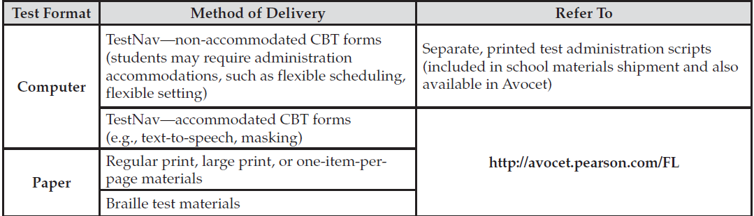
Test Administration Manual
Instructions for administering the FCAT 2.0 Reading Retake and the NGSSS Algebra 1 Retake, Biology 1, Civics, and U.S. History End-of-Course (EOC) assessments are included in the Spring/Summer 2017 NGSSS EOC & Retakes Manual and available online at http://avocet.pearson.com/FL/Home
Test Scripts

Slide 9
What’s New
FSA Algebra 1 EOC Retake
Students who need to retake the FSA Algebra 1 EOC or first-time test takers who are seniors participate in the Algebra 1 EOC Retake (March 27–April 7).
Scores will be reported in time for seniors to have them prior to scheduled graduations.
Students may not participate in both administrations.
Test Administrators will use the Algebra 1 EOC script (no separate Retake script).
Retake accommodations will be set in TIDE under the Algebra 1 column.
Ensure the correct Algebra 1 Retake assessment is administered (FSA vs. NGSSS).

Slide 10
Test Administration Schedule
FSA ELA Writing | CBT | PBT Accommodations
Grades 8-10 | February 27 – March 10 | February 28 (makeups to March 4) Accommodations only
Retakes | February 27 – March 10 | February 28 (makeups to March 4) Accommodations only
Grades 4-10 and Retake Make-up Window #1 | April 3-7
Grades 4-10 Only (NO Retake) Make-up Window #2* | May 8-12
*Results in late reporting.
Any deviation from this schedule requires written approval from the Florida Department of Education (FLDOE).
FSA CBT TAM i

Slide 11
Test Administration Schedule
Session Lengths by Grade Level and Subject
FSA ELA Writing
All FSA ELA Writing assessments are administered in one 120-minute session.
For the FSA ELA Writing Retake sessions, any student who has not completed the session by the end of the allotted time may continue working; however, each session may last no longer than half the length of a typical school day.
ELA Writing scripts now contain a scheduled stretch break at 60 minutes. Ensure you provide test administrators with the amount of time allowed for the stretch break and procedures for securing the environment during the break (e.g., monitors turned off).
FSA CBT TAM i

Slide 12
Test Administration Schedule
FSA and NGSSS Retake
Grades | Retake Tests | CBT | PBT Accommodations
10+ - Adult | FSA ELA Reading Retake | March 27-April 7 | March 27-31
 | FCAT 2.0 Reading Retake
7- Adult | FSA Algebra 1 EOC Retake* | March 27-April 7 | March 27-31
 | NGSSS Algebra 1 EOC Retake
* Students who need to retake the FSA Algebra 1 EOC will participate in the March 27–April 7 Retake administration, and students taking the assessment for the first time will participate in the April 17–May 12 EOC administration. Students may NOT participate in both administrations.
Any deviation from this schedule requires written approval from the Florida Department of Education (FLDOE).
FSA CBT TAM i; NGSSS CBT TAM-back of cover page

Slide 13
Test Administration Schedule
Session Lengths by Subject
FCAT 2.0 Reading Retake
The FCAT 2.0 Reading Retake must be conducted over two days.
Students have half of a typical school day to complete Session 1 and half of a typical school day to complete Session 2.
  Test administrators must be told what constitutes half a school day.
Students must complete Session 1 before beginning Session 2, even for make-up administrations.
NGSSS CBT TAM-back of cover page

Slide 14
Test Administration Schedule
Grades | FSA* | CBT | PBT Accommodations
4-10 | ELA Reading | April 17– May 12 | April 17-28
3-8 | Mathematics
*Notes: Calibration schools selected for a computer-based test (CBT) must administer that grade-level subject test the first week of testing (April 17-21).
Grades 3–4 Mathematics will be computer-based administrations.
Any deviation from this schedule requires written approval from the Florida Department of Education (FLDOE).
FSA CBT TAM i

Slide 15
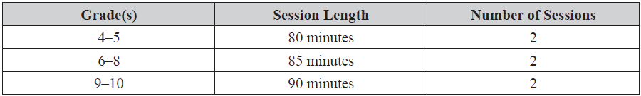
Test Administration Schedule
Session Lengths by Grade Level and Subject
FSA ELA Reading
All FSA ELA Reading assessments are administered in two sessions over two days.
For the FSA ELA Reading Retake sessions, any student who has not completed the session by the end of the allotted time may continue working; however, each session may last no longer than half the length of a typical school day.
  Test administrators must be told what constitutes half a school day.
FSA CBT TAM i

Slide 16
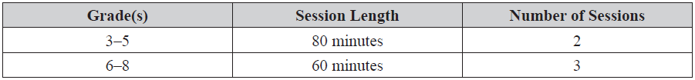
Test Administration Schedule
Session Lengths by Grade Level and Subject
FSA Mathematics
All FSA Mathematics assessments are administered over two days.
For Grades 6–8, Session 1 must be administered on Day 1 and Sessions 2 and 3 on Day 2.
FSA CBT TAM i

Slide 17
Test Administration Schedule
Students | FSA | CBT | PBT Accommodations
Enrolled Students | Algebra 1*, Algebra 2, Geometry | April 17 - May 12 | April 17-28
*Students taking the assessment for the first time will participate in the April 17–May 12 EOC administration , and students who need to retake the FSA Algebra 1 EOC will participate in the March 27–April 7 Retake administration. Students may NOT participate in both administrations.
Any deviation from this schedule requires written approval from the Florida Department of Education (FLDOE).
FSA CBT TAM i

Slide 18

Test Administration Schedule
Session Lengths by Subject
FSA EOC Assessments
All FSA EOC assessments are administered in two sessions over two days.
Any student who has not completed a session by the end of the allotted time may continue working; however, each session may last no longer than half the length of a typical school day.
  Test administrators must be told what constitutes half a school day.
FSA CBT TAM i

Slide 19
Test Administration Schedule
Students | NGSSS | CBT | PBT Accommodations
Enrolled Students | Biology 1, Civics, and US History | April 17 - May 19 | April 17 – May 5
Any deviation from this schedule requires written approval from the Florida Department of Education (FLDOE).
NGSSS CBT TAM-back of cover page

Slide 20
Test Administration Schedule
Session Lengths by Subject
NGSSS EOC Assessments
Each NGSSS EOC assessment will be administered in one 160-minute session with a scheduled 10-minute break after 80 minutes.
Any student who has not completed the test by the end of the allotted time may continue working; however, testing must be completed within one school day.
After the first 80 minutes, students may be dismissed from the testing room as they complete testing; however, no special incentives should be given to students to encourage them to finish early.
NGSSS CBT TAM 1

Slide 21
FSA Glossary of Terms
American Institutes for Research (AIR): AIR is the assessment vendor for FSA assessments.
Data Recognition Corporation (DRC): DRC is the vendor responsible for processes associated with paper-based FSA materials, including printing, shipping, receiving, and scanning.
FSA Portal: Resources and information for district and school personnel are located on the FSA Portal, which is accessed at www.FSAssessments.org. The portal includes links to TDS, TIDE, and the FSA Reporting System.
FSA Reporting System: The FSA Reporting System will deliver state, district, and school score results and is located on the FSA Portal.
FSA CBT TAM ix

Slide 22
FSA Glossary of Terms
On-Demand PreID Labels: On-Demand PreID Labels may be printed locally for any students who were not included in the original PreID upload. Schools will receive blank labels for printing On-Demand PreID Labels.
Secure Browser: The secure browser allows students to access the computer-based FSA assessments. This software must be installed on all computers or devices that will be used for student testing.
Session ID: Session IDs are unique codes generated by the Test Administrator (TA) Interface. In addition to their first names and usernames, students use the Session ID to log in to computer-based FSA assessments.
Student Interface: Students use the Student Interface via the secure browser to log in to and take computer-based FSA assessments.
Test Administrator Interface: Test administrators use the Test Administrator (TA) Interface to create and monitor test sessions for all computer-based FSA assessments.
FSA CBT TAM ix

Slide 23
FSA Glossary of Terms
Test Delivery System (TDS): All computer-based FSA assessments are administered via TDS, which includes the TA Interface and the Student Interface.
Test Information Distribution Engine: TIDE is the enrollment and user management system for FSA assessments. Student enrollment and test eligibility information is managed in TIDE. All school personnel involved in the administration of FSA assessments must have TIDE user accounts.
FSA CBT TAM ix

Slide 24
Pearson Glossary of Terms
PearsonAccess (www.fl.pearsonaccessnext.com) is a website used for almost all test preparation, setup, administration, and reporting tasks for all FCAT 2.0/EOC computer-based testing. Managing secure information in PearsonAccess requires username and password setup.
PearsonAccess Training Center provides an opportunity to practice PearsonAccess tasks and is the means of managing the Infrastructure Trial in preparation for testing. The Training Center requires username and password setup. It can be accessed at www.trng-fl.pearsonaccessnext.com.
Proctor Caching is the process of loading test content locally on a computer for all FCAT 2.0/EOC computer-based testing at the school or district level. It does not require a separate caching server and can run on any workstation on the network that meets the specified requirements.
Section is the term used in TestNav to identify separate portions of a test. The FCAT 2.0 Reading Retake has three sections including the seal code.
TestNav 8 (TestNav) is the platform that Florida uses for FCAT 2.0 and NGSSS EOC computer-based statewide assessments.
NGSSS CBT TAM vii

Slide 25
Students to Be Tested
All students enrolled in tested grade levels/subjects participate in the Spring 2017 FSA administration with or without accommodations, per Section 1008.22(3)(a), Florida Statutes (F.S.).
Students must take the test(s) appropriate for the grade level/subject in which they are receiving instruction.
For FSA ELA, students must take the same grade-level test for ELA Writing and ELA Reading to receive an ELA score.
FSA CBT TAM 2

Slide 26
Students to Be Tested
ELA Retake
Students who entered Grade 9 in the 2013–2014 school year and beyond and are pursuing a standard Florida high school diploma must pass the Grade 10 FSA ELA assessment (Reading and Writing components).
Retained Grade 10 (with an FSA score on file) or Grades 11–12 students who have not met the Grade 10 FSA ELA assessment requirement are eligible to participate in the Spring 2017 FSA ELA Retake.
Grade 10 students who entered Grade 9 during the
2015–2016 school year will participate in the Spring 2017 Grade 10 FSA ELA assessment.
FSA CBT TAM 2
Notes:
.

Slide 27
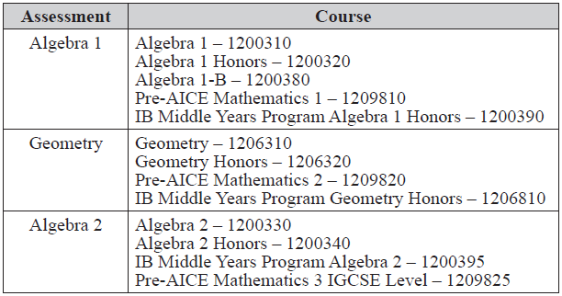
Students to Be Tested
FSA EOC Assessments
Students enrolled in and completing one of the following courses aligned to the Florida Standards participate in the appropriate assessment as indicated in the table below:
FSA CBT TAM 2

Slide 28
Students to be Tested
NGSSS EOC
Students enrolled in and completing one of the courses aligned to the Next Generation Sunshine State Standards participate in the appropriate assessment as indicated in the Spring/Summer 2017 NGSSS EOC & Retakes Manual; pages 1-3:
Algebra 1 Retake EOC (students who took the course prior to Fall 2014)
Biology 1
Civics
US History
FCAT 2.0 Reading Retake
Students who entered Grade 9 in the 2009–2010 school year through the 2012–2013 school year and are pursuing a standard Florida high school diploma must pass the Grade 10 FCAT 2.0 Reading test or obtain a concordant score on the ACT or SAT as one of the requirements for graduation.
NGSSS CBT TAM 1-3

Slide 29
Students to Be Tested
The following students are eligible to participate in FSA/NGSSS EOC administrations:
  Students who still need to pass an assessment for graduation purposes (Algebra 1 Retake only)
  Students who must earn a passing score on an assessment for a standard diploma with a scholar designation (Geometry, Algebra 2, Biology, and US History)
  Students who have not yet taken an assessment to be averaged as 30% of their course grades
  Students who are in grade forgiveness programs and wish to retake an assessment to improve their course grades
  Students in a credit acceleration program (CAP) who wish to take an assessment to earn course credit
FSA CBT TAM 3 ; NGSSS CBT TAM 1-2

Slide 30
Students to Be Tested
Special Programs |  | District Number | School Number
FLVS | Full-Time K-8 | 71 | 0300
 | Full-Time 9-12 | 71 | 0400
 | FL Virtual Academy | 50 | 7079
Miami-Dade Online Academy |  | 13 | 7001
Florida Home Education |  | 13 | 9998
McKay Scholarship |  | 13 | 3518
Florida Tax Credit Scholarship |  | 97 | 9999
Hospital/Homebound* (Brucie Ball Educational Center) |  | 13 | 9732
*Miami-Dade program not in the Test Administration Manual.
FSA CBT TAM 3-4 ; NGSSS CBT TAM 3-4; TP 23-39

Slide 31
Students to Be Tested
English Language Learners (ELLs)—All ELLs participate in statewide assessments. Students who are identified as ELLs (Levels 1-4) must be provided with the allowable accommodations.
Important Note: Per District policy, All ELLs enrolled in tested grade levels and subjects are expected to participate in the statewide assessments no matter how long these students have been enrolled in a U.S. school.
  Cross out page 4 in FSA CBT manual that indicates that ELLs may be exempted from the FSA ELA test if they have been in the US less than one year.
FSA CBT TAM 4 ; NGSSS CBT TAM 5; Appendix A

Slide 32
Students to Be Tested
Students with Disabilities—Students with disabilities participate in the statewide assessment program by taking one of the following:
FSA/NGSSS without accommodations,
FSA/NGSSS with accommodations, or
Florida Standards Alternate Assessment.
All determinations regarding participation in the statewide assessment program must be documented in the student’s IEP or Section 504 plan.
FSA CBT TAM 4-5; NGSSS CBT TAM 5; Appendix A

Slide 33
Accommodations
General Information about Accommodations
For eligible students participating in the computer-based assessments, the following accommodations are available (as applicable):
Computer-Based Accommodations
Masking (FSA/NGSSS)
Text-to-speech (FSA/NGSSS)
  Recommendation: Download and install NeoSpeech voice pack for use on supported Windows computers (Windows 7, 8.0, 8.1, and 10).
  American Sign Language (ASL) videos for ELA Reading tests (FSA only)
Closed captioning for ELA Reading tests (FSA Only)
Writing and Reading Passage Booklets
Regular print Writing/Reading Passage Booklets (FSA/NGSSS)
Large print Writing/Reading Passage Booklets (FSA Only)
FSA CBT TAM 6 ; NGSSS CBT TAM 5; Appendix A

Slide 34
Accommodations
General Information about Accommodations
Spring/Summer 2017 FSA Accommodations Test Administration Manual for information about accommodated assessments, including scripts. This manual is located on the FSA Portal only.
Paper-Based Accommodations
Regular Print (FSA/NGSSS)
Large Print (FSA/NGSSS)
Braille
  English Braille American Edition (EBAE) (contracted and uncontracted)
  Unified English Braille (UEB) (contracted and uncontracted)
One-Item-Per-Page (OIPP)
Remember: paper-based accommodations should only be provided for CBT tests if students CANNOT access assessments on the computer.
Please refer to Weekly Briefing #20635 for further information
FSA CBT TAM 6 ; NGSSS CBT TAM 5; Appendix A

Slide 35
Accommodations
ESE/504 Accommodation Types
  ESE/504 Accommodation Type – Flexible Presentation
  ESE/504 Accommodation Type – Flexible Responding
  ESE/504 Accommodation Type – Flexible Scheduling
  ESE/504 Accommodation Type – Flexible Setting
  ESE/504 Accommodation Type – Assistive device(s) other than standard calculator
ELL Accommodation Types
  ELL Accommodation Type – Flexible Scheduling
  ELL Accommodation Type – Flexible Setting
  ELL Accommodation Type – Assistance in Heritage Language
  ELL Accommodation Type – Approved Dictionary
FSA CBT TAM 6 ; NGSSS CBT TAM 28; Appendix A

Slide 36
Accommodations
SPED Office Contacts for 504
Temporary Section 504 Plan: When a student sustains an impairment / injury during a statewide test window, they may be eligible for Section 504.
  CENTRAL
  (786) 413-3001
  Alfredia Robinson
    Instructional Supervisor
  Maria Verjano
    Lead Staffing Specialist
  SOUTH
JRE Lee Educational Ctr. (786)-268-4757
  Lyasell Gigi Arrieta
    Instructional Supervisor
  Connie Vindigni
    Lead Staffing Specialist
SPED Annex at CIE (305) 242-8432
  Lyasell Gigi Arrieta
    Instructional Supervisor
  Maria Sifre
    Lead Staffing Specialist
  NORTH
  (305) 827-3025
    Alina Rodriguez and Susanne Meadows
      Instructional Support Specialists
    Cynthia O’Donnell
      Lead Staffing Specialist

Slide 37
Tools and Accommodations on CBT Platforms
 | TDS (AIR) | TestNav 8 (Pearson)
Available to All Students | Enlarge Print Size/Zoom Color Contrast Black Text on White Black Text on Yellow Black Text on Blue Black Text on Light Blue Black Text on Magenta Yellow Text on Dark Blue White Text on Black White Text on Navy Mouse Pointer Color/Size Line Reader Highlighter | Zoom Magnifier Color Contrast Black Text on White Black Text on Cream Black Text on Light Blue Black Text on Light Magenta White Text on Black Yellow Text on Blue Gray Text on Green Line Reader Mask Highlighter
Accommodations Only | Text-to-Speech (TTS) Masking American Sign Language (Reading only) Closed Captioning (Reading only) | Text-to-Speech Masking

Slide 38
Test Materials
Students participating in this CBT administration receive the following materials, as applicable:
  CBT Worksheets (mandatory for FSA ELA Reading) (optional for FCAT 2.0 Reading Retake, and Civics and US History EOCs)
  Florida Computer-Based Testing Work Folders (FSA Mathematics and EOCs, and NGSSS Algebra 1 Retake and Biology 1 EOCs)
  Writing Planning Sheets (ELA Writing/Retake only)
  Writing Passage Booklets (FSA ELA Writing with eligible accommodation only)
  Reading Passage Booklets (FSA ELA Reading and FCAT 2.0 Reading Retake with eligible accommodation only)
FSA CBT TAM 6 ; NGSSS CBT TAM 30-32

Slide 39
Test Materials
CBT Worksheets
CBT Worksheets are one-page letter-sized worksheets. Students may use the front and back of the worksheet to take notes. The Testing Rules Acknowledgment is printed on the back of the CBT Worksheet.
Worksheets are distributed to students at the beginning of each CBT test session. School assessment coordinators and test administrators must ensure that students have enough desk space to use their worksheets.
CBT Worksheets are mandatory for FSA ELA Reading and optional for FCAT 2.0 Reading Retake, US History and Civics EOCs.
Each student must be given a new worksheet for each test session.
Used worksheets are considered secure materials and must be kept in locked storage and returned in the District Assessment Coordinator ONLY box.
FSA CBT TAM 6 ; NGSSS CBT TAM 31

Slide 40
Test Materials
Work Folders
Florida Computer-Based Testing Work Folders are four-page folders that students may use to work the problems. The Testing Rules Acknowledgment is printed on page 2. The last page of the folder (back cover) is printed with graph paper.
Work folders are distributed to students at the beginning of each FSA Mathematics and EOC, and NGSSS Algebra 1 Retake and Biology 1 EOC test session. School assessment coordinators and test administrators must ensure that students have enough desk space to use their folders.
Note: Each student must be given a new work folder for each FSA Mathematics and EOC test session, with the exception of Grades 6–8 FSA Mathematics. For Sessions 2 and 3 of Grades 6–8 FSA Mathematics, students should use the same work folder for Session 2 and Session 3.
Used work folders are considered secure materials and must be kept in locked storage and returned in the District Assessment Coordinator ONLY box.
FSA CBT TAM 6 ; NGSSS CBT TAM 31

Slide 41
Test Materials
Writing Planning Sheets
All students taking ELA Writing receive Writing Planning Sheets that they may use to take notes and plan their responses. The planning sheet is a one-page, letter-sized sheet. The front of the sheet is lined. The Testing Rules Acknowledgment is printed on the back of the sheet.
Planning sheets are distributed to students at the beginning of the ELA Writing test session. School assessment coordinators and test administrators must ensure that students have enough desk space to use their planning sheets.
Used planning sheets are considered secure materials and must be kept in locked storage and returned in the District Assessment Coordinator ONLY box.
FSA CBT TAM 7

Slide 42
Test Materials
Writing and Reading Passage Booklets
For FSA ELA Writing and Reading CBT, Writing/Reading Passage Booklets are provided for eligible students who require their use as indicated in their IEPs or Section 504 plans. Students must be marked in TIDE/PearsonAccess with this accommodation to ensure that the passages in their CBT test form match the passages in the passage booklet.
The Writing Passage Booklets contain the writing passages but do not contain the writing prompt. The Reading Passage Booklets contain the reading passages but do not contain test items.
Students may write in the booklets but will respond to the writing prompt or to test items on the computer or device they are using to take the assessment.
FSA CBT TAM 7 ; NGSSS CBT TAM 31

Slide 43
Test Materials
Writing and Reading Passage Booklets
Sessions 1 and 2 of the Reading Passage Booklet are sealed separately. Students should break the appropriate seal at the beginning of each session, according to the instructions in the administration script.
Only regular print Reading Passage Booklets are available for eligible ESE students who use require them for the FCAT 2.0 Reading Retake.
Passage Booklets are secure materials and must be stored in a secure location before and after testing.
Written documentation is required when assigning Passage Booklets to test administrators and Chain of Custody Form must be completed when handling these materials.
Passage Booklets will be returned in the white NOT TO BE SCORED box(es).
FSA CBT TAM 7 ; NGSSS CBT TAM 31

Slide 44
Test Materials
Scientific Calculators for FSA Mathematics and EOCs
Grades 7 and 8 FSA Mathematics and Algebra 1, Geometry, and Algebra 2 EOC assessments include a scientific calculator in the Test Delivery System. The scientific calculator is available for Sessions 2 and 3 of Grades 7 and 8 Mathematics and for Session 2 of the Algebra 1, Geometry, and Algebra 2 EOCs.
The FSA Mathematics Calculator and Reference Sheet Policies document, available on the FSA Portal, includes a list of required and prohibited calculator functionalities as well as a list of FDOE-approved calculators for the 2016–2017 school year.
Providing a calculator with prohibited functionality or in the incorrect test session (Session 1) is cause for test invalidation.
Students who will test using paper-based accommodations must be provided handheld scientific calculators during the allowed session(s).
FSA CBT TAM 8

Slide 45
Test Materials
Four-Function Calculators for NGSSS
TestNav has a built-in four-function calculator. Students may use the built-in calculator, or they may use a handheld four-function calculator.
Students taking the Algebra 1 Retake EOC and the Biology 1 EOC may use the handheld four-function calculators.
Students with visual impairments may use the approved large key/large display four-function calculators or approved talking four-function calculators.
Students who will test using paper-based accommodations must be provided handheld four-function calculators.
No other calculators may be used.
Test administrators should provide handheld calculators at the beginning of a test session to all students who request one, as indicated in the test administration script.
NGSSS CBT TAM 32

Slide 46
Test Materials
FSA Reference Sheets
Reference sheets are provided for Grades 4–8 FSA Mathematics and all FSA EOC assessments in an online format for computer-based testing. The reference sheets are displayed in pop-up windows in their respective tests.
Schools may provide hardcopy reference sheets to students. Ensure that copies are available for all students taking the test. Any hardcopy reference sheets must be photocopies of the files found on the portal.
Each copy must be carefully checked against the original to ensure that all content is copied and that it is clear and easy to read.
After students complete the test, test administrators must collect all reference sheets.
Used reference sheets are secure materials. The school assessment coordinator should package all used and unused reference sheets in the District Assessment Coordinator ONLY box.
FSA CBT TAM 8

Slide 47
Test Materials
NGSSS Reference Sheet and Periodic Table
The Algebra 1 Retake End-of-Course Assessment NGSSS Reference Sheet and the Periodic Table of the Elements for the Biology 1 EOC Assessment are provided only in an online format for computer-based testing (students with paper-based accommodations are provided paper copies).
The reference sheet and periodic table are displayed in pop-up windows in their respective tests.
The reference sheet and periodic table are also provided in Appendix D of the Spring/Summer 2017 NGSSS EOC & Retakes Manual.
Schools may provide hardcopy reference sheets or periodic tables to students taking the computer-based assessments.
NGSSS CBT TAM 32

Slide 48
Test Materials
NGSSS Reference Sheet and Periodic Table
Schools that provide hardcopy reference sheets must ensure copies are available for all students taking the test.
Each copy must be carefully checked against the original to ensure all content is copied and that it is clear and easy to read.
After students complete the test, the test administrator should collect all reference sheets and periodic tables.
Used reference sheets and periodic tables are secure materials and must not be reused.
The school assessment coordinator should package all used and unused reference sheets in the District Assessment Coordinator ONLY box.
NGSSS CBT TAM 32

Slide 49
Test Materials
Headphones/Earbuds (FSA ELA Reading)
Students must have headphones or earbuds for both sessions of ELA Reading. FDOE does NOT provide headphones or earbuds.
There are no technical specifications for headphones or earbuds.
Schools may allow students to use their own headphones or earbuds.
Headphones or earbuds should be checked to ensure that they work with the computer or device the students will use for the assessment prior to the first day of testing.
Plug headphones or earbuds in and adjust system volume prior to launching the secure browser on each day of testing. A sound check is also built in to the assessment, and students are asked to verify that headphones and earbuds are working prior to entering the test.
FSA CBT TAM 8

Slide 50
Test Materials
Required Administration Information
Ensure test administrators collect the required administration information, which includes the following:
  Students assigned to the room—
  provide Student Names and
  Student ID Numbers
  Grade level
  Accommodations provided to
  students
  Signatures of test administrator
  and school assessment coordinator
  Dates and times when secure materials
  (e.g., test tickets, passage booklets)
  are received and returned
Copy and file all required administration information for future reference.
Return the originals in the District Assessment Coordinator ONLY Box.
  Attendance information—P=Present, A=Absent, W=Withdrawn, and P/I=Present but Invalidated
  Session ID (generated in TIDE when a test session is created)
  Test Group Code (if applicable)
  Accommodations used by students
  Unique security numbers of secure materials assigned to each student, if applicable
  Dates and times when secure materials (e.g., test tickets, passage booklets) are received and returned
FSA CBT TAM 20 ; NGSSS CBT TAM 27; Appendix D

Slide 51
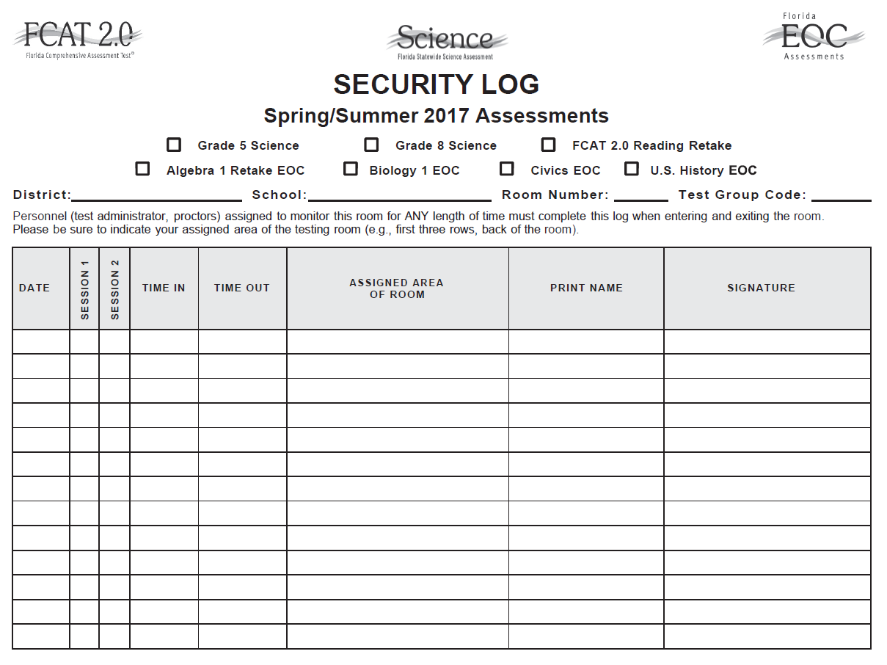
Test Materials
Security Log
Test administrators are required to maintain an accurate Security Log for each testing room.
Anyone who enters a testing room for the purpose of monitoring a test must sign the log for that testing room. This applies to test administrators, proctors, and anyone who relieves a test administrator, even for a short break, regardless of how much time he or she spends monitoring a testing room.
After testing, copy all security logs, file the copies, and package the originals in the District Assessment Coordinator ONLY box.
FSA CBT TAM 22 ; NGSSS CBT TAM 29; Appendix D

Slide 52
Test Materials
Seating Charts
Test administrators are required to maintain an accurate seating chart for each group of students in their rooms during testing.
Ensure that test administrators record all information indicated and that they create a new seating chart if the seating configuration changes during a test session.
After testing, copy all seating charts, file the copies, and package the originals in the District Assessment Coordinator ONLY box.
FSA CBT TAM 21 ; NGSSS CBT TAM 28; Training Packet

Slide 53
Test Materials
FSA Test Tickets
Each student must have a test ticket to log in to computer-based FSA assessments. Test tickets are generated in TIDE and contain a student’s username, last name, first name, grade, date of birth, student ID number, district, and school. Test tickets will be printed by school assessment coordinators and will be distributed to test administrators on the day of testing.
NGSSS Student Authorization Tickets
Each student needs the Username and Password printed on his or her Student Authorization Ticket to sign in to the test. Students will need a pen or pencil during testing to sign their tickets.
Test tickets and Student Authorization Tickets are considered secure materials and must be stored in a secure location before and after testing.
FSA CBT TAM 10 ; NGSSS CBT TAM 30

Slide 54
Test Materials
NGSSS Advanced Session Roster
The School Assessment Coordinator Responsibilities Before Testing section of the Spring/Summer manual provides instructions for creating and printing Advanced Session Rosters. A Session Roster is a list of all students scheduled in a test session.
Advanced Session Rosters must be handled in a secure manner and returned to the school assessment coordinator immediately after each test session is completed.
To view the Advanced Session Roster, log in to PearsonAccess, go to Reports and select Operational Reports, then select Online Testing from the Report Categories and click Advanced Session Roster.
NGSSS CBT TAM 7, 30

Slide 55
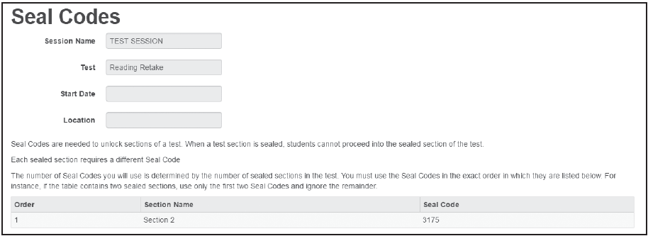
Test Materials
Seal Code (FCAT 2.0 Reading Retake)
A seal code is a unique four-digit number used to allow students to access Session 2 of the FCAT 2.0 Reading Retake after they have completed Session 1.
Seal codes will be provided in PearsonAccess, and all students in a test session will use the same seal code.
Students should not be given seal codes until Session 2/Day 2, when indicated in the Session 2 administration script.
Seal codes must be handled securely and must not be used as test group codes.
NGSSS CBT TAM 31

Slide 56
Computer Preparations
Weekly Briefings #19797 and 20448
The latest version of the 2016–2017 AIR FSA Secure Browser must be installed on all computers or devices that students will use for testing.
  Information on devices supported for testing are found in 2016–2017 System Requirements for Online Testing, also available on the portal.
Pearson has released a new TestNav app and has updated the ProctorCache software for the 2016–17 school year.
  If your school is using the TestNav desktop or mobile app, the updated TestNav app is available at http://download.testnav.com.
Schools may use secured tablets for testing in Spring 2017, in accordance with District guidelines.
  Attachable keyboards are required for test administration, along with headphones for applicable sessions.
  All students to be tested on the tablets should complete the practice test on the tablet, to ensure comfort with the device.
Mobile technologies (laptops and/or tablets) must be fully charged and activated to allow for installation of updates in advance of the testing window. In addition, the appropriate infrastructure trial must be conducted using the devices.
FSA CBT TAM 26; NGSSS CBT TAM 6

Slide 57
Computer Preparations
The FSA Infrastructure Trial must be loaded on each workstation or device prior to a computer-based test administration.
The Infrastructure Trial uses mock content that simulates the loading and processing of an operational test administration.
Instructions for running this trial can be found in the Infrastructure Trial Guide available on the FSA Portal.
  District-wide FSA Trial: Wednesday, February 15
  Complete the FSA Infrastructural Trial survey available at (https://www.surveymonkey.com/r/FSATrial ) by February 17
Please refer to Weekly Briefings # 20212 and 20444
FSA CBT TAM 10

Slide 58
Computer Preparations
The NGSSS Infrastructure Trial must be loaded on each workstation or device prior to a computer-based test administration.
The Infrastructure Trial uses mock content that simulates the loading and processing of an operational test administration.
Instructions for running this trial can be found in the Infrastructure Trial Guide available at http://avocet.pearson.com/FL/Home.
  School-wide NGSSS Trial: the week of March 13-17
  Complete the NGSSS Infrastructural Trial survey available at (https://www.surveymonkey.com/r/NGSSSTrial ) by March 17
Please refer to Weekly Briefings # 20212 and 20444
NGSSS CBT TAM 6

Slide 59
Test Security
State and District Requirements
Per Test Security Statute, s. 1008.24, F.S., and Florida State Board of Education Rule, 6A-10.042, Florida Administrative Code (FAC), inappropriate actions by school or district personnel can result in student or classroom invalidations, loss of teaching certification, and/or involvement of law enforcement.
Examples of prohibited activities include the following:
Reading or viewing the passages or writing prompts or test items before, during, or after testing
Revealing the passages or writing prompts or test items
Copying the passages or writing prompts or test items
Explaining or reading the passages or writing prompts or test items for students
Changing or otherwise interfering with student responses to writing prompts or test items
Copying or reading student responses
Causing achievement of schools to be inaccurately measured or reported
FSA CBT TAM 13 ; NGSSS CBT TAM 17

Slide 60

Test Security
State and District Requirements
Standards, Guidelines, and Procedures for Test Administration and Test Security available at http://oada.dadeschools.net/TestChairInfo/InfoForTestChair.asp
  Adopted by School Board
Florida Test Security Statute and Rule
School Procedural Checklist (FM-6927)
Screencast training on Test Security for school-level training sessions: http://oada.dadeschools.net/Screencasts/TestSecurity/TestSecurity.html
FSA CBT TAM 13; NGSSS CBT TAM 17; Appendix C

Slide 61
Test Security Policies and Procedures
Caveon Data Forensics
The FDOE uses Caveon Test Security to provide its Caveon Data Forensics™ for all statewide assessments.
Caveon analyzes data to identify highly unusual test results for two primary groups:
  Students with extremely similar test responses; and
  Schools with improbable levels of similarity, gains and/or erasures.
Flagging only the most extreme results.
FSA CBT TAM 25 ; NGSSS CBT TAM 32

Slide 62
Test Security Policies and Procedures
The security of all test materials must be maintained before, during, and after test administration.
No more than three people should have access to the locked storage room.
The Test Materials Chain of Custody Form must be maintained at all times.
Secure materials should never be destroyed (e.g., shredded, thrown in the trash), except for soiled documents.
Under no circumstances are students permitted to assist in preparing secure materials before testing or in organizing and returning materials after testing.
For security purposes, photo identification, such as a Florida ID or school ID, must be checked before admitting unfamiliar students to a testing room.
FSA CBT TAM 13 ; NGSSS CBT TAM 17; Appendix D

Slide 63
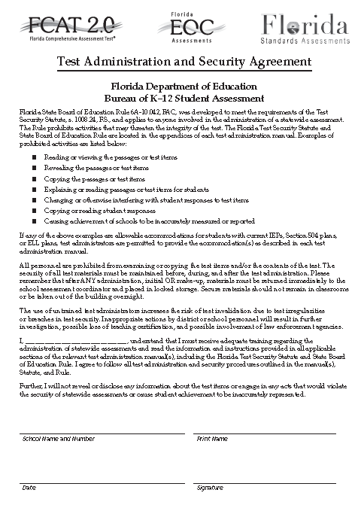
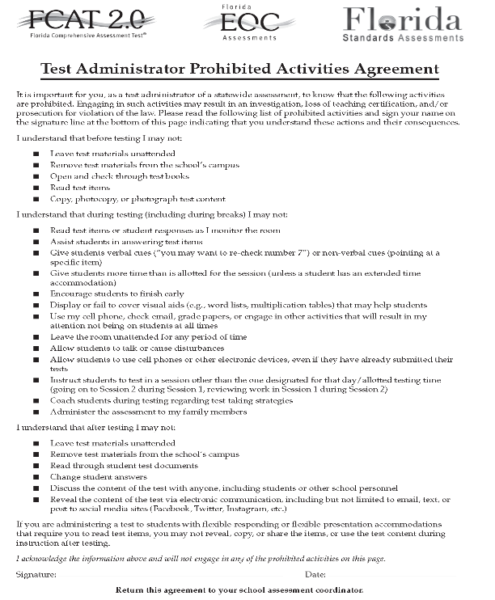
Test Security Policies and Procedures
School administrators, school assessment coordinators, test administrators, and proctors must receive adequate training prior to test administration.
ALL personnel must sign and return a Test Administration and Security Agreement stating that they have read and agree to abide by all test administration and test security policies and procedures.
  Including any other person who assists the school assessment coordinator or test administrator must sign and return a security agreement.
  Technology coordinators must also sign a security agreement form.
Test administrators must also read, sign, and return a Test Administrator Prohibited Activities Form.
Test administrators must not administer tests to their family members. Students related to their assigned test administrator should be reassigned to an alternate test administrator. In addition, a student’s parent/guardian should not be present in that student’s testing room.
FSA CBT TAM 13 ; NGSSS CBT TAM 17; Appendix D

Slide 64
Test Security Policies and Procedures
Make-Up Administration Procedures
All security and administration procedures must be followed while conducting make-up tests. Please remember that after ANY administration, initial or make-up, secure materials must be returned immediately to the school assessment coordinator and placed in locked storage.
Secure materials must never remain in classrooms or be removed from the school’s campus overnight.
For all FSA & NGSSS assessments, sessions must be completed in the designated order. For example, Session 1 must be completed before Session 2.
Three session FSA Math tests must be administered over two days (with Session 1 administered on Day 1 and Sessions 2 and 3 administered on Day 2). Any students absent for a session may not participate in the next session until they have completed the session that they missed.
FSA CBT TAM 6 ; NGSSS CBT TAM 6

Slide 65
Test Security Policies and Procedures
Discussing Test Content with Students
While you may encourage students to continue working, you may not talk with them about the items or passages or help them with their responses.
Any desktop-viewing programs or similar software that would enable you to view or record test content and student responses must be turned off during testing.
If students finish the test before the allotted time has elapsed, you may encourage them to go back and check their work.
You may not provide students with any information that would allow them to infer the correct answer, such as suggesting that they might want to check their work on specific items.
You may not read or comment on student responses or help students plan what to write or respond to items. Further, you may not read planning sheets, worksheets, or work folders or check through test and answer books, return them to students after they have been collected, or discuss test content, even after all test materials have been returned and testing has been completed.
FSA CBT TAM 29 ; NGSSS CBT TAM 35

Slide 66
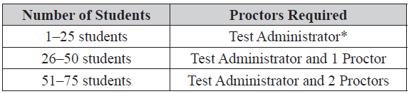
Test Security Policies and Procedures
Proctors
To ensure that test security and avoid situations that could result in test invalidation, FDOE strongly discourages testing students in large groups (e.g., in a cafeteria or an auditorium). If students are tested in a large group, the appropriate number of proctors must be assigned to the room to assist the test administrator. Refer to the table below for the required number of proctors.
* FDOE strongly recommends that proctors be assigned to rooms with fewer than 26 students whenever possible.
FSA CBT TAM 14 ; NGSSS CBT TAM 18

Slide 67
Test Security Policies and Procedures
Proctors
Prior to testing, proctors must be informed of their duties and of the appropriate test security policies and procedures.
School Personnel
May assist test administrators during test administration
Duties may include preparing and distributing materials
Providing accommodations
Non-School Personnel
May assist test administrators during test administration
However, they may NOT participate in any of the test administration procedures (e.g., distributing and collecting test materials, providing accommodations)
Volunteers (e.g., parents, retired teachers) may be trained as proctors and may perform non-school personnel duties.
FSA CBT TAM 14 ; NGSSS CBT TAM 18

Slide 68
Test Security Policies and Procedures
Security Numbers
All Reading and Writing Passage Booklets and PBT accommodations (regular print, large print, braille, and one-item-per-page) are secure documents and must be protected from loss, theft, and reproduction in any medium.
A unique identification number and a barcode are printed on the front cover of all secure documents.
  For FSA: The security number consists of the last eight digits of the identification number. These eight digits are located next to the barcode.
  For NGSSS: The security number consists of a nine-digit number followed by a check digit.
Schools must maintain test security by using the security numbers to account for all secure test materials before, during, and after test administration until the time they are returned to the contractors.
FSA CBT TAM 14 ; NGSSS CBT TAM 19-21

Slide 69
Test Security Policies and Procedures
Test Group Code
Test group codes are required for all FSA PBT administrations, NGSSS EOCs and FCAT 2.0 Reading Retake administrations.
  Note: Session ID numbers are used for FSA CBT administrations instead of the test group codes.
Test group codes are used to identify groups of students tested together and may be needed during investigations after testing to verify whether students were tested in the same room.
School assessment coordinators will create and distribute unique four-digit codes to all test administrators.
Schools must ensure that each test administrator uses one unique four-digit test group code in his or her testing room. Each testing room must use a different test group code.
For two-session tests, test administrators must use the same test group code for both Session 1 and Session 2. If students are absent for a test session, a different unique code must be used for each make‑up session.
FSA PBT TAM 5 ; NGSSS CBT TAM 7; FSA CBT TAM ix, 20

Slide 70
Test Security Policies and Procedures
Communicate Testing Policies to Parents/Guardians and Students
Prior to testing, make sure students and their parents/ guardians understand the following policies:
Electronic Devices Policy—Students are not permitted to have any electronic devices, including, but not limited to, cell phones, smartphones, and smartwatches, at any time during testing or during breaks (e.g., restroom), even if they are turned off or students do not use them. If a student is found with an electronic device, his or her test will be invalidated.
Testing Rules Acknowledgment—All tests include a Testing Rules Acknowledgment that reads: “I understand the testing rules that were just read to me. If I do not follow these rules, my test score may be invalidated.” Prior to testing, test administrators read the rules to students, and students acknowledge that they understand the testing rules by signing below the statement.
Calculator Policy—For FSA Mathematics and FSA EOC assessments, calculators may be used during SESSION 2 and 3 (if applicable) only.
FSA CBT TAM 24; NGSSS CBT TAM 32; Test Chairperson Info Website:

Slide 71
Test Security Policies and Procedures
Communicate Testing Policies to Parents/Guardians and Students
Leaving Campus—If students leave campus before completing a test session (for lunch, an appointment, illness, etc.), they will not be allowed to return to that session. If a student does not feel well on the day of testing, it may be best for the student to wait and be tested on a make-up day.
Working Independently—Students are responsible for doing their own work during the test and for protecting their answers from being seen by others. If students are caught cheating during testing, their tests will be invalidated. In addition, FDOE employs Caveon Test Security to analyze student test results to detect unusually similar answer patterns. Student tests within a school that are found to have extremely similar answer patterns will be invalidated.
Discussing Test Content after Testing—The last portion of the testing rules read to students before they affirm the Testing Rules Acknowledgment reads, “Because the content of all statewide assessments is secure, you may not discuss or reveal details about the test items or passages after the test. This includes any type of electronic communication, such as texting, emailing, or posting online, for example, on websites like Facebook, Twitter, or Instagram.”
FSA CBT TAM 24; NGSSS CBT TAM 32; Test Chairperson Website

Slide 72
Test Irregularities and Security Breaches
Hazardous Materials
If a used secure test is soiled (e.g., with blood or vomit), the school assessment coordinator should email the security number to Mara at mugando@dadeschools.net. School personnel may transcribe responses into a replacement document.
The damaged secure test should then be destroyed or disposed of in a secure manner (e.g., shredding, burning). Soiled tests should NOT be returned with test materials.
Missing Materials
School assessment coordinators must verify that all secure materials are received and should report any mispackaged or missing materials to SAET immediately at 305-995-7520.
Individuals responsible for handling secure materials are accountable for the materials assigned to them. Test administrators should report any missing materials to the school assessment coordinator immediately.
Schools must investigate any report of missing materials. If, after a thorough investigation, a secure document is not found, the school assessment coordinator must contact the SAET at 305-995-7520.
FSA PBT TAM 13-14; NGSSS CBT TAM 20-22

Slide 73
Test Irregularities and Security Breaches
Test Irregularities
Test administrators should report any test irregularities (e.g., disruptive students) to the school assessment coordinator immediately. School assessment coordinators must notify SAET at 305-995-7520 of any test irregularities that are reported.
Security Breaches
Test administrators should report possible breaches of test security (e.g., secure test content that has been photographed, copied, or otherwise recorded) to the school assessment coordinator immediately.
If a security breach is identified, the school assessment coordinator must contact SAET at 305-995-7520 to discuss a plan of action. This action may include the involvement of school police. For all security breaches, a written report must be submitted to the Office of SAET as indicated in the next slide.
FSA CBT TAM 15 ; NGSSS CBT TAM 19

Slide 74
Test Irregularities and Security Breaches
Missing Materials and Security Breach
A written report must be submitted to the Office of SAET within 7 calendar days after secure materials have been identified as missing or a security breach as been reported. The report must include the following, as applicable:
  The nature of the situation
  The time and place of the occurrence
  The names of the people involved
  Copies of completed forms (Test Administration and Security Agreements, Test Administrator Prohibited Activities Agreements, Test Materials Chain of Custody Form, etc.)
  A description of the communication between SAET and school personnel
  How the incident was resolved
  What steps are being implemented to avoid future losses
FSA CBT TAM 15 ; NGSSS CBT TAM 19

Slide 75
Test Invalidation
Policies and Procedures
Test Invalidation
For assistance identifying circumstances when invalidation may be an appropriate course of action, review the following guidelines.
A student has an electronic device during testing.
A student is cheating during testing.
A student becomes ill and is unable to finish, or a student is not allowed the correct amount of time.
A student is given an accommodation not allowed on statewide assessments.
A student is given an accommodation not indicated on the student’s IEP, Section 504 plan, or ELL plan.
A student was not provided an allowable accommodation indicated on the student’s IEP, Section 504 plan, or ELL plan.
FSA CBT TAM 17-18 ; NGSSS CBT TAM 24-25

Slide 76
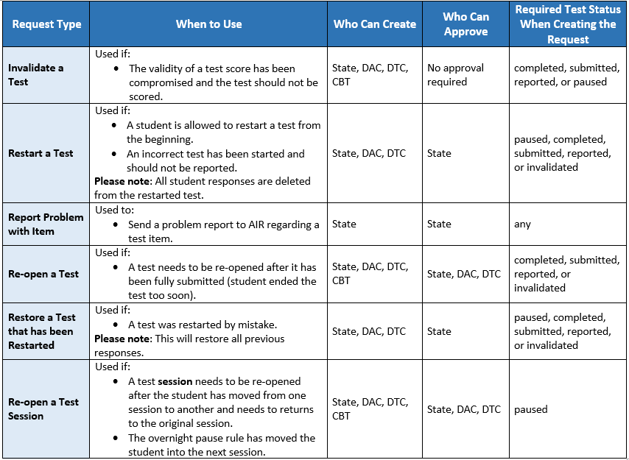
Test Invalidation
Policies and Procedures
Test Invalidation
A student works in the incorrect session.
An error occurs in test administration procedures that could compromise the validity of test results.
A student is given unauthorized help during testing.
A student is disruptive during testing.
FSA Invalidations and Requests Summary
Use the document during the administration if you have questions how to submit an invalidation and re-open request.
Posted to the FSA Portal > Test Administration page.
FSA CBT TAM 17-18; NGSSS CBT TAM 24-25; TIDE User Guide

Slide 77
School Assessment Coordinator
Before Testing
FSA Receive Materials
You will receive the following materials for this administration, as applicable:
  Test administration manuals
  Planning sheets
  CBT Work folders
  CBT Worksheets
  Writing/Reading Passage Booklets, if applicable (CBT accommodations)
  PBT accommodations, if applicable (regular print, large print, OIPP, and braille)
FSA CBT TAM 22-23

Slide 78
School Assessment Coordinator
Before Testing
NGSSS Receive Materials
You will receive the following materials for this administration, as applicable:
  Test administration manuals
  CBT test scripts manuals
  CBT Work folders
  Reading Passage Booklets, if applicable (CBT accommodations)
  PBT accommodations, if applicable (regular print, large print, OIPP, and braille)
NGSSS CBT TAM 30-32

Slide 79
School Assessment Coordinator
Before Testing
Student Demographic Information
The following student demographic information must be verified in TIDE and PearsonAccess Next before testing:
  Student name – Grade level
  District/school number – Gender
  Date of birth – Ethnicity
  Florida Student ID Number – Race
  In addition to verifying this information, the categories on the following slide must also be verified, if applicable. If demographic information needs to be updated, follow the instructions in the TIDE User Guide and Florida PearsonAccess Next User Guide.
FSA CBT TAM 10-12 ; NGSSS CBT TAM 11-15

Slide 80
School Assessment Coordinator
Before Testing
Student Demographic Information
Primary Exceptionality
Section 504
Testing Accommodations Listed on IEP or 504 Plan
ESE/504 and ELL Accommodation Types
ELL (length of time)
Student Enrollment Information (EOC only)
FSA CBT TAM 10-12 ; NGSSS CBT TAM 11-15

Slide 81
School Assessment Coordinator
Before Testing
Manage Student Information in TIDE (FSA)
Instructions on managing student information in TIDE can be found in the TIDE User Guide, available on the FSA Portal. Prior to testing, please ensure that all students have been added to TIDE and all information listed in TIDE is correct, including any accommodations students will use for testing. It is important that student information is correct to ensure that results are reported accurately.
Also see the TIDE User Guide for instructions on how to perform the following tasks prior to testing:
  Adding students
  Assigning accommodations
  Printing Test Tickets
Assign Writing or Reading Passage Booklets
Verify that all students who will use Passage Booklets for ELA Reading or ELA Writing have been correctly identified in TIDE as having that accommodation.
  Printing On-Demand Labels
  Editing student demographic information
FSA CBT TAM 252-253; TIDE User Guide

Slide 82
School Assessment Coordinator Before Testing
Manage Student Information in PearsonAccess Next (NGSSS)
PreID Upload and Test Sessions
  When the PreID file was uploaded, all students were placed into a session in PearsonAccess.
  Sessions created through the PreID upload will have the following test session names to identify the tested subject.
    FCAT 2.0 Reading Retake: RR2- NGFCATRD
    Algebra 1 Retake: ART- NGALGEBRA1
    Biology 1: BIO-NGBIOLOGY1
    Civics: CIV-NGCIVICS
    U.S. History: HIS-NGUSHISTORY
  Note: The district-created test sessions can be temporary sessions for the purpose of verifying student information, or they can be the test sessions you plan to use for testing.
NGSSS CBT TAM 44-45; PearsonAccess Next User Guide

Slide 83
School Assessment Coordinator
Before Testing
Preidentification Student Information (FSA)
Test | Wave 1 Date | Wave 2 Date | Test Management in TIDE
FSA ELA Writing, Reading, and Mathematics | December 2 | January 20 | February 6
FSA ELA Retake (Writing and Reading) | January 20 |  | February 6
FSA Algebra 1, Algebra 2, Geometry EOC | January 27 |  | February 13
  Important Note: Eligible students who have PBT accommodations added to their IEP or Section 504 plan after these cut off dates will NOT have these materials ordered. Please contact Mara Ugando via email at mugando@dadeschools.net to order these additional materials.

Slide 84
School Assessment Coordinator
Before Testing
Preidentification Student Information (NGSSS)
Test | Date | Test Management in PearsonAccess Next
NGSSS Retakes (FCAT 2.0 Reading and Algebra 1) | February 24 | March 6
NGSSS Biology 1, Civics, US History EOC | March 3 | March 13
  Important Note: Eligible students who have PBT accommodations added to their IEP or Section 504 plan after these cut off dates will NOT have these materials ordered. Please contact Mara Ugando via email at mugando@dadeschools.net to order these additional materials.

Slide 85
School Assessment Coordinator
Before Testing
Manage Class Codes in TIDE (FSA)
Spring 2017 FSA Reading, Writing, and Math
SP17WR-Homeroom or SP17WR
SP17RD-Homeroom or SP17RD
SP17MA-Homeroom or SP17MA
Spring 2017 FSA ELA Retake
SP17WTK
SP17RTK
Spring 2017 FSA Algebra 1 Retake EOC
SP17ALG1RTK-Homeroom or SP17ALG1RTK
Spring 2017 FSA EOC
SP17ALG1- Homeroom or SP17ALG1
SP17GEO-Homeroom or SP17GEO
SP17ALG2-Homeroom or SP17ALG2
PREID information in TIDE is sorted by class code and homeroom for elementary, k-8 centers, and middle schools.

Slide 86
School Assessment Coordinator Before Testing
Manage Class Information in PearsonAccess Next (NGSSS)
Class is a required field in PearsonAccess. When students are added to PearsonAccess, either through PreID upload or manually using the Create/Edit Student task in PearsonAccess, they are assigned to a class.
Class assignment was NOT used when the PreID file was uploaded to PearsonAccess. Therefore, the default class is FL-CLASS.
Class assignment may be used to manage students in PearsonAccess (e.g., to indicate groups of students tested together); however, school assessment coordinators may choose to disregard class assignment
  Instead school assessment coordinators can manage groups of students tested together through test session assignments.
NGSSS CBT TAM 46; PearsonAccess Next User Guide

Slide 87
School Assessment Coordinator Before Testing
Manage Test Sessions Tasks in PearsonAccess Next (NGSSS)
View or Edit an Online Test Session—Check the session details and verify that students are assigned to the correct session.
Add Students to Test Sessions—Manage student session assignments.
Manage Class Information (optional)—Classes can be used to manage students in PearsonAccess.
Manage Other Student Information—Some student data may be changed in PearsonAccess.
Assign Accommodated Forms – Ensure students who require an accommodated CBT form have been assigned the correct form in PearsonAccess.
  Note: If students are moved to a different session, their form assignments may change. Check the form assignment very carefully prior to testing.
  MAIN is used for non-accommodated forms.
NGSSS CBT TAM 46; PearsonAccess Next User Guide

Slide 88
School Assessment Coordinator Before Testing
Manage Test Sessions Tasks in PearsonAccess Next (NGSSS)
Prepare Test Sessions—This step must be completed before sessions can be started.
  Sessions must be marked Prepared before a school may proctor cache or start a session.
  Proctor Cache Test Items (Technology Coordinator)—Proctor Caching is required for efficient test delivery. Provide technology coordinators with a list of all test sessions for the school.
Unlock/Lock a Test Session—Sessions no longer need to be unlocked before they can be started and students begin signing in to the test.
Note: After starting a test session, you can unlock or lock a test for students in that test session. Unlocking makes a test available to students for testing. Locking makes a test unavailable to students for testing. This can be done for all students in a session or by individual student.
NGSSS CBT TAM 46; PearsonAccess Next User Guide

Slide 89
School Assessment Coordinator
Before Testing
Print PreID Student Labels for PBT Accommodations
FSA
The FSA front cover of the test and answer books do NOT contain bubbles to grid demographic information. PreID labels must be used.
If a PreID label is not available, an On-Demand PreID Label must be printed and applied to the test and answer book.
Students must still write in on the book: student name, date of birth, school name, district name, date, and test group code information.
See the TIDE User Guide for instructions on generating and printing PreID labels.
NGSSS
Schools will receive PreID labels for students that were uploaded to PearsonAccess with NGSSS PBT accommodations. PreID labels can now be printed locally for students who were not captured via the PreID upload.
For information on printing PreID labels, see the PearsonAccess Next User Guide.
Important Note: If schools do not use a PreID label, then the student demographic information MUST be bubbled on the student grid sheet.
FSA CBT TAM ix; TIDE User Guide; NGSSS CBT TAM 39; PearsonAccess Next User Guide

Slide 90
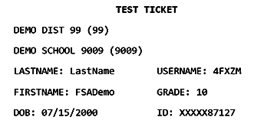
School Assessment Coordinator
Before Testing
Print FSA Test Tickets
Prior to computer-based test administrations, print test tickets to distribute to test administrators. Test tickets are generated in TIDE.
Test tickets contain login information for students. Each student must have a test ticket to log in to computer-based FSA assessments.
See the TIDE User Guide for instructions on generating and printing test tickets.
FSA CBT TAM 23; TIDE User Guide

Slide 91
School Assessment Coordinator Before Testing
Print NGSSS Student Authorization Tickets, Seal Codes, and Advanced Session Rosters
Each student must have a Student Authorization Ticket to sign in to a test. Each authorization ticket contains the TestNav URL, the student’s unique Username and a Password.
You may also print an Advanced Session Roster for a list of the students tested in the same session. This roster may be used to collect the required administration information.
Ensure these files are deleted from your computer after you have printed them.
Distribute the appropriate materials on each day of testing. Seal codes should only be distributed to test administrators immediately before students begin Session 2 of the FCAT 2.0 Reading Retake.
See the Florida PearsonAccess Next User Guide for instructions on how to print authorization tickets, seal codes, and rosters.
NGSSS CBT TAM 46; PearsonAccess Next User Guide

Slide 92
School Assessment Coordinator
Before Testing
Meet with Technology Coordinator
It is important that technology coordinators understand their responsibilities before, during, and after FSA and NGSSS computer-based test administrations.
Review the instructions and information for technology coordinators (located on the FSA Portal and PearsonAccess), as well as all test administration and security policies and procedures included in this manual, with your technology coordinator and create a plan for handling issues during testing.
Technology coordinators are required to sign the Test Administration and Security Agreement. The technology coordinator should also be involved in all planning meetings to provide input on logistics and resolve any network issues.
NGSSS CBT TAM 40

Slide 93
School Assessment Coordinator
Before Testing
Prepare Test Settings, Computers, and Devices
Tests should be administered in a room that has comfortable seating and good lighting. Make sure that testing rooms are adequately ventilated and free of distractions.
Sufficient workspace should be provided for students to use worksheets, work folders, planning sheets, reference sheets, and passage booklets, as applicable.
Avoid testing students in large groups (e.g., in a cafeteria or auditorium); however, in the event that students are tested in a large group, the appropriate number of proctors must be present during the test session.
Ensure that each room has a working clock. Starting and stopping times should be displayed for students according to the instructions in the test administration script.
  Remember that failure to provide the correct amount of time will likely result in test invalidation.
FSA CBT TAM 254; NGSSS CBT TAM 40

Slide 94
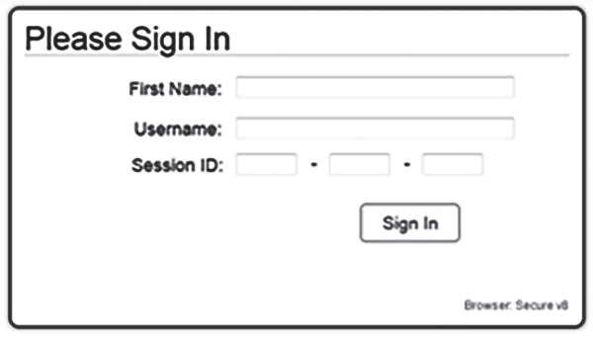
School Assessment Coordinator
Before Testing
Prepare Test Settings, Computers, and Devices
Check the configuration of the testing rooms to make sure you will be able to provide a secure environment during testing. If necessary, use visual blocks (e.g., file folders taped to the sides of computer screens).
Also, check for and remove all unauthorized visual aids posted in classrooms or affixed to student desks.
Ensure that the technology coordinator has verified that all computers and devices meet the requirements needed to administer the computer-based tests, and has installed the correct secure browser.
  If wireless devices are to be used, power them up to ensure that all pushed updates have been installed, well before the testing window.
Before each test session, test administrators should launch the FSA secure browser and/or TestNav app on each computer or device.
FSA CBT TAM 255; NGSSS CBT TAM 40

Slide 95
School Assessment Coordinator
Before Testing
  Electronic Devices and Breaks
    Determine your school’s policy for the storage of electronic devices (including smart watches) during testing.
    Direct test administrators on what to do if students have electronic devices in their possession before testing begins.
    Ensure that test administrators are aware of the policy that students are NOT allowed to access electronic devices at any time during a test session, including breaks.
    If a student accesses his or her electronic device(s) during testing or a break, his or her test must be invalidated.
    Ensure that test administrators are aware of how to secure a student’s computer or device during a break.
      For short breaks (e.g., restroom), it is recommended that a visual block be applied to the student’s computer screen or device.
      For longer breaks, it is recommended that the student pause the test. If a student pauses the test, he or she will not be able to continue testing until he or she is approved to resume testing in TDS and PearsonAccess.
FSA CBT TAM 256; NGSSS CBT TAM 41

Slide 96
School Assessment Coordinator
Before Testing
Preparation and Training
Train all test administrators and proctors, including non-school-based instructors (e.g., itinerant teachers). You must train several employees to act as possible alternates. In the absence of sufficiently trained administrators, postpone testing until trained personnel are available.
Ensure that all test administrators have active usernames and passwords to log in to TIDE.
Note: Test administrator accounts are optional in PearsonAccess Next.
Test administrators will need to access the TA Interface to administer FSA computer-based tests and access to the Assessment Viewing Application (AVA) to administer ELA Reading paper-based tests.
In addition, test administrators should access and become familiar with the Test Administrator User Guide (available on the FSA Portal) prior to testing and have access to it during testing.
FSA CBT TAM 255-256; NGSSS CBT TAM 41

Slide 97
School Assessment Coordinator
Before Testing
Preparation and Training
Be aware of the following policies, procedures, and instructions, and emphasize this information during training at your school:
Test Administrators
    Should refer to the Test Administrator Checklist before, during, and after testing.
    Must read and be familiar with all appropriate sections of the manuals.
    Should provide either a short or an extended break between Session 2 and Session 3 of Grade 6 and Grades 7–8 FSA Mathematics. Direct which Session 3 script they should use depending on your school’s decision.
    Must be trained in the use of accommodations and are familiar with the “FSA ELA Reading Instructions for Oral Presentation Accommodations” section available in Appendix A, as necessary.
FSA CBT TAM 255-256; NGSSS CBT TAM 42

Slide 98
School Assessment Coordinator
Before Testing
Assessment Viewing Application (AVA) for FSA ELA Reading PBT Accommodations (Grades 4-10/Retake)
Practice tests are available in AVA so students and test administrators can become familiar with the site.
Operational test content only available during the test administration window.
Available in AVA:
  Audio Passages/animations
  ASL for audio passages/animations
  Closed Captioning for audio passages/animations
TAs must have the AVA User Role assigned in TIDE.
An AVA guide is available on the FSA portal to assist test administrators with logging into the site to give access audio clips.
AVA User Guide

Slide 99
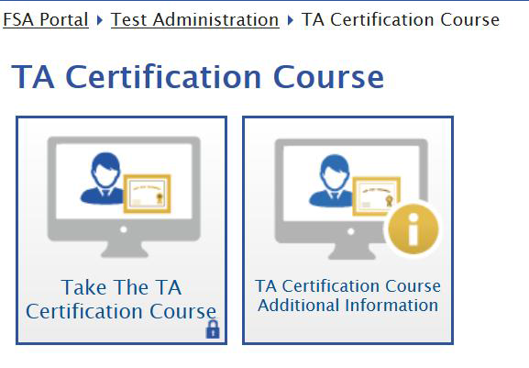
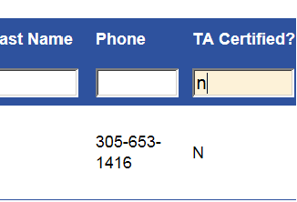
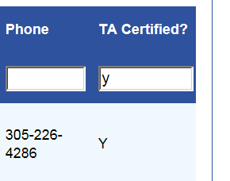
School Assessment Coordinator
Before Testing
FSA Test Administrator Certification Course
A recommended online training course and additional information document are available for test administrators who will be administering the computer-based Florida Standards Assessments.
The course and the document are available on the Test Administration page on the FSA portal (http://www.fsassessments.org/ta-certification-course).
Test administrators must use the additional information document which includes specifics for the Florida testing program.
School assessment coordinators may track completion via TIDE under Manage Users tab.

Slide 100
School Assessment Coordinator
Before Testing
FSA Train Test Administrators (TA) to use the TA Interface
In the TA Interface, the TA will create, start, monitor, and close the test session he/she is administering.
During testing, TA can monitor student progress by viewing the Student Status column in the TA Interface.
  This page automatically refreshes every 60 seconds. When the page refreshes, student statuses are updated.
  TAs can refer to the “i” icon in the Pause Test column for more information about how and why a student’s test was paused or exited.
Note: As a security measure, test administrators are automatically logged out of the TA Interface after 90 minutes of test administrator and student inactivity.
Once all students have paused or submitted their tests, end the test session immediately by clicking Stop in the TA Interface. This will pause any remaining tests, so only select Stop after all students have finished testing.
Log out of the TA Interface by clicking Log Out in the upper right corner of the screen.
FSA CBT TAM 27-28; TA User Guide

Slide 101
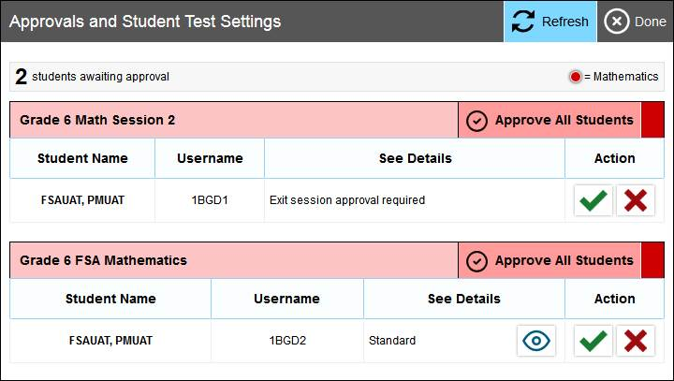
School Assessment Coordinator
Before Testing
FSA TA Interface – Approving Students
Separate tables for approving students into the session or approving Exit Session requests for Grades 6–8 Mathematics.
FSA CBT TAM 27-28; TA User Guide

Slide 102
School Assessment Coordinator
Before Testing
Train Test Administrators (TA): Technical Issues
If a student’s computer or device is disconnected from his or her test, TA must contact the technology coordinator to help diagnose any technical issues. Then assist the student with logging in again.
Once a student logs back in to his or her test, TA/SAC will need to approve the student again in TDS/PearsonAccess and provide the correct amount of remaining time.
If a student still has difficulty logging in or is logged out of his or her test more than once, have the student refrain from logging in until the issue is diagnosed and resolved.
If a disruption occurs during testing, note the time of the disruption in order to provide students the appropriate amount of remaining time once testing resumes.
Additional troubleshooting information is available in the Test Administrator User Guide for FSA and TestNav Common Errors and Solutions for PearsonAccess Next.
FSA CBT TAM 29-30

Slide 103
School Assessment Coordinator
Before Testing
Train Test Administrators (TA): Defective Item
If a student reports a test item that he or she thinks is defective, note the student’s name, grade level, subject, item number, and basic student concern (e.g., two possible answers, no correct answer); however, do NOT review the item on your own.
Most concerns result from a student not reading an item carefully; therefore, encourage the student to reread the item. If the student still thinks that the item is defective, reassure the student that a flawed item will not be used to calculate student scores.
The student should answer the item to the best of his or her ability and continue with the test.
Once testing has ended, TA must inform the school assessment coordinator of the concern. School assessment coordinator should contact SAET at 305-995-7520 to report the defective item.
FSA CBT TAM 29; NGSSS CBT TAM 35

Slide 104
School Assessment Coordinator
Before Testing
  Train Test Administrators (TA): CBT Policies and Procedures
  In the test administration scripts, test administrators are instructed to contact you in the following circumstances. Provide instructions for how to handle these circumstances:
  A student has not participated in a practice test session.
  A student has trouble logging in the first time or is logged out of his or her test more than once.
  A test administrator does not have a test ticket for a student.
  A First Name or Student ID Number is not correct (e.g., misspelled) on the test ticket.
  A student is in the wrong test or the wrong accommodated form.
  A student refuses to acknowledge the testing rules.
  A defective Writing or Reading Passage Booklet or paper-based accommodation material (regular print, large print, OIPP, braille) is discovered.
  A test administrator is concerned that a student is unable (e.g., too ill) to begin or finish the test.
  A disruption occurs (e.g., a technical disruption, power outage, disruptive behavior).
  For EOC and Retake administrations only, a student has not completed the test at the end of the allotted time and will need additional time to continue working.
FSA CBT TAM 256; NGSSS CBT TAM 42

Slide 105
School Assessment Coordinator
Before Testing
Train Test Administrators: After Testing Is Complete
Review school’s policy on appropriate procedures (Options A, B, or C), when students taking the FSA ELA Reading, or a Mathematics or EOC, or NGSSS EOC complete testing. (Not applicable for Writing.)
Inform test administrators if students will be allowed to read after they have finished a session and their test materials (e.g., test tickets, reference sheets, work folders, and worksheets) have been collected.
While still in the testing room, students are NOT permitted to write or to use their computers or devices after they have finished a session, even after their test materials have been collected.
Test materials may not be returned to students once the materials have been collected.
FSA CBT TAM 30 and Scripts; NGSSS CBT TAM Scripts

Slide 106
School Assessment Coordinator
Before Testing
Arrange FSA CBT Practice Test Sessions
CBT students are required to participate in a practice-test session prior to testing.
  Session in TA Training Site – secure browser
  Guest users – any supported browser
Students with CBT accommodations must use the appropriate accommodated practice test.
  Text-to-speech – secure browser
CBT Practice Test Scripts are located under the Scripts tab in FSA Resources.
Students retaking an assessment who previously completed this requirement for the test they will take (EOC or Retake) are not required to participate in another practice test.
Students should practice on the type of computer or device they will use for testing (e.g., PC, tablet, laptop).
FSA CBT TAM 257

Slide 107
School Assessment Coordinator
Before Testing
Arrange NGSSS CBT Practice Test (ePAT) Sessions
All students who will participate in this administration MUST participate in a practice test conducted at their school unless students previously took a TestNav 8 practice test for the subject test they are scheduled to take this school year.
Students who will test using accommodated computer-based forms (text-to-speech, masking) must practice using the accommodated practice test.
The practice tests contain sample test items to prepare students for each assessment. They will help familiarize your students with the CBT tools, including the TestNav Calculator tool and reference sheet, and the process for responding to items in TestNav.
For each practice test, you will need the appropriate practice test script available at http://avocet.pearson.com/FL/Home.
NGSSS CBT TAM 43

Slide 108
School Assessment Coordinator
Before Testing
Arrange FSA PBT Accommodations Practice Test Sessions
Students who will take an FSA ELA Reading or Mathematics paper-based test are required to participate in a PBT Test Item Practice Session.
Directions for Completing Test Items and Scripts for the following grade-level/subject tests are on the FSA Portal under the ELA/Mathematics tab in FSA Resources:
  Grade 3 FSA ELA Reading
  Grades 4–10 Reading PBT Accommodations
  Grades 3–8 Mathematics PBT Accommodations
Students taking PBT ELA Writing are not required to take a practice test, but are strongly encouraged to do so to become familiar with the amount of space they will have for their responses.
Note: Eligible students with a braille or large print accommodation should participate in a practice test session using the appropriate accommodated practice test. LP and Braille practice materials will be delivered to schools in early February.
FSA PBT TAM 4

Slide 109
School Assessment Coordinator
Before Testing
NGSSS EOC PBT Practice Test Sessions
Sample questions are developed by FDOE to assist teachers in preparing students for the paper-based NGSSS EOCs. Schools are encouraged to use sample questions to familiarize students with the test format.
Sample questions and answer keys can be accessed online at http://www.fldoe.org/accountability/assessments/k-12-student-assessment/end-of-course-eoc-assessments/.
  Algebra 1 Retake EOC
  Biology 1 EOC
  Civics EOC
  U.S. History EOC
Teachers should instruct students that they can access the materials themselves at any time as they prepare for testing.
Students are NOT required to participate in an NGSSS PBT practice test.
NGSSS CBT TAM 43-44

Slide 110
School Assessment Coordinator
During Testing
Distribute Test Materials (FSA)
On each day of testing, you are responsible for providing each test administrator with the following FSA test materials before testing begins, as applicable:
  Test tickets
  PBT Accommodations (regular print, large print, OIPP, braille)
  Test group code (PBT accommodations only)
  CBT Work folders or CBT Worksheets
  Writing/Reading Passage Booklets
  Planning sheets
  Reference Sheets (Grades 4–8 Mathematics and EOC only)
  Scientific Calculators (Grades 7–8 Sessions 2 and 3 and EOC Session 2 only)
  Students should have a pen or pencil to sign below the Testing Rules Acknowledgment, write their names, take notes, and/or work the problems on their planning sheets, worksheets, or work folders on each day of testing.
FSA CBT TAM 258

Slide 111
School Assessment Coordinator During Testing
Distribute Test Materials (NGSSS)
On each day of testing, you are responsible for providing each test administrator the following NGSSS test materials before testing begins, as applicable:
  CBT Work folders
  Test group code
  Advanced Session Rosters
  Reading Passage Booklets
  Student Authorization Tickets
  Seal code (FCAT 2.0 Reading Retake Session 2 only)
  PBT Accommodations (regular print, large print, OIPP, braille)
  CBT Worksheets (optional)
  Reference Sheets
  Periodic Tables
  Four-Function Calculators
NGSSS CBT TAM 49

Slide 112
School Assessment Coordinator
During Testing
Supervise Test Administration and Maintain Test Security
Test administrators should have their full attention on students at all times during testing.
Test administrators should contact you or the technology coordinator if an error message appears on a student’s computer screen or device during testing and he or she cannot resolve the issue.
If a technical issue interrupts testing and cannot be resolved quickly, the school assessment coordinator must contact the FSA Help Desk or Pearson Customer Support and notify SAET at 305-995-7520 immediately.
  Refer to Appendix B in the manual for all the information they will need when calling the Help Desk.
  Obtain the student’s Results ID and Session ID for faster assistance.
FSA CBT TAM 258; NGSSS CBT TAM 49

Slide 113
School Assessment Coordinator
During Testing
  Submit Re-open a Test Session and Re-open a Test requests in TIDE for students who need to return to an FSA test session after mistakenly submitting it (same day only). Contact SAET at 305-995-7520 for assistance with processing these requests.
  Create requests through the Create Requests page or upload multiple at a time through the Upload Requests page.
Which requests to use in different scenarios:
  Re-Open a Test – re-open after it’s been fully submitted (student ended test too soon).
  Re-open a Test Session – a test session needs to be re-opened after the student has moved from one session to another and needs to return to the original session.
  Restart a Test – if a student needs to restart from the beginning or an incorrect test has been started & shouldn’t be reported (all responses deleted from restarted test). Must be approved by FDOE.
  Restore a test that has been Restarted – a test was restarted by mistake. Must be approved by FDOE.
FSA CBT TAM vii; 258, TIDE User Guide

Slide 114
School Assessment Coordinator
During Testing
Monitor Student Progress in TIDE (FSA)
Student progress and test completion rates for computer-based tests can be monitored in TIDE.
School assessment coordinators should use Participation Reports and Test Completion Rates in TIDE to track completion rates and determine which students still need to be tested.
Further information on Participation Reports can be found in the TIDE User Guide.
Supervise Make-Up Administrations
Ensure that all test security and test administration policies and procedures are followed while conducting make-up tests. Be available to assist test administrators as needed during make-up administrations.
FSA CBT TAM 259, Scripts; TA User Guide; NGSSS CBT TAM 51

Slide 115
School Assessment Coordinator During Testing
Monitor Student Progress in PearsonAccess Next (NGSSS)
The following describes the main test session management tasks performed during testing:
  Start Test Sessions—A session must be started in PearsonAccess before students can begin the test.
  Monitor Session Status—Keep track of each student’s testing status in PearsonAccess.
  Resume Students’ Tests—Resume tests for students who have exited (intentionally or unintentionally) and will finish later.
    Students’ test can be resumed by the Test Administrator if the he/she has an account in PearsonAccess.
NGSSS CBT TAM 51; PearsonAccess Next User Guide

Slide 116
School Assessment Coordinator During Testing
Monitor Real-Time Status in PearsonAccess Next (NGSSS)
Status | Description
Ready | The student has not started the test.
Active | The student has logged in and started the test.
Exited | The student has exited the test but has not submitted his or her answers.
Resumed | The student has been authorized to resume the test but has not yet logged in.
Resumed-Upload | The student has been authorized to resume the test, and any responses saved locally will be uploaded.
Completed | The student’s submitted test data have been processed.
NGSSS CBT TAM 50

Slide 117
School Assessment Coordinator
After Testing
Update Student Information
If student information is discovered to be incorrect during testing, update the information in TIDE and PearsonAccess immediately following test administration. Instructions for updating student information can be found in the TIDE User Guide and Florida PearsonAccess Next User Guide .
Invalidate Tests
Test invalidations for computer-based tests are entered in TIDE and PearsonAccess. To invalidate a test, you will need the student’s ID number and the reason for invalidation. Complete instructions on invalidating computer-based tests are available in the TIDE User Guide and Florida PearsonAccess Next User Guide. Invalidations must be entered by the last day of the test administration window.
Record Accommodations
Ensure that all accommodations provided to and used by students are recorded on each record of required administration information, as applicable. This documentation may be necessary in the case of investigations regarding possible test irregularities.
FSA CBT TAM 260; TIDE User Guide; NGSSS CBT TAM 53; PearsonAccess Next User Guide

Slide 118
School Assessment Coordinator
After Testing
After Testing Is Complete Tasks in PearsonAccess Next (NGSSS)
Mark a Student’s Test Complete—Mark a student’s test complete if a student exits the test and will not resume the same test.
Stop Test Sessions—A test session cannot be stopped until all students are in Completed or Marked Complete status and all Ready students have been removed.
Invalidate Tests—Any tests that should not be scored must be invalidated.
Incorrect Student Profiles – If a Student Name or Student ID is incorrect for a student added via the New Student wizard, it may be updated before or after testing.
School assessment coordinator should contact SAET at 305-995-7520, to submit a request by 10 am on the final day of testing for each administration.
NGSSS CBT TAM 53; PearsonAccess Next User Guide

Slide 119
School Assessment Coordinator
After Testing
Prepare Materials for Return
Store CBT test tickets and Student Authorization tickets for one calendar school year, and then destroy them securely.
File the signed Test Administration and Security Agreements and Test Administrator Prohibited Activities Agreements along with your school training documents for one calendar school year.
Reading and Writing Passage Booklets are secure documents and must be packaged and returned in white labeled box(es).
Ensure that the proper materials are packed in your District Assessment Coordinator ONLY box (along with any other ancillary materials) according to the Friendly Reminders.
For detailed instructions on preparing and packaging paper-based accommodations for return, refer to the FSA Paper-Based Materials Return Instructions, available in Appendix C of the FSA PBT test administration manuals.
FSA CBT TAM 260; NGSSS CBT TAM 52

Slide 120
School Assessment Coordinator
After Testing
Directions for Returning Typed FSA ELA Writing Responses
For students taking a paper-based FSA ELA Writing test using a flexible responding accommodation to provide a typed response, transcription of the response into the paper-based test is no longer required.
Directions for returning typed ELA Writing responses are included in Appendix A.
FSA PBT TAM Appendix A

Slide 121
TDC Important Announcements Regarding Material Returns
The following exams are ALL due back to the vendors prior to Spring Break and must ship no later than April 7th:
  FCAT Reading Retakes & NGSSS Algebra 1 Retakes
  FSA ELA Retakes and FSA Algebra 1 Retakes
  Grade 3 FSA ELA Reading (Calibration & Non-Calibration)
  SAT-10 and FSA ELA Writing Window 1 Make ups
It is imperative that materials be delivered as early as possible, by April 5th, to allow the staff at TDC time to prepare return shipments. PLEASE DO NOT WAIT UNTIL APRIL 6TH TO RETURN MATERIALS.
Delivery schedule at TDC has been modified as follows:
  Monday, Tuesday, Thursday and Friday – deliveries will be accepted from 8:00 am to 2:00 pm
  Wednesday – deliveries will be accepted from 8:00 am to 1:00 pm

Slide 122
FSA ELA Writing and Writing Retake:
Return Schedule
Elementary, K-8 Centers, Middle Schools, Senior High Schools and Alternative Centers hand-deliver “TO BE SCORED” boxes ONLY :
TEST MATERIALS* | RETURN LABELS | TO BE SCORED ONLY RETURN DATES
FSA ELA WRITING (GRADES 4-10 AND RETAKES) | STRIPED GREEN –CALIBRATION “TO BE SCORED” OR GREEN - NON CALIBRATION “TO BE SCORED” | Thursday-Monday March 2-6
Also return: BLUE – “TO BE SCORED” large print, One-item-per-page and PINK - “TO BE SCORED” Braille materials, if applicable.
*Includes PBT Accommodations for Grades 8-10 and Retakes
Note: Schools must hand-deliver TO BE SCORED materials to TDC by 2 p.m. daily, EXCEPTION is on Wednesdays, return by 1 PM. TDC is at 13135 S.W. 26 Street, Miami, FL 33175.
Friendly Reminders

Slide 123
FSA ELA Writing and Writing Retake:
Make-up Return Schedule
Elementary, K-8 Centers, Middle Schools, Senior High Schools and Alternative Centers hand-deliver “TO BE SCORED” boxes ONLY :
TEST MATERIALS* | RETURN LABELS | TO BE SCORED RETURN DATES
FSA ELA WRITING (GRADES 4-10 AND RETAKES) | STRIPED GREEN - CALIBRATION “TO BE SCORED” OR GREEN – NON-CALIBRATION “TO BE SCORED” | Window 1: April 5-6 Window 2 (No Retakes): May 11-12
Also return: BLUE – “TO BE SCORED” large print, One-item-per-page and PINK - “TO BE SCORED” Braille materials, if applicable.
*Includes PBT accommodations for Grades 8-10 and Retake
Note: Schools must hand-deliver TO BE SCORED materials to TDC by 2 p.m. daily, EXCEPTION is on Wednesdays, return by 1 PM. TDC is at 13135 S.W. 26 Street, Miami, FL 33175.
Friendly Reminders

Slide 124
FSA and NGSSS Retakes:
Return Schedule
Senior HS and Alternative Centers hand-deliver “TO BE SCORED” boxes ONLY :
TEST MATERIALS* | RETURN LABELS | TO BE SCORED RETURN DATES
FCAT 2.0 Reading Retake NGSSS Algebra 1 Retake EOC | RED “TO BE SCORED” | Thursday and Friday, March 30-31
FSA ELA Reading Retake | ORANGE “TO BE SCORED” | Monday-Wednesday, April 3-5
FSA Algebra 1 EOC Retake | PURPLE “TO BE SCORED”
Also return: BLUE – “TO BE SCORED” large print, One-item-per-page and PINK - “TO BE SCORED” Braille materials, if applicable.
ADULT CENTERS ONLY: Hand-deliver the Retake District Coordinator Only Box: April 19-20
*PBT Accommodations
Note: Schools must hand-deliver TO BE SCORED materials to TDC by 2 p.m. daily, EXCEPTION is on Wednesdays, return by 1 PM. TDC is at 13135 S.W. 26 Street, Miami, FL 33175.
Friendly Reminders

Slide 125
FSA ELA (4-10) and Mathematics (3-8):
Return Schedule
Elementary, K-8 Centers, Middle Schools, Senior High Schools and Alternative Centers hand-deliver “TO BE SCORED” boxes ONLY :
TEST MATERIALS* | RETURN LABEL | TO BE SCORED RETURN DATES
FSA ELA READING (4-10 ) FSA MATHEMATICS (3-8) | ORANGE “TO BE SCORED” | Thursday – Monday, April 27-May 1
Also return: BLUE – “TO BE SCORED” large print, One-item-per-page and PINK - “TO BE SCORED” Braille materials, if applicable.
Grade 3 Reading PBT will be hand-delivered by Mar. 31st for calibration and by Apr. 5th for non-calibration.
*PBT accommodations
Note: Schools must hand-deliver TO BE SCORED materials to TDC by 2 p.m. daily, EXCEPTION is on Wednesdays, return by 1 PM. TDC is at 13135 S.W. 26 Street, Miami, FL 33175.
Friendly Reminders

Slide 126
EOC: Return Schedule
K-8 Centers, Middle Schools, Senior HS and Alternative Centers hand-deliver “TO BE SCORED” boxes ONLY:
TEST MATERIALS* | RETURN LABELS | TO BE SCORED RETURN DATES
FSA Algebra 1, Algebra 2, and Geometry | PURPLE “TO BE SCORED” | Thursday – Monday, April 27- May 1
NGSSS Biology 1, Civics, and US History | BROWN “TO BE SCORED” | Tuesday –Thursday, May 9-11
Also return: BLUE – “TO BE SCORED” large print, One-item-per-page and PINK – “TO BE SCORED” Braille materials, if applicable.
ADULT CENTERS ONLY: Hand-deliver the EOC District Coordinator Only Box: May 24-25
*PBT accommodations for FSA and NGSSS EOC Assessments
Note: Schools must hand-deliver TO BE SCORED materials to TDC by 2 p.m. daily, EXCEPTION is on Wednesdays, return by 1 PM. TDC is at 13135 S.W. 26 Street, Miami, FL 33175.
Friendly Reminders

Slide 127
District Assessment Coordinator
Only Box
Place the following materials in the District Assessment Coordinator Only Box(es):
  Original Test Materials Chain of Custody Form (for PBT accommodations)
  Original School Procedural Checklist (FM-6927) (One per administration)
  Original Test Administration and Security Agreements and Test Administrator Prohibited Activities Agreements
  Original records of required administration information, such as Administration Record/Security Checklist
  Original Security Logs
  Original Seating Charts
  Original Advanced Session Rosters (NGSSS CBT tests)
  Seal Codes (FCAT 2.0 Retake CBT Only)
  All used and unused planning sheets, work folders, worksheets, reference sheets, and periodic tables
  Group documentation by type and by test administration and include a cover page.
Seal the box.
Complete, print and tape a box label to the side of the box (TDC Documents webpage)
NEW
Friendly Reminders

Slide 128
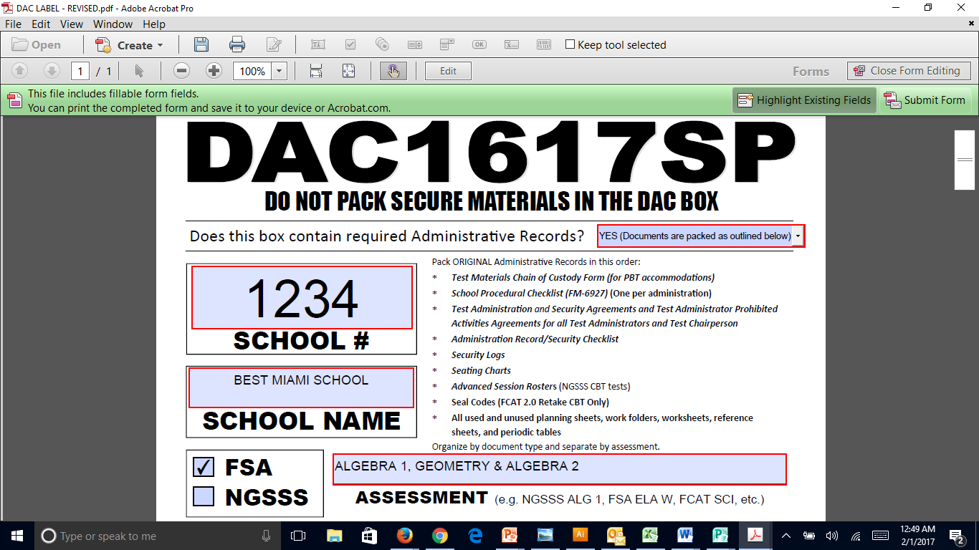
District Assessment Coordinator Only Box LABEL

Slide 129
Pick-Up Dates of NTBS and DAC Boxes
Comet Delivery Services will pick- up FSA and NGSSS “NOT TO BE SCORED” and District Assessment Coordinator boxes:
MATERIALS | RETURN LABEL | PICK UP DATE AT SCHOOLS
All “NOT TO BE SCORED” materials (including NOT TO BE SCORED special documents) | WHITE “NOT TO BE SCORED” | May 19-26
DISTRICT ASSESSMENT COORDINATOR ONLY BOXES (DAC) (No Color Return Label) Include documentation for: FSA ELA Writing (Grades 4-10 and Retakes); FSA ELA Reading (Grades 3-10 and Retakes); FSA Mathematics (Grades 3-8); FCAT 2.0 Science (Grades 5 and 8); FCAT 2.0 Reading Retake; NGSSS Algebra 1 Retake EOC; FSA Algebra 1 Retake EOC; and FSA and NGSSS EOC Assessments |  | May 30-June 5
Please note: schools that don’t have materials ready for pick-up must hand- deliver these materials to TDC by 2:00 p.m. no later than June 5th.
Friendly Reminders

Slide 130
School Assessment Coordinator Before Testing
Ordering Additional Materials (New this Year!)
TDC Documents webpage (link located above the “Test Chairperson Info” link)
Orders submitted before 3:00 pm will be available for pick up in 24 hours; order placed after 3:00 pm will require 48 hours processing
Email will only be sent by TDC when materials are on backorder

Slide 131
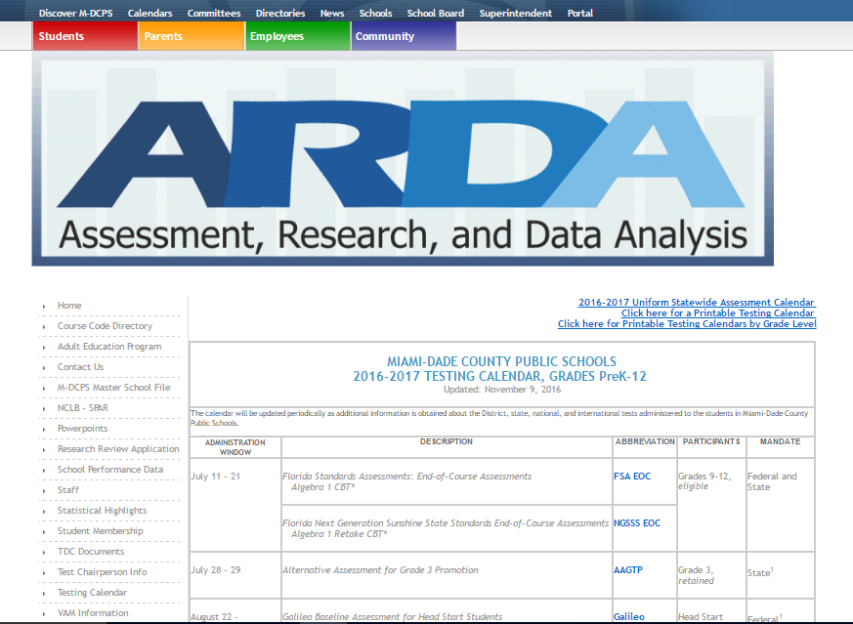

Slide 132
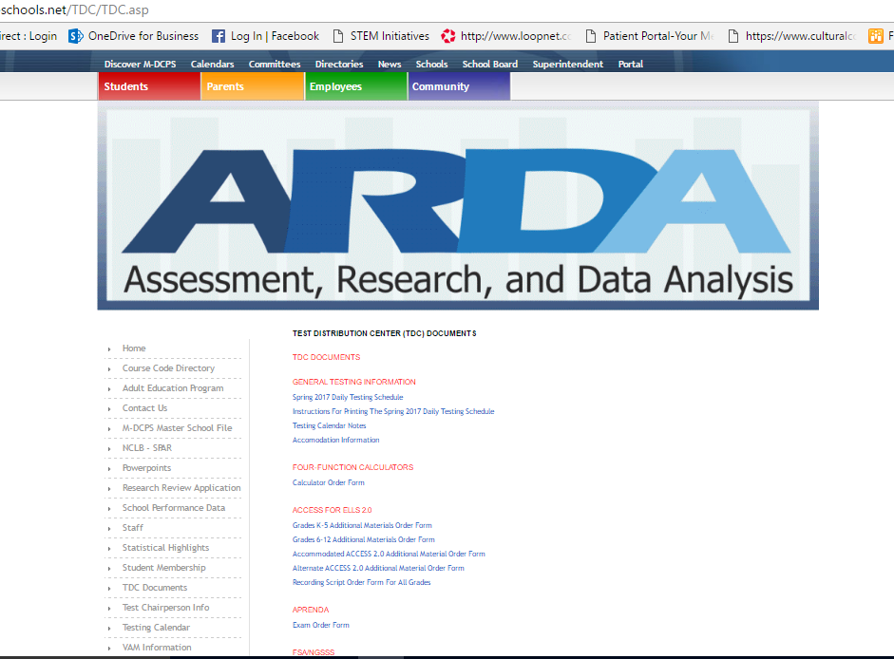
Exam Titles
Available Forms

Slide 133
School Assessment Coordinator
After Testing
Comment Forms
After testing, test administrators, school coordinators, and technology coordinators are encouraged to complete the appropriate comment form:
  For the FSA, access the FSA Portal at www.fsassessments.org > FSA Resources > Test Administration
  For the NGSSS, access Avocet at http://avocet.pearson.com/FL/Home > Comment Form
Information from the comment forms will be summarized by the test contractors for FDOE use.
Please provide feedback that will be meaningful to FDOE and the test contractors.
If you have comments pertaining to district procedures, please contact the Office of SAET at 305-995-7520.
FSA CBT TAM 251; NGSSS CBT TAM 37

Slide 134
Appendices
FSA
Appendices in the Spring/Summer 2017 FSA CBT Manual include:
Appendix A—Accommodations
Appendix B—FSA Help Desk
Appendix C—Florida Test Security Statute and Rule
Appendix D—Perforated Forms and Signs
NGSSS
Appendices in the Spring/Summer 2017 CBT Manual include:
  Appendix A: Accommodations
  Appendix B: Pearson Custom Support
  Appendix C: Florida Test Security Statute and Rule
  Appendix D: Perforated Forms and Signs

Slide 135
Technical Support
District MSTs will be available to help schools with any hardware/internet issues.
District technical support is available at:
Phone: 305-995-3377
Email: TestTechSupport@dadeschools.net
FSA
Contact FSA Help Desk at:
  1- 866-815-7246
  (Monday–Friday, 7:00 am –8:30 pm ET)
  fsahelpdesk@air.org
NGSSS
Contact Pearson Customer Support at:
  1-877-847-3043
  (Monday–Friday, 7:00 am–8:30 pm ET)
  Florida@support.pearson.com

Slide 136
Contact Information
Student Assessment and Educational Testing
  Maria C. Bruguera, Director
  Email: mbruguera@dadeschools.net
  Mara Ugando, Staff Specialist
  Email: mugando@dadeschools.net
Phone: 305-995-7520
Fax: 305-995-7522

Slide 137
Thank you for ensuring a secure
and successful
test administration!

