Slide 1
Proposed Changes to School Grades for
2011-12 and Beyond

Slide 2
Inclusion of Civics and U.S. History in Middle and Senior High Schools
Requires using Civics and U.S. History in the School Grade Calculation
Will be included as a new Component worth 100 points

Slide 3
Inclusion of
English Language Learners(ELL) and
Exceptional Students(ESE)
in Proficiency
Requires ELL and ESE students’ performance on the FCAT to be included in the computation of proficiency points

Slide 4
Replacement of the
NGA Graduation Rate with the Federal Graduation Rate
NGA Rate
Includes all Standard and
Special Diploma recipients
Federal Rate:
Only includes Standard Diplomas
Students receiving a Special Diploma or withdrawn to Adult Education are considered dropouts

Slide 5
Inclusion of
Two Graduation Rates
100 points allocated for the Federal Graduation Rate
100 points allocated for a modified 5-Year Federal Graduation Rate:
Providing credit for students who graduate in 5 years
Including both Standard and Special Diplomas

Slide 6
Inclusion of
A Minimum Proficiency Trigger to earn a School Grade of A, B or C
Requires that schools meet a minimum percent of students proficient in Reading in order to receive a School Grade of C or better

Slide 7
Middle School Acceleration Component
Requires Using Algebra End of Course Results
Imposing 100 additional points for Middle Schools
Expects all 8th grade students scoring FCAT level 3-5 to be enrolled in Algebra

Slide 8
Modification in the Computation of the High School Acceleration Component
Changes the computation to a rate based on the number of assessments as opposed to the number of students
Will discourage schools from
offering advanced courses
that have lower success rates

Slide 9
School Grading Scale
Different Grading Scale
School Grading Scale Trigger
Every time the percentage of ‘A’ and ‘B’ schools reaches 75% in a current year, the minimum required points for grades of A, B, C, and D would be increased.
Different Grading Scale | Old | New
Elementary Schools | 800 | 800
Middle Schools | 800 | 900
Senior High Schools | 1600 | 1600

Slide 10
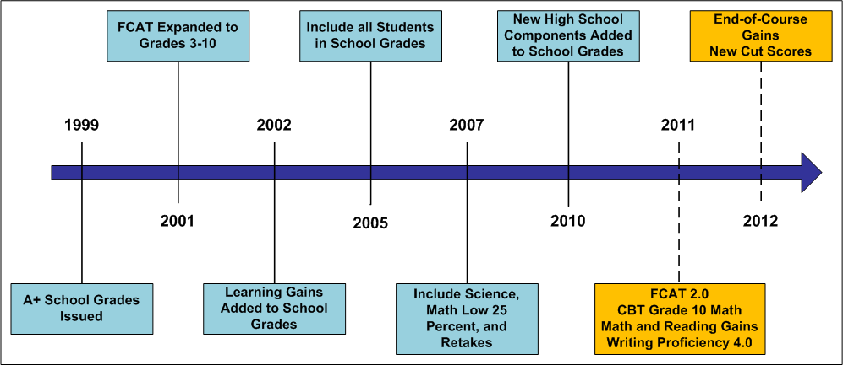
School Grades 2011-12

Slide 11
The Bottom Line
The state's changes in the accountability system may result in a decline in school performance grades even if students scores increase.

