Slide 1
2012-13 federal high school graduation rates
A-1

Slide 2
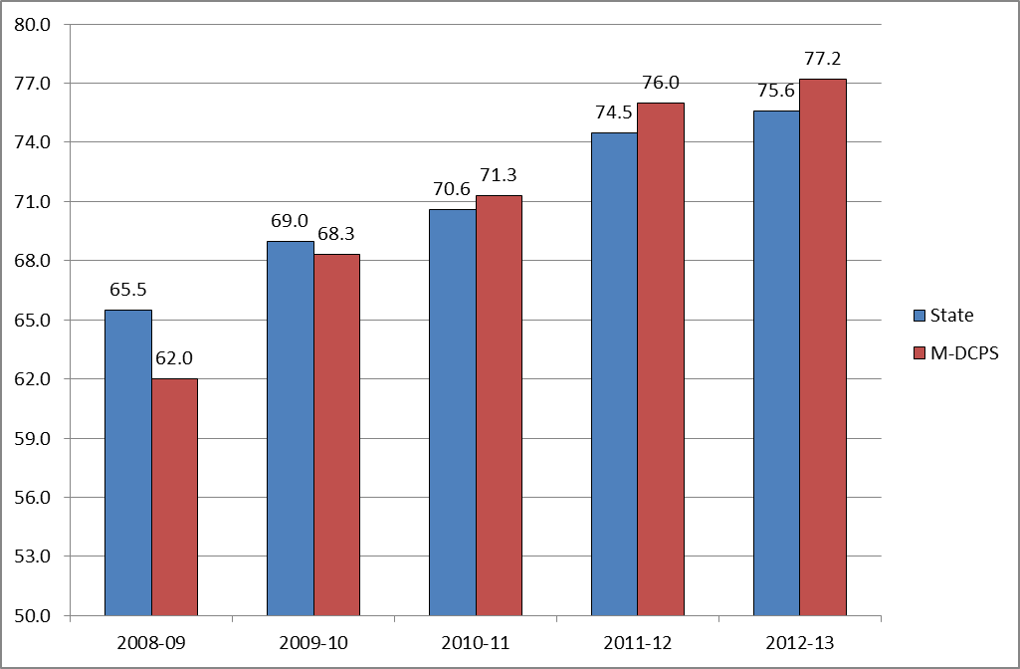
2011-12 and 2012-13 Federal High School Graduation Rates State and M-DCPS

Slide 3
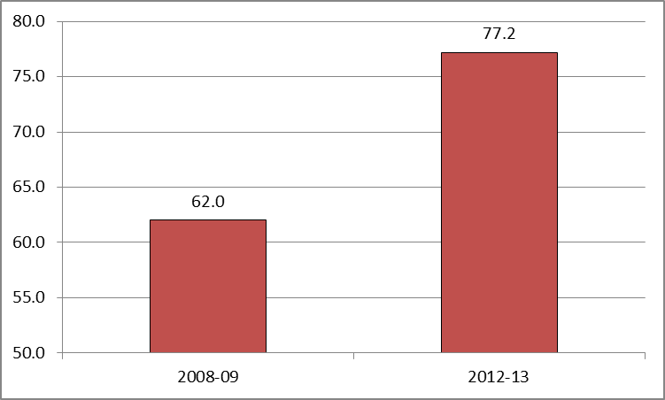
2008-09 and 2012-13 Federal High School Graduation Rates
+15.2 Increase

Slide 4
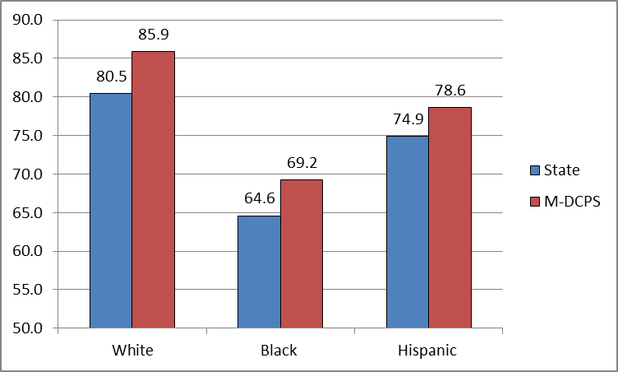
2011-12 and 2012-13 Federal High School Graduation Rates State and M-DCPS By Ethnic Groups

Slide 5
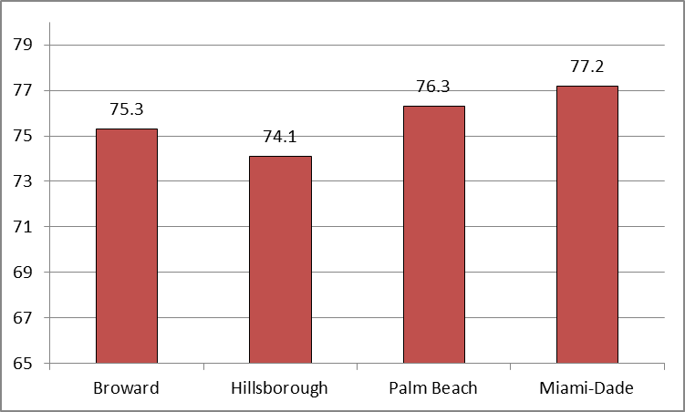
2012-13 Federal High School Graduation Rates District Comparisons

