Slide 1
October Principal Meeting Proposed Framework for the School Grading System for 2014-15 and Beyond
Gisela Feild
Administrative Director
Assessment, Research and Data Analysis
October 2014

Slide 2
Senate Bill 1642–Education Accountability Revisions
Re-focuses the school grading formula on student success measures
Achievement
Learning gains
Graduation
Earning College Credit and/or Industry Certifications
Maintains a focus on students who need the most support
ELLs included in Achievement after 2 years
Establishes a learning gains calculation that (1) requires students scoring below grade level to grow toward grade level performance, and (2) requires students already at grade level to progress beyond grade level performance
Notes:
State trying to revert to old ELL policy of only including students in ELL > two years
Worried about this definition : requires students already at grade level to progress beyond grade level performance
This terminology implies acceleration rather than one year’s growth

Slide 3
Senate Bill 1642–Education Accountability Revisions
Eliminates provisions that over-complicate the formula and muddle the meaning of a school grade
No bonus factors or additional weighting that may raise a school grade
No additional requirements or no automatic adjustments that may lower a school grade
Ensures that the level of performance associated with an A-F school grade is transparently evident
Report all school grade components as percentages, each worth a maximum of 100 points
Report A-F grades based on a percentage of points earned (e.g., 70%, 80%), rather than a point total
Notes:
Bonus factors like : passing extra AP courses or industry certifications
No more dropping a grade for reading trigger, adequate progress (50 in reading and math in lowest 25)
66 percent of points = A (800 points)
62 percent of points = B

Slide 4
Senate Bill 1642–Education Accountability Revisions
Requires the State Board to reset the grading scale avoiding the compression of the current scale
There must be at least five percentage points separating the percentage thresholds needed to earn each of the school grades
The State Board must periodically review the scale to determine whether the expectations should be raised to encourage increased student achievement
If the Board adjusts the grading scale upward, it must inform the public and the school districts of the reasons for the adjustment and the anticipated impact on school grades

Slide 5
School Grading Rules (all levels)
The school grade is based on the percentage of total points earned
Provisions that may raise or lower a school’s grade beyond what the percentage of points would indicate are eliminated (no additional requirements; no additional weights/bonus; no automatic adjustments)
No more Single Writing Component
Writing is included within the English/Language Arts components

Slide 6
School Grading Rules (all levels)
Schools will only be graded on the components for which they have enough data
Schools that don’t have enough data for one or more components will still receive a grade
Schools that don’t have enough data for a component will NO longer receive the district average
For example, a school that does not have sufficient students (n=10) with learning gains, will still receive a grade on just proficiency.

Slide 7
Elementary School Grades Model (700 points)
English/ Language Arts | Mathematics | Science
Achievement (0% to 100%) | Achievement (0% to 100%) | Achievement (0% to 100%)
Learning Gains (0% to 100%) | Learning Gains (0% to 100%)
Learning Gains of the Low 25% (0% to 100%) | Learning Gains of the Low 25% (0% to 100%)

Slide 8
Middle School Grades Model (900 points)
The school grade is based on the percentage of total points earned
Provisions that may raise or lower a school’s grade beyond what the percentage of points would indicate are eliminated (no additional requirements; no additional weights/bonus; no automatic adjustments)
Writing is included within the English/Language Arts components
English/ Language Arts | Mathematics | Science | Social Studies (Civics EOC) | Acceleration Success
Achievement (0% to 100%) | Achievement (0% to 100%) | Achievement (0% to 100%) | Achievement (0% to 100%) | Percentage who pass H.S. EOCs & industry certifications (0% to 100%)
Learning Gains (0% to 100%) | Learning Gains (0% to 100%)
Learning Gains of the Low 25% (0% to 100%) | Learning Gains of the Low 25% (0% to 100%)
Notes:
NO more WRITING – now including CIVICS (was 900 points last year)

Slide 9
Middle Grades Acceleration – Possible Denominators
Currently:
Grade 8 students who scored level 3 or higher on the grade 7 FCAT Mathematics assessment plus students who qualify for denominator
Options:
Over time - look at success throughout enrollment in school
Grade 8 students

Slide 10
Senior High School Grades Model (1000 points)
The school grade is based on the percentage of total points earned
Provisions that may raise or lower a school’s grade beyond what the percentage of points would indicate are eliminated (no additional requirements; no additional weights/bonus; no automatic adjustments)
Writing is included within the English/Language Arts components
Additional graduation rates (At-Risk and 5-year), college readiness measures (based on SAT, ACT, and PERT), and a stand-alone acceleration participation measure are eliminated from the model
English/ Language Arts | Mathematics | Science | Social Studies (US History EOC) | Graduation Rate | Acceleration Success
Achievement (0% to 100%) | Achievement (0% to 100%) | Achievement (0% to 100%) | Achievement (0% to 100%) | Overall, 4-Year Graduation Rate (0% to 100%) | Percentage of students who can earn college credit - AP,IB,AICE,DE, IC (0% to 100%)
Learning Gains (0% to 100%) | Learning Gains (0% to 100%)
Learning Gains of the Low 25% (0% to 100%) | Learning Gains of the Low 25% (0% to 100%)
Notes:
Previously 1600 points
Lost ALL college readiness (SAT,ACT,PERT), at-risk graduation rate, 5 year graduation rate, lost participation in acceleration

Slide 11
Senior High Acceleration – Possible Denominators
Currently:
Grade 11 and 12 students plus students in grades 9 and 10 who qualify for numerator
Options:
Annual snapshot
Over time - look at success throughout enrollment in school
Graduates
12th graders

Slide 12
Senate Bill 1642–Education Accountability Transition Year
For the current school year (2013-14), there are no changes to the school grading system, except those already directed by existing statute or State Board rule
After Florida students take the new assessments for the first time in 2014-15, student performance level expectations (“cut scores”) will be set in the summer immediately following the first administration of the new assessment
A new baseline calculation of school grades will occur in Fall 2015, which accurately reflects student performance on the Florida Standards and FSA
This baseline, informational approach in the first year provides everyone – parents, schools, districts, the general public – a clear understanding of a student’s and a school’s starting point on the new, more rigorous Florida Standards and FSA
Notes:
Look up briefing about FSA

Slide 13
Senate Bill 1642–Education Accountability Transition Year
No Consequences from the Baseline 2014-15 School Grades
No interruption in current support to underperforming schools through our Differentiated Accountability teams
A school may not be required to select and implement a turnaround option in the 2015-16 school year based on the 2014-15 grade or school improvement rating
A district or charter school system designated as high-performing may not lose the designation based on the 2014-15 grades
For purposes of determining grade 3 retention and high school graduation, student performance on the 2014-15 assessments shall be linked to 2013-14 student performance expectations
Same process used for FCAT to FCAT 2.0
Notes:
We believe that is a school improves a grade or maintains an ‘A” – the school recognition funds would be in effect

Slide 14
Implementation Schedule
Commissioner re-establishing advisory groups to receive input
LPAC, Leadership Policy Advisory Committee
AAAC, Assessment and Accountability Advisory Committee
LPAC and AAAC will meet in the summer and fall
Draft of school grades rule to the State Board in early 2015
Standards setting meetings held summer 2015
Draft of rule on school grading scale to the State Board in Sept/Oct 2015
2014-15 Grades calculated in Oct/Nov 2015

Slide 15
District-Designated End-of-Course Assessments (DDEOC)
SB 736 – Student Success Act
Requires at least 50 percent of a school administrator and a classroom teacher’s performance evaluation be based upon student learning growth assessed annually by statewide assessments or, for subjects and grade levels not measured by statewide assessments, by school district assessments.

Slide 16
DDEOCs
Assessments may include:
Statewide assessments;
Other standardized assessments including nationally recognized standardized assessments;
Industry certification examinations;
District-developed or district-selected EOC assessments; and/or
Teacher/principal-selected assessments.

Slide 17
Existing Sources of Items/Assessments
FCAT 2.0/ FSA/FAA/
SAT-10
Reading/ English/ Language Arts
Mathematics
End of Course Tests
Algebra 1
Science
Geometry
Biology 1
US History
Civics
[Algebra 2]
IBTP Non-Core Content
Physical Education/Health
Visual Arts
Performing Arts
World Languages
Career/Technical
CFAC Grant Gap Courses
Spanish
Social Studies
Science
Mathematics
English/ Language Arts
IBTP Core Content
Other Established Standardized Tests
AP
IB
AICE
Industry Certification

Slide 18
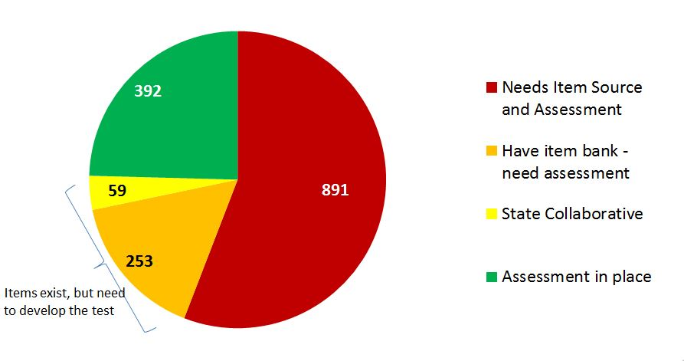
Status of Courses - Grades K-12

Slide 19
Plan for 2014-15 School Year:
DDEOC
Courses with existing items or EOCs
Finalized list of courses to be covered will be published in November
Assessments will be multiple-choice and conducted within a class period
Scores will be reported through the electronic gradebook system.
For the baseline year, DDEOC scores will not be calculated into students’ final grades.

Slide 20
Preliminary Plan for 2014-15 School Year:
Principal/Teacher Selected Tests
Possible Plan for Courses with no assessment
Principals will designate use of departmentalized or teacher-created EOCs and report to district
Student results will be entered into Gradebook
Priority for further development of DDEOCs based on student enrollment in uncovered courses.

Slide 21
Administration –
2014-15 Baseline Year
Test Window: May 11- June 5, 2015
DDEOC assessments will be administered through Thinkgate and Florida IBTP
Schools will have option to print test forms and use scannable answer sheets.
Strict security protocols must be followed.

Slide 22
Questions

